Slide 1
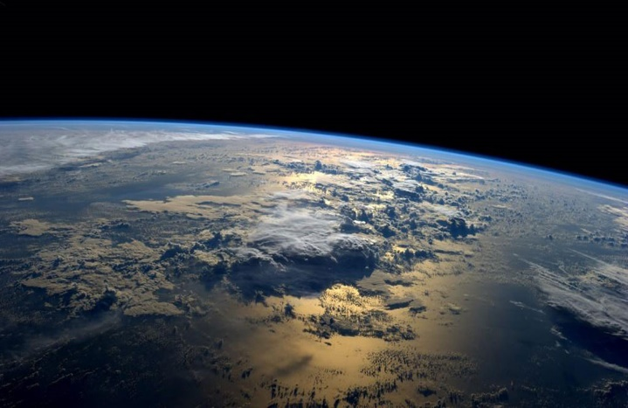
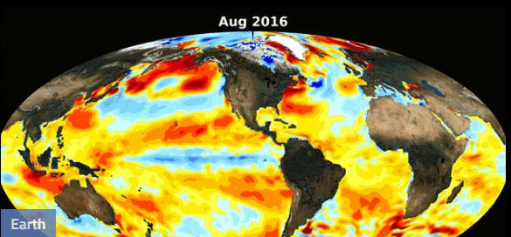
The OLLI West Campus
Mitigating & Adapting to our Changing Climate
Presented by Paul Belanger, Ph.D.
Geologist, Paleoclimatologist
Friday April 7th, 2017
denverclimatestudygroup.com/
www.facebook.com/denverclimatestudygroup
pebelanger@glassdesignresources.com
c. 303-249-7966;
Belanger: OLLI West 4/7/2017
Designed by Anya Hess
photo from NASA

Slide 2
Mitigating & Adapting to our Changing Climate
OUTLINE
Part 1: Global Warming:
  The Science
  The Consequences
    Warming & Extreme weather
    Ice, Glacial Melting
    Ultimate Sea Level Rise
    Associated Refugees
    Ocean Acidification
    Degraded Sustainability
BREAK
Belanger: OLLI West 4/7/2017
Designed by Anya Hess
photo from NASA

Slide 3
Mitigating & Adapting to our Changing Climate
OUTLINE (cont.)
Part 2: Solutions:
Overcome our Inertia and Apathy
  Reduce Carbon Emissions in Electric Generation, Transportation and in Heating
  Carbon Dioxide Removal (CDR); Negative Emission Technology (NET); Greenhouse Gas Removal (GGR)
Belanger: OLLI West 4/7/2017
Designed by Anya Hess
photo from NASA

Slide 4
Mitigating & Adapting to our Changing Climate
POP QUIZ
Do you think climate change is an urgent problem?
Do you think getting the world off fossil fuels is difficult?
MOST answer Yes to one or the other, but not both
Belanger: OLLI West 4/7/2017
Designed by Anya Hess
photo from NASA

Slide 5
Mitigating & Adapting to our Changing Climate
POP QUIZ
Do you think climate change is an urgent problem?
Do you think getting the world off fossil fuels is difficult?
IF you answered “yes” to both you’re in a minority
Belanger: OLLI West 4/7/2017
Designed by Anya Hess
photo from NASA

Slide 6
Adapting to our Changing Climate
POP QUIZ
Do you think climate change is an urgent problem?
Do you think getting the world off fossil fuels is difficult?
My goal/my hope for a take-away:
Yes
Yes, but NOT Insurmountable
Belanger: OLLI West 4/7/2017
Designed by Anya Hess
photo from NASA

Slide 7
Adapting to our Changing Climate
Global warming:
The Science
Belanger: OLLI West 4/7/2017
Designed by Anya Hess
photo from NASA

Slide 8
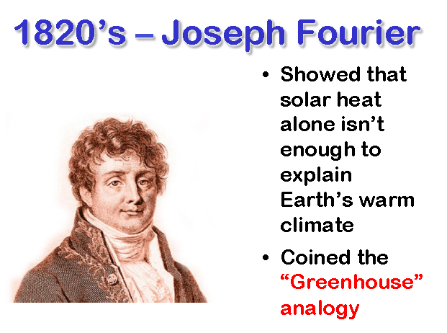
Greenhouse gas analogy
From Where has all the carbon gone: Scott.Denning@ColoState.edu

Slide 9
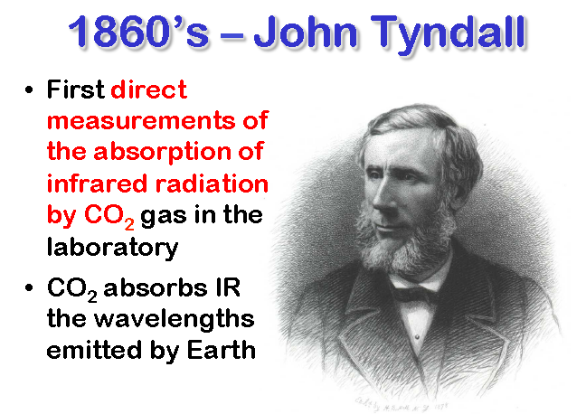
From Where has all the carbon gone: Scott.Denning@ColoState.edu

Slide 10
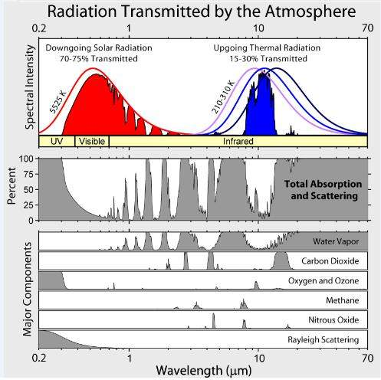

Slide 11
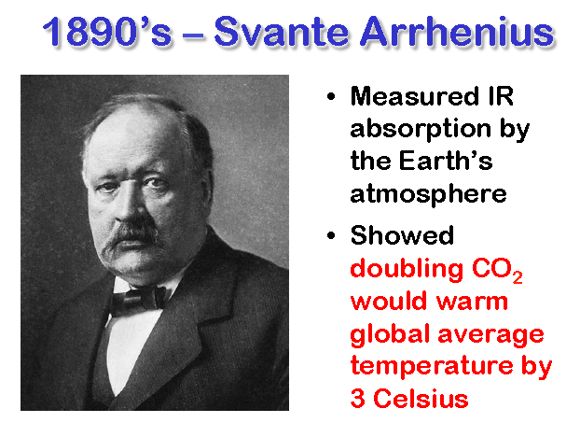
From Where has all the carbon gone: Scott.Denning@ColoState.edu

Slide 12



The CO₂ greenhouse gas effect is concentrated in the polar regions ! ! !
The Earth and its atmosphere
The most potent greenhouse gas is H₂O - vapor
Particularly in the Arctic !
The large H₂O
greenhouse effect
is controlled by temperature –
H₂O saturation doubles with every
10°C Increase
As a result It is concentrated in
the lower atmosphere
of the tropics
CO₂ and other Greenhouse gases are evenly distributed throughout the atmosphere

Slide 13
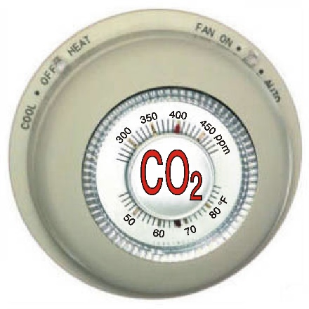
More Water Vapor and Clouds
Warmer Air, Warmer Water (Global Warming)
Atmosphere Biosphere
Hydrosphere Cryosphere
(Climate Change)
Human Activity
J
Courtesy Phil Nelson
Notes:
J = journalism, especially science journalism

Slide 14
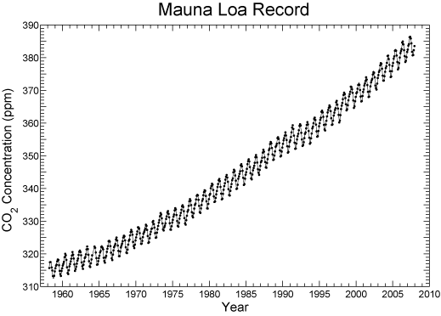
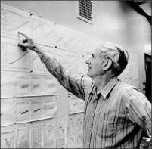
EMISSIONS FROM HUMAN ACTIVITIES LARGELY TO BLAME
40% increase in CO₂
Dead carbon altering atmospheric C¹⁴
That Carbon is more negative/enriched in C¹²

Slide 15
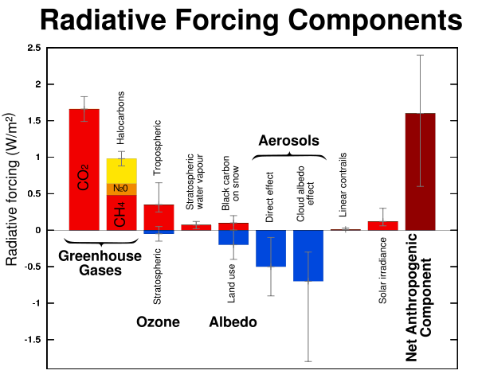
GLOBAL WARMING CONCERNS
Incoming Solar irradiance: 342 W/m²
IPCC, 2007

Slide 16
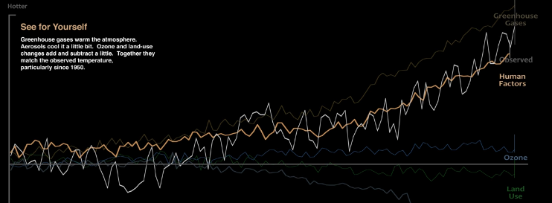
How global warming stacks up
https://www.youtube.com/watch?v=-gHUHoqBn-Y
Published on Sep 15, 2016
Skeptics of manmade climate change offer various natural causes to explain why the Earth has warmed 1.4 degrees Fahrenheit since 1880. But can these account for the planet’s rising temperature? Watch to see how much different factors, both natural and industrial, contribute to global warming, based on findings from NASA’s Goddard Institute for Space Studies.

Slide 17
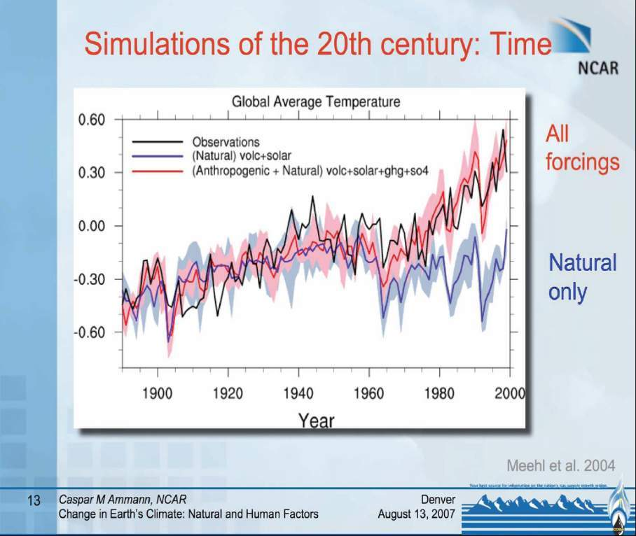

Slide 18
Adapting to our Changing Climate
Global warming:
The Consequences
Belanger: OLLI West 4/7/2017
Designed by Anya Hess
photo from NASA

Slide 19
More Water Vapor and Clouds
Warmer Air, Warmer Water (Global Warming)
Atmosphere Biosphere
Hydrosphere Cryosphere
(Climate Change)
Human Activity
J
Courtesy Phil Nelson
Notes:
J = journalism, especially science journalism

Slide 20
Adapting to our Changing Climate
Global warming:
The Consequences
Warming & Extreme Weather
It’s what people identify with most easily
Belanger: OLLI West 4/7/2017
Designed by Anya Hess
photo from NASA

Slide 21
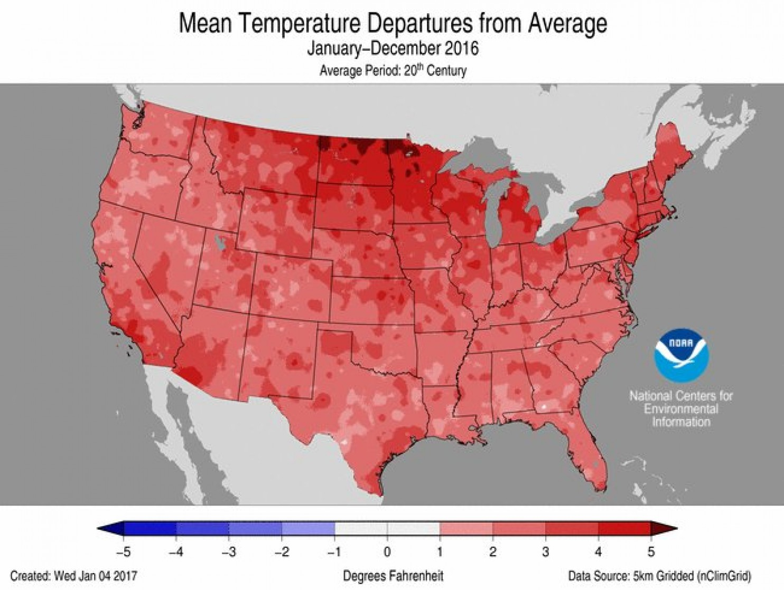
U.S. posts second-warmest year (2016) on record, breadth of warmth ‘unparalleled’ Washington Post, 9 Jan 2017
NOAA:
“The breadth of the 2016 warmth is unparalleled in the nation’s climate history,”
“No other year had as many states breaking or close to breaking their warmest annual-average temperature.”
Notes:
https://www.washingtonpost.com/news/capital-weather-gang/wp/2017/01/09/u-s-posts-second-warmest-year-on-record-breadth-of-warmth-unparalleled/?utm_term=.ecff65b62c96

Slide 22
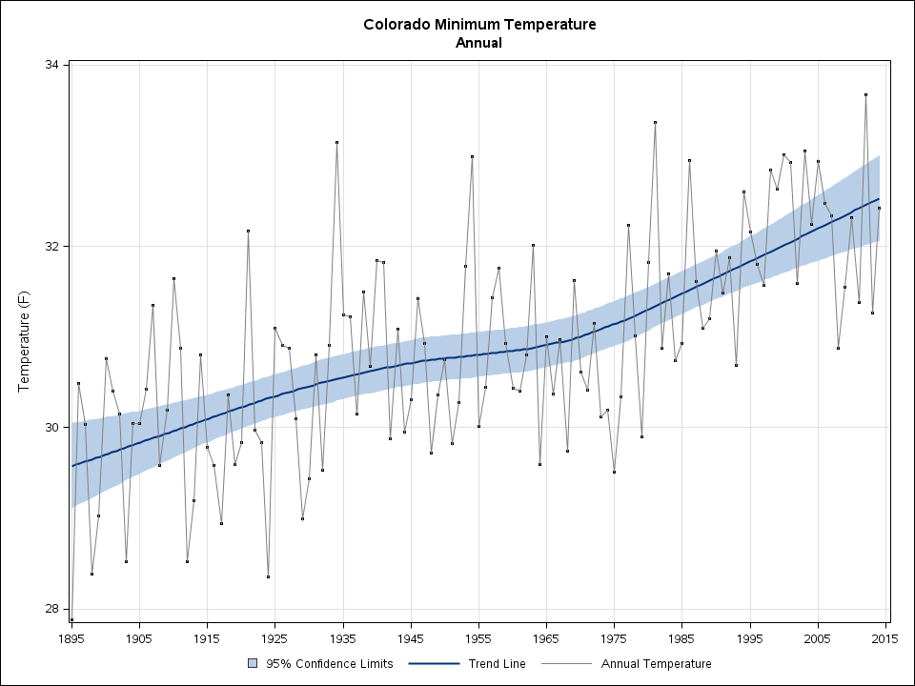
In Colorado, an increase in the minimum annual temperature over 120 years.
Jagged brown line—annual temperature
Solid blue line—smoothed trend line
Blue shading—95% confidence interval
Source: National Climatic Data Center, NOAA
32 F
30 F
1895
2015
Notes:
http://www.ncdc.noaa.gov/temp-and-precip/state-temps/

Slide 23
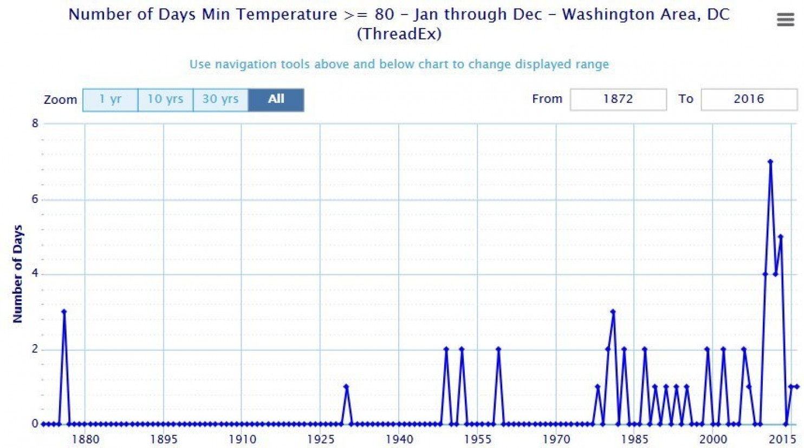
Hot nights have increased at a startling rate in Washington, D.C.
Since the turn of the 19th century, Washington, D.C., has witnessed a stunning increase in unusually warm nights.
Happening five to 10 times more frequently than they used to.
8
6
4
2
0
Number of days in a year with minimum temperature greater than 80F, from 1872 to 2016
Washington Post July 25, 2016
Notes:
https://www.washingtonpost.com/news/capital-weather-gang/wp/2016/07/25/hot-nights-have-increased-at-a-startling-rate-in-washington-d-c/

Slide 24
Loaded Climate Dice:
global warming is increasing extreme weather events.
Extreme summer heat anomalies now cover about 10% of land area, up from 0.2%.
This is based on observations, not models.
Vertical axis: Northern Hemisphere: Frequency of local June-July-August temperature anomalies (relative to 1951-1980 mean)
Horizontal axis: Units of local standard deviation.
OBSERVATION:
  1951-1980 match closely the normal distribution ("bell curve", shown in green) separated:
  cold (blue), typical (white) and hot (red) seasons = 33.3% probability for each
  SHIFT to the right as a consequence of the global warming of the past three decades
  CONCLUSION: cool summers now cover only half of one side of a six-sided die, white covers one side, red covers four sides, and an extremely hot (red-brown) anomaly covers half of one side.
Source: Hansen, J., Sato, M., and Ruedy, R., Proc. Natl. Acad. Sci., 2012.

Slide 25
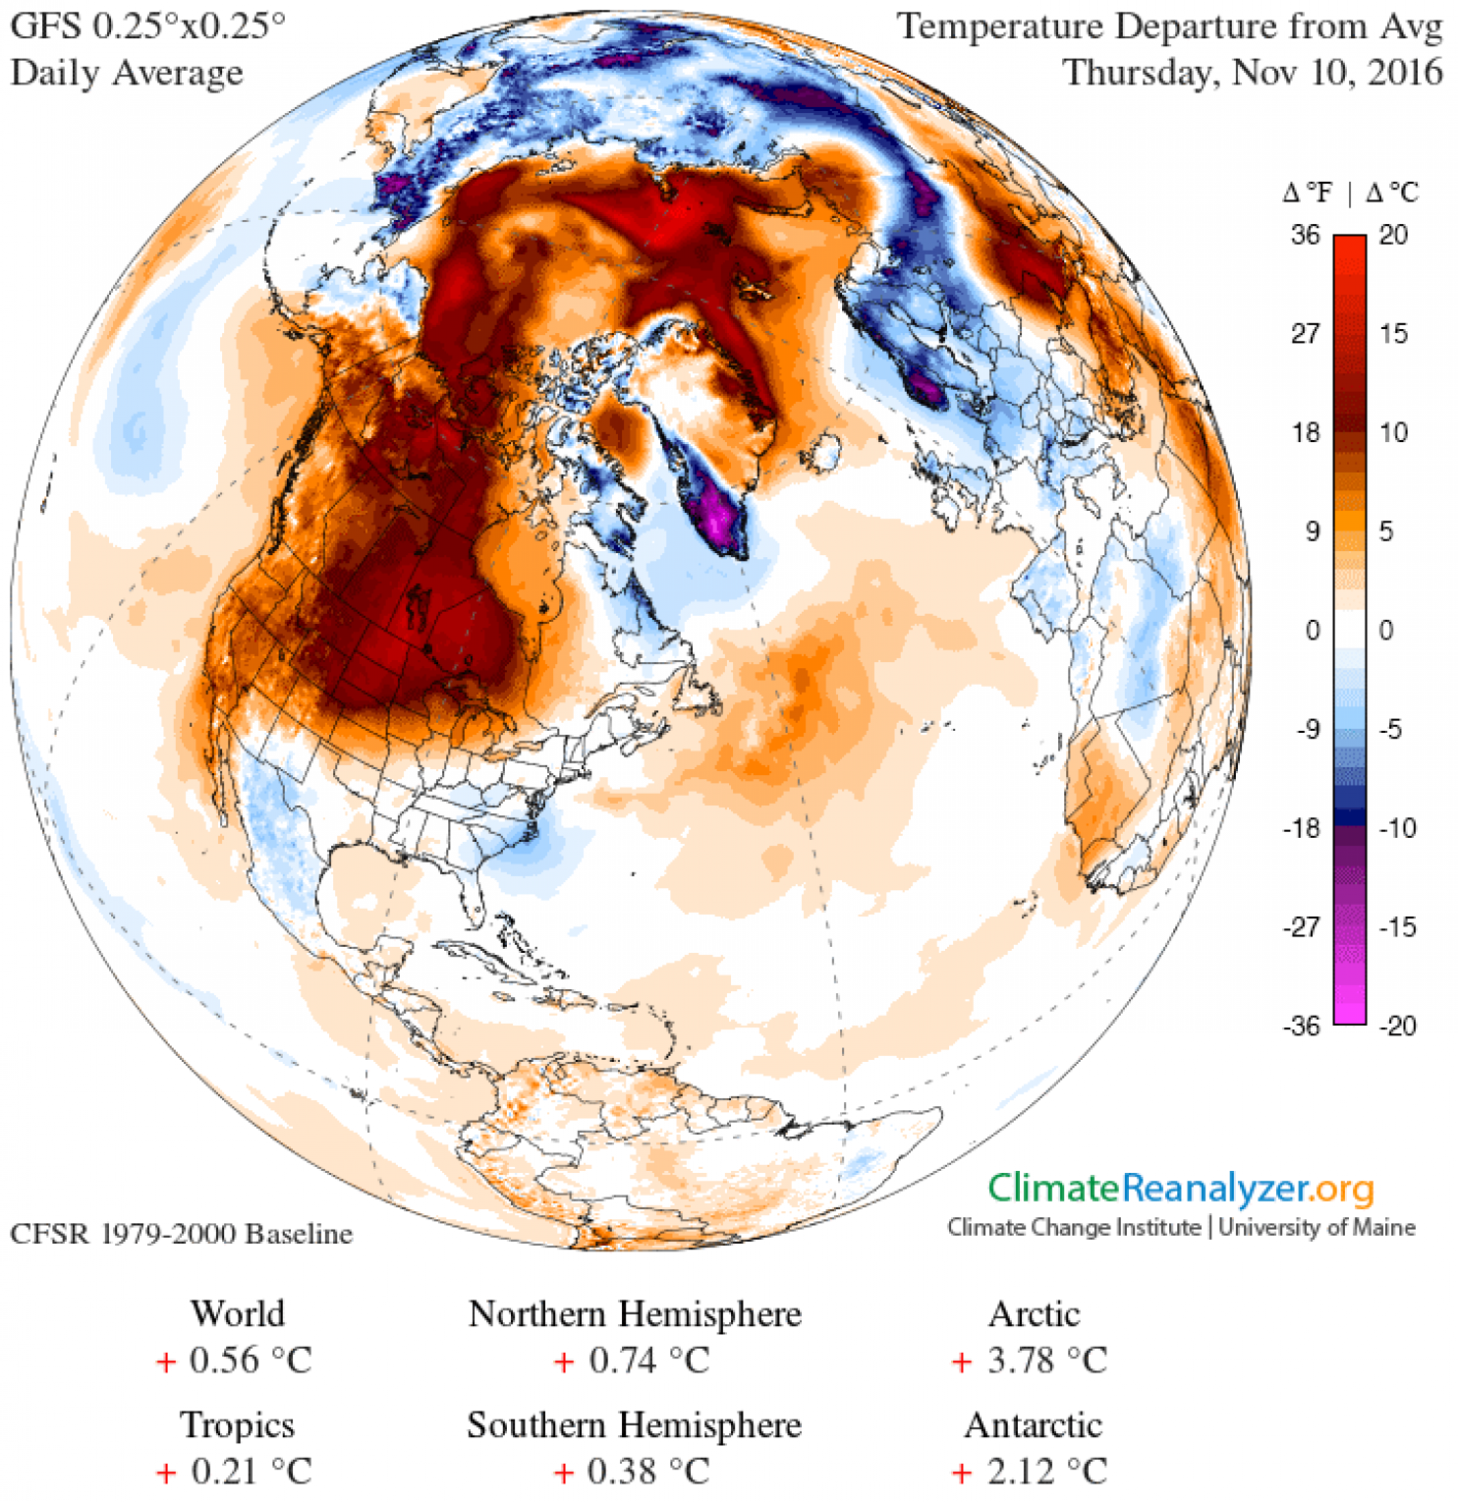
North America is flooded in warmth and there is no sign of real winter Washington Post, 10 Nov 2016
The United States experienced its third-warmest October on record, and warmth has continued through the first third of November.
[This fall has been so warm, some cities are setting records for latest first freeze]
Temperature difference from normal over the Northern Hemisphere, Nov. 10, 2016. (Climate Reanalyzer, Climate Change Institute, University of Maine, USA.)
Notes:
https://www.washingtonpost.com/news/capital-weather-gang/wp/2016/11/10/north-america-is-flooded-in-warmth-and-there-is-no-sign-of-real-winter/

Slide 26
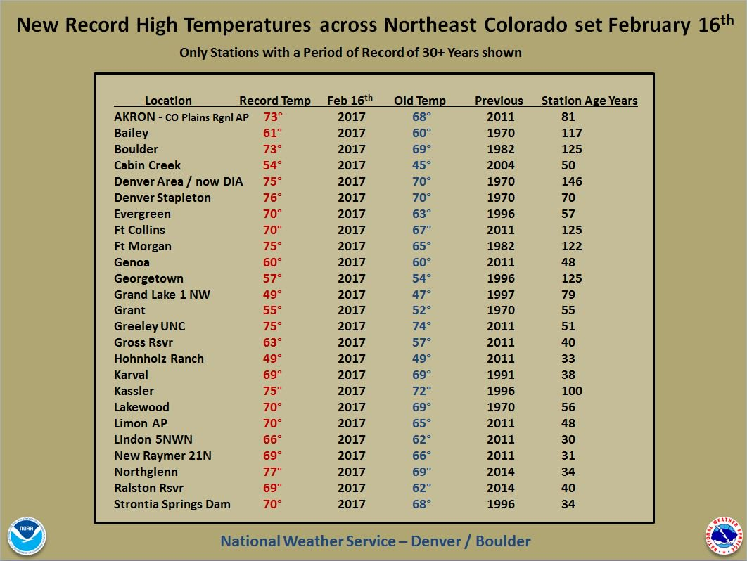
There has never been a hotter February day in Denver, Colorado Springs or Pueblo
The temperature reached 80 degrees — yes, seriously — at Denver International Airport
Denver Post 17 Feb 2017
Notes:
http://www.denverpost.com/2017/02/10/denver-breaks-high-temperature-record/

Slide 27
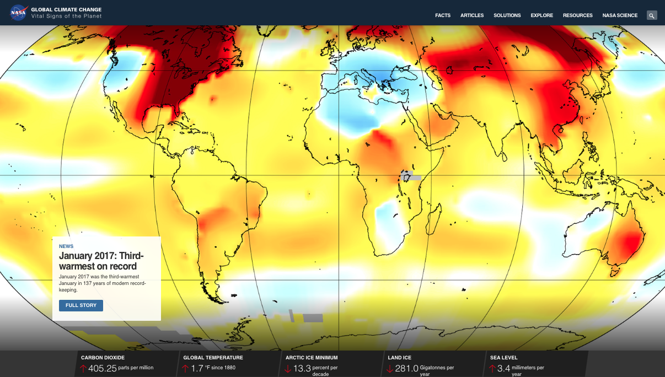
Nasa Climate Change Website: January 2017
http://climate.nasa.gov/

Slide 28

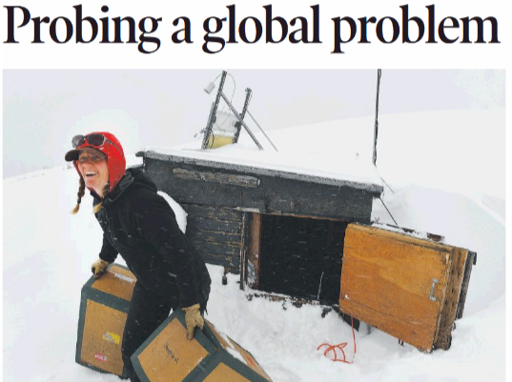
Niwot Ridge: A NOAA Scientist, Jen Morse, collects CO2 flasks; measurements reached 413 ppm
she wrestles with the question that’s been bothering her all week: How humans can know that potentially ruinous climate change is happening yet balk at trying to stop it.
“We understand we are sealing our own fate. We can see it happening,” Morse said with fat, wet snowflakes pelting her face. “And we mostly know how to solve it. We know what is producing emissions and we know what we have to do.”
“Part of it is that everyone is so busy living their lives day to day. And we don’t have a good system in place for solving global problems. This is a global problem,” she said.
http://www.denverpost.com/2017/04/03/measuring-climate-change-in-the-rockies/

Slide 29
Adapting to our Changing Climate
Global warming:
The Consequences
Ice & Glacial Melting
Belanger: OLLI West 4/7/2017
Designed by Anya Hess
photo from NASA

Slide 30
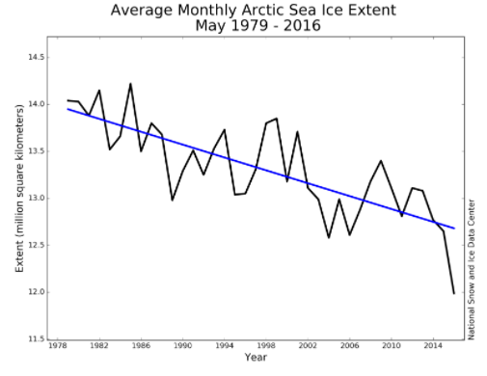
For more see: http://www.skepticalscience.com/melting-ice-global-warming.htm
http://nsidc.org/arcticseaicenews/2016/06/

Slide 31
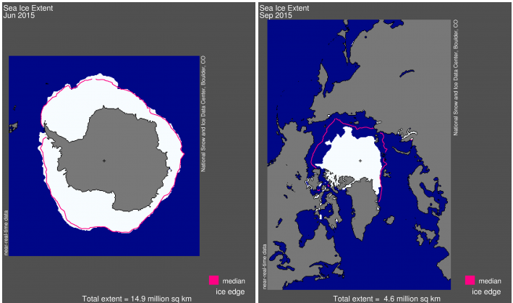
12. ARCTIC ICE vs. ANTARCTIC SEA ICE
Ans. More moisture in air around Antarctica (AA) to nucleate sea ice
Despite > AA is does not compensate for Arctic loss
2015
http://nsidc.org/arcticseaicenews/2015/

Slide 32
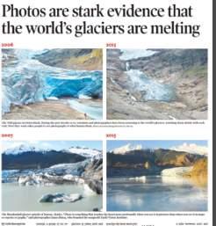
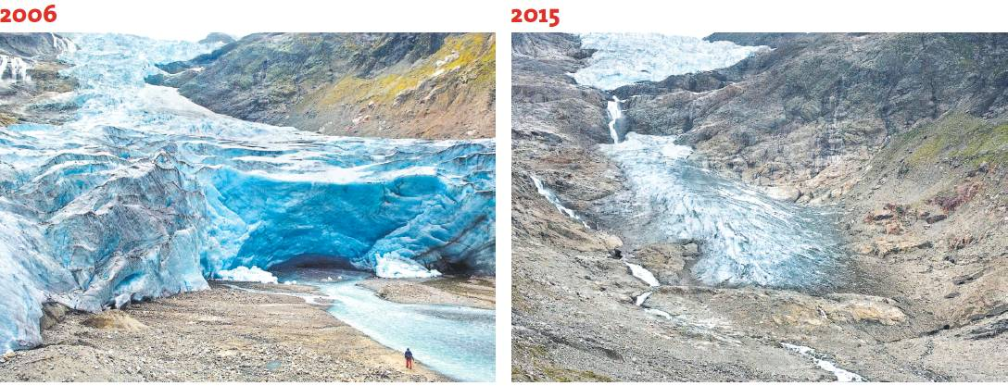
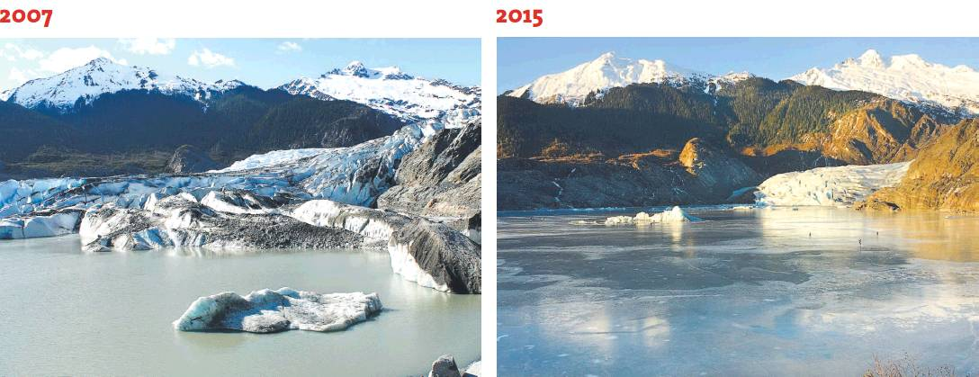
Evidence
Wednesday, Denver Post 4/5/2017
2006
2015
Switzerland
2007
2015
Juneau, AK

Slide 33
Adapting to our Changing Climate
Global warming:
The Consequences
Sea Level Rise
Belanger: OLLI West 4/7/2017
Designed by Anya Hess
photo from NASA

Slide 34
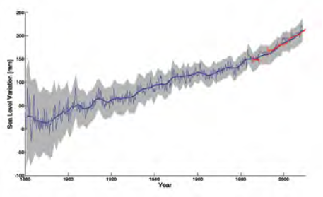
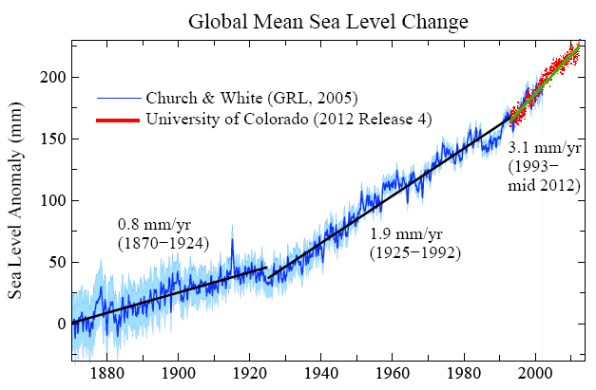
14: HOW FAST IS SEA LEVEL RISING?
Blue: Sea level change from tide-gauge data (Church J.A. and White N.J., Geophys. Res. Lett. 2006; 33: L01602)
Red: Univ. Colorado sea level analyses in satellite era (http://www.columbia.edu/~mhs119/SeaLevel/).

Slide 35
Adapting to our Changing Climate
Global warming:
The Consequences
Associated Refugees
Belanger: OLLI West 4/7/2017
Designed by Anya Hess
photo from NASA

Slide 36

We have not seen anything yet regarding future refugee problems

Slide 37
Adapting to our Changing Climate
Global warming:
The Consequences
Ocean Acidification
Belanger: OLLI West 4/7/2017
Designed by Anya Hess
photo from NASA

Slide 38
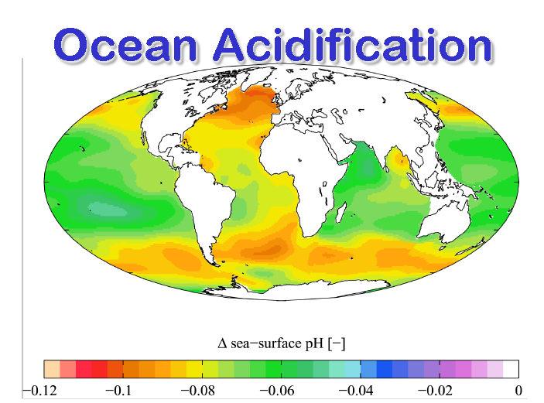
Ocean Acidification
What’s will be its impact on the food chain?
From Where has all the carbon gone: Scott.Denning@ColoState.edu

Slide 39
Adapting to our Changing Climate
Global warming:
The Consequences
Degraded Sustainability
Belanger: OLLI West 4/7/2017
Designed by Anya Hess
photo from NASA

Slide 40
Floods

Slide 41
Drought

Slide 42
Wildfires

Slide 43
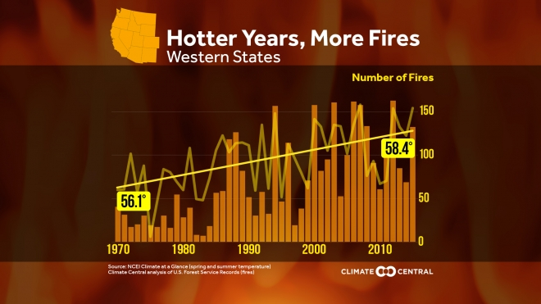
The 2015 wildfire season was the worst on record in the U.S., with more than 10 million acres burned
There are now three times more large wildfires burning across the West each year than in the 1970s.
The annual area burned in these wildfires has increased six-fold. And wildfire season is now an average of 105 days longer than it was in the 1970s.
Notes:
http://www.climatecentral.org/gallery/graphics/hotter-years-more-fires
Also
http://www.climatecentral.org/news/western-wildfires-climate-change-20475

Slide 44
Are Consequences Statistically Significant?
Attribution and risk
Maybe they are not currently statistical but should be wait for that?
The Attribution confidence varies
There are other factors as well

Slide 45
Pollution
Not Attributable to climate change
But is related to our fossil fuel burning that is causing climate change

Slide 46
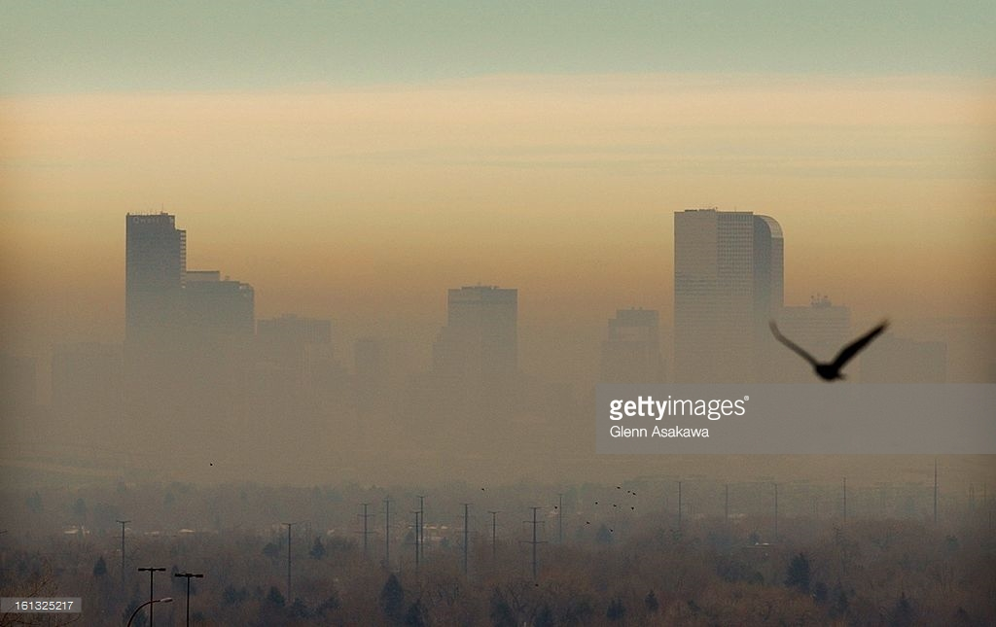
Denver’s Brown Cloud
http://www.gettyimages.com/detail/news-photo/the-worst-brown-cloud-since-last-winter-shrouds-downtown-news-photo/161325217

Slide 47
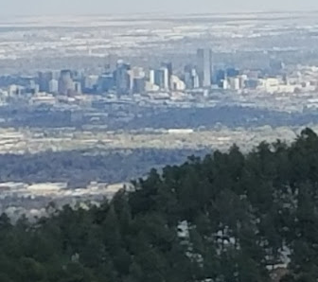
Vs. NO Brown Cloud – all the time!

Slide 48
The American Public and Climate Change
Yale Program on Climate Change Communication
Climate Change and the American Mind - November, 2016
    70% believe global warming is occurring
    55% understand it is caused by human activity
    Only 5% believe anything can or will be done
http://climatecommunication.yale.edu/
Kathleen Wells, Denver CCL, 2017

Slide 49
Yale Program on Climate Change Communication
How Americans Construe Climate Change:
76% Environmental issue
70% Scientific issue
65% Agricultural issue
62% Health issue
61% Severe weather issue
60% Economic issue
56% Political issue
37% Moral issue
http://climatecommunication.yale.edu/
Kathleen Wells, Denver CCL, 2017

Slide 50
How does one respond to Deniers of climate change?
With Simple Facts and Logic
1. Is climate changing? YES
  Scientific ….
2. Do people have anything to do with it? YES
  Greenhouse gas emissions (primarily carbon dioxide from fossil fuel burning) have to warm the atmosphere—it is what they do. ….
3. Is climate change bad? YES
  …change in the environment of stable civilizations is disruptive to those civilizations….
  Alterations in areas in which crops can be grown… when leaves fall, when insects emerge, etc.), …
  Shifting storm tracks, and rising sea level may have devastating economic, social, and political consequences on modern societies.
  Ocean Acidification
4. Can we do anything about it? YES
  ….cessation of emissions can stabilize climate in the 21st century….
5. Is it worth doing anything about? YES
  Economic analyses ….
https://eos.org/editors-vox/responding-to-climate-change-deniers-with-simple-facts-and-logic?utm_source=eos&utm_medium=email&utm_campaign=EosBuzz033117

Slide 51
WHAT TO DO?
PLEASE QUESTION MOTIVES IF ONE SAYS:
“Well I’m not really sure how much is man-made”
AND ASK or think about their credentials!
  Are they climate scientists?
AND Don’t spend too much time (waste?) expecting to change world views

Slide 52
Web Links on Climate
https://skepticalscience.com/
  https://skepticalscience.com/denial101x-videos-and-references.html
http://www.realclimate.org/
http://climatecentral.org/
https://climate.nasa.gov/ https://climate.nasa.gov/causes/ , etc.
Jeffrey Bennett: http://www.globalwarmingprimer.com/tour/
  http://www.globalwarmingprimer.com/primer/primer4/
Jeff Masters/Weather underground: https://www.wunderground.com/weather-infographics/climate-change-today
  https://www.wunderground.com/blog/JeffMasters/show.html
http://www.nationalgeographic.com/magazine/2017/04/seven-things-to-know-about-climate-change/
Extreme Weather: Phil Nelson: https://www.youtube.com/watch?v=gQ1kPMYCFEY&t=9s

Slide 53
Mitigating & Adapting to our Changing Climate
OUTLINE (cont.)
BREAK
NEXT:
Part 2: Solutions:
How to Overcome our Inertia and Apathy
Belanger: OLLI West 4/7/2017
Designed by Anya Hess
photo from NASA

Slide 54

https://i.kinja-img.com/gawker-media/image/upload/t_original/ihsllhptnnm4vb7wuvgq.jpg
Paul Belanger
http://denverclimatestudygroup.com/ https://www.facebook.com/denverclimatestudygroup/
pebelanger@glassdesignresources.com
c. 303-249-7966;

Slide 55
Mitigating & Adapting to our Changing Climate
OUTLINE (cont.)
BREAK
NEXT:
Part 2: Solutions:
Overcome our Inertia and Apathy
  Reduce Carbon Emissions in Electric Generation, Transportation and in Heating
  Carbon Dioxide Removal (CDR); Negative Emission Technology (NET); Greenhouse Gas Removal (GGR)
Belanger: OLLI West 4/7/2017
Designed by Anya Hess
photo from NASA

Slide 56

Part 2: Solutions
How to Overcome our Inertia and Apathy

Slide 57
The American Public and Climate Change
Yale Program on Climate Change Communication
Climate Change and the American Mind - November, 2016
    70% believe global warming is occurring
    55% understand it is caused by human activity
    Only 5% believe anything can or will be done
http://climatecommunication.yale.edu/
Kathleen Wells, Denver CCL, 2017

Slide 58
APATHY / INERTIA
WHY?
IT’S too late
It’s too big a problem
It’s up to the government
I’m not long for here anyway
It’s too expensive
I’m too busy
https://eos.org/articles/climate-scientists-new-hurdle-overcoming-climate-change-apathy

Slide 59

APATHY / INERTIA vs. good motives:
IT’S our planet
It’s the right thing to do
I CARE FOR FUTURE GENERATIONS!
It’s for our grandkids, or dogs or cats
I believe in promoting the best of human values by example
https://eos.org/articles/climate-scientists-new-hurdle-overcoming-climate-change-apathy

Slide 60
SOLUTIONS TO APATHY
#1 - CHANGE OUR WAY OF THINKING

Slide 61
Earth in human hands
Kerry Emanuel, MIT Prof. Meteorology:
“…there are few, if any, historical examples of civilizations consciously making sacrifices on behalf of descendants two or more generations removed”
NEEDED CABINET POSTION:
  Secretary of the future

Slide 62

We are a planet with brains
Climate change is only the most visible of the modifications we've made--up until this point, inadvertently--to the planet.
And our current behavior threatens not only our own future but that of countless other creatures.
….shows what a strange and novel development it is for a species to evolve to build machines, and ultimately, global societies with world-shaping influence.
BTW – David Grinspoon will be at Conf. World Affairs (CWA), Boulder NEXT week of 4/8: http://www.colorado.edu/cwa/

Slide 63
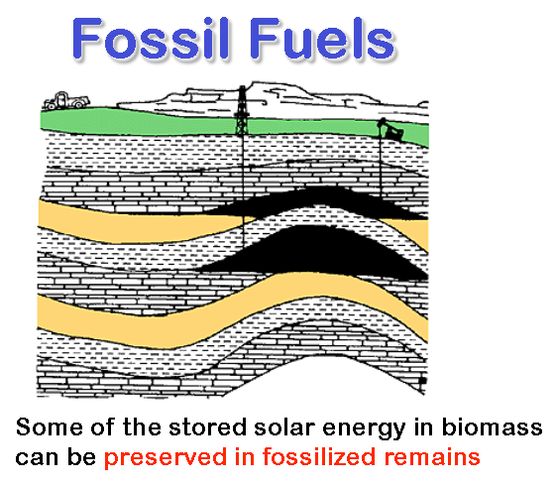
Fossil fuels: oil, gas, coal
We owe a lot to fossil fuels
It’s only recently we’ve fully appreciated it’s consequences
It’s time for change!
From Where has all the carbon gone: Scott.Denning@ColoState.edu

Slide 64
SOLUTIONS
Part A: - REDUCE OUR GREENHOUSE GAS
(GHGs) EMISSIONS
Electric Generation
Transportation
in Heating

Slide 65
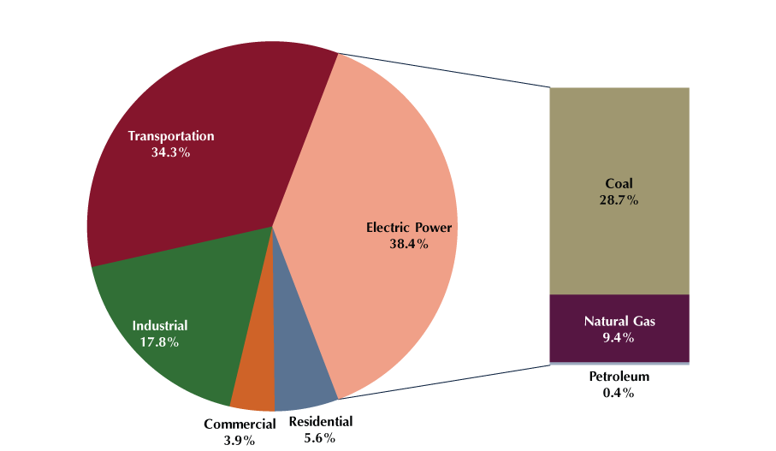
Source of CO₂ Emissions
EIA: https://www.eia.gov/

Slide 66
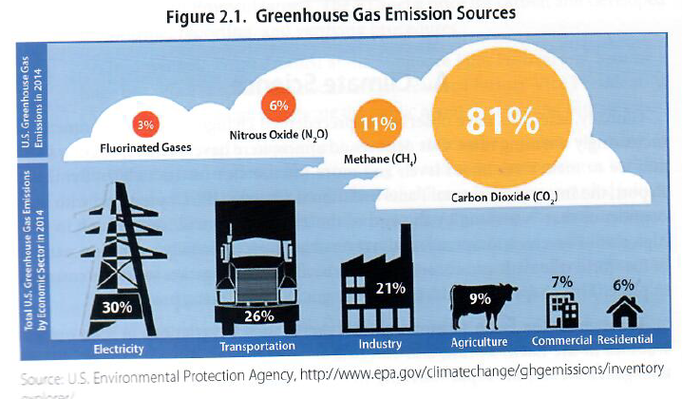
Source of CO₂ Emissions
K.K. DuVivier, Energy Law Basics, 2017

Slide 67
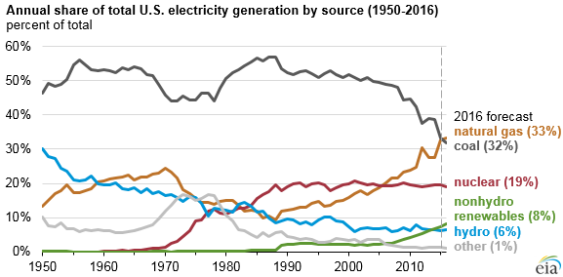
Sources of Electricity in Colorado: 2015
60% coal
22% natural gas
18% renewable energy
NATIONALLY:
32% coal
33% natural gas
19% nuclear
8%+6% renewable/hydro
1% other
Colorado Is a Magnet for Renewable Energy Companies:
Colorado 6th in nation overall potential
Denver 5th in clean-tech employment
Fastest growing industry in the region
https://www.eia.gov/todayinenergy/detail.php?id=25392
Kathleen Wells, Denver CCL, 2017

Slide 68
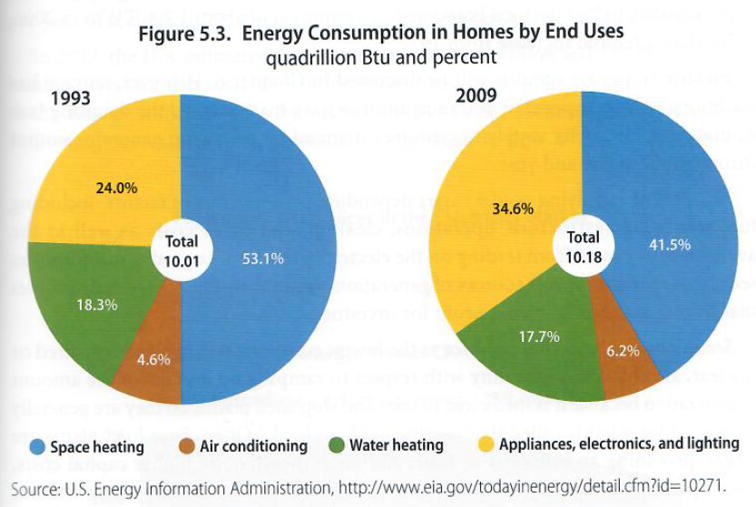

Slide 69
SOLUTIONS TAKE AWAY:
ELECTRIFY EVERYTHING BY NON-CARBON SOURCED ELECTRICAL GENERATION!
OR SOLAR THERMAL

Slide 70

Powering Forward: …America's Energy Revolution
A historic energy revolution is underway in the United States & THE WORLD:
  Wind, sunlight, and other sustainable resources
  Power plants on their roofs
  Entire communities are switching to 100 percent renewable energy; Hawaii has such a commitment!
  Urgent need to prevent climate change is causing people around the planet to question their reliance on carbon-intensive oil, coal, and natural gas.

Slide 71

National Oceanic and Atmospheric Administration estimated in 2016:
“renewable sources could supply (within 15 years) most of the nation’s electricity at costs similar to today’s”

Slide 72
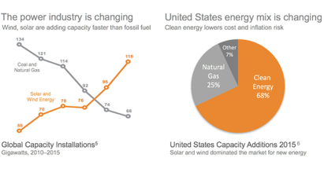
Renewable Energy is Expanding
2010-2015
2015
www.generation180.org
Kathleen Wells, Denver CCL, 2017

Slide 73
Perceptions
LAST WEEK’S unfortunate and misguided rollback of Environmental protections has led to a DEPRESSING and widespread belief that the U.S. can no longer meet its commitment under the Paris climate change agreement:
  WRONG!
WE ARE overestimating Washington’s influence
WE CAN – don’t make the same mistake of those:
  that think they will put coal miners back to work
  that underestimate the role that cities, states, businesses and consumers are playing in driving down emissions of their own
  > 250 coals plants ARE switching to cleaner fuels and/or renewables – because consumers don’t want fuels that poison their air and water – and because there are cheaper alternatives
    Wind $20/megawatt vs. $30/ for coal plants in region
    Sierra club “beyond coal program” http://content.sierraclub.org/coal/
    Vehicle fuel efficiency and
    EVs with greater range
    81 companies in 2015 signed pledges (including Apple, Wal-Mart; Anheuser-Busch 100% energy from renewables by 2025
    Pueblo – similar https://www.compactofmayors.org/
https://www.nytimes.com/2017/03/31/opinion/climate-progress-with-or-without-trump.html?_r=1

Slide 74
SOLUTIONS
Part A: - REDUCE EMISSIONS
Liken it to “DIET”
NOW
Part B: - Carbon Dioxide Removal
Liken it to “EXERCISE”
To get ride of the “fat – CO₂” we’ve put in the atmosphere

Slide 75
SOLUTIONS
Part B: - Carbon Dioxide Removal
Part of what’s called GEOENGINEERING OPTIONS:
  Solar Radiation Management (SRM) – not discussed today/not recommended
  Carbon Dioxide Removal (CDR); Negative Emission Technology (NET); Greenhouse Gas Removal (GGR)
    GOALS of 350.org: https://350.org/

Slide 76



One way: Biochar
http://www.biochar-international.org/
http://biochar-international.org/biochar
A Colorado company
http://www.coolplanet.com/

Slide 77
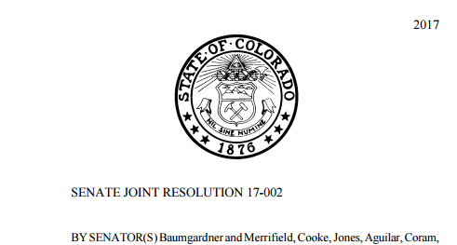
Colorado Biochar Resolution 17-002
Former State Senator Ellen Roberts (R) SW Colorado
98 of 100 senators/representatives sponsored:
Be It Resolved by the Senate of the Seventy-first General Assembly of the State of Colorado, the House of Representatives concurring herein: That we, the members of the Colorado general assembly, support the United States Forest Service, the Agricultural Research Service of the United States Department of Agriculture, and other research into the removal of fuel loads on the forest floor for the creation of biochar and the use of biochar as a soil amendment for reforestation, the continued creation of biochar from woody biomass
http://leg.colorado.gov/sites/default/files/documents/2017A/bills/2017A_SJR002_enr.pdf

Slide 78
So What can WE do?

Slide 79
More Water Vapor and Clouds
Warmer Air, Warmer Water (Global Warming)
HUMAN RESPONSES
Personal
Family, Friends, Neighbors
Town and City
State
National
International
Atmosphere Biosphere
Hydrosphere Cryosphere
(Climate Change)
Courtesy Phil Nelson
Notes:
J = journalism

Slide 80
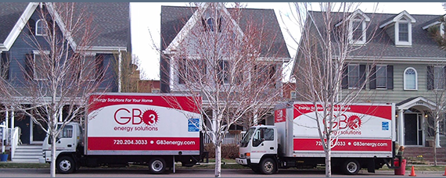
PERSONAL -- Save Energy at Home
GB3 Energy, Golden Colorado
Energy audit, add insulation, replace windows, heating system upgrade, weatherize, crawlspace insulation, …..
Courtesy Phil Nelson
Notes:
http://www.gb3energy.com/

Slide 81
We can Invest in Solar Panels or Community Solar
AN INVESTMENT - Here’s why:
  A personal story
  SPENT:
    $30,000 (minus 30% fed credit) for 30 panels (rounding out cost)
  RETURN:
    Saved $1000 in electricity for 1 year
    With my Leaf – powered by solar panels I drove 14,000 miles replacing a car 25mpg say $2.50 / gallon = i.e. I did NOT spend $1,400 on gasoline
    RETURN $2,400 in ONE year on $30,000 investment! = 8%
    RETURN WITH 30% FED TAX CREDIT = 11.4%

Slide 82
Buy and Electric Vehicle (EV)
100 mpg equivalent
Batteries > 100,000 miles
Motor 1,000,000 miles
No oil change EVER
No maintenance
Why Gasoline Powered Cars Are Obsolete - Jim Smith https://www.youtube.com/watch?v=d7tRlsoZgdI

Slide 83
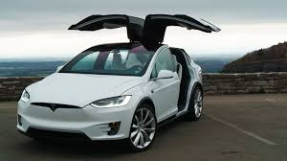
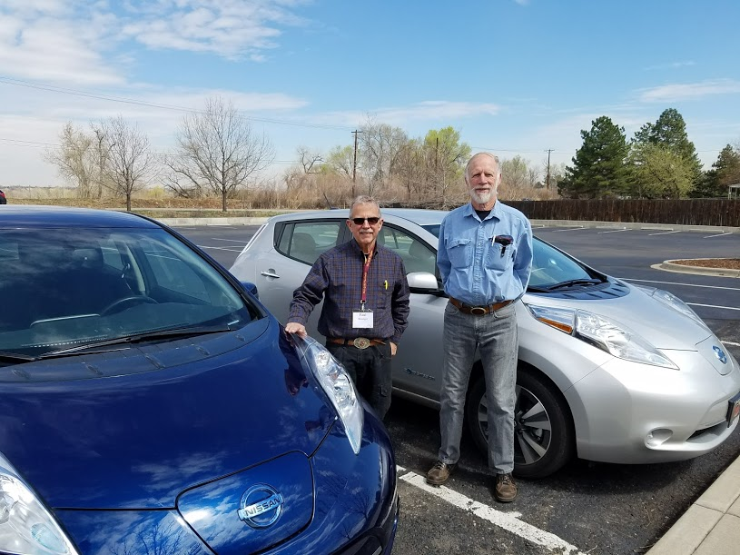
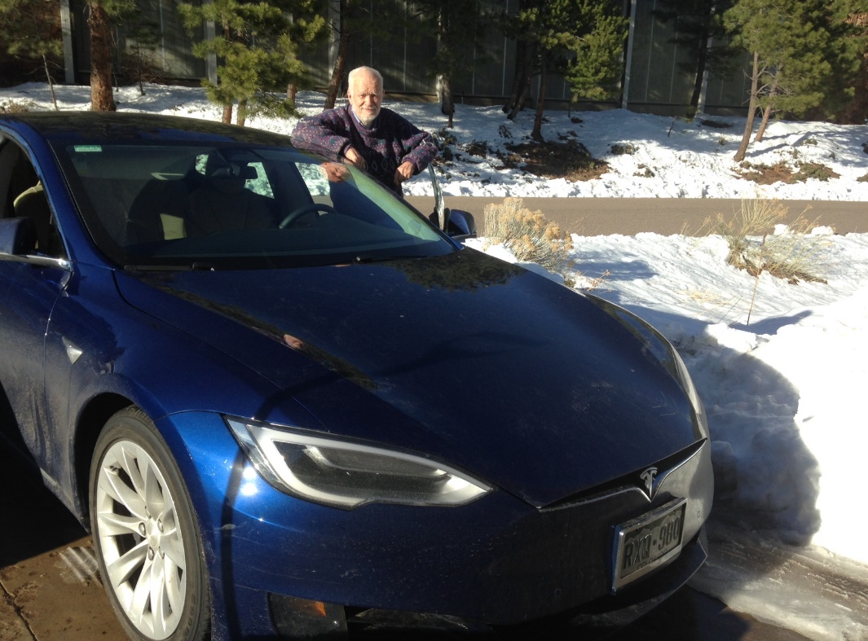
EVs no Emissions
Steve Stevens with Tesla X
90 kWh = 300 mile range
Paul Belanger & Phil Nelson with their Nissan Leafs
30 kWh = 107 mile range
Ron Larson with Tesla S
75 kWh = 250 mile range

Slide 84
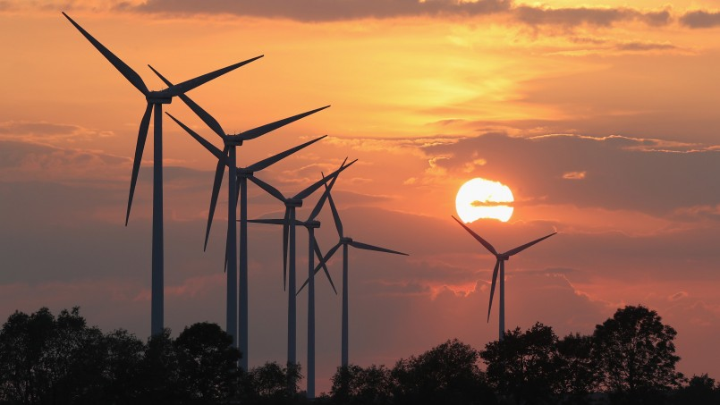
Imagining a World After Fossil Fuels
https://skepticalscience.com/How-Green-is-My-EV.html
https://www.stratfor.com/weekly/imagining-world-after-fossil-fuels

Slide 85
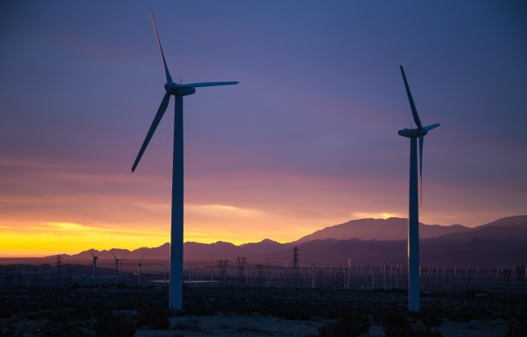
BREATHE EASY:
COAL is not coming back
Renewables win!
RENEWABLES are cheaper!
  Wind especially
  PV next – but will become even cheaper
  Battery backup
  Concentrated Solar Power for Thermal backup
http://www.coloradoindependent.com/164687/bill-ritter-colorado-clean-energy-trump-coal

Slide 86
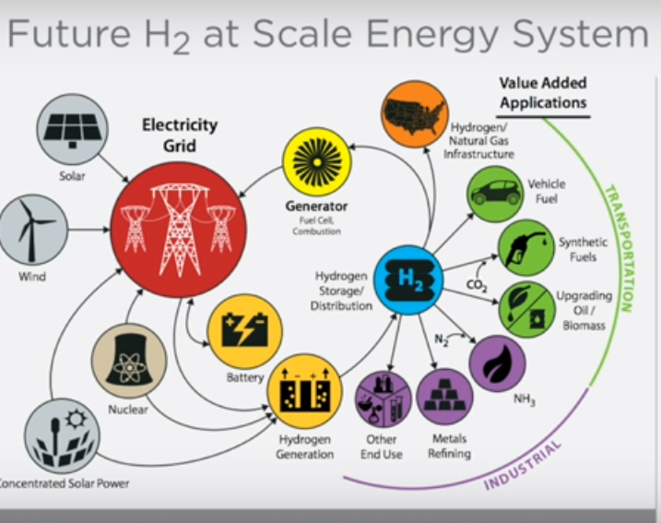
When you have excess power:
Ramping Up Solar to Power the World - Greg Wilson, NREL: https://www.youtube.com/watch?v=7CDPHxcnq4c

Slide 87
What Can Town, Cities and Communities DO?
More Water Vapor and Clouds
Warmer Air, Warmer Water (Global Warming)
HUMAN RESPONSES
Personal
Family, Friends, Neighbors
Town and City
State
National
International
Atmosphere Biosphere
Hydrosphere Cryosphere
(Climate Change)
Courtesy Phil Nelson
Notes:
J = journalism

Slide 88
RATHER
ITS WHAT THEY ARE ALREADY DOING!

Slide 89
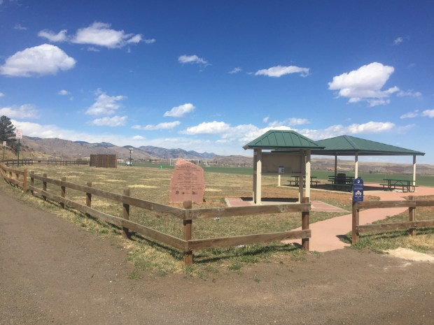
Golden wants Rooney Road soccer fields to share space with solar garden, but needs voter OK first
Josie Klemaier, YourHub, Denver Post, 30 March 2017
Golden’s Sustainability Advisory Committee has been exploring the possibility of a community solar garden since 2008 as a way to help meet the goal to have 50 percent of all energy used by the city and its residents come from renewable sources by 2027.
Golden already has solar power for 10 of its city facilities, eight of which are net zero, meaning they get all of their energy from solar power.
Rooney Road Sports Complex.
On the ballot in November 2017.
Courtesy Phil Nelson
Notes:
http://www.cityofgolden.net/live/sustainability-initiative/renewable-energy/community-solar-garden/
http://www.denverpost.com/2017/03/28/golden-rooney-road-solar-garden/

Slide 90
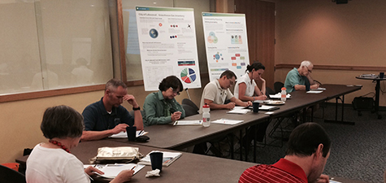
On May 11, 2015 City Council approved Lakewood's first community-wide Sustainability Plan
Lakewood.org extracted Feb 2017
Sustainability plan: climate adaptation; energy-water-environment; sustainable economy; zero waste; public health; natural systems; transportation
Sustainability Division (2 permanent staff) in the Planning Department.
Courtesy Phil Nelson
Notes:
http://lakewood.org/Sustainability/Planning_for_Sustainability/Planning_for_Sustainability.aspx

Slide 91

CITIES: Sustainable Denver Summit, 14 Nov 2016
Mayor Michel B. Hancock
The Sustainable Denver Summit brought together 580 leaders from across the city’s business, nonprofit and civic communities to develop and announce commitments for new and expanded initiatives that will help Denver achieve its ambitious 2020 Sustainability Goals.
Courtesy Phil Nelson
Notes:
https://www.denvergov.org/content/denvergov/en/office-of-sustainability.html

Slide 92
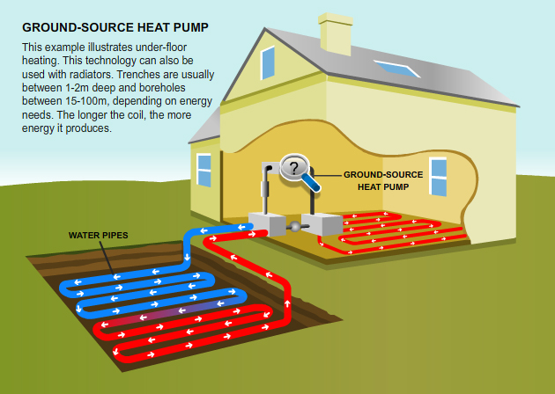
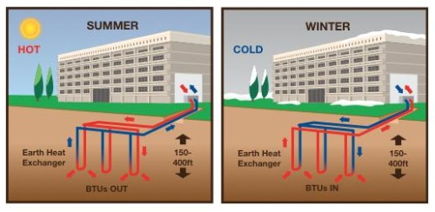
Geothermal:
Personal level or city level
In operation:
Pagosa Springs
Glenwood Springs
Others

Slide 93
More Water Vapor and Clouds
Warmer Air, Warmer Water (Global Warming)
HUMAN RESPONSES
Personal
Family, Friends, Neighbors
Town and City
State
National
International
Atmosphere Biosphere
Hydrosphere Cryosphere
(Climate Change)
Courtesy Phil Nelson
Notes:
J = journalism

Slide 94
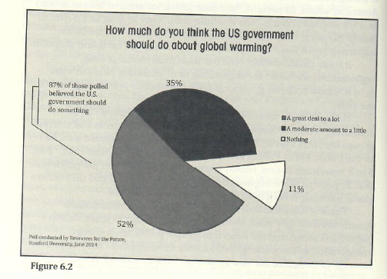
We’d like the role of Government
BUT
IT DOES NOT LOOK PROMISING RIGHT NOW?
Bill Ritter, Jr., Powering Forward, 2016

Slide 95
It isn't going to happen right now
RESPONSES
State level: Varies by State
PUCs
Munis/Power companies/Co-ops
Nations: Also Varies by Nation
China proving to be #1
Europe – especially Germany: also a leader
U.S. – not so much

Slide 96
SOLUTION
VOTE
SUPPORT YOUR SENATORS AND REPRESENTATIVES SPEAKING OUT
WRITE/HARRASS THOSE THAT ARE NOT

Slide 97
Senator Bennet
https://www.bennet.senate.gov/?p=blog&id=3860
  Bennet Urges President to Rescind Anti-Climate Executive Order: https://www.bennet.senate.gov/?p=blog&id=3860

Slide 98
Rep. Ed Perlmutter
http://perlmutter.house.gov/
Perlmutter Responds to Trump’s Climate Change Executive Order: http://perlmutter.house.gov/news/documentsingle.aspx?DocumentID=1671

Slide 99
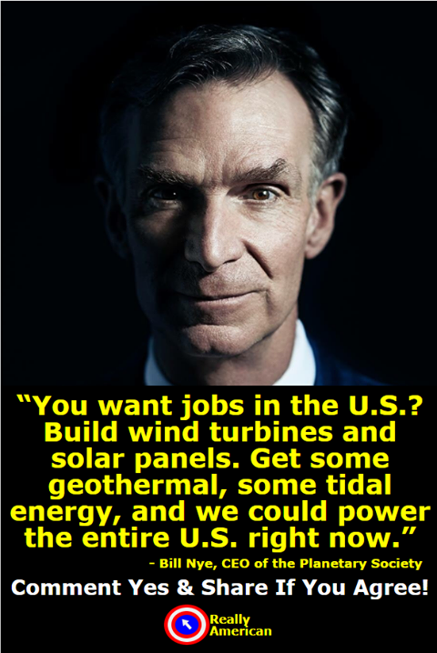
JOB Concerns
https://www.facebook.com/reallyamerican/?hc_ref=PAGES_TIMELINE

Slide 100

Former Gov. Bill Ritter
One in 50 new jobs in America is now in solar energy.
http://www.coloradoindependent.com/164687/bill-ritter-colorado-clean-energy-trump-coal

Slide 101



Gardyloo “Gardez L’eau”: The grim story of unsanitary Edinburgh
The street cleaners lost their jobs!
But new careers to be had: PLUMBERS!
And we were all the better for it
http://www.scotsman.com/heritage/people-places/gardyloo-the-grim-story-of-unsanitary-edinburgh-1-4073295

Slide 102

JOB Concerns
NREL could be hit hard by deep cuts to parent agency’s budget http://www.denverpost.com/2017/04/03/nrel-cuts-trump-budget/

Slide 103

Job Concerns
EPA could be hit hard by deep cuts to parent agency’s budget
  What the West was like before the EPA:
    http://www.hcn.org/articles/what-the-west-was-like-before-the-epa

Slide 104
Is it only about Economics
SHOULD IT BE?
Credit to Steve Stevens for reaffirming the following thoughts:
  Well … I hope it is not only for the economics
  I Hope we are caring about Future Generations
  For Nature,
  For Human Values ….

Slide 105



Herman Daly: Steady State Economics
Limits to Growth
Alec Tsoucatos teaches these concepts at Regis and OLLI West class winter 2017
Growth Busters
Jefferson County Open School
4/22/2017

Slide 106
BECOME AN ACTIVIST
Get Involved
April 22nd: Earth Day Activities
April 29th March; https://actionnetwork.org/events/peoples-climate-march-on-denver-2?source=facebook&
Join Citizens Climate Lobby
  Here at JUC 2nd Saturday 10 a.m.
  TOMORROW April 8th

Slide 107




Jim Hansen, Bill McKibben among others: activists
Jim Hansen
https://en.wikipedia.org/wiki/James_Hansen
http://www.columbia.edu/~jeh1/
https://350.org/

Slide 108


https://www.ourchildrenstrust.org/news

Slide 109
Guiding Principles
So a little more on Citizens Climate Lobby
Politicians don’t create political will, they respond to it.
The bipartisan carbon fee and dividend policy is a simple, transparent policy to address the climate crisis.
CCL volunteers show respect for diverse views and appreciation for the work of others.
Kathleen Wells, Denver CCL, 2017

Slide 110
Strategies
CCL Website: www.citizensclimatelobby.org
https://www.facebook.com/CitizensClimateLobbyDenverChapter
Lobbying
Writing
Educating
Building Partnerships
  JOIN US HERE TOMORROW April 8th
  10:30 A.M.
Kathleen Wells, Denver CCL, 2017

Slide 111
Concerns about
Colorado Economy and Fossil Fuels?
(abstracted from work of Phil Nelson)
Colorado GDP
$306B
It Will Require Adjustments
But
NOT Insurmountable
Budget
$25B
Oil & Gas State & Federal Revenue $1.2B Total
$100 Million
$1 Billion
$10 Billion
$100 Billion
$1 Trillion
__________________________________________________________________________
Oil, gas, & coal revenues within Colorado economy in 2014
Kathleen Wells, Denver CCL, 2017

Slide 112
The Transition to Renewable Energy and
The Colorado Economy
Colorado economy is robust and diverse
Colorado fossil fuel industry has a modest impact on state economy
Colorado is a magnet for the renewable energy industry
Colorado economy can adjust to gradually declining fossil fuel industry
Kathleen Wells, Denver CCL, 2017

Slide 113
Fossil Fuel Industry in Colorado: 2014 Summary
(abstracted from work of Phil Nelson)
Oil and gas contributed 4% of state revenues in 2014.
Employment in clean-tech (23,400) closing in on that of oil and gas (38,650).
Colorado distributes funds to counties impacted by oil and gas drilling.
Tax revenues from oil and gas are distributed to a variety of entities, as determined by legislation.
Kathleen Wells, Denver CCL, 2017

Slide 114
Web Links Energy/Other
U.S. Energy Information Administration https://www.eia.gov/
CRES https://www.cres-energy.org/
  YouTube https://www.youtube.com/channel/UCr81EUb2qVJVfmmlJMxEHVw
  NREL Presentation: GREG WILSON https://www.youtube.com/watch?v=7CDPHxcnq4c&t=23s
  Governor Ritter Presentation https://www.youtube.com/watch?v=agowW1QKwms&t=6s
https://skepticalscience.com/How-Green-is-My-EV.html
http://energyshouldbe.org/
  Why Storage is Key for a Renewable Energy Future: https://www.youtube.com/watch?v=Yc_hULwykvQ&t=13s
  Clean Energy through Open Electricity Markets: https://www.youtube.com/watch?v=seGwTKTm38A

Slide 115
In closing
“ASK NOT WHAT YOU OUGHT TO DO, RATHER ASK WHAT YOU MUST DO!”
(attributed to a philosopher – please let me know who)
AND
For those that say “it can’t be done” I say: Stay out of the way of those that are DOING IT!

Slide 116

What if?
Joel Pett

Slide 117
Acknowledgments
OLLI West for giving me to opportunity to give this talk
Ron Larson
Phil Nelson, CCL
Kathleen Wells, CCL
Steve Stevens
Martin Voelker, CRES
All my colleagues committed to future Sustainability
And anyone else I’ve omitted

Slide 118
https://i.kinja-img.com/gawker-media/image/upload/t_original/ihsllhptnnm4vb7wuvgq.jpg
Paul Belanger
http://denverclimatestudygroup.com/ https://www.facebook.com/denverclimatestudygroup/
pebelanger@glassdesignresources.com
c. 303-249-7966;

