Slide 1
Mitigating & Adapting to Climate change: Extreme Weather Events, a Worldwide Energy Revolution and Geoengineering options
Week 5: April 24th, 2017
Wind and Solar
Paul Belanger, Ph.D.

Slide 2
Announcements

Slide 3

Michael Bloomberg
new book, “Climate of Hope: How Cities, Businesses, and Citizens Can Save the Planet,” co-authored by former Sierra Club executive director Carl Pope.
specific policy objective: to help save an international agreement, negotiated in Paris, to reduce global carbon emissions
believed the U.S. would hit that goal regardless of what Trump does because of leadership at the state level and market forces already at play in the private sector.

Slide 4
Thursday April 27th , 7 p.m.
HERE at JUC
Colorado Renewable Energy Society:
  Jeffco chapter presents:
KK DuVivier: Deep Decarbonization - It's the Rules, Stupid!
  https://www.cres-energy.org/

Slide 5
NREL TOUR MAY 8TH
  Energy Systems Integration Lab
  1:30-3:00 p.m.; please aim to be there ~1 p.m.
  GOVERNMENT ID: CDL / passport
  Read attachments I sent
Paul Belanger:
  PEBelanger@glassdesignresources.com
  c. 303-249-7966; h 303-526-7996

Slide 6
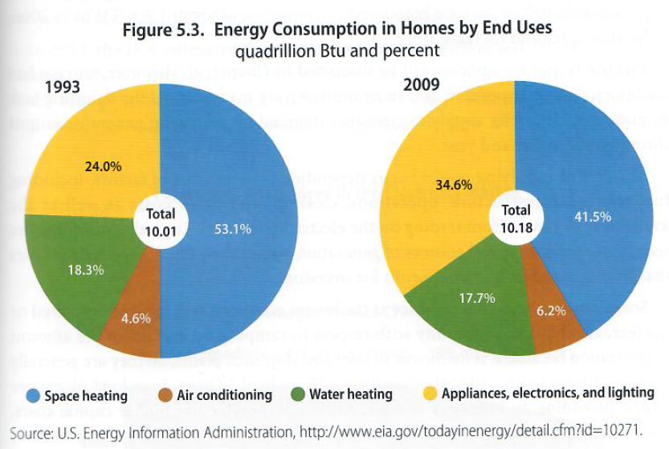

Slide 7
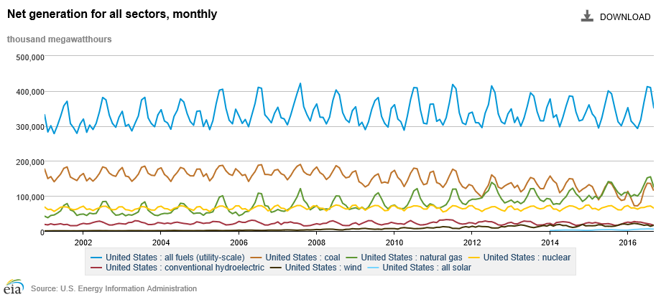
Electricity Generation in the U.S. by Source
U.S. Energy Information Administration, Nov 2016
total
hydroelectric
natural gas
nuclear
coal
wind
solar
Overall electrical generation in the United States is roughly flat for 2006-2016.
Coal-fired generation has been dropping since 2009.
Summer usage causes annual fluctuations of about one-third.
Wind is 5.1% and solar is 1.4% of all electrical generation as of October 2016.
Notes:
http://www.eia.gov/electricity/data/browser/

Slide 8
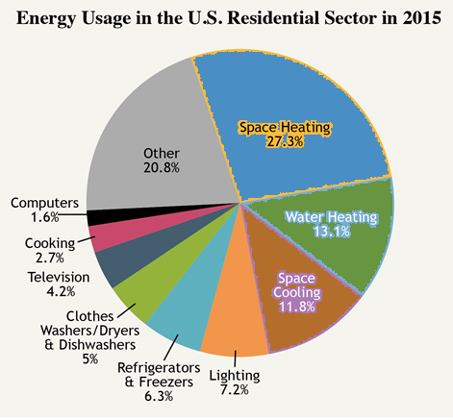
1993 vs. 2009 vs. 2015
http://needtoknow.nas.edu/energy/energy-use/home-work/

Slide 9
LAST WEEK - SOLUTIONS TAKE AWAY
(modified):
ELECTRIFY EVERYTHING BY NON-CARBON SOURCED ELECTRICAL GENERATION!
SOLAR THERMAL
BIOCHAR/BIOFUELS

Slide 10
To Do that (i.e. non-Carbon Energy), in addition to efficiency improvements:
Might need to subsidize nuclear
Storage: battery, thermal, other
Grid conversion / infrastructure

Slide 11
Decisions
David Grinspoon:
“The decisions we make today will have an impact not only on this 21st century but on the 22nd and 23rd centuries and beyond”

Slide 12
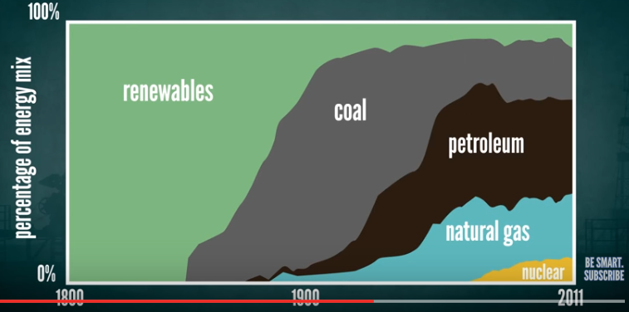
HISTORICAL
Renewables to Coal-Petroleum-
Natural Gas-Nuclear
https://www.youtube.com/watch?v=Fjbx5Xq_ULc&t=10s

Slide 13
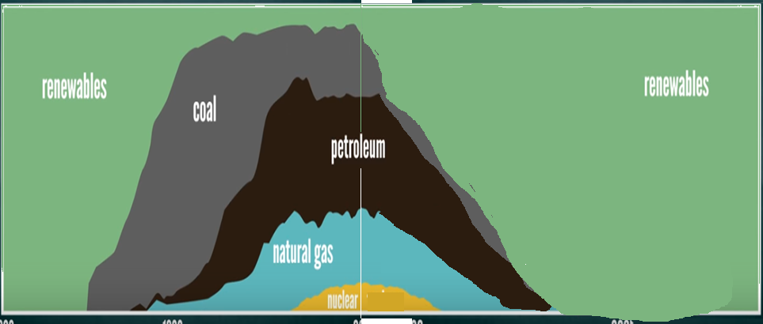
PROJECTIONS:
Renewables to Coal-Petroleum-Natural Gas-Nuclear --
Back to Renewables
https://www.youtube.com/watch?v=Fjbx5Xq_ULc&t=10s

Slide 14
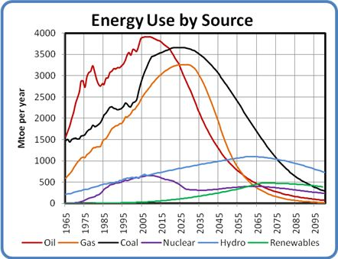
VERY few figures that I could find beyond 2050
AND the figures for renewables are
LAUGHABLE!
http://www.greatchange.org/ov-cherfuka,WEAP.html
http://www.economywatch.com/economy-business-and-finance-news/how-energy-consumption-employment-and-recessions-are-interlinked.26-09.html

Slide 15
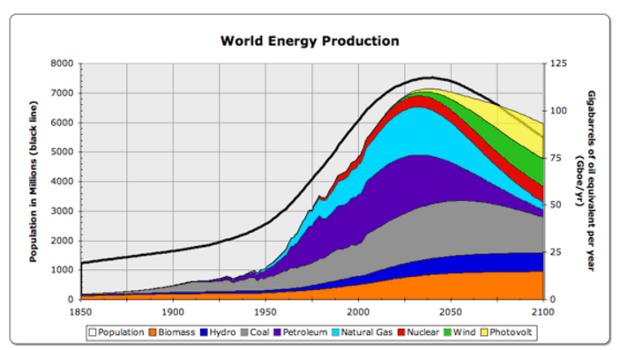
AND the figures for renewables are
LAUGHABLE!
LINK to click on picture for your own assumptions:
http://tqe.quaker.org/2007/TQE155-EN-WorldEnergy-1.html

Slide 16
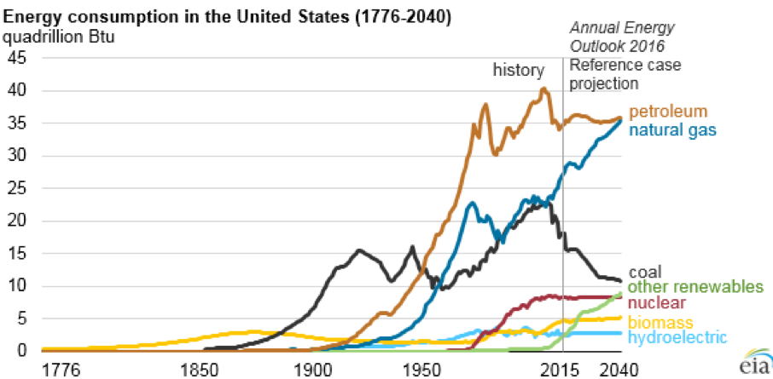
AND the figures for renewables are
LAUGHABLE!

Slide 17
THIS WEEK – SOLAR AND WIND
SOLAR
  PV – PhotoVoltaics
    Monocrystalline, Multi, thin-film
    Road, sidewalk, rooftop, tracking 1-axis/2-axis, etc.
  CSP – Concentrated Solar Power
Wind
  Turbines
  Vertical, etc.

Slide 18
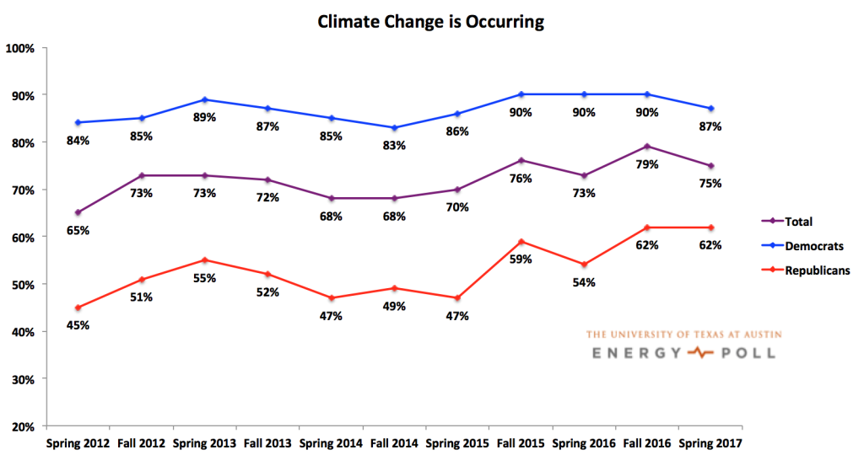
RENEWABLES / NON-CARBON SOURCES OF ENERGY:
THE ENERGY TRANSITION THAT NEEDS TO HAPPEN
  BUT REMEMBER – THE CHALLENGE:
    70% believe global warming is occurring
    55% understand it is caused by human activity
    Only 5% believe anything can or will be done
http://www.utenergypoll.com/
http://climatecommunication.yale.edu/

Slide 19
BEFORE WE GO ON:
UNITS
POWER
SI = Watt = J/s
Other units – see white board:
kW, GW, TW
(for Kilo- 10³,
giga- 10⁹,
tera- 10¹²)
BTU
QUADS (10¹⁵ BTUs)
ENERGY
SI = J = power-time
Or Watt-s
Or what you are used to getting billed for:
kWh @ ~0.11/kWh
CARBON
Gt C = Gt CO2/3.67
(mass 44/mass 12 C)
32.7/3.67 = 8.91 Gt C

Slide 20

Images
of change—
The Energy Transition
Some Compiled by Phil Nelson, 2017

Slide 21

Earth
Human Population = 7.3 B
Annual Electricity Demand = 23,300 TWh
Annual CO2 Emissions = 32.2 Gt
Fraction of GHG Emissions from Energy Use ≈ 68%
Gt C = Gt CO2/3.67
(mass 44/mass 12 C)
32.7/3.67 = 8.91 Gt C

Slide 22
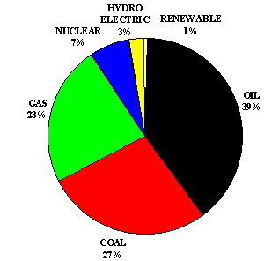
Total Worldwide Energy Production
http://www.worldfuturefund.org/wffmaster/Charts-HTML/Energy/wff-energy.htm

Slide 23
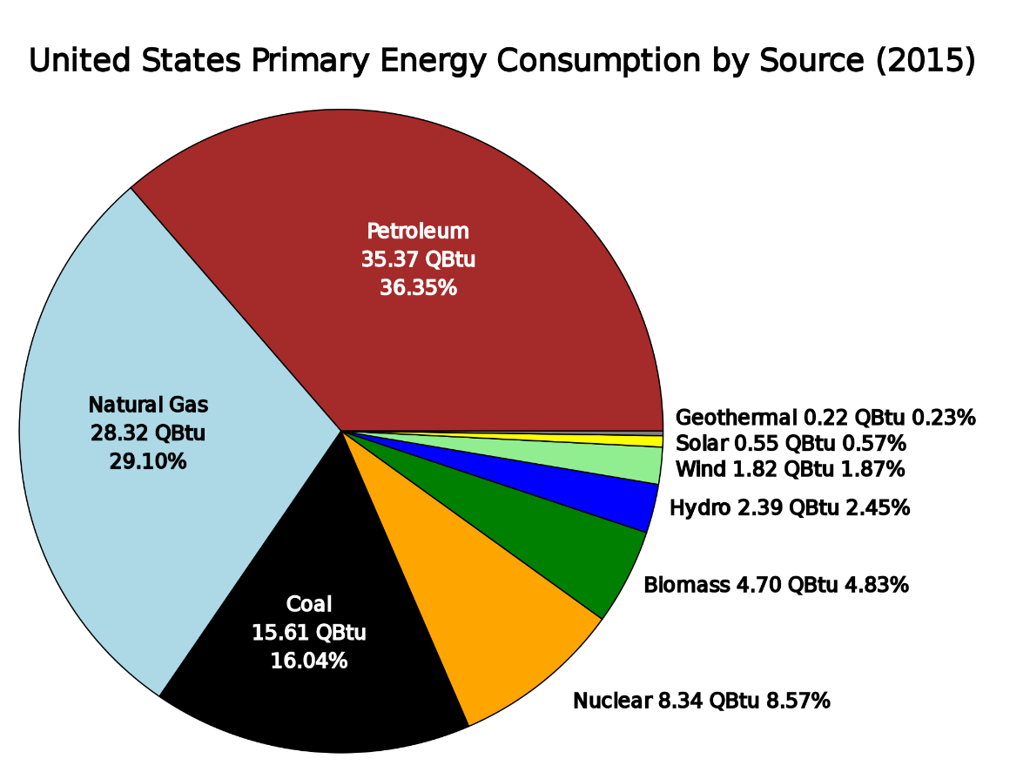
Total Worldwide vs. U.S. Energy Production
http://www.worldfuturefund.org/wffmaster/Charts-HTML/Energy/wff-energy.htm
https://en.wikipedia.org/wiki/Energy_policy_of_the_United_States

Slide 24
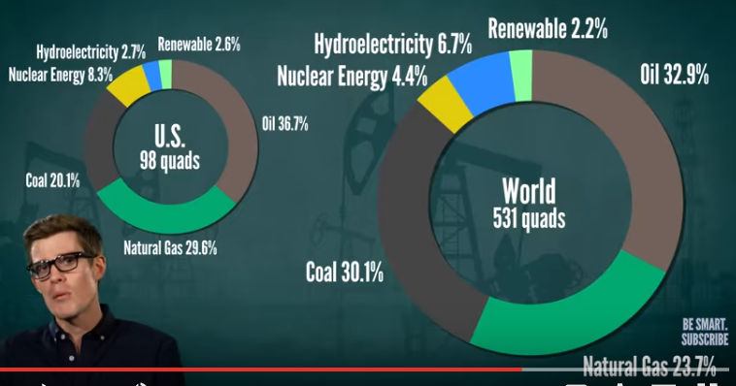
U.S. Use Matches World in Proportion

Slide 25
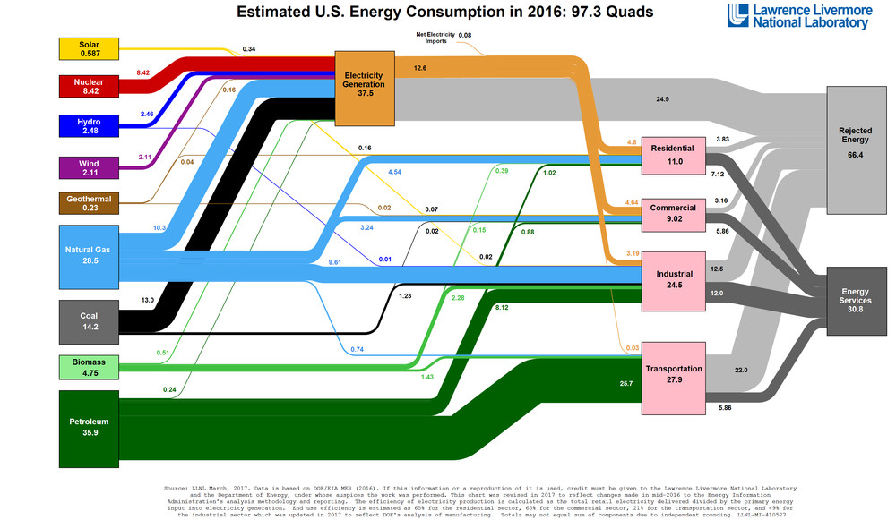
Energy in the U.S. in 2016 – Sources, What it is used for, and how much of it is wasted – a bit of a mind-blower Vox.com April 2017
Rejected
Energy Services
Notes:
http://www.vox.com/energy-and-environment/2017/4/13/15268604/american-energy-one-diagram

Slide 26
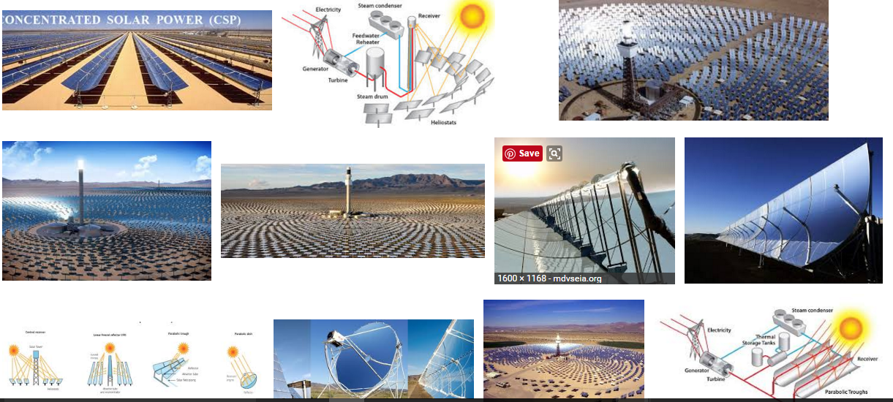
Concentrated Solar Power – (CSP)

Slide 27
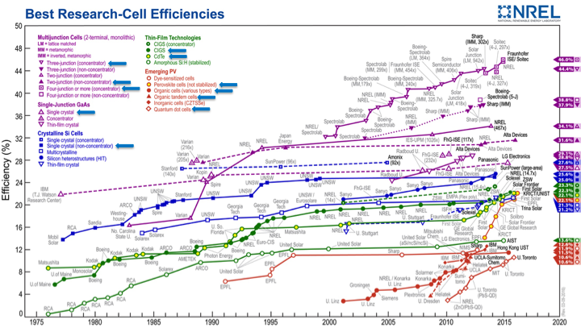
NREL’s PV Research Portfolio
PV Research at NREL
PV Technologies
PV Cross-Cutting R&D
Thin Film PV
CIGS / CdTe / Novel
III-V
MJ & 1J
Silicon
cSi 1J & Tandems
Perovskites
& OPV
Measurements & Characterization
Module Reliability & Systems Engineering

Slide 28
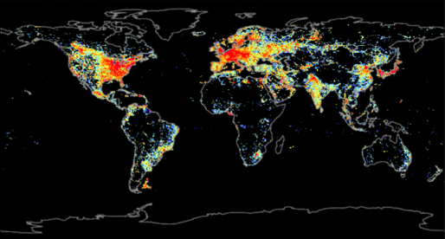
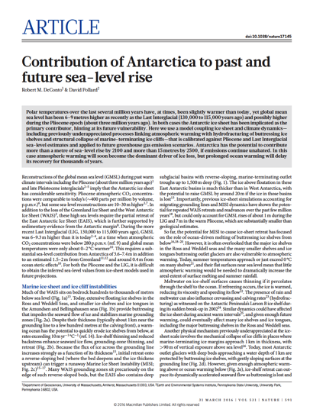
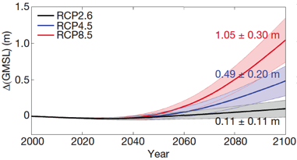
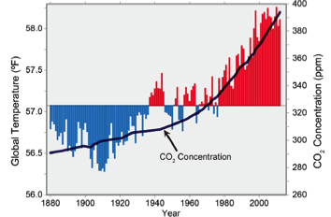
Motivation is Clear – Energy Needs vs. CO₂
Humanity requires ~6 TW of electrical generating capacity, ~2/3 from fossil fuels.
[CO₂] ~402 ppm and rising.
Source: 2014 U.S. National Climate Assessment
Nature - 31 March, 2016

Slide 29
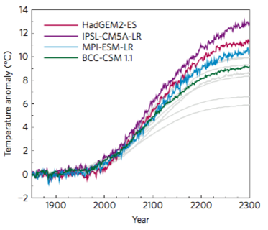
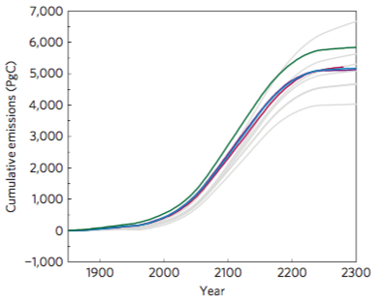
Latest Earth System Model Results
Predicted global average surface temperature has gone up, not down, with increasingly sophisticated earth system models.
Warming and CO2 emissions are in fact roughly linear.
Burning all of earth’s fossil fuel resources, projected by ~2200 given current trends, would result in global average warming of 6.4–9.5° C, mean Arctic warming of 14.7–19.5° C.
Actual in gray – conservative
Vs. actual
Source: Tokarska et al., Nature Clim Change, 23MAY16

Slide 30
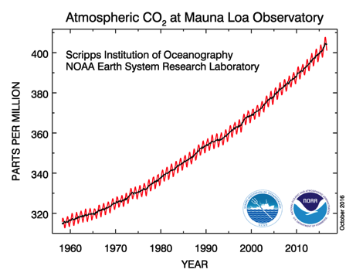
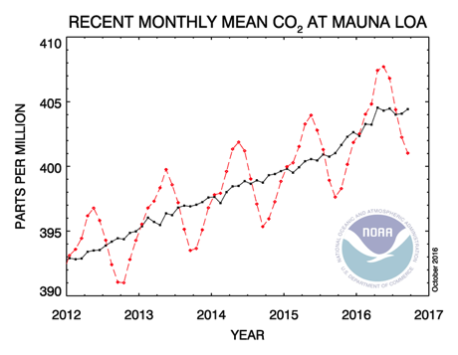
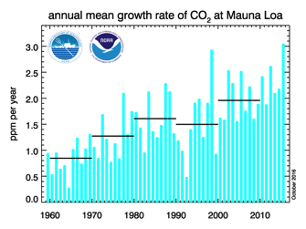
450ppm Goal: Dramatic Change Needed
Average rate of CO₂ increase for last decade was 2 ppm/year.
Average global CO₂ concentration is now approaching 402 ppm so even with last decade’s rate of increase, we’ll hit 450 ppm by 2040!

Slide 31
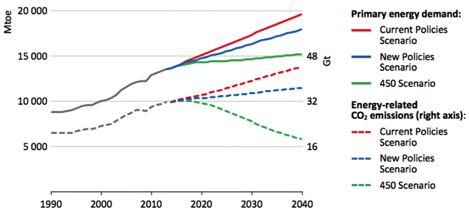
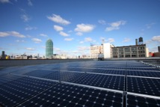
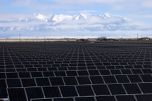
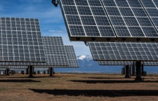
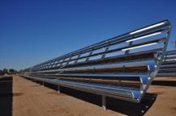
450ppm Goal: Dramatic Change Needed
Source: 2015 IEA World Energy Outlook
Must hold overall energy consumption essentially flat for the next 25 years through major gains in energy efficiency.
Must begin a major shift to zero carbon generation immediately, with measurable reductions by 2020.

Slide 32
HOW IS THE WORLD RESPONDING?
THE WORLDWIDE ENERGY REVOLUTION!

Slide 33


World EnergyRessources
renewable
finite
World Energy Resources (TW-yr)
WIND
60-120
per year
215
Total
SOLAR
23,000 per year
Natural Gas
Waves
0.2-2 per year
3 -11 per year
OTEC
240
Total
Petroleum
2 – 6 per year
2010 World required ~16 TW
Biomass
3 – 4 per year
90-300
Total
HYDRO
TIDES
0.3 – 2 per year
2050: ~28 TW
0.3 per year
Geothermal
Uranium
900
Total reserve
© R. Perez et al.
COAL
33
Notes:
33
33
33

Slide 34
renewable
finite
World Energy Resources (TW-yr)
WIND
60-120
per year
330
Total
SOLAR
23,000 per year
Natural Gas
Waves
0.2-2 per year
SHALE
3 -11 per year
OTEC
310
Total
Petroleum
2 – 6 per year
2010 World required ~16 TW
Biomass
3 – 4 per year
90-300
Total
HYDRO
TIDES
0.3 – 2 per year
2050: ~28 TW
0.3 per year
Geothermal
Uranium
900
Total reserve
© R. Perez et al.
COAL
34
Notes:
34
34
34

Slide 35
HOW IS THE WORLD RESPONDING?
THE WORLDWIDE ENERGY REVOLUTION!

Slide 36
Overview
Brief introduction of NREL, the MCST Directorate and NREL’s PV Program.
Energy and climate change.
Cell efficiency and module cost - 39 years of progress.
Enabling PV as a global carbon emissions reduction tool.
10TW by 2030.

Slide 37
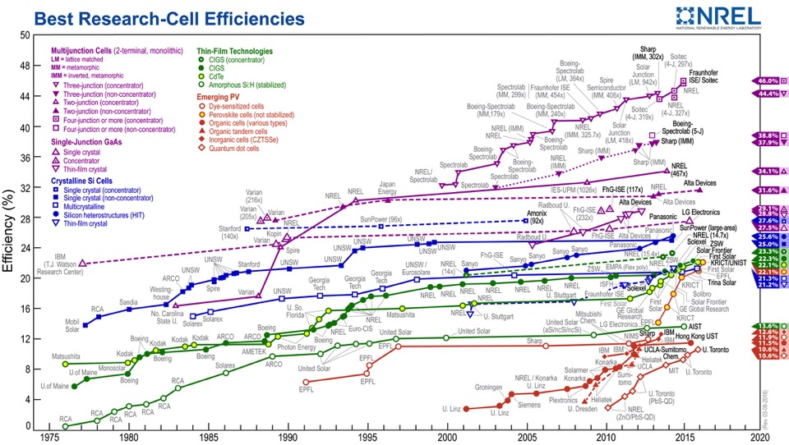
PV Research – Dramatic Progress

Slide 38
Silicon PV Module Cost Decline
SunShot 2020 Goal: 50¢/W
Current wholesale price:
< 45¢/W for multi-Si modules
Sources: Strategies Unlimited, Navigant Consulting & Paula Mints

Slide 39
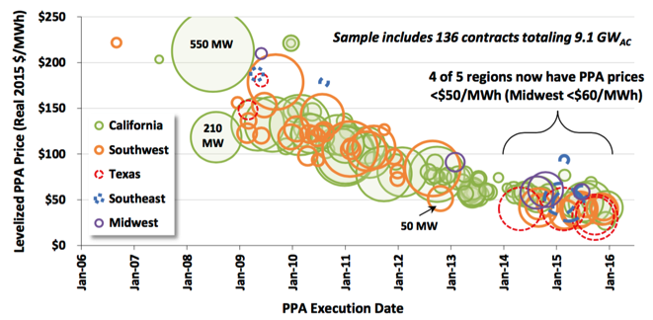
US System Pricing – Utility Scale >5 MW
Source: Utility-Scale Solar 2015, Bolinger & Seel (LBNL, AUG16)
PV system costs at all scales declining rapidly.
SunShot goal of $1/W corresponds to LCOE of 6 ¢/kWh.
Original Source: NREL 3Q15 Solar Update, Feldman et al., 19JAN16

Slide 40
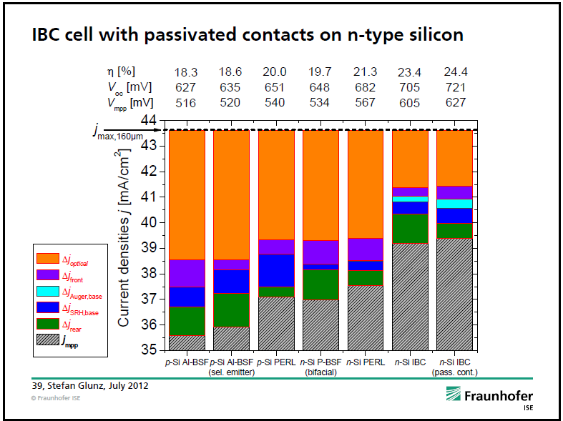
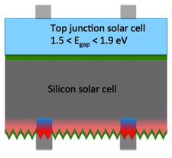
Si Tandem Cells
1.1 eV
Source: Stefan Glunz presentation, NREL Si Workshop in Vail, CO, July, 2012
Path to > 30% efficiency for Si wafer based cells.
Top cell requirements:
  Lattice & CTE match to Si if epitaxially grown
  ~1.7 eV band gap
Perovskites may evolve into good polycrystalline choice.

Slide 41
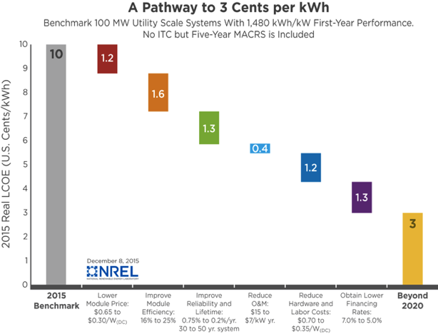
Example – Path to 3¢/kWh LCOE Target
Module cost, efficiency and reliability will be the focus of major new R&D efforts.

Slide 42
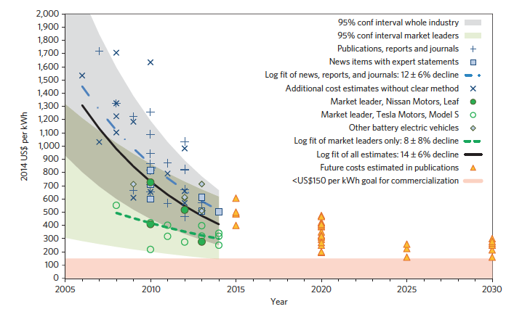
Li Ion Batteries - Cost Declines
Source: Nykvist & Nilsson, Nature Climate Change, 23MAR15

Slide 43
Future Energy System – Commodity H₂

Slide 44
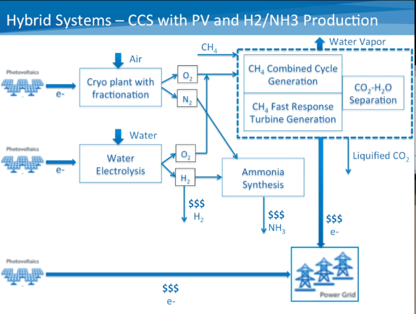

Slide 45
Overview
Brief introduction of NREL, the MCST Directorate and NREL’s PV Program.
Energy and climate change.
Cell efficiency and module cost - 39 years of progress.
Enabling PV as a global carbon emissions reduction tool.
10TW by 2030.

Slide 46
10TW by 2030

Slide 47
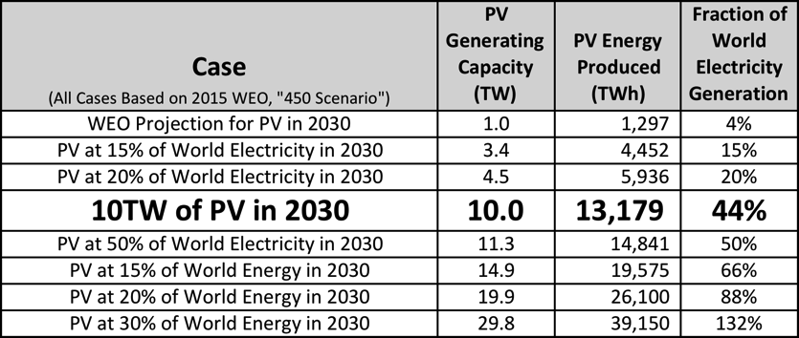
Pathway to 10TW of PV in 2030
10TW of cumulative PV generating capacity by 2030 is needed to meet atmospheric CO2 targets.
How will we get there?
  Cheap PV generated electricity will create new demand.

Slide 48
10TW by 2030 – Capital Intensity Role
Left axis shows annual production capacity required in GW/year.
Right axis shows annual mfg. investments required in $B/year.
Red line and bars shows the case for 3TW by 2030 assuming only a 20% decline in capital intensity.
Blue line and bars shows the case for 10TW by 2030 comparing both a 20% and 70% decline in capital intensity.

Slide 49
Silicon PV Module Cost Decline
SunShot 2020 Goal: 50¢/W
Current wholesale price:
< 45¢/W for multi-Si modules
Sources: Strategies Unlimited, Navigant Consulting & Paula Mints

Slide 50
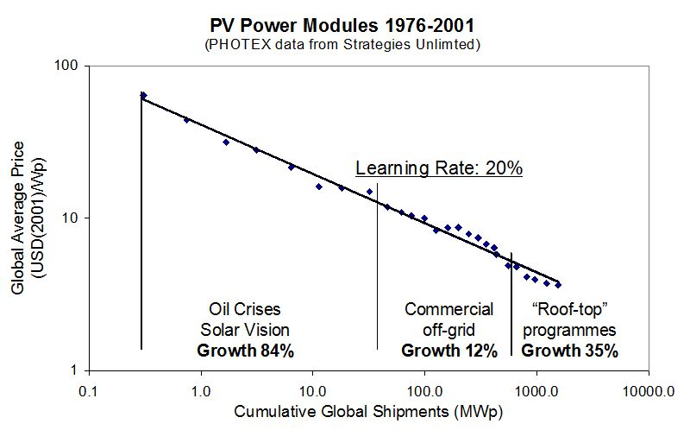
https://www.intechopen.com/books/climate-change-research-and-technology-for-adaptation-and-mitigation/energy-technology-learning-key-to-transform-into-a-low-carbon-society

Slide 51
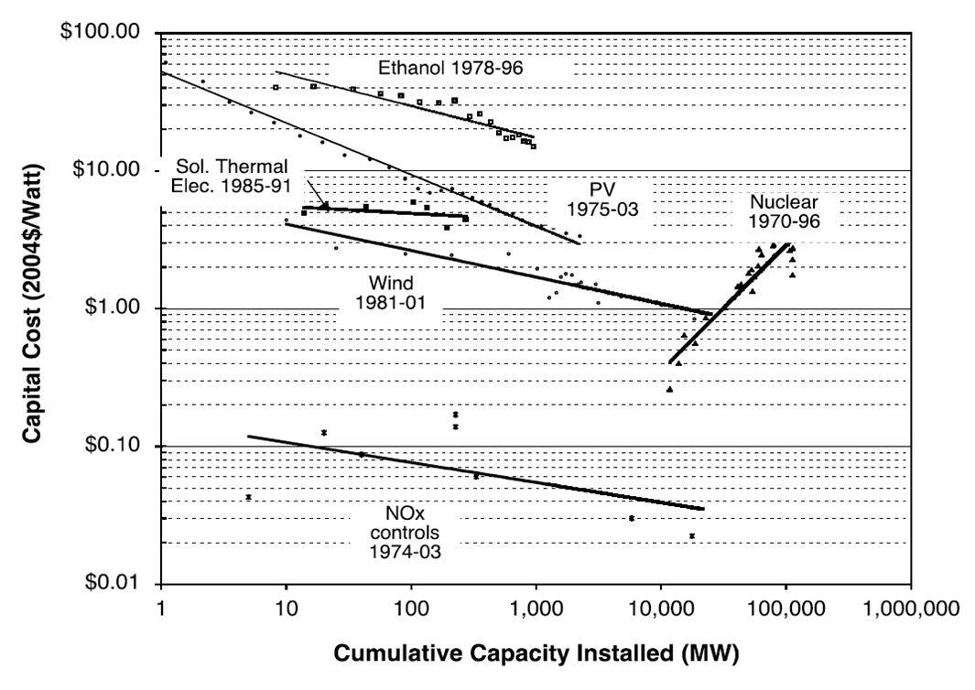
https://carbonremoval.files.wordpress.com/2014/12/energy-learning-curves.png

Slide 52
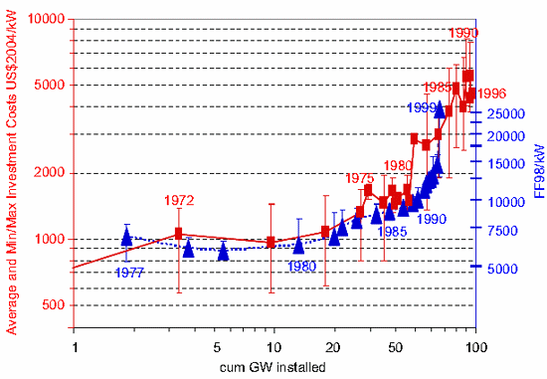
https://thinkprogress.org/does-nuclear-power-have-a-negative-learning-curve-b389ef2de998

Slide 53
PV

Slide 54
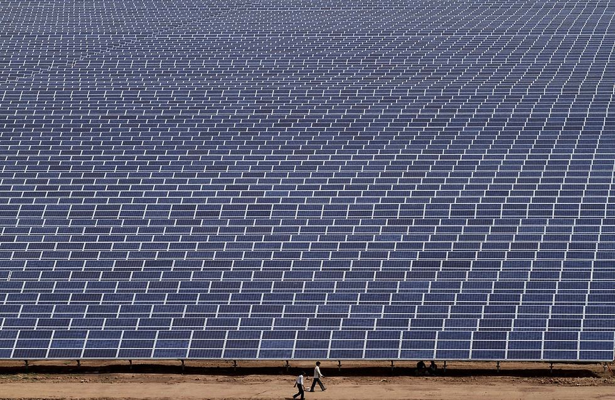
Solar Energy
Golmud Solar Park, Western China – 200 MW

Slide 55
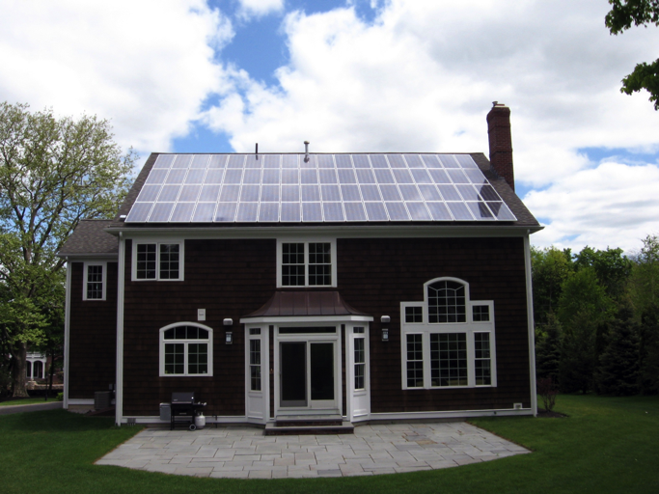

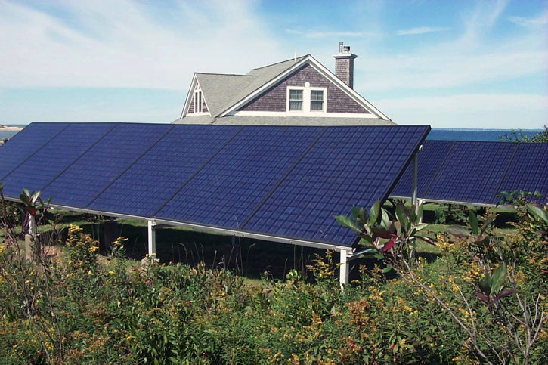
PV Markets – Residential

Slide 56
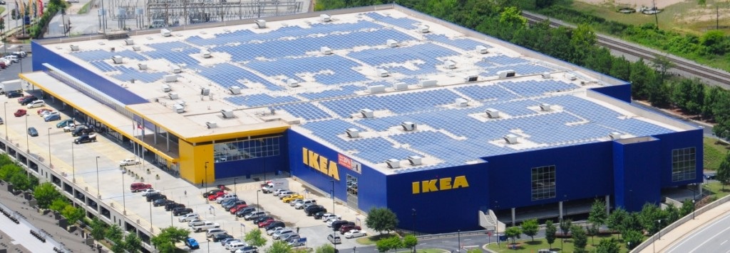
PV Markets – Commercial
Credit: IKEA

Slide 57
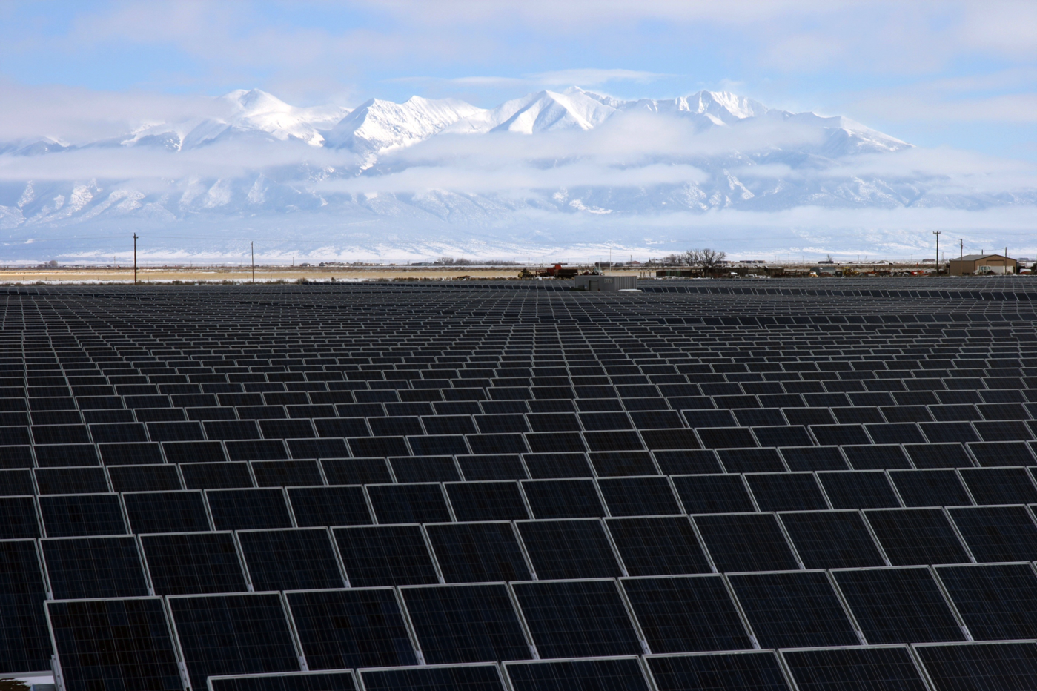
PV Markets – Utility

Slide 58
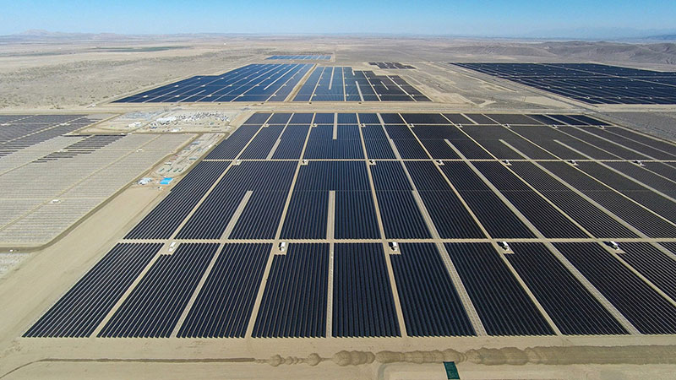
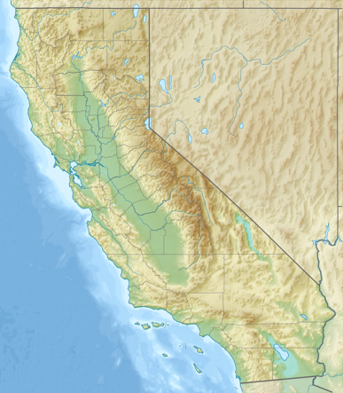
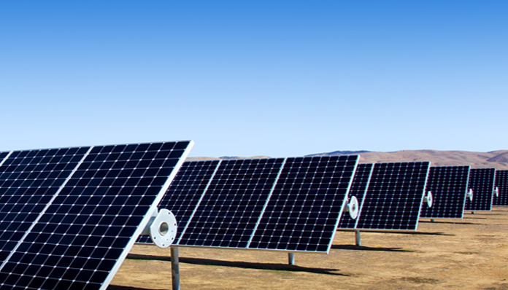
PV Markets – Utility
Solar Star
BHE Renewables
1.7 million SunPower c-Si panels
579 MWac
Power for 255,000 homes
300,000 tons CO2 displaced
5 square miles

Slide 59
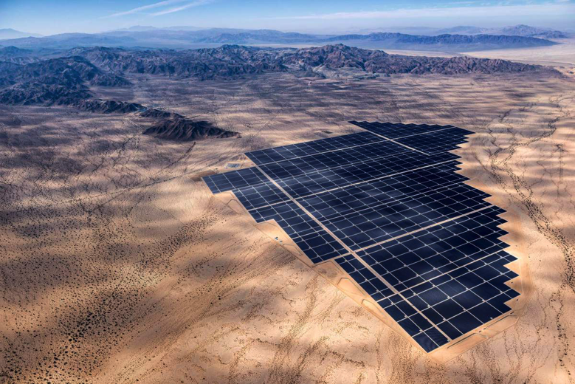
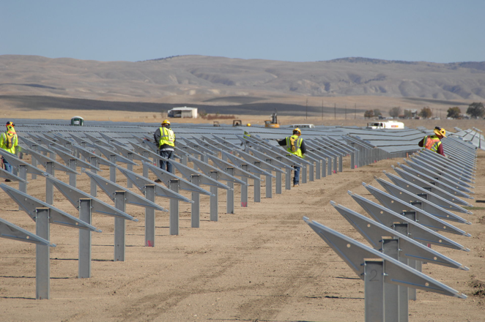
PV Markets – Utility
Desert Sunlight Solar Farm
NextEra Energy
8.8 million First Solar CdTe panels
550 MWac
Power for 160,000 homes
300,000 tons CO2 displaced
6.2 square miles

Slide 60


Global Solar Energy Markets - 2015

Slide 61

U.S. Solar Deployment
Sources: GTM/SEIA and IREC

Slide 62
The Energy Transition—
Trends

Slide 63
Electricity Generation in the U.S. by Source
U.S. Energy Information Administration, Nov 2016
total
hydroelectric
natural gas
nuclear
coal
wind
solar
Overall electrical generation in the United States is roughly flat for 2006-2016.
Coal-fired generation has been dropping since 2009.
Summer usage causes annual fluctuations of about one-third.
Wind is 5.1% and solar is 1.4% of all electrical generation as of October 2016.
Notes:
http://www.eia.gov/electricity/data/browser/

Slide 64

Wind energy is blowing away expectations
…due to its low cost, US wind energy has tripled since 2008. Wind now supplies 5% of total US electricity generation. DOE 2016 report, via The Guardian, 3 Oct 2016.
Notes:
https://www.theguardian.com/environment/climate-consensus-97-per-cent/2016/oct/03/doe-charts-show-why-climate-doom-and-gloom-isnt-needed#img-3

Slide 65

Solar energy’s bright future
Utility-scale solar farm costs have fallen 64% since 2008, and distributed solar costs have fallen by 54%. DOE 2016 report, via The Guardian, 3 Oct 2016.
Notes:
https://www.theguardian.com/environment/climate-consensus-97-per-cent/2016/oct/03/doe-charts-show-why-climate-doom-and-gloom-isnt-needed#img-3

Slide 66

The World’s First Solar Road Opens in France
Justin Worland, Time, 22 Dec 2016
The French Ministry of the Environment funded the 1-km (0.6 mile) project to test whether solar panels can be implemented effectively at a large scale. The project is intended to power the streetlights in the French town of Tourouvre-au-Perche in Normandy.
French Minister for Ecology, Sustainable Development and Energy, Segolene Royal walks on a solar panel road during its inauguration in Tourouvre, France
Notes:
http://time.com/4616848/reindeer-arctic-climate-change-global-warming/

Slide 67

Renewable Energy Grows in an Unlikely Place: the Sunny Mideast
By Beth Gardner, NY Times, Nov 3, 2016
The Shams Ma’an photovoltaic power plant built by First Solar in Jordan. It began operation in September near Petra. Credit First Solar
Not surprisingly, though, it is the energy importers who are moving most aggressively. For countries like Jordan, which endured disruptions to natural gas supplies from Egypt when a pipeline was repeatedly bombed during the Arab Spring uprisings, energy independence is a question of political and economic security. (Jordan has very little oil or gas production.)
Notes:
http://www.nytimes.com/2016/11/03/business/energy-environment/renewable-energy-grows-in-an-unlikely-place-the-sunny-mideast.html?ref=energy-environment&_r=0

Slide 68

The Largest Solar Farm In Alabama Is Now Online
Steve Hanley, ClearTechnica, March 19, 2017
The largest solar farm in Alabama history is now online and contributing about 75 megawatts of clean renewable energy.
Jay Stowe, vice president of distributed energy resources for the Tennessee Valley Authority, says, “It is a 640-acre solar energy center. There’s about 300,000 solar panels that will be able to produce enough power to supply about 15,000 homes with carbon-free electricity.” The River Bend solar farm cost $150 million and is the largest in the TVA system or the state of Alabama
Notes:
https://cleantechnica.com/2017/03/19/largest-solar-farm-alabama-now-online/?utm_content=buffer3968a&utm_medium=social&utm_source=twitter.com&utm_campaign=buffer0
The River Bend solar farm was developed in cooperation with NextEra Energy Resources, which will operate the facility. It will supply electricity from the River Bend solar farm to the TVA for the next 20 years pursuant to the terms of a power purchase agreement. The solar panels are mounted to a tracking system that allows them to follow the sun across the sky which maximizes the amount of electricity produced.

Slide 69

U.S Solar Jobs Boom While Oil, Coal Struggle Fortune, 12 Jan 2016
More Americans are now installing solar panels on building rooftops than mining coal or extracting oil and gas, according to a report released Tuesday by the non-profit solar advocacy group The Solar Foundation.
The U.S. solar industry grew dramatically in 2015, and is expected to continue to do so this year. The industry now employs 209,000 workers after adding over 35,000 jobs last year. By the end of this year, its ranks are expected to grow to 240,000 workers.
An installer for Stellar Solar carries a solar panel during installation at a home in Encinitas in San Diego, California, U.S. Photograph by Sam Hodgson — Bloomberg via Getty Images
Notes:
http://fortune.com/2016/01/12/solar-jobs-boom/

Slide 70

Renewables are beating fossil fuels 2 to 1
Bloomberg News, by Tom Randall
Investment in World Power Capacity, 2008-2015
Bloomberg New Energy Finance, UNEP 6 Apr 2016.
Notes:
http://www.bloomberg.com/news/articles/2016-04-06/wind-and-solar-are-crushing-fossil-fuels

Slide 71

We’re adding record amounts of wind and solar — and we’re still not moving fast enough Washington Post, 25 Oct 2016
Renewable energy projects surpassed all other sources of new electricity added to the global supply last year, says a new report released this week by the International Energy Agency. In 2015, renewables made up more than half of all new installed capacity, with the greatest gains seen in onshore wind and solar.
That said, renewable energy sources still only account for about 23 percent of the electricity actually produced worldwide, the report notes. The agency predicts that this share will increase to 28 percent by the year 2021, making renewables the fastest-growing source of electricity generation in the world.
The report predicts that the U.S. will commission 107 gigawatts of new renewable additions — mostly wind and solar — by 2021, a 50 percent increase from 2015. The report attributes the U.S. success to a long-term extension of federal tax credits for renewables…
A general view shows solar panels used to produce renewable energy at the photovoltaic park during its official 2015 inauguration in Cestas, southwestern France. (Reuters/Regis Duvignau)
Notes:
https://www.washingtonpost.com/news/energy-environment/wp/2016/10/26/were-adding-record-amounts-of-wind-and-solar-and-were-still-not-moving-fast-enough/?postshare=441477505263329&tid=ss_tw&utm_term=.dbd468bb01fe

Slide 72
The Energy Transition—
Wind Power

Slide 73

Wind Energy
Gansu Wind Farm
Gansu, China
8 GW (going to 20 GW)

Slide 74


Wind Energy - Offshore
Westermeerwind Wind Farm
Noordoostpolder, Netherlands
144 MW
Horn Rev Wind Farm
West coast of Denmark
160 MW

Slide 75


Wind Energy - Onshore
Peetz Table Wind Energy Center
Peetz, Colorado
575 MW
Cedar Creek Wind Farm
Grover, Colorado
550 MW

Slide 76


Wind Machines - Scale
National Wind Technology Center
Boulder, Colorado
GE – 1.5 MW
Alstom – 3 MW
Siemens – 2.3 MW

Slide 77


Wind Machines - Scale

Slide 78

Global Wind Markets - 2015
Global Installed Capacity – 487 GW
Offshore – 14 GW

Slide 79


Colorado Wind Development
Sources: NREL and AWEA

Slide 80

Colorado Wind Market
Colorado Rank – 10
Under Construction – 76 MW
Technical Potential – 387,000 MW

Slide 81

Colorado Wind Development
Source: AWEA

Slide 82
U.S. Wind Market Growth
2016 Cumulative – 81,312 MW
2016 – 8,727 MW
(EIA)
Source: DOE 2016: Revolution…now, the future arrives for five clean energy technologies

Slide 83
AND I’LL CONTINUE FROM HERE NEXT WEEK
FINISH WIND
COVER NUCLEAR
COVER STORAGE
COVER GRID OPTIONS
DISCUSS NREL VISIT NEXT WEEK
PERSONAL SOLUTIONS INVIDIDUALS CAN MAKE

Slide 84
LINKS
Greg Wilson: Ramping Up Solar to Power the World https://www.youtube.com/watch?v=7CDPHxcnq4c
David Mooney Energy In Transition. NREL's David Mooney on Renewables https://www.youtube.com/watch?v=zYKrXVgmqW4
Stanford http://thesolutionsproject.org/infographic/
Other videos: https://www.youtube.com/channel/UCr81EUb2qVJVfmmlJMxEHVw/videos

Slide 85
OTHER LINKS
https://www.eia.gov/
https://www.eia.gov/totalenergy/
https://www.eia.gov/energyexplained/
https://www.eia.gov/tools/faqs/
https://www.eia.gov/environment/

Slide 86

https://i.kinja-img.com/gawker-media/image/upload/t_original/ihsllhptnnm4vb7wuvgq.jpg

