Slide 1
Mitigating & Adapting to Climate change: Extreme Weather Events, a Worldwide Energy Revolution and Geoengineering options Week 6: May 1st , 2017 Part A: Nuclear Power (fission and fusion) Part B: Storage and Grid Options EXTRAS Paul Belanger, Ph.D.

Slide 2
EXTRAS

Slide 3
LINKS
Stanford http://thesolutionsproject.org/infographic/
http://www.iea.org/newsroom/news/2017/april/statistics-key-electricity-trends-2016.html
http://www.noaanews.noaa.gov/stories2016/012516-rapid-affordable-energy-transformation-possible.html
Commonwealth club of California – Environment & Natural Resources chair
https://www.ourchildrenstrust.org/
https://www.ourchildrenstrust.org/us/federal-lawsuit/
Other videos: https://www.youtube.com/channel/UCr81EUb2qVJVfmmlJMxEHVw/videos

Slide 4
OTHER LINKS
https://www.eia.gov/
https://www.eia.gov/totalenergy/
https://www.eia.gov/energyexplained/
https://www.eia.gov/tools/faqs/
https://www.eia.gov/environment/

Slide 5
Energy in the U.S. in 2016 – Sources, What it is used for, and how much of it is wasted – a bit of a mind-blower Vox.com April 2017
Rejected
Energy Services
Notes:
http://www.vox.com/energy-and-environment/2017/4/13/15268604/american-energy-one-diagram

Slide 6
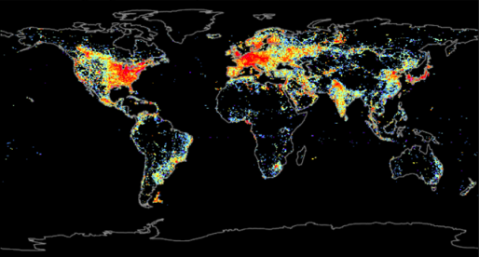
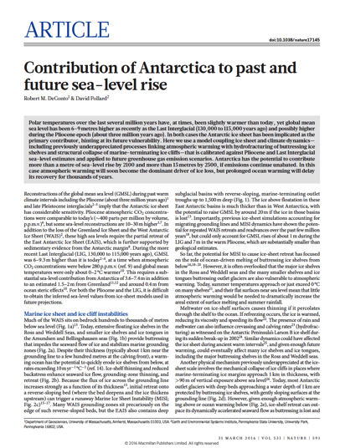
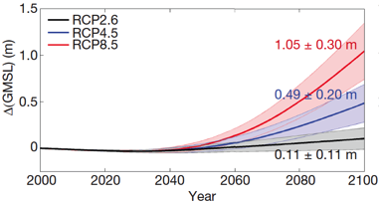
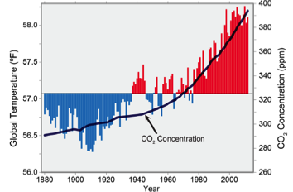
Motivation is Clear – Energy Needs vs. CO₂
Humanity requires ~6 TW of electrical generating capacity, ~2/3 from fossil fuels.
[CO₂] ~402 ppm and rising.
Source: 2014 U.S. National Climate Assessment
Nature - 31 March, 2016

Slide 7
World EnergyRessources
renewable
finite
World Energy Resources (TW-yr)
WIND
60-120
per year
215
Total
SOLAR
23,000 per year
Natural Gas
Waves
0.2-2 per year
3 -11 per year
OTEC
240
Total
Petroleum
2 – 6 per year
2010 World required ~16 TW
Biomass
3 – 4 per year
90-300
Total
HYDRO
TIDES
0.3 – 2 per year
2050: ~28 TW
0.3 per year
Geothermal
Uranium
900
Total reserve
© R. Perez et al.
COAL
7
Notes:
7
7
7

Slide 8
renewable
finite
World Energy Resources (TW-yr)
WIND
60-120
per year
330
Total
SOLAR
23,000 per year
Natural Gas
Waves
0.2-2 per year
SHALE
3 -11 per year
OTEC
310
Total
Petroleum
2 – 6 per year
2010 World required ~16 TW
Biomass
3 – 4 per year
90-300
Total
HYDRO
TIDES
0.3 – 2 per year
2050: ~28 TW
0.3 per year
Geothermal
Uranium
900
Total reserve
© R. Perez et al.
COAL
8
Notes:
8
8
8

Slide 9
ENERGY CONSUMPTION: PRESENT AND FUTURE PROJECTIONS

Slide 10
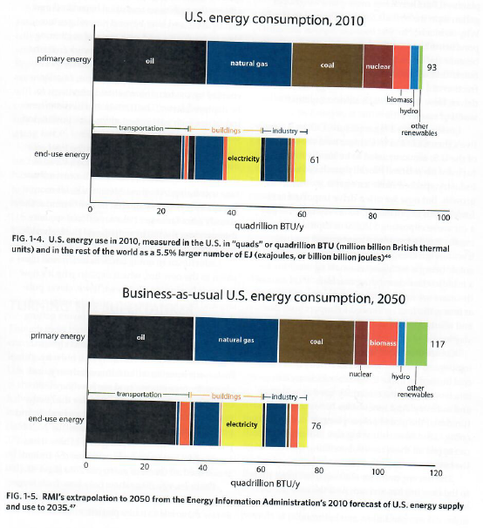
Reinventing Fire…, Lovins, A. 2011

Slide 11
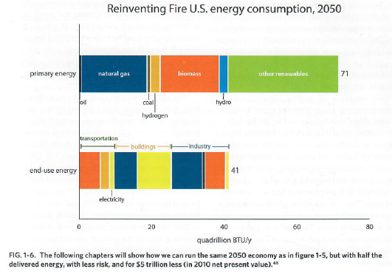
Reinventing Fire…, Lovins, A. 2011

Slide 12
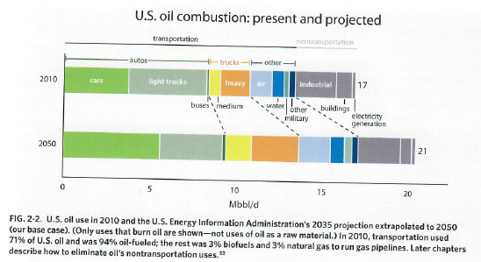
Reinventing Fire…, Lovins, A. 2011

Slide 13
SUBSIDIES and TAX BREAKS

Slide 14
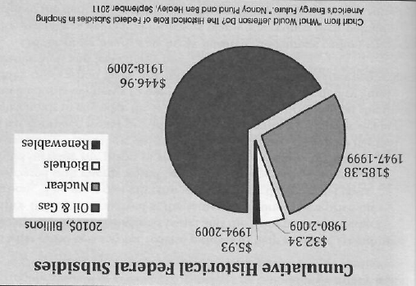
Powering Forward, Ritter, 2016

Slide 15
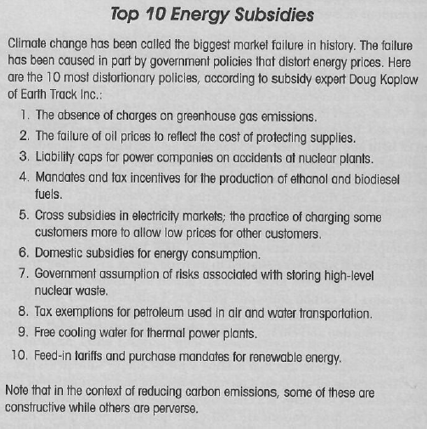
Powering Forward, Ritter, 2016

Slide 16
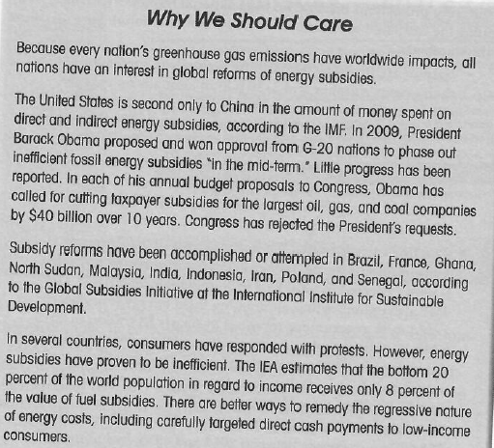
Powering Forward, Ritter, 2016

Slide 17
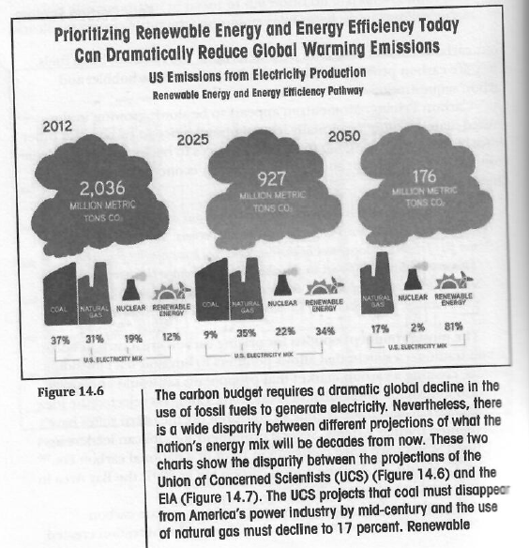
Powering Forward, Ritter, 2016

Slide 18
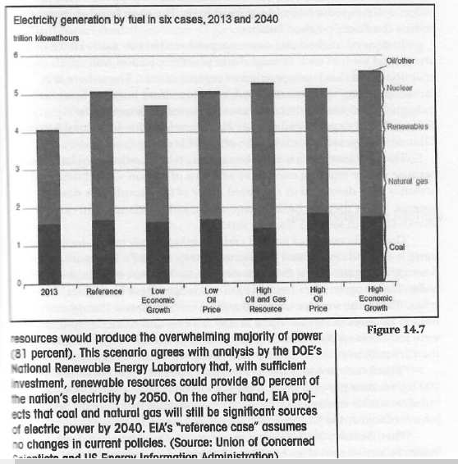
Powering Forward, Ritter, 2016

Slide 19
New Capacity and Jobs

Slide 20
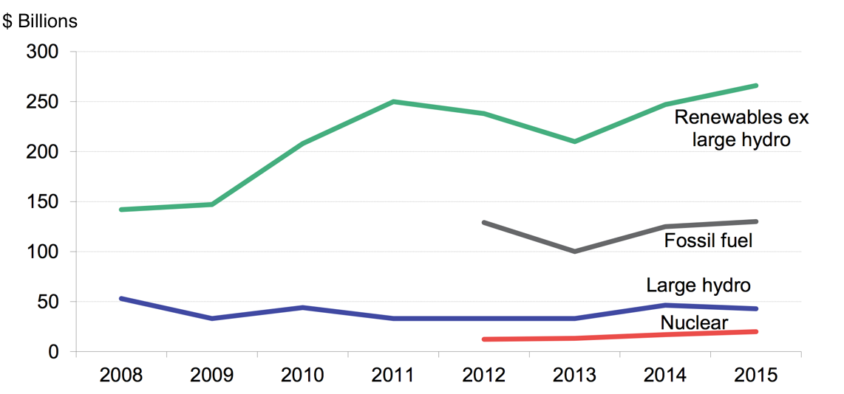
Renewables are beating fossil fuels 2 to 1 Bloomberg News, by Tom Randall
Investment in World Power Capacity, 2008-2015
Bloomberg New Energy Finance, UNEP 6 Apr 2016.
Notes:
http://www.bloomberg.com/news/articles/2016-04-06/wind-and-solar-are-crushing-fossil-fuels

Slide 21
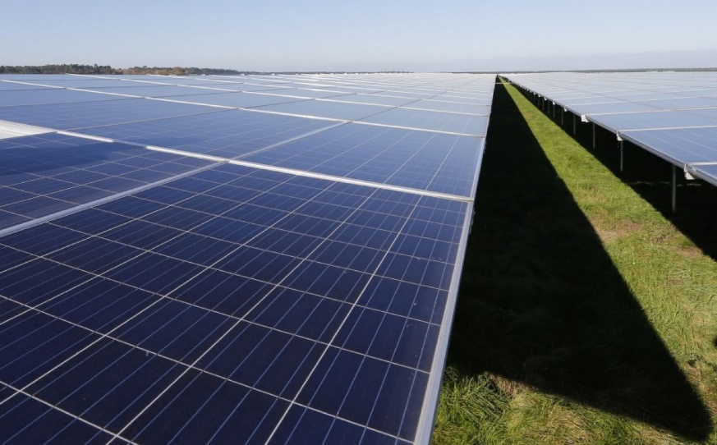
We’re adding record amounts of wind and solar — and we’re still not moving fast enough Washington Post, 25 Oct 2016
Renewable energy projects surpassed all other sources of new electricity added to the global supply last year, says a new report released this week by the International Energy Agency. In 2015, renewables made up more than half of all new installed capacity, with the greatest gains seen in onshore wind and solar.
That said, renewable energy sources still only account for about 23 percent of the electricity actually produced worldwide, the report notes. The agency predicts that this share will increase to 28 percent by the year 2021, making renewables the fastest-growing source of electricity generation in the world.
The report predicts that the U.S. will commission 107 gigawatts of new renewable additions — mostly wind and solar — by 2021, a 50 percent increase from 2015. The report attributes the U.S. success to a long-term extension of federal tax credits for renewables…
A general view shows solar panels used to produce renewable energy at the photovoltaic park during its official 2015 inauguration in Cestas, southwestern France. (Reuters/Regis Duvignau)
Notes:
https://www.washingtonpost.com/news/energy-environment/wp/2016/10/26/were-adding-record-amounts-of-wind-and-solar-and-were-still-not-moving-fast-enough/?postshare=441477505263329&tid=ss_tw&utm_term=.dbd468bb01fe

Slide 22
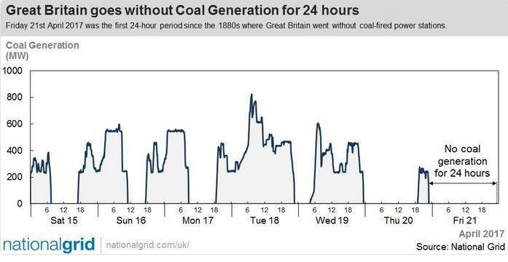
Historic Day in Britain: First Coal-Free Day Since 1882 Andy Rowell, Ecowatch 21 April 2017
The UK's energy provider, the National Grid, called it a "watershed" moment and it is seen as a significant step towards the UK Government's plans to phase out coal generating power plants by 2025.
Britain is not alone in phasing out coal, either. Earlier this month, a coalition of European energy companies announced that there would be no new coal plants built throughout the European Union after 2020.
Notes:
http://www.ecowatch.com/uk-coal-free-day-2376307938.html?utm_campaign=crowdfire&utm_content=crowdfire&utm_medium=social&utm_source=twitter

Slide 23
UNITS
POWER
SI = Watt = J/s
Other units – see white board:
kW, GW, TW
Kilo- 10³,
giga- 10⁹,
tera- 10¹²)
BTU
QUADS (10¹⁵ BTUs)
ENERGY
SI = J = power-time
Or Watt-s
Or what you are used to getting billed for:
kWh @ ~0.11/kWh
CARBON
Gt C = Gt CO2/3.67
(mass 44/mass 12 C)
32.7/3.67 = 8.91 Gt C

Slide 24
EXTRAS – Outline from David Mooney presentation BCRES 4/ 2017 – see video at CRES YouTube
Global Renewable Energy Markets Update
Technology Overviews
Wind and Solar
Market Segments
Global and US Markets
Cost Trends
Status in Colorado
A Changing Power System
Jobs in the Energy Sector

Slide 25
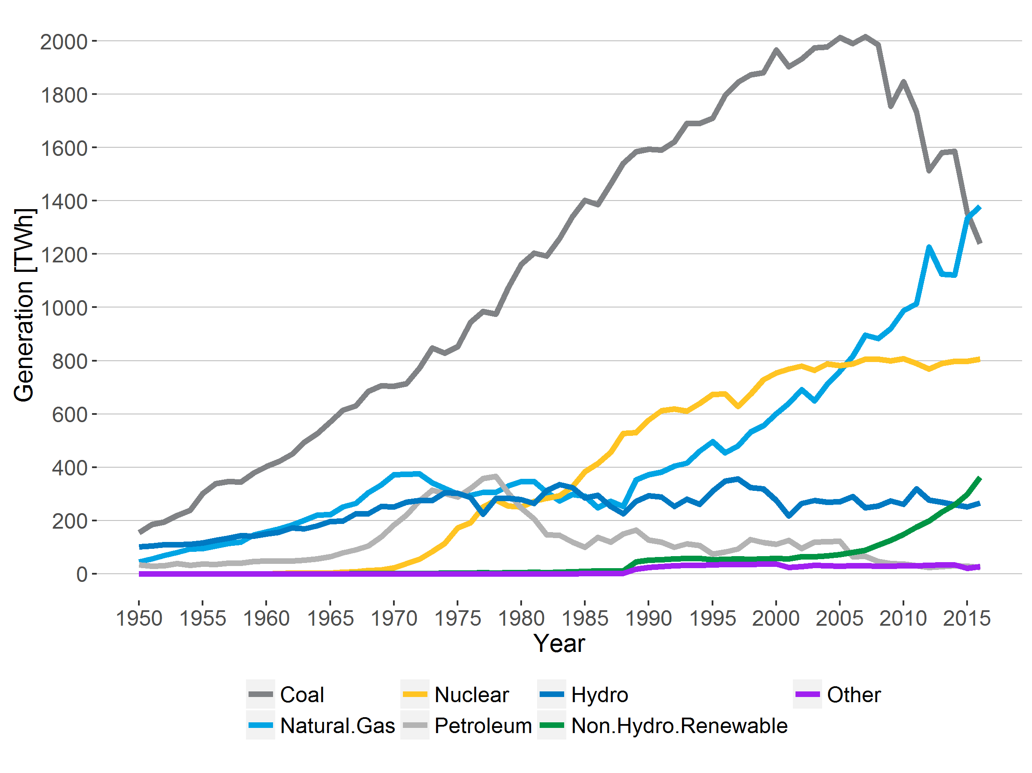
Trends in the U.S. Power System
Source: EIA – Electric Power Annual
Notes:
Key points:
Historically have had a system dominated by coal generation.
Low cost gas and declining costs of renewable technologies have driven an increase in gas and RE
2016 was the first year in U.S. history that gas dominated the U.S. power system

Slide 26
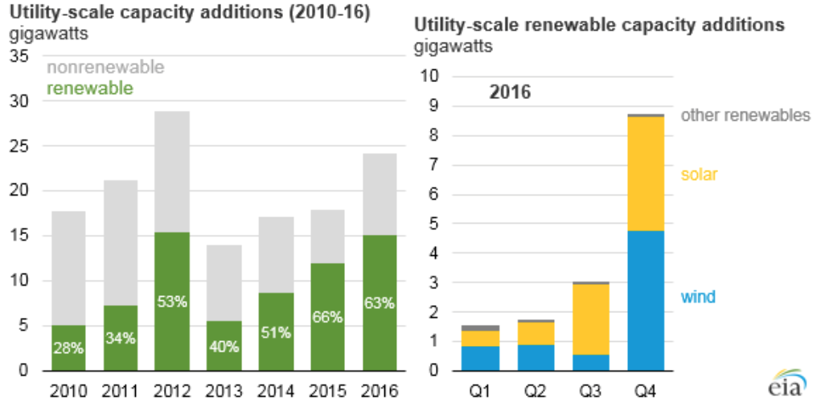
Trends in the U.S. Power System
Notes:
Key points:
Historically have had a system dominated by coal generation.
Low cost gas and declining costs of renewable technologies have driven an increase in gas and RE
2016 was the first year in U.S. history that gas dominated the U.S. power system

Slide 27
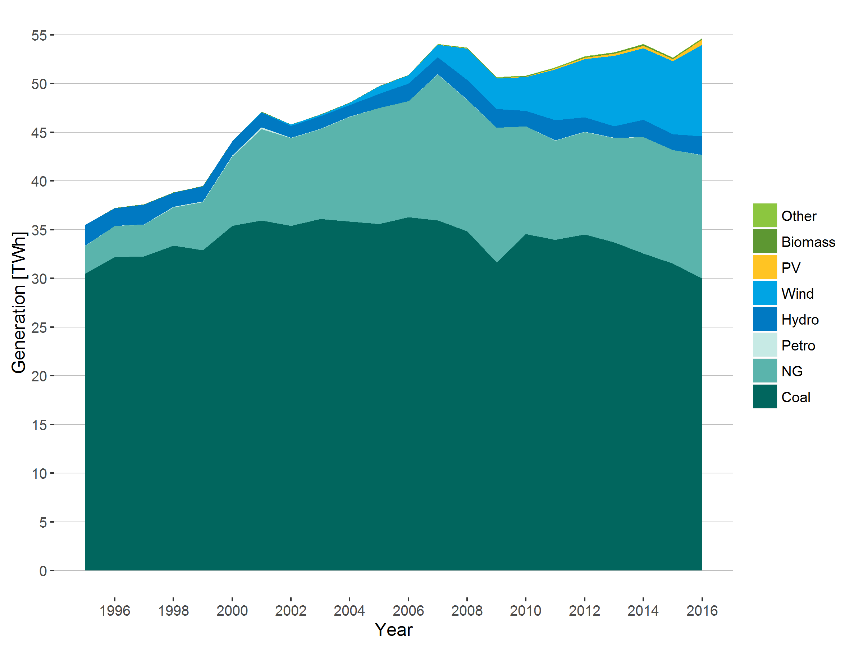
Trends in the Colorado Power System
Source: EIA-923; Steinberg 2016 – Colorado and the Clean Power Plan, Presentation to the CDPHE
Notes:
Similar to national picture
Seen growth in NG and RE generation
In Colorado this has been supported by:
Colorado clean air and clean jobs act
Colorado Renewable Portfolio Standard
Declining costs of renewables (and improvements in performance)
Low cost of natural gas

Slide 28
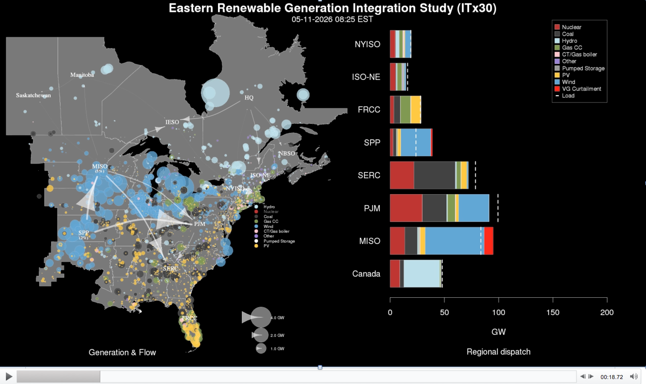

Slide 29
TOO BIG TO LOAD – CONTACT ME

Slide 30
Outline
Global Renewable Energy Markets Update
Technology Overviews
Wind and Solar
Market Segments
Global and US Markets
Cost Trends
Status in Colorado
A Changing Power System
Jobs in the Energy Sector

Slide 31
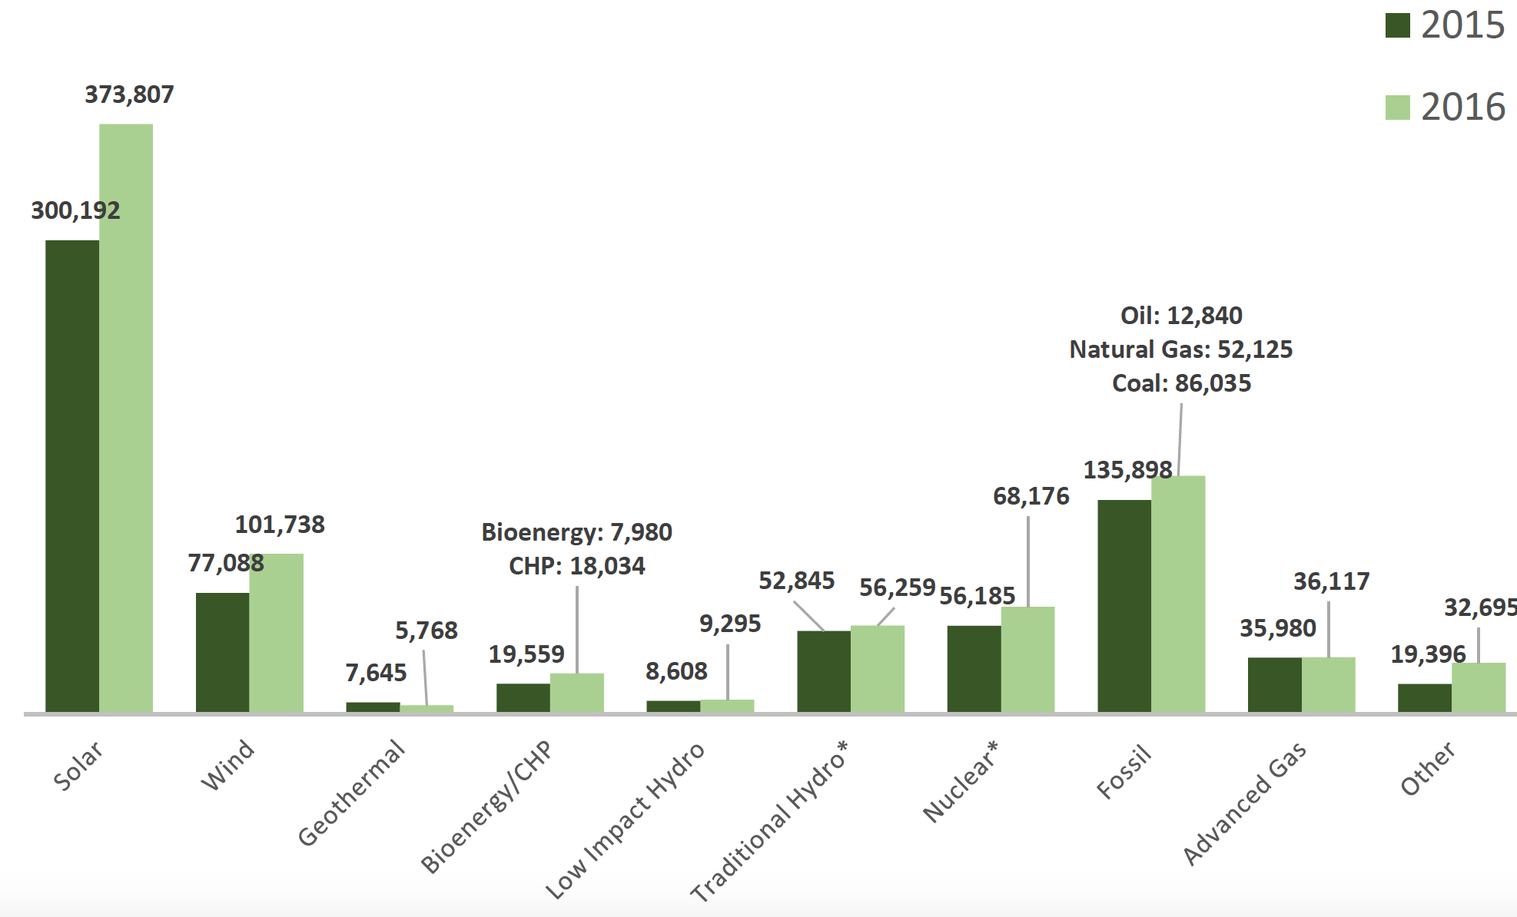
US Electricity Generation Jobs
Source: US DOE Energy and Employment Report

Slide 32
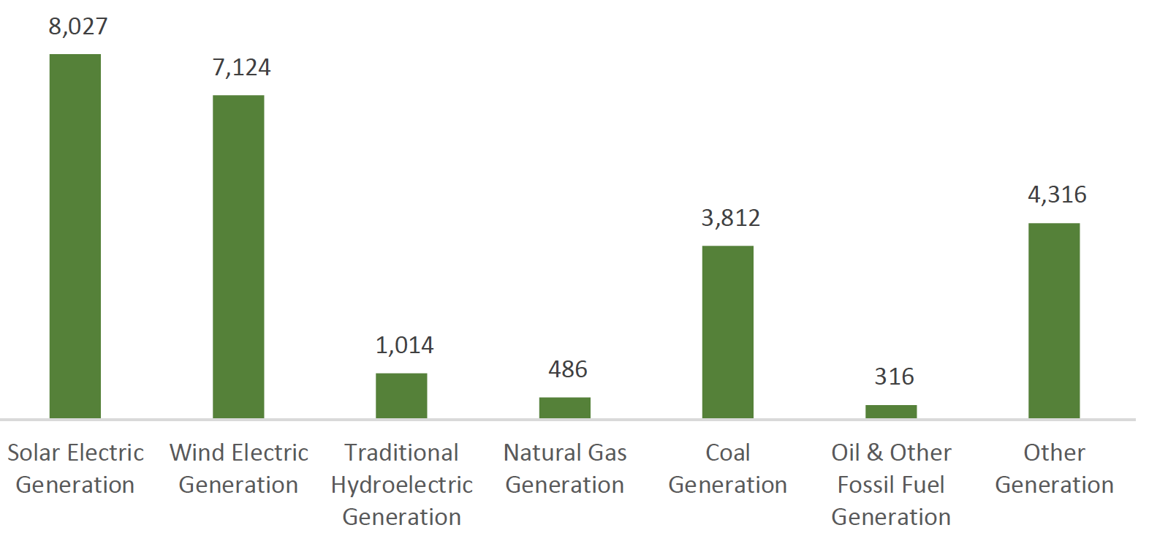
Colorado Electricity Generation Jobs - 2016
Electricity Gen – 25,095
Fuels – 36,765
T, D, and Storage – 28,252
Efficiency – 29,756
Source: US DOE Energy and Employment Report

Slide 33
Thanks! david.mooney@nrel.gov

Slide 34
Additional Slides

Slide 35
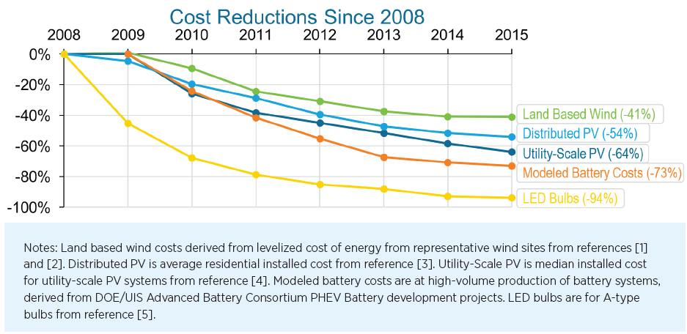
Renewable Technology Cost Reductions

Slide 36
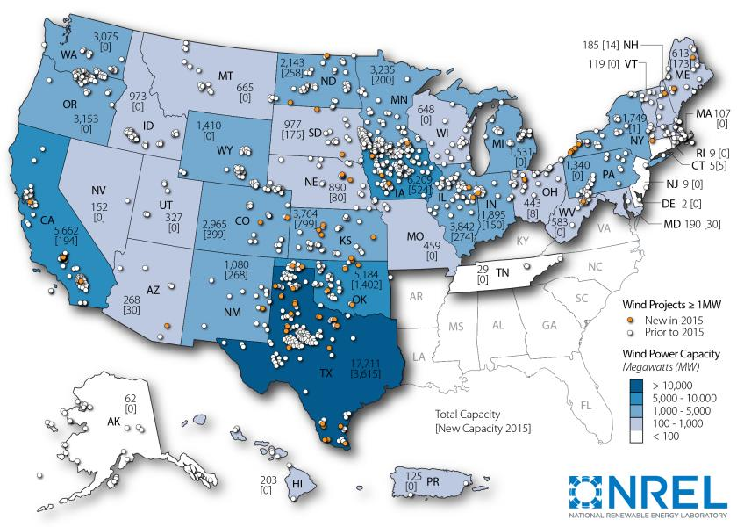
Geographic Distribution of Wind Plants (2015)

Slide 37
Trends in Wind Power
Wind capacity in the U.S. has tripled since 2008
In 2015:
Wind comprised 41% of all new capacity added
8.6 GW added, representing $14.5 billion invested
GE and Vestas captured 73% of U.S. market in 2015
Performance improvements due to increasing capacity, hub height, and rotor diameter of turbines
Installed costs continue to fall: current costs $1,690/kW
National average PPAs have fallen to $20/MWh
Notes:
63 GW were added globally
Average capacity factors of wind plants that came online in 2014 was 41% and 2015 plants are expected to be higher (upwards of 45%)

Slide 38
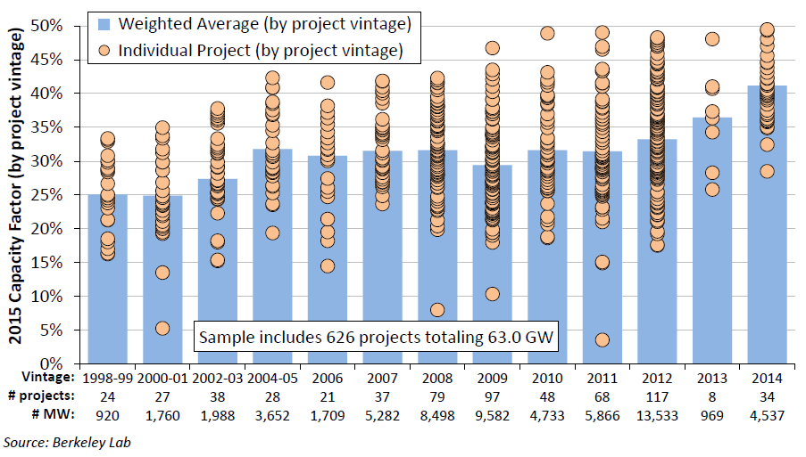
Calendar year 2015 capacity factors by project vintage

Slide 39
PV Module Prices

