Slide 1
Earth’s Climate: Past, Present and Future
OLLI Central Spring 2016: week 7 (May 11th) & week 8
Paul Belanger
Solutions – part A
The Ultimate Primary Focus: Energy and Sequestration of CO2
Economics
  of doing nothing (solely adapting) vs. the economics of mitigation
  Actuality: it WILL be a combination
Capitalism, GDP/growth based economics vs. “Herman Daly” economics (no-growth/steady-state)
Solutions? Paradigm shift? From we can’t/too expensive to WE CAN
There is promise, but at what cost? (One might be surprised).
  Energy
  Mitigation – Agricultural revolution/biofuels: Biochar for Carbon Dioxide Removal (CDR)

Slide 2
The economics/the solutions? continued
Geoengineering:
  Solar Radiation Management (SRM) and
  Carbon Dioxide Removal (CDR)
Biochar vs. BECCS solutions SEE MY BIOCHAR LINK IN OTHER PAGES: http://denverclimatestudygroup.com/?page_id=28
Efficiency – the single quickest way to reduce:
  What NREL is doing: Efficiency, Solar, wind, other
Other strategies:
  CCL – carbon fee/dividend
  Cap and trade?
Gloom and Doom? NO! IT’S A CHALLENGE, and humanity has always been challenged and we are an adaptable species that has met the challenge over and over again!

Slide 3
FIRST
Web site:
  Week 6 – the Anthropocene
  Week 7 (and 8)
A reading: Richard Alley’s a Terrible shower – transitions are not without difficulty – but also with opportunity
http://denverclimatestudygroup.com/wp-content/uploads/2015/10/A-terrible-shower.pdf

Slide 4
SECOND
WHY I hope you are convinced
  climate change is happening at an unprecedented rate
  There are unknown implications of ocean acidification at these rates of change
  There are economic repercussions
    due to sea level rise
    increased incidents of severe weather
    Agricultural
    Etc.

Slide 5
And to review the data

Slide 6
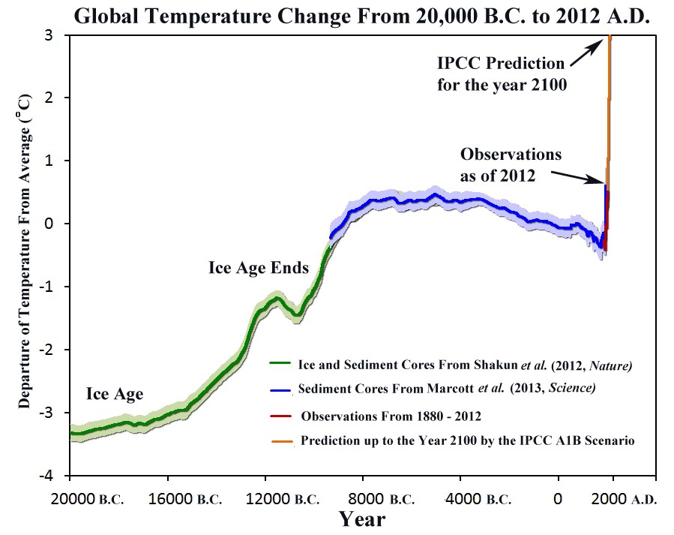

Slide 7
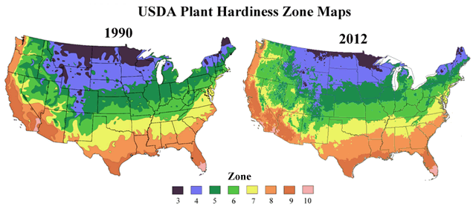
Plants and Animals are Responding to a Warming Climate
Spring is springing forward: Spring events, like bird and butterfly migrations, flower blooming times, and frog mating, have been advancing by about three days per decade over the past 30 years.
Source: Jeong et al., 2011, “Phenology shifts at start vs. end of growing season in temperate vegetation over the Northern Hemisphere for the period 1982–2008”

Slide 8
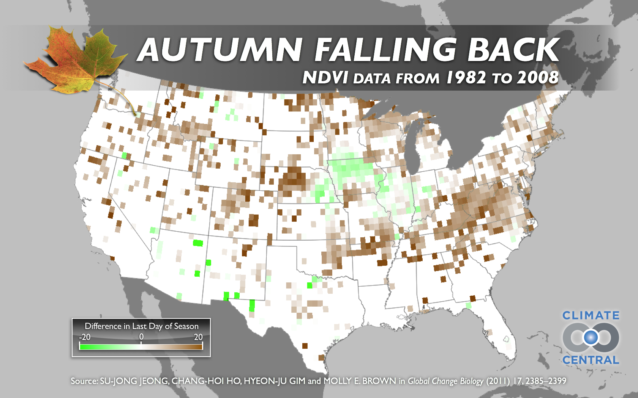
Fall is falling back: From 2000 - 2008, the end of the growing season was delayed by 2.3 days. In the U.S., fall now occurs ten days later than it did 30 years ago.

Slide 9
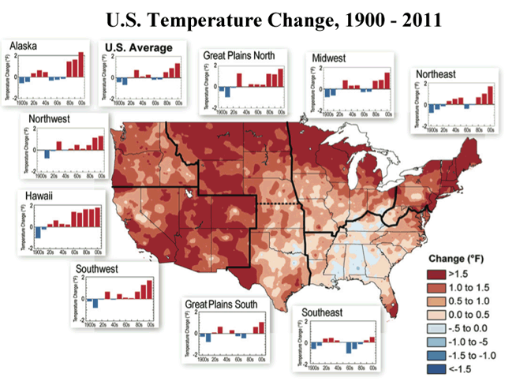

Slide 10
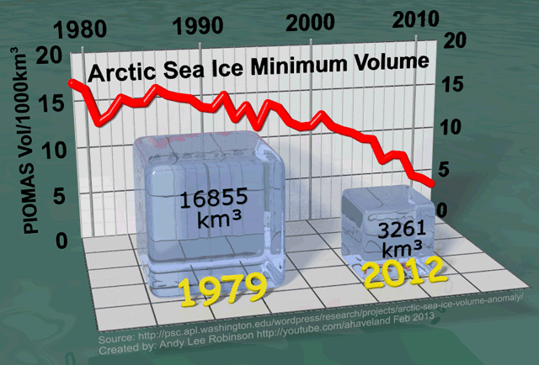
Arctic Sea Ice Volume has Shrunk by 5x; Extent by 2x

Slide 11
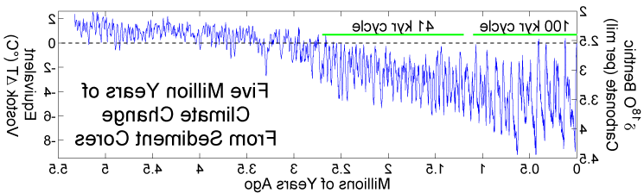

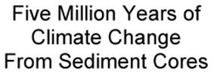
Climate Changes from Ocean Sediment Cores, since 5 Ma. Milankovitch Cycles
the last time inferred temperatures will have been this high – once equilibrium is reached, will have been 3-5 million years ago or more
41K
100 K
*
we are now about here
5.0Ma
4.0Ma
3.0Ma
2.0Ma
1.0Ma
0
When CO₂ levels get below ~400-600 ppm Orbital parameters become more important than CO₂

Slide 12
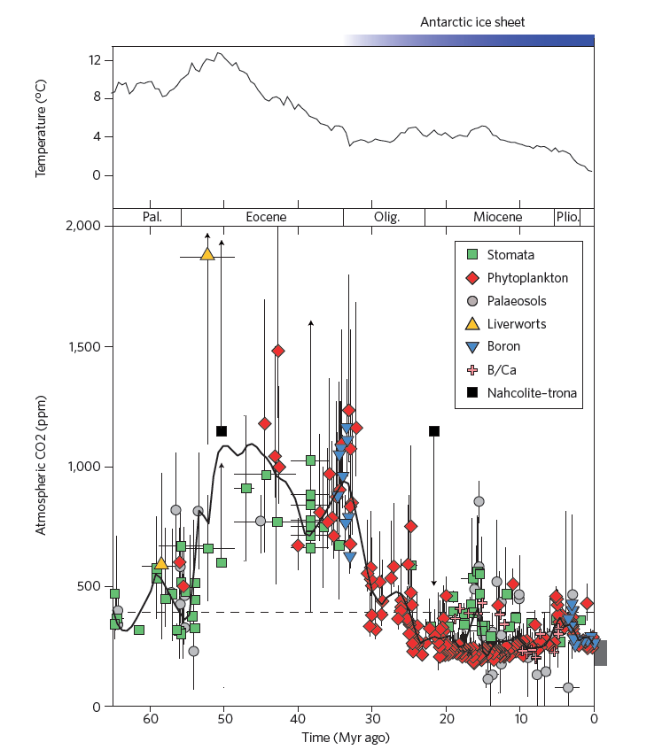
DATA
Azolla event:
~ 49 Ma
Notes:
12

Slide 13
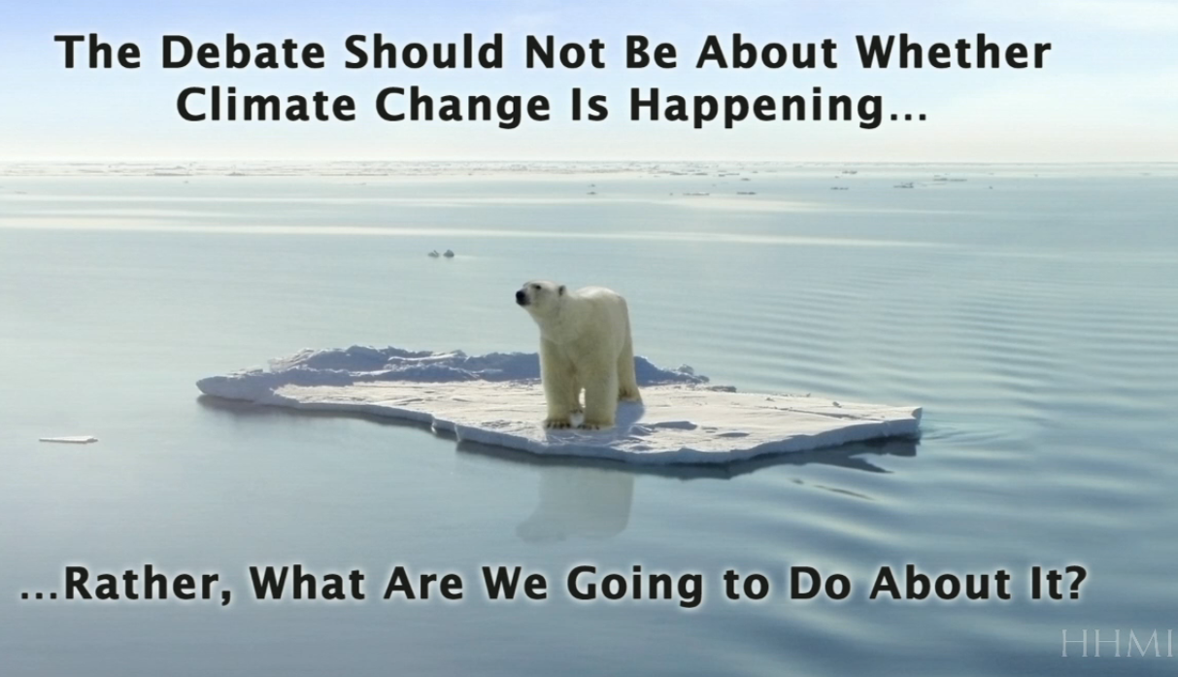
http://media.hhmi.org/hl/12Lect4.html

Slide 14
Earth’s Climate: Past, Present and Future
Solutions – part A
Economics
  of doing nothing (solely adapting) vs. the economics of mitigation
  Actuality: it WILL be a combination
Capitalism, GDP/growth based economics vs. “Herman Daly” economics (no-growth/steady-state)
Solutions? Paradigm shift? From we can’t/too expensive to WE CAN
There is promise, but at what cost? (One might be surprised).
  Energy
  Mitigation – Agricultural revolution/biofuels: Biochar for Carbon Dioxide Removal (CDR)

Slide 15
Economics
See week 7 links, EEE links and AR5-WG2:
  Economic related reports:
  2015 The Social Cost of Carbon study summary
  2007.03.18 Discount Rate and Climate Change DLC
  Stern Report: sternreview_report_complete
  Nordhaus briefly describes the “free rider” problem and his proffered solution as a lead-in to his recent review of the book, Climate Shock. Here’s the link to the NY Review of Books website: http://www.nybooks.com/articles/archives/2015/jun/04/new-solution-climate-club/
  In a different format, Nordhaus produced a 30-slide PowerPoint version for his Presidential address to the AEA last January. Available at http://carbon-price.com/wp-content/uploads/2015-01-04-Nordhaus-ClimateClubAEA-v2-slides.pdf
  2015-01-04-Nordhaus-ClimateClubAEA-v2-slides
  MIT: GOOGLE LIST OF LINKS: https://scholar.google.com/scholar?q=mit+report+on+climate+change+economics&hl=en&as_sdt=0&as_vis=1&oi=scholart&sa=X&ved=0CBsQgQMwAGoVChMIkMfkl8i9yAIVSuJjCh1x7wKk
  IPCC AR5 WG2: http://www.ipcc.ch/report/ar5/wg2/#.UuAsbxDn9hE

Slide 16
Notes
Stern/Nordhaus – promote support a high discount rate – doing something NOW
IPCC acknowledges adaptation will be a must (the change is in the bank and accumulating interest)
Bjorn Lomborg – Danish economist (not a denier) argues for spending later – i.e. no discount rate
  https://en.wikipedia.org/wiki/Bj%C3%B8rn_Lomborg
  http://www.desmogblog.com/bjorn-lomborg
Which leads to whether or not we need a paradigm shift (#3)

Slide 17
Earth’s Climate: Past, Present and Future
Solutions – part A
Economics
  of doing nothing (solely adapting) vs. the economics of mitigation
  Actuality: it WILL be a combination
Capitalism, GDP/growth based economics vs. “Herman Daly” economics (no-growth/steady-state)
Solutions? Paradigm shift? From we can’t/too expensive to WE CAN
There is promise, but at what cost? (One might be surprised).
  Energy
  Mitigation – Agricultural revolution/biofuels: Biochar for Carbon Dioxide Removal (CDR)

Slide 18
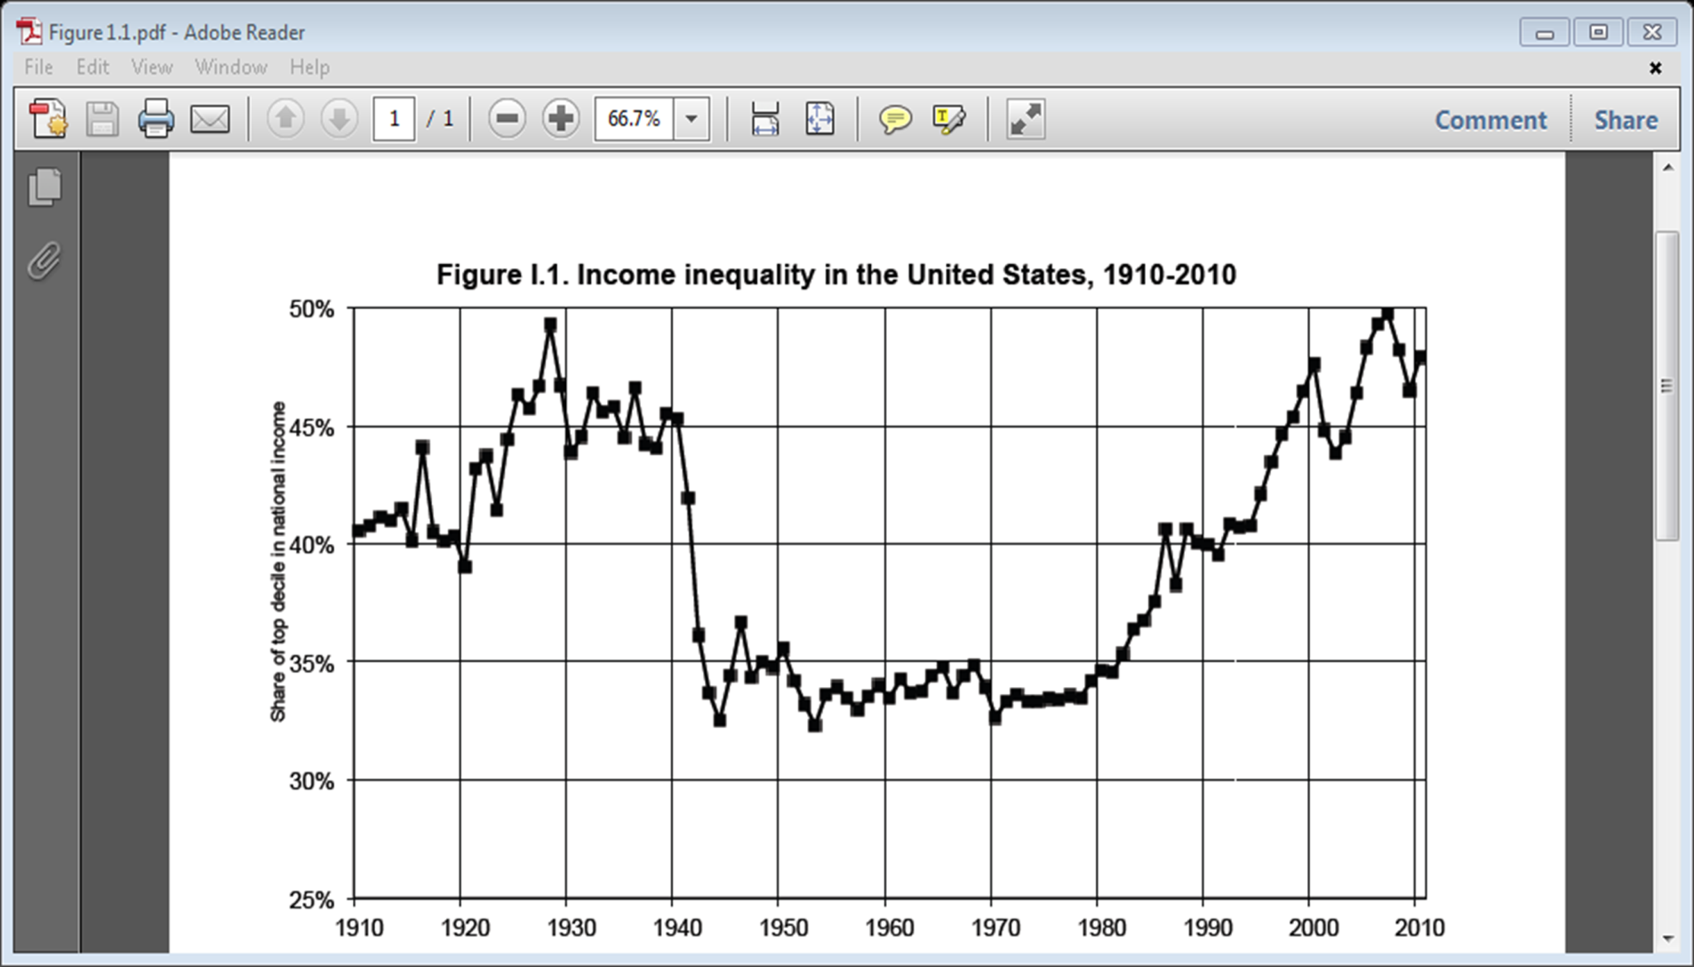
Courtesy of Gary Wyngarden: Capitalism vs. the Planet

Slide 19
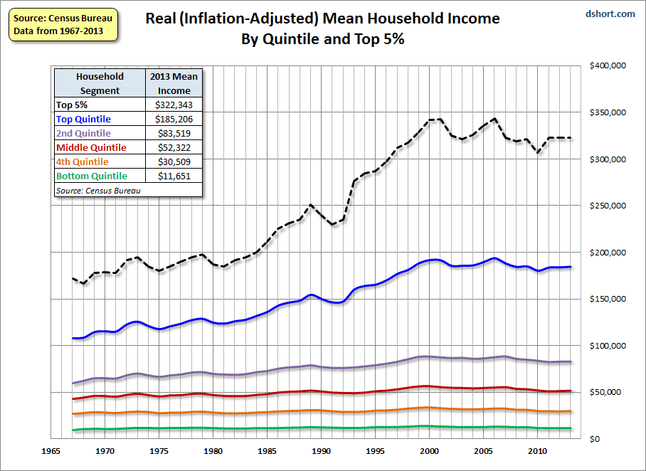
Courtesy of Gary Wyngarden: Capitalism vs. the Planet

Slide 20
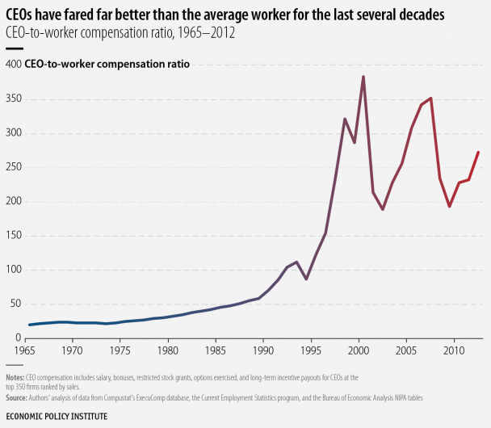
Courtesy of Gary Wyngarden: Capitalism vs. the Planet

Slide 21
Global Footprint see http://www.footprintnetwork.org/en/index.php/GFN/page/glossary
Human activities consume resources and produce waste
Ecological Footprint Accounting addresses whether the planet is large enough to keep up with the demands of humanity.
Biocapacity represents the planet’s biologically productive land areas including our forests, pastures, cropland and fisheries
Biocapacity can then be compared with humanity’s demand on nature: our Ecological Footprint. The Ecological Footprint represents the productive area required to provide the renewable resources humanity is using and to absorb its waste.

Slide 22
Our current global situation: Since the 1970s, humanity has been in ecological overshoot with annual demand on resources exceeding what Earth can regenerate each year.
It now takes the Earth one year and six months to regenerate what we use in a year.
We maintain this overshoot by liquidating the Earth’s resources. Overshoot is a vastly underestimated threat to human well-being and the health of the planet, and one that is not adequately addressed.
Notes:
Biggest piece of that is what we’ve been talking about—clearing the air of carbon dioxide. Because we are in overshoot we have a carbon dioxide buildup with consequent climate change impacts.

Slide 23
For 9 billion people (midrange projection for 2050) to live at North American/Western European standards will require 5 planets.

Slide 24
Drawbacks of Capitalism
Wealth and Income Distribution
Largely ignoring the ecological impacts and biocapacity of the planet
Notes:
Very one dimensional profits and growth thereof

Slide 25
Growth Dilemma
Growth is unsustainable in its current form
De-growth is unstable

Slide 26
Obama quoted in episode of Years of Living Dangerously (paraphrased): “It’s difficult in a Democracy to do something/pass something where the pay-back is 10 or more years out”
http://media.hhmi.org/hl/12Lect4.html

Slide 27
The solution: steady state economics?
Herman Daly’s steady state economics see:
  https://en.wikipedia.org/wiki/Herman_Daly
  http://steadystate.org/herman-daly/
  http://steadystate.org/category/herman-daly/
The problem: how to effect that change

Slide 28
Earth’s Climate: Past, Present and Future
Solutions – part A
Economics
  of doing nothing (solely adapting) vs. the economics of mitigation
  Actual will likely be a combination
Capitalism, GDP/growth based economics vs. “Herman Daly” economics (no-growth/steady-state)
Solutions? Paradigm shift? From we can’t/too expensive to WE CAN
There is promise, but at what cost? (One might be surprised).
  Energy
  Mitigation – Agricultural revolution/biofuels: Biochar for Carbon Dioxide Removal (CDR)

Slide 29
Need for a paradigm shift
Kerry Emanuel quote on p. 76: “…costs may be high and those paying them are not likely to be serious beneficiaries of their own actions. Indeed, there are few, if any, historical examples of civilizations consciously making sacrifices on behalf of descendents (sic) two or more generations removed.”
That’s what the discount rate is about. In that regard we need a social paradigm shift
  If we are so concerned about leaving a national debt to our children and grandchildren, shouldn’t we put the costs of climate change as part of that equation?
  For those that don’t accept climate change maybe it would be a good thing to limit CO2 into the atmosphere anyway, especially at the rates we are putting it into the atmosphere – BECAUSE OF OCEAN ACIDIFICATION issues and the law of unintended consequences!

Slide 30
Earth’s Climate: Past, Present and Future
Solutions – part A
Economics
  of doing nothing (solely adapting) vs. the economics of mitigation
  Actuality: it WILL be a combination
Capitalism, GDP/growth based economics vs. “Herman Daly” economics (no-growth/steady-state)
Solutions? Paradigm shift? From we can’t/too expensive to WE CAN
There is promise, but at what cost? (One might be surprised).
  Energy
  Mitigation – Agricultural revolution/biofuels: Biochar for Carbon Dioxide Removal (CDR)

Slide 31
Renewables:
Photovoltaics (PV)
Concentrated solar power (CSP)
Wind
Geothermal
  Ground source
  Deep thermal
Hawaii becomes First State to Mandate 100% Renewable Energy.
See NREL slides for more details: http://denverclimatestudygroup.com/wp-content/uploads/2015/04/OSHER-10.14.15.pdf

Slide 32
Renewables:
The myth of Baseload https://www.youtube.com/watch?v=deWtgpheDJM&feature=youtu.be ; see other related videos at http://energyshouldbe.org/
Wind power:
7/7/2015 — A: Colorado Matters: Could Conservative Denver Billionaire (Phil Anschutz) Become West’s Climate Hero?
  It’s an argument of engaging energy companies vs. “dissing” them for renewables. See more at: http://www.cpr.org/news/story/could-conservative-denver-billionaire-become-wests-climate-hero#.dpuf
  excerpt: “This will generate four times the amount of power that comes out of Hoover Dam. It would supply every household in Los Angeles and San Francisco combined with green power.”

Slide 33
Colorado changes in renewable energy

Slide 34
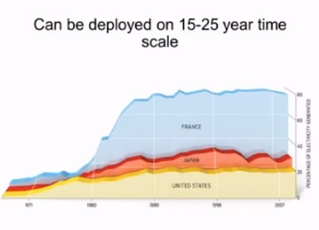
Other non-carbon sourced energy to consider?
Non Carbon based: Nuclear (fission and fusion)
  Fission: Very Controversial
  Fusion: clean / difficult to achieve
  Need national policy change on reprocessing
  See Kerry video at 56 minutes for discussion and conclusions thereafter: https://www.youtube.com/watch?v=7so8GRCWA1k

Slide 35
However – POTENTIAL big game changers in Energy and Carbon Dioxide Removal
Energy – from fusion
Mitigation in the form of carbon dioxide removal (CDR), agricultural changes and biofuels

Slide 36

Energy – from fusion
Lockheed Martin Compact Fusion breakthrough?
  http://www.lockheedmartin.com/us/products/compact-fusion.html
  http://aviationweek.com/blog/high-hopes-can-compact-fusion-unlock-new-power-space-and-air-transport
  http://aviationweek.com/fusion-podcast

Slide 37
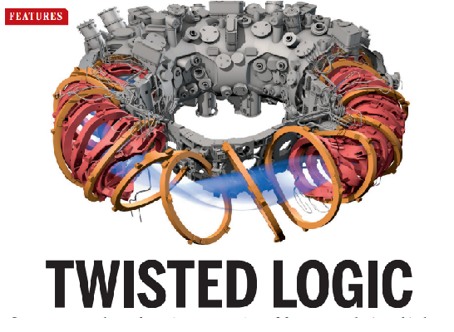
More on Fusion:
Fusion article in Science: Twisted Logic Science-2015-Clery-369-7

Slide 38
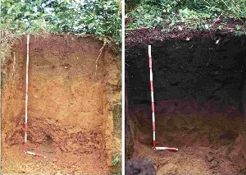
Biochar
Carbon Dioxide Removal (CDR)
See week 7, 2014 http://denverclimatestudygroup.com/?page_id=776
And biochar tab: http://denverclimatestudygroup.com/?page_id=28

Slide 39
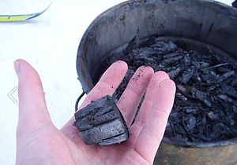
Carbon Dioxide Removal (CDR)
https://en.wikipedia.org/wiki/Biochar:
“Biochar is charcoal used as a soil amendment. Like most charcoal, biochar is made from biomass via pyrolysis. Biochar is under investigation as an approach to carbon sequestration to produce negative carbon dioxide emissions.^{[1]} Biochar thus has the potential to help mitigate climate change via carbon sequestration.^{[2][3]} Independently, biochar can increase soil fertility ofacidic soils (low pH soils), increase agricultural productivity, and provide protection against some foliar and soil-borne diseases.^{[4]} Furthermore, biochar reduces pressure on forests.^{[5]} Biochar is a stable solid, rich in carbon, and can endure in soil for thousands of years.^{[1]”}

Slide 40
The rest – next week, week 8

