Slide 1
Earth’s Climate: Past, Present and Future
OLLI Central: week 5, 4/27/2017
Paul Belanger
Skepticism vs. Denial: The issues, the disinformation campaign and its psychology
13 Misconceptions about Global Warming
Five characteristics of science denial
The Psychology of denial – The Worldview Backfire Effect
Industry positions: past and present
Disinformation campaigns and motivations
Solutions; among them: Carbon Fee and Dividend

Slide 2
VIDEO LINK:
13 Misconceptions About Global Warming https://www.youtube.com/watch?v=OWXoRSIxyIU&feature=youtu.be

Slide 3
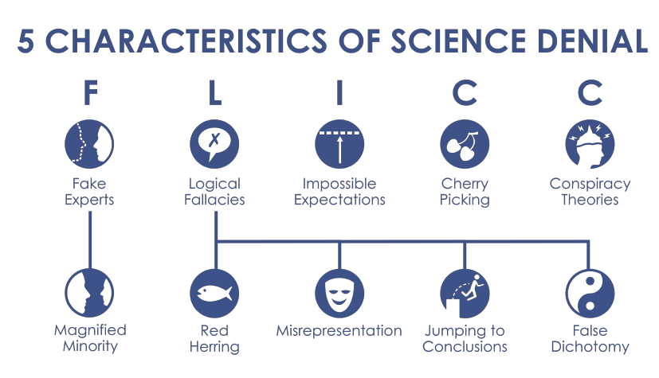
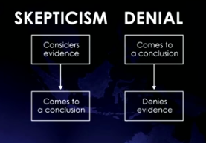
Five characteristics of science denial: FLICC
https://www.youtube.com/watch?v=wXA777yUndQ&feature=youtu.be
Scientific skepticism/conclusions:
data/consider the evidence,
Hypothesize and test,
come to a conclusion as the evidence becomes overwhelming
Denial arguments presented as if real skepticism:
Have a conclusion 1st
Deny the evidence / ignore the data

Slide 4
Quick review
Kerry Emanuel video – hoping you’ll find it useful:
https://www.youtube.com/watch?v=7so8GRCWA1k
Week 4 20 point NAS-Royal Academy PowerPoint or PDF:
  Belanger joint NAS-Royal Society answers to 20 points Pptx; or Belanger joint NAS-Royal Society answers to 20 points pdf

Slide 5
Why I’ve come to my conclusions
I’ve studied and generated data about climate
I’ve looked at the data:
  Isotopes of Oxygen and Carbon: forams and ice core
  CO₂ data (ice core) and CO₂ proxy data
  Milankovitch Orbital parameters
  Time trends
  Exceptions: PETM and other hyperthermals, Azolla, etc.
And concluded that the science is sound and gives me reason for concern.
One has to step back to not be bothered by minutes “curves” in how it’s going to happen….but there are solutions

Slide 6
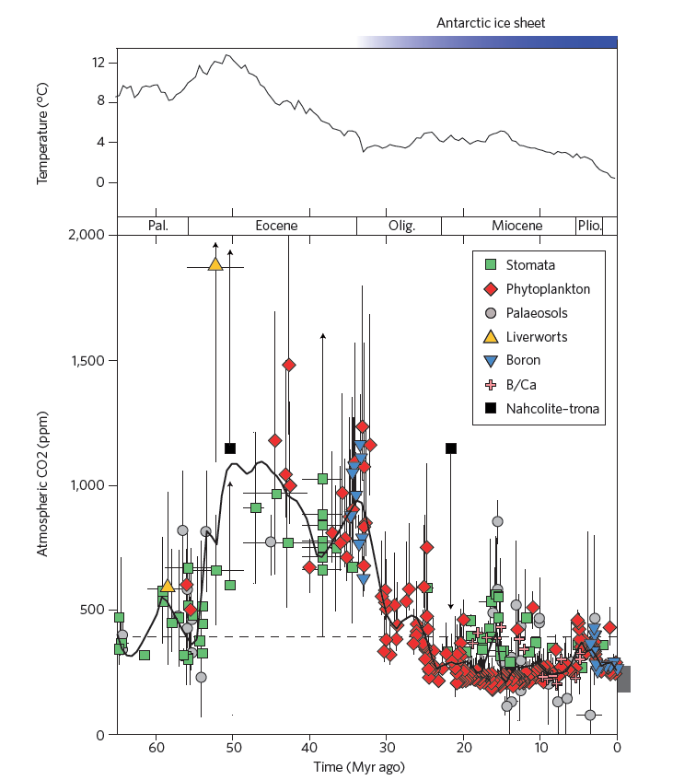
DATA
Azolla event:
~ 49 Ma
Notes:
6

Slide 7
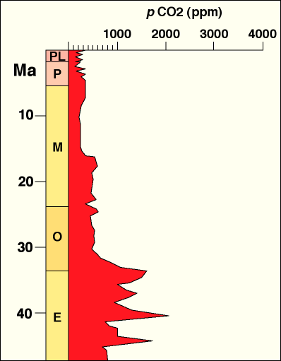
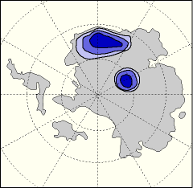
1200 ppm
CONJECTURE
1200 ppm
poor data
minor glaciation
1200 ppm
J. Bujak, personal comm.

Slide 8
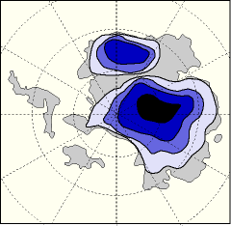
800 ppm
CONJECTURE
increased glaciation
fall in CO₂
800 ppm
poor data
800 ppm
1200 ppm
J. Bujak, personal comm.

Slide 9
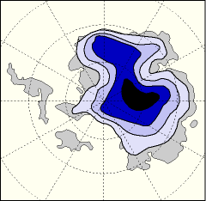
extensive continental glaciation
fall in CO₂
600 ppm
600 ppm
poor data
800 ppm
CONJECTURE
1200 ppm
J. Bujak, personal comm.

Slide 10
can this be used to predict the effect of future increases in CO₂ on Antarctic deglaciation?
600 ppm
poor data
800 ppm
1200 ppm
J. Bujak, personal comm.

Slide 11
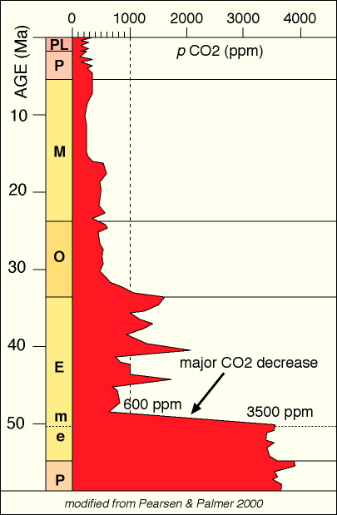
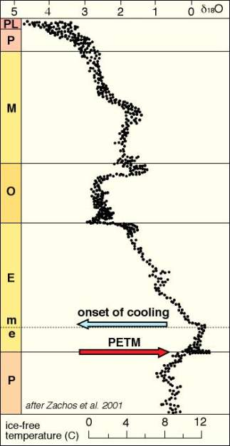
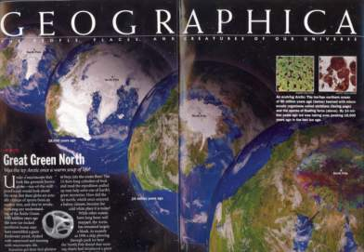
  triggering the shift
  from supergreenhouse
  towards the modern
  icehouse state at
  base Middle Eocene
J. Bujak, personal comm.

Slide 12
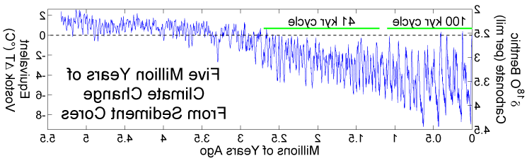

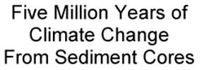
Climate Changes from Ocean Sediment Cores, since 5 Ma. Milankovitch Cycles
41K
100 K
5.0Ma
4.0Ma
3.0Ma
2.0Ma
1.0Ma
0
When CO₂ levels get below ~400-600 ppm Orbital parameters become more important than CO₂

Slide 13
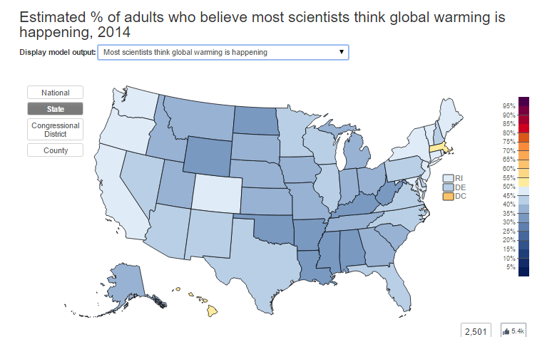
YALE STUDY:
http://environment.yale.edu/poe/v2014
What climate scientists think vs. what public thinks we think:

Slide 14
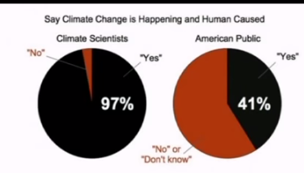
What we think vs. what public thinks we think:
DISCUSSION: what contributes to science uncertainty?

Slide 15
DENIAL 101X: World view Backfire effect
https://www.youtube.com/watch?v=CtSk03efSqQ&feature=youtu.be
Worldview Backfire Effect | https://youtu.be/CtSk03efSqQ

Slide 16
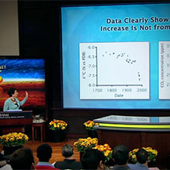
OTHER – for your perusal
Naomi Oreskes and George Marshall
Climate Change: How Do We Know We're Not Wrong?
THIS IS PART OF: Changing Planet: Past, Present, Future
Climate Change: How Do We Know We’re Not Wrong?
by Naomi Oreskes, PhD
And here’s the link to the George Marshall video:
https://www.youtube.com/watch?v=wBlTu9Tpvvo

Slide 17
Industry views: past
Exxon’s past role:
  Exxons Climate Concealment NOreskes-NYTimes

Slide 18
That led to the disinformation campaign
…that continues to this day
SLICK, WELL FUNDED, Meant to confuse

Slide 19
Climate Change Denial/Disinformation
The Heartland Institute
The Heartland Institute is a 31 year old national nonprofit organization devoted to discovering, developing, and promoting free market solutions to social and economic problems.
“The primary American organization pushing climate change skepticism.” The NY Times
“The world’s most prominent think tank supporting skepticism about man-made climate change.” The Economist
Modified Courtesy of Gary Wyngarden: Capitalism vs. the Planet

Slide 20
Climate Change Denial
Senator James Inhofe
Republican from Oklahoma
Representative from 1986-1994
Senator from 1994 to present
Chairman of US Senate Committee on Environment and Public Works from 2003-2007 and from 2015-present
Author of The Greatest Hoax: How the Global Warming Conspiracy Threatens Your Future
Quote: “[Because] God’s still up there, [the] arrogance of people to think that we, human beings, would be able to change what He is doing in the climate is outrageous.”
Keynote 5/2015 Heartland Inst. Speaker: https://www.youtube.com/watch?v=BjVx3PeBIEM
Courtesy of Gary Wyngarden: Capitalism vs. the Planet

Slide 21
Heartland Institute Background
James Taylor lobbyist against Renewable mandates
“Rachel was Wrong” defending continued use of DDT
Long involvement in defense of the tobacco industry
“Heartland does many things that benefit Phillip Morris’ bottom line, things that no other organization does.” (solicitation of funding from Heartland’s president to Phillip Morris.)
Phillip Morris on Heartland’s board and a major contributor.
Modified Courtesy of Gary Wyngarden: Capitalism vs. the Planet

Slide 22
Heartland’s President
Joseph Bast only president since founding in 1984
“Joe Camel is Innocent”
“Five Lies About Tobacco”
“smoking in moderation has few if any adverse health effects”
“FDA and EPA use junk science”
Courtesy of Gary Wyngarden: Capitalism vs. the Planet

Slide 23
Heartland’s Climate Change Expert
Dr. Willie Soon has PhD from USC in Aerospace Engineering and is a part-time employee of the Harvard-Smithsonian Center for Astrophysics
Believes global warming is caused by solar variation as opposed to human activity
Climate scientists have rebutted his arguments and the Smithsonian does not support his conclusions.
Soon has received over $1,000,000 from petroleum and coal interests since 2001 including the American Petroleum Institute, Koch Foundation, Exxon Mobil, Electric Power Research Institute
Failed to disclose conflicts of interest
Courtesy of Gary Wyngarden: Capitalism vs. the Planet

Slide 24
Industry views: present?
Current positions of Exxon and others:
EXXON-MOBIL: http://www.exxonmobilperspectives.com/2015/05/06/exxonmobil-paris-and-carbon-policy/
SHELL: http://www.shell.com/global/environment-society/environment/climate-change.html
Chevron: http://www.chevron.com/documents/pdf/CVX_Climate_Principles.pdf
Conoco Phillips: lame links to being “sustainable climate change position is fully aligned with out vision” http://www.conocophillips.com/search/Pages/default.aspx?k=climate%20change
BP: you have to search at bp.com to find statements (vs. US sites); see various links athttp://www.bp.com/en/global/corporate/search.html?q=climate+change&_charset_=UTF-8 and in this one citing 6 companies seeking carbon pricing: http://www.bp.com/en/global/corporate/press/press-releases/oil-and-gas-majors-call-for-carbon-pricing.html

Slide 25
OTHER – slow progress being made
Republican pledges $175 million to push party on climate Read more:
http://www.politico.com/story/2015/06/republican-climate-change-jay-faison-118755#ixzz3oH7FBgMb
Global Food Companies Unite On Climate Action
In Joint Letter Released Today, Chief Executive Officers of 10 Leading Food Companies Call on U.S. and World Leaders to Act Swiftly and Decisively: http://www.ceres.org/press/press-releases/global-food-companies-unite-on-climate-action

Slide 26
SOLUTIONS
IN next 2 WEEKS:

Slide 27
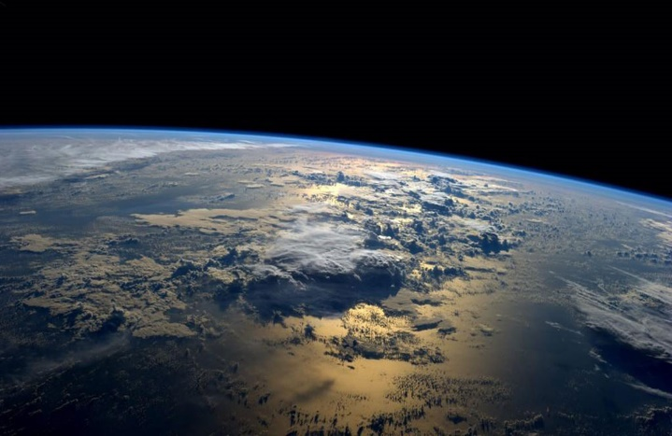
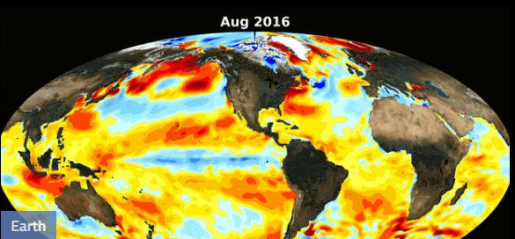
Mitigating & Adapting to our Changing Climate
Solutions:
Overcome our Inertia and Apathy
  Reduce Carbon Emissions in Electric Generation, Transportation and in Heating
  Carbon Dioxide Removal (CDR); Negative Emission Technology (NET); Greenhouse Gas Removal (GGR)
Belanger: OLLI West 4/7/2017
Designed by Anya Hess
photo from NASA

Slide 28

How to Overcome our Inertia and Apathy

Slide 29
The American Public and Climate Change
Yale Program on Climate Change Communication
Climate Change and the American Mind - November, 2016
    70% believe global warming is occurring
    55% understand it is caused by human activity
    Only 5% believe anything can or will be done
http://climatecommunication.yale.edu/
Kathleen Wells, Denver CCL, 2017

Slide 30
APATHY / INERTIA
WHY?
IT’S too late
It’s too big a problem
It’s up to the government
I’m not long for here anyway
It’s too expensive
I’m too busy
https://eos.org/articles/climate-scientists-new-hurdle-overcoming-climate-change-apathy

Slide 31

APATHY / INERTIA vs. good motives:
IT’S our planet
It’s the right thing to do
I CARE FOR FUTURE GENERATIONS!
It’s for our grandkids, or dogs or cats
I believe in promoting the best of human values by example
https://eos.org/articles/climate-scientists-new-hurdle-overcoming-climate-change-apathy

Slide 32
SOLUTIONS TO APATHY
#1 - CHANGE OUR WAY OF THINKING

Slide 33
Decisions
David Grinspoon:
“The decisions we make today will have an impact not only on this 21st century but on the 22nd and 23rd centuries and beyond”

Slide 34
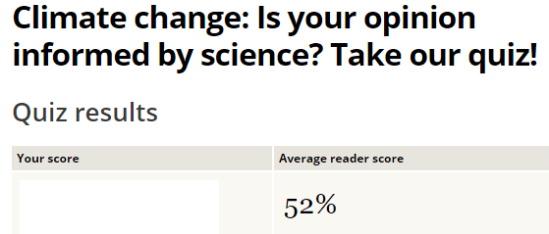
A Climate knowledge quiz; have you taken it yet?
From 2014 – so some will be incorrect
http://www.csmonitor.com/Environment/2014/0827/Climate-change-Is-your-opinion-informed-by-science-Take-our-quiz/Gas

