Slide 1
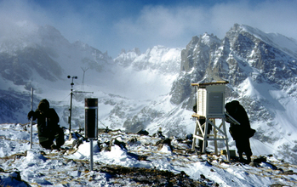
Niwot Ridge, west of Boulder, Colorado
Data gathered at research site since the 1940s.
NSF Niwot Ridge LTER site, John Marr collection
Notes:
http://www.nsf.gov/discoveries/disc_summ.jsp?org=NSF&cntn_id=137309&preview=false
The researchers also discovered increased discharges of water from Green Lakes Valley in late summer and fall after the annual snowpack has melted.
The increases appear to be due to higher summer temperatures melting "fossil" ice present for centuries or millennia in glaciers, rock glaciers, permafrost and other subsurface ice.
"We are taking the capital out of our hydrological bank account and melting that stored ice," Williams said. "While some may think this late summer water discharge is the new normal, it is really a limited resource that will eventually disappear."

Slide 2
Too Much Heat
Part one—
Heat Waves
Compiled by Phil Nelson, 2017

Slide 3
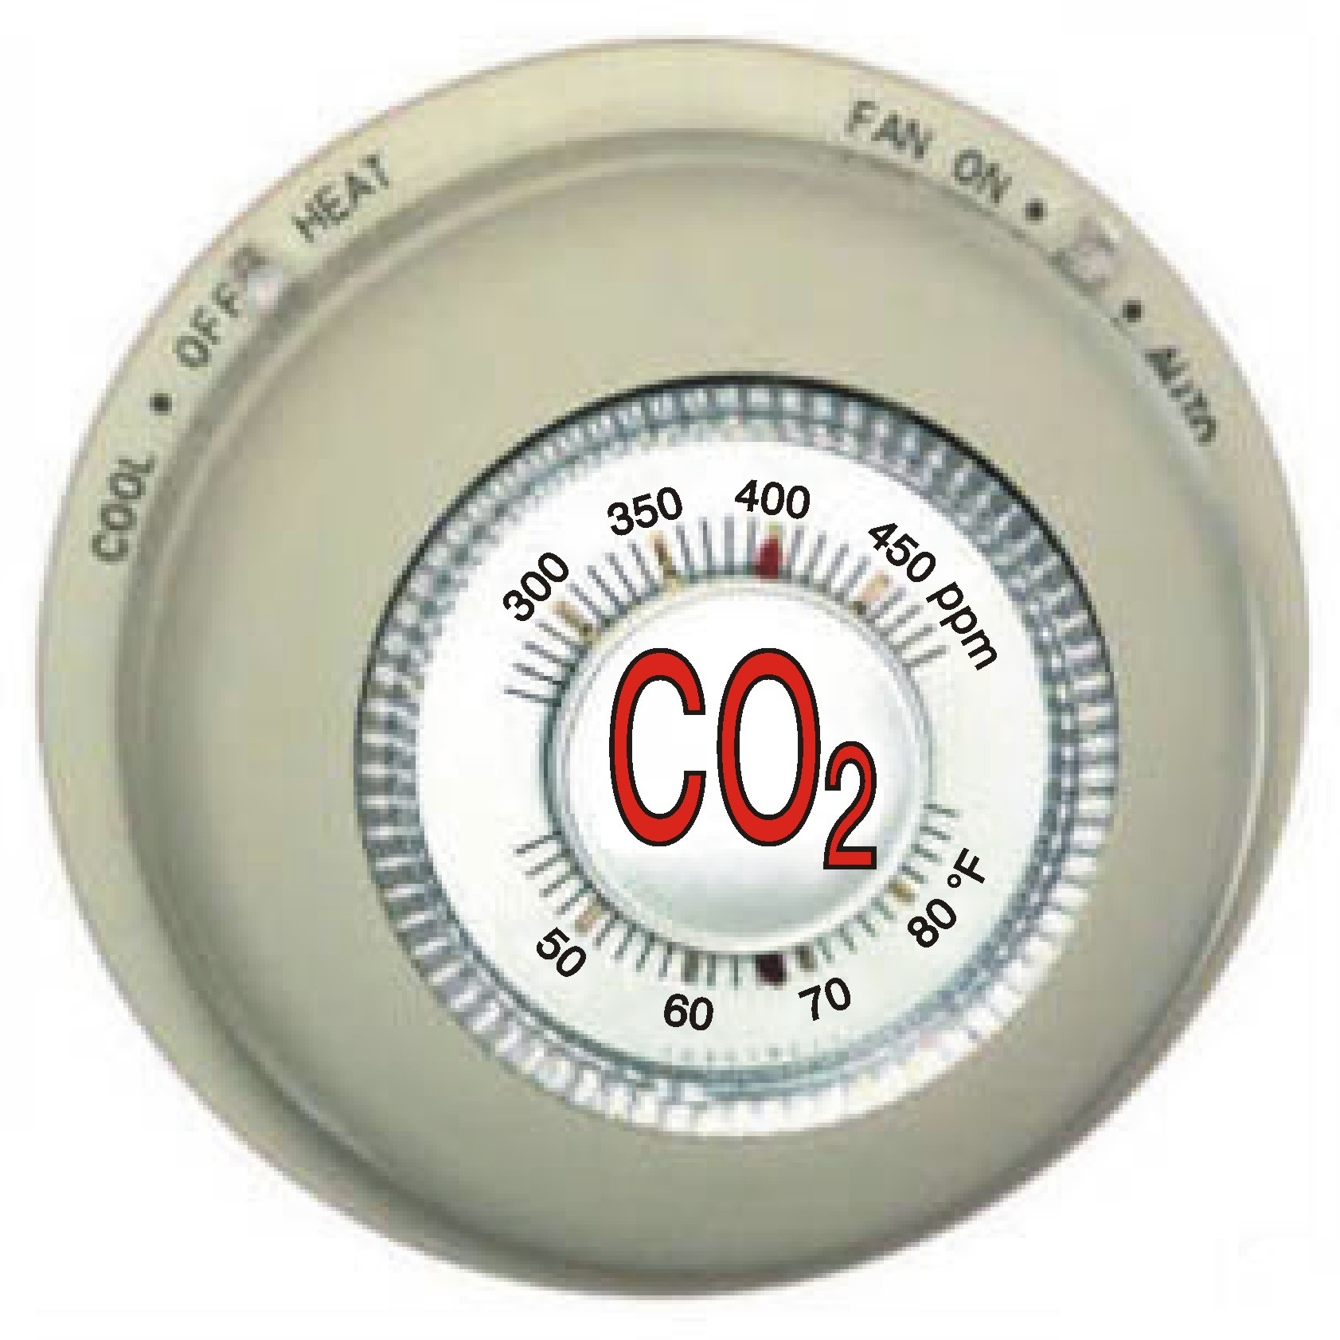
More Water Vapor and Clouds
Warmer Air, Warmer Water (Global Warming)
Atmosphere Biosphere Cryosphere
(Climate Change)
Human Activity
J
Notes:
J = journalism, especially science journalism

Slide 4
Heat Waves
Attribution confidence for extreme heat: high

Slide 5
Hyderabad, India, May, 2015 Fifth deadliest heat wave in recorded history, 113 F

Slide 6
Delhi, India, May, 2015 Man sprays ice cream truck so ice cream won’t melt, 112 F
The Indian Express

Slide 7
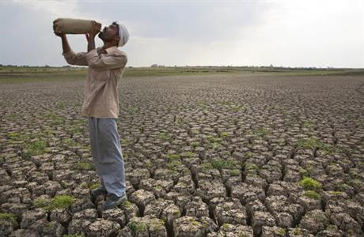
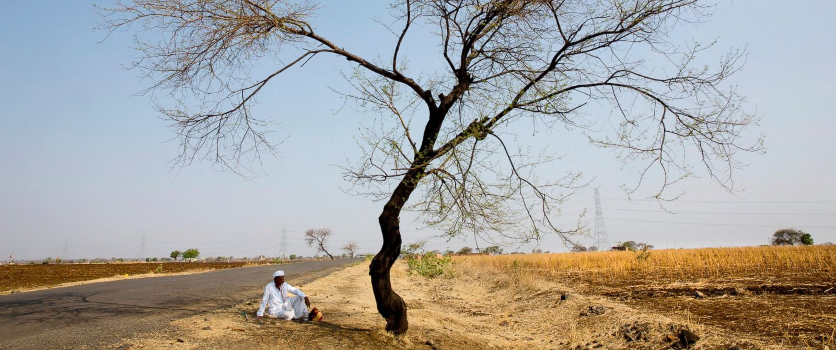
Phalodi, India, May 2016 ”Like heat waves coming out of a clay oven”, 124 F Sydney Morning Herald
AP
Photo: Rajesh Kumar Singh
AP
ABC News
Notes:
http://bigstory.ap.org/article/f906a3717f1c4fae883593fc7f46babe/crippling-drought-central-india-leaves-millions-brink
An Indian child bathes under a public fountain on a hot afternoon in Lucknow. Photo: Rajesh Kumar Singh Read more: http://www.smh.com.au/world/like-heatwaves-were-coming-out-of-a-clay-over-temperature-sets-record-in-india-20160520-gp0fxg#ixzz49UtuIAMA Follow us: @smh on Twitter | sydneymorningherald on Facebook
http://www.huffingtonpost.in/2016/05/20/highest-temperature-rajasthan_n_10041294.html
http://abcnews.go.com/International/record-breaking-heat-grips-india-amid-rash-farmer/story?id=39263639

Slide 8
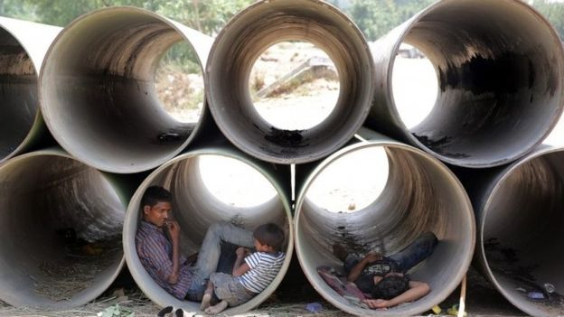
Northern India, 2016 Unused water pipes provide shelter in May’s record temperatures
Justin Rowlatt, BBC South Asia
Notes:
http://www.bbc.com/news/world-asia-india-36989173

Slide 9
Kuwait Fries in 54°C (129.2°F) Heat By: Jeff Masters , 3:01 AM GMT on July 22, 2016 It was a historic day in the annals of meteorology on Thursday, July 21, 2016 in the Middle East, where the temperature in Mitribah, Kuwait soared to an astonishing 54°C (129.2°F). If verified, this would be Earth's hottest temperature ever reliably measured outside of Death Valley, California, according to wunderground's weather historian Christopher C. Burt. The temperature is likely to be verified, since Thursday's incredible heat also extended into Iraq, which set their all-time heat record: 128°F (53.4°C) at Basrah.
Notes:
https://www.wunderground.com/blog/JeffMasters/eastern-hemispheres-alltime-temperature-record-kuwait-frys-in-54c

Slide 10
Record temperatures in Greenland On Thursday June 9, 2016, temperatures in Nuuk, Greenland’s capital, reached 75 degrees F. That was the warmest temperature ever recorded in the Arctic country during June, according to Jason Samenow of the Washington Post. “It was warmer in Nuuk than it was in New York City, where the high was only 71 degrees,”.
Notes:
http://blogs.discovermagazine.com/imageo/2016/06/12/surface-melting-of-snow-and-ice-in-greenland-explodes/#.V17r6Y-cHct

Slide 11
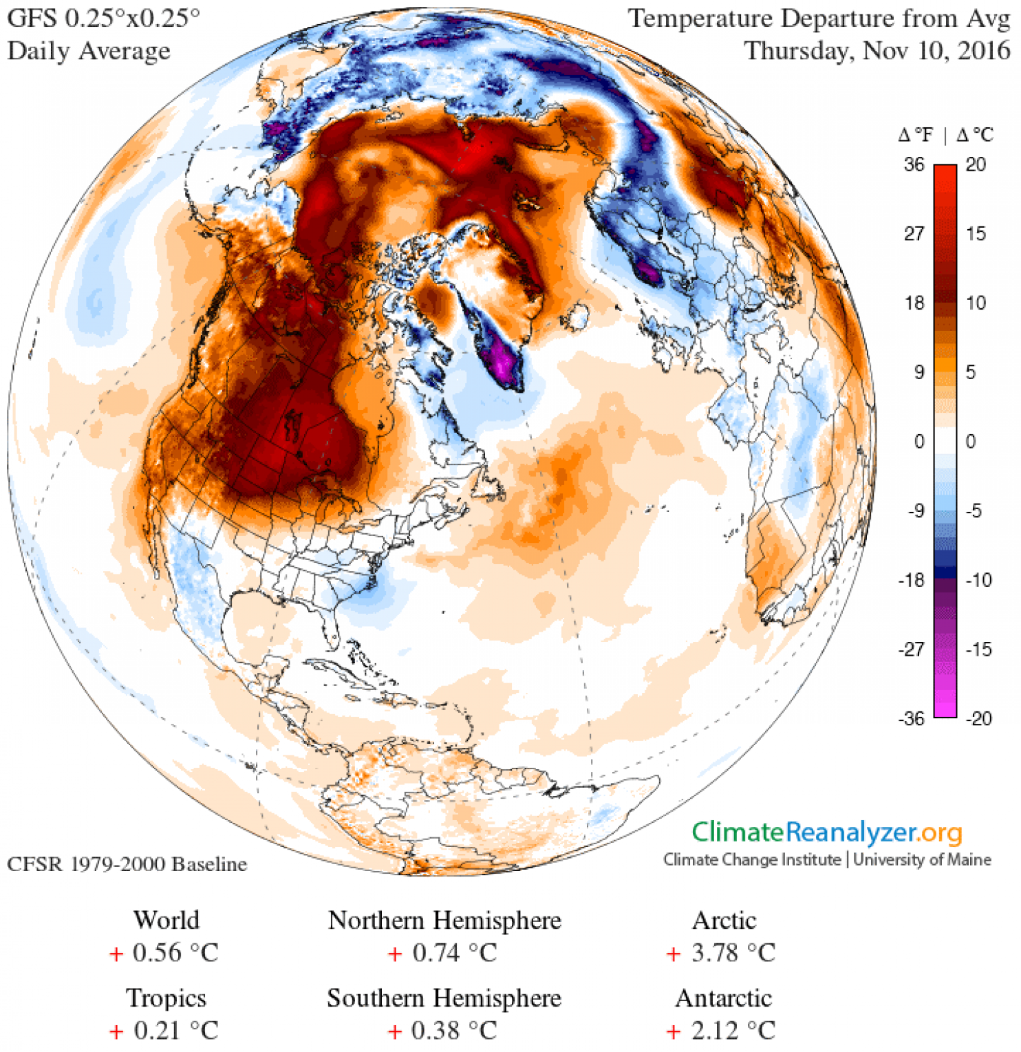
North America is flooded in warmth and there is no sign of real winter Washington Post, 10 Nov 2016
The United States experienced its third-warmest October on record, and warmth has continued through the first third of November.
[This fall has been so warm, some cities are setting records for latest first freeze]
Temperature difference from normal over the Northern Hemisphere, Nov. 10, 2016. (Climate Reanalyzer, Climate Change Institute, University of Maine, USA.)
Notes:
https://www.washingtonpost.com/news/capital-weather-gang/wp/2016/11/10/north-america-is-flooded-in-warmth-and-there-is-no-sign-of-real-winter/

Slide 12
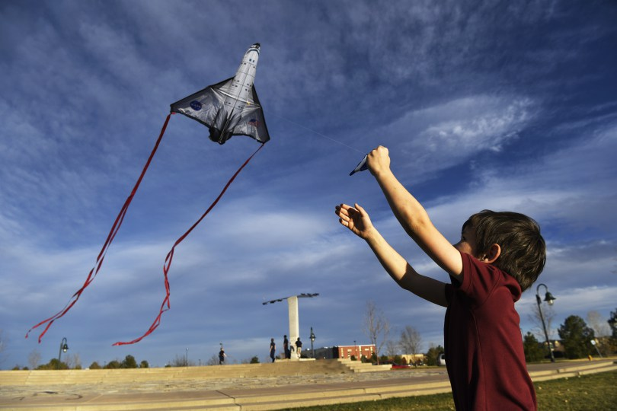
Denver beats 75-year-old warmth record as thermometer hits 78 degrees Denver Post, 16 Nov 2016
Denver surpassed a temperature record that stood since shortly before the bombing of Pearl Harbor Wednesday — a day before snow is predicted to fall in Denver.
On Nov. 16, 1941, the high temperature was 77 degrees. A thermometer at Denver International Airport, where Denver’s official temperature is recorded, registered 78 degrees at 1 p.m., according to the National Weather Service in Boulder.
Notes:
http://www.denverpost.com/2016/11/16/denver-forecast-record-warmth-before-winter-weather/

Slide 13
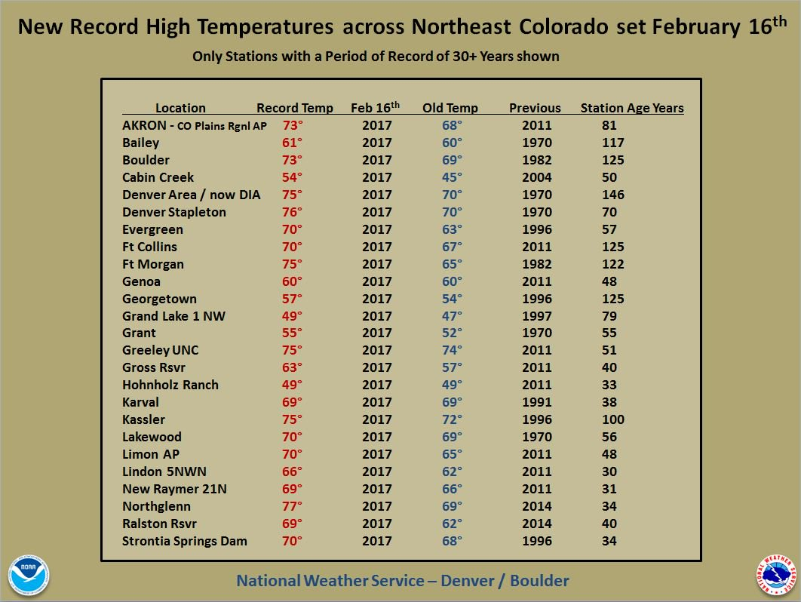
There has never been a hotter February day in Denver, Colorado Springs or Pueblo The temperature reached 80 degrees — yes, seriously — at Denver International Airport Denver Post 17 Feb 2017
The previous record-high February daily temperature in Denver was 77 degrees, reached in both 2006 and — you’re reading this right — 1890, the weather service said in a tweet. The city’s average high temperature in June is 81 degrees.
Notes:
http://www.denverpost.com/2017/02/10/denver-breaks-high-temperature-record/

Slide 14
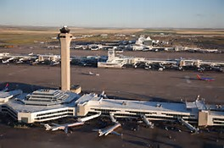
Hot Winter Eclipses Averages Bruce Finley, Denver Post, 27 Nov 2016
havayolu101.com
Denver has been a whopping 9 degrees warmer in March.
The recent precipitation in the mountains had boosted February snowpack in all the major river basins to higher than normal, except for the Yampa River Basin.
Notes:
Taken from print version

Slide 15
U.S. posts second-warmest year on record, breadth of warmth ‘unparalleled’ Washington Post, 9 Jan 2017
All of the Lower 48 states registered one of their top-seven warmest years. “The breadth of the 2016 warmth is unparalleled in the nation’s climate history,” NOAA said. “No other year had as many states breaking or close to breaking their warmest annual-average temperature.”
Notes:
https://www.washingtonpost.com/news/capital-weather-gang/wp/2017/01/09/u-s-posts-second-warmest-year-on-record-breadth-of-warmth-unparalleled/?utm_term=.ecff65b62c96

Slide 16
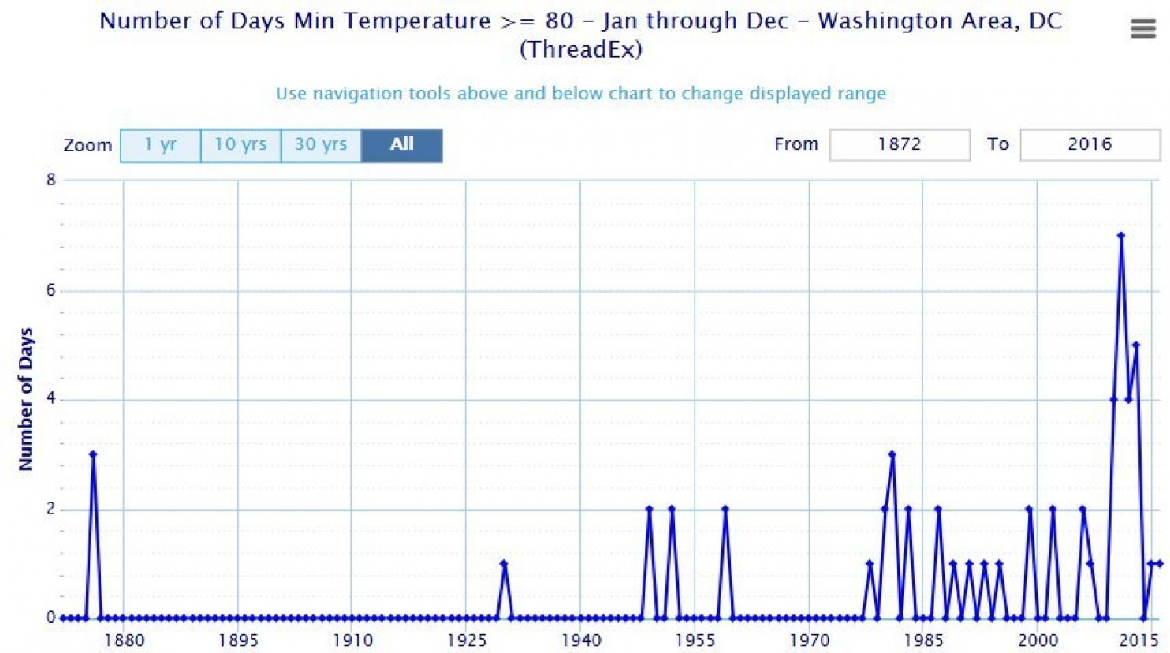
Hot nights have increased at a startling rate in Washington, D.C.
Since the turn of the century, Washington, D.C., has witnessed a stunning increase in unusually warm nights. These are the nights when you walk outside and the heat overwhelms you as if it’s the middle of the day. They’re now happening five to 10 times more frequently than they used to.
8
6
4
2
0
Number of days in a year with minimum temperature greater than 80F, from 1872 to 2016
Washington Post July 25, 2016
Notes:
https://www.washingtonpost.com/news/capital-weather-gang/wp/2016/07/25/hot-nights-have-increased-at-a-startling-rate-in-washington-d-c/

Slide 17
Sarah Perkins Kirkpatrick, heat wave researcher abc.net.au Oct 27, 2016
“This is scary. No-one really wants to know that 2C warming means we will have an extra 20 heatwave days here in Australia”.
Kirkpatrick worries every day about the figures she sees as a senior heatwave researcher at the University of NSW’s Climate Change Research Centre. “I don’t do this to get depressed. I do this to get things to change, so it doesn’t get as bad as it currently looks like it will.”
Notes:
http://www.abc.net.au/news/2016-10-27/sarah-perkins-kirkpatrick-senior-heatwave-researcher-at-unsw/7968580

Slide 18
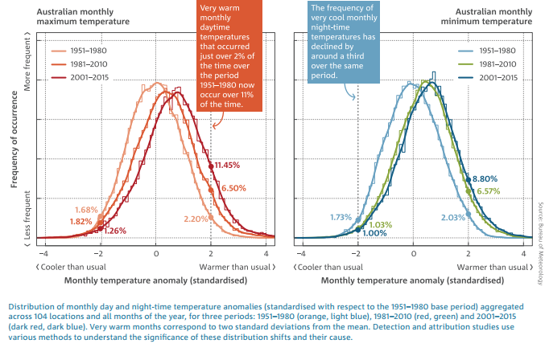
Australia experiencing more extreme fire weather, hotter days as climate changes Sydney Morning Herald Oct 27, 2016
Australian monthly maximum temperature
Australian monthly minimum temperature
Notes:
http://www.smh.com.au/environment/climate-change/australia-experiencing-more-extreme-fire-weather-hotter-days-as-climate-changes-20161025-gsao24.html
Australia is already experiencing an increase in extreme conditions from climate change and more sophisticated modelling is allowing scientists to pinpoint humans' contribution to the wilder weather, the Bureau of Meteorology and CSIRO said.
The fourth State of the Climate report found Australia's mean surface temperature has risen by about 1 degree since 1910, rainfall patterns are shifting away from the nation's south, and there is a marked increase in heatwaves and extreme fire weather days.

Slide 19
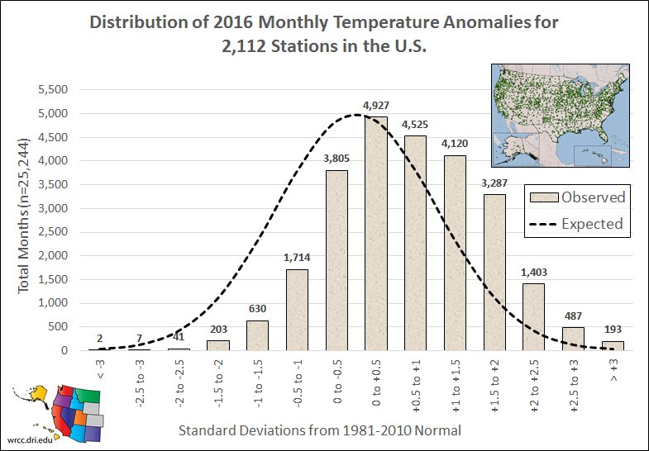
2016 monthly temperature anomalies were strongly “warm skewed” WRCCclimate
Notes:
https://twitter.com/WRCCclimate
WRCC = western regional climate center

Slide 20
“Extreme events are the primary way people experience climate change”
Quote from a presentation at AGU meeting, December 2016

Slide 21
Human activity implicated in Europe's 2003 heat wave Greenhouse emissions doubled the risk of a high temperature summer. Roxanne Khamsi, Nature, 2004
Man-made pollution during the past century doubled the chances of the heat wave that hit Europe last summer, say climatologists. It's the first time that a study has estimated how much human activity increased the risk of a specific weather event.
The sweltering temperatures of August 2003 left many people, particularly the elderly, struggling to cope. The heat wave caused many thousands of extra deaths, while forest fires ravaged large areas of land, causing $1.6 billion worth of damage in Portugal, for example.
(This is “the landmark 2003 heat wave paper” – Michael Wehner, Lawrence Berkeley Lab, Jan 2017)
The 2003 heat wave triggered thousands of extra deaths, as well as forest fires that caused billions of dollars worth of damage. ©Punchstock
Notes:
http://www.nature.com/news/2004/041129/full/news041129-6.html
https://nexusmedianews.com/a-climate-paradox-rising-temperatures-to-bring-more-droughts-and-floods-554d678940a7#.iirfi0jio

Slide 22
Heat Waves 2013 – Event Attribution
Bulletin American Meteorological Society v. 95, 2014
“Long duration heat waves during the summer and prevailing warmth for annual conditions are becoming increasingly likely due to a warming planet, as much as 10 times more likely due to the current cumulative effects of human-induced climate change, as found for the Korean heat wave of summer 2013.”
Of the nine heat-wave events in 2013 that were studied, all were attributed to anthropogenic climate change, as documented in a special issue of the Bulletin of the American Meteorological Society.
Since 1980, global temperature averages show more hot days and fewer cool nights.
Notes:
Herring, S. C., M. P. Hoerling, T. C. Peterson, and P. A. Stott, Eds., 2014: Explaining Extreme Events of 2013 from a Climate Perspective. Bull. Amer. Meteor. Soc., 95 (9), S1–S96, Table 24.1 in Section 24, Summary and broader context

Slide 23
Heat Waves 2015 – Event Attribution
Bulletin American Meteorological Society v. 97, Summary, 2016
“As observed in years past, all the papers that looked at heat events around the world—from Egypt, Australia, Europe, Indonesia, Asia, India, and Pakistan—all found that climate change played a role in increasing the severity of the event.
In addition, many of these events were influenced by both El Niño and natural variability, and in all cases researchers were able to distinguish between these drivers.”

Slide 24
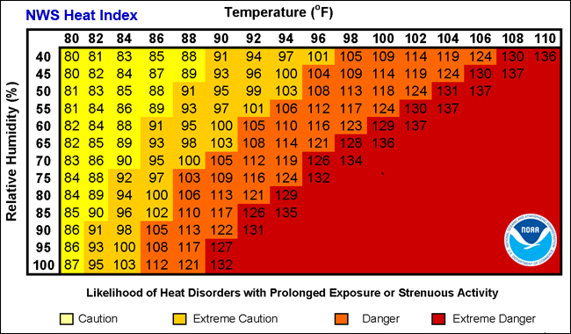
Heat Index – how hot it really feels
National Weather Service/NOAA
Fatigue is possilbe
Heat exhaustion is possible
Heat stroke is probable
Heat stroke is imminent
Notes:
http://www.nws.noaa.gov/om/heat/heat_index.shtml
https://en.wikipedia.org/wiki/Heat_index

Slide 25
More Water Vapor and Clouds
Warmer Air, Warmer Water (Global Warming)
HUMAN RESPONSES
Personal
Family, Friends, Neighbors
Town and City
State
National
International
Atmosphere Biosphere Cryosphere
(Climate Change)
Notes:
J = journalism

Slide 26
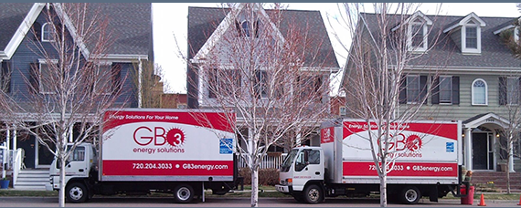
PERSONAL -- Save Energy at Home
GB3 Energy, Golden Colorado
Energy audit, add insulation, replace windows, heating system upgrade, weatherize, crawlspace insulation, …..
Notes:
http://www.gb3energy.com/

Slide 27
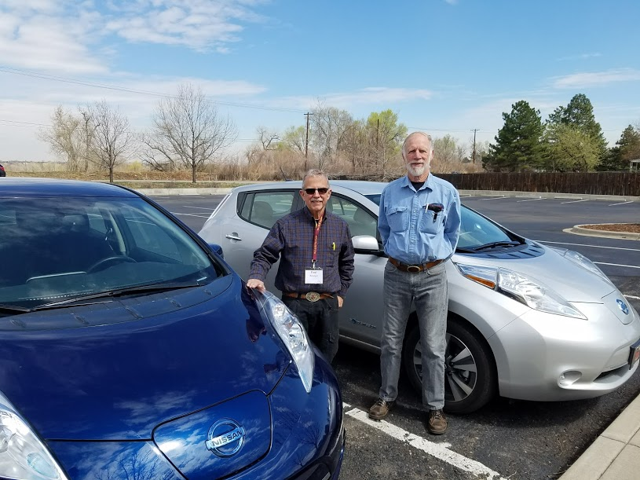
You Too Can Own an Electric Vehicle
2016 Nissan Leaf.
All electric,
battery powered.
100-mile range on a charge.
Paul Belanger and Phil Nelson, owners, March 2017

Slide 28
'Sea change' voyage looks at climate change on Lake Superior. Gordon family of Minnesota and crew of 4 stop in Thunder Bay to discuss climate change and Great Lakes Cathy Alex, CBC News, May 16, 2016 jpl.nasa.gov
She's encouraged by the amount of discussion she's hearing regarding the effects of greenhouse gas emissions on the largest of the Great Lakes..
Notes:
A Minnesota woman, who has spent the last three years sailing around Lake Superior, says she's encouraged by the amount of discussion she's hearing regarding the effects of greenhouse gas emissions on the largest of the Great Lakes.
Sailing family says climate change evident on Lake Superior
In 2013, Katya Gordon, her husband Mark, and their two daughters — 13-year-old Cedar and 11-year-old Lamar — along with a rotating crew of four, embarked on the "Sea Change" voyage to raise awareness about the impact of climate change on Lake Superior, and inspire people to take action.
http://www.cbc.ca/news/canada/thunder-bay/lake-superior-climate-change-1.3583402

