Slide 1
OLLI WEST: EARTH CLIMATE – WEEK 6
Future Promise:
Fusion
Geoengineering (SRM, CDR, Carbon negative technologies);
economics
Tuesday October 21st, 2014
Paul E. Belanger, Ph.D.

Slide 2
Fusion breakthrough
http://www.lockheedmartin.com/us/products/compact-fusion.html
http://aviationweek.com/blog/high-hopes-can-compact-fusion-unlock-new-power-space-and-air-transport
http://aviationweek.com/fusion-podcast

Slide 3
Naomi Oreskes
Slides excerpted from:
http://www.hhmi.org/biointeractive/climate-change-how-do-we-know-were-not-wrong
http://media.hhmi.org/hl/12Lect4.html

Slide 4
Polls on climate change:
(on evolution ~ half don’t believe in evolution)
See National Center for Science Education (NCSE): http://ncseprojects.org/ on climate: http://ncseprojects.org/climate
http://media.hhmi.org/hl/12Lect4.html

Slide 5
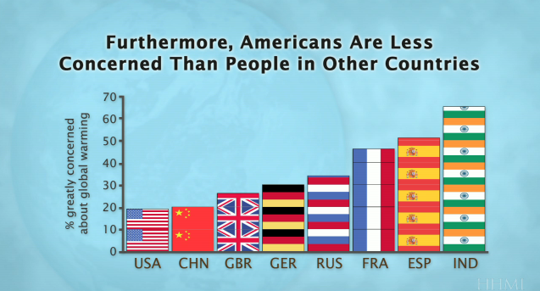
Got to ask why, no?
http://media.hhmi.org/hl/12Lect4.html

Slide 6
http://media.hhmi.org/hl/12Lect4.html

Slide 7
We try!
http://media.hhmi.org/hl/12Lect4.html

Slide 8
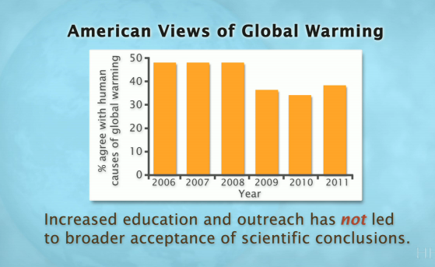
Got to ask why, no?
http://media.hhmi.org/hl/12Lect4.html

Slide 9
http://media.hhmi.org/hl/12Lect4.html

Slide 10
http://media.hhmi.org/hl/12Lect4.html

Slide 11
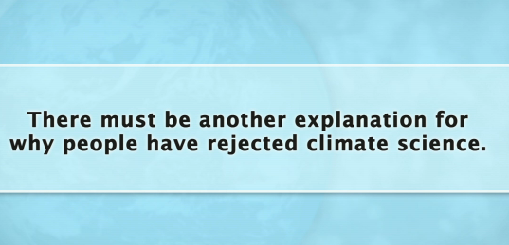
http://media.hhmi.org/hl/12Lect4.html

Slide 12
It started with the Marhall Institute
http://media.hhmi.org/hl/12Lect4.html

Slide 13
After the cold war ended, they went after perceived internal “threats”
http://media.hhmi.org/hl/12Lect4.html

Slide 14
http://media.hhmi.org/hl/12Lect4.html

Slide 15
It comes down to ideology, not science!
http://media.hhmi.org/hl/12Lect4.html

Slide 16
And it “mushroomed”
http://media.hhmi.org/hl/12Lect4.html

Slide 17
http://media.hhmi.org/hl/12Lect4.html

Slide 18
http://media.hhmi.org/hl/12Lect4.html

Slide 19
http://media.hhmi.org/hl/12Lect4.html

Slide 20
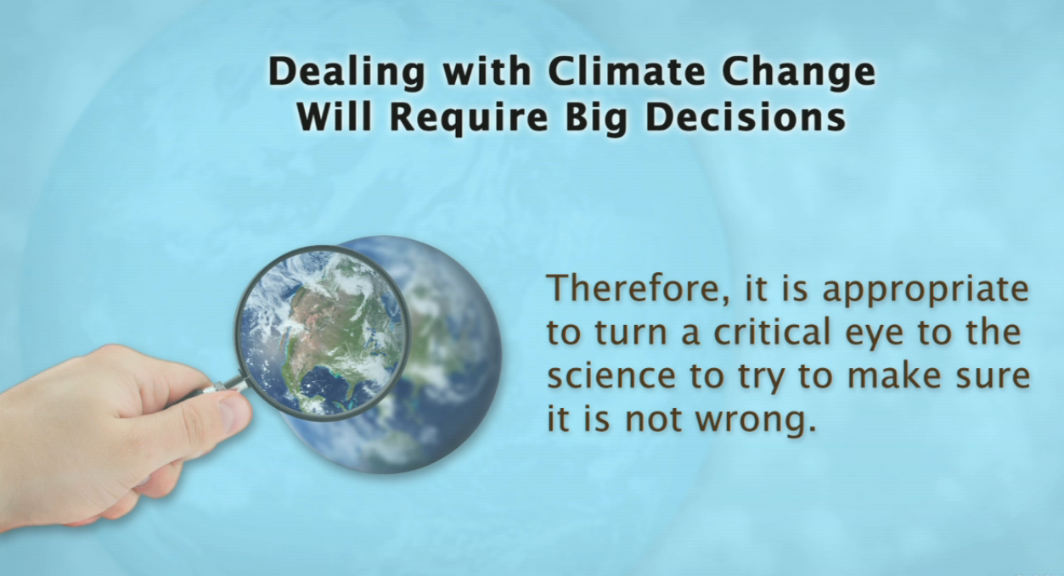
http://media.hhmi.org/hl/12Lect4.html

Slide 21
http://media.hhmi.org/hl/12Lect4.html

Slide 22
http://media.hhmi.org/hl/12Lect4.html

Slide 23
http://media.hhmi.org/hl/12Lect4.html

Slide 24
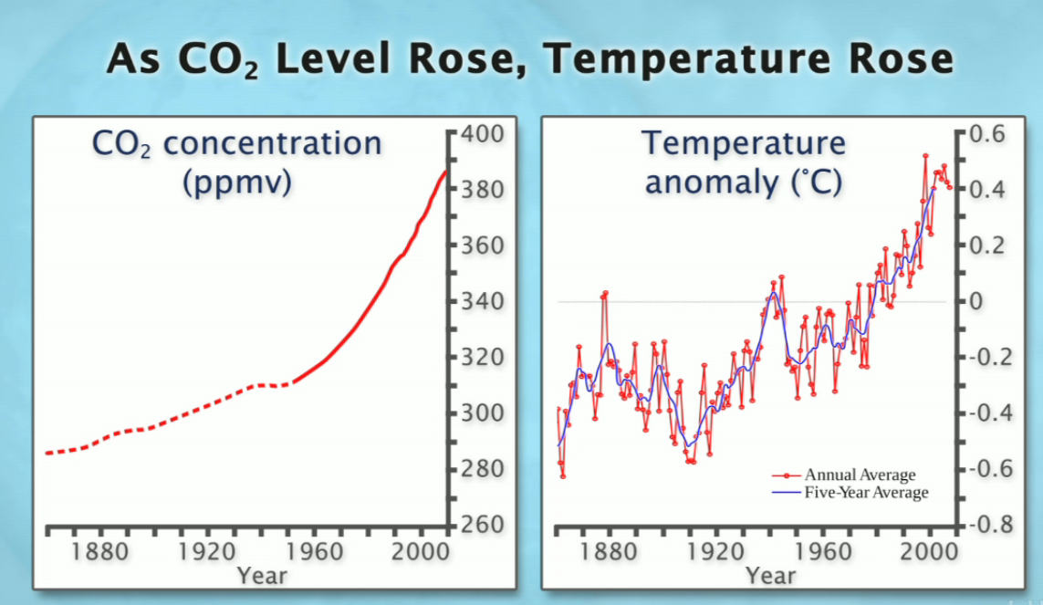
http://media.hhmi.org/hl/12Lect4.html

Slide 25
http://media.hhmi.org/hl/12Lect4.html

Slide 26
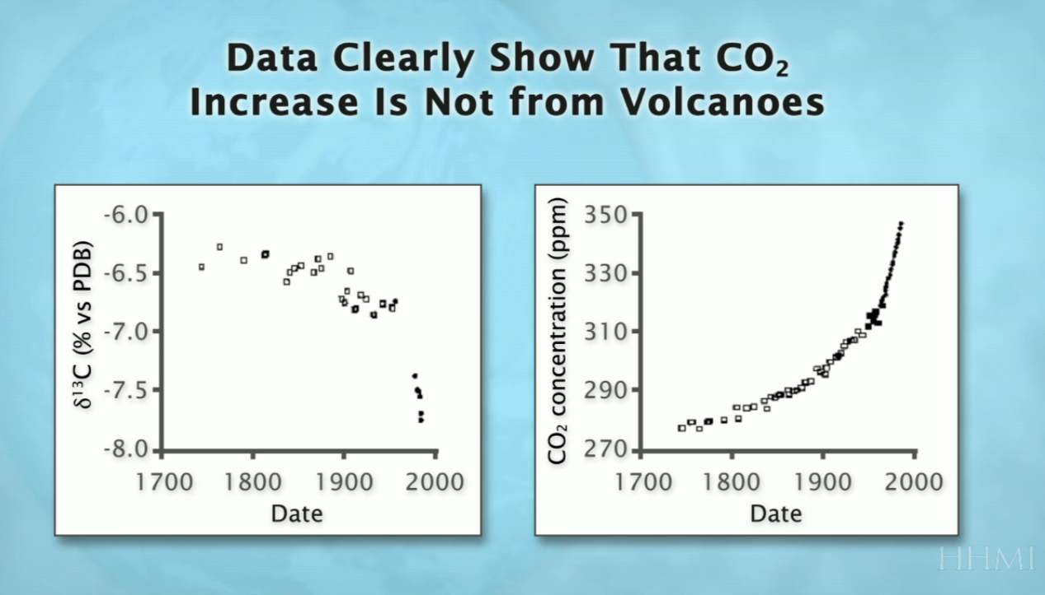
How to test the hypothesis
Inorganic CO2 from volcanoes are isotopically more positive; organic matter depleted in C13 = Fossil carbon is negative
“To claim otherwise:
Confused, ignorant or lying”
http://media.hhmi.org/hl/12Lect4.html

Slide 27
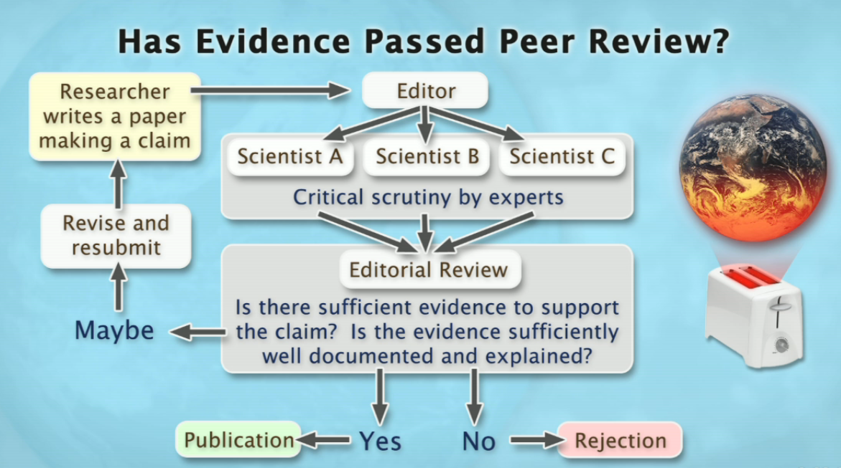
How peer review works
http://media.hhmi.org/hl/12Lect4.html

Slide 28
http://media.hhmi.org/hl/12Lect4.html

Slide 29
http://media.hhmi.org/hl/12Lect4.html

Slide 30
http://media.hhmi.org/hl/12Lect4.html

Slide 31
http://media.hhmi.org/hl/12Lect4.html

Slide 32
http://media.hhmi.org/hl/12Lect4.html
http://media.hhmi.org/hl/12Lect4.html

Slide 33
http://media.hhmi.org/hl/12Lect4.html

Slide 34
Obama quoted in episode of Years of Living Dangerously (paraphrased): “It’s difficult in a Democracy to do something/pass something where the pay-back is 10 or more years out”
http://media.hhmi.org/hl/12Lect4.html

Slide 35
End or class PowerPoint week 6;
Go back to syllabus

