Slide 1
Earth’s Climate: Past, Present and Future
Fall Term - OLLI West: week 2; 9/22/2015
Paul Belanger
Earth's past climate history and what caused those changes
Earth’s deep past before the Cambrian (600 MaBP): hot and cold
Earth’s past: Cambrian onward: mostly hot-house Earth; 100s parts per million (ppm)
Climate trend in the Cenozoic – the last 65 million years; proxy data from 3600ppm to <200 ppm.
More recent past: 180-280 part per million; how do we know – empirical data. Preview of next week’s field trip
Today: 400 ppm and growing 2-3ppm/year

Slide 2
REVIEW OF WEEK 1 ITEM
TOA – TOP OF ATMOSPHERE
HOMEWORK: 2 = ROOMS, BOTH SAME TEMP.
  100% HUMIDITY
  20% HUMIDITY
  WHICH IS DENSER? The answer may surprise some of you
El Nino/La Nina map and world temperatures

Slide 3
REVIEW OF WEEK 1 ITEM
GAS LAWS
  N₂ (78%), atomic mass 14 (7p/7n) x 2 = 28
  O₂ (21%), atomic mass 16 (8p/8n) x2 = 32
  H₂O (varies <1%), H – 1p x 2 = 2 + 16 = 18
Water vapor mixed in air makes it LESS DENSE
Why rain associated with LOW pressure
Joule (ISU), calorie, BTU
  Takes 80 cal to melt ice; 1 cal (4.2J)/ ºC; 540 c to steam

Slide 4
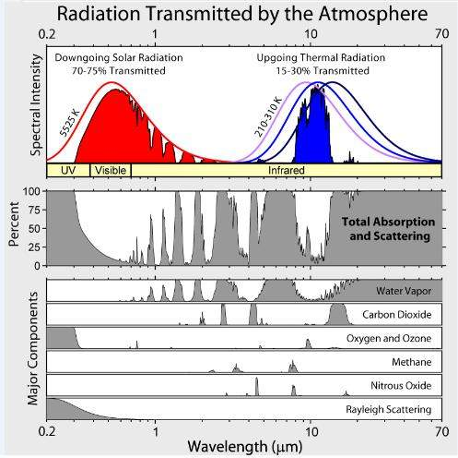

Slide 5
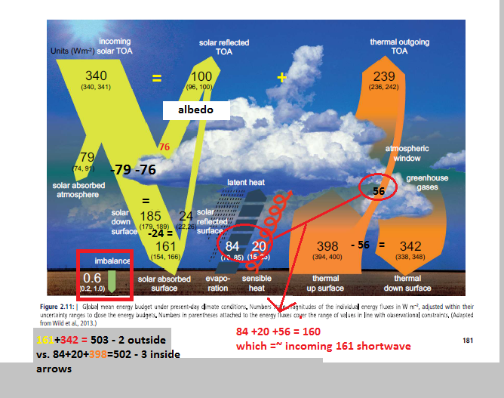
SHORTER WAVE/HIGHER ENERGY
LONGER WAVE/LOWER ENERGY

Slide 6
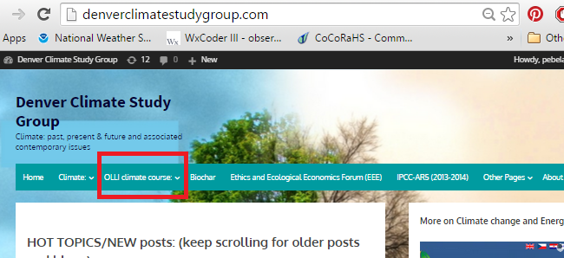
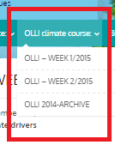
WEB PAGE http://www.denverclimatestudygroup.com/

Slide 7
Objectives:
Educate / That the science is sound
Present you with the geologic evidence; Earth’s past
Understand the denial movement and how to counter it
Motivate you
Give you hope / look at potential game changers

Slide 8
Earth’s past climate
Earth’s deep past before the Cambrian (600 MaBP): hot and cold
Earth’s past: Cambrian onward: mostly hot-house Earth; 100s parts per million (ppm)
Climate trend in the Cenozoic – the last 65 million years; proxy data from 3600ppm to <200 ppm.
More recent past: 180-280 part per million; how do we know – empirical data. Preview of next week’s field trip
Today: 400 ppm and growing

Slide 9
Earth’s past climate 1 of 2
Earth’s deep past and early atmosphere before the Cambrian (600 MaBP): hot and cold
  Earth self regulates 2.1 -2.3 Tim Lenton video – 9 minute overview
  Nat geographic – not terribly good – but at 2:30 describe dropstones - evidence
  https://www.youtube.com/watch?v=mX3pHD7NH58 but at Better description of cause: http://www.sciencechannel.com/tv-shows/how-the-universe-works/videos/snowball-earth/
  3-4 minutes each

Slide 10
Earth’s past climate 2 of 2
Earth’s deep past and early atmosphere before the Cambrian (600 MaBP): hot and cold
  48 minutes https://www.youtube.com/watch?v=YOLbE8frMrM
  WIKI: https://en.wikipedia.org/wiki/Snowball_Earth
  Article Link: BBC Nature --- video is not currently working 9/20/2015 at http://www.bbc.co.uk/nature/ancient_earth/Snowball_Earth but here’s a link about the video including a link to the transcript: http://www.bbc.co.uk/science/horizon/2000/snowballearth.shtml
  You Tube – leaving for you to watch on your own: https://www.youtube.com/results?search_query=snow+ball+earth – various links

Slide 11
Earth’s past climate
Earth’s deep past before the Cambrian (600 MaBP): hot and cold
Earth’s past: Cambrian onward: mostly hot-house Earth; 100s parts per million (ppm)
Climate trend in the Cenozoic – the last 65 million years; proxy data from 3600ppm to <200 ppm.
More recent past: 180-280 part per million; how do we know – empirical data. Preview of next week’s field trip
Today: 400 ppm and growing

Slide 12
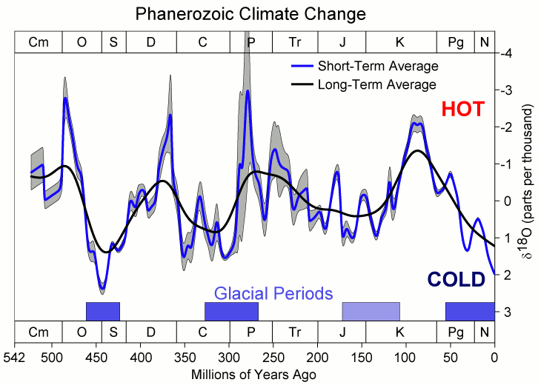
PALEOZOIC
MESOZOIC
CENOZ.

Slide 13
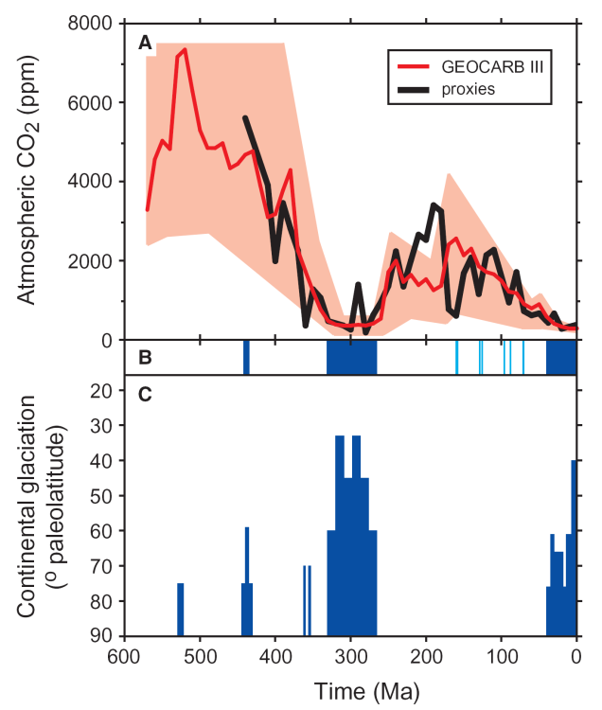
Alternating Greenhouse Earth / Ice-house Earth
Geologic cycles: Climate through the Phanerozoic:
Carbon is the culprit
Royer et al., 2003

Slide 14
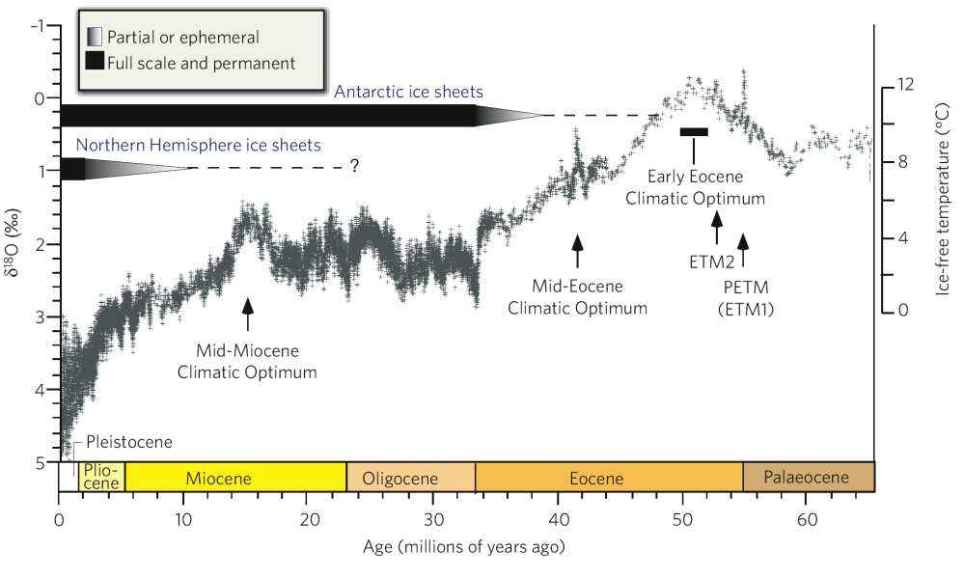
Cenozoic Deep Sea Climate Record
Azolla sequestering event
hyperthermals
41k-100k & amplitude
change:
Increase in
Antarctic ice
Changes in W. Pacific/Indian Ocean and/or closing of
Isthmus
of Panama
Opening of the Drake passage isolating Antarctica and further drop in CO₂
Zachos et al. 2008

Slide 15
Cenozoic Deep Sea Climate Record
Azolla sequestering event
hyperthermals
41k-100k & amplitude
change:
Increase in
Antarctic ice
Changes in W. Pacific/Indian Ocean and/or closing of
Isthmus
of Panama
Opening of the Drake passage isolating Antarctica and further drop in CO₂
Zachos et al. 2008

Slide 16
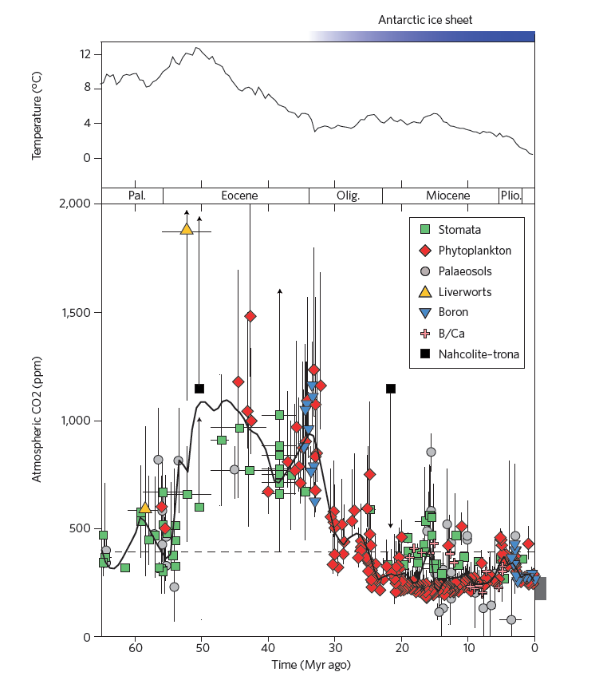
Correlation of
CO₂ and temperature over last 65 million years
Beerling and Royer, Nature 2011

Slide 17
Azolla event:
~ 49 Ma
Notes:
17

Slide 18
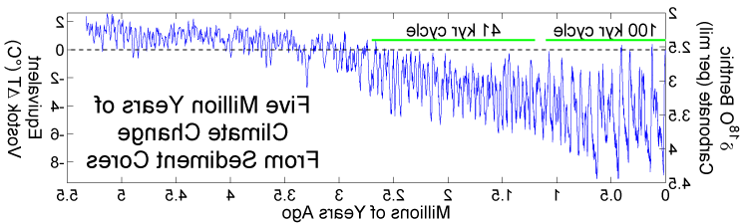

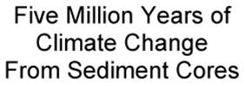
Climate Changes from Ocean Sediment Cores, since 5 Ma. Milankovitch Cycles
41K
100 K
5.0Ma
4.0Ma
3.0Ma
2.0Ma
1.0Ma
0
When CO₂ levels get below ~400-600 ppm Orbital parameters become more important than CO₂

Slide 19
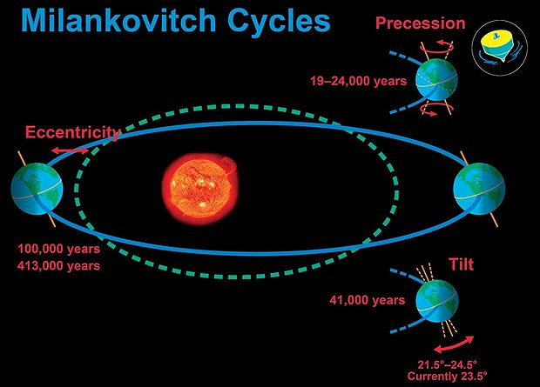
http://cnx.org/content/m38572/1.5/
Notes:
COMET® at the University Corporation for Atmospheric Research (UCAR) pursuant to a Cooperative Agreements with the National Oceanic and Atmospheric Administration, U.S. Department of Commerce. ©1997-2009 University Corporation for Atmospheric Research. All Rights Reserved.
Maybe use a ball and stick model?

Slide 20
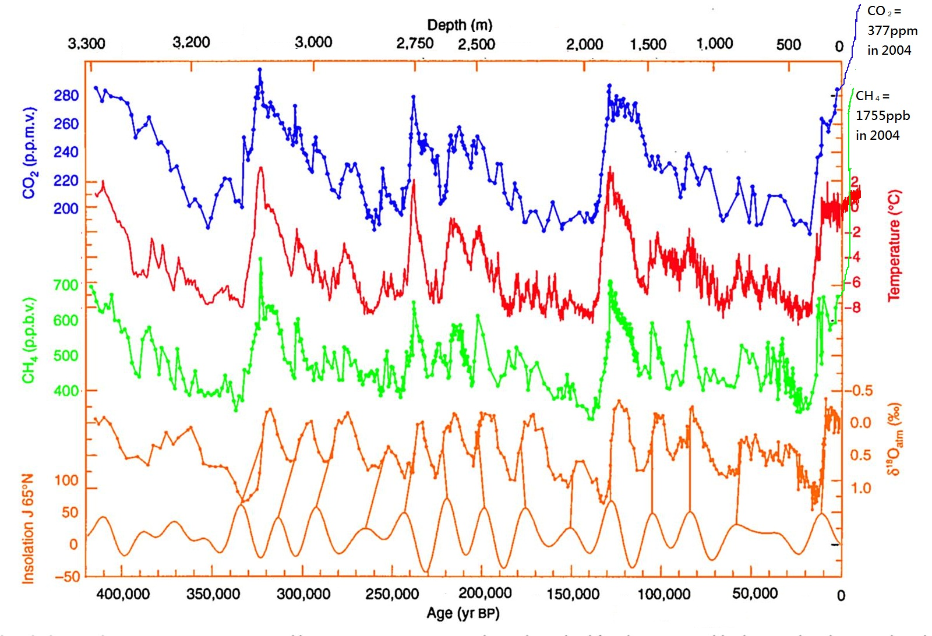
http://www.antarcticglaciers.org/climate-change/
Notes:
Source: http://www.antarcticglaciers.org/climate-change/

Slide 21
Earth’s past climate
Earth’s deep past before the Cambrian (600 MaBP): hot and cold
Earth’s past: Cambrian onward: mostly hot-house Earth; 100s parts per million (ppm)
Climate trend in the Cenozoic – the last 65 million years; proxy data from 3600ppm to <200 ppm.
More recent past: 180-280 part per million; how do we know – empirical data. Preview of next week’s field trip
Today: 400 ppm and growing

Slide 22
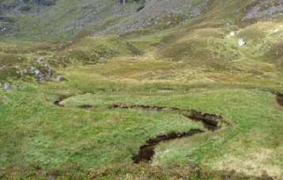
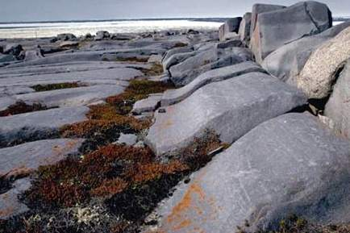
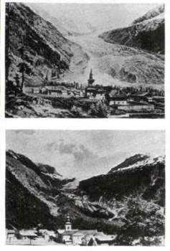
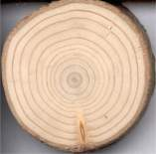
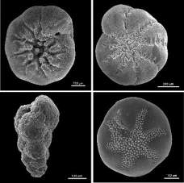
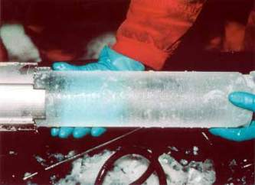
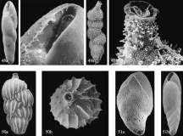

Scientific History of Climate change – PROXY DATA

Slide 23
Long-term Carbon Cycle: rocks
Two generalized reactions…
Photosynthesis/Respiration
CO₂ + H₂0 ↔ CH₂O + O₂
Weathering/Precipitation
CO₂ + CaSiO₃ ↔ CaCO₃ + SiO₂

Slide 24
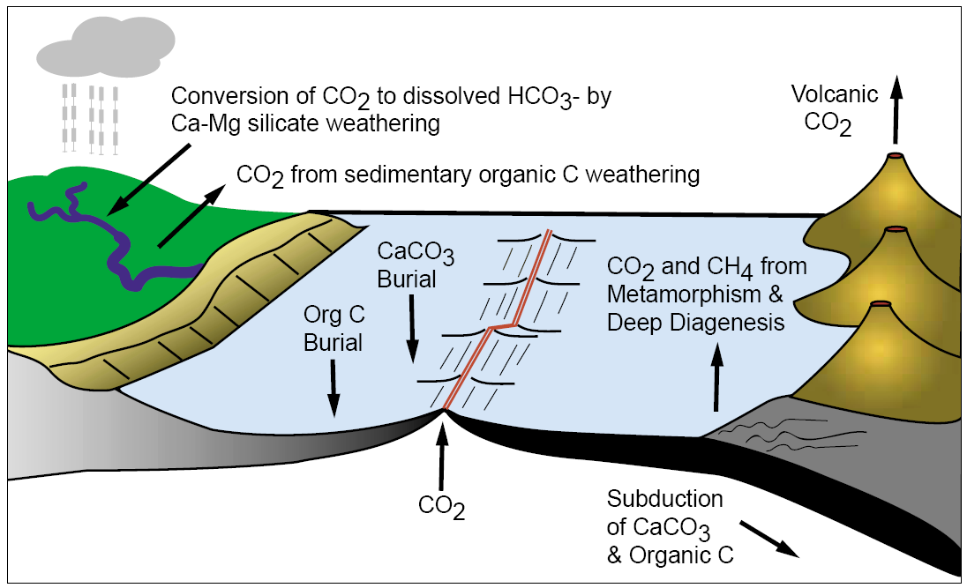
Long-term carbon cycle: rocks
Berner, 2001

Slide 25
Azolla event:
~ 49 Ma
50 million years ago (50 MYA) Earth was ice-free.
Atmospheric CO₂ amount was of the order of 1000 ppm 50 MYA.
Atmospheric CO₂ imbalance due to plate tectonics ~ 10⁻⁴ ppm per year.
Notes:
25

Slide 26
Azolla event:
~ 49 Ma
Notes:
26

Slide 27
So – what changed?
Volcanism decreased; some slowing of spreading rates: less CO₂ emitted by volcanoes
Weathering/Precipitation increased; India colliding into Asia/Himalayans

Slide 28
Earth’s past climate
Earth’s deep past before the Cambrian (600 MaBP): hot and cold
Earth’s past: Cambrian onward: mostly hot-house Earth; 100s parts per million (ppm)
Climate trend in the Cenozoic – the last 65 million years; proxy data from 3600ppm to <200 ppm.
More recent past: 180-280 part per million; how do we know – empirical data. Preview of next week’s field trip
Today: 400 ppm and growing

Slide 29
Climate Changes from Ocean Sediment Cores, since 5 Ma. Milankovitch Cycles
41K
100 K
5.0Ma
4.0Ma
3.0Ma
2.0Ma
1.0Ma
0
When CO₂ levels get below ~400-600 ppm Orbital parameters become more important than CO₂

Slide 30
Earth’s past climate
Earth’s deep past before the Cambrian (600 MaBP): hot and cold
Earth’s past: Cambrian onward: mostly hot-house Earth; 100s parts per million (ppm)
Climate trend in the Cenozoic – the last 65 million years; proxy data from 3600ppm to <200 ppm.
More recent past: 180-280 part per million; how do we know – empirical data. Preview of next week’s field trip
Today: 400 ppm and growing

Slide 31
- SO –
WHAT CONTROLS
CLIMATE

Slide 32
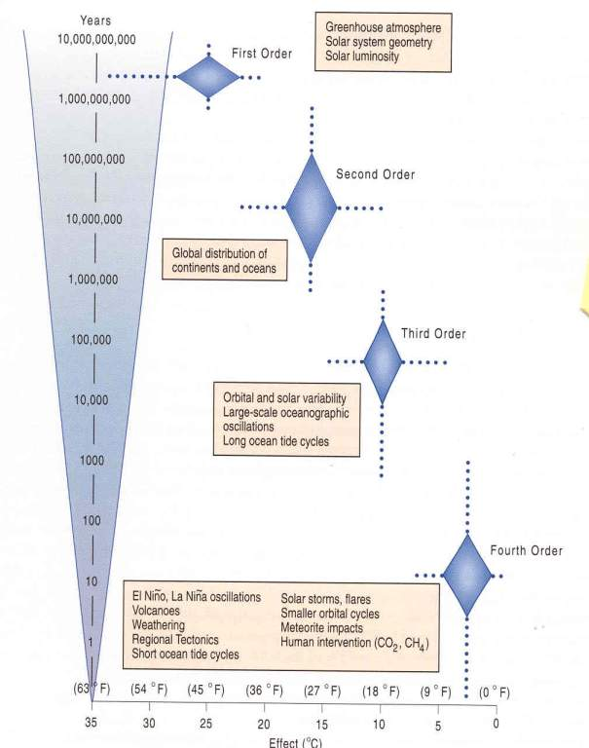
Gerhard et al., 2001

Slide 33
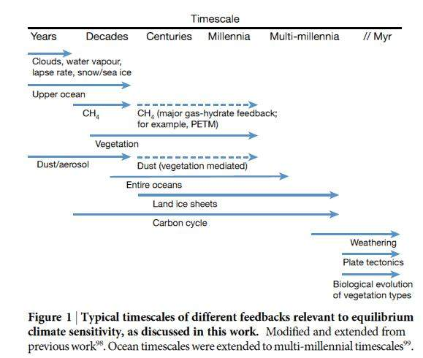
FEEDBACKS
2º Forcings
Continents
(latitudes & elevations)
Ocean
circulation
weathering
CO₂
4º Forcings
Volcanic eruptions
Sunspots
Cycles
El Nino/
La Nina
Cloud
Solar storms
3º Forcings
Obliquity
Precession
Eccentricity
CO₂ /CH₄
1º Forcings
Solar
Luminosity
Atm. Comp.
Rohling, et al., (PALAESENS Project mbrs), 2012
Notes:
FIRST ORDER: CONTINENTAL POSITIONS, LAND COVER,

Slide 34
End of week 2
EXTRAS FOLLOW

Slide 35
Paleocene/Eocene Thermal Maximum
PETM

Slide 36
Azolla event:
~ 49 Ma
Notes:
36

Slide 37
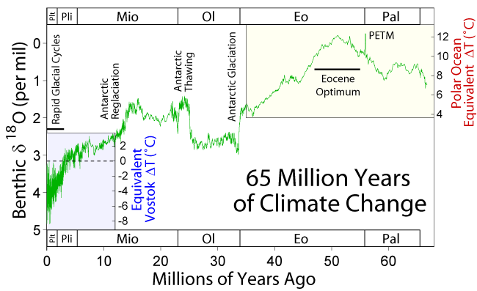
Proxy data: stable isotopes
Wikipedia
Notes:
Complexities here relate to the onset of current ice-house stage. Continental configuration important – opening of the Drake Passage, closing of the Isthmus of Panama forcing the present North Atlantic conveyor belt. Gulf Stream – start of Northern Hemisphere glaciations. But let us also look at an astronomical driver – cycles in earth’s orbit

Slide 38
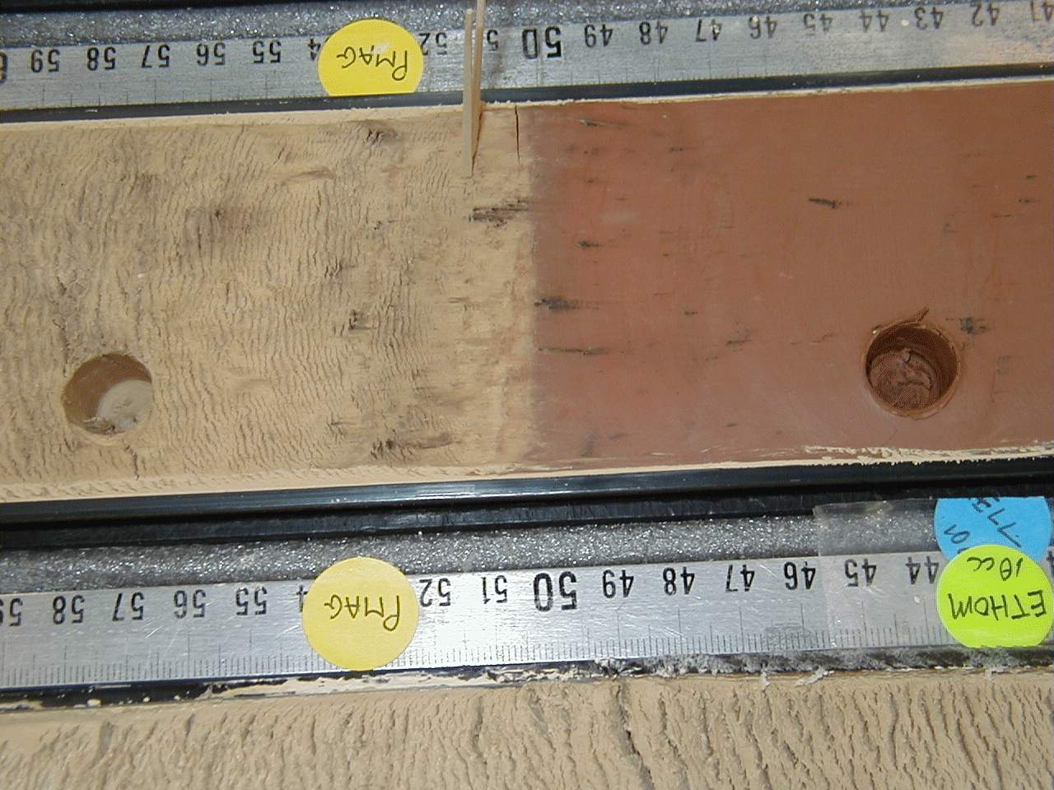

Slide 39
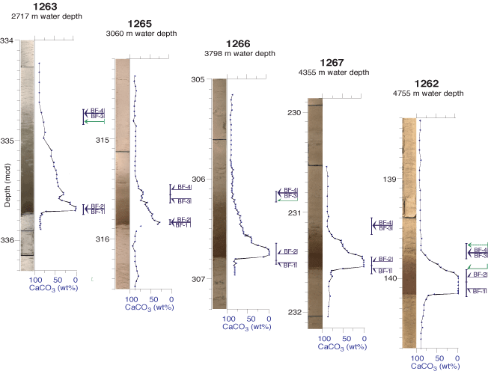

Slide 40
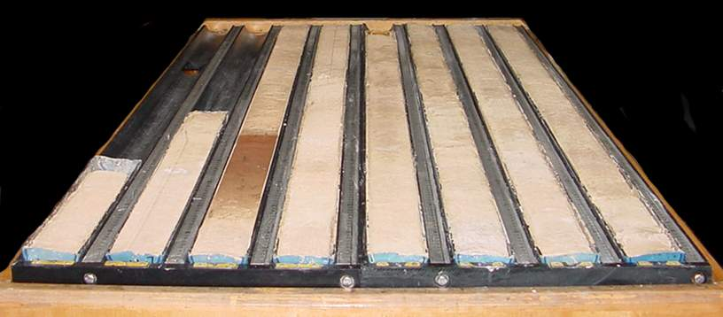

Slide 41
PETM - THE LAND RECORD

Slide 42
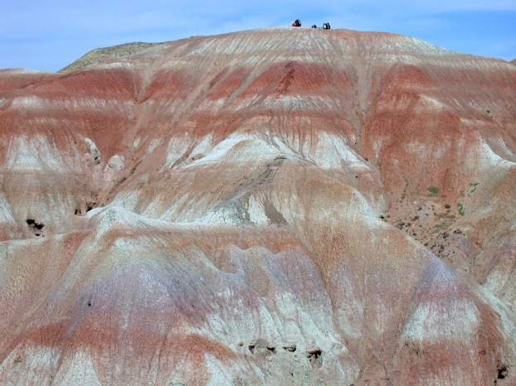
Bighorn Basin
PETM interval in fluvial deposits with excellent alluvial paleosols - seen as color bands, which are soil horizons
Found in Willwood Fm
Reds, purples due to iron oxides in B horizons

Slide 43
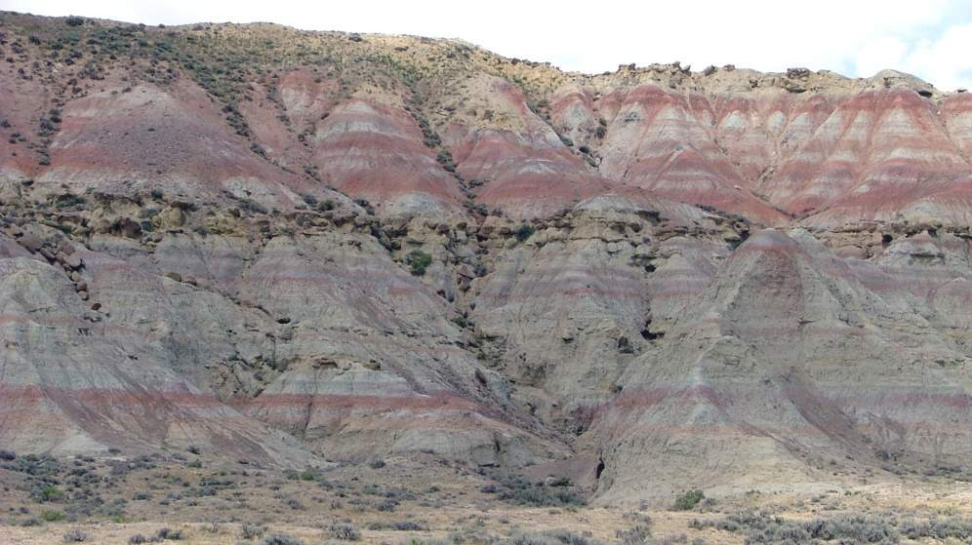
Paleosol Density
PETM
Pre-PETM

Slide 44
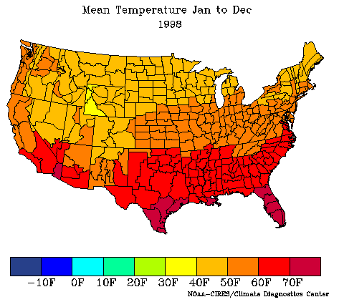
Bighorn Basin Climate
Plant fossils and isotopes show Mean Annual Temperature of 20º to 25º C or 68 to 77º F
Similar to Gulf Coast region today

Slide 45
PROXY DATA-EXTRAS

Slide 46
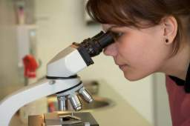
FROM CSI TO GSI:
GEOLOGICAL SAMPLE
INVESTIGATION
LET THE EVIDENCE SPEAK
FOR ITSELF

Slide 47
WE CALL THIS EVIDENCE
“PROXY” DATA

Slide 48
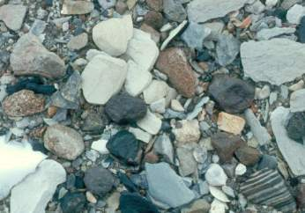
SOME OF THE EARLIEST PROXY DATA
WAS FROM TERRESTRIAL DEPOSITS
Strandlines/shorelines
Moraines
Till
Kettle lakes, etc.
We may know what caused these today, but imagine back then?

Slide 49
IT’S THE INTERPRETATION THAT’S NOT ALWAYS CORRECT
Darwin observed ancient Alpine shorelines:
interpreted as ocean shoreline
Agassiz – later correctly interpreted as ice- dammed lake-shore strandlines/shoreline

Slide 50
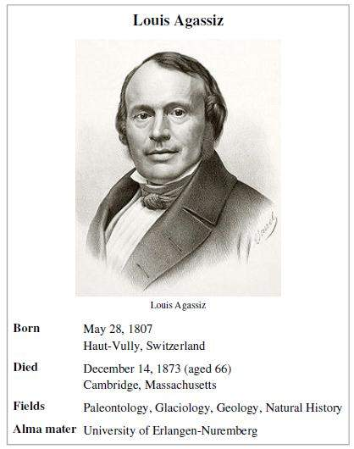
Jean Louis R. Agassiz
“Father” of Glaciology
1807-1873
Paleontologist
Glaciologist

Slide 51
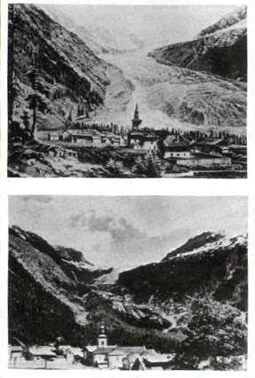
Photographic proxy data/evidence
Ruddiman, 2008

Slide 52
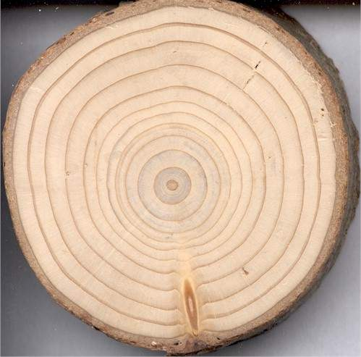
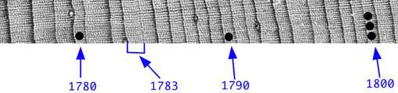
EARLY PROXY DATA:
TREE RINGS

Slide 53
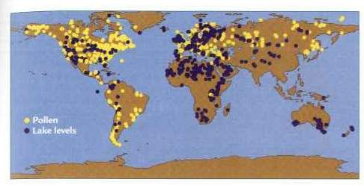
Pollen & Lake core data
Ruddiman, 2008

Slide 54
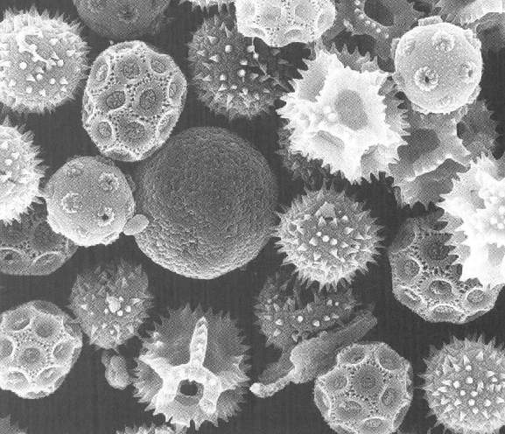
PROXY DATA:
POLLEN DATA

Slide 55
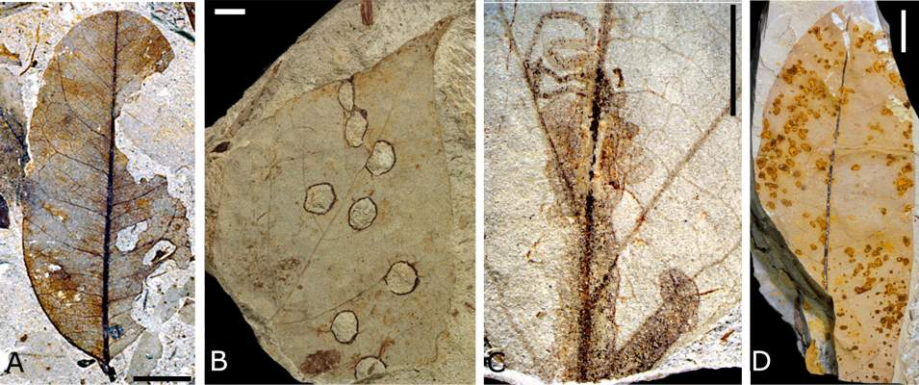
PROXY DATA:
LEAVES

Slide 56
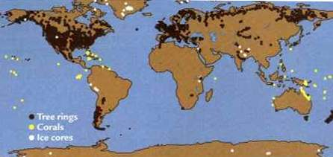
Tree rings, corals, ice cores
Ruddiman, 2008

Slide 57
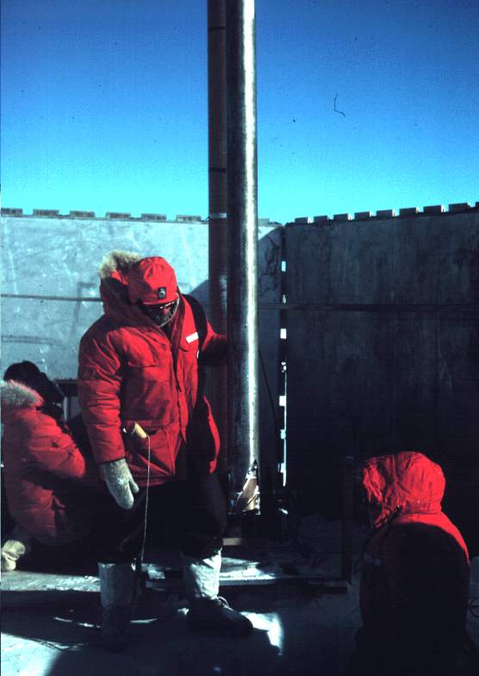
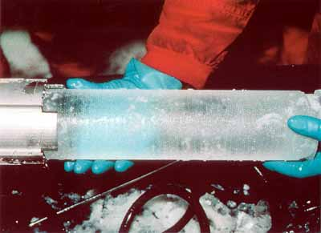
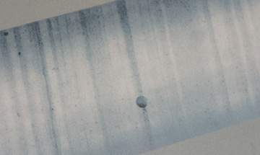
PROXY DATA:
ICE CORES

Slide 58
TERRESTRIAL DATA
North American:
Wisconsin
Illinoian
Kansan
Nebraskan
European:
Wurm
Riss
Mindel
Gunz

Slide 59
LATER EVIDENCE CAME FROM
THE MARINE RECORD
NOT WITHOUT IT’S PROBLEMS,
BUT MORE COMPLETE

Slide 60
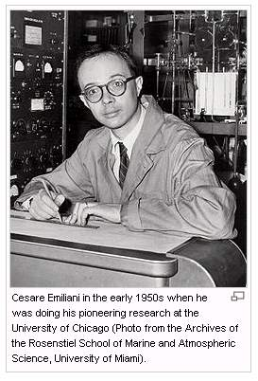
Cesare
Emilani:
Paleontologist,
Chemist
Father of
Paleoceanography

Slide 61
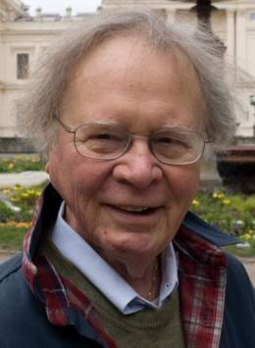
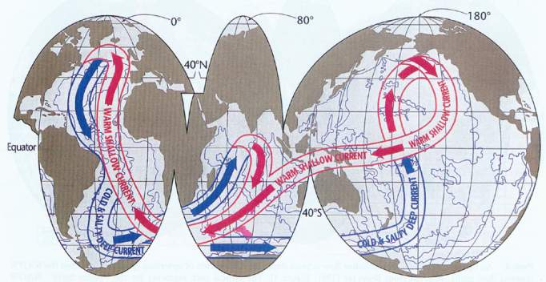
Other Paleoceanographers
Wally Broecker
Thermal-haline
“conveyor” belt of circulation

Slide 62



Other Paleoceanographers
Bill Ruddiman
Nick Shackleton

Slide 63
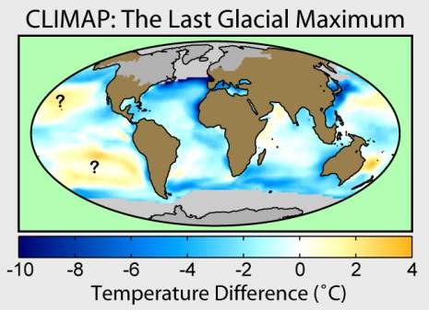


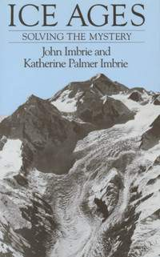
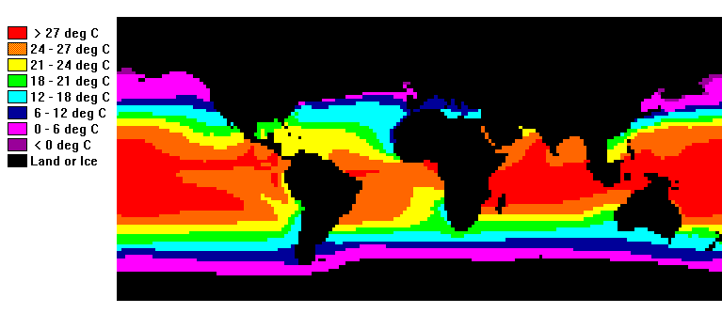
Other Paleoceanographers
John Imbrie:
CLIMAP

Slide 64
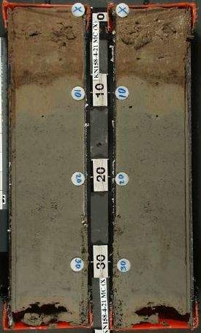
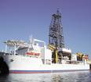


PROXY DATA:
CORE DATA

Slide 65




PROXY DATA:
BENTHIC
FORAMS

Slide 66


PROXY DATA:
PLANKTONIC
FORAMS

Slide 67


Deep Sea Coring
Ruddiman, 2008

Slide 68
The Azolla event

Slide 69



Precipitation (sink):
CO₂ + CaSiO₃ → CaCO₃ + SiO₂
GUESS WHAT:
AS CONTINENTS DRIFT TO HIGH LATITUDES AND HIGHER ELEVATIONS AND BECOME GLACIATED IT LEADS TO:
GREATER MECHANICAL WEATHERING OF SILICATES:
    increasing sequestration of CO₂ in sediments
    decreasing the amount in the atmosphere
ADDITIONALLY in the Cenozoic:
MID-OCEAN SPREADING RATES SLOW DOWN
    Less CO₂ into the atmosphere for volcanoes
=
CO₂ DRAW DOWN THROUGH TIME!

Slide 70
Cenozoic Deep Sea Climate Record
Azolla sequestering event
hyperthermals
41k-100k & amplitude
change:
Increase in
Antarctic ice
Changes in W. Pacific/Indian Ocean and/or closing of
Isthmus
of Panama
Opening of the Drake passage isolating Antarctica and further drop in CO₂
Zachos et al. 2008

Slide 71
Correlation of
CO₂ and temperature over last 65 million years
Beerling and Royer, Nature 2011

Slide 72



ARCTIC EVENTS
Brinkhuis et al,, 2006
Moran et al., 2006

Slide 73


The Arctic Sea 50 million years ago

Slide 74

ACEX Azolla core
>8 meter ACEX core with 90% Azolla
Azolla occurs as laminated layers
indicates Azolla deposited in situ
bottom-water anoxia at ACEX site
Bujak, pers. Comm.

Slide 75


UNPRECEDENTED DROP IN CO₂
the massive decrease in atmospheric CO₂?
Bujak, pers. Comm.

Slide 76




can this be used to predict the effect of future increases in CO2 ?
climate models indicate that full Antarctic glaciation cannot occur unless CO2 ppm is less than 1000 ppm
600 ppm
poor data
800 ppm
1200 ppm
Bujak, pers. Comm.

