Slide 1
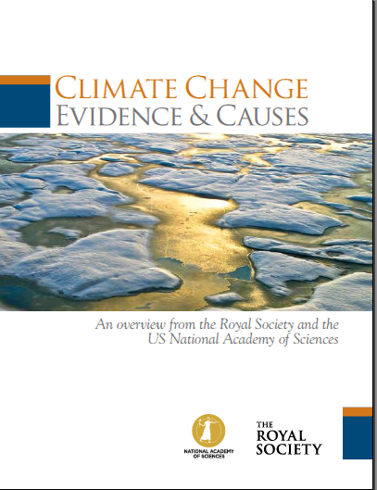
Detailed answers along with disinformation campaign
Joint U.S. National Academy of Science and Royal Society 20-point summary:

Slide 2
20
Q/As to follow this slide
Joint U.S. National Academy of Science and Royal Society 20-point summary:

Slide 3

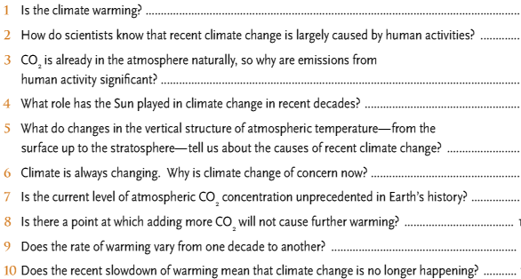

Slide 4
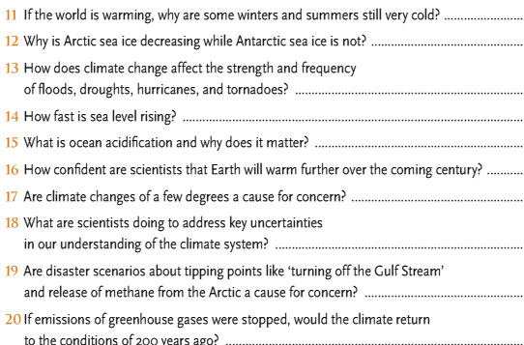

Slide 5
1: THE CLIMATE IS WARMING
The evidence:
  Atmosphere
  Oceans
  Cryosphere
  Sea Level
  Carbon and Other Biogeochemical Cycles

Slide 6
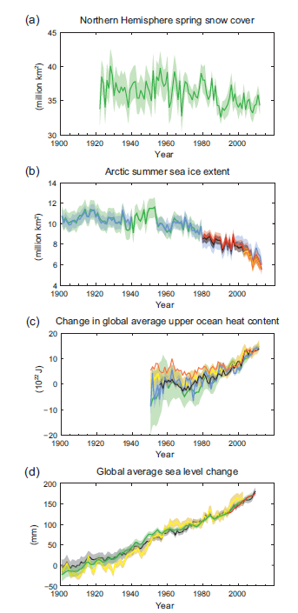
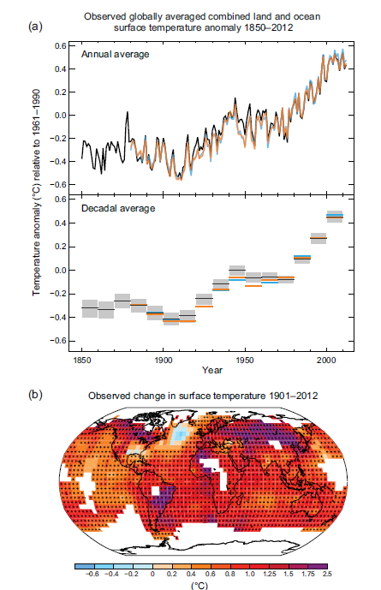
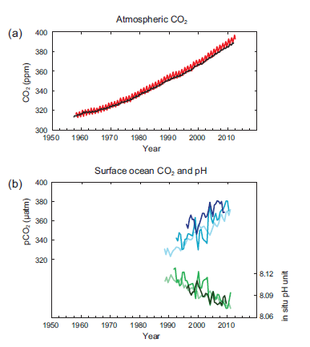
1 – Resulting in:

Slide 7
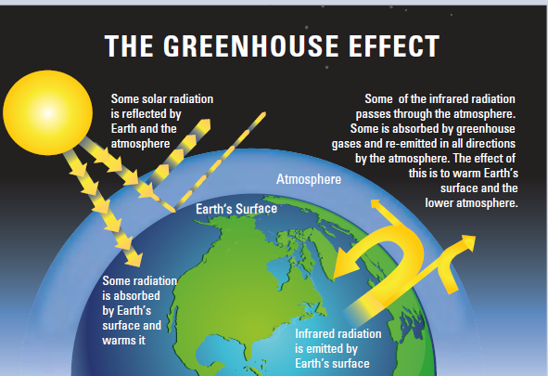
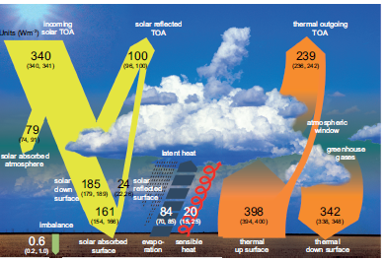

Slide 8
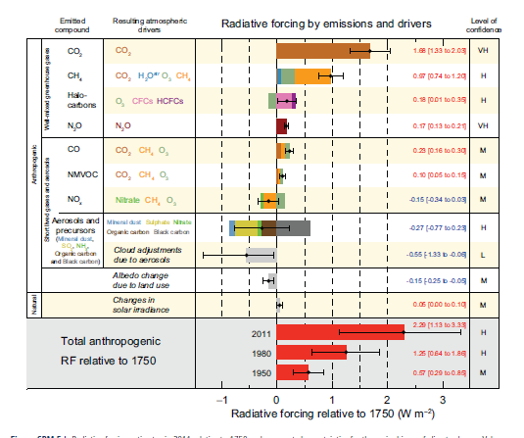
1: THE CLIMATE IS WARMING
Drivers, aka forcings (causes)

Slide 9
Disinformation campaign
(see next 5 slides)
Will focus on last 15-17 years and claim global warming isn’t happening – all part of natural variability
Or, Arctic Sea Ice recovering
Or focus on select glaciers growing
Or Antarctic sea ice growing
Mostly ignore ocean acidification

Slide 10
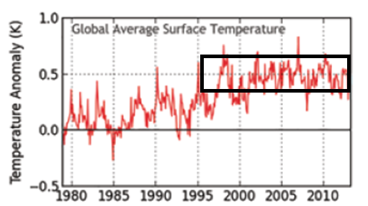
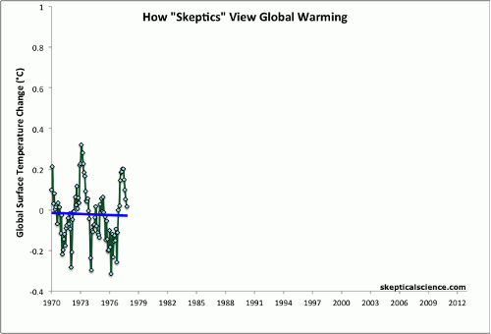

Slide 11
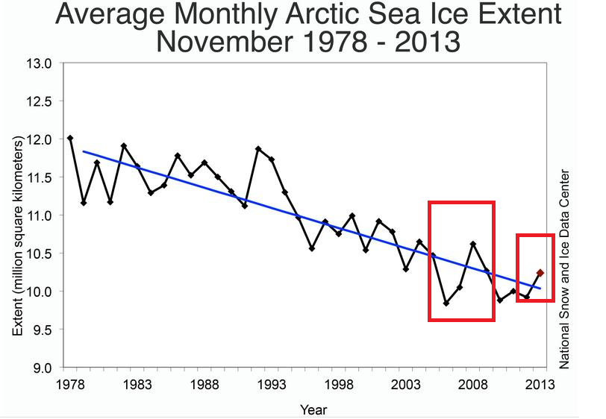
For more see: http://www.skepticalscience.com/melting-ice-global-warming.htm

Slide 12
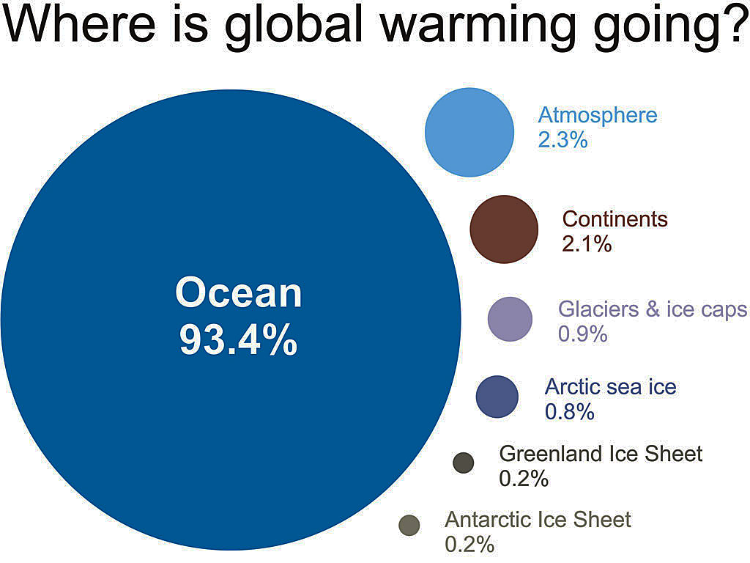
Only ~2% stays in atmosphere
~2% warms the land
Melting ice absorbs ~2%
John Cook, from IGPP 2007 data; ~93% to oceans continues (NOAA/NODC, 2012)

Slide 13
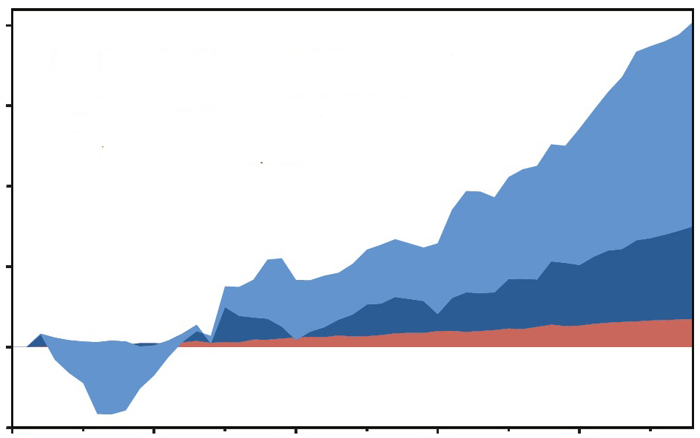
Change in heat content, 1958-2011
20
5-year moving averages
15
Oceans, 0-700 m depth
Oceans, 700-2000 m depth
10
10²² Joules
(Increasing heat, not shown, goes deeper than 2000 m)
5
0
Atmosphere + land + ice melting
-5
1960 1970 1980 1990 2000
(NOAA 2012 data, Nuccitelli et al. 2012 plot)

Slide 14
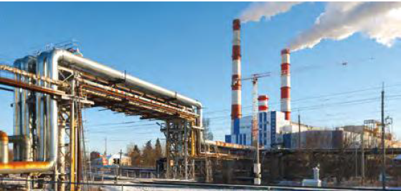
2: LARGELY CAUSED BY HUMAN ACTIVITIES

Slide 15
Disinformation campaign
Might argue the economics of change and pollution of generating metals for batteries
….not that there aren’t environmental concerns for new technology
For more, see: http://www.skepticalscience.com/its-not-us.htm

Slide 16
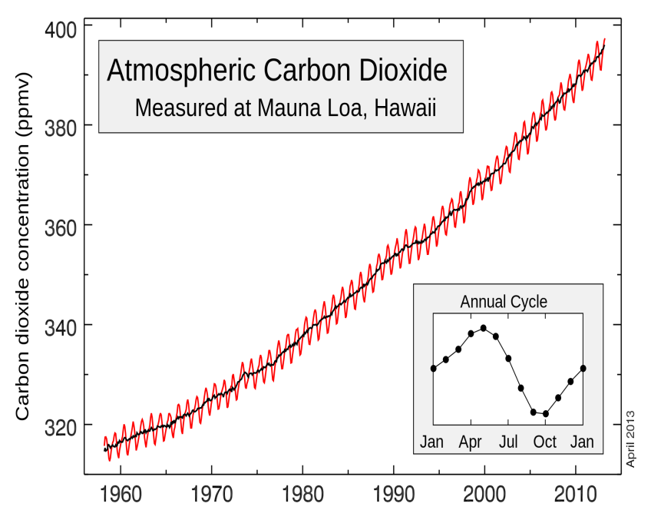
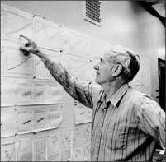
3: EMISSIONS FROM HUMAN ACTIVITIES LARGELY TO BLAME
43% increase in CO₂
Dead carbon altering atmospheric C¹⁴
That Carbon is more negative/enriched in C¹²
400 ppm
*

Slide 17

Lest we forget: CO2 is still going up
*
400 ppm
http://en.wikipedia.org/wiki/Keeling_Curve

Slide 18
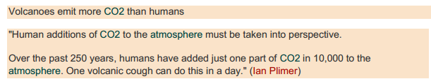
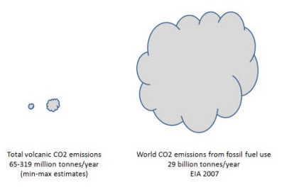
Disinformation campaign
Plimer (and others):
http://www.skepticalscience.com/volcanoes-and-global-warming.htm
  Versus - <1 % (I have the references)

Slide 19
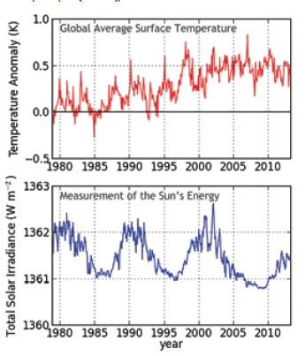
4: THE SUN’S ROLE IS MINIMIZING

Slide 20
Disinformation campaign
Predict long cold period coming, citing Russian studies that predict entering another “Little Ice Age”
Predicted last solar cycle wasn’t going to happen – go dormant / that didn’t occur!

Slide 21
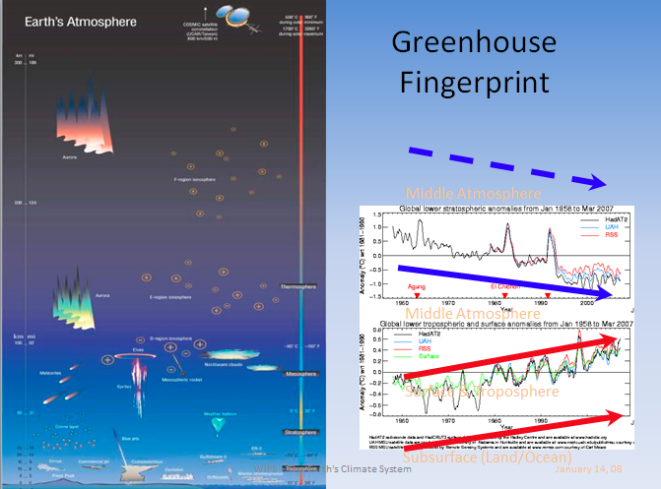
5: SURFACE TO STRATOSPHERE CHANGES

Slide 22
Disinformation campaign
Spencer and Christie will focus on cooling of Tropopause and mislead people
Etc….
For more see: http://www.skepticalscience.com/satellite-measurements-warming-troposphere.htm

Slide 23
6: CLIMATE IS ALWAYS CHANGING
– SO WHAT?
It’s not about whether the Earth will survive – it will!
It’s about sustainability with expected consequences
  Refugees
  Economies
  Etc., etc.

Slide 24
50 million years ago (50 MYA) Earth was ice-free.
Atmospheric CO₂ amount was of the order of 1000 ppm 50 MYA.
Atmospheric CO₂ imbalance due to plate tectonics ~ 10⁻⁴ ppm per year.
Notes:
24

Slide 25
Disinformation campaign
Fish analogy:
  Some meteorologists who don’t buy climate change: in bottom of fish tank looking at the sand grains.
  Some geologists who don’t buy climate change: in outer space looking at the fish tank.
  BOTH not seeing the pyranahs swirling in the fish tank : It’s about sustainability!
For more see: http://www.skepticalscience.com/climate-change-little-ice-age-medieval-warm-period.htm

Slide 26
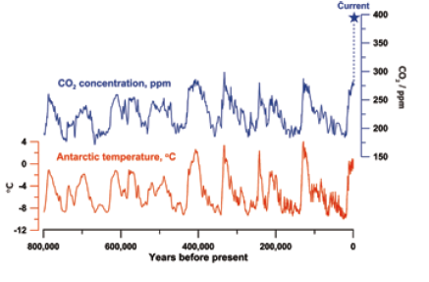
7: HISTORICALLY UNPRECEDENTED CO₂ CONCENTRATIONS

Slide 27
8: WILL ADDING MORE CO2 EVENTUALLY STOP CAUSING WARMING?
NO

Slide 28
Disinformation campaign
Say CO₂ saturated
Water vapor as more abundant and more important green house gas (GHG) – ignoring feedback increase cause by warming caused by increases in CO₂
PETM shows that CO₂ spikes do continue to influence climate
See next 3 slides

Slide 29
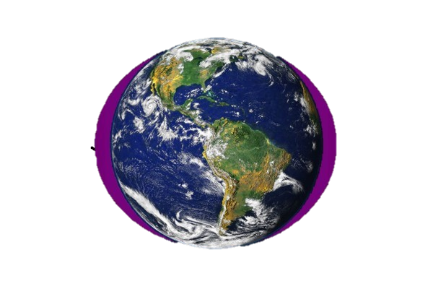

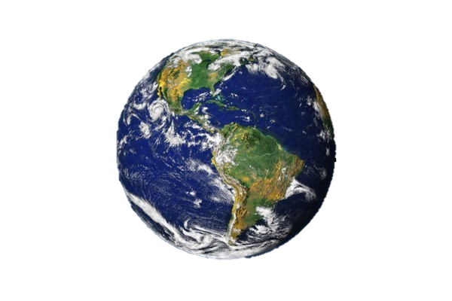
The CO₂ greenhouse gas effect is concentrated in the polar regions ! ! !
The Earth and its atmosphere
The most potent greenhouse gas is H₂O - vapor
Particularly in the Arctic !
The large H₂O
greenhouse effect
is controlled by temperature –
H₂O saturation doubles with every
10°C Increase
As a result It is concentrated in
the lower atmosphere
of the tropics
CO₂ is evenly distributed throughout the atmosphere

Slide 30
50 million years ago (50 MYA) Earth was ice-free.
Atmospheric CO₂ amount was of the order of 1000 ppm 50 MYA.
Atmospheric CO₂ imbalance due to plate tectonics ~ 10⁻⁴ ppm per year.
Notes:
30

Slide 31
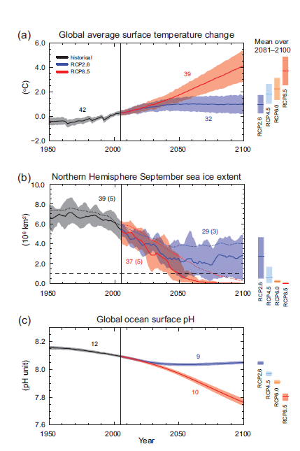
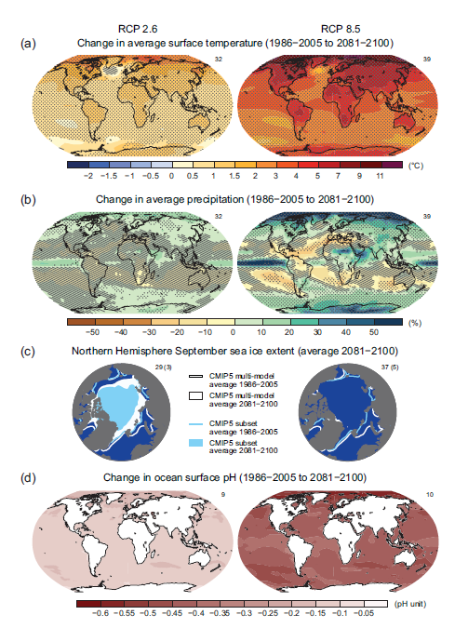

Slide 32
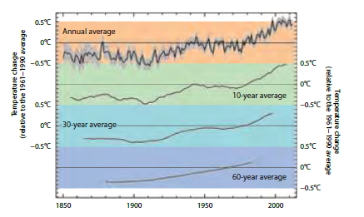
9: DOES RATE OF WARMING CHANGE BY DECADE TO DECADE?
YES

Slide 33
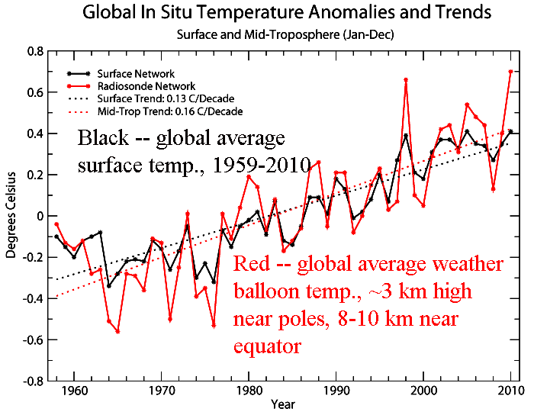
b
El Niño
Major volcanic eruption
La Niña
Warm El Niño tropical Pacific releases ocean heat to air
Cool La Niña is less cloudy, so water absorbs more solar heat and atmosphere gets less

Slide 34
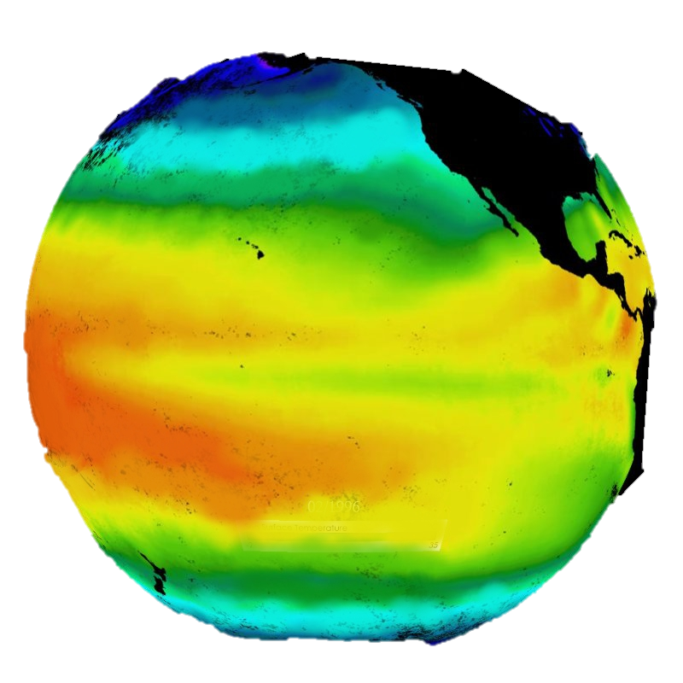
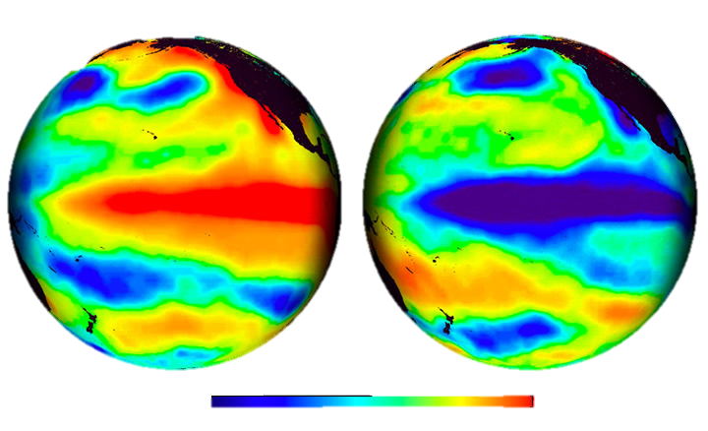
The Pacific –
‘normal condition’
El Niño
La Niña
Temperature Anomaly °C
-4
-2
0
2
4

Slide 35
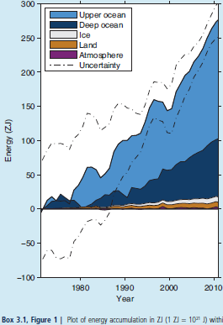
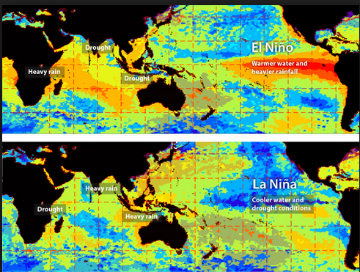
http://www.skepticalscience.com/graphics.php?g=47

Slide 36
10: DOES CURRENT WARMING SLOWDOWN MEAN WARMING IS NO LONGER HAPPENING?
NO
Ignores most warming taken up by the ocean
Ignores prolonged La Ninas giving pause to vast areas of Pacific Ocean upwelling cooler waters
Ignores global dimming by pollutants
Ignores the fact that one of the data sets does not include Arctic temperatures due to lack of stations

Slide 37
Disinformation campaign
Harp on climate-gate
Harp on hockey stick curve by Mann, subsequently addressed by NAS – i.e. in support of the curve, albeit proxy data has large error bars

Slide 38
11: WHY ARE SOME WINTERS STILL VERY COLD?

Slide 39
Disinformation campaign
A favorite one whereby they point out the anomalies of winter weather to deny global warming – ignoring the GLOBAL PICTURE
Do you know that the entire U.S. area, including Alaska (and lets not forget Hawaii) = 2% of Earth surface?

Slide 40
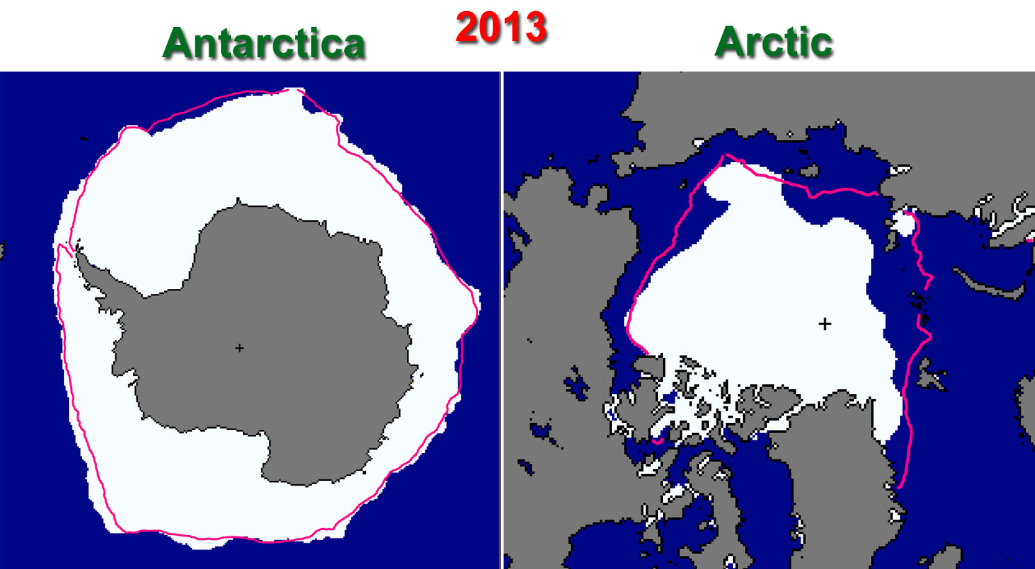
12. ARCTIC ICE vs. ANTARCTIC SEA ICE
Ans. More moisture in air around Antarctica (AA) to nucleate sea ice
Despite > AA is does not compensate for Arctic loss
https://itsnotnova.files.wordpress.com/2013/10/arcticvsantarctic2013.jpg

Slide 41
13: HOW DOES CLIMATE CHANGE AFFECT THE STRENGTH AND FREQUENCY OF FLOODS, DROUGHTS, HURRICANES AND TORNADOES?

Slide 42
First: the Disinformation campaign
Another favorite one with some validity IN THAT NOT YET STATISTICALLY RELEVANT: Judith Curry, Roger Pielke, Jr.
So my answer: they do not have the geologic perspective (see next 3 slides) and thus I ask: should we wait until it is statistically relevant?

Slide 43
50 million years ago (50 MYA) Earth was ice-free.
Atmospheric CO₂ amount was of the order of 1000 ppm 50 MYA.
Atmospheric CO₂ imbalance due to plate tectonics ~ 10⁻⁴ ppm per year.
Notes:
43

Slide 44
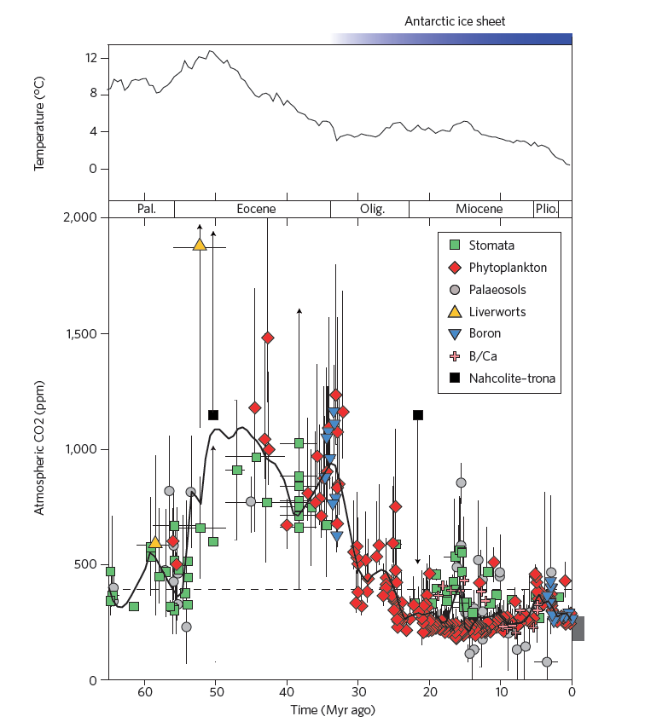
Correlation of
CO₂ and temperature over last 65 million years
Beerling and Royer, Nature 2011

Slide 45
Notes:
45

Slide 46
14: HOW FAST IS SEA LEVEL RISING?
…let the next slide answer that

Slide 47
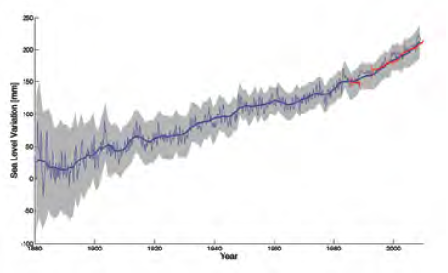
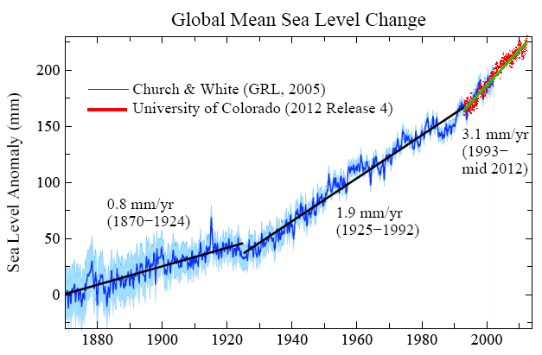
14: HOW FAST IS SEA LEVEL RISING?
Blue: Sea level change from tide-gauge data (Church J.A. and White N.J., Geophys. Res. Lett. 2006; 33: L01602)
Red: Univ. Colorado sea level analyses in satellite era (http://www.columbia.edu/~mhs119/SeaLevel/).

Slide 48
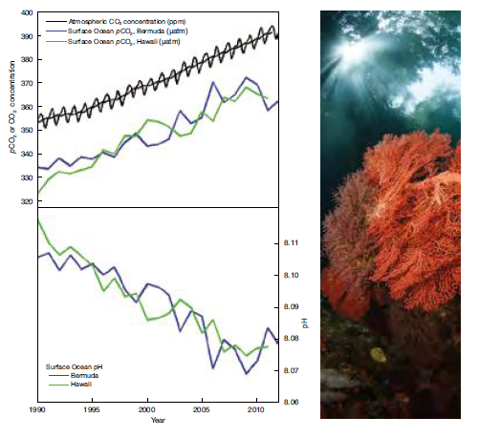
15: OCEAN ACIDIFICATION
Makes aragonite harder to be deposited
Growth rates slow down
Favors calcite secreting organisms
Complex with feedbacks

Slide 49
Disinformation campaign
Will cite coral bleaching recovery cases, the few there are – and that’s true
Natural cycles of not? Time will tell.
Temperatures rises are also a factor in coral bleaching and subsequent temporary cooling of affected areas can result it recovery

Slide 50
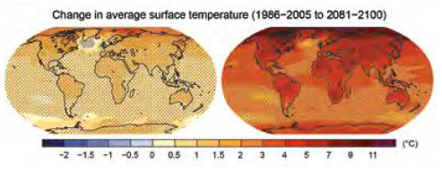
16: HOW CONFIDENT ARE CLIMATE SCIENTISTS ABOUT FUTURE WARMING?
Quite confident – the basis of AR5

Slide 51
Disinformation campaign
Will cite overstated claims that didn’t happen
  e.g. Himalayas glaciers to melt by 2030, a AR4 mistake/retraction
  Various quotes that don’t happen in the time frame specified by the quote
  Then ridicule them
  Lesson to be learned – be cautious about what you say

Slide 52
Disinformation campaign
Will cite coral bleaching recovery cases, the few there are – and that’s true
Natural cycles of not? Time will tell.
Temperatures rises are also a factor in coral bleaching and subsequent temporary cooling of affected areas can result it recovery

Slide 53
17: SO WHAT’S A FEW DEGREES?
Let the next slide address this

Slide 54
Loaded Climate Dice: global warming is increasing extreme weather events.
Extreme summer heat anomalies now cover about 10% of land area, up from 0.2%.
This is based on observations, not models.
Frequency of occurrence (vertical axis) of local June-July-August temperature anomalies (relative to 1951-1980 mean) for Northern Hemisphere land in units of local standard deviation (horizontal axis). Temperature anomalies in the period 1951-1980 match closely the normal distribution ("bell curve", shown in green), which is used to define cold (blue), typical (white) and hot (red) seasons, each with probability 33.3%. The distribution of anomalies has shifted to the right as a consequence of the global warming of the past three decades such that cool summers now cover only half of one side of a six-sided die, white covers one side, red covers four sides, and an extremely hot (red-brown) anomaly covers half of one side.
Source: Hansen, J., Sato, M., and Ruedy, R., Proc. Natl. Acad. Sci., 2012.

Slide 55
18: WHAT ARE SCIENTISTS DOING TO ADDRESS KEY UNCERTAINTIES?
100s/1000s continuing to study:
  To gather data
  Better understand
  Refine models
  Etc., etc….

Slide 56
19: ARE TIPPING POINTS OF CONCERN?
AR5 mostly dismissive of tipping points causing catastrophe as often carried out in alarmism statements
Beware of what you say and how you say it!

Slide 57
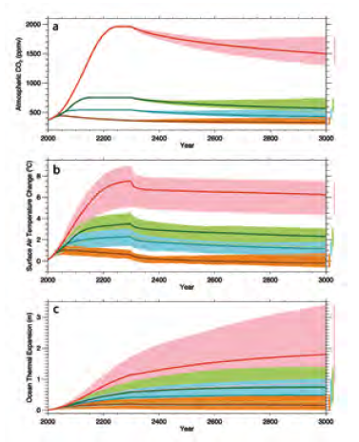
20: IF WE STOPPED OR CONTINUED EMISSIONS, WHAT WOULD HAPPEN?
It’s in the bank, without Geoengineering options:
  Solar Radiation Management (SRM)
  Carbon Dioxide Removal (CDR) – for which Biochar gets lumped into this latter category

Slide 58
So is there hope?
YES
SRM has some serious unintended consequences, and if ever stopped huge subsequent corrections
CDR: BECCS and/or Biochar have the greatest promise – cost and effectiveness will be key!
  My personal favorite is Biochar: for more see http://denverclimatestudygroup.com/?page_id=28 (Denver climate study group page – under page drop-down and click on Biochar)
    See Promise for the future regarding agriculture and sequestering Carbon (with a potential claim of 100 ppm in 30 years) Cool Planet and associated YouTube.

Slide 59
Conclusions/Recommendations
Don’t let ideologies blind oneself to the data and science
Be careful what and how you say, or how a person says or makes claims; it comes back to haunt one.
Ridicule accomplishes nothing
Study and discuss; weigh the factors of choices:
  Do nothing
  Mitigate
  Save for the future
  Or various combinations of the above based on economics and consequences

Slide 60
Websites to consider:
http://www.skepticalscience.com/
http://www.realclimate.org/
http://www.climatecentral.org/
http://www.noaa.gov/ , particularly http://www.noaa.gov/climate.html
…etc…..

Slide 61
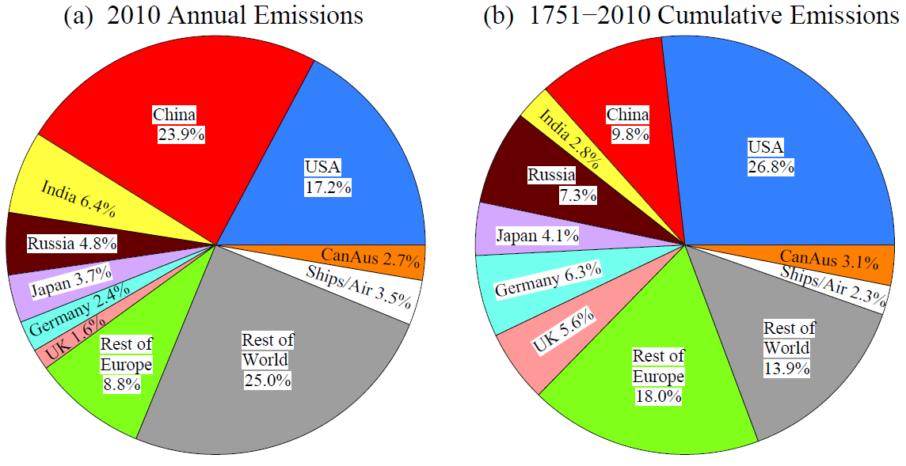
China has the largest fossil fuel emissions today.
However, climate change is driven by cumulative emissions, so developed nations, especially the U.S., have greatest responsibility.

Slide 62
Intergovernmental Panel on Climate Change
(IPCC) Headlines and answers

Slide 63

1: THE CLIMATE IS WARMING
The evidence:
  Atmosphere
  Oceans
  Cryosphere
  Sea Level
  Carbon and Other Biogeochemical Cycles
Headline #1

Slide 64

1: THE CLIMATE IS WARMING
The evidence:
  Atmosphere
  Oceans
  Cryosphere
  Sea Level
  Carbon and Other Biogeochemical Cycles
Headline #2

Slide 65

1: THE CLIMATE IS WARMING
The evidence:
  Atmosphere
  Oceans
Headline #3

Slide 66

1: THE CLIMATE IS WARMING
The evidence:
  Atmosphere
  Oceans
  Cryosphere
Headline #4

Slide 67

1: THE CLIMATE IS WARMING
The evidence:
  Atmosphere
  Oceans
  Cryosphere
  Sea Level
Headline #5

Slide 68
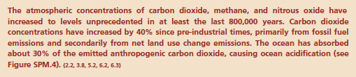
1: THE CLIMATE IS WARMING
The evidence:
  Atmosphere
  Oceans
  Cryosphere
  Sea Level
  Carbon and Other Biogeochemical Cycles
Headline #6

Slide 69

1: THE CLIMATE IS WARMING
Drivers; aka forcings, i.e. causes
Headline #7

Slide 70
1: THE CLIMATE IS WARMING
Drivers, aka forcings (causes)

Slide 72
1 – Resulting in:

Slide 74

2: LARGELY CAUSED BY HUMAN ACTIVITIES
Headline #8

Slide 75

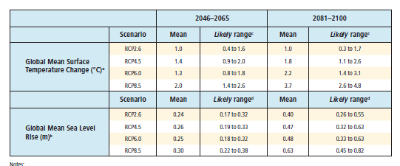

Modeling
Headline # 9
Headline # 10

Slide 76
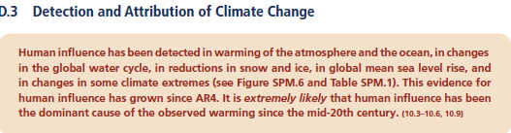

2: Causes and Effects
Headline # 11
Headline # 12

Slide 77
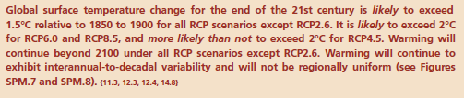
2: Effects: Temperature rise
Headline # 13

Slide 78
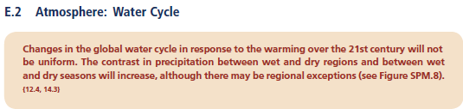

Effects: Hydrologic and Ocean responses
Headline # 14
Headline # 15

Slide 79
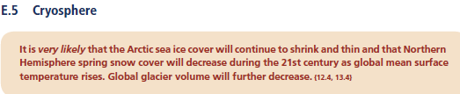
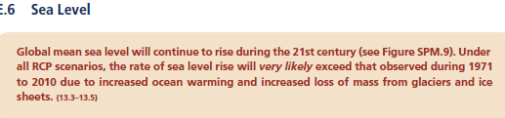
Effects: Snow & Ice/Sea level responses
Headline # 16
Headline # 17

Slide 80
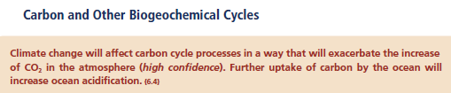
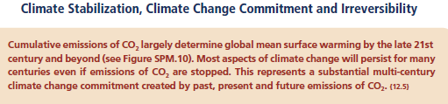
Effects: Ocean Acidification/other consequences
Headline # 18
Headline # 19

