Slide 1
Earth’s Climate: Past, Present and Future
Fall Term - OLLI West: week 4, 10/6/2015
Paul Belanger
Ocean acidification, rates, modeling/future, IPCC
A little more on ocean acidification
Rates of change
Models
Future projections and feedbacks:
IPCC Fifth Assessment report (AR5): http://www.ipcc.ch/report/ar5/

Slide 2
Ocean acidification
Web page post Monday October , 2015 (and fb)
Let’s start with a video: https://youtu.be/W1TZ8g8JYVU from http://www.skepticalscience.com/ocean-acidification-global-warming.htm

Slide 3
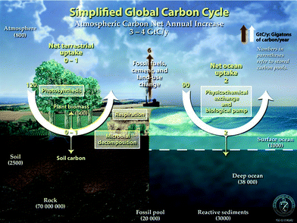
http://www.pmel.noaa.gov/co2/story/Ocean+Carbon+Uptake

Slide 4
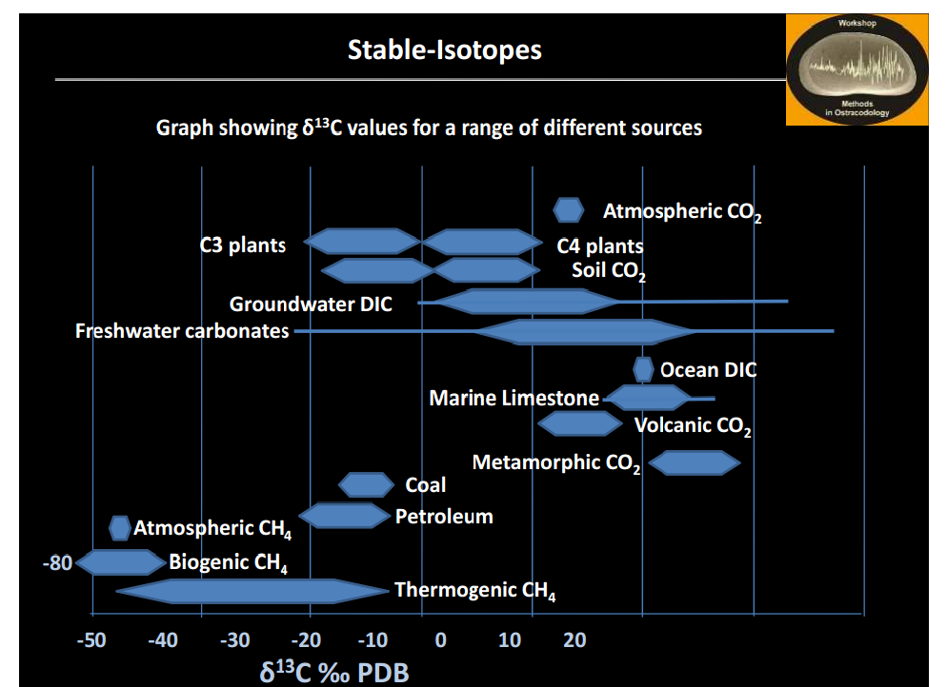

Slide 5
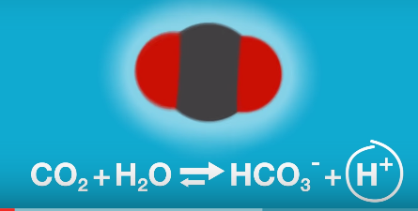
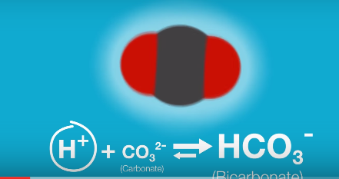
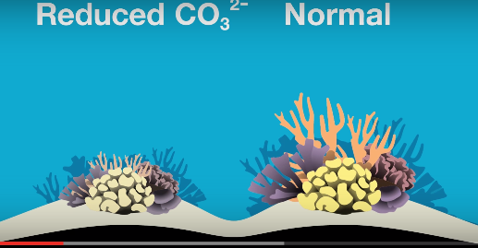
VIDEO HIGHLIGHTS: Ocean acidification
  Adding CO₂ adds H⁺ ions making water more acidic (lowers pH)
  This in turn reduces CO₃ ⁻² ions
  reducing CO₃ ⁻² makes it more difficult for organisms to make their shell – especially aragonitic ones
http://www.skepticalscience.com/ocean-acidification-global-warming.htm

Slide 6
Continued
  Takes hundreds of years to equilibrate from weathering – or buffering from the deep sea carbonates as we saw in the PETM
  0.1 decrease in pH = 26% CO₃ ⁻² ions
  reducing CO₃ ⁻² makes it more difficult for organisms to make their shell – especially aragonitic ones

Slide 7
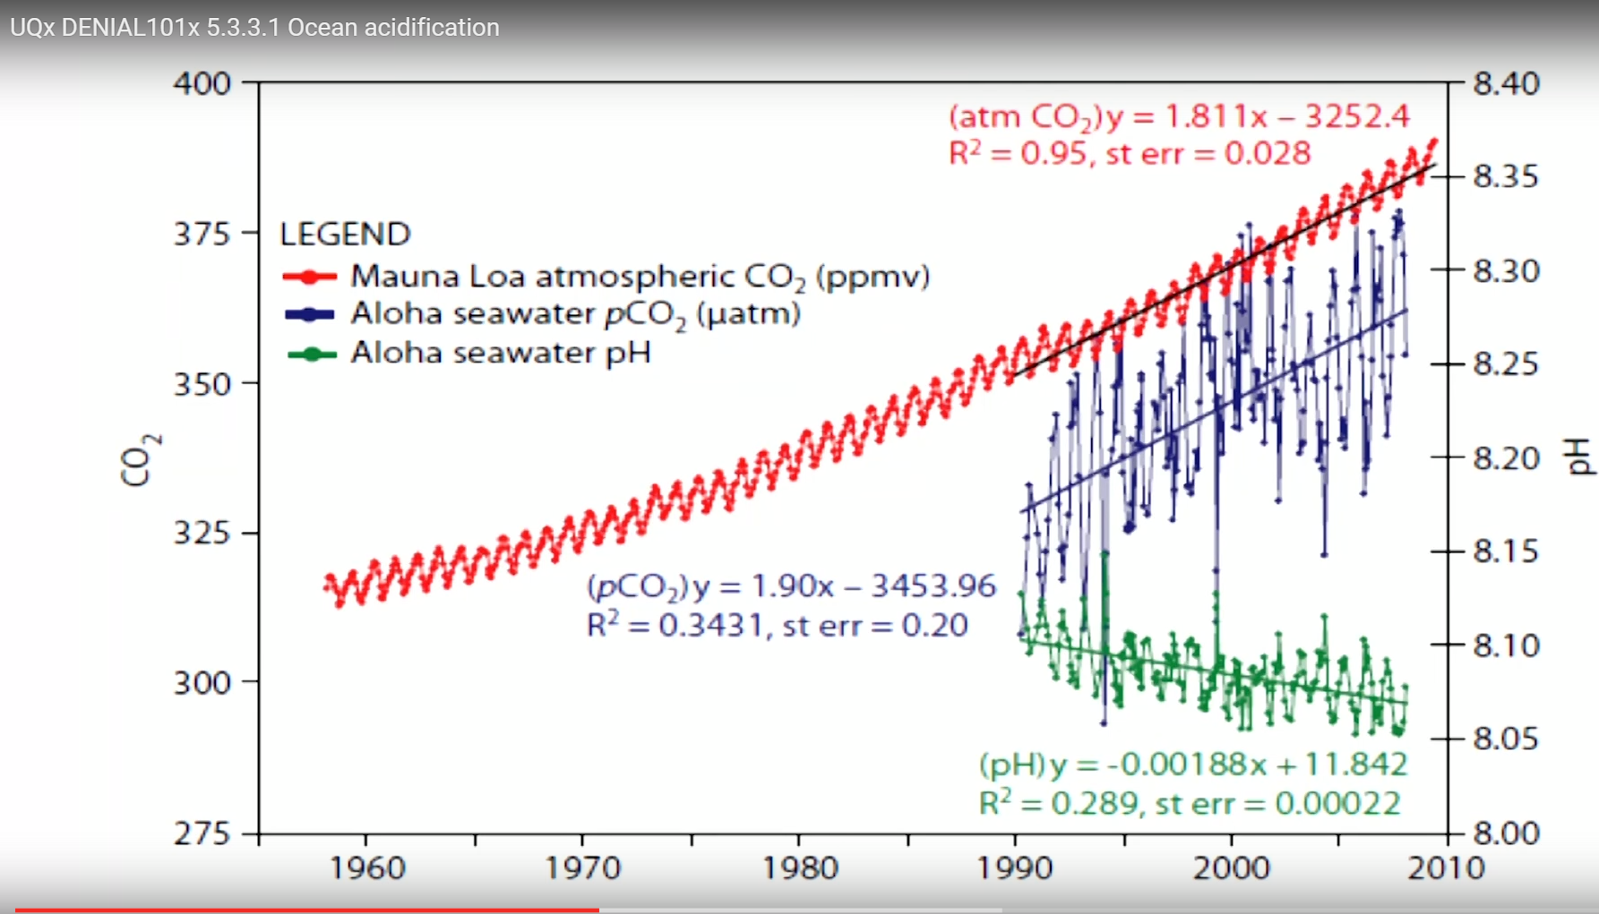
http://www.skepticalscience.com/ocean-acidification-global-warming.htm

Slide 8
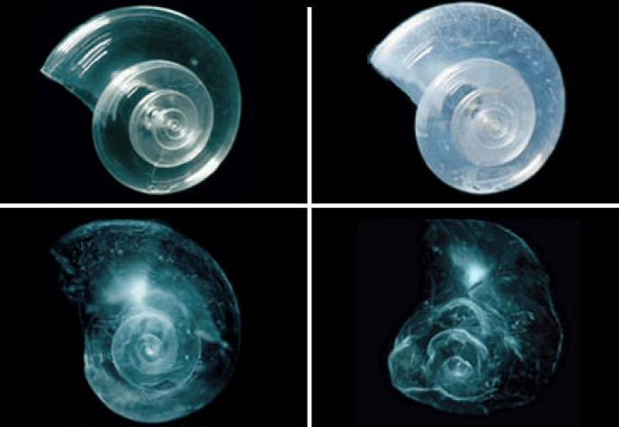
Pteropods
http://ocean.si.edu/ocean-acidification?gclid=Cj0KEQjw-b2wBRDcrKerwe-S5c4BEiQABprW-CHiUm54_8lcDb8ns9yN_W-5pYHfqqSf7QUb6MFohssaAmCM8P8HAQ

Slide 9
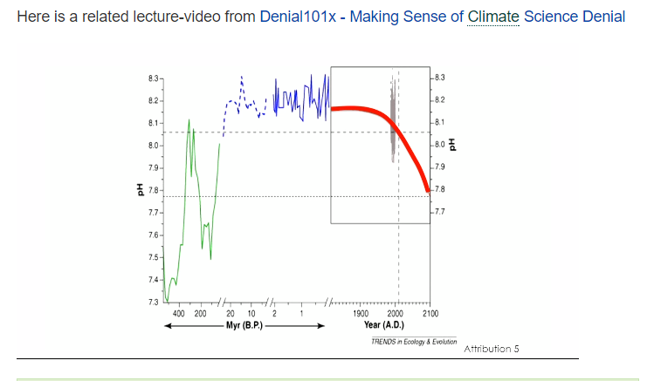
pH through time

Slide 10
PETM CaCO₃ shallowing of the Carbonate Compensation Depth (CCD)
~= 2000 meters
2000 m
3000 m
4000 m
5000 m

Slide 11
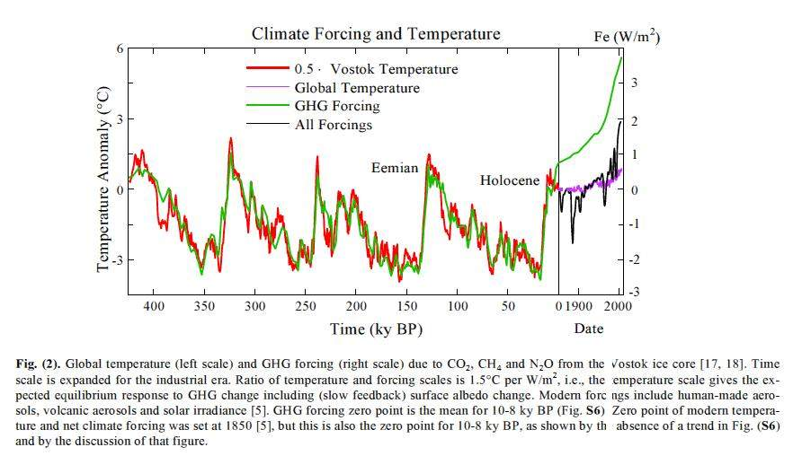
400 ppm
(2014)
280ppm
180ppm

Slide 12
Rates of Change

Slide 13
What are the rates of change seen here?
50 million years ago (50 MYA) Earth was ice-free.
Atmospheric CO₂ amount was of the order of 1000 ppm 50 MYA.
Atmospheric CO₂ imbalance due to plate tectonics ~ 10⁻⁴ ppm per year.
Notes:
13

Slide 14
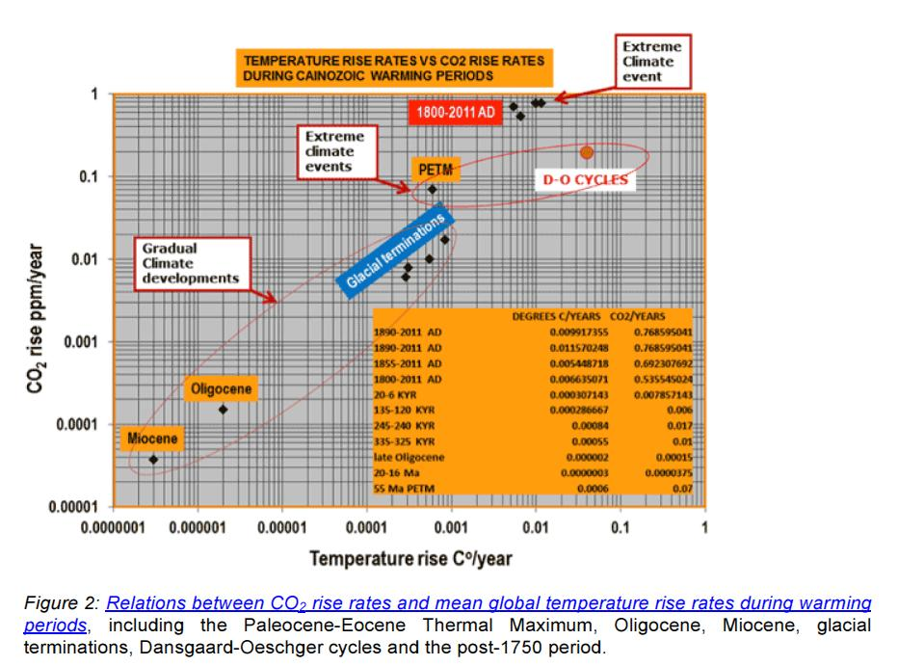
Unprecedented rates of change

Slide 15
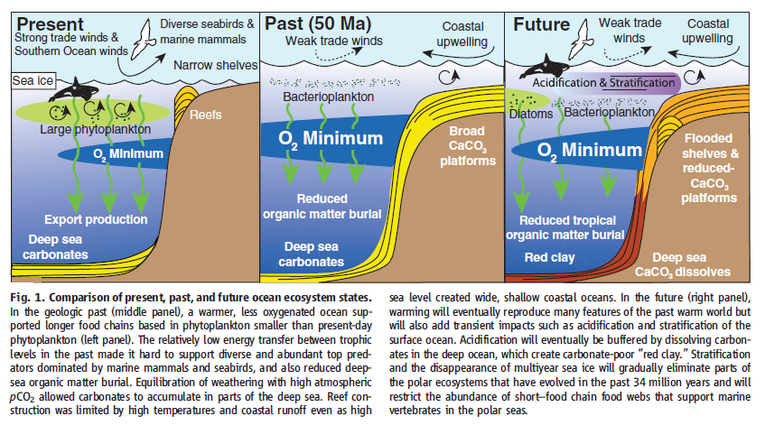
Past and present; future estimates
R. Norris et al., Science, 2013

Slide 16
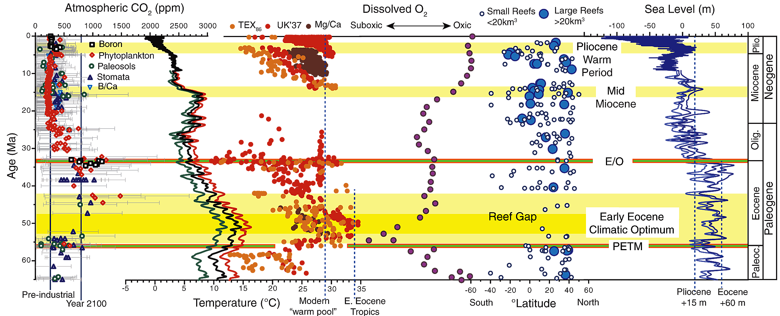
History of oceans for last 65 m.y.
We know a great deal about past CO₂ , temp., etc.
Now
65 m.y.
R. Norris et al., Science, 2013

Slide 17
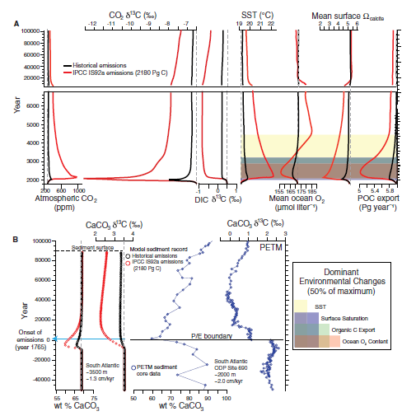
History of oceans for last 65 m.y. and 100,000 year projections into the future
Using the past to model the future
…and a SEGWAY to Modeling
R. Norris et al., Science, 2013

Slide 18
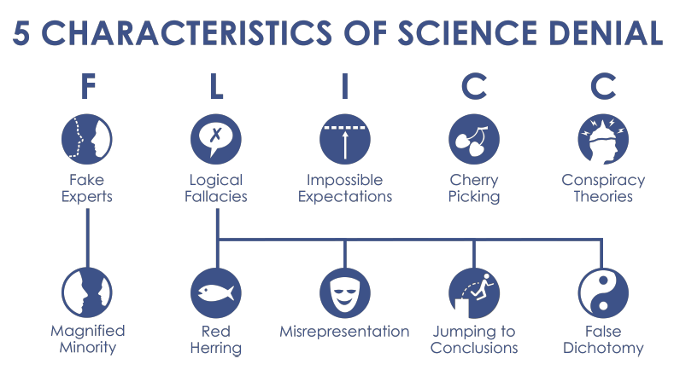
But first – terminology you’ll see being used regarding misrepresentation

Slide 19
Models – 2 videos
Principles that models are built on – view today
https://www.youtube.com/watch?v=mYU2uawYPlE&feature=youtu.be
From the experts: Climate models – leaving it for you to view at your leisure:
https://www.youtube.com/watch?v=PZo1TYpsy2U&feature=youtu.be
NOAA’s Science On a Sphere (SOS) http://sos.noaa.gov/What_is_SOS/index.html ; used at DMNS where I’ve been co-developing a climate change playlist, soon to be released. In the meantime see http://spaceodyssey.dmns.org/exhibitsprograms/interactives-exhibits/sos.aspx

Slide 20
Full list of Videos from Skeptical Science
http://www.skepticalscience.com/denial101x-videos-and-references.html

Slide 21
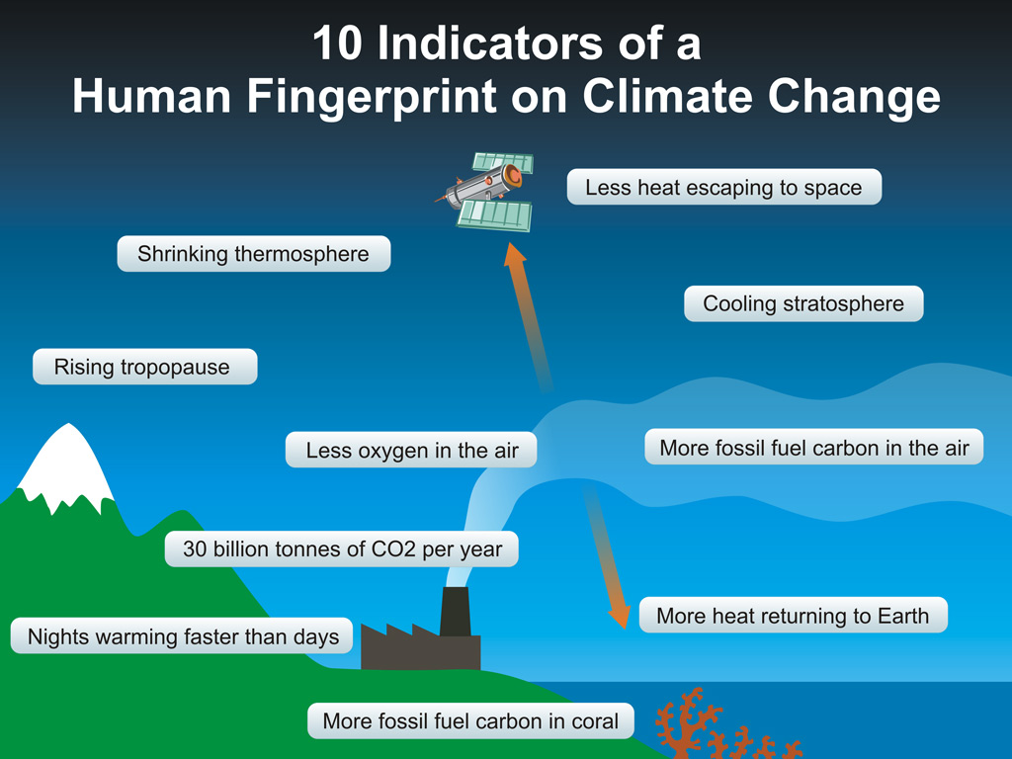

Slide 22
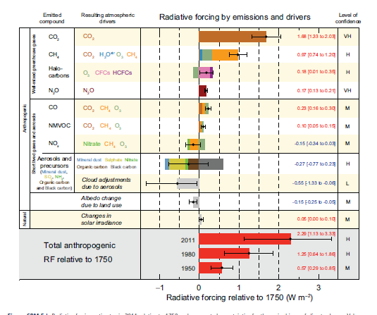
1: THE CLIMATE IS WARMING
Drivers, aka forcings (causes)

Slide 23
Intergovernmental Panel on Climate Change
IPCC
http://www.ipcc.ch/report/ar5/ - three working groups:
  WG I: Physical Science Basis – what we’ve been dealing with thusfar
    Especially headlines for policy makers and chapters 5 (paleoclimate), 6 (Carbon) and 9 (models) that can be found at http://denverclimatestudygroup.com/?page_id=63
  WG II: Impacts, Adaptations and Vulnerability; Part A: Global and Sectoral Aspects
  WG III: Mitigation of Climate change – in coming weeks
Synthesis report – my other PowerPoint based on http://www.ipcc.ch/report/ar5/syr/

Slide 24
Joint U.S. National Academy of Science and Royal Society 20-point summary:
OR: Joint U.S. National Academy of Science and Royal Society 20-point summary: 20-point Climate-Change Summary (pdf) – summarized in the following 3 slides

Slide 25
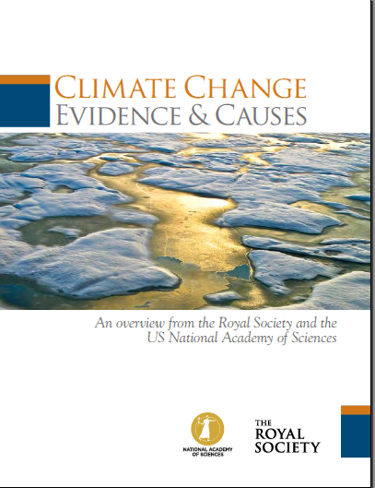
20
Q/As to follow this slide
Joint U.S. National Academy of Science and Royal Society 20-point summary:

Slide 26
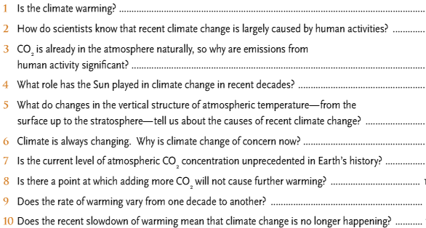

Slide 27
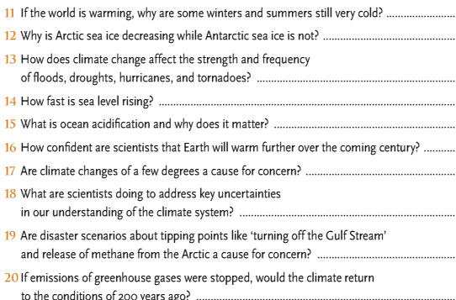

Slide 28
Joint U.S. National Academy of Science and Royal Society 20-point summary:
FOR ANSWERS SEE MY OTHER PowerPoint

Slide 29
Joint U.S. National Academy of Science and Royal Society 20-point summary:
OR: Joint U.S. National Academy of Science and Royal Society 20-point summary: 20-point Climate-Change Summary (pdf) – summarized in the following 3 slides

Slide 30
If we are so concerned about leaving a national debt to our children and grandchildren, and BTW we should be, shouldn’t we put the costs of climate change as part of that equation?
For those that don’t accept climate change maybe it would be a good thing to limit CO₂ into the atmosphere anyway, especially at the rates we are putting it into the atmosphere – BECAUSE OF OCEAN ACIDIFICATION issues and the law of unintended consequences!

Slide 31
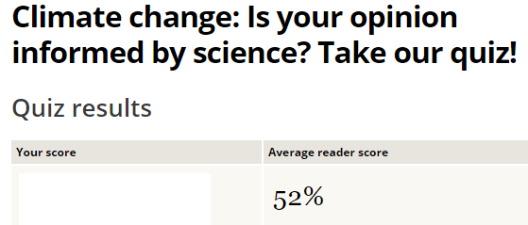
A Climate knowledge quiz:
http://www.csmonitor.com/Environment/2014/0827/Climate-change-Is-your-opinion-informed-by-science-Take-our-quiz/Gas

