Slide 1
Adapting to Climate change: Extreme Weather Events, a Worldwide Energy Revolution and Geoengineering options
Paul Belanger, Ph.D.; & Phil Nelson, Ph.D.
Geologist/Paleoclimatologist; & Geophysicist
Week 1: March 27th, 2017

Slide 2
INTRODUCTIONS – part 1
  Lou Henefeld: classroom assistant, liaison to me/OLLI
    Logistics: bathrooms, breaks, no open containers
    LouHenefeld@comcast.net
  303-278-8275
Paul Belanger:
  PEBelanger@glassdesignresources.com
  c. 303-249-7966; h 303-526-7996
Phil Nelson:
  PhilHNelson@aol.com
  C. 720-277-7900

Slide 3
INTRODUCTIONS – part 2
Intro:
  Yourselves – what brought you here
  Paul and Phil
  Web page –
  http://denverclimatestudygroup.com/ (OLLI tab)
  Facebook - https://www.facebook.com/denverclimatestudygroup/

Slide 4
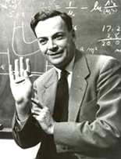
A thought – passed on from Warren Hamilton
“In this age of specialization, men who thoroughly know one field are often incompetent to discuss another. . . . You must not fool yourself--and you are the easiest person to fool”
Richard Feynman, 1974
My comment:
We’ve become a country of self-proclaimed experts on everything.

Slide 5
So What is Climate Change

Slide 6
Weather vs. Climate
Weather: consists of the short-term (minutes to months) changes in the atmosphere.
  temperature, humidity, precipitation, cloudiness, brightness, visibility, wind, and atmospheric pressure, as in high and low pressure.
Climate: long-term averages of daily weather.
  The statistics of weather
https://www.nasa.gov/mission_pages/noaa-n/climate/climate_weather.html

Slide 7
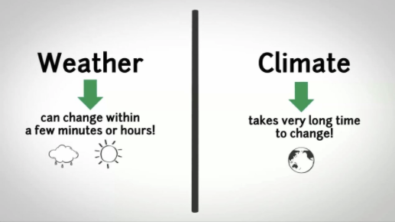

Slide 8
Links to what is climate
http://www.metoffice.gov.uk/climate-guide

Slide 9
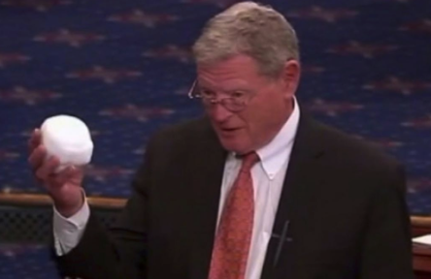
TAKE AWAY: This is Weather
This is NOT Climate Change
Chair of the Senate Environment Committee

Slide 10
What determines Earth’s climate
      The Sun
      Orbital parameters aka Milankovitch
      Greenhouse Gases (GHGs)

Slide 11
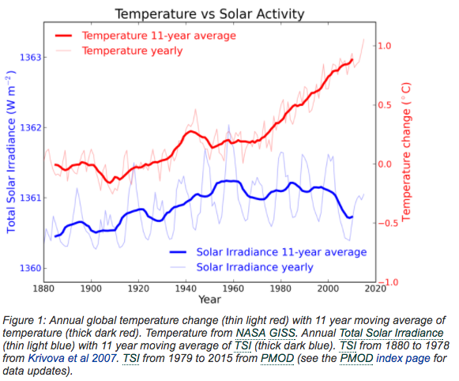
The Sun
https://skepticalscience.com/solar-activity-sunspots-global-warming.htm

Slide 12
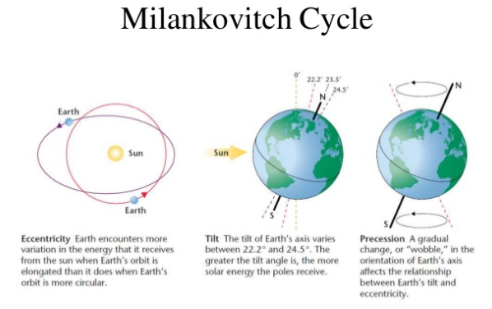
100,000 years
400,000 years
41,000 years
19 – 24,000 years
https://www.slideshare.net/syadur/milankovitch-theory

Slide 13
Thus it leaves it to Greenhouse Gases
And so we will explore this a little further

Slide 14
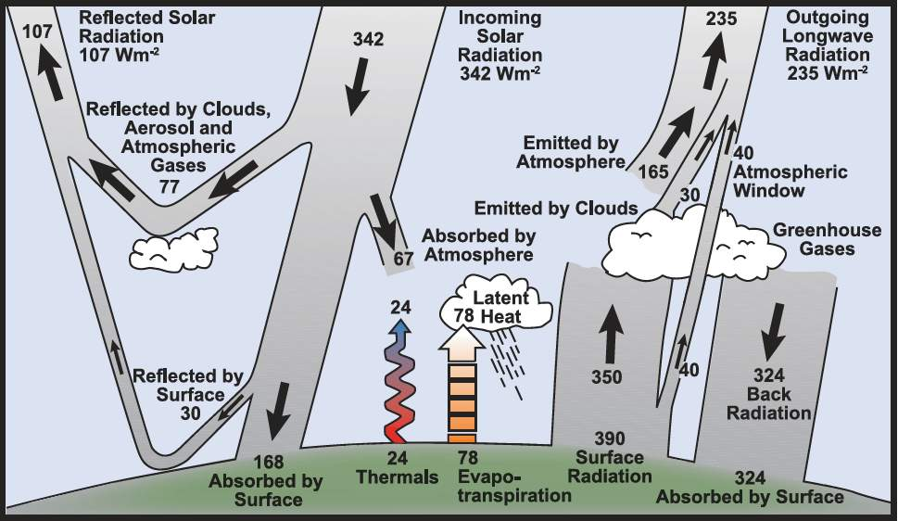
Milankovitch ~= 3-8 W/m²
Sunspots ~=
0.3 – 0.5 W/m²
Current
GHGs ~= 1.6W/m²
DOUBLING: 280 to 560 ppm CO2 = ~ 3 W/m²
Referred to as climate sensitivity
http://www.skepticalscience.com/Milankovitch.html
Notes:
See http://www.skepticalscience.com/Milankovitch.html for good explanation
Eccentricity affects entire globe equally; 100,000 year periodicity: 0.45 w/m-2; yearly delta of 6.4% over course of year
Obliquity - hemispherical: 22-25; currently 23.5, 41,000 year periodicity
Precession: 19k 23k – when n. hemisphere nearest sun in summer (currently we are furthest) – why hypsithermal was slightly warmer.
Precession varies on timescales of 19,000 and 23,000 years, and is thus important even over historical times. The precessional cycle is the key player behind the Holocene Climate Optimum, a time between ~7,000 and 5,000 years ago of particularly warm Northern Hemispheric extra tropical summers, and colder tropical and extra tropical winters.
Eccentricity is the only Milankovitch cycle that alters the annual-mean global solar insolation (i.e., the total energy the planet receives from the sun at the top of the atmosphere). For the mathematically inclined, the annually-averaged insolation changes in proportion to 1/(1-e²)^{0.5,} so the solar insolation increases with higher eccentricity. This is a very small effect though, amounting to less than 0.2% change in solar insolation, equivalent to a radiative forcing of ~0.45 W/m² (assuming present-day albedo). This is much less than the total anthropogenic forcing over the 20th century. However, eccentircity does modulate the precessional cycle, as we shall see.
Obliquity: Obliquity describes how tilted a planet’s axis is (Fig. 3 shows the obliquity of eight planets, plus Pluto which is labeled as a planet). The tilt of the Earth is ultimately what allows for the existence of seasons, since the Northern Hemisphere is pointed toward the sun in the boreal summer, and away from the sun in the boreal winter. The tilt of Earth’s axis (in other words, the angle between the spin–axis and a line perpendicular to the orbital plane) varies between about 22 to 25° (currently 23.5°) over a period of nearly 41,000 years, driving changes in the distribution of sunlight between the equator and high latitudes (with more tilt implying more sunlight at high latitudes, and less at lower latitudes; therefore more oblique orbits favor deglaciation on Earth).
Precession: Precession does not describe how tilted the Earth’s axis is, but rather the direction of its axis. This changes what star is the “North Star” over time (today it is Polaris, but near the end of the last deglaciation it was Vega), and as described below, governs the timing of the seasons. This is illustrated in Figure 4 (a and b) below.

Slide 15
FOR THERE TO HAVE NO CLIMATE CHANGE
Energy in (Visible)
=
Energy out (infrared)
Relatively stable last 10,000 years
GHGs Now Changing our climate – but at an unprecedented rate
  Threatens our sustainability as DO other factors:
    Population
    Sea level rise
    Extreme weather
    Resources (Energy, food)
    Ocean acidification

Slide 16

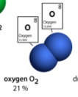

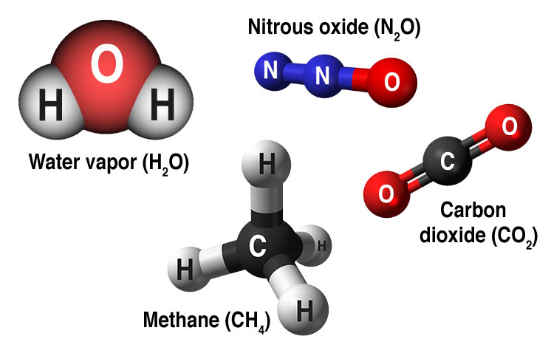
Let’s look at our atmosphere
  N₂ = 78%
  O₂ = 21%
  Ar = 0.93%
  CO₂ = -.408%
  H₂0 = variable
  Other: CH₄, CFCs, O_{3,} etc.
Notes:
.

Slide 17
GREENHOUSE GASES (GHGs)
  Water – H₂O – the amount is a feedback of temperature held in by the “blanket” of other GHGs
  Carbon dioxide - CO₂
  Methane - CH₄
  Ozone - O₃
  Nitrous oxide- N₂O
  others

Slide 18
Some basic Meteorology
First some facts:
  Atmospheric circulation
  Coriolis forces
Then Background for some Explanations:
  Gas laws
  Weather: Highs and Lows –
    Causes
    Coriolis effect
  Latent heat

Slide 19
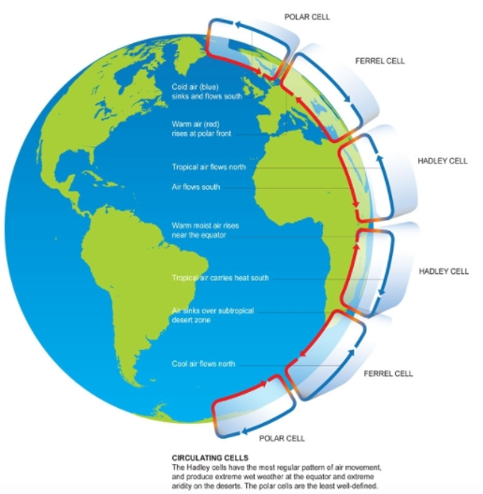
Atmospheric circulation
http://maps.unomaha.edu/Peterson/geog1000/Notes/Notes_Exam1/Seasons&Climate.htm

Slide 20
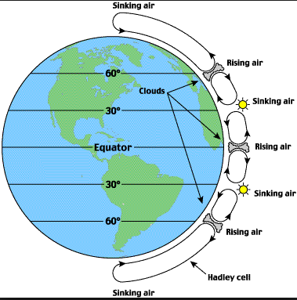
Cont.
http://maps.unomaha.edu/Peterson/geog1000/Notes/Notes_Exam1/Seasons&Climate.htm

Slide 21
Some basic Meteorology
First some facts:
  Atmospheric circulation
  Coriolis forces
Then Background for some Explanations:
  Gas laws
  Weather: Highs and Lows –
    Causes
    Coriolis effect
  Latent heat

Slide 22
Coriolis forces affecting movement
prop

Slide 23
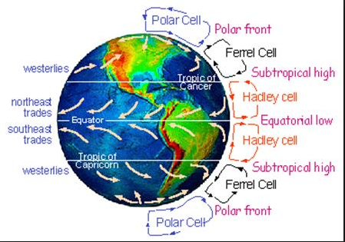
http://maps.unomaha.edu/Peterson/geog1000/Notes/Notes_Exam1/Seasons&Climate.htm

Slide 24
Some basic Meteorology
First some facts:
  Atmospheric circulation
  Coriolis forces
Then Background for some Explanations:
  Gas laws
  Weather: Highs and Lows –
    Causes
    Coriolis effect
  Latent heat

Slide 25
Gas laws
Boyles Law, Charles Law, Gay-Lussac Law
BUT THIS IS THE RELATIONSHIP YOU NEED TO KNOW:
IDEAL GAS LAW (COMBINED):
  PV = nR T
http://chemistry.bd.psu.edu/jircitano/gases.html
For more info: https://en.wikipedia.org/wiki/Gas_laws

Slide 26
T, P and V relationships with density
PV = nR T
Temperature: INCREASES
  V increases and thus
  Density decreases
Pressure: INCREASES
  V decreases and thus
  Density increase
Volume: INCREASES
  T decreases and thus
  Density Decreases
HOWEVER:
Changes in the composition of medium can also cause density to change

Slide 27
Some basic Meteorology
First some facts:
  Atmospheric circulation
  Coriolis forces
Then Background for some Explanations:
  Gas laws
  Weather: Highs and Lows – DENSITY
    Causes
    Along with the Coriolis force/effect
  Latent heat

Slide 28
A TRICK QUIZ
2 ROOMS – EQUAL IN SIZE, ELEVATION and TEMPERATURE
  ROOM 1 – 10% HUMIDITY
  ROOM 2 – 95% HUMIDITY
WHICH ONE WEIGHS MORE (I.E. IS DENSER: DENSITY = MASS/VOLUME)
  ROOM 1?
  ROOM 2?

Slide 29
A TRICK QUIZ
2 ROOMS – EQUAL IN SIZE, ELEVATION and TEMPERATURE
  ROOM 1 – 10 HUMIDITY
  ROOM 2 – 95% HUMIDITY
  YOU PROBABLY DON’T REALIZE YOU KNOW THE ANSWER
  HINT:
    WEATHER:
      WHAT’S A STORM ASSOCIATED WITH
        HIGH PRESSURE
        Or LOW PRESSURE?
        WHY?

Slide 30
Our Atmosphere
  N₂ = 78% Mass 14 x 2 = 28
  O₂ = 21% Mass 16 x 2 = 32
  Ar = 1% Mass 18 x 1 = 18
  CO₂ = -.408% C=12; 12 +32 = 44
  H₂0 = variable H = 1; (1x2) + 16 = 18
  Other: CH₄, CFCs, O_{3,} etc.
Negligible
Not so much
Notes:
.

Slide 31
ANSWER as to which weighs more:
2 ROOMS – EQUAL IN SIZE, ELEVATION and TEMPERATURE
  ROOM 1 – 10% HUMIDITY
  ROOM 2 – 95% HUMIDITY
WEIGHS MORE
    WEATHER:
      WHAT’S A STORM ASSOCIATED WITH
        LOW PRESSURE?
        WHY?
MOISTURE: STORMS, HURRICANES
WATER VAPOR WEIGHS LESS THAN N₂ & O₂

Slide 32
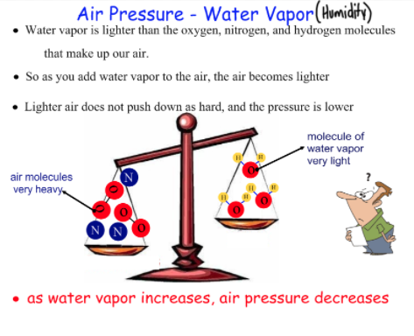

Slide 33
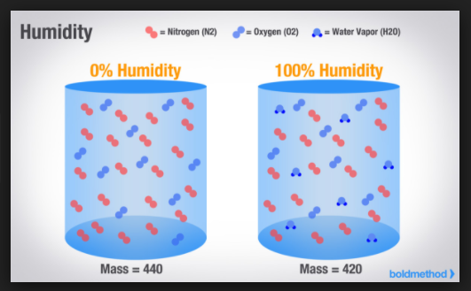

Slide 34
TAKE AWAY: adding H₂O VAPOR decreases density

Slide 35
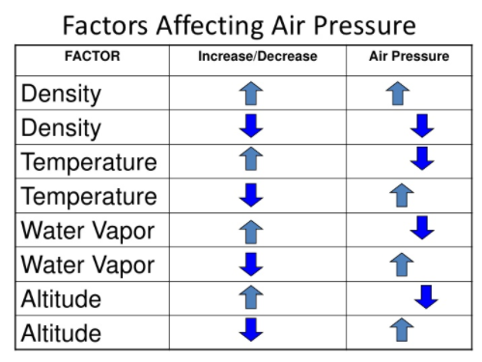
A summary table:

Slide 36
TAKE AWAY:
Low Atmospheric Pressure
ASSOCIATED WITH AN INCREASE OF WATER VAPOR

Slide 37
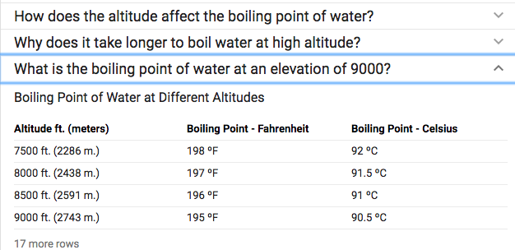
An Aside:
ALTITUDE ALSO AFFECTS PRESSURE and
BOILING POINT

Slide 38
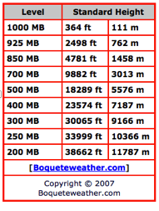
ALTITUDE ALSO AFFECTS PRESSURE
and
BOILING POINT

Slide 39
TAKE AWAY: air cools 10ºC for every km elevation gain due to decrease pressure

Slide 40
Water vapor
The amount of water vapor
that the atmosphere can hold
DOUBLES FOR EVERY 10ºC

Slide 41
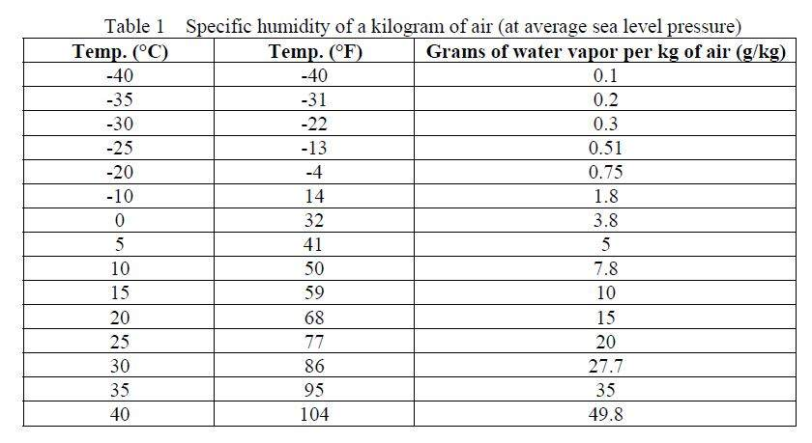

0.8562 m³
(95 cm x 95 cm x 95 cm)

Slide 42
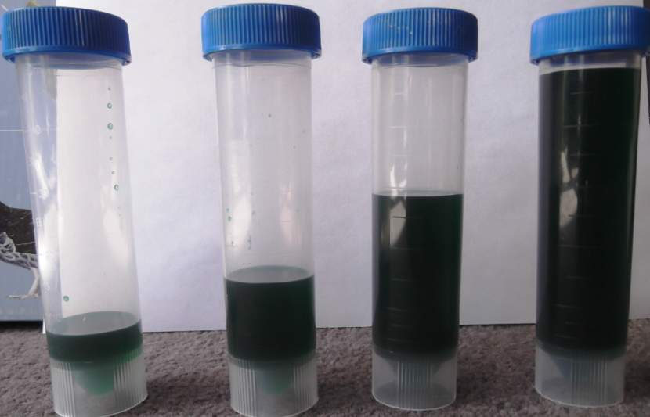
@ 30ºC +1ºC = 8% increase in vapor
10ºC = (50ºF)
7.8 cc
20ºC = (68ºF)
15 cc
30ºC = (86ºF)
27.7 cc
40ºC = (104ºF)
49.8 cc

Slide 43
TAKE AWAY:
Water vapor in the atmosphere
~ DOUBLES WITH EVERY +10ºC

Slide 44
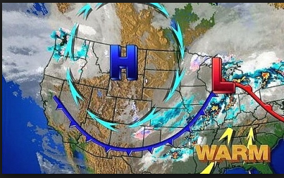
AIR MOVES FROM H TO L
BUT NOT IN A STRAIGHT LINE DUE TO CORIOLIS

Slide 45
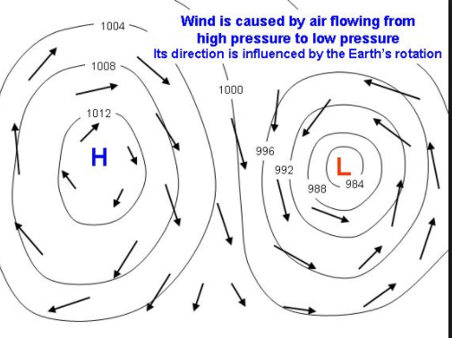
AIR MOVES FROM H TO L
BUT NOT IN A STRAIGHT LINE DUE TO CORIOLIS

Slide 46
Some basic Meteorology
First some facts:
  Atmospheric circulation
  Coriolis forces
Then Background for some Explanations:
  Gas laws
  Weather: Highs and Lows –
    Causes
    Coriolis effect
  Latent heat = ENERGY IN WATER VAPOR

Slide 47
The Energy involved with
WATER VAPOR
To melt ice (solid to liquid) = 80 calories / gram
To heat water 1º C = 1 calorie / gram
To go from 100º C liquid to 100º C steam/vapor – 540 calories / gram

Slide 48
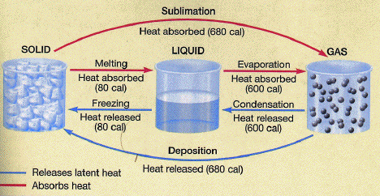
The Energy in phase changes
http://www.uh.edu/~jbutler/physical/chapter6notes.html

Slide 49
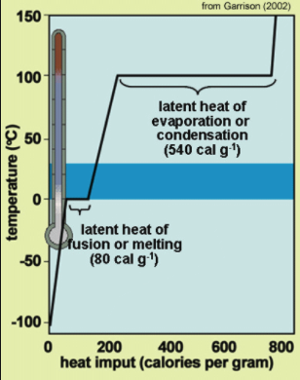
The Energy in phase changes
http://www.aqob.com.au/details.php?p_id=371

Slide 50
TAKE AWAY:
IF YOU INCREASE THE AVERAGE ATMOSPHERIC TEMPERATURE YOU INCREASE THE AMOUNT OF WATER VAPOR IT HOLDS
IF YOU DO THAT YOU INCREASE THE AMOUNT OF ENERGY IN THE ATMOSPHERE

Slide 51
TO RE-EMPHASIZE: THE TAKE AWAY:
IF YOU INCREASE THE AVERAGE ATMOSPHERIC TEMPERATURE YOU INCREASE THE AMOUNT OF WATER VAPOR IT HOLDS
IF YOU INCREASE THE AMOUNT OF WATER VAPOR IN THE ATMOSPHERE YOU INCREASE THE AMOUNT OF ENERGY IN THE ATMOSPHERE
The warmer the greater the increase!

Slide 52
EARTH’S HEAT BUDGET

Slide 53
RADIATION RECEIVED vs.
RADIATION EMITTED BACK TO SPACE

Slide 54
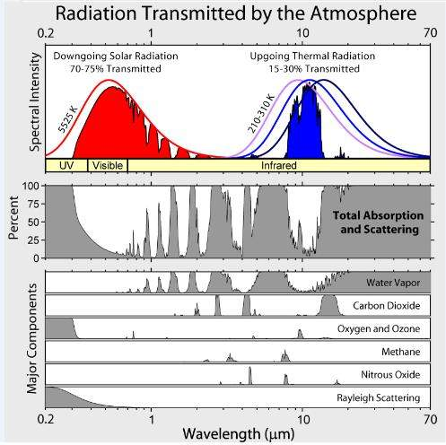

Slide 55
IF EARTH’S HEAT BUDGET
CHANGES WE HAVE EITHER:
COOLING or
WARMING

Slide 56
How GHGs Blanket the Earth
Blanket Earth:
http://climate.nasa.gov/causes/
https://www.youtube.com/watch?v=aqkGoCglp_U&feature=youtu.be
https://www.youtube.com/watch?v=we8VXwa83FQ

Slide 57
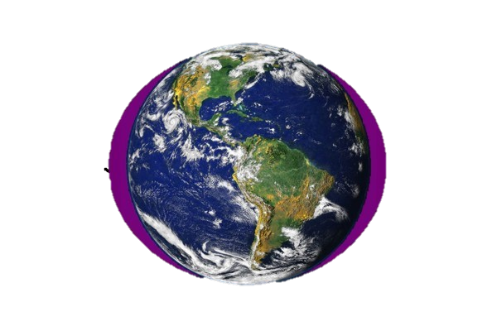

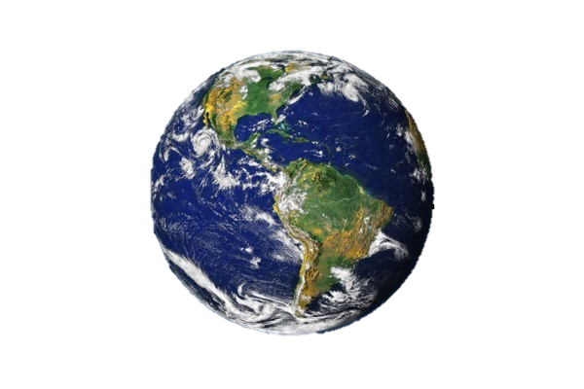
The CO₂ greenhouse gas effect is concentrated in the polar regions ! ! !
The Earth and its atmosphere
The most potent greenhouse gas is H₂O - vapor
Particularly in the Arctic !
The large H₂O
greenhouse effect
is controlled by temperature –
H₂O saturation doubles with every
10°C Increase
As a result It is concentrated in
the lower atmosphere
of the tropics
CO₂ and other Greenhouse gases are evenly distributed throughout the atmosphere

Slide 58
RESULTS:
Greater warming at High Latitudes
Reduction Arctic sea ice
Melting glaciers
Rising sea levels
Average temperature increases
Earlier springs / earlier snow melt
Ocean acidification

Slide 59
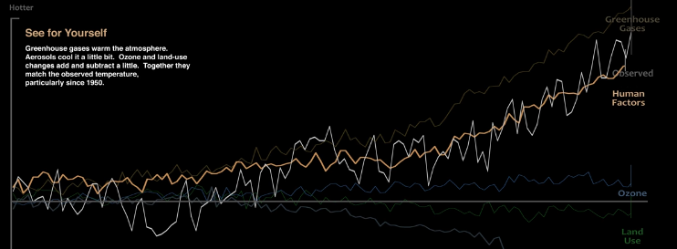
How global warming stacks up
https://www.youtube.com/watch?v=-gHUHoqBn-Y
Published on Sep 15, 2016
Skeptics of manmade climate change offer various natural causes to explain why the Earth has warmed 1.4 degrees Fahrenheit since 1880. But can these account for the planet’s rising temperature? Watch to see how much different factors, both natural and industrial, contribute to global warming, based on findings from NASA’s Goddard Institute for Space Studies.

Slide 60
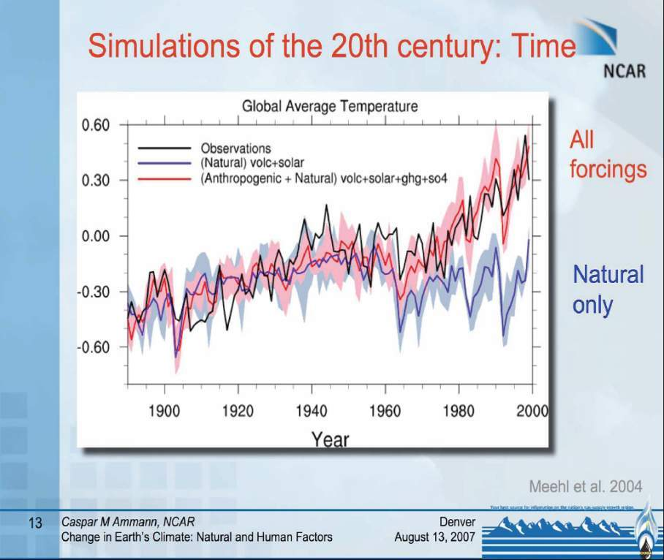

Slide 61
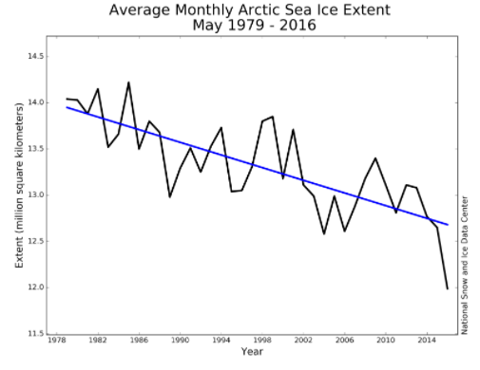
For more see: http://www.skepticalscience.com/melting-ice-global-warming.htm
http://nsidc.org/arcticseaicenews/2016/06/

Slide 62
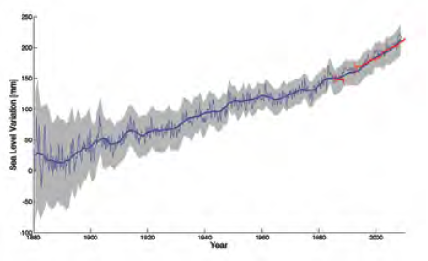
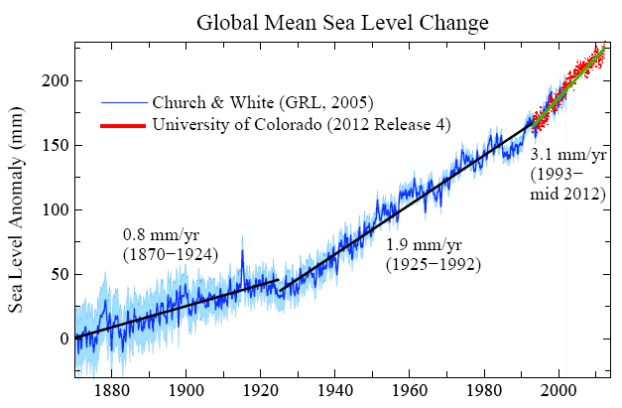
14: HOW FAST IS SEA LEVEL RISING?
Blue: Sea level change from tide-gauge data (Church J.A. and White N.J., Geophys. Res. Lett. 2006; 33: L01602)
Red: Univ. Colorado sea level analyses in satellite era (http://www.columbia.edu/~mhs119/SeaLevel/).

Slide 63
Loaded Climate Dice: global warming is increasing extreme weather events.
Extreme summer heat anomalies now cover about 10% of land area, up from 0.2%.
This is based on observations, not models.
Frequency of occurrence (vertical axis) of local June-July-August temperature anomalies (relative to 1951-1980 mean) for Northern Hemisphere land in units of local standard deviation (horizontal axis). Temperature anomalies in the period 1951-1980 match closely the normal distribution ("bell curve", shown in green), which is used to define cold (blue), typical (white) and hot (red) seasons, each with probability 33.3%. The distribution of anomalies has shifted to the right as a consequence of the global warming of the past three decades such that cool summers now cover only half of one side of a six-sided die, white covers one side, red covers four sides, and an extremely hot (red-brown) anomaly covers half of one side.
Source: Hansen, J., Sato, M., and Ruedy, R., Proc. Natl. Acad. Sci., 2012.

Slide 64
So what do we do?
NOTHING? AND ADAPT?
CHANGE OUR WAYS AND MITIGATE
  COSTS NOW vs.
  COSTS LATER

Slide 65
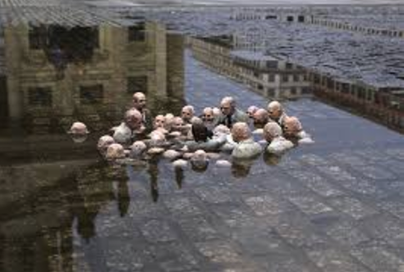
Politicians debating climate change
Isaac Cordal: http://www.dailykos.com/story/2014/5/7/1297486/-The-Most-Striking-Climate-Change-Sculpture-You-ll-Ever-See

Slide 66
THAT’S GOING NOWHERE!
IT’S UP TO US

Slide 67
NEXT
Adaptation to extreme weather events (today and next 2 weeks)
Mitigation: DIET and EXERCISE – weeks 4-8
  Reduce our emissions GHGs
    decarbonize our electrical energy generation
    Decarbonize our transportation sector
  Sequester some of what we’ve already emitted: BIOCHAR, OTHER

Slide 68

A book to consider:
Simple succinct Summary:
  What We Know About Climate Change (Boston Review Books) by Kerry Emanuel (Nov 30, 2012)
Web page to consider:
  https://skepticalscience.com/

Slide 69
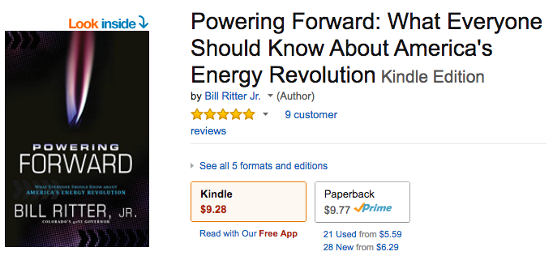
A book to consider for weeks 4-7:

Slide 70
Next up:
Phil Nelson

Slide 71

https://i.kinja-img.com/gawker-media/image/upload/t_original/ihsllhptnnm4vb7wuvgq.jpg

