Slide 1
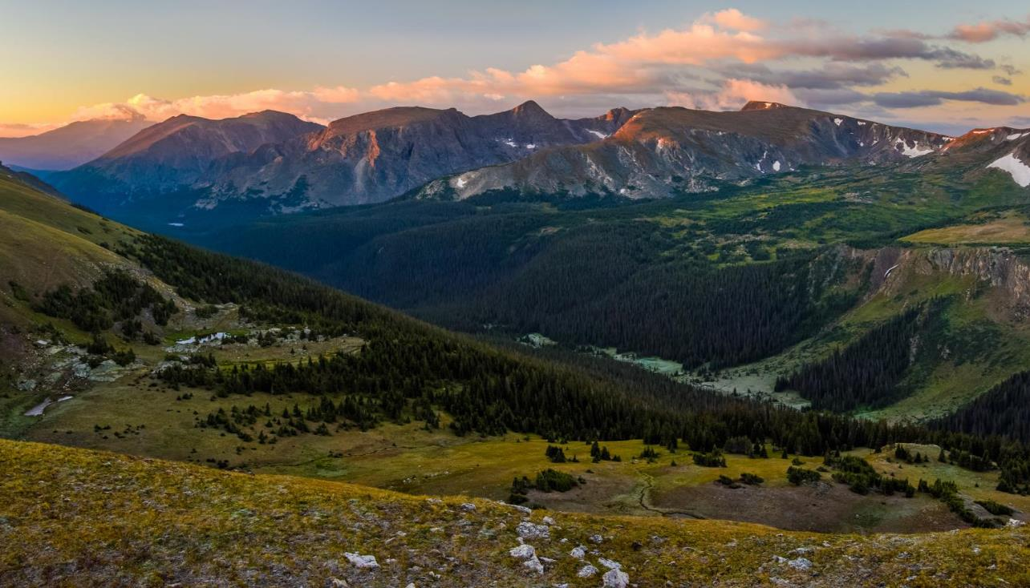

North America
Strategy
Natural Climate Solutions:
Using Nature to Mitigate Climate Change & Help Nature & People Adapt
  March 26, 2018
  Betsy Neely, The Nature Conservancy
Ethics and Ecological Economics Forum
Denver, Colorado

Slide 2
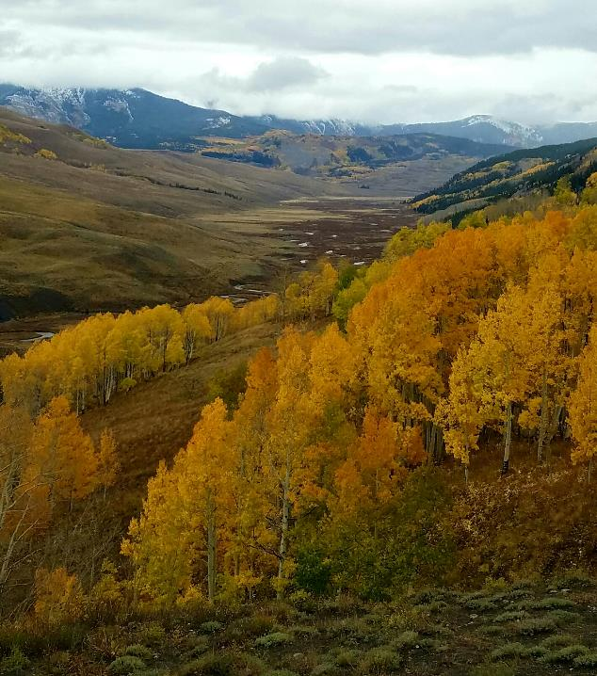

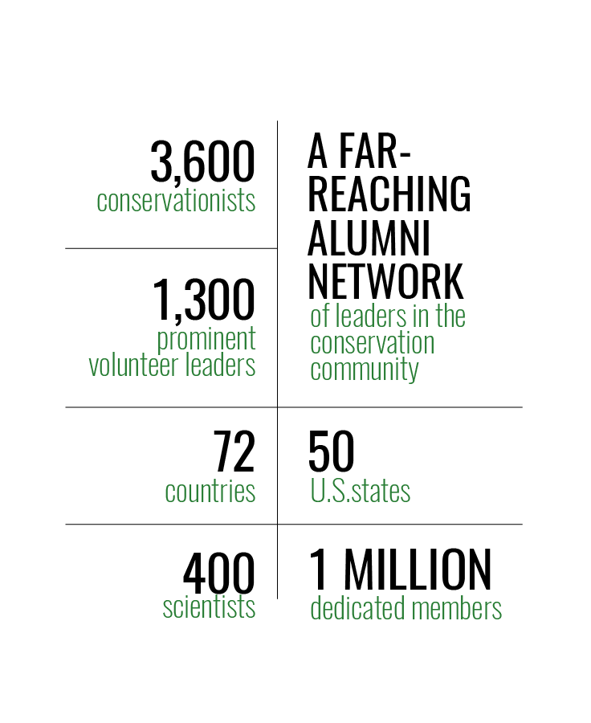
The Nature Conservancy

Slide 3

Mission: conserve the lands & waters on which all life depends.
Vision: we envision a world where the diversity of life thrives, people act to conserve nature for its own sake & for its ability to enrich and fulfill our lives.
Shared Conservation Agenda: focus all of our energy, passion, innovation & experimentation on solving the biggest challenges facing our mission so that we can move at a pace & scale that matters.

Slide 4







What is Standing in the Way of a Future where
People and Nature Thrive Together?
8 GLOBAL CHALLENGES
Climate Change –
Mitigation and Adaptation
Expanding Footprint of Cities
High Agricultural Inputs
Invasive Species
Wood Products and
Connected Air & Water Pollution
Unsustainable Fisheries
Deficient Sanitation & Wastewater
Forests & Fire Suppression – U.S. Only
Energy Expansion & Sprawl
Notes:
Challenges for Nature that are also challenges for People
Identified through CbD 2.0
If solutions to the Global Challenges can be achieved at a global scale, then the major global drivers of biodiversity loss would be removed and the lives of hundreds of millions to billions of people globally could be improved.

Slide 5

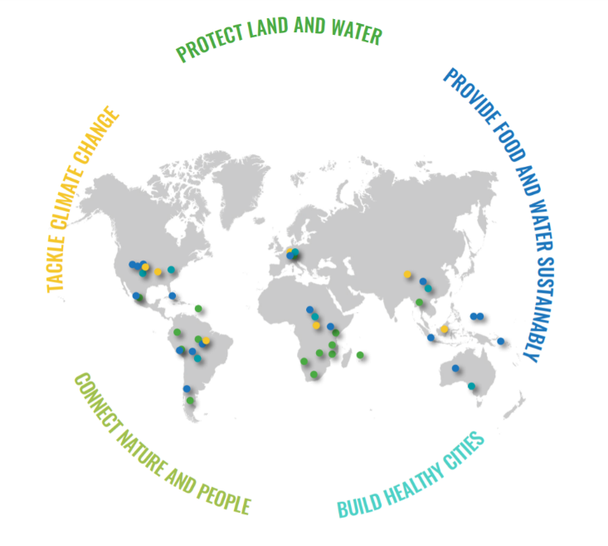
Global Priorities

Slide 6
Tackle Climate Change
North America Priority Strategies
​Climate Action
Reduce US emissions by at least 26% from 2005 levels with policies in place for steeper reductions.
Natural Climate Solutions - Mitigation
Reduce GHG emissions annually by 118 MMtCO2e by avoided forest conversion, reforestation & improved forest management.
​Energy and Infrastructure
Double renewable energy compared to 2016 with at least 75% of new projects & infrastructure deployed in low-impact areas.
Natural Climate Solutions - Adaptation
Influence decision-making & bring nature-based solutions to enough communities at risk that investments become standard practice, to prepare for, adapt to & manage the effects of flooding & drought.
Notes:
Implement and increase emphasis on readily available, cost-effective natural climate solutions, such as reforestation, and drive policy changes to accelerate our transition to a clean energy future
2025 Outcomes

Slide 7
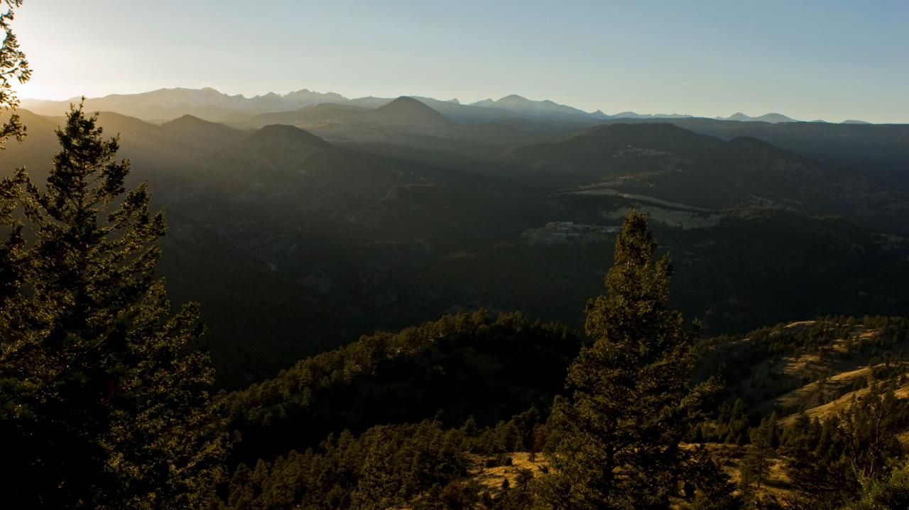
Natural Climate Solutions
Restoring, conserving & better managing forests, grasslands, farmlands & wetlands
Could deliver 37% of carbon reductions needed by 2030 to keep warming below 2°C & help nature & people adapt
Griscom et al. 2017 PNAS
Notes:
Could reduce emissions by 11. 3 billion tons/year

Slide 8
Natural Climate Solutions https://global.nature.org/initiatives/natural-climate-solutions/natures-make-or-break-potential-for-climate-change
Griscom et al. 2017 PNAS
Notes:
Could reduce emissions by 11. 3 billion tons/year

Slide 9
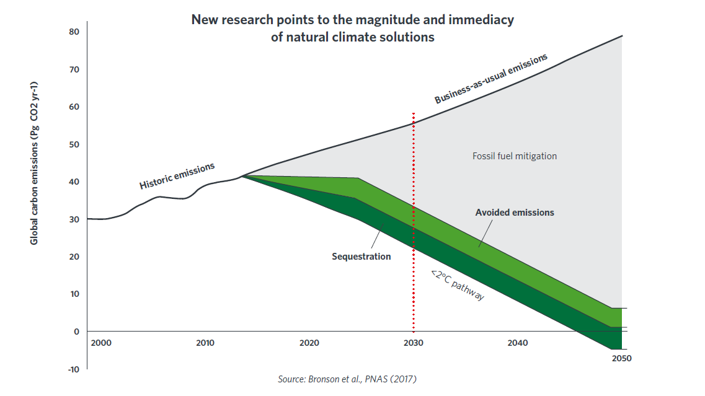
Rapid decarbonization of energy sector alone is insufficient

Slide 10
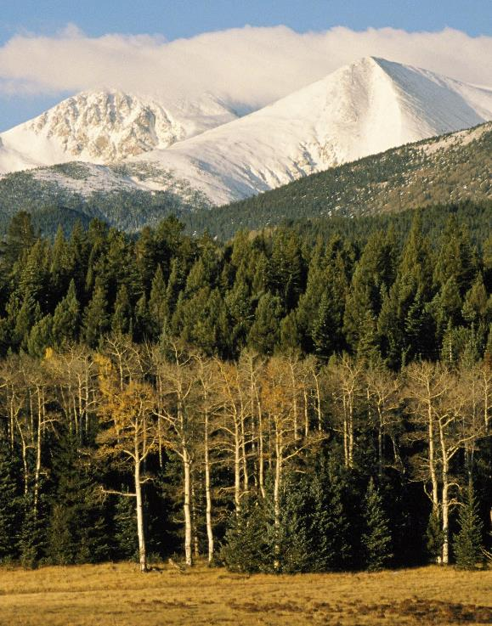
“We cannot hit the 2° C or below target through reforms in energy, industry & transportation sections alone.
Preventing further loss of nature & investing in NCS are essential to climate stability.
The good news is that these opportunities are abundant & have many other benefits.”
Bronson Griscom, Director, Forest Carbon Science, TNC
Harold Malde
Notes:
PC: Harold E. Malde
Change co policy context to just policy context

Slide 11
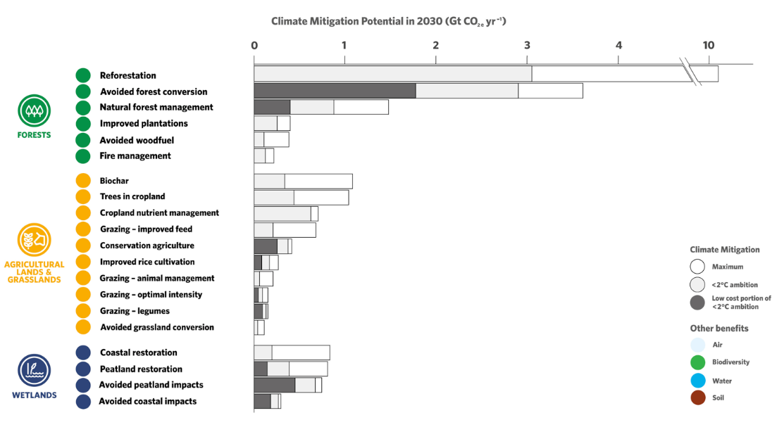
Climate Mitigation Potential of 20 Natural Pathways
Notes:
Climate mitigation potential of 20 natural pathways. We estimate maximum climate mitigation potential with safeguards for reference year 2030. Light gray portions of bars represent cost-effective mitigation levels assuming a global ambition to hold warming to <2 °C (<100 USD MgCO₂e⁻¹ y⁻¹). Dark gray portions of bars indicate low cost (<10 USD MgCO₂e⁻¹ y⁻¹) portions of <2 °C levels. Wider error bars indicate empirical estimates of 95% confidence intervals, while narrower error bars indicate estimates derived from expert elicitation. Ecosystem service benefits linked with each pathway are indicated by colored bars for biodiversity, water (filtration and flood control), soil (enrichment), and air (filtration). Asterisks indicate truncated error bars. See SI Appendix, Tables S1, S2, S4, and S5 for detailed findings and sources.

Slide 12
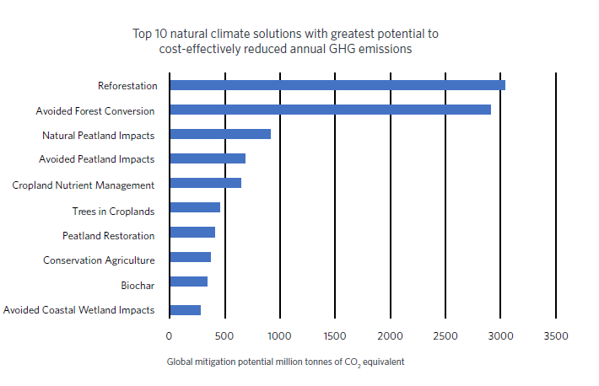
Top 10 Cost-Effective Natural Climate Solutions
Griscom et al. 2017

Slide 13
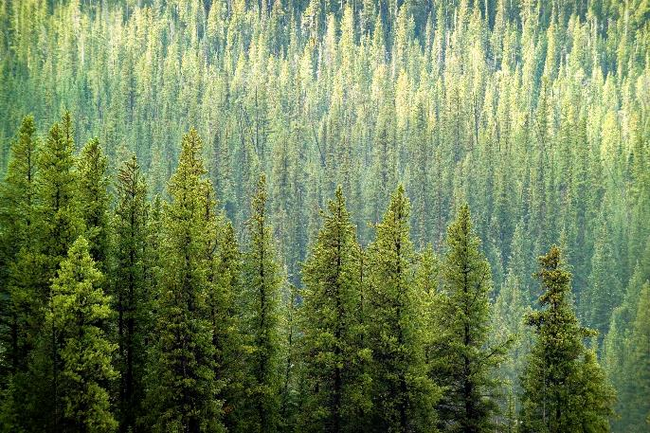
North America Priority
Natural Climate Solutions: Mitigation
  Greenhouse gas emissions are reduced annually by 118 MMtCO2e by:
Improved forest management
Reforestation
Avoided forest conversion

Slide 14
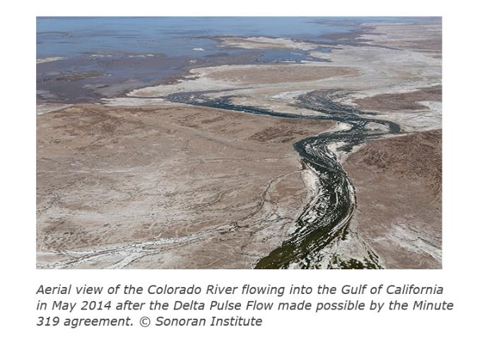
North America Priority
Natural Climate Solutions: Adaptation
Bring nature-based solutions to communities at risk so that investments in response to climate change become standard practice to:
prepare for, adapt to &
manage the effects of flooding and drought.
Notes:
Establish natural and nature-based solutions as commonplace, established strategies for increasing water supplies and reducing the
impact of extreme (long-lasting and severe) droughts on vulnerable communities and ecosystems.
U.S.-Mexico Colorado River Water Security Agreements (Colorado River Program/AZFO/Mexico & Northern Central American program
U.S.-Mexico agreement on water benefits all.
Story Highlights
In an important victory for people and nature, The Nature Conservancy and its partners helped negotiate Minute 323, an international agreement that establishes how the United States and Mexico share water in the Colorado River.
This treaty is the successor to Minute 319, the first international treaty to which non-governmental organizations were a party, which was passed in 2012 and will expire in December. The new agreement scales up ongoing environmental restoration projects and makes provisions for future water security.
“We’re pleased to have worked with many partners to support Minute 319 and now its successor, Minute 323,” says Taylor Hawes, Colorado River program director at the Conservancy. “In this time of political divisiveness, formalizing the agreement today is a testament to the partnership, alliance, and long-term common goals for sustainability of the Colorado River between the United States and Mexico.”
By guiding the implementation of the 1944 U.S.-Mexico Water Treaty, the Minute agreements represent an extraordinary collaboration that helps citizens in both countries. The agreements establish the rules by which water will be shared when there is a surplus and restrictions will be adopted when there is drought, as well as protecting the ecology of the Colorado River Delta.

Slide 15
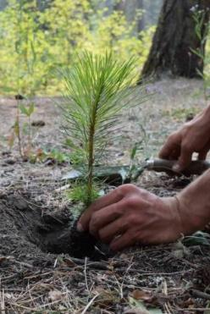
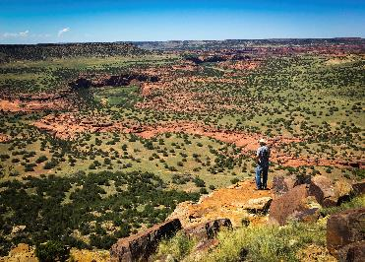
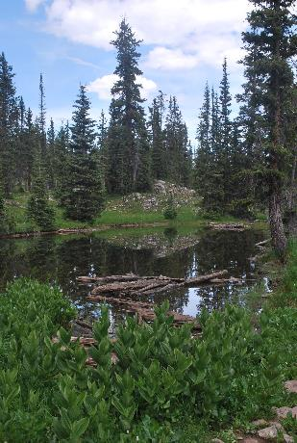
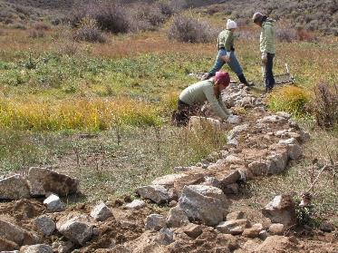
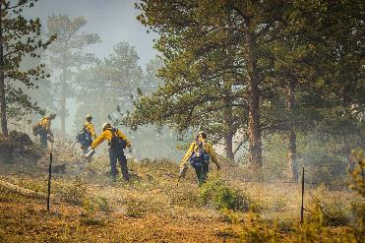
Natural Climate Solutions: Colorado

Slide 16
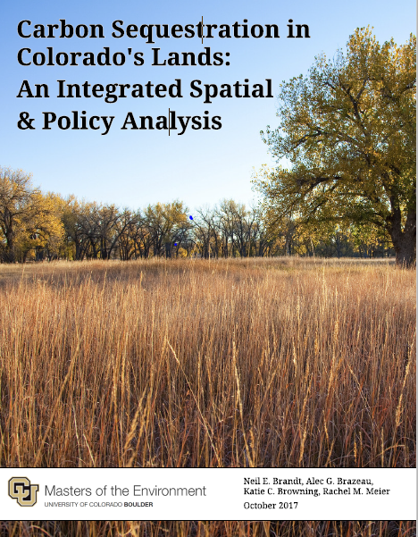
Questions
How much carbon is currently sequestered in CO & how much might be sequestered in the future?
What programs & policies have the greatest impact to improve carbon sequestration rates?

Slide 17
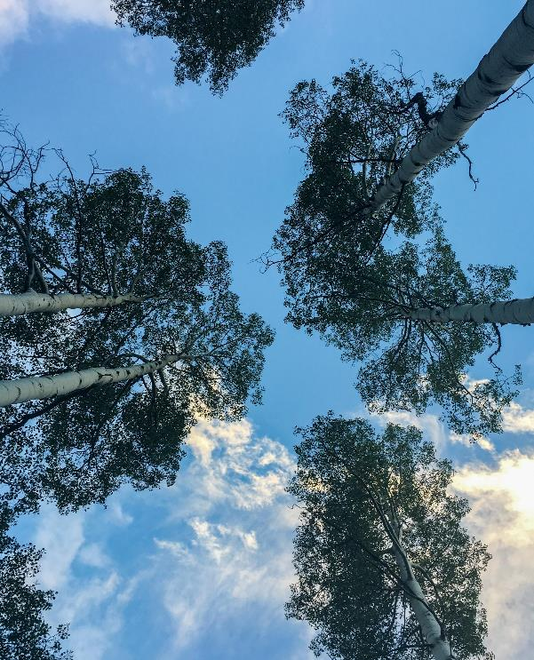
Definitions
Stock: Amount of carbon stored in a landscape (MT CO2eq)
Sequestration: process by which atmospheric carbon dioxide is taken up by plants through photosynthesis & stored as carbon in biomass & soils

Slide 18
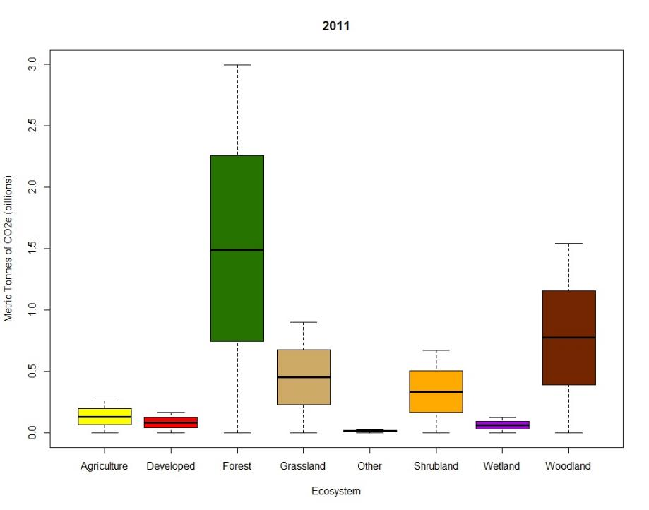
Carbon Stocks by Land Cover Type - 2011
Land Cover Type
Notes:
We had a range of values (challenge of lit review), we accounted for those when looking at how much carbon was in the landscape, we see the spread because we accounted for those. Even with that variability we can draw these conclusions

Slide 19
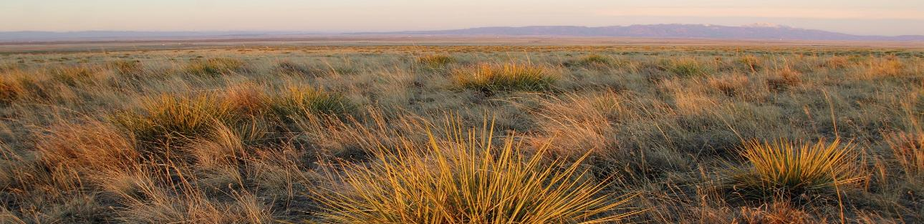
Conclusions
Colorado lands play a crucial role in mitigating climate change
Managing lands to improve carbon sequestration can contribute to climate goals (CO goal: reduce emissions by 26% of 2005 levels by 2025)
Seek policies & practices to improve land management for carbon
John Fielder
Notes:
PC: John Fielder
2:15 min

Slide 20
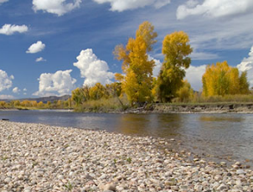

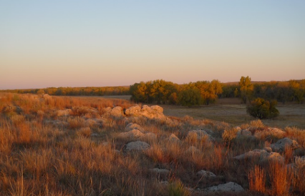
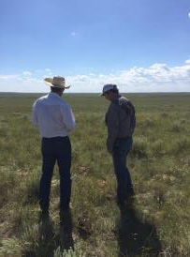
Climate Impacts & Opportunities Project
3-4 C

Slide 21
Climate
Scenarios
Ecological Response Models
Situation
Analysis
Goals
Results Chains
Drought
Fire
Insects
Stream Flows
Temperature
Social & Ecological Connections
Climate Impacts
Interventions
Strategies
Actions
Hot & Dry
Feast & Famine
Warm & Wet
Hot & Wet
Targets &
Goals

Slide 22
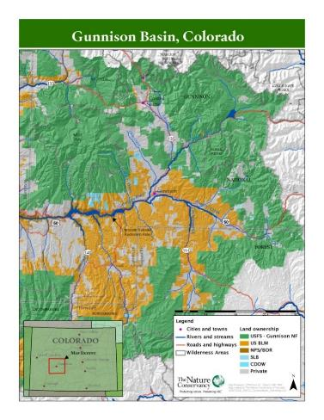
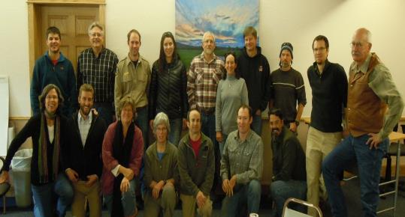
Gunnison Climate Working Group
Preparing for Change in the Gunnison River Basin
Notes:
GOALS
Understand impacts of climate change on nature and people and increase awareness
Develop strategies to reduce impacts
Promote coordinated action across boundaries
Gunnison Climate Working Group (GCWG), a public-private partnership, to enhance resilience of riparian and wet meadow habitats across the Gunnison Basin to help the Gunnison sage-grouse (Centrocercus minimus) adapt to a changing climate.
Represented by USFS, CPW, BLM, NRCS, Gunnison County, TU, NPS, TNC, and WSCU
AND various landowners (from lawyer to ranchers)

Slide 23
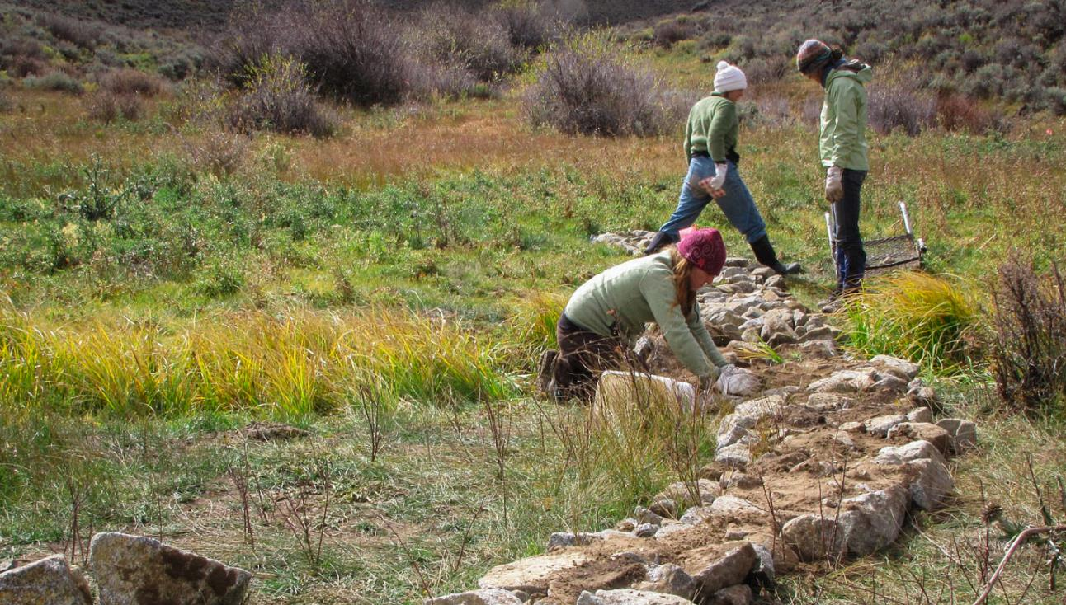
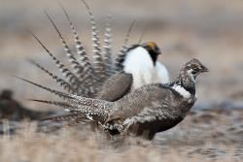

Restore & Build Resilience of Wet Meadows in Sagebrush Steppe
A Collaborative Project of the Gunnison Climate Working Group
Notes:
Build resilience by restoring hydrologic/ecologic function of wet meadows to help Gunnison sage-grouse, other species & ranchers adapt to a changing climate

Slide 24
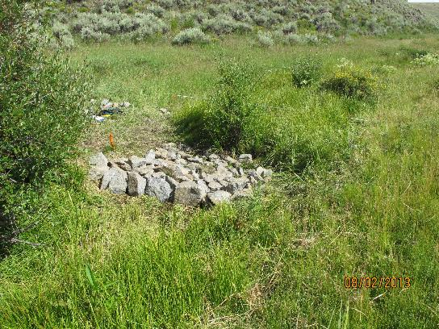
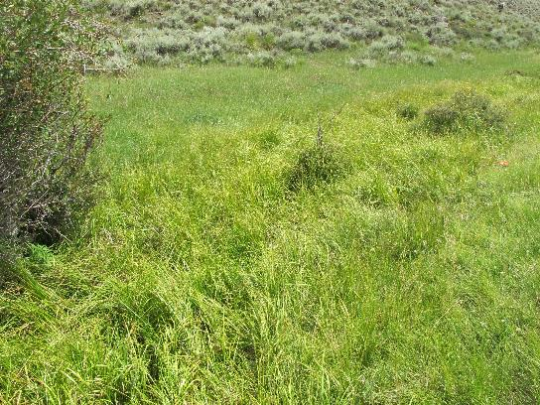
Monitor Progress & Share Best Practices
8/2/2013
7/31/2017
Restore & Build Resilience of Wet Meadows in Sagebrush Landscape
Rondeau, CNHP

Slide 25
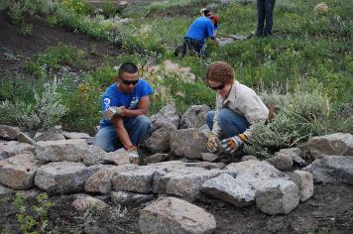
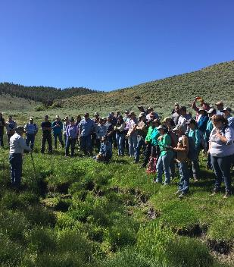
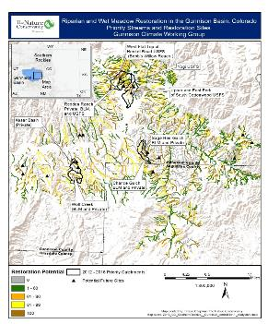
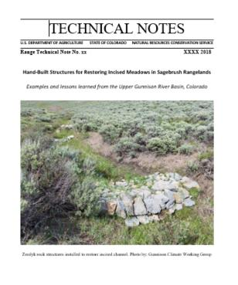
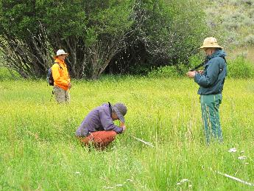
Scaling Up for Greater Impact
Grant, UGRD
Rondeau, CNHP

Slide 26
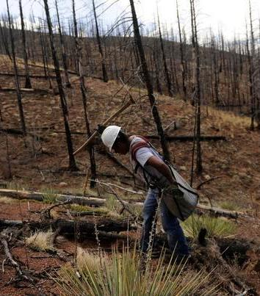

Reforestation
Scope feasibility of accelerated reforestation of severely burned areas
Benefits: carbon storage, forest resilience, wildlife habitat, flood control

Slide 27
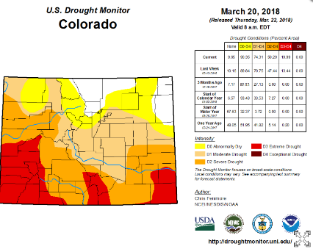
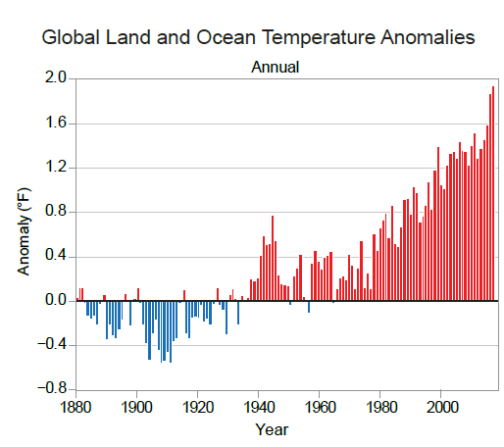
Moving the Needle
Statewide collaborative cross-boundary climate initiative
CO Climate Summit
  Natural climate solutions
  Adaptation
  Mitigation
4th National Climate Assessment 2017
Notes:
Figure ES.1: (left) Global annual average temperature has increased by more than 1.2°F (0.7°C) for the period 1986–
2016 relative to 1901–1960. Red bars show temperatures that were above the 1901–1960 average, and blue bars
indicate temperatures below the average. (right) Surface temperature change (in °F) for the period 1986–2016 relative
to 1901–1960. Gray indicates missing data. From Figures 1.2. and 1.3 in Chapter 1.

Slide 28
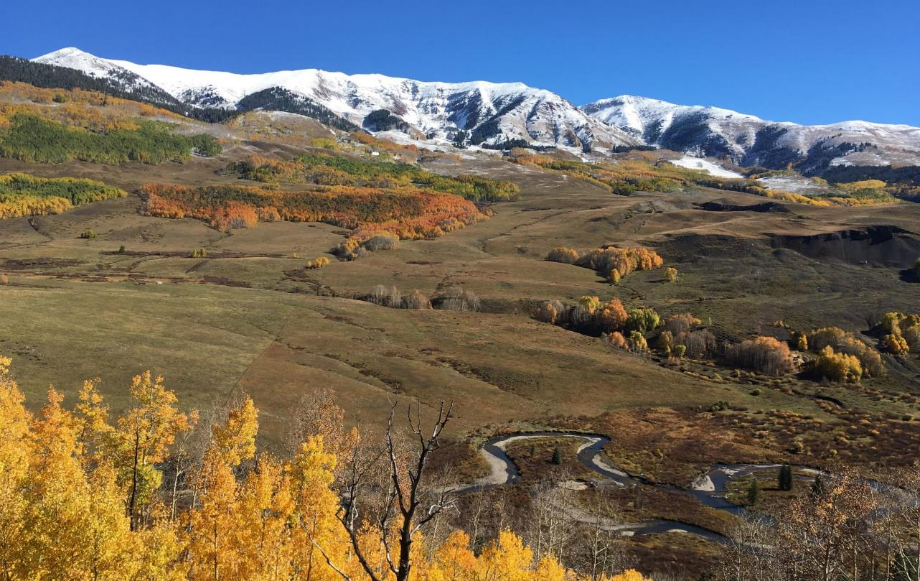


OTHER SLIDES
Questions?
Thank you!
Betsy Neely
bneely@tnc.org
720-974-7015
The Nature Conservancy
www.nature.org/Colorado
https://global.nature.org/initiatives/natural-climate-solution

Slide 29
OTHER SLIDES

Slide 30
What is Standing in the Way of a Future where
People and Nature Thrive Together?
8 GLOBAL CHALLENGES
Climate Change –
Mitigation and Adaptation
Expanding Footprint of Cities
High Agricultural Inputs
Invasive Species
Wood Products and
Connected Air & Water Pollution
Unsustainable Fisheries
Deficient Sanitation & Wastewater
Forests & Fire Suppression – U.S. Only
Energy Expansion & Sprawl
Notes:
Challenges for Nature that are also challenges for People
Identified through CbD 2.0
If solutions to the Global Challenges can be achieved at a global scale, then the major global drivers of biodiversity loss would be removed and the lives of hundreds of millions to billions of people globally could be improved.

Slide 31
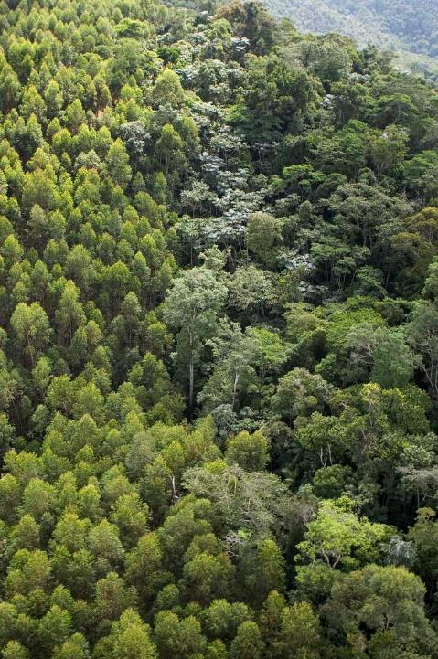
Tackle Climate Change /
Make the Case for Natural Climate Solutions
Reforestation in Brazil
The OPPORTUNITY
Reforestation is the biggest untapped opportunity to solve climate change with the potential to sequester the equivalent of half of global transportation emissions.
The IDEA
Help countries around the world turn bold climate commitments into action by demonstrating how reforestation can create jobs and grow the economy.
The PLACE
Reforesting 150,000 hectares in Brazil’s Serra da Mantiqueira region could make the case needed to accelerate restoration globally.

Slide 32
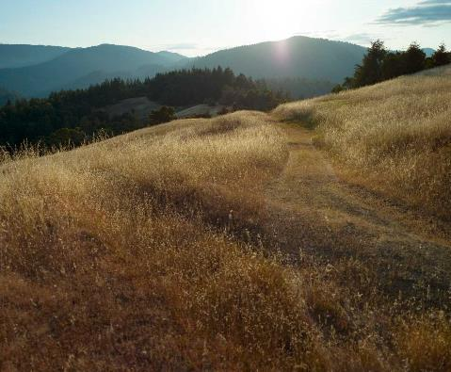
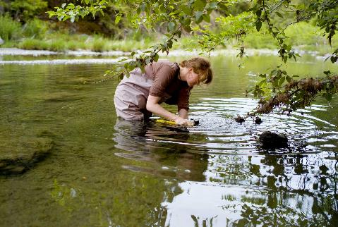
Tackle Climate Change /
Inspire Climate Action
Climate Policy and Action in the U.S.
The OPPORTUNITY
Reduce greenhouse gas emissions by informing policy and investing in nature-based solutions.
The IDEA
Harness local knowledge and relationships in each of TNC’s U.S. state programs to promote clean energy, generate bipartisan support and reduce emissions nationwide.
The PLACE
TNC’s California program is bringing innovative on-the- ground conservation solutions together with advocacy efforts to reduce emissions, sequester carbon and adapt to climate change.

Slide 33
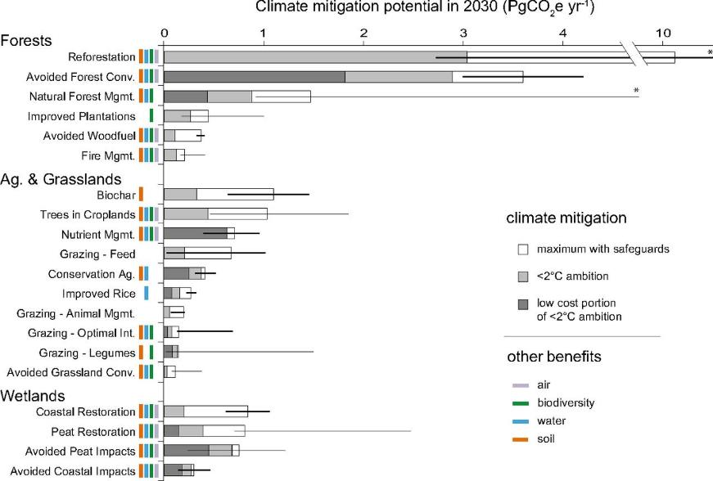
Climate Mitigation Potential of 20 Natural Pathways.
Griscom et al. PNAS 2017;114:11645-11650
Notes:
Climate mitigation potential of 20 natural pathways. We estimate maximum climate mitigation potential with safeguards for reference year 2030. Light gray portions of bars represent cost-effective mitigation levels assuming a global ambition to hold warming to <2 °C (<100 USD MgCO₂e⁻¹ y⁻¹). Dark gray portions of bars indicate low cost (<10 USD MgCO₂e⁻¹ y⁻¹) portions of <2 °C levels. Wider error bars indicate empirical estimates of 95% confidence intervals, while narrower error bars indicate estimates derived from expert elicitation. Ecosystem service benefits linked with each pathway are indicated by colored bars for biodiversity, water (filtration and flood control), soil (enrichment), and air (filtration). Asterisks indicate truncated error bars. See SI Appendix, Tables S1, S2, S4, and S5 for detailed findings and sources.

