Slide 1
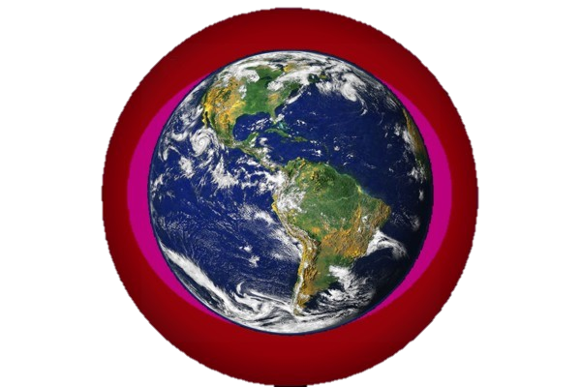
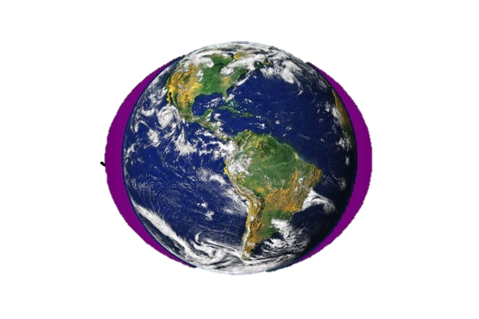
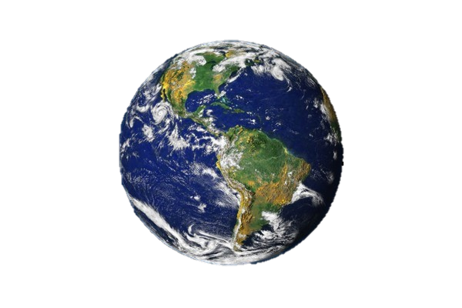
The CO₂ greenhouse gas effect is concentrated in the polar regions ! ! !
The Earth and its atmosphere
The most potent greenhouse gas is H₂O - vapor
Particularly in the Arctic !
The large H₂O
greenhouse effect
is controlled by temperature –
H₂O saturation doubles with every
10°C Increase
As a result It is concentrated in
the lower atmosphere
of the tropics
CO₂ and other Greenhouse gases are evenly distributed throughout the atmosphere

