Slide 1
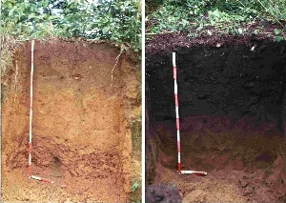
BIOCHAR for Bayard Breeding: Achieving food sustainability in the future Paul Belanger, Ph.D. – Geologist/Paleoclimatologist 10/13/2016
http://denverclimatestudygroup.com/ and on Facebook https://www.facebook.com/denverclimatestudygroup/
pebelanger@glassdesignresources.com
– slides-climate-change-solutions-what-you-thought-you-knew-is-obsolete-joe-romm PPTX

Slide 2
Acknowledgement: Ron Larson, Ph.D.

Slide 3
Biochar
In context of GEOENGINEERING:
Solar Radiation management (SRM)
& Carbon Dioxide Removal (CDR)
Web page BIOCHAR: http://denverclimatestudygroup.com/?page_id=28

Slide 4
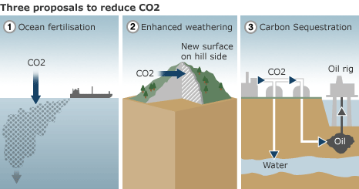
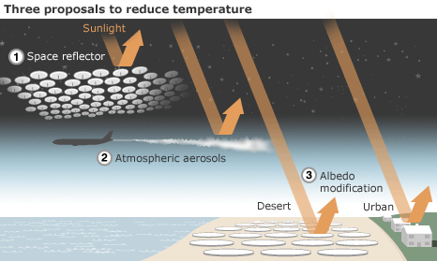
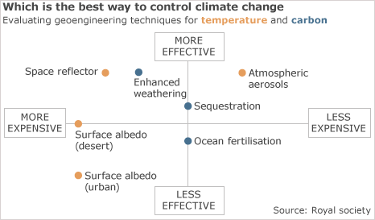
SRM VS. CDR
Mitigation and adaptation – 7.1 3.35 minutes

Slide 5
SEE February 15, 2016 discussion on EEE tab: http://denverclimatestudygroup.com/?page_id=683
NAS Climate Intervention: Preface and links (Click here); detailed reports below:
NATIONAL ACADEMY OF SCIENCES ONLINE: CLIMATE INTERVENTION: REFLECTING SUNLIGHT TO COOL EARTH (2015), AT HTTP://WWW.NAP.EDU/READ/18988;
AND CLIMATE INTERVENTION: CARBON DIOXIDE REMOVAL AND RELIABLE SEQUESTRATION (2015), AT HTTP://WWW.NAP.EDU/READ/18805.

Slide 6
BIOCHAR’s dual role: Soil enhancement & Atmospheric CO2 at the same time

Slide 7
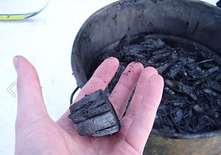
What is Biochar
https://en.wikipedia.org/wiki/Biochar:
“Biochar is charcoal used as a soil amendment. Like most charcoal, biochar is made from biomass via pyrolysis. Biochar is under investigation as an approach to carbon sequestration to produce negative carbon dioxide emissions.^{[1]} Biochar thus has the potential to help mitigate climate change via carbon sequestration.^{[2][3]} Independently, biochar can increase soil fertility ofacidic soils (low pH soils), increase agricultural productivity, and provide protection against some foliar and soil-borne diseases.^{[4]} Furthermore, biochar reduces pressure on forests.^{[5]} Biochar is a stable solid, rich in carbon, and can endure in soil for thousands of years.^{[1]”}

Slide 8
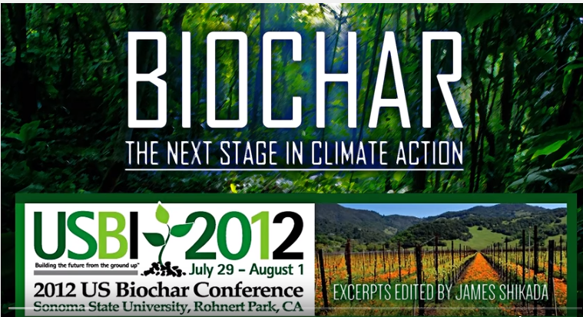
Cool Planet - @ 9:00 minutes
https://youtu.be/JPJsYZLU_sM?t=535

Slide 10
About C3, C4 and Cam Photosynthesis and Plants:
Photosynthetic efficiency: http://en.wikipedia.org/wiki/Photosynthetic_efficiency
C3 carbon fixation: http://en.wikipedia.org/wiki/C3_carbon_fixation
C4 carbon fixation:http://en.m.wikipedia.org/wiki/C4_carbon_fixation
Summary table comparison: http://www.cropsreview.com/types-of-photosynthesis.html
C3 C4 CAM Photosynthesis video: https://www.youtube.com/watch?v=Yg_pdXzWXVA

Slide 11
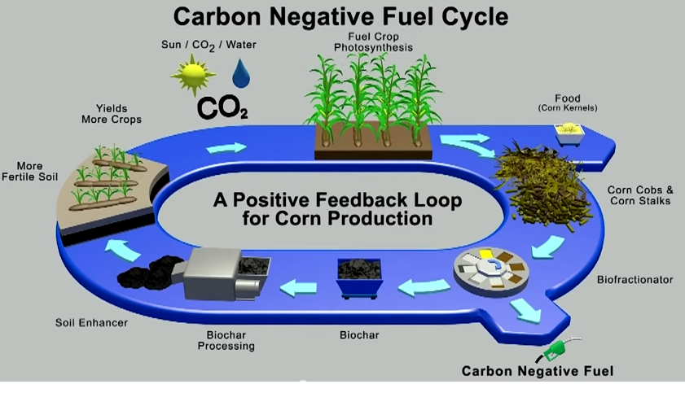
Carbon negative fuel cycle: Biochar and biofuels

Slide 12
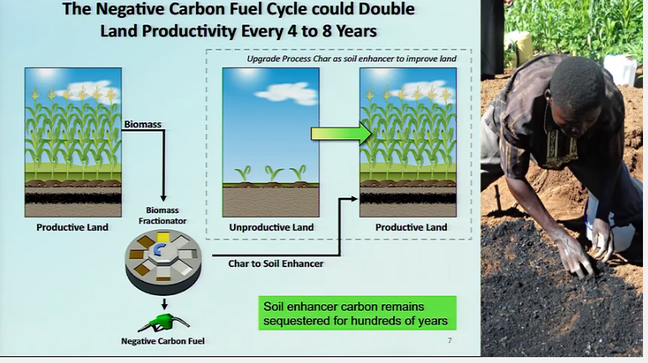
Soil Enhancement

Slide 13
3 Core Technologies:

Slide 14
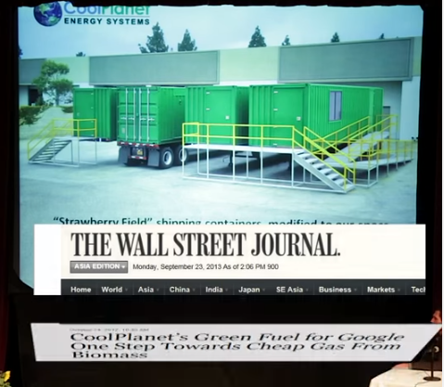

Slide 15
CARBON NEGATIVE BENEFITS: - Sequester CO2 - create Biofuels

Slide 16
Other resources:
Organizations / web pages
International Biochar Initiative http://www.biochar-international.org/
Climate change threatens nation’s agriculture: Dark clouds cast gloom over future domestic food production as global temperatures rise: http://www.japantimes.co.jp/life/2016/08/06/environment/climate-change-threatens-nations-agriculture/#.V_-Am-ArK03
Ithaka institute for carbon intelligence: http://www.ithaka-institut.org/en/
Does Biochar Deliver Carbon-Negative Energy? https://www.youtube.com/watch?v=pX3zhZ6ETWI

Slide 17
Facebook:
International Biochar Initiative: https://www.facebook.com/International-Biochar-Initiative-151512738198724/
BioChar Will Change The World! https://www.facebook.com/groups/49204917708/members/
google TED TALKs BY:
LOPA BRUJNES
Robert Lerner
Josiah Hunt
Lists: various – maybe I’ll update later; google in meantime

Slide 18
Acknowledgement: Ron Larson, Ph.D.
A note from Ron Larson: http://denverclimatestudygroup.com/wp-content/uploads/2014/07/email-fromRonLarsonbiocharexpert-1.pdf
Is it Gloom and Doom? NO! IT’S A CHALLENGE, and humanity has always been challenged and we are an adaptable species that has met the challenge over and over again!
http://denverclimatestudygroup.com/ and on Facebook https://www.facebook.com/denverclimatestudygroup/
pebelanger@glassdesignresources.com

