Slide 1
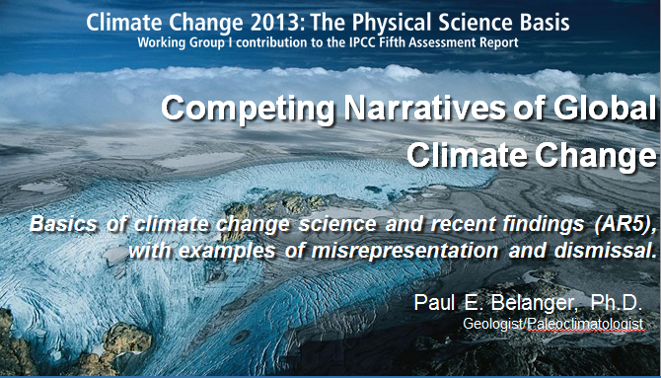
Competing Narratives of Global
Climate Change
Basics of climate change science and recent findings (AR5), with examples of misrepresentation and dismissal.
Paul E. Belanger, Ph.D.
Geologist/Paleoclimatologist
Ethics and Ecological Economics Study Group
September 8, 2014
pebelanger@glassdesignresources.com
http://denverclimatestudygroup.com/

Slide 2
A report on AR5 with details of the 20-point NAS/Royal Society report along with the Headlines of the 19-point Summary for Policy Makers (SPM)
In the “extras” slides

Slide 3
OUTLINE
IPCC History/Overview
Physical Science Summary – Vol 1 (1552 pp.)
  2 approaches:
    “Headlines” of Working Group
    20 points by Royal Soc./Nat. Academy of Sciences
  Interspersed with supportive slides
  Interspersed with where things get misrepresentations/dismissals by misinformation campaign groups
Ideological drivers, ridicule and alarmism
Conclusions and recommendations

Slide 4
Disclaimer
Any views expressed here are the result of my study, education and research and not those of associated affiliated societies or organizations.

Slide 5
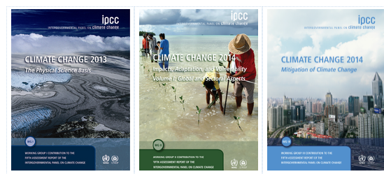
Intergovernmental Panel on Climate change(IPCC); aka: Fifth Assessment Report (AR5) - 3 volumes
http://www.ipcc.ch/report/ar5/:
September 2013
Physical Science
March 2014
Impacts, Adaptation & Vulnerability
April 2014
Mitigation

Slide 6
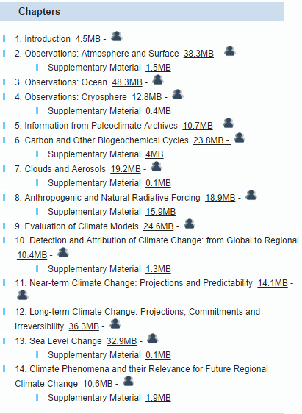
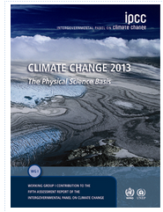
WG I – The Physical Basis

Slide 7
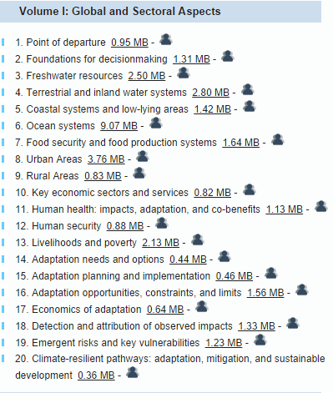
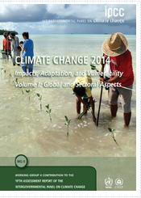
WG II – Impacts, Adaptation, Vulnerability

Slide 8
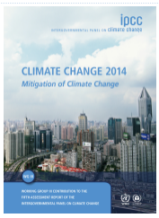
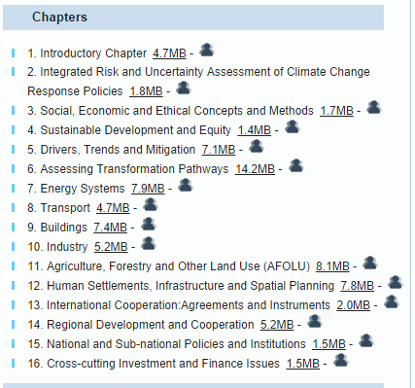
WG III – Mitigation of Climate Change

Slide 9
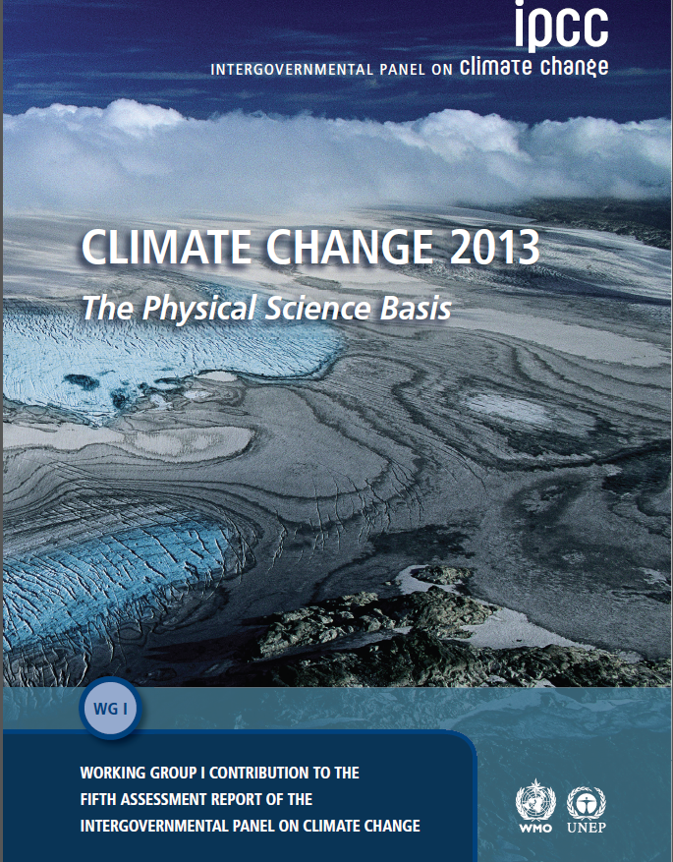
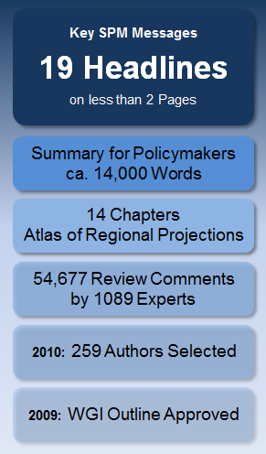

Slide 10

Physical Basis:
Communicating the main points

Slide 11
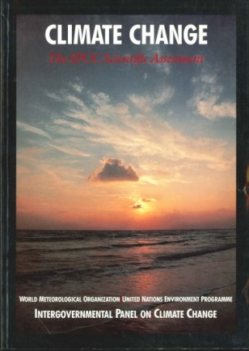
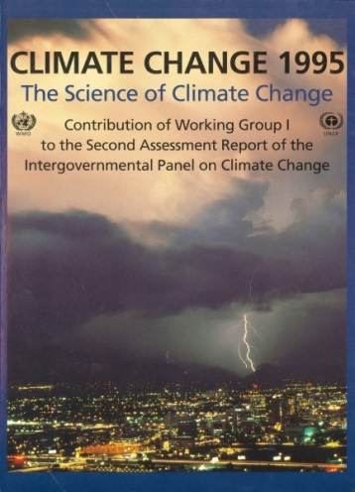
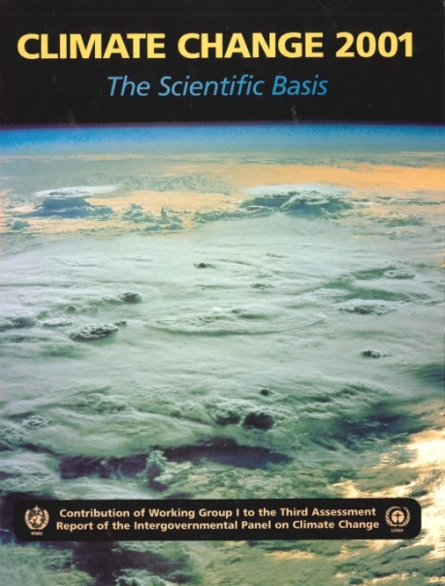
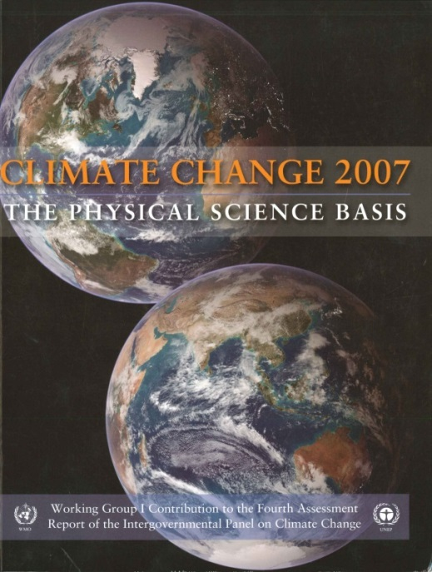
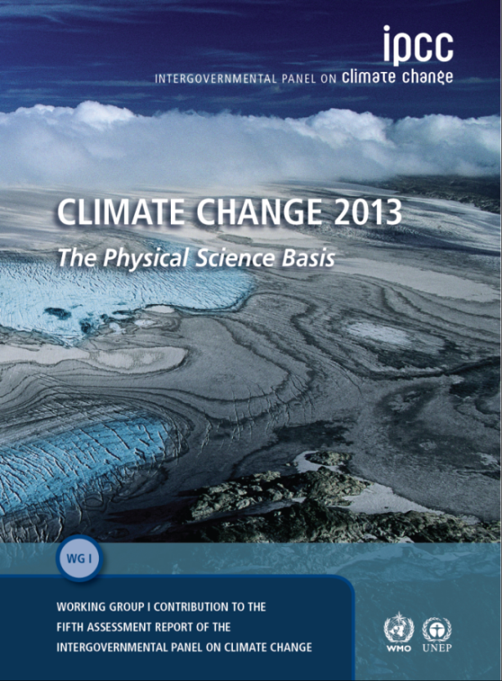
IPCC Assessment Reports since 1990: WGI Contribution
1990
1995
2001
2007
2013
Notes:
All IPCC Assessment Reports are available at www.ipcc.ch

Slide 12

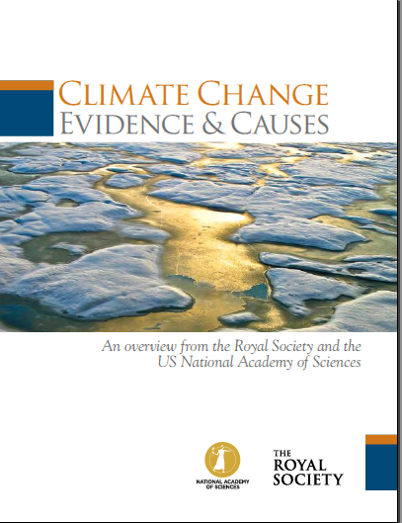
Summary for Policy Makers (SPM)
2 SUMMARY APPROACHES
19 “HEADLINES”
Majority: Temperature focused
Causes, Modeling, Effects
VS.
Public oriented queries
More comprehensive
summary of the science
Royal Society & US National Academy of Sciences (RS/NAS)

Slide 13
Approach
# 1
19
“Headlines”

Slide 14
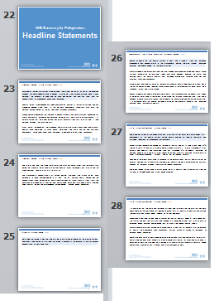
19 “Headlines” / 6 slides

Slide 15
Approach
# 2
20
Q/As to follow this slide

Slide 16
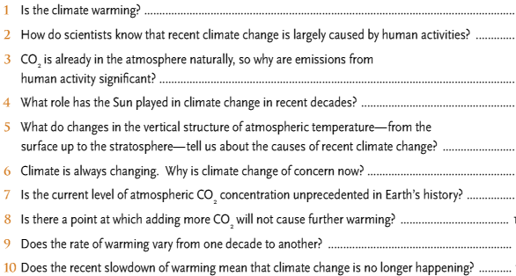

Slide 17
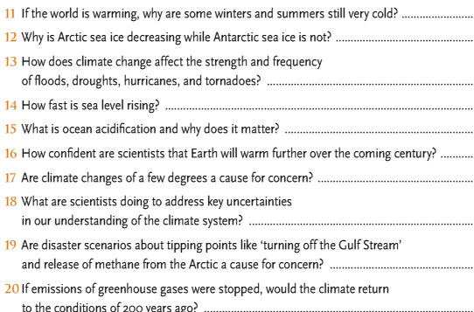

Slide 18
1: THE CLIMATE IS WARMING
The evidence:
  Atmosphere
  Oceans
  Cryosphere
  Sea Level
  Carbon and Other Biogeochemical Cycles

Slide 19
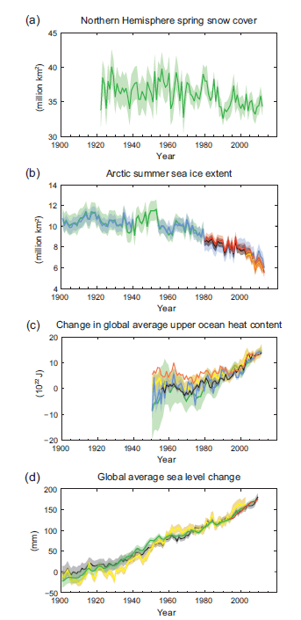
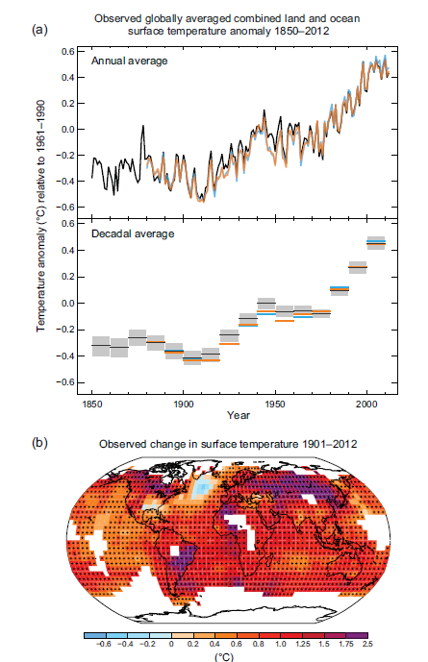
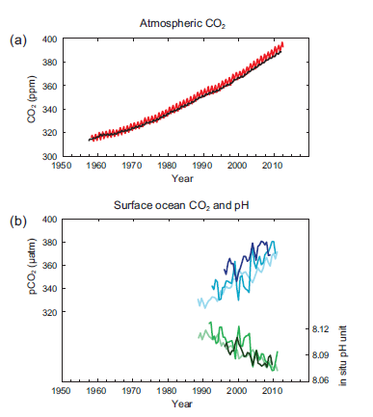
1 – Resulting in:

Slide 20
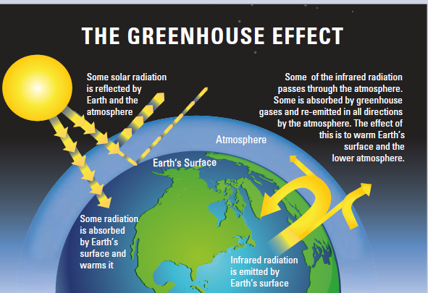
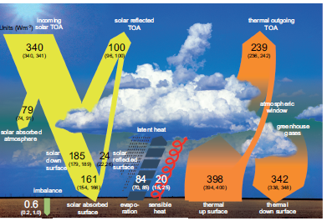

Slide 21
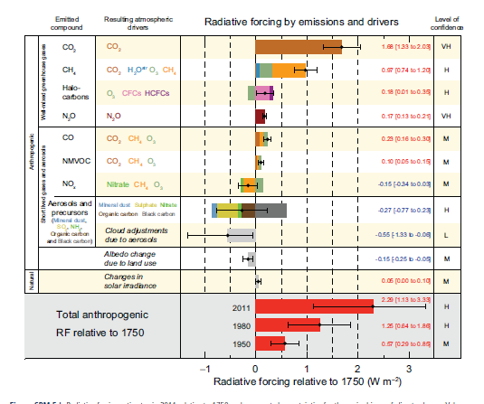
1: THE CLIMATE IS WARMING
Drivers; aka forcings, i.e. causes

Slide 22
Disinformation campaign
(see next 5 slides)
Will focus on last 15-17 years and claim global warming isn’t happening – all part of natural variability
Or, Arctic Sea Ice recovering
Or focus on select glaciers growing
Or Antarctic sea ice growing
Mostly ignore ocean acidification

Slide 23
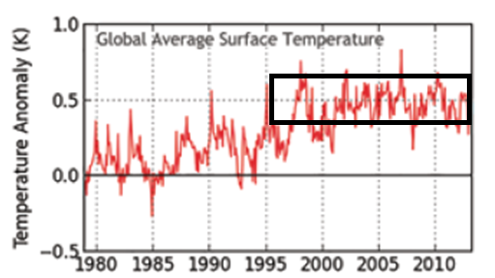
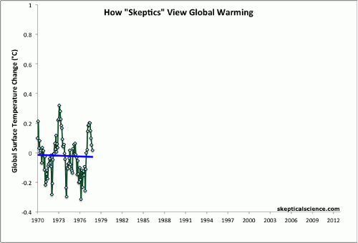

Slide 24
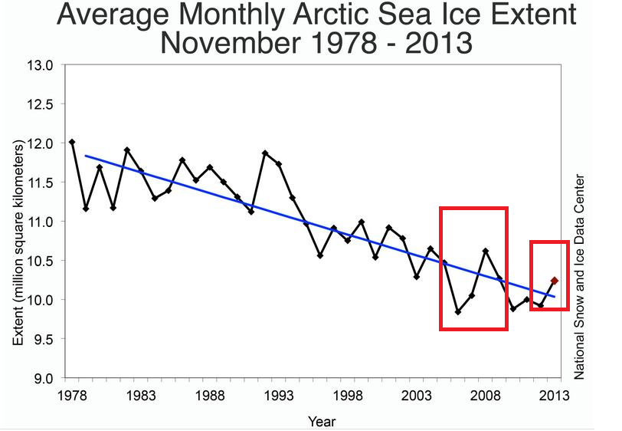
For more see: http://www.skepticalscience.com/melting-ice-global-warming.htm

Slide 25
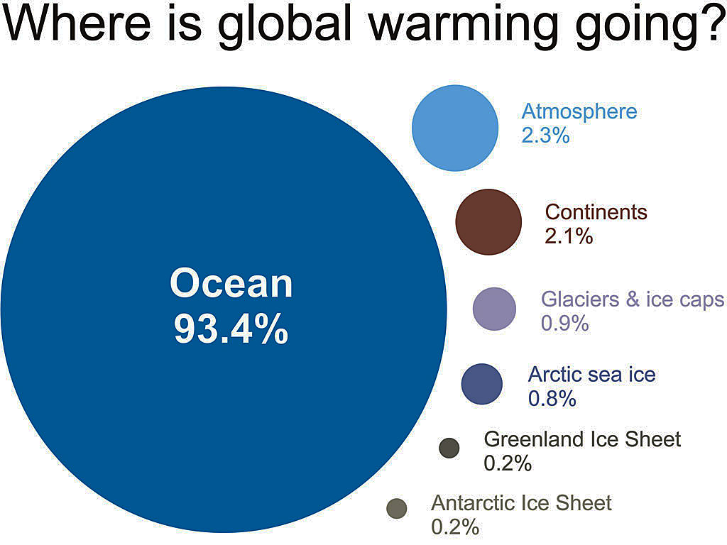
Only ~2% stays in atmosphere
~2% warms the land
Melting ice absorbs ~2%
John Cook, from IGPP 2007 data; ~93% to oceans continues (NOAA/NODC, 2012)

Slide 26
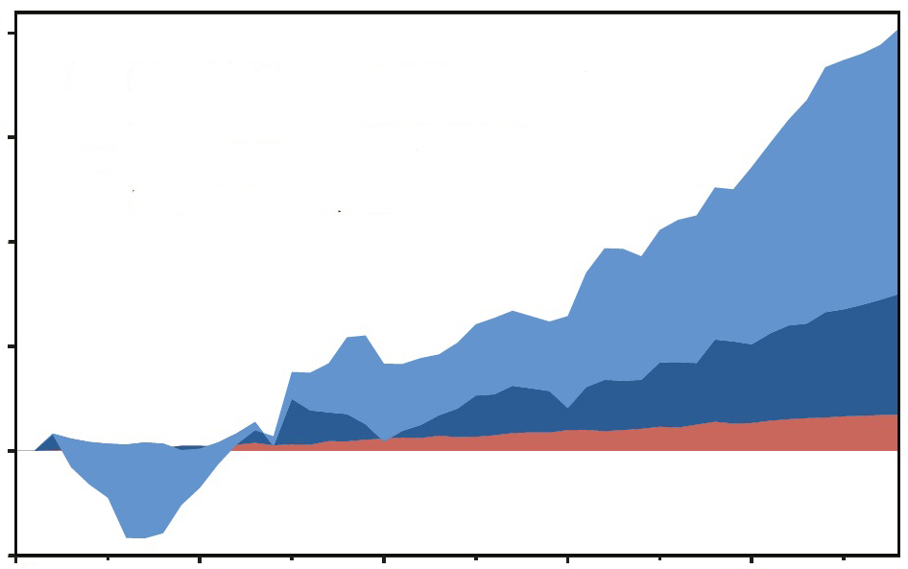
Change in heat content, 1958-2011
20
5-year moving averages
15
Oceans, 0-700 m depth
Oceans, 700-2000 m depth
10
10²² Joules
(Increasing heat, not shown, goes deeper than 2000 m)
5
0
Atmosphere + land + ice melting
-5
1960 1970 1980 1990 2000
(NOAA 2012 data, Nuccitelli et al. 2012 plot)

Slide 27
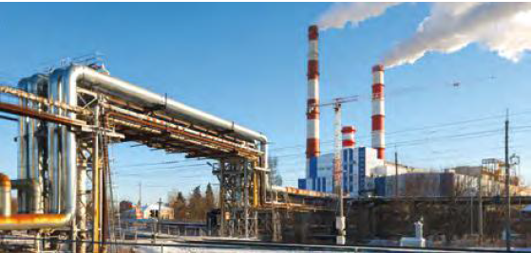
2: LARGELY CAUSED BY HUMAN ACTIVITIES

Slide 28
Disinformation campaign
Might argue the economics of change and pollution of generating metals for batteries
….not that there aren’t environmental concerns for new technology
For more, see: http://www.skepticalscience.com/its-not-us.htm

Slide 29
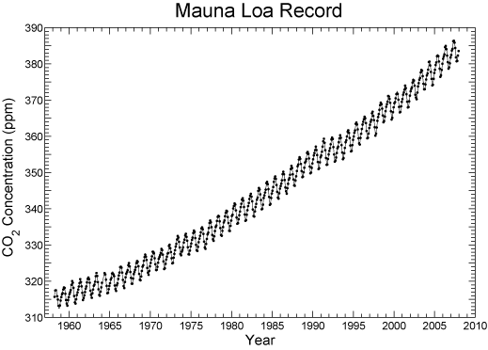
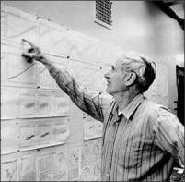
3: EMISSIONS FROM HUMAN ACTIVITIES LARGELY TO BLAME
40% increase in CO₂
Dead carbon altering atmospheric C¹⁴
That Carbon is more negative/enriched in C¹²

Slide 30
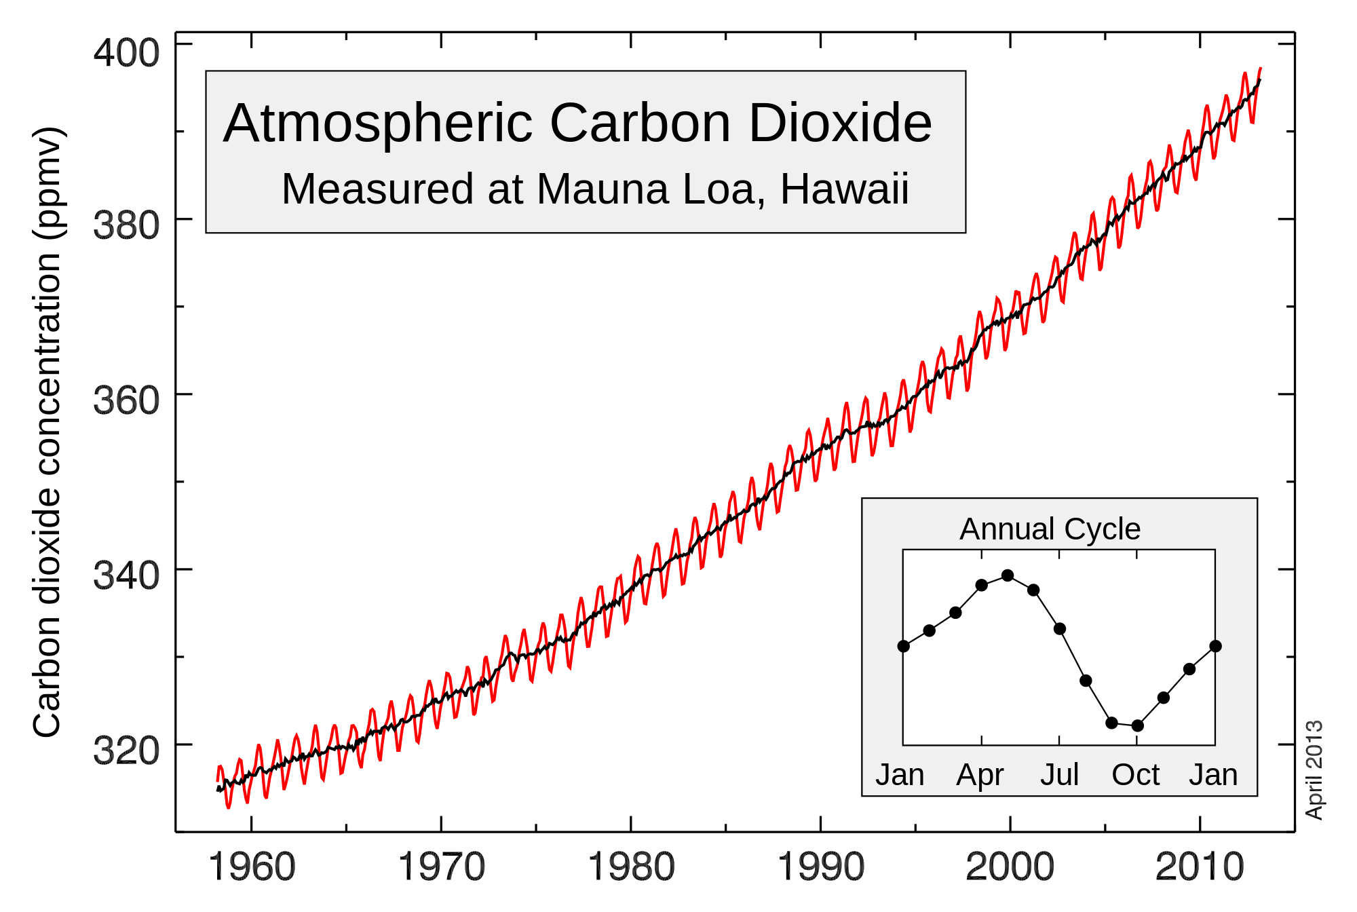
Lest we forget: CO2 is still going up
*
400 ppm
http://en.wikipedia.org/wiki/Keeling_Curve

Slide 31
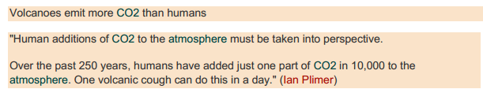
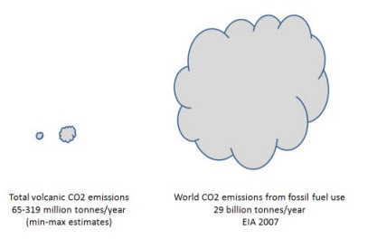
Disinformation campaign
Plimer (and others):
http://www.skepticalscience.com/volcanoes-and-global-warming.htm
  Versus - <1 % (I have the references)

Slide 32
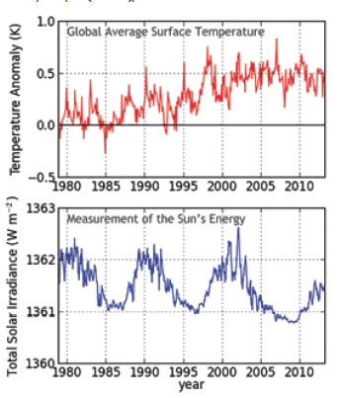
4: THE SUN’S ROLE IS MINIMIZING

Slide 33
Disinformation campaign
Predict long cold period coming, citing Russian studies that predict entering another “Little Ice Age”
Predicted last solar cycle wasn’t going to happen – go dormant / that didn’t occur!

Slide 34
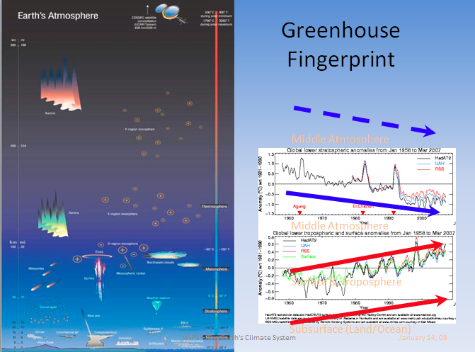
5: SURFACE TO STRATOSPHERE CHANGES

Slide 35
Disinformation campaign
Spencer and Christie will focus on cooling of Tropopause and mislead people
Etc….
For more see: http://www.skepticalscience.com/satellite-measurements-warming-troposphere.htm

Slide 36
6: CLIMATE IS ALWAYS CHANGING
– SO WHAT?
It’s not about whether the Earth will survive – it will!
It’s about sustainability with expected consequences
  Refugees
  Economies
  Etc., etc.

Slide 37
50 million years ago (50 MYA) Earth was ice-free.
Atmospheric CO₂ amount was of the order of 1000 ppm 50 MYA.
Atmospheric CO₂ imbalance due to plate tectonics ~ 10⁻⁴ ppm per year.
Notes:
37

Slide 38
Disinformation campaign
Fish analogy:
  Some meteorologists who don’t buy climate change: in bottom of fish tank looking at the sand grains.
  Some geologists who don’t buy climate change: in outer space looking at the fish tank.
  BOTH not seeing the pyranahs swirling in the fish tank : It’s about sustainability!
For more see: http://www.skepticalscience.com/climate-change-little-ice-age-medieval-warm-period.htm

Slide 39
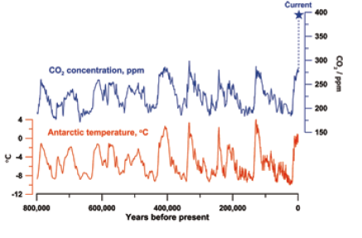
7: HISTORICALLY UNPRECEDENTED CO₂ CONCENTRATIONS

Slide 40
8: WILL ADDING MORE CO2 EVENTUALLY STOP CAUSING WARMING?
NO

Slide 41
Disinformation campaign
Say CO₂ saturated
Water vapor as more abundant and more important green house gas (GHG) – ignoring feedback increase cause by warming caused by increases in CO₂
PETM shows that CO₂ spikes do continue to influence climate
See next 3 slides

Slide 42
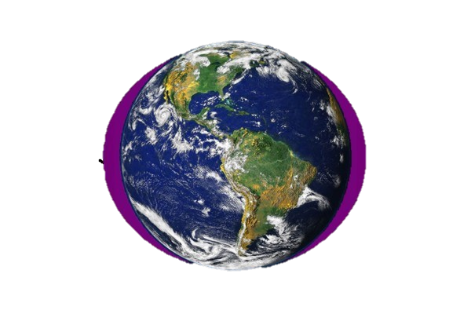

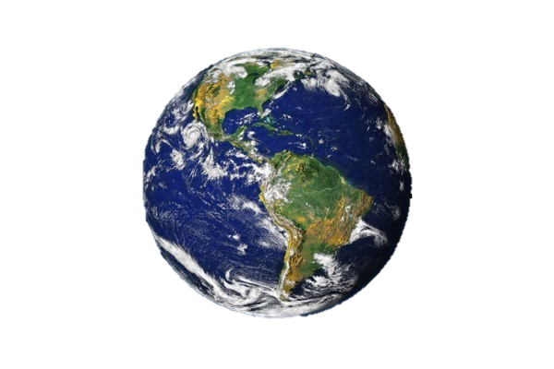
The CO₂ greenhouse gas effect is concentrated in the polar regions ! ! !
The Earth and its atmosphere
The most potent greenhouse gas is H₂O - vapor
Particularly in the Arctic !
The large H₂O
greenhouse effect
is controlled by temperature –
H₂O saturation doubles with every
10°C Increase
As a result It is concentrated in
the lower atmosphere
of the tropics
CO₂ is evenly distributed throughout the atmosphere

Slide 43
50 million years ago (50 MYA) Earth was ice-free.
Atmospheric CO₂ amount was of the order of 1000 ppm 50 MYA.
Atmospheric CO₂ imbalance due to plate tectonics ~ 10⁻⁴ ppm per year.
Notes:
43

Slide 44
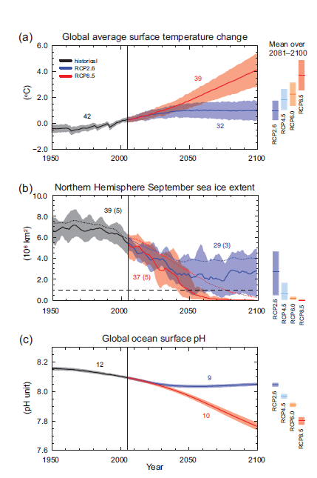
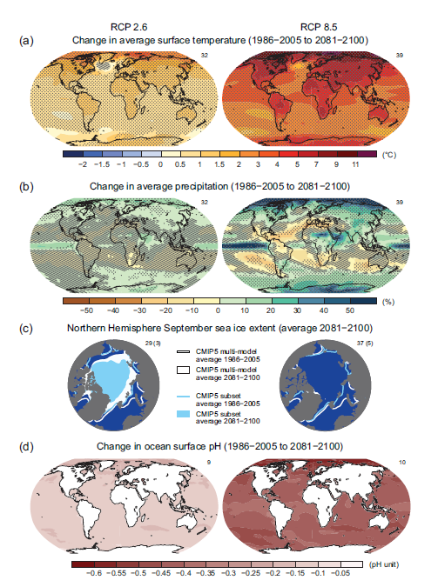

Slide 45
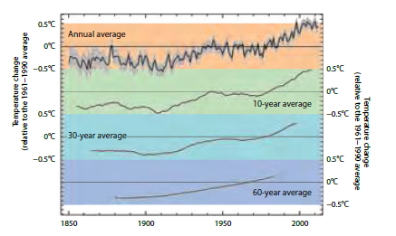
9: DOES RATE OF WARMING CHANGE BY DECADE TO DECADE?
YES

Slide 46
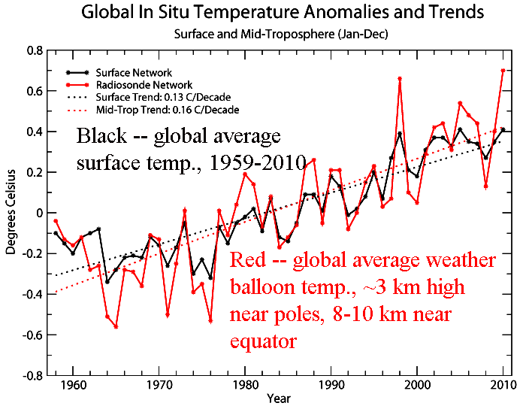
b
El Niño
Major volcanic eruption
La Niña
Warm El Niño tropical Pacific releases ocean heat to air
Cool La Niña is less cloudy, so water absorbs more solar heat and atmosphere gets less

Slide 47
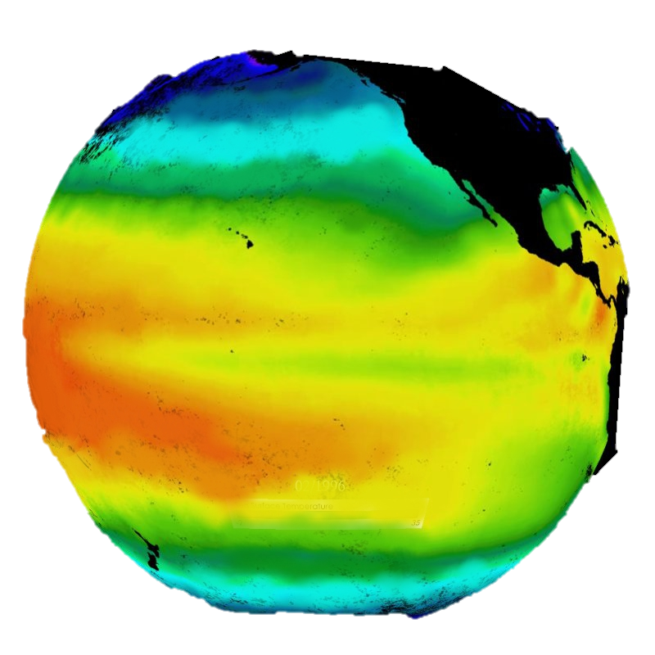
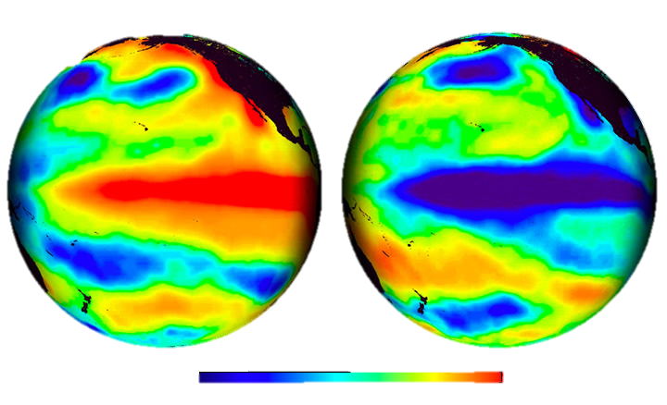
The Pacific –
‘normal condition’
El Niño
La Niña
Temperature Anomaly °C
-4
-2
0
2
4

Slide 48
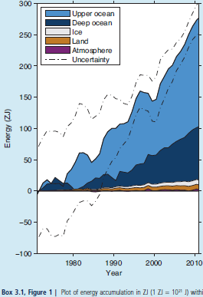
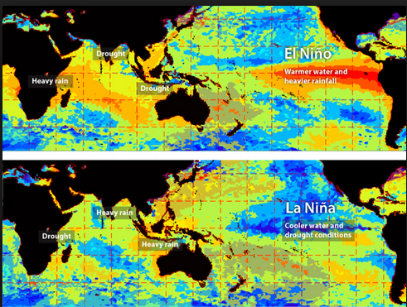
http://www.skepticalscience.com/graphics.php?g=47

Slide 49
10: DOES CURRENT WARMING SLOWDOWN MEAN WARMING IS NO LONGER HAPPENING?
NO

Slide 50
Disinformation campaign
Harp on climate-gate
Harp on hockey stick curve by Mann, subsequently addressed by NAS – i.e. in support of the curve, albeit proxy data has large error bars

Slide 51
11: WHY ARE SOME WINTERS STILL VERY COLD?

Slide 52
Disinformation campaign
A favorite one whereby they point out the anomalies of winter weather to deny global warming – ignoring the GLOBAL PICTURE

Slide 53
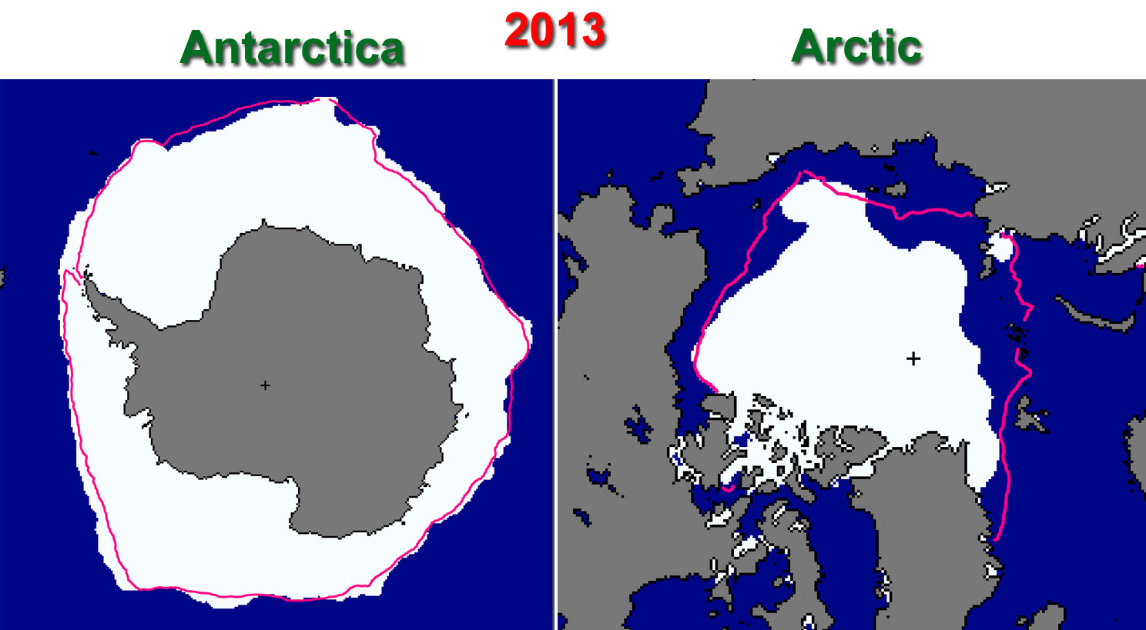
12. ARCTIC ICE vs. ANTARCTIC SEA ICE
Ans. More moisture in air around Antarctica (AA) to nucleate sea ice
Despite > AA is does not compensate for Arctic loss
https://itsnotnova.files.wordpress.com/2013/10/arcticvsantarctic2013.jpg

Slide 54
13: HOW DOES CLIMATE CHANGE AFFECT THE STRENGTH AND FREQUENCY OF FLOODS, DROUGHTS, HURRICANES AND TORNADOES?

Slide 55
First: the Disinformation campaign
Another favorite one with some validity IN THAT NOT YET STATISTICALLY RELEVANT: Judith Curry, Roger Pielke, Jr.
So my answer: they do not have the geologic perspective (see next 3 slides) and thus I ask: should we wait until it is statistically relevant?

Slide 56
50 million years ago (50 MYA) Earth was ice-free.
Atmospheric CO₂ amount was of the order of 1000 ppm 50 MYA.
Atmospheric CO₂ imbalance due to plate tectonics ~ 10⁻⁴ ppm per year.
Notes:
56

Slide 57

Correlation of
CO₂ and temperature over last 65 million years
Beerling and Royer, Nature 2011

Slide 58
Notes:
58

Slide 59
14: HOW FAST IS SEA LEVEL RISING?
…let the next slide answer that

Slide 60


14: HOW FAST IS SEA LEVEL RISING?
Blue: Sea level change from tide-gauge data (Church J.A. and White N.J., Geophys. Res. Lett. 2006; 33: L01602)
Red: Univ. Colorado sea level analyses in satellite era (http://www.columbia.edu/~mhs119/SeaLevel/).

Slide 61

15: OCEAN ACIDIFICATION
Makes aragonite harder to be deposited
Growth rates slow down
Favors calcite secreting organisms
Complex with feedbacks

Slide 62
Disinformation campaign
Will cite coral bleaching recovery cases, the few there are – and that’s true
Natural cycles of not? Time will tell.
Temperatures rises are also a factor in coral bleaching and subsequent temporary cooling of affected areas can result it recovery

Slide 63

16: HOW CONFIDENT ARE CLIMATE SCIENTISTS ABOUT FUTURE WARMING?
Quite confident – the basis of AR5

Slide 64
Disinformation campaign
Will cite overstated claims that didn’t happen
  e.g. Himalayas glaciers to melt by 2030, a AR4 mistake/retraction
  Various quotes that don’t happen in the time frame specified by the quote
  Then ridicule them
  Lesson to be learned – be cautious about what you say

Slide 65
Disinformation campaign
Will cite coral bleaching recovery cases, the few there are – and that’s true
Natural cycles of not? Time will tell.
Temperatures rises are also a factor in coral bleaching and subsequent temporary cooling of affected areas can result it recovery

Slide 66
17: SO WHAT’S A FEW DEGREES?
Let the next slide address this

Slide 67
Loaded Climate Dice: global warming is increasing extreme weather events.
Extreme summer heat anomalies now cover about 10% of land area, up from 0.2%.
This is based on observations, not models.
Frequency of occurrence (vertical axis) of local June-July-August temperature anomalies (relative to 1951-1980 mean) for Northern Hemisphere land in units of local standard deviation (horizontal axis). Temperature anomalies in the period 1951-1980 match closely the normal distribution ("bell curve", shown in green), which is used to define cold (blue), typical (white) and hot (red) seasons, each with probability 33.3%. The distribution of anomalies has shifted to the right as a consequence of the global warming of the past three decades such that cool summers now cover only half of one side of a six-sided die, white covers one side, red covers four sides, and an extremely hot (red-brown) anomaly covers half of one side.
Source: Hansen, J., Sato, M., and Ruedy, R., Proc. Natl. Acad. Sci., 2012.

Slide 68
18: WHAT ARE SCIENTISTS DOING TO ADDRESS KEY UNCERTAINTIES?
100s/1000s continuing to study:
  To gather date
  Better understand
  Refine models
  Etc., etc….

Slide 69
19: ARE TIPPING POINTS OF CONCERN?
AR5 mostly dismissive of tipping points causing catastrophe as often carried out in alarmism statements
Beware of what you say and how you say it!

Slide 70

20: IF WE STOPPED OR CONTINUED EMISSIONS, WHAT WOULD HAPPEN?
It’s in the bank, without Geoengineering options:
  Solar Radiation Management (SRM)
  Carbon Dioxide Removal (CDR) – for which Biochar gets lumped into this latter category

Slide 71
So is there hope?
YES
SRM has some serious unintended consequences, and if ever stopped huge subsequent corrections
CDR: BECCS and/or Biochar have the greatest promise – cost and effectiveness will be key!
  My personal favorite is Biochar: for more see http://denverclimatestudygroup.com/?page_id=28 (Denver climate study group page – under page drop-down and click on Biochar)
    See Promise for the future regarding agriculture and sequestering Carbon (with a potential claim of 100 ppm in 30 years) Cool Planet and associated YouTube.

Slide 72
Conclusions/Recommendations
Don’t let ideologies blind oneself to the data and science
Be careful what and how you say, or how a person says or makes claims; it comes back to haunt one.
Ridicule accomplishes nothing
Study and discuss; weigh the factors of choices:
  Do nothing
  Mitigate
  Save for the future
  Or various combinations of the above based on economics and consequences

Slide 73



Three books to consider:
Simple succinct Summary:
  What We Know About Climate Change (Boston Review Books) by Kerry Emanuel (Nov 30, 2012)
Intermediate Level Book:
  Earth: The Operators' Manual by Richard B. Alley (Apr 18, 2011)
  http://earththeoperatorsmanual.com/
More comprehensive book:
Experimenting on a Small Planet: A Scholarly Entertainment by William W. Hay (Dec 14, 2012)

Slide 74
Websites to consider:
http://www.skepticalscience.com/
http://www.realclimate.org/
http://www.climatecentral.org/
http://www.noaa.gov/ , particularly http://www.noaa.gov/climate.html
…etc…..

Slide 75
THANK YOU
QUESTIONS?
Ethics and Ecological Economics Study Group
September 8, 2014
pebelanger@glassdesignresources.com
http://denverclimatestudygroup.com/

Slide 76
EXTRAS

Slide 77
LONGER TIME-FRAME CONTROLS ON CLIMATE
NEXT 2 SLIDES

Slide 78







INTRODUCTION: Definitions:
  First order Forcings: EXTERNAL Influences (3):
    SOLAR input:
0.9% less 100 My ago
Obliquity
Precession
Eccentricity
    Atmospheric Opacity
    (gases that absorb radiation in or out)
    Albedo (30-85%)
  Feedbacks: INTERNAL dynamics and responses
    e.g. higher water vapor in atm. due to heating of atm

Slide 79

3º
Milankovitch
Cycles
1º
(in order of greatest
Influence @65º)
2º
Notes:
See http://www.skepticalscience.com/Milankovitch.html for good explanation
Eccentricity affects entire globe equally; 100,000 year periodicity: 0.45 w/m-2; yearly delta of 6.4% over course of year
Obliquity - hemispherical: 22-25; currently 23.5, 41,000 year periodicity
Precession: 19k 23k – when n. hemisphere nearest sun in summer (currently we are furthest) – why hypsithermal was slightly warmer.
Precession varies on timescales of 19,000 and 23,000 years, and is thus important even over historical times. The precessional cycle is the key player behind the Holocene Climate Optimum, a time between ~7,000 and 5,000 years ago of particularly warm Northern Hemispheric extra tropical summers, and colder tropical and extra tropical winters.
Eccentricity is the only Milankovitch cycle that alters the annual-mean global solar insolation (i.e., the total energy the planet receives from the sun at the top of the atmosphere). For the mathematically inclined, the annually-averaged insolation changes in proportion to 1/(1-e²)^{0.5,} so the solar insolation increases with higher eccentricity. This is a very small effect though, amounting to less than 0.2% change in solar insolation, equivalent to a radiative forcing of ~0.45 W/m² (assuming present-day albedo). This is much less than the total anthropogenic forcing over the 20th century. However, eccentricity does modulate the precessional cycle, as we shall see.
Obliquity: Obliquity describes how tilted a planet’s axis is (Fig. 3 shows the obliquity of eight planets, plus Pluto which is labeled as a planet). The tilt of the Earth is ultimately what allows for the existence of seasons, since the Northern Hemisphere is pointed toward the sun in the boreal summer, and away from the sun in the boreal winter. The tilt of Earth’s axis (in other words, the angle between the spin–axis and a line perpendicular to the orbital plane) varies between about 22 to 25° (currently 23.5°) over a period of nearly 41,000 years, driving changes in the distribution of sunlight between the equator and high latitudes (with more tilt implying more sunlight at high latitudes, and less at lower latitudes; therefore more oblique orbits favor deglaciation on Earth).
Precession: Precession does not describe how tilted the Earth’s axis is, but rather the direction of its axis. This changes what star is the “North Star” over time (today it is Polaris, but near the end of the last deglaciation it was Vega), and as described below, governs the timing of the seasons. This is illustrated in Figure 4 (a and b) below.

Slide 80
The physics of spectral absorption
NEXT SLIDE

Slide 81


Slide 82
Details of the past 65 Ma
NEXT SLIDE

Slide 83

Cenozoic Deep Sea Climate Record
Azolla sequestering event
hyperthermals
41k-100k & amplitude
change:
Increase in
Antarctic ice
Closing of
Isthmus
of Panama
Opening of the Drake passage isolating Antarctica and further drop in CO₂
Zachos et al. 2008

Slide 84
50 million years ago (50 MYA) Earth was ice-free.
Atmospheric CO₂ amount was of the order of 1000 ppm 50 MYA.
Atmospheric CO₂ imbalance due to plate tectonics ~ 10⁻⁴ ppm per year.
Notes:
84

Slide 85

History of oceans for last 65 m.y.
We know a great deal about past CO₂ , temp., etc.
Now
65 m.y.
R. Norris et al., Science, 2013

Slide 86


Slide 87
Correlation of
CO₂ and temperature over last 65 million years
Beerling and Royer, Nature 2011

Slide 88



Climate Changes from Ocean Sediment Cores, since 5 Ma. Milankovitch Cycles
41K
100 K
5.0Ma
4.0Ma
3.0Ma
2.0Ma
1.0Ma
0
When CO₂ levels get below ~400-600 ppm Orbital parameters become more important than CO₂

Slide 89

400 ppm
(2014)
280ppm
180ppm

Slide 90
Water vapor trends with temperature
NEXT 2 slides

Slide 91


0.8562 m³
(95 cm x 95 cm x 95 cm)

Slide 92

Amount of water vapor, if condensed in 1 kg air (`1 cubic meter)
@ 30ºC +1ºC = 8% increase in vapor
10ºC = (50ºF)
7.8 cc
20ºC = (68ºF)
15 cc
30ºC = (86ºF)
27.7 cc
40ºC = (104ºF)
49.8 cc

Slide 93

The effects of sea-level rise. Tan = - 130 m – Last Glacial Maximum (24,000 BP)
Red = +2 m – possible by 2100. Orange = +4 m (2200) Yellow = Greenland ice gone. The white area shows the transgression if all ice (Greenland + Antarctica) were to melt.

Slide 94


Slide 95


Slide 96

China has the largest fossil fuel emissions today.
However, climate change is driven by cumulative emissions, so developed nations, especially the U.S., have greatest responsibility.

Slide 97

1: THE CLIMATE IS WARMING
The evidence:
  Atmosphere
  Oceans
  Cryosphere
  Sea Level
  Carbon and Other Biogeochemical Cycles
Headline #1

Slide 98

1: THE CLIMATE IS WARMING
The evidence:
  Atmosphere
  Oceans
  Cryosphere
  Sea Level
  Carbon and Other Biogeochemical Cycles
Headline #2

Slide 99

1: THE CLIMATE IS WARMING
The evidence:
  Atmosphere
  Oceans
Headline #3

Slide 100

1: THE CLIMATE IS WARMING
The evidence:
  Atmosphere
  Oceans
  Cryosphere
Headline #4

Slide 101

1: THE CLIMATE IS WARMING
The evidence:
  Atmosphere
  Oceans
  Cryosphere
  Sea Level
Headline #5

Slide 102

1: THE CLIMATE IS WARMING
The evidence:
  Atmosphere
  Oceans
  Cryosphere
  Sea Level
  Carbon and Other Biogeochemical Cycles
Headline #6

Slide 103

1: THE CLIMATE IS WARMING
Drivers; aka forcings, i.e. causes
Headline #7

Slide 104
1: THE CLIMATE IS WARMING
Drivers; aka forcings, i.e. causes

Slide 106
1 – Resulting in:

Slide 108

2: LARGELY CAUSED BY HUMAN ACTIVITIES
Headline #8

Slide 109



Modeling
Headline # 9
Headline # 10

Slide 110


2: Causes and Effects
Headline # 11
Headline # 12

Slide 111

2: Effects: Temperature rise
Headline # 13

Slide 112


Effects: Hydrologic and Ocean responses
Headline # 14
Headline # 15

Slide 113


Effects: Snow & Ice/Sea level responses
Headline # 16
Headline # 17

Slide 114


Effects: Ocean Acidification/other consequences
Headline # 18
Headline # 19

