Slide 1
Contemporary Issues Regarding Climate Change and Solutions
Paul Belanger, Ph.D.,
Geologist/Paleoclimatologist
Tuesday October 10th , 2017:
Follow up to NICL
Contemporary events
Population

Slide 2
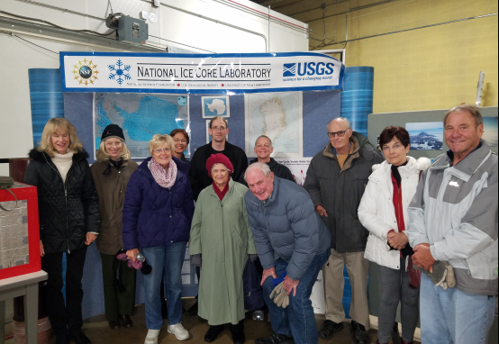
Follow-up to NICL

Slide 3
Azolla event:
~ 49 Ma
50 million years ago (50 MYA) Earth was ice-free.
Atmospheric CO₂ amount was of the order of 1000 ppm 50 MYA.
Atmospheric CO₂ imbalance due to plate tectonics ~ 10⁻⁴ ppm per year.
Notes:
3

Slide 4
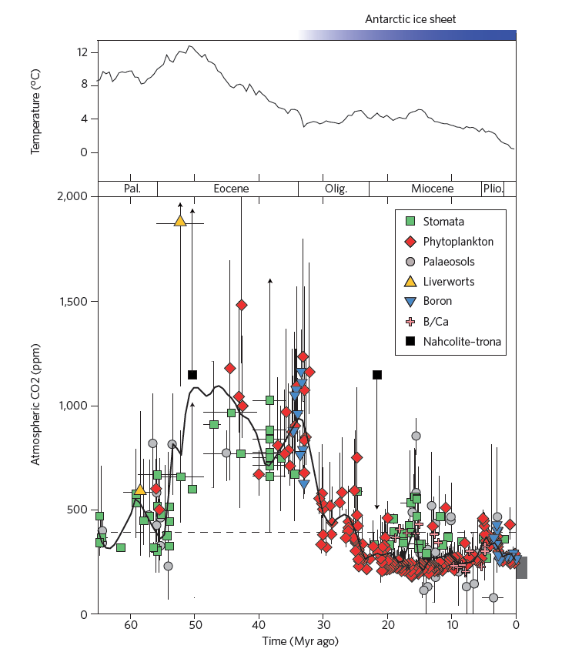
Azolla event:
~ 49 Ma
Notes:
4

Slide 5
Long-term Carbon Cycle: rocks
Two generalized reactions…
Photosynthesis/Respiration
CO₂ + H₂0 ↔ CH₂O + O₂
Weathering/Precipitation
CO₂ + CaSiO₃ ↔ CaCO₃ + SiO₂

Slide 6
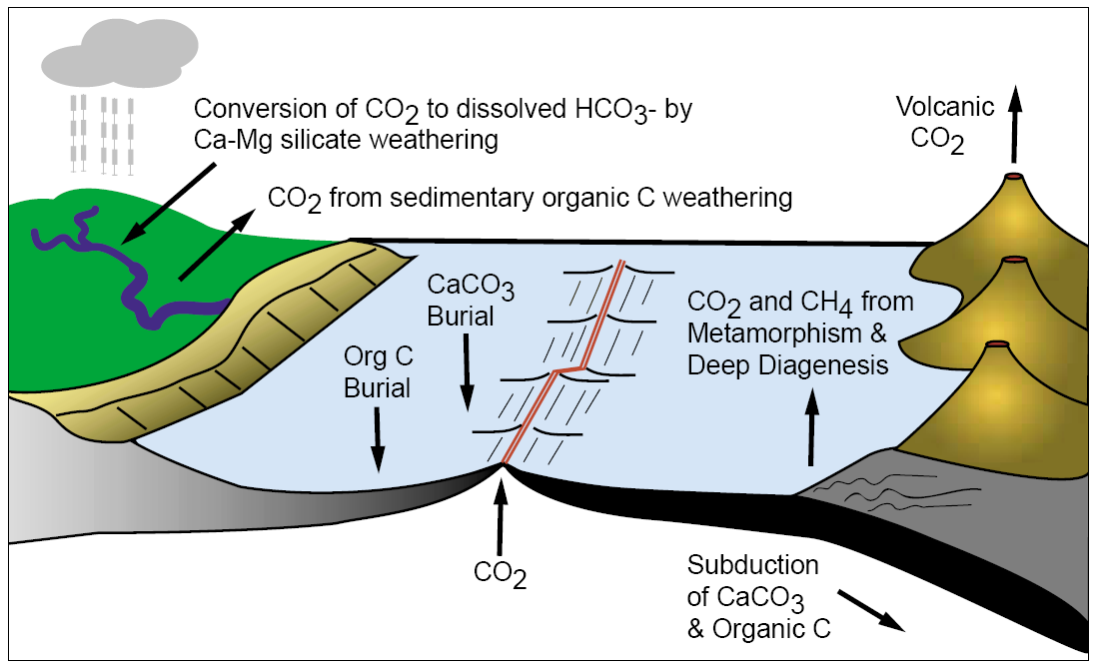
Long-term carbon cycle: rocks
Berner, 2001

Slide 7
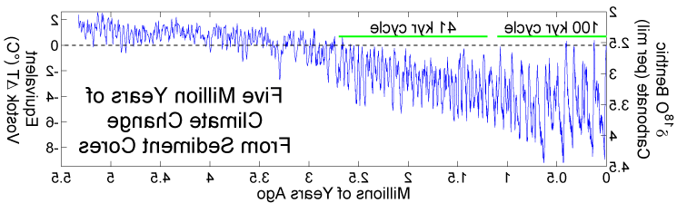

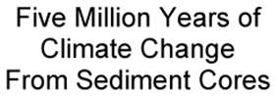
Climate Changes from Ocean Sediment Cores, since 5 Ma. Milankovitch Cycles
41K
100 K
5.0Ma
4.0Ma
3.0Ma
2.0Ma
1.0Ma
0
When CO₂ levels get below ~400-600 ppm Orbital parameters become more important than CO₂

Slide 8
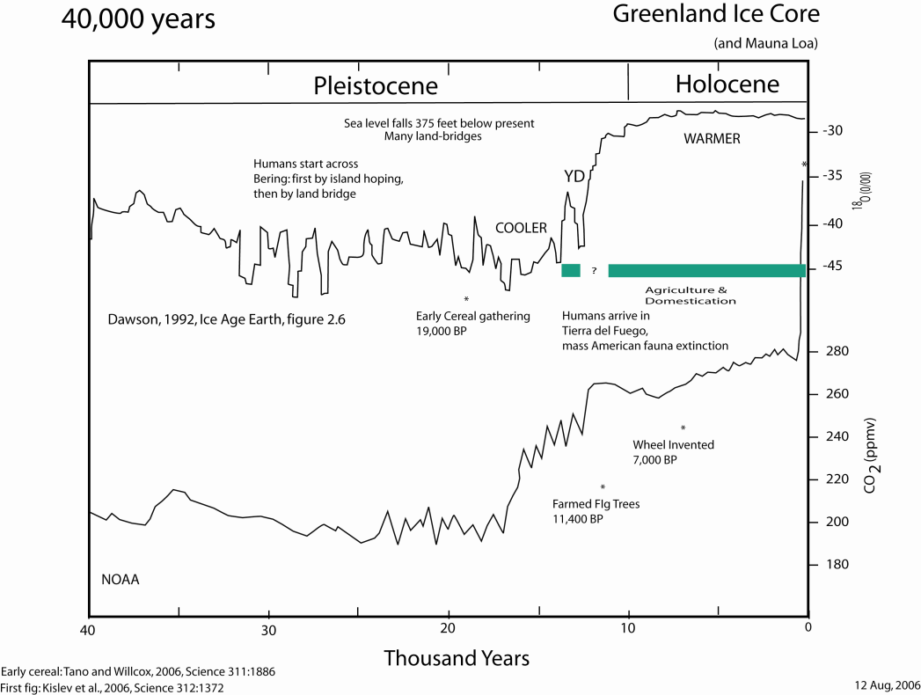

Slide 9
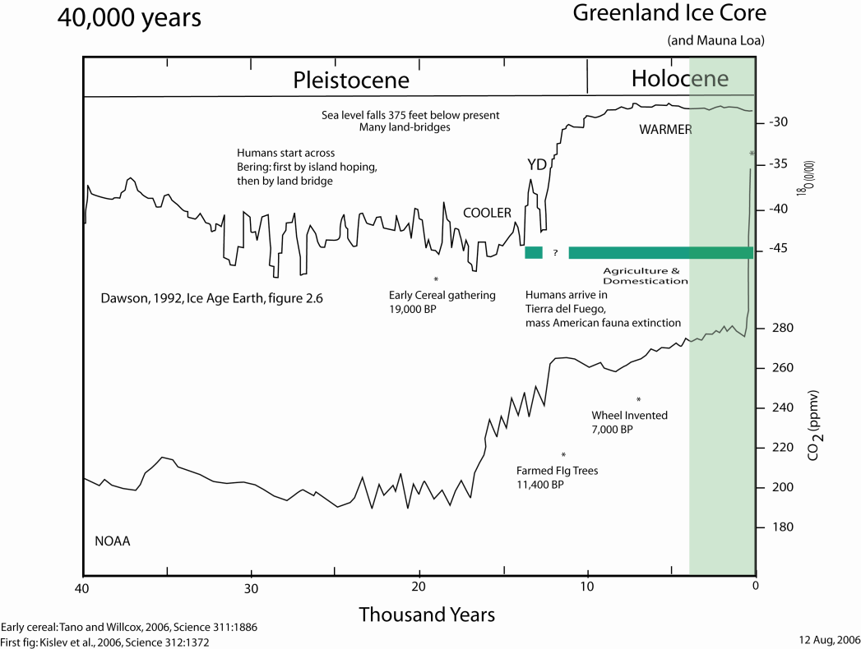

Slide 10
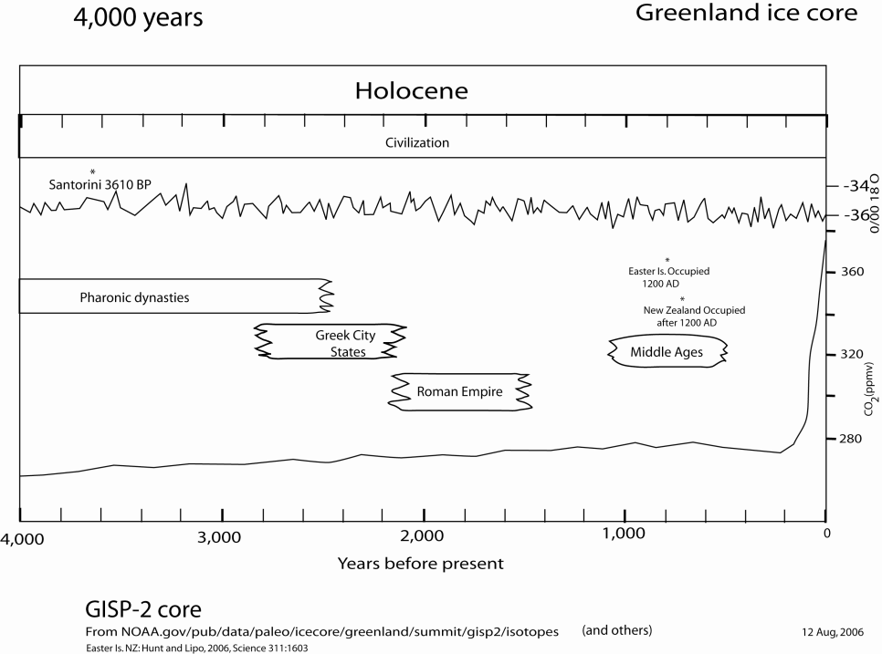

Slide 11
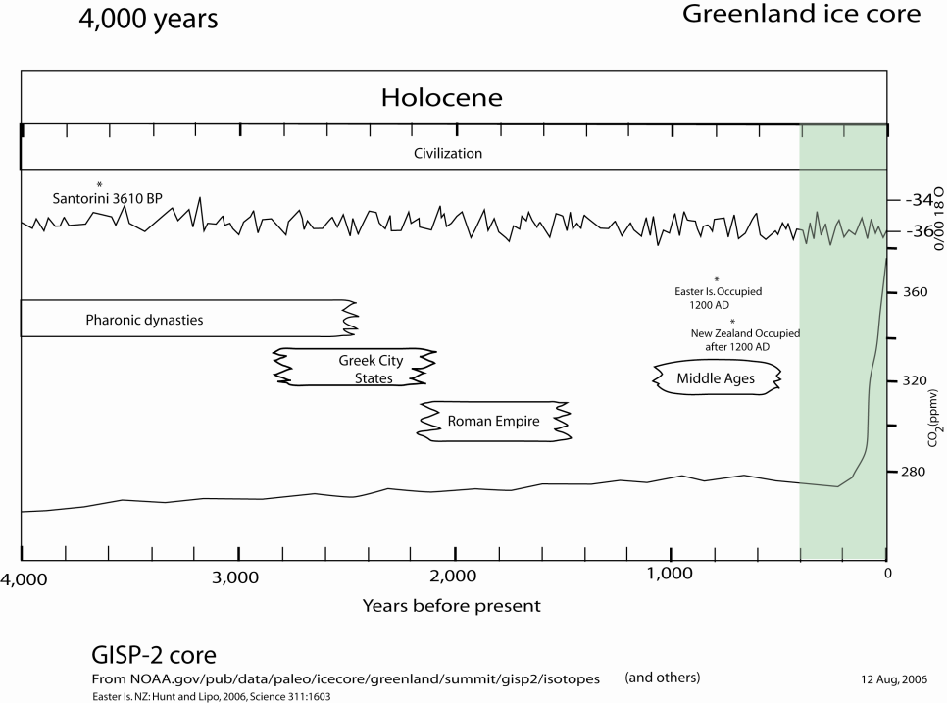

Slide 12
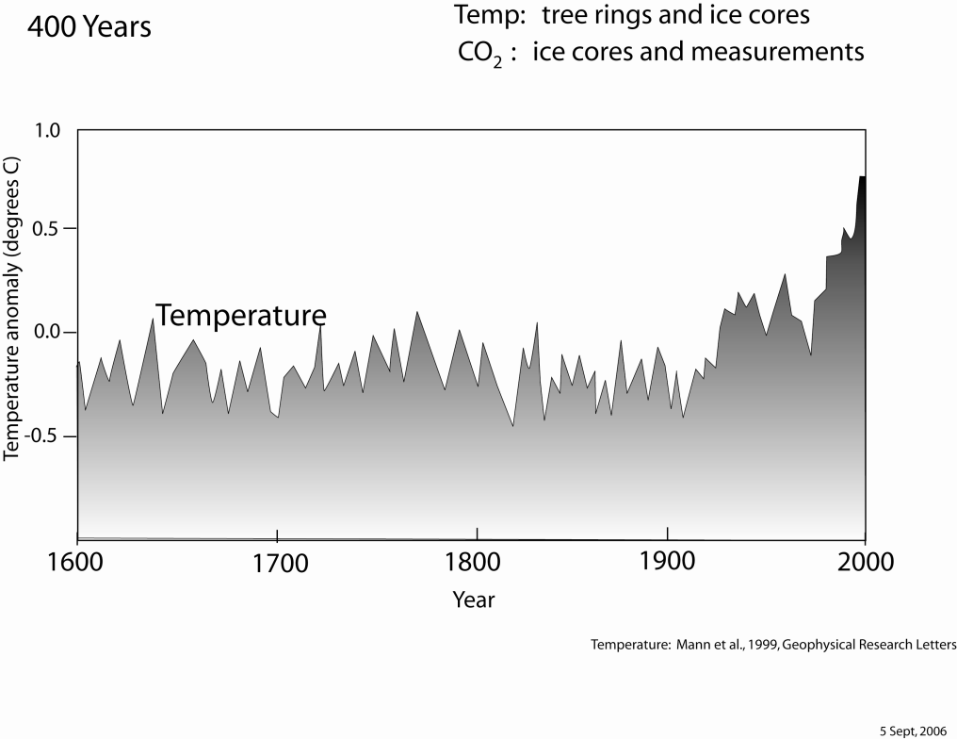

Slide 13
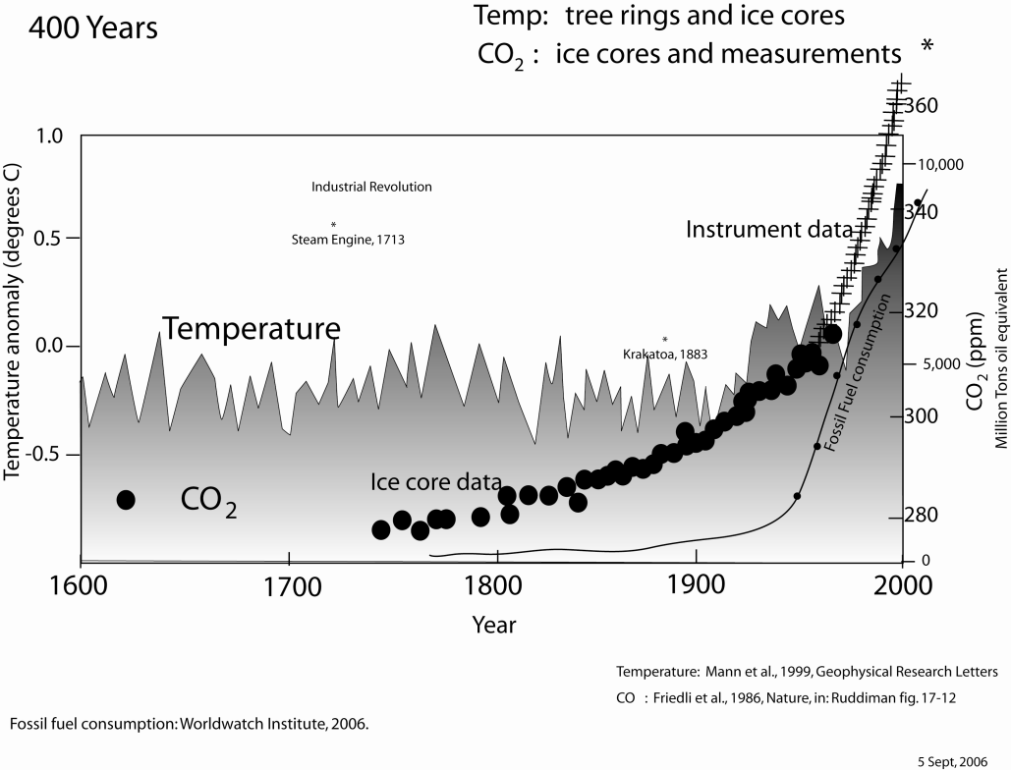

Slide 14
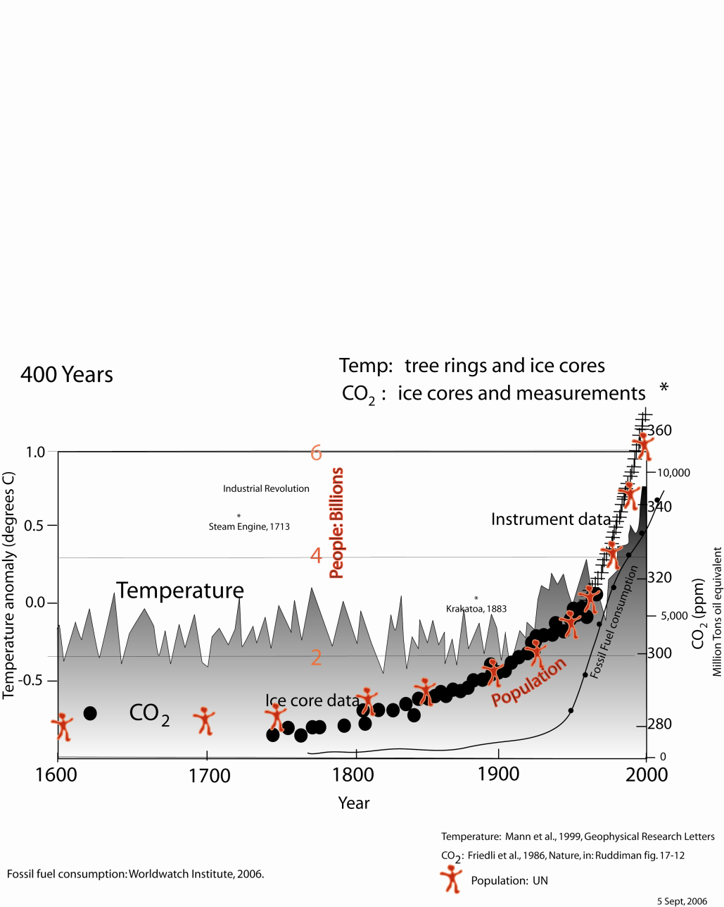

Slide 15
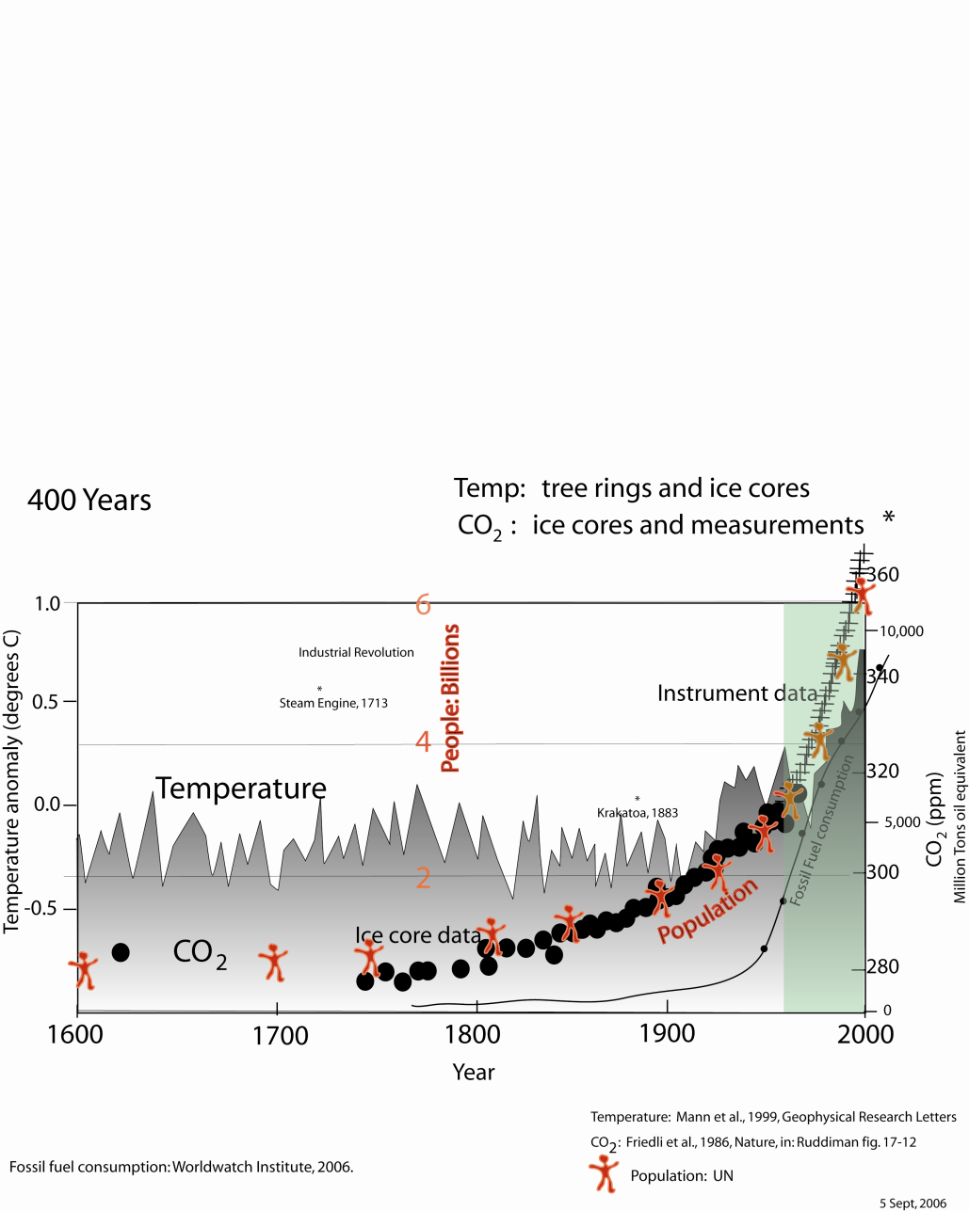

Slide 16
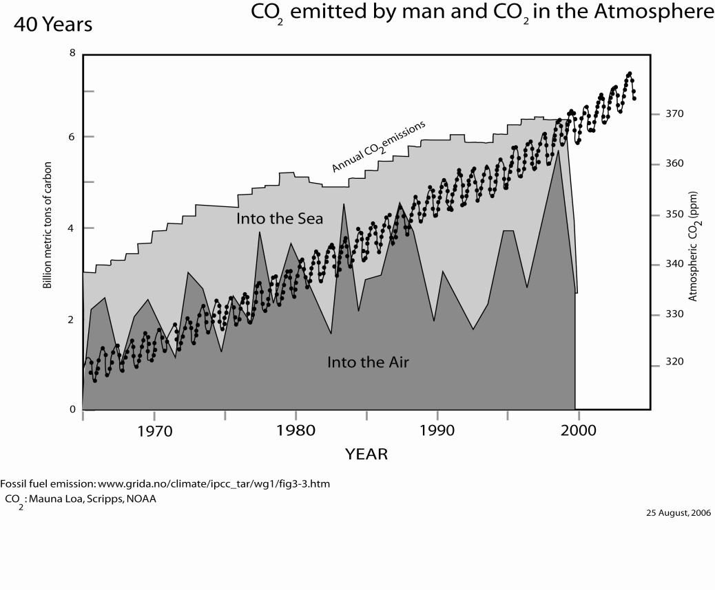

Slide 17
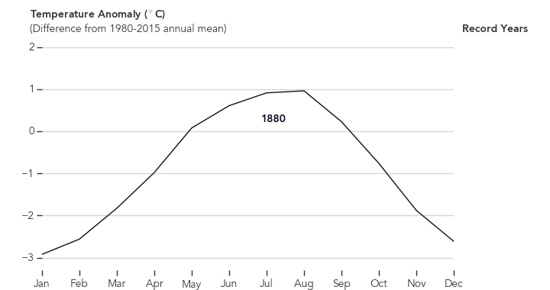
Seasonal change 1880-2016 (NASA)
Goddard Institute for Space Studies
Notes:
Global temperature changes based on 6300 met. Stations.
https://earthobservatory.nasa.gov/blogs/earthmatters/2016/09/12/heres-how-the-warmest-august-in-136-years-looks-in-chart-form/
CO2 warms the planet.

Slide 18
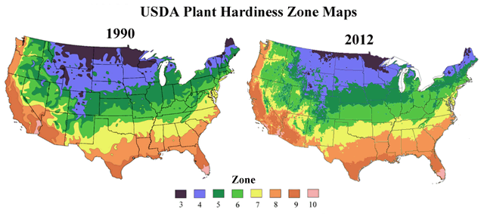
Plants and Animals are Responding to a Warming Climate
1990 vs. 2012
Spring is springing forward: Spring events, like bird and butterfly migrations, flower blooming times, and frog mating, have been advancing by about three days per decade over the past 30 years.
Source: Jeong et al., 2011, “Phenology shifts at start vs. end of growing season in temperate vegetation over the Northern Hemisphere for the period 1982–2008”
https://www.arborday.org/media/zones.cfm

Slide 19
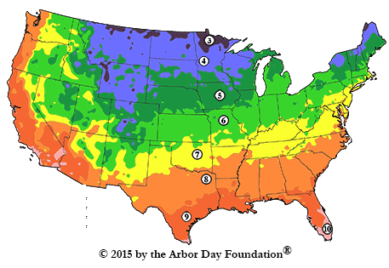
Plants and Animals are Responding to a Warming Climate
1990 vs. 2015
2015
Spring is springing forward: Spring events, like bird and butterfly migrations, flower blooming times, and frog mating, have been advancing by about three days per decade over the past 30 years.
Source: Jeong et al., 2011, “Phenology shifts at start vs. end of growing season in temperate vegetation over the Northern Hemisphere for the period 1982–2008”
https://www.arborday.org/media/zones.cfm

Slide 20
Plants and Animals are Responding to a Warming Climate
1990 vs. 2012
2015
Spring is springing forward: Spring events, like bird and butterfly migrations, flower blooming times, and frog mating, have been advancing by about three days per decade over the past 30 years.
Source: Jeong et al., 2011, “Phenology shifts at start vs. end of growing season in temperate vegetation over the Northern Hemisphere for the period 1982–2008”
https://www.arborday.org/media/zones.cfm

Slide 21
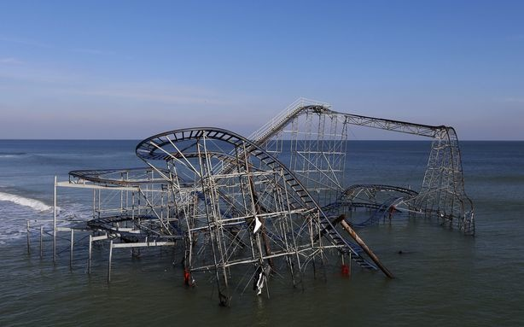
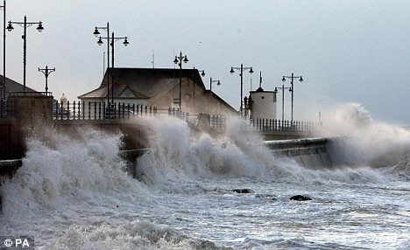
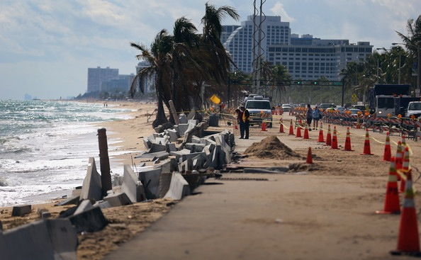
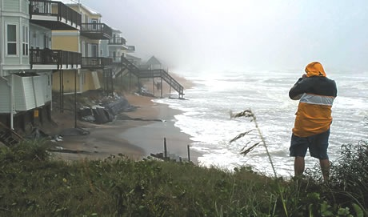
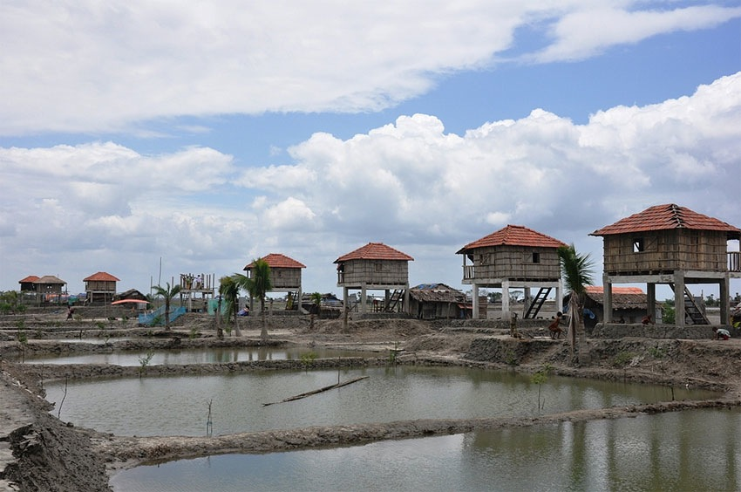
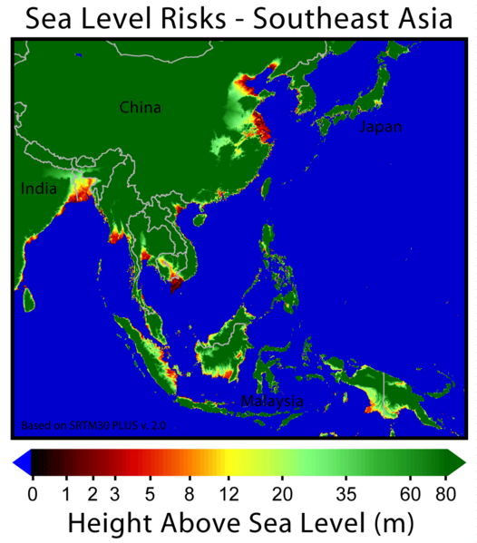
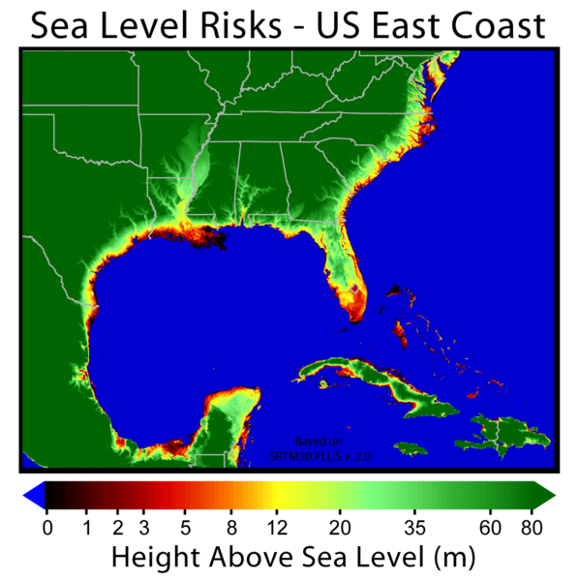
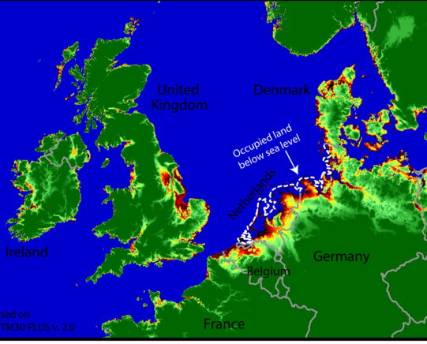
Global Impacts → Rising sea level is affecting
coasts worldwide

Slide 22
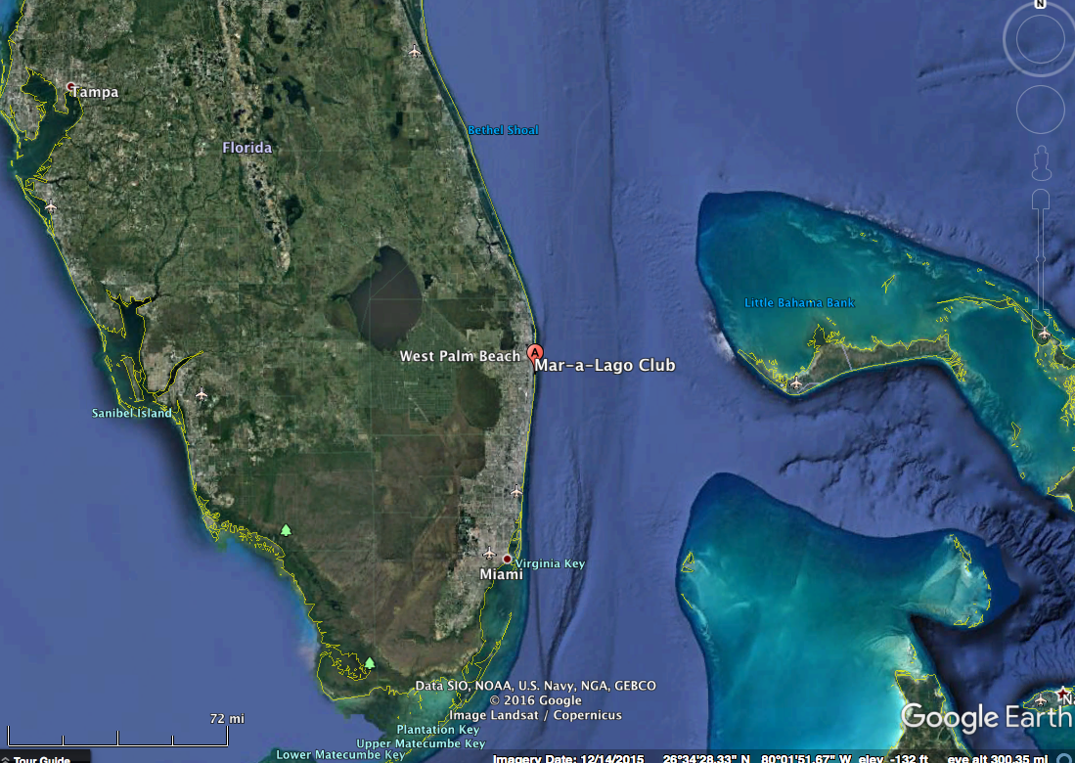
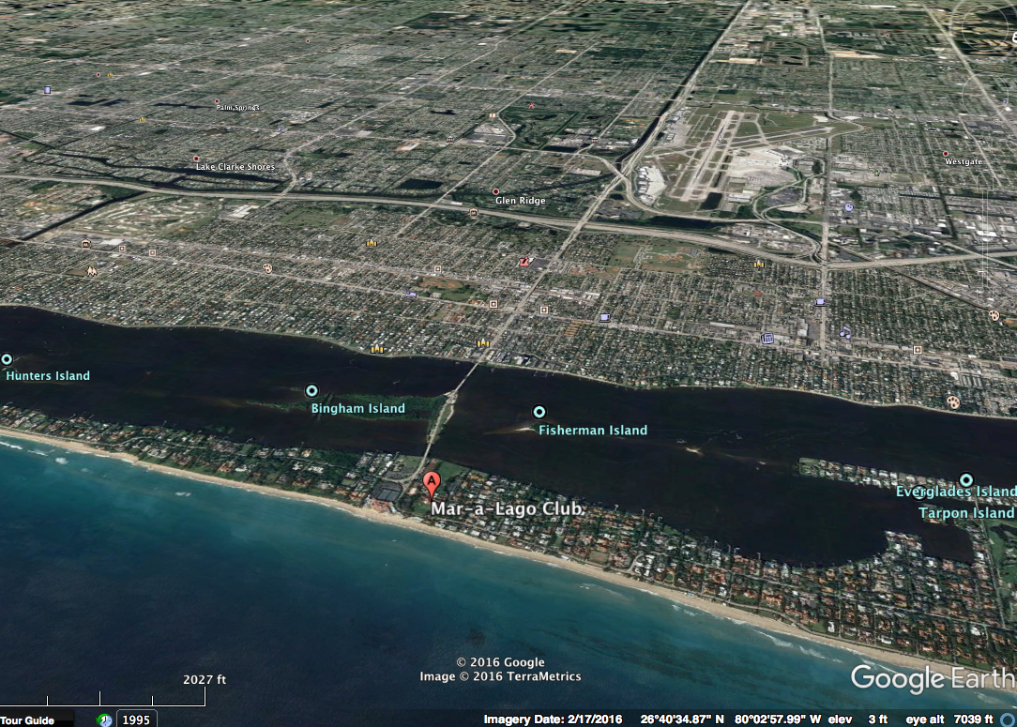

Mar-a-Lago Resort
West Palm Beach

Slide 23
Mar-a-Lago Resort
West Palm Beach

Slide 24
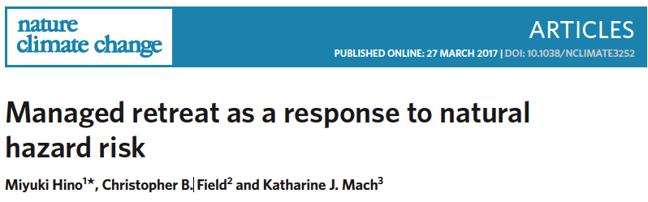
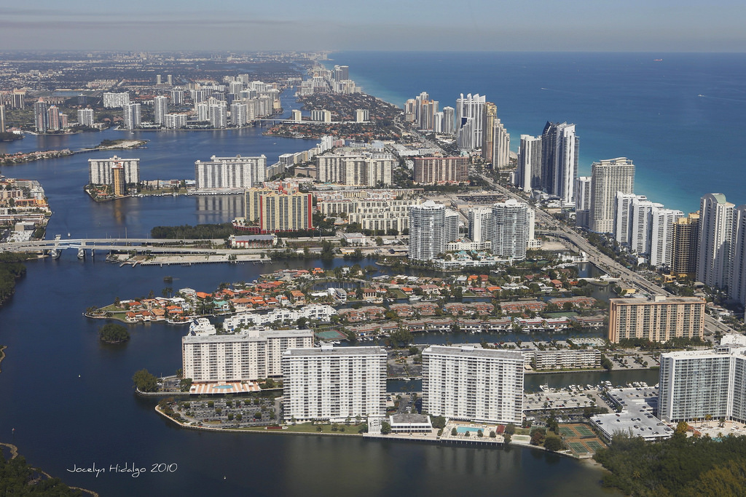
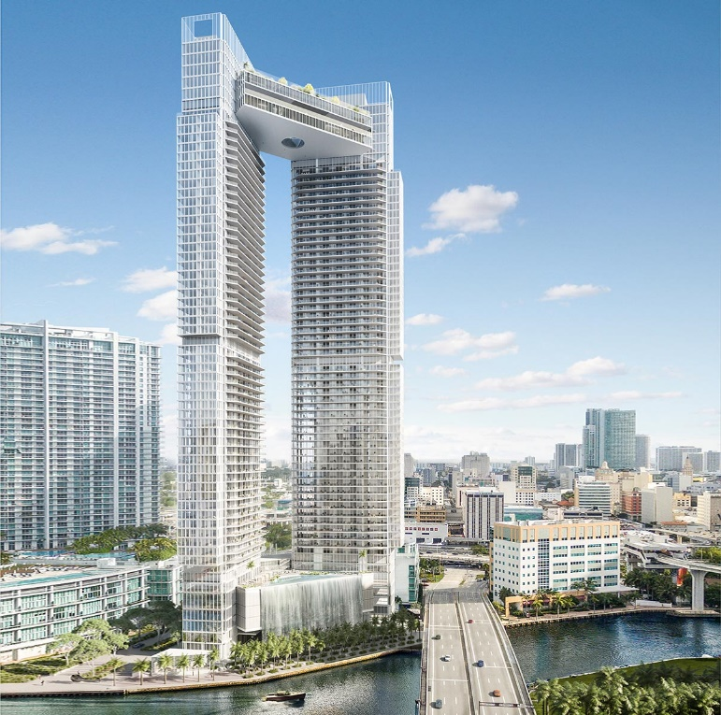
the application of coastal zone management designed to move existing and planned development out of the path of eroding coastlines and coastal hazards
Miami skyline Today
One River Point Miami Luxury condos – to be built

Slide 25
Broader Society
Benefits from Relocation
MUTUAL
AGREEMENT
GREATER GOOD
Implementing party to over
come Initial opposition
Post disaster voluntary relocation
Property buyouts
Residents
do not
Initiate the move
Residents
Initiate the move
Residents resist and
Societal gain questioned
Resident struggle to get govt help
HUNKERED
DOWN
SELF
RELIANCE
Only Residents benefits
From Relocation
Hino et al 2017
Nat.ClimChange

Slide 26
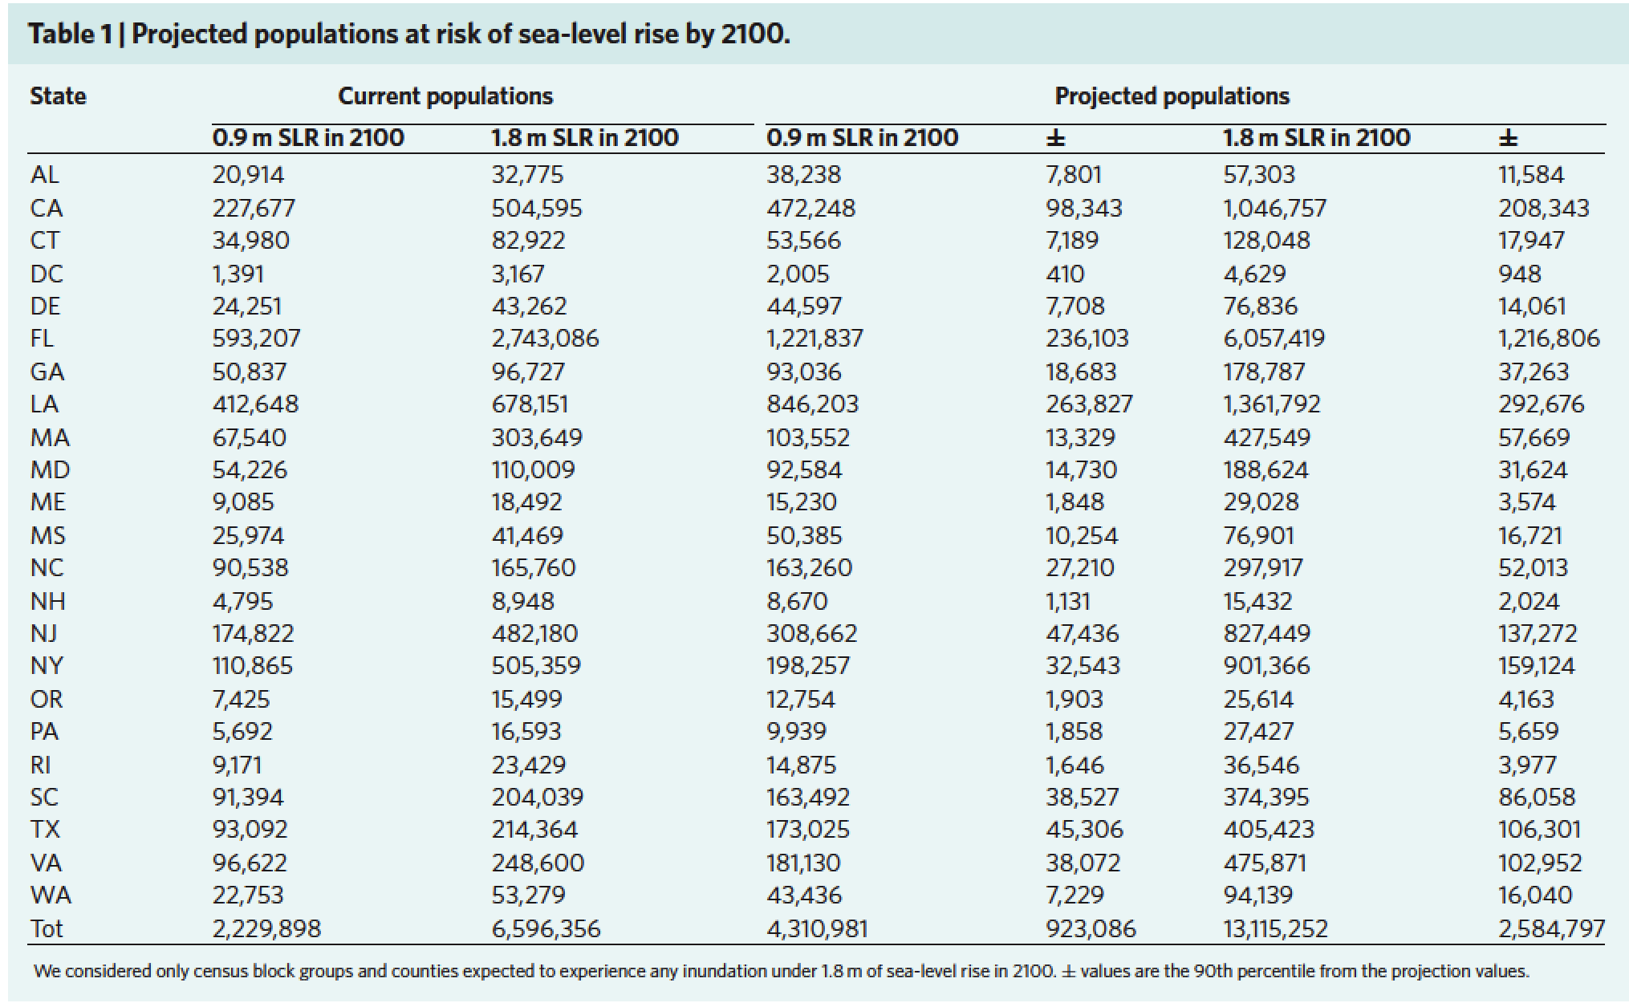
HAUER ET AL., 2017
CURRENT POPULATIONS
PROJECTED POPULATIONS
2.23 MILLION
0.9 m SLR 2100
6.6 MILLION
1.8 m SLR 2100
4.3 MILLION
0.9 m SLR 2100
13.1 MILLION
1.8 m SLR 2100
Notes:
New paper by Kopp et al in press says RCM 8.5

Slide 27
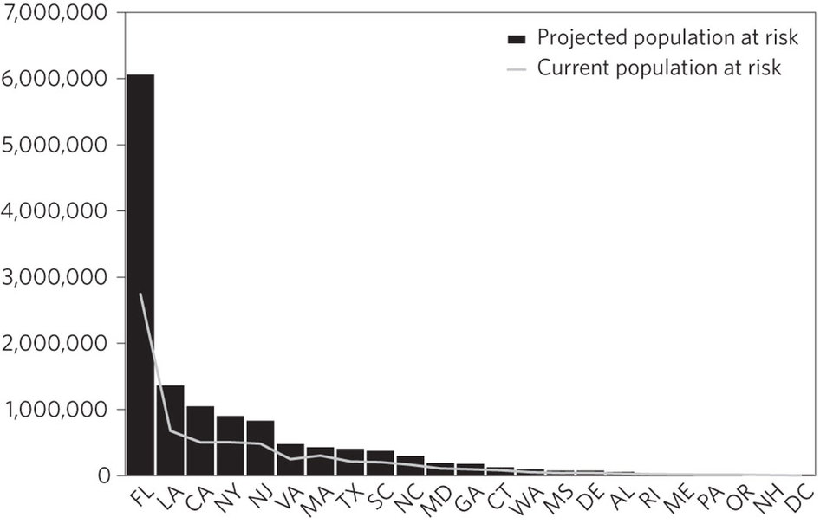
It’s called (OR WILL BE) a DOMESTIC REFUGEE CRISIS
HAUER ET AL., 2017

Slide 28
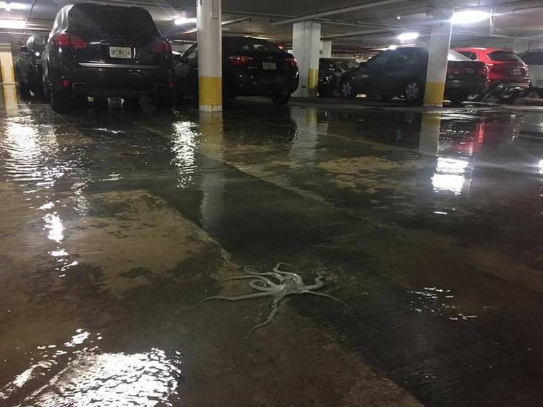
In the Garages of Miami

Slide 29

New Policies Needed: Plan for Managed Retreat
(even though unthinkable)
Evaluate financial constraints to rebuild after natural disasters
Drive self-reliance into community planning
Develop comprehensive governance framework for communities and agencies to shift work from protection in place to community relocation.
Requires sensitivity to place attachment, heritage and social dimensions of decision-making
Hino et al. 2017 NatClimChange
First graders today
will be 40 years old
by 2050 when sea level could be 3 feet higher.
Notes:
Accept of evidence human-induced environmental change requires an educated citizenry about solutions
We need to prepare them with hard knowledge and soft social skills.

Slide 30
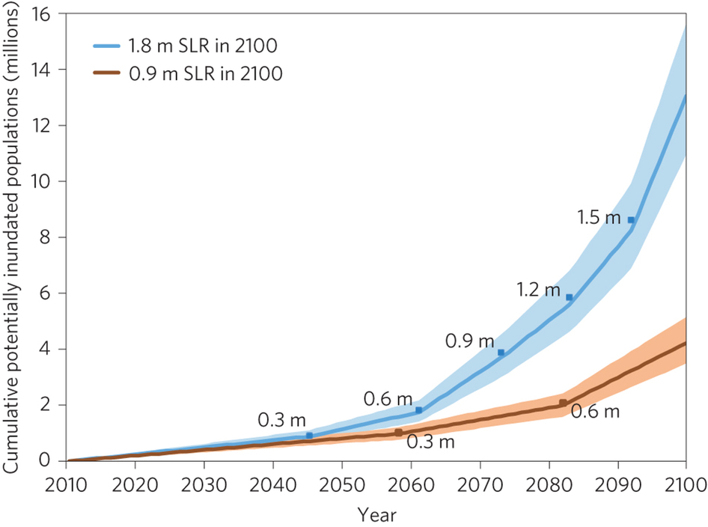
HAUER ET AL., 2017

Slide 31


President Obama
Anchorage AK
August 2015

Slide 32

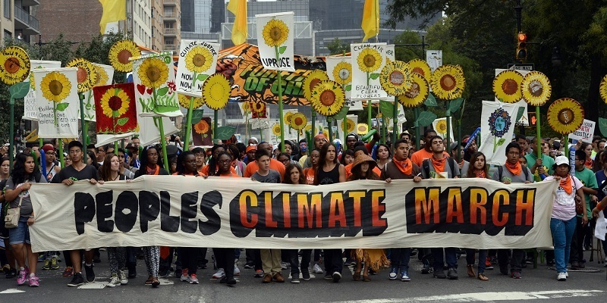
The Urgency of Now
“We are now faced with the fact that tomorrow
is today. We are confronted with the fierce urgency of now. In this unfolding conundrum of life and history, there "is" such a thing as being too late.
This is no time for apathy or complacency. This is a time for vigorous and positive action.”
------ Martin Luther King Jr
“Don’t relax. Don’t feel good about yourselves.
See how bad it is, and then
make it good.
And feel good about that.”
Gov. Jerry Brown 4/20/17

Slide 33
Take Home Points
Models still underestimate rates and magnitude of change in parts of Earth system
Geologic evidence from the Arctic and Antarctic show that Greenland and West Antarctic ice sheets are much more sensitive to forcings then thought.
Plan for Managed Retreat (though unthinkable now)
Evaluate financial constraints to rebuild after natural disasters
Drive self-reliance into community planning
Educate K to Gray!*
Notes:
Scientists need to find ways to take what they know and communicate it in a way that improves socieites everywhere to a sustainable future. Today;s

Slide 34
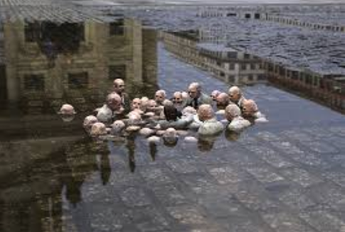
Politicians debating climate change:
SLOW LEARNERS
Isaac Cordal: http://www.dailykos.com/story/2014/5/7/1297486/-The-Most-Striking-Climate-Change-Sculpture-You-ll-Ever-See

Slide 35
Contemporary events
We had snow!
We had to shovel or snow-blow
Or use a green-plow!

Slide 36
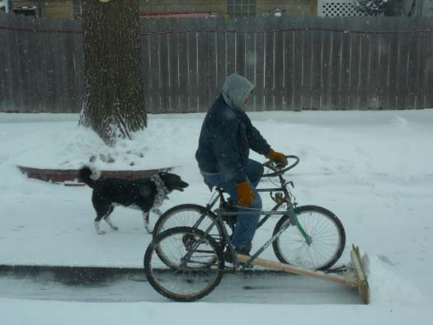
A low-carbon footprint snowplow

Slide 37
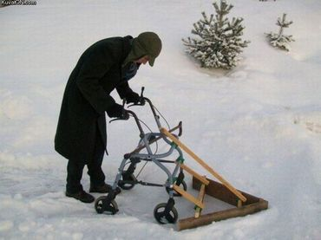
Another low-carbon footprint snowplow

Slide 38

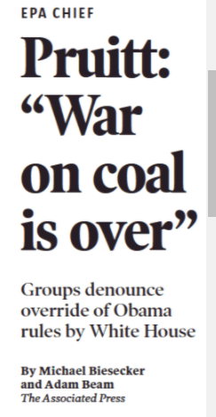
TODAY
Where’s the moral compass regarding human health
It doesn’t even make economic sense; no utilities are building new coal plants in the U.S.

Slide 39
Solar Decathlon
Through Sunday: 61st and Pena –
A-line rail stop
https://www.solardecathlon.gov/
Thursday, Oct. 12–Sunday, Oct. 15, 2017: 11 a.m.–7 p.m

Slide 40

https://www.solardecathlon.gov/

Slide 41
Citizens Climate Lobby
October 14, Sat 1030 AM. CCL Golden monthly meeting at Abrusci’s Fire & Wine, 2200 Youngfield St, back room.

Slide 42

Colorado Renewable Energy Society:
https://www.cres-energy.org/

Slide 43

Colorado Renewable Energy Society – YouTube of selected talks:
https://www.youtube.com/channel/UCr81EUb2qVJVfmmlJMxEHVw

Slide 44
Changes are Happening
POPULATION

Slide 45
THE BIG PICTURE
Sustainability:
  Population
  Resources
  Energy
  World stability
  Conflict
  Climate change
  Weather
  Pestilence
  Etc. – very complex
CLIMATE-RELATED

Slide 46

Earth
Human Population = 7.3 B
Annual Electricity Demand = 23,300 TWh
Annual CO2 Emissions = 32.2 Gt
Fraction of GHG Emissions from Energy Use ≈ 68%
Gt C = Gt CO2/3.67
(mass 44/mass 12 C)
32.7/3.67 = 8.91 Gt C

Slide 47

Museums, Zoos and Your Children will save the World

Slide 48
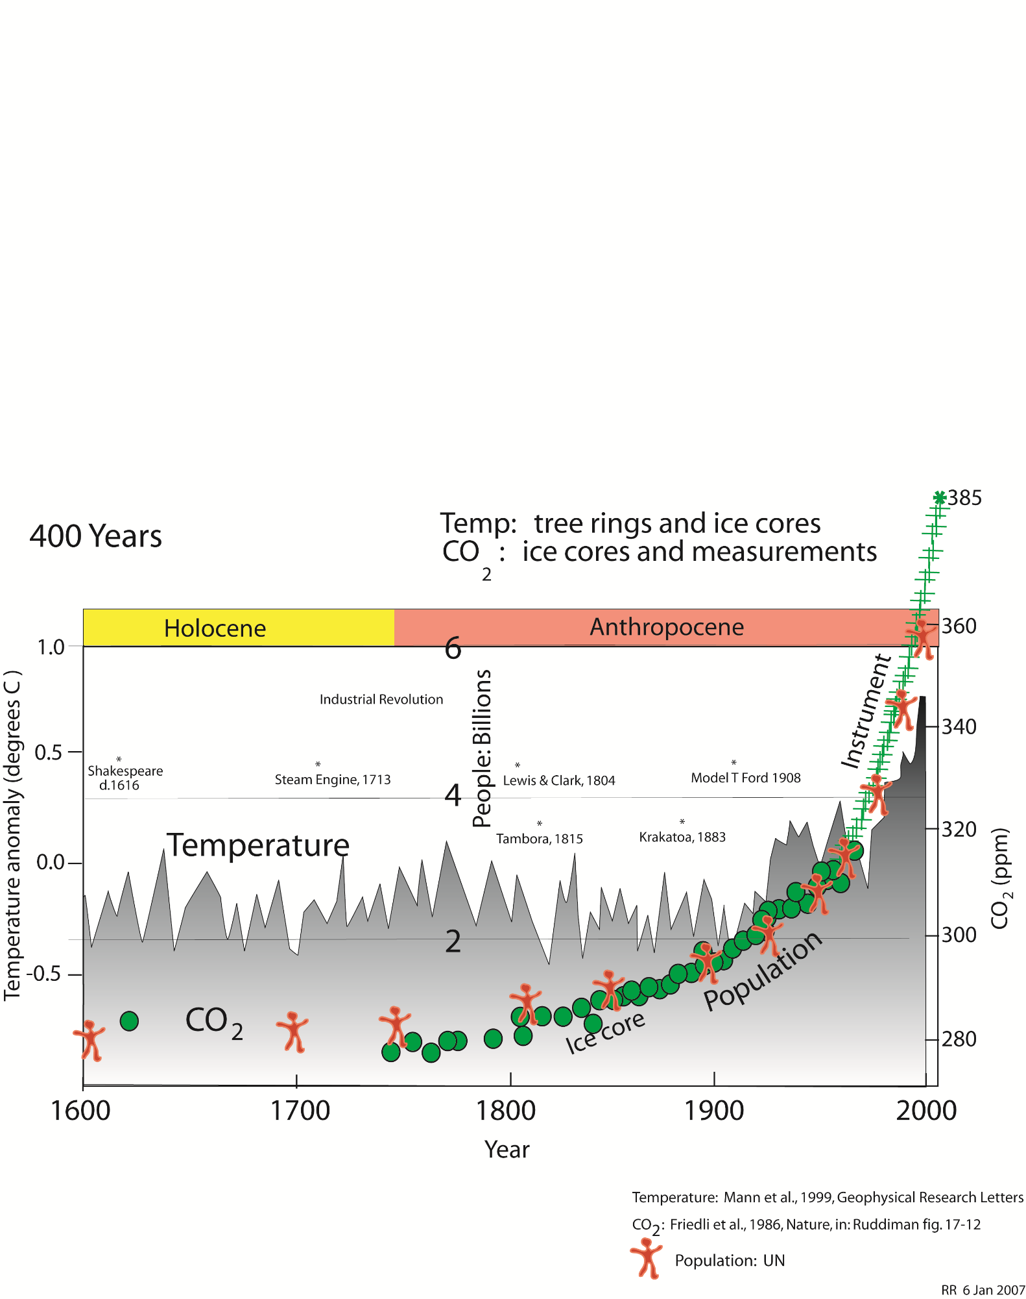

Slide 49



Slide 50
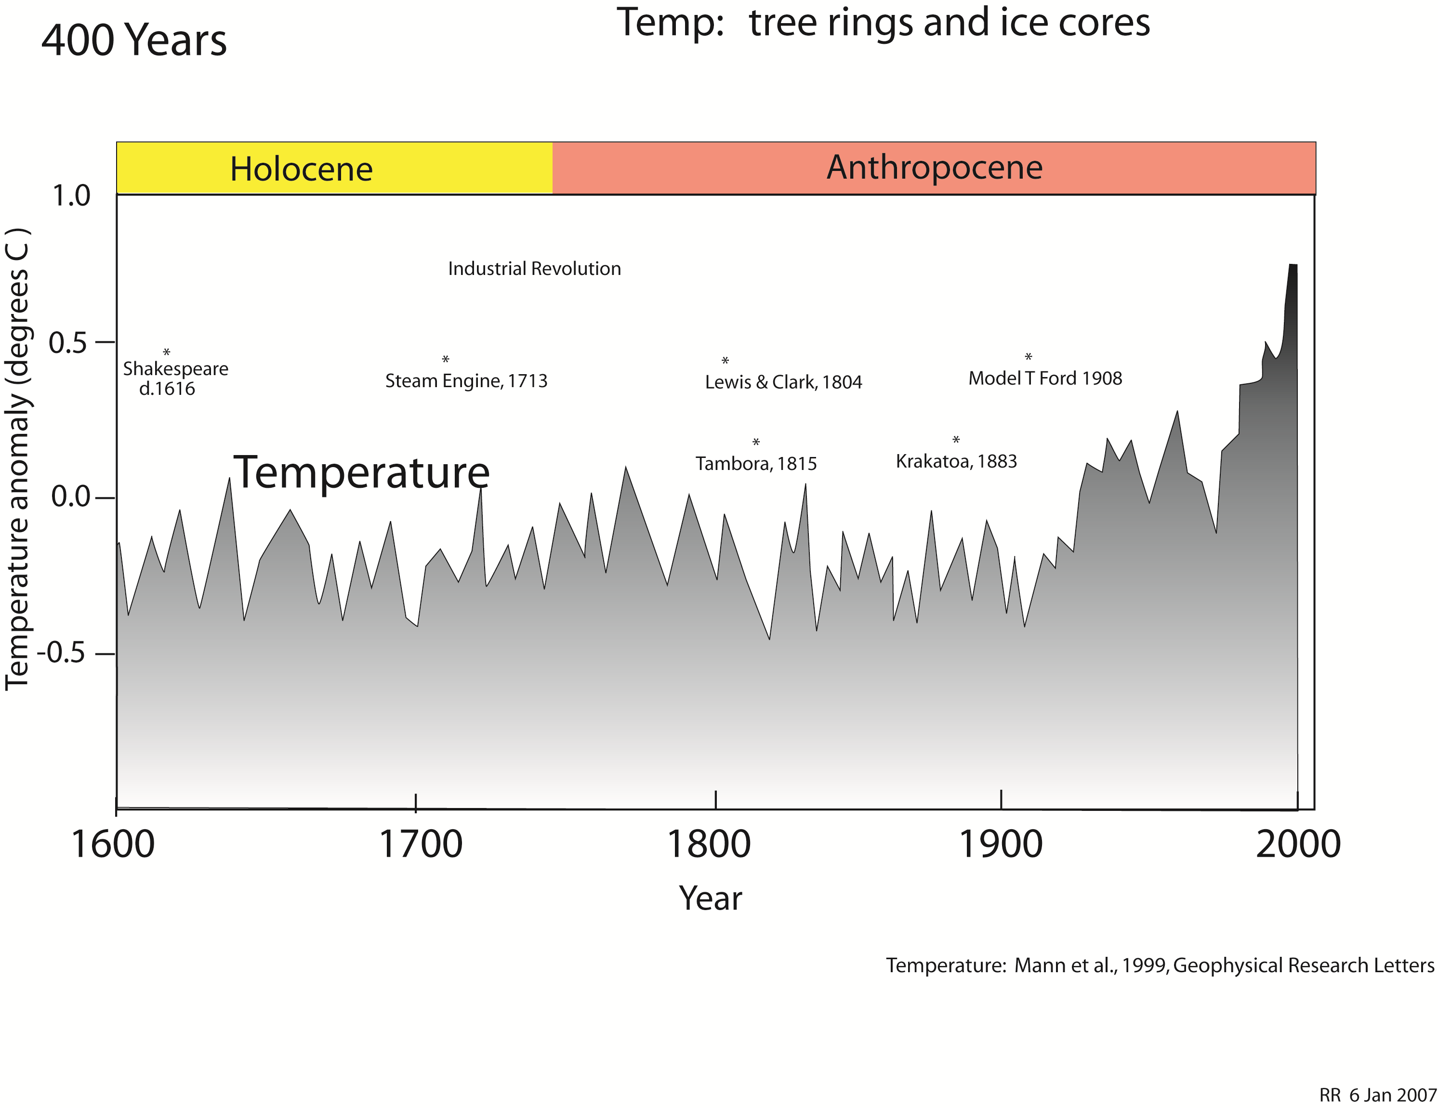

Slide 51
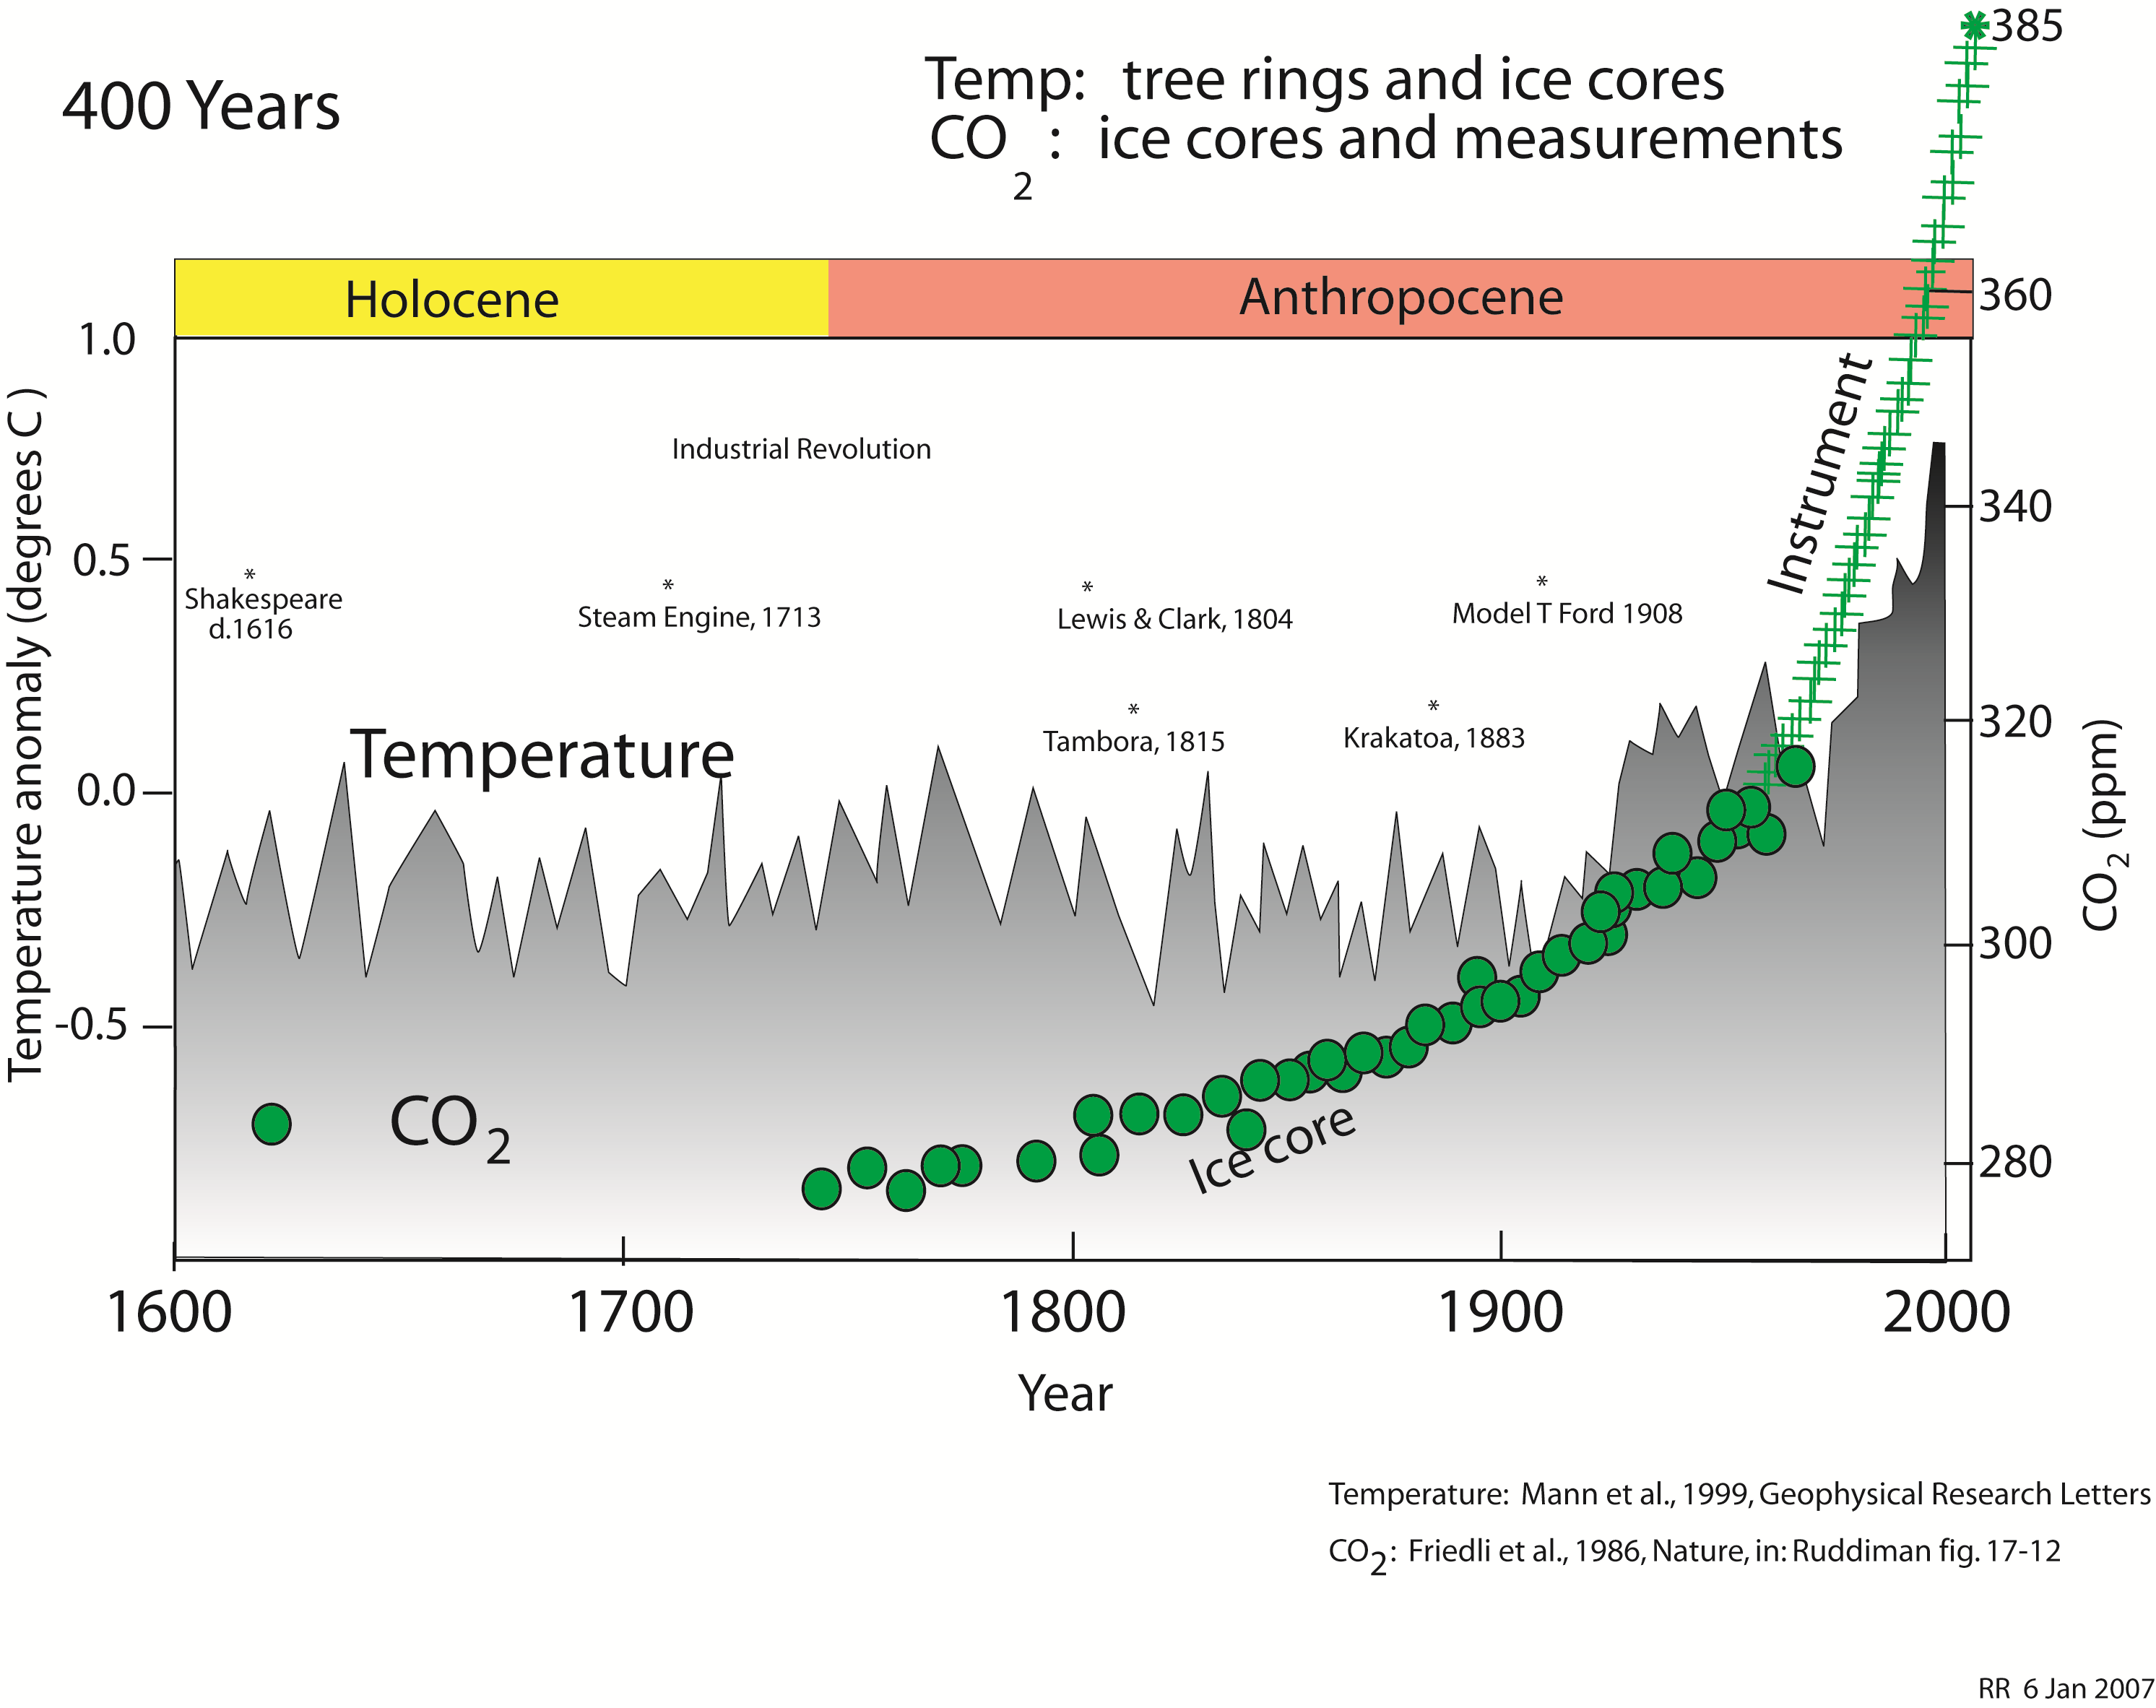

Slide 52


Slide 53
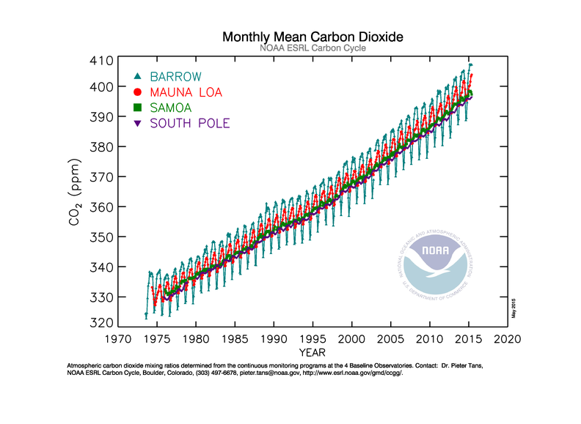

Slide 54
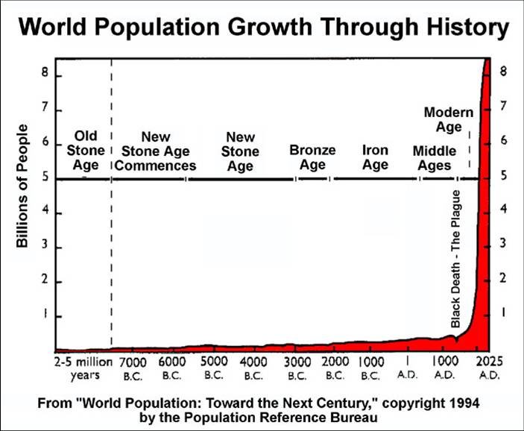

Slide 55
Fertility rate vs.
Zero Population Growth
Total Fertility Rate: https://en.wikipedia.org/wiki/Total_fertility_rate
  The total fertility rate (TFR), sometimes also called the fertility rate, absolute/potential natality, period total fertility rate (PTFR) or total period fertility rate (TPFR) of a population is the average number of children that would be born to a woman over her lifetime if:
  She were to experience the exact current age-specific fertility rates (ASFRs) through her lifetime, and
  She were to survive from birth through the end of her reproductive life.^{[1]}
  It is obtained by summing the single-year age-specific rates at a given time.

Slide 56
Fertility rate vs.
Zero Population Growth
Zero population growth (ZPG): https://en.wikipedia.org/wiki/Zero_population_growth
  Zero population growth, sometimes abbreviated ZPG (also called the replacement level of fertility),^{[1]} is a condition of demographic balance where the number of people in a specified population neither grows nor declines, considered as a social aim by some.^{[2]} According to some, zero population growth, perhaps after stabilizing at some optimum population, is the ideal towards which countries and the whole world should aspire in the interests of accomplishing long-term environmental sustainability.^{[3]} What it means by ‘the number of people neither grows nor declines’ is that births plus in-migrants equal deaths plus out-migrants.^{[4]}

Slide 57
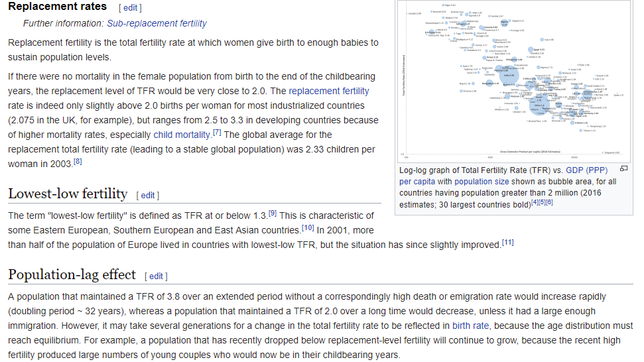

Slide 58
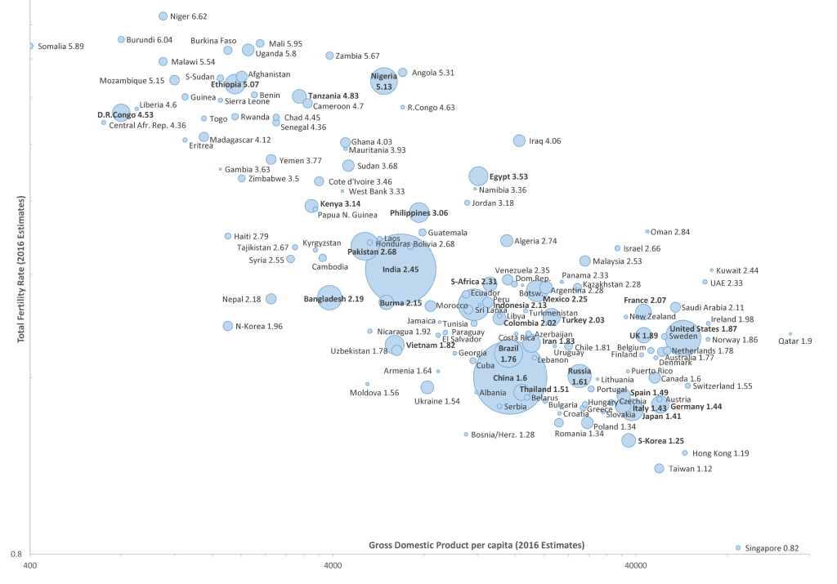
Log-log graph of Total Fertility Rate (TFR) vs. GDP (PPP) per capita with population size shown as bubble area, for all countries having population greater than 2 million (2016 estimates; 30 largest countries bold)
https://en.wikipedia.org/wiki/Total_fertility_rate#/media/File:CIA_WFB_TotFertilityRate-GDP-Population_-_Simplified_2016.png

Slide 59
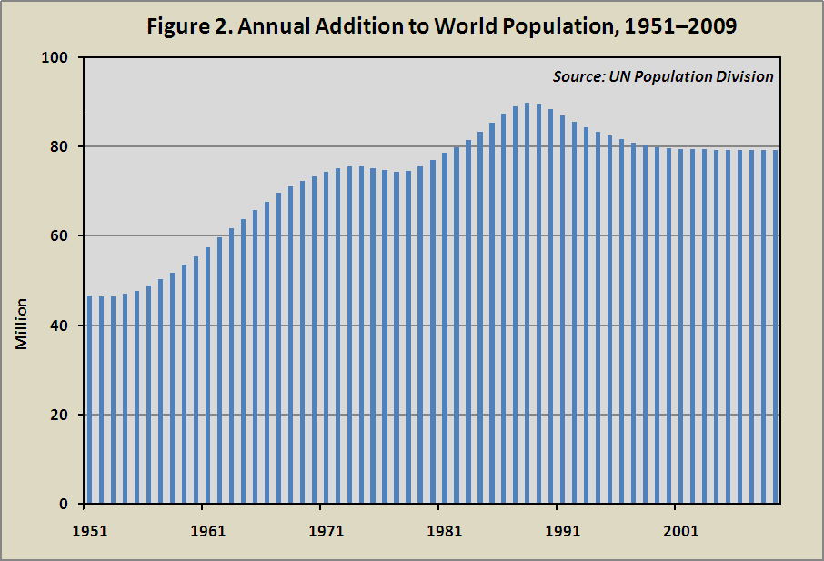
Peak Baby

Slide 60
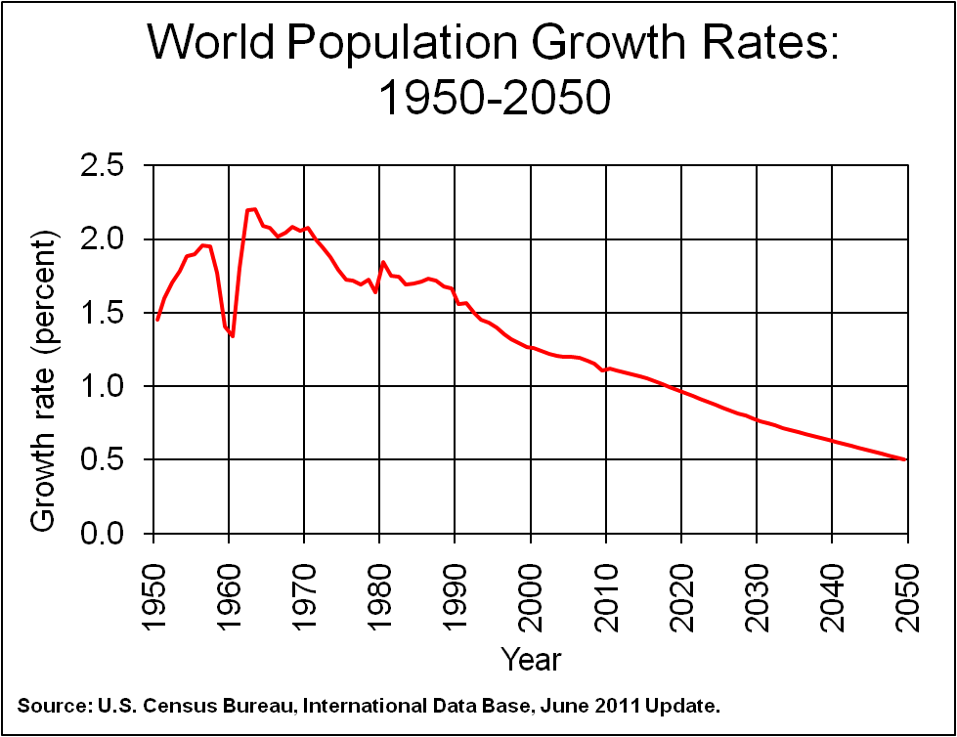
Great Leap
Forward

Slide 61
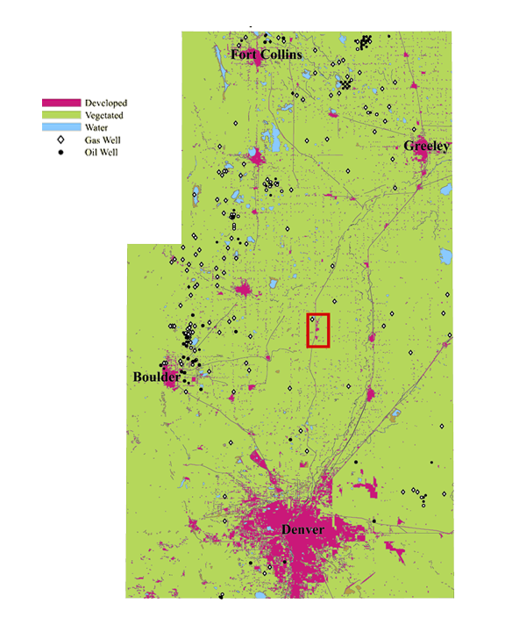
1960
UUSGS
USGS

Slide 62
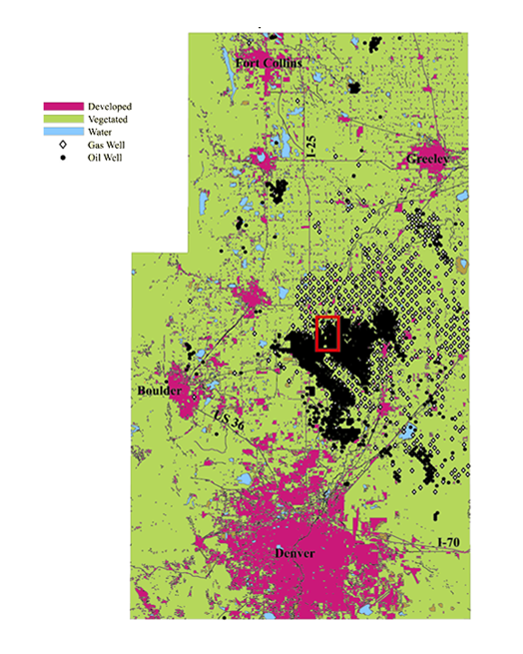
1980
UUSGS
USGS

Slide 63

2000
UUSGS
USGS

Slide 64

Jonah Field, Wyoming August 1994

Slide 65

Jonah Field, Wyoming August 2006

Slide 66



UN projections 2010

Slide 67


Fertility Rates
(Children per Family)
World Statistics
http://www.pregnantpause.org/numbers/fertility.htm

Slide 68
4 PDFs documents for you to peruse depending on your interest:
  Science Mag June 30, 2017: Estimating economic damage from climate change in the United States
  UN World Fertility Report: 2007: UN World Fertility Report 2007:compilation of key indicators of fertility, nuptiality, contraceptive use and population policies regarding childbearing for 192 countries referring
  mostly to two periods: the 1970s and the latest year for which data are available
  UN World Fertility Report 2012: Report_WFR2012
  World population stabilization unlikely this century: Science-2014-Lee-229-34

Slide 69

ECONOMIC DEMOGRAPHY
Is low fertility really a problem?
Population aging, dependency, and consumption
Ronald Lee,1* Andrew Mason,2,3* members of the NTA Network†
Longer lives and fertility far below the replacement level of 2.1 births per woman are
leading to rapid population aging in many countries. Many observers are concerned that
aging will adversely affect public finances and standards of living. Analysis of newly
available National Transfer Accounts data for 40 countries shows that fertility well above
replacement would typically be most beneficial for government budgets. However,
fertility near replacement would be most beneficial for standards of living when the
analysis includes the effects of age structure on families as well as governments. And
fertility below replacement would maximize per capita consumption when the cost of
providing capital for a growing labor force is taken into account. Although low fertility will
indeed challenge government programs and very low fertility undermines living
standards, we find that moderately low fertility and population decline favor the broader
material standard of living.

Slide 70


Slide 71
End of class slides October 10th , 2017

Slide 72

https://i.kinja-img.com/gawker-media/image/upload/t_original/ihsllhptnnm4vb7wuvgq.jpg

