Slide 1
Contemporary Issues Regarding Climate Change and Solutions Paul Belanger, Ph.D., Geologist/Paleoclimatologist Tuesday October 17th , 2017:
Follow up: Population
Contemporary Issues
Denialism : email & next week
Solutions: What can I/we do
Solutions: Economic

Slide 2
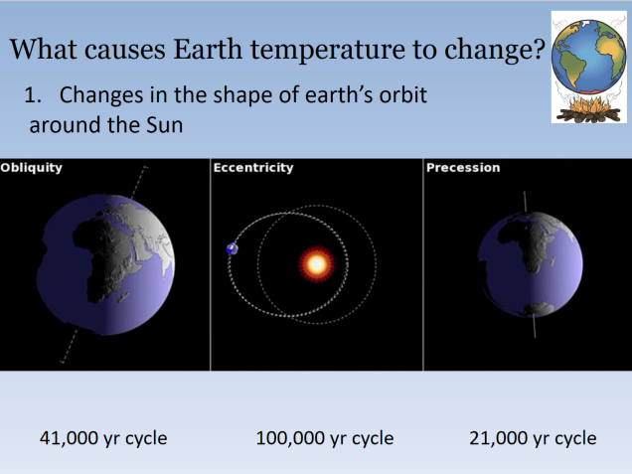
What causes Earth temperature to change?
Changes in the shape of earth’s orbit
around the Sun
41,000 yr cycle
100,000 yr cycle
21,000 yr cycle

Slide 3
What causes Earth temperature to change?
2. Green houses gases:
GO HERE FOR COOL ANIMATIONS
https://www.youtube.com/watch?v=gH6fQh9eAQE
NOAA 2016; Youtube, Pumphandle 2016
Notes:
https://www.youtube.com/watch?v=gH6fQh9eAQE
for the newst version Sept 2016.

Slide 4
What causes Earth temperature to change?
2. Green houses gases – pausing at last 35 years
https://www.youtube.com/watch?v=gH6fQh9eAQE
NOAA 2016; Youtube, Pumphandle 2016
Notes:
https://www.youtube.com/watch?v=gH6fQh9eAQE
for the newst version Sept 2016.

Slide 5
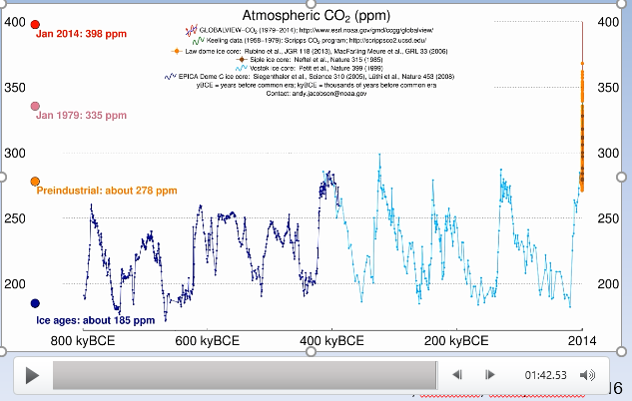
What causes Earth temperature to change?
2. Green houses gases – pausing at last 35 years end, last 800,000 years
https://www.youtube.com/watch?v=gH6fQh9eAQE
NOAA 2016; Youtube, Pumphandle 2016
Notes:
https://www.youtube.com/watch?v=gH6fQh9eAQE
for the newst version Sept 2016.

Slide 6
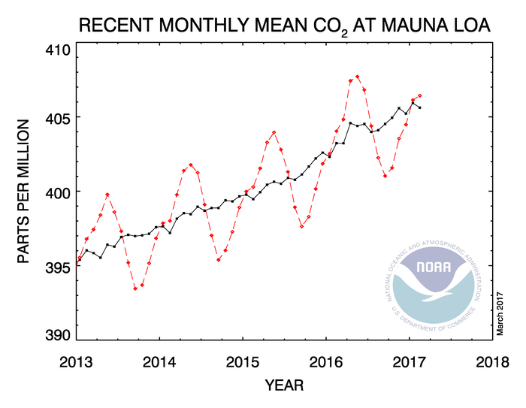
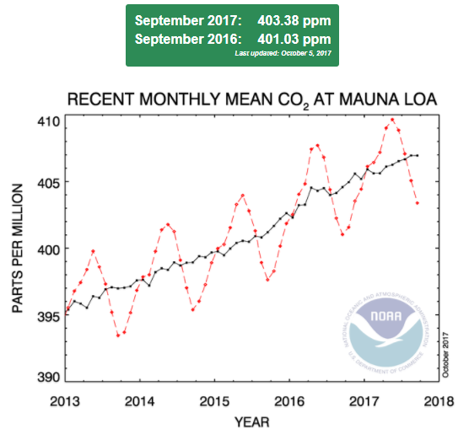
We will not see another month with CO₂ below 400 ppm in our lifetimes!
Photosynthesis
Decomposition
Notes:
“Stopping carbon will be like stopping a heroin addiction.”
Gov. Jerry Brown April 20, 2017

Slide 7
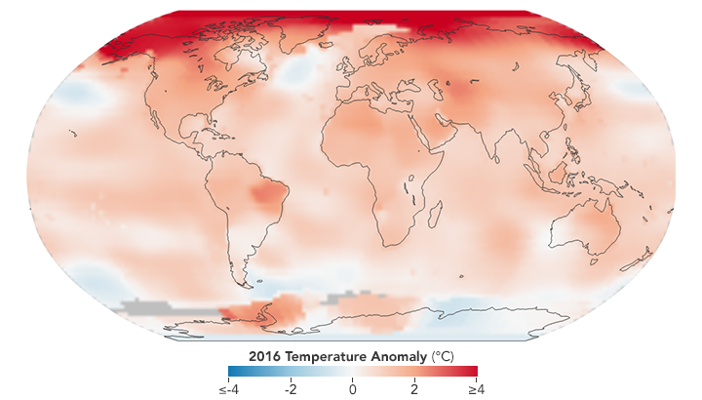
Arctic Change →Temperatures are rising twice as fast as global average
Polar
Amplification
https://earthobservatory.nasa.gov/IOTD/view.php?id=89469
Notes:
Baseline period is 1951-1980.

Slide 8
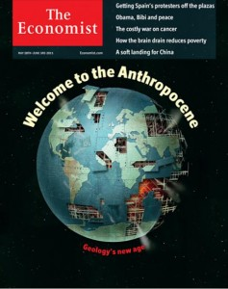
The Anthropocene
PDF – Olli Anthropocene Oct 2017
Bob Raynolds April 2017 talk

Slide 9
Population – follow-up
4 PDFs documents for you to peruse depending on your interest:
Science Mag June 30, 2017: Estimating economic damage from climate change in the United States
UN World Fertility Report: 2007: UN World Fertility Report 2007:compilation of key indicators of fertility, nuptiality, contraceptive use and population policies regarding childbearing for 192 countries referring mostly to two periods: the 1970s and the latest year for which data are available
UN World Fertility Report 2012: Report_WFR2012
World population stabilization unlikely this century: Science-2014-Lee-229-34

Slide 10
Population – follow-up
HANS ROSLING: Global population growth, box by box – sent in email
https://www.ted.com/talks/hans_rosling_on_global_population_growth/transcript?language=en#t-468462

Slide 11
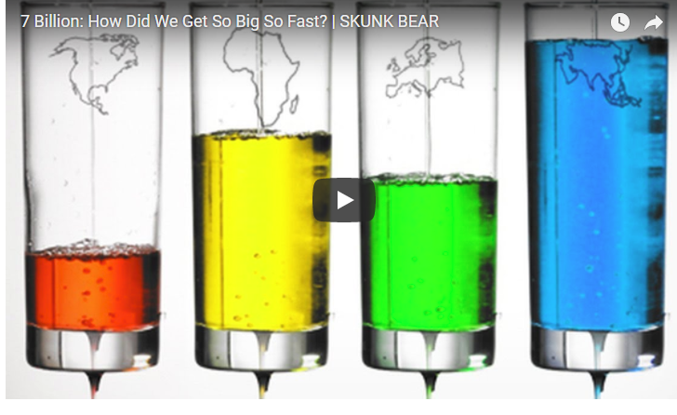
Population – excellent blog & explanation
Visualizing how a population grows to 7 billion (NPR)
https://youtu.be/VcSX4ytEfcE
https://jepoirrier.org/tag/population/

Slide 12
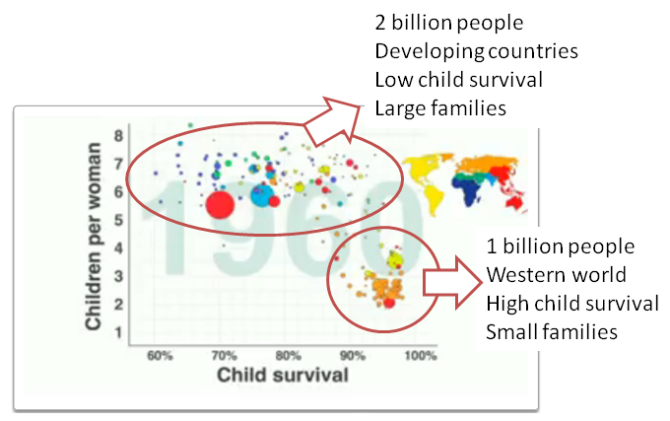
Population – excellent blog & explanation
https://jepoirrier.org/tag/population/

Slide 13
Population – excellent blog & explanation
https://jepoirrier.org/tag/population/

Slide 14
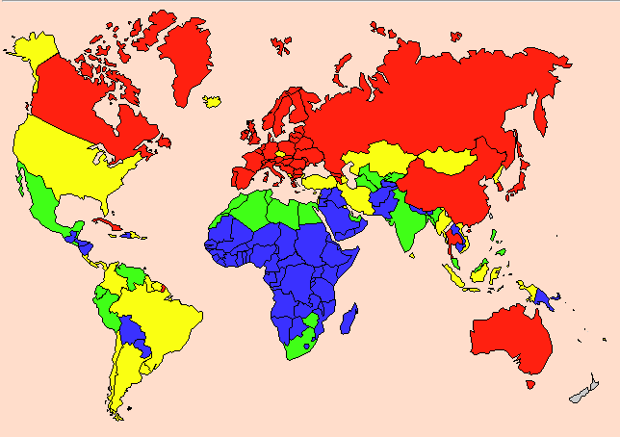
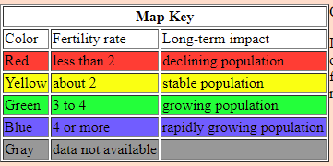
Fertility Rates (Children per Family) World Statistics
http://www.pregnantpause.org/numbers/fertility.htm

Slide 15
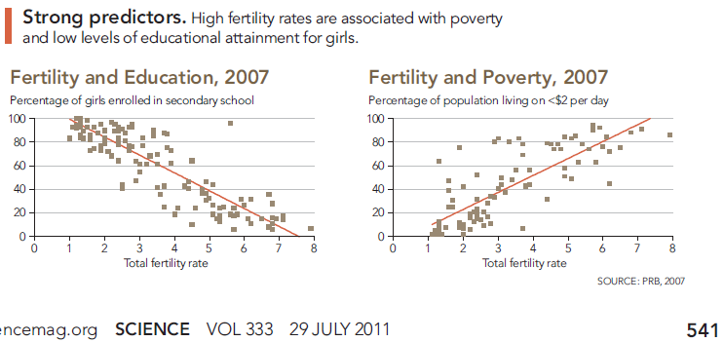
Population – excellent blog & explanation
https://jepoirrier.org/tag/population/

Slide 16
LOCAL Contemporary NEWS
Colorado’s growing pains: From roads to water, here are 5 key issues as the state’s population swells
Traffic
Unaffordable Housing
Growing Older
Water Worries
Growing Divide: urban vs. rural
http://www.denverpost.com/2017/10/15/colorado-growing-population-issues/

Slide 17
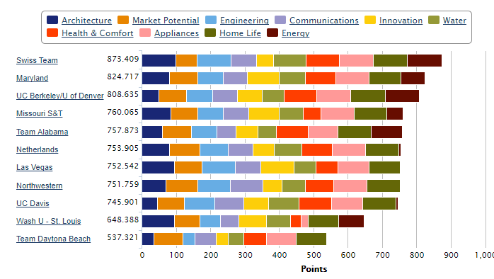
Solar Decathlon
Winners:
https://www.solardecathlon.gov/

Slide 18
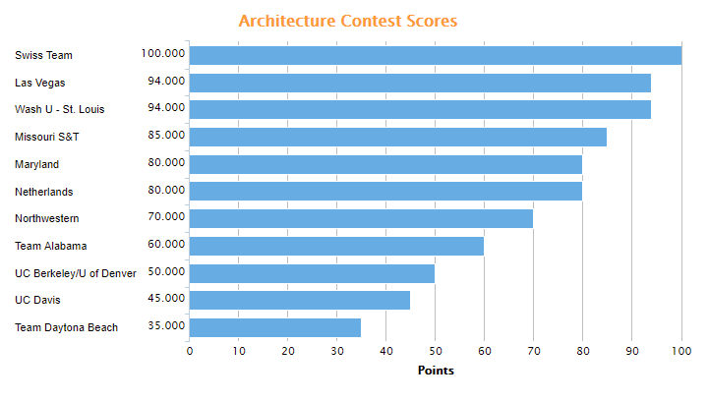
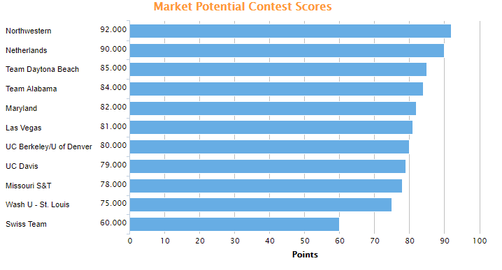
Solar Decathlon
https://www.solardecathlon.gov/
By Contest: Architecture & Market Potential

Slide 19
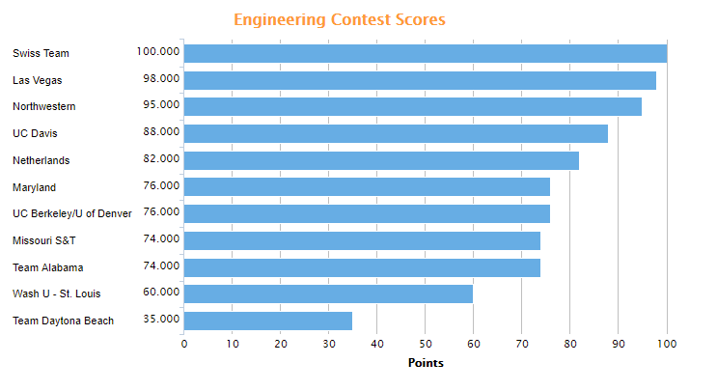
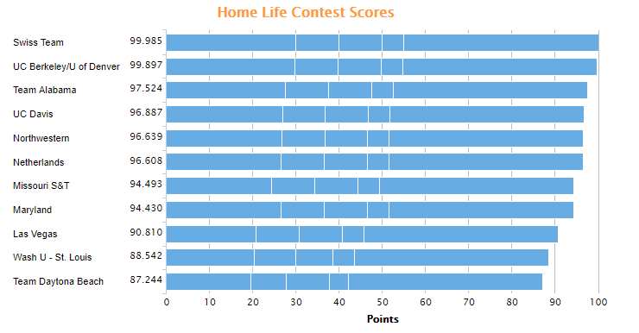
Solar Decathlon
https://www.solardecathlon.gov/
By Contest: Engineering & Home Life

Slide 20
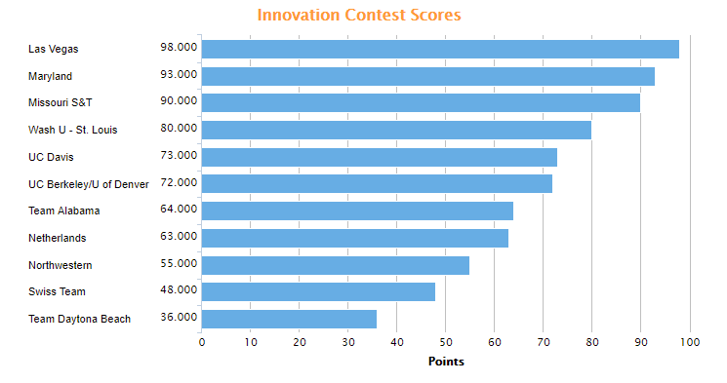
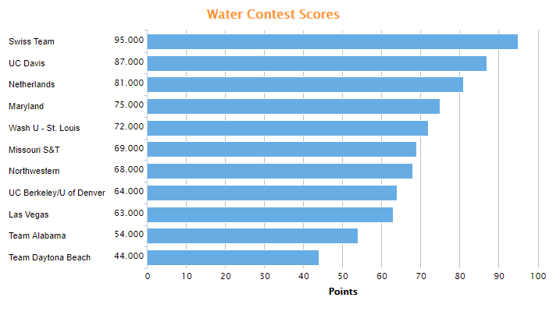
Solar Decathlon
Innovation and Water

Slide 21
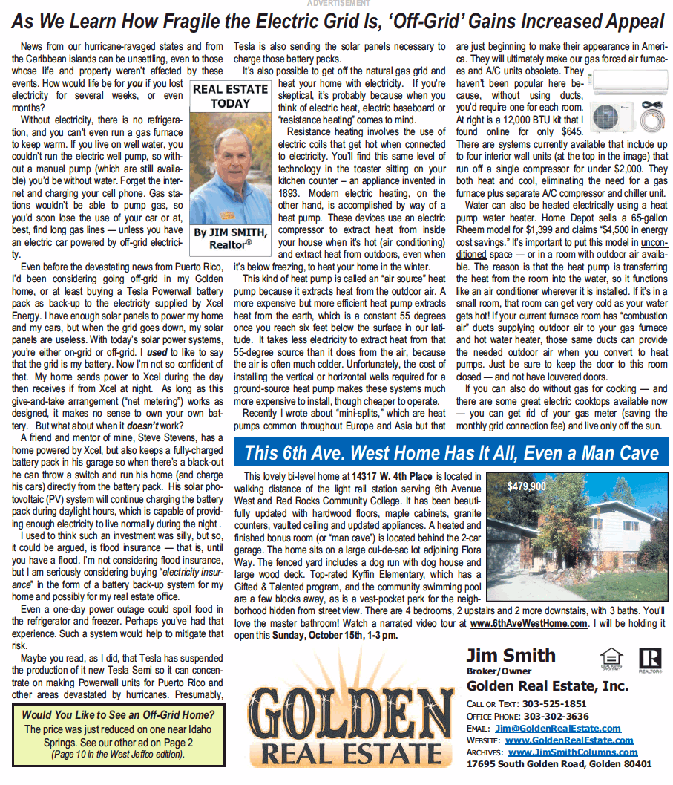
Contemporary Events: OFF-Grid Discussion by Jim Smith in DP HUB
xxx
http://www.denverpost.com/news/yourhub/

Slide 22
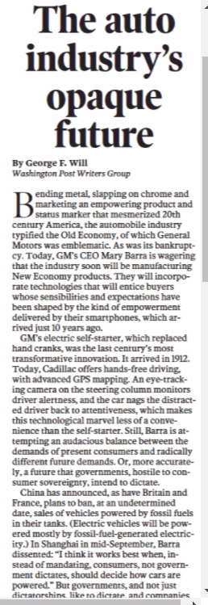
DP 10/15/2017 – George Will

Slide 23
DP 10/12/2017 –
By PETER HOLLEY | The Washington Post
PUBLISHED: October 12, 2017 at 10:45 am | UPDATED: October 12, 2017 at 10:49 am
http://www.denverpost.com/2017/10/12/2017-electric-cars-auto-sales/

Slide 24
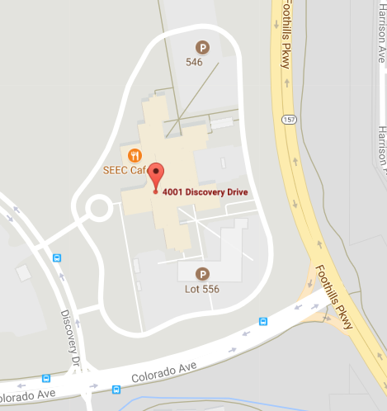
Colorado Renewable Energy Society: TONIGHT IN BOULDER
https://www.cres-energy.org/
https://www.meetup.com/Boulder-Colorado-Renewable-Energy-Society-Meetup/events/243202354/?fromEmail=243202354&rv=me1
Alison Mason - Energy Storage for 100% Renewables on the Grid
Tuesday, October 17, 2017: 6:45 PM to 8:45 PM
CU Sustainability, Energy, and Environment Complex (SEEC) - Auditorium (C120); 4001 Discovery Drive, Boulder, CO (map)

Slide 25
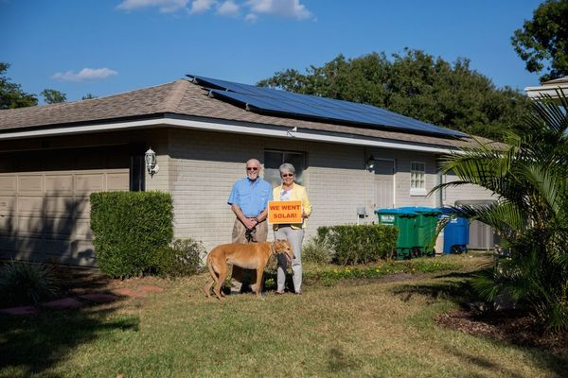
Colorado Renewable Energy Society: THIS THURSDAY @ Alliance Center
https://www.cres-energy.org/
https://www.meetup.com/Metro-Denver-CRES/events/243891101/
The Future is in Our Hands: How Can We Increase Solar in Colorado?
Thursday, October 19, 2017; 6:30 PM to 8:30 PM
The Alliance Center, 1536 Wynkoop Street, 1st Floor , Denver, CO (map)

Slide 26
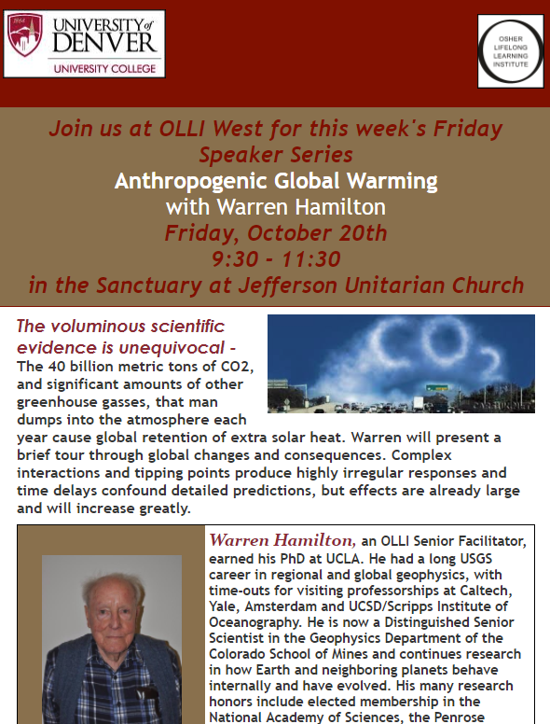
OLLI FRIDAY SERIES
Anthropogenic Global Warming with Warren Hamilton Friday October 20th, 9:30-11:30
Slides available
http://campaign.r20.constantcontact.com/render?m=1103133034549&ca=0dc4b94e-aac5-4c92-84a2-9546b4d43bcb

Slide 27
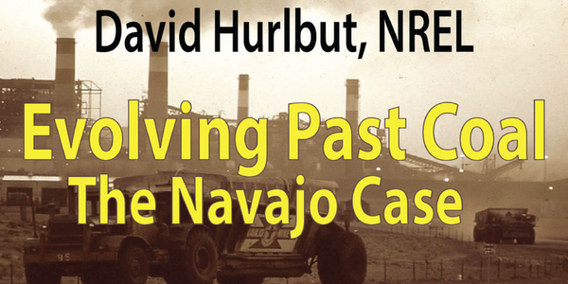
Colorado Renewable Energy Society: put on your Calendar: October 26th
https://www.cres-energy.org/
https://www.meetup.com/J-CRES/events/243961082/
Dave Hurlbut, NREL; Evolving Past
Thursday, October 26, 2017; 7:00 PM
Jefferson Unitarian Church; 14350 W. 32nd Ave. Golden, CO (map)

Slide 28
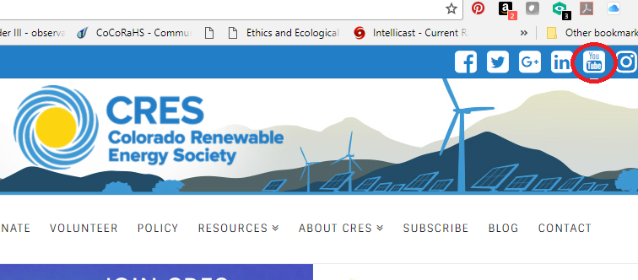
Colorado Renewable Energy Society – YouTube of selected talks:
https://www.youtube.com/channel/UCr81EUb2qVJVfmmlJMxEHVw

Slide 29
DENIALISM
Responding to Climate Change Deniers with Simple Facts and Logic
A sequence of five questions and answers that can be used by scientists to communicate some simple concepts of climate change to broader audiences.
By Dork Sahagianon 30 March 2017
SENDING VIA EMAIL
More Next Week

Slide 30
SOLUTIONS to Address Climate Change Issues:
Implies an Acknowledgement that We Need to Do Something! WHAT?
De-Carbonize our Energy Needs:
Electricity,
Transportation,
Farming,
Living (cooking/heating)
and Manufacturing
Mitigate
Adapt

Slide 31
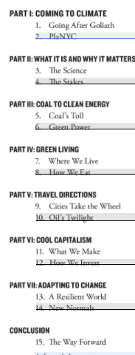
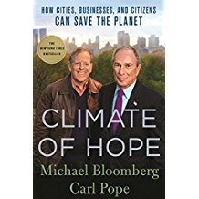
Climate of Hope - Solutions

Slide 32
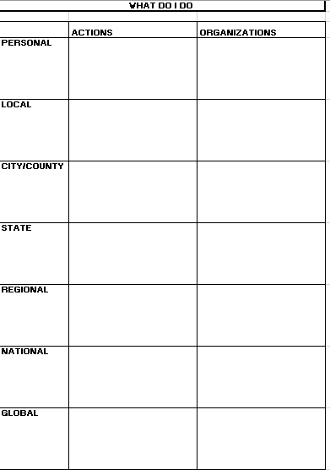
What Do I Do? (Personal) What Do We Need to DO (Societal)

Slide 33
SOLUTIONS:
WHAT ARE THE ECONOMICS DOING THAT?
CAN CAPITALISM SOLVE OUR ISSUES?
IF SO: HOW?
IF NOT: WHAT?
Economics
of doing nothing (solely adapting) vs. the economics of mitigation
Actuality: it WILL be a combination
Capitalism, GDP/growth based economics vs. “Herman Daly” economics (no-growth/steady-state)
Solutions? Paradigm shift? From we can’t/too expensive to WE CAN
There is promise, but at what cost? (One might be surprised).
Energy
Mitigation – Agricultural revolution/biofuels: Biochar for Carbon Dioxide Removal (CDR)

Slide 34
SOLUTIONS: To Be Covered Next Week
Geoengineering:
Solar Radiation Management (SRM) and
Carbon Dioxide Removal (CDR)
Biochar vs. BECCS solutions SEE MY BIOCHAR LINK IN OTHER PAGES: http://denverclimatestudygroup.com/?page_id=28
Efficiency – the single quickest way to reduce:
What NREL is doing: Efficiency, Solar, wind, other
Other strategies:
CCL – carbon fee/dividend
Cap and trade?
Gloom and Doom? NO! IT’S A CHALLENGE, and humanity has always been challenged and we are an adaptable species that has met the challenge over and over again!

Slide 35
1. Economics
See Links Below & EEE links and AR5-WG2 on web page:
Economic related reports:
2015 The Social Cost of Carbon study summary
2007.03.18 Discount Rate and Climate Change DLC
Stern Report: sternreview_report_complete
Nordhaus briefly describes the “free rider” problem and his proffered solution as a lead-in to his recent review of the book, Climate Shock. Here’s the link to the NY Review of Books website: http://www.nybooks.com/articles/archives/2015/jun/04/new-solution-climate-club/
Nordhaus produced a 30-slide PowerPoint version for his Presidential address to the AEA January. Available at http://carbon-price.com/wp-content/uploads/2015-01-04-Nordhaus-ClimateClubAEA-v2-slides.pdf
2015-01-04-Nordhaus-ClimateClubAEA-v2-slides
MIT: GOOGLE LIST OF LINKS: https://scholar.google.com/scholar?q=mit+report+on+climate+change+economics&hl=en&as_sdt=0&as_vis=1&oi=scholart&sa=X&ved=0CBsQgQMwAGoVChMIkMfkl8i9yAIVSuJjCh1x7wKk
IPCC AR5 WG2: http://www.ipcc.ch/report/ar5/wg2/#.UuAsbxDn9hE

Slide 36
Notes
Stern/Nordhaus – promote support a high discount rate – doing something NOW
IPCC acknowledges adaptation will be a must (the change is in the bank and accumulating interest)
Bjorn Lomborg – Danish economist (not a denier) argues for spending later – i.e. no discount rate
https://en.wikipedia.org/wiki/Bj%C3%B8rn_Lomborg
http://www.desmogblog.com/bjorn-lomborg
Which leads to whether or not we need a paradigm shift (#3)

Slide 37
2. Form of Government & Economic System: Growth vs. Steady-State
Economics
of doing nothing (solely adapting) vs. the economics of mitigation
Actuality: it WILL be a combination
Capitalism, GDP/growth based economics vs. “Herman Daly” economics (no-growth/steady-state)
Solutions? Paradigm shift? From we can’t/too expensive to WE CAN
There is promise, but at what cost? (One might be surprised).
Energy
Mitigation – Agricultural revolution/biofuels: Biochar for Carbon Dioxide Removal (CDR)

Slide 38
Income Inequality
Courtesy of Gary Wyngarden: Capitalism vs. the Planet

Slide 39
Income Inequality
Courtesy of Gary Wyngarden: Capitalism vs. the Planet

Slide 40
Income Inequality
Courtesy of Gary Wyngarden: Capitalism vs. the Planet

Slide 41
Global Footprint see http://www.footprintnetwork.org/en/index.php/GFN/page/glossary
Human activities consume resources and produce waste
Ecological Footprint Accounting addresses whether the planet is large enough to keep up with the demands of humanity.
Biocapacity represents the planet’s biologically productive land areas including our forests, pastures, cropland and fisheries
Biocapacity can then be compared with humanity’s demand on nature: our Ecological Footprint. The Ecological Footprint represents the productive area required to provide the renewable resources humanity is using and to absorb its waste.

Slide 42
Global Footprint
Our current global situation: Since the 1970s, humanity has been in ecological overshoot with annual demand on resources exceeding what Earth can regenerate each year.
It now takes the Earth one year and six months to regenerate what we use in a year.
We maintain this overshoot by liquidating the Earth’s resources. Overshoot is a vastly underestimated threat to human well-being and the health of the planet, and one that is not adequately addressed.
Notes:
Biggest piece of that is what we’ve been talking about—clearing the air of carbon dioxide. Because we are in overshoot we have a carbon dioxide buildup with consequent climate change impacts.

Slide 43
Global Footprint
For 9 billion people (midrange projection for 2050) to live at North American/Western European standards will require 5 planets.

Slide 44
Drawbacks of Capitalism
Wealth and Income Distribution
Largely ignoring the ecological impacts and biocapacity of the planet
Notes:
Very one dimensional profits and growth thereof

Slide 45
Growth Dilemma
Growth is unsustainable in its current form
De-growth is unstable

Slide 46
How do different countries handle it?
Japan:
China:
Malaysia:
U.S.:
Germany:
Others:

Slide 47
Obama quoted in episode of Years of Living Dangerously (paraphrased): “It’s difficult in a Democracy to do something/pass something where the pay-back is 10 or more years out”
http://media.hhmi.org/hl/12Lect4.html

Slide 48
The solution: steady state economics?
Herman Daly’s steady state economics see:
https://en.wikipedia.org/wiki/Herman_Daly
http://steadystate.org/herman-daly/
http://steadystate.org/category/herman-daly/
The problem: how to effect that change

Slide 49
Paradigm shift in thinking
Economics
of doing nothing (solely adapting) vs. the economics of mitigation
Actual will likely be a combination
Capitalism, GDP/growth based economics vs. “Herman Daly” economics (no-growth/steady-state)
Solutions? Paradigm shift? From we can’t/too expensive to WE CAN
There is promise, but at what cost? (One might be surprised).
Energy
Mitigation – Agricultural revolution/biofuels: Biochar for Carbon Dioxide Removal (CDR)

Slide 50
Paradigm shift
Kerry Emanuel quote on p. 76: “…costs may be high and those paying them are not likely to be serious beneficiaries of their own actions. Indeed, there are few, if any, historical examples of civilizations consciously making sacrifices on behalf of descendents (sic) two or more generations removed.”
That’s what the discount rate is about. In that regard we need a social paradigm shift
If we are so concerned about leaving a national debt to our children and grandchildren, shouldn’t we put the costs of climate change as part of that equation?
For those that don’t accept climate change maybe it would be a good thing to limit CO2 into the atmosphere anyway, especially at the rates we are putting it into the atmosphere – BECAUSE OF OCEAN ACIDIFICATION issues and the law of unintended consequences!

Slide 51
End of class slides October 17th , 2017

Slide 52
https://i.kinja-img.com/gawker-media/image/upload/t_original/ihsllhptnnm4vb7wuvgq.jpg

