Slide 1
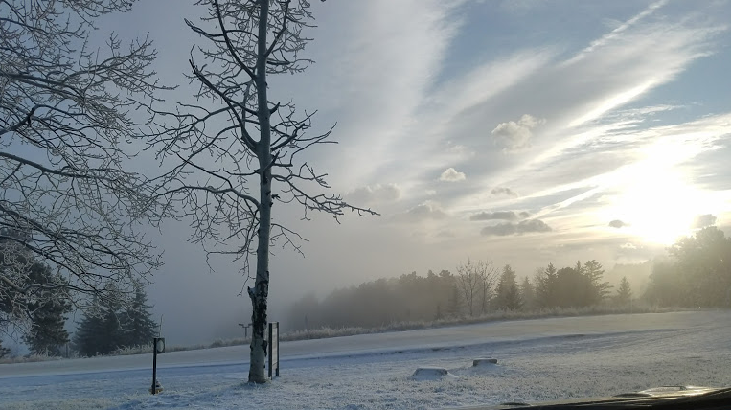
Contemporary Issues Regarding Climate Change and Solutions Paul Belanger, Ph.D., Geologist/Paleoclimatologist Tuesday October 31st , 2017:
SOLUTIONS

Slide 2
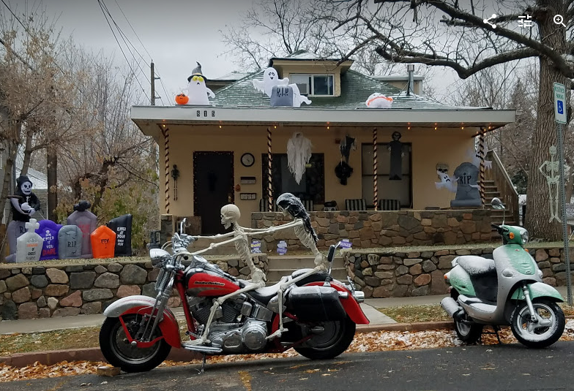

Slide 3
Contemporary Issues Regarding Climate Change and Solutions Paul Belanger, Ph.D., Geologist/Paleoclimatologist Tuesday October 31st , 2017:
SOLUTIONS

Slide 4
Contemporary Issues Regarding Climate Change and Solutions Tuesday October 31ST , 2017:
Announcements
Solutions
Energy: Conservation and De-carbonizing
Geoengineering:
Solar Radiation Management (SRM)
Carbon Dioxide Removal (CDR)
Local Government
Personal

Slide 5
Announcements
http://files.constantcontact.com/5384ad7d001/e864e167-d221-43b3-8421-5eea93f9440e.pdf
Tuesday January 16th through Monday March 12th

Slide 6
Announcements
OLLI West 10th Anniversary and Halloween Party Potluck
TODAY

Slide 7
Solutions: Energy

Slide 8
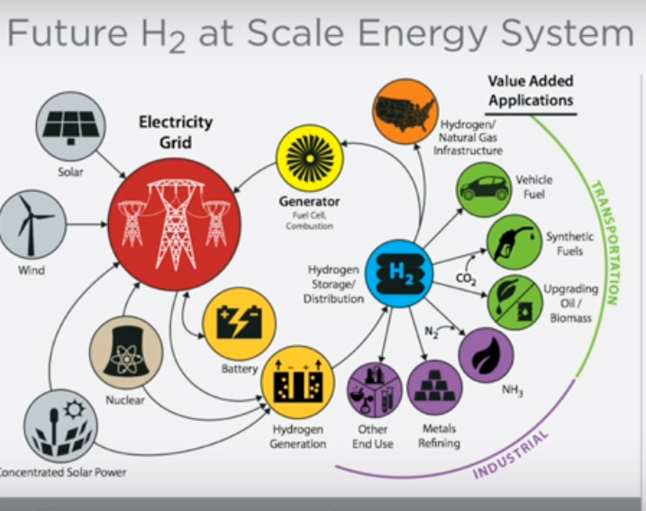
Colorado Renewable Energy Society – YouTube of selected talks:
ON Hydrogen:
Ramping Up Solar to Power the World - Greg Wilson, NREL: https://www.youtube.com/watch?v=7CDPHxcnq4c
Can Hydrogen Save our Energy System? Mark Ruth, NREL
https://www.youtube.com/watch?v=4u93y-l0cwM

Slide 9
Solutions: Geoengineering
Geoengineering:
Solar Radiation Management (SRM) and
Carbon Dioxide Removal (CDR) / Greenhouse Gas (GHG) Capture
Focus on: Biochar vs. Bio-Energy with Carbon Capture and Storage (BECCS) solutions
Direct Air Capture (DAR) also in this category
Reducing Enteric Methane (BURPED stomach gases from Ruminants) too
SEE MY BIOCHAR web page LINK: http://denverclimatestudygroup.com/?page_id=28

Slide 10
Extras to investigate outside of class
SEE February 15, 2016 discussion on EEE tab: http://denverclimatestudygroup.com/?page_id=683
National Academy of Science (NAS) Climate Intervention: Preface and links (Click here); detailed reports below:
NATIONAL ACADEMY OF SCIENCES (NAS) ONLINE: CLIMATE INTERVENTION: REFLECTING SUNLIGHT TO COOL EARTH (2015), AT HTTP://WWW.NAP.EDU/READ/18988;
AND CLIMATE INTERVENTION: CARBON DIOXIDE REMOVAL AND RELIABLE SEQUESTRATION (2015), AT HTTP://WWW.NAP.EDU/READ/18805.

Slide 11
Terminology
No terminology is going to be complete
Despite NAS efforts Geoengineering as a term is still currently the most common term used

Slide 12
Extras to investigate outside of class
IPCC Assessment report-5 (AR5); Working Group III (WGIII): Mitigation
WGIII_AR5_Presentation or in PDF format
wg3_ar5_summary-for-policymakers_approved
Video – the geoengineering dilemma 4.5 7.3 minutes https://www.futurelearn.com/courses/climate-change-challenges-and-solutions/1/steps/3297
Are Ideas to cool the planet realistic
http://news.bbc.co.uk/2/hi/technology/8338853.stm

Slide 13
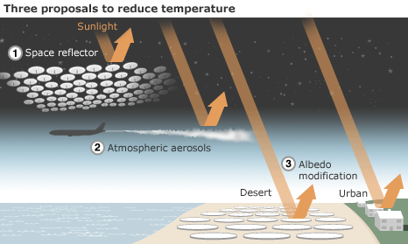
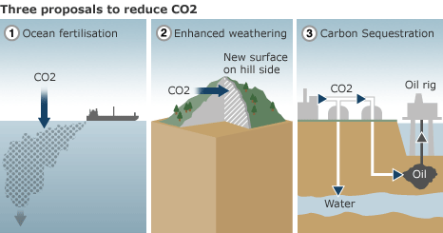
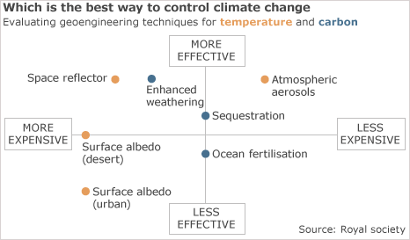
Solar Radiation Management vs. Carbon dioxide Removal (SRM VS. CDR)
Biochar & Beccs
https://en.wikipedia.org/wiki/Biochar
https://en.wikipedia.org/wiki/Bio-energy_with_carbon_capture_and_storage
Royal Society

Slide 14
Additional
SRM – Solar Radiation Management
Cloud Brightening to increase Earth’s Albedo (reflectivity) also investigated
CDR – Carbon Dioxide Removal (carbon negativity)
Ocean fertilization with Iron to create algal blooms that sink to the sea floor:
https://en.wikipedia.org/wiki/Ocean_fertilization
Enhanced weathering: taking unstable mantle minerals, particularly Olivine to lock up Carbon https://en.wikipedia.org/wiki/Enhanced_weathering
Carbon Sequestration often ignores the potential of Biochar
Carbon Sequestration synonymous with Carbon Negativity

Slide 15
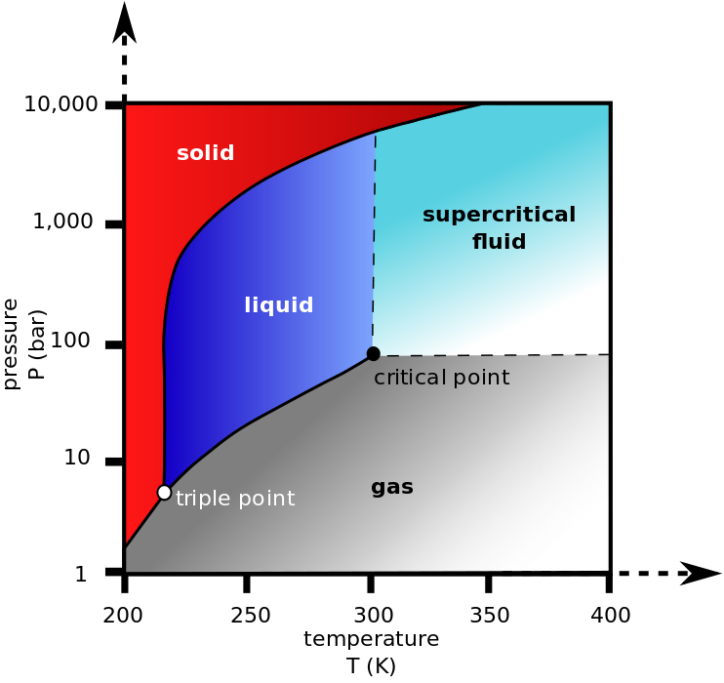
Supercritical CO₂
See https://en.wikipedia.org/wiki/Supercritical_carbon_dioxide
Miscible with salt water (saline aquifers)
it can adopt properties midway between a gas and a liquid. More specifically, it behaves as a supercritical fluid above its critical temperature (304.25 K, 31.10 °C, 87.98 °F) and critical pressure (72.9 atm, 7.39 MPa, 1,071 psi), expanding to fill its container like a gas but with a density like that of a liquid.

Slide 16
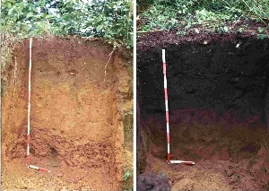
Biochar
Definition: https://en.wikipedia.org/wiki/Biochar
Biochar tab: http://denverclimatestudygroup.com/?page_id=28
Left: usual Tropical soil; Right: Biochar soil (hundreds of years old)

Slide 17
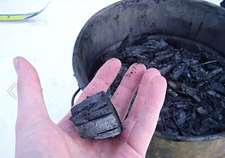
Carbon Dioxide Removal (CDR)
Left: usual Tropical soil; Right: Biochar soil (hundreds of years old) – continues taking CO2 OUT OF ATMOSPHERE!
https://en.wikipedia.org/wiki/Biochar:
“Biochar is charcoal used as a soil amendment. Like most charcoal, biochar is made from biomass via pyrolysis. Biochar is under investigation as an approach to carbon sequestration to produce negative carbon dioxide emissions.^{[1]} Biochar thus has the potential to help mitigate climate change via carbon sequestration.^{[2][3]} Independently, biochar can increase soil fertility ofacidic soils (low pH soils), increase agricultural productivity, and provide protection against some foliar and soil-borne diseases.^{[4]} Furthermore, biochar reduces pressure on forests.^{[5]} Biochar is a stable solid, rich in carbon, and can endure in soil for thousands of years.^{[1]”}

Slide 18
Cool Planet - @ 9:00 minutes where this link starts
https://youtu.be/JPJsYZLU_sM?t=535

Slide 19
Following slides from Cool Planet Video
https://youtu.be/JPJsYZLU_sM?t=535

Slide 20
Types of Photosynthesis: links
About C3, C4 and Cam Photosynthesis and Plants:
Photosynthetic efficiency: http://en.wikipedia.org/wiki/Photosynthetic_efficiency
C3 carbon fixation: http://en.wikipedia.org/wiki/C3_carbon_fixation
C4 carbon fixation:http://en.m.wikipedia.org/wiki/C4_carbon_fixation
Summary table comparison: http://www.cropsreview.com/types-of-photosynthesis.html
C3 C4 CAM Photosynthesis video: https://www.youtube.com/watch?v=Yg_pdXzWXVA

Slide 21
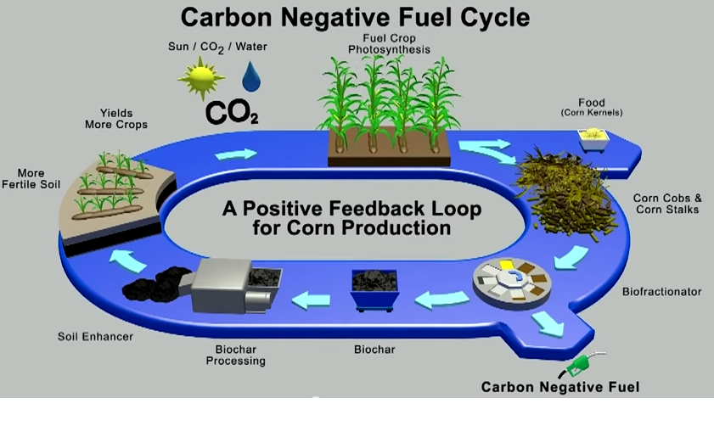
Carbon negative fuel cycle: Biochar and Biofuels
https://youtu.be/JPJsYZLU_sM?t=535

Slide 22
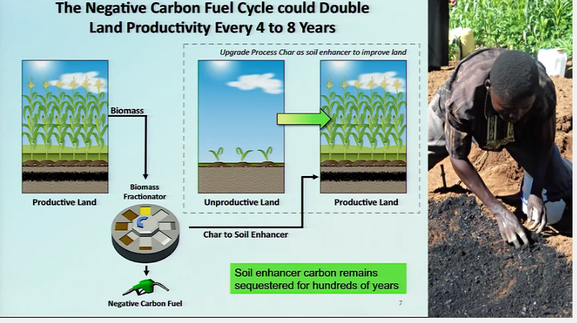
Soil Enhancement
https://youtu.be/JPJsYZLU_sM?t=535

Slide 23
Core Technologies:
https://youtu.be/JPJsYZLU_sM?t=535

Slide 24
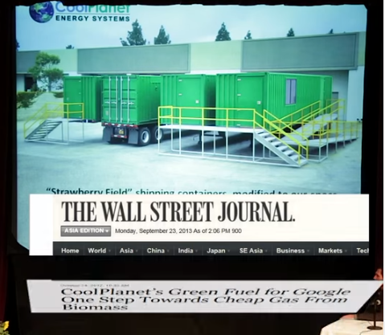
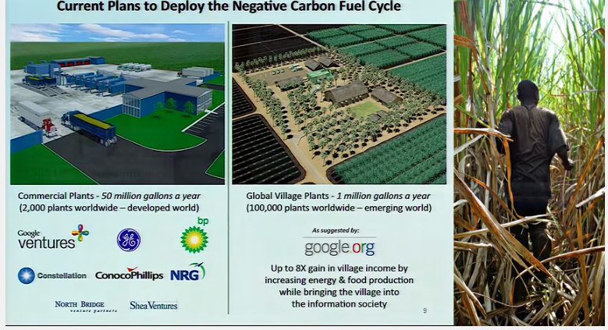
Sponsorships
https://youtu.be/JPJsYZLU_sM?t=535

Slide 25
CARBON NEGATIVE BENEFITS: - Sequester CO2 - create Biofuels
https://youtu.be/JPJsYZLU_sM?t=535

Slide 26
Bio-energy with carbon capture and storage: (BECCS)
Bio-energy with carbon capture and storage
https://en.wikipedia.org/wiki/Bio-energy_with_carbon_capture_and_storage

Slide 27
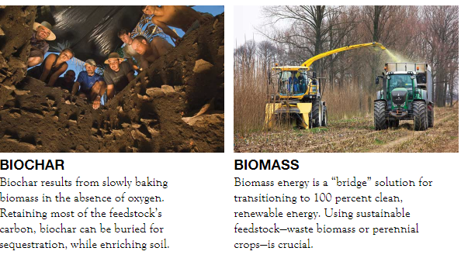
Solutions: Geoengineering options

Slide 28
Biochar:
Slides excerpted from Ron Larson Presentation - OLLI west, Spring 2017: http://denverclimatestudygroup.com/wp-content/uploads/2014/07/Larson-biochar-PART-B-BIOCHAR2017.pdf

Slide 29
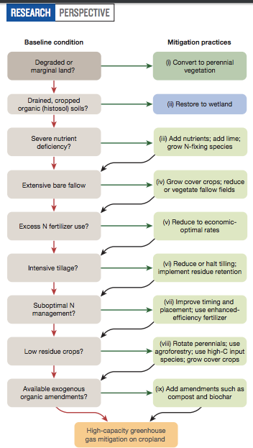
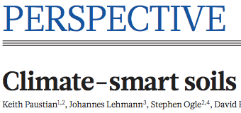

Slide 30
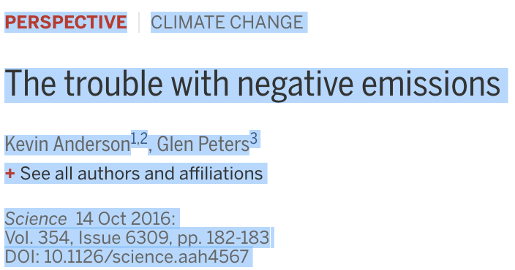
Next slide from

Slide 32
Links
http://www.biocharnow.com/index.php/biochar/climate-change
http://nas-sites.org/dels/studies/cdr/?utm_source=Division+on+Earth+and+Life+Studies&utm_campaign=70eb2a0789-EMAIL_CAMPAIGN_2017_04_13&utm_medium=email&utm_term=0_3c0b1ad5c8-70eb2a0789-233932773&mc_cid=70eb2a0789&mc_eid=4ea23050ce
https://earth.stanford.edu/jason-funk
https://www.google.com/search?q=center+for+carbon+removal&oq=center+for+carbon+removal&aqs=chrome.0.0l6.5640j0j7&sourceid=chrome&ie=UTF-8

Slide 33
SOLUTIONS

Slide 34
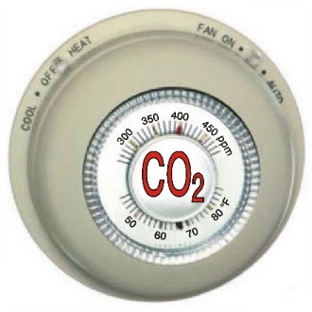
The Thermostat is Going UP
More Water Vapor and Clouds
Warmer Air, Warmer Water (Global Warming)
Atmosphere Biosphere
Hydrosphere Cryosphere
(Climate Change)
Human Activity
J
Courtesy Phil Nelson
Notes:
J = journalism, especially science journalism

Slide 35
More Water Vapor and Clouds
Warmer Air, Warmer Water (Global Warming)
HUMAN RESPONSES
Personal
Family, Friends, Neighbors
Town and City
State
National
International
Atmosphere Biosphere Cryosphere
(Climate Change)
Courtesy Phil Nelson
Notes:
J = journalism

Slide 36
Solutions: Local Governments

Slide 37
What Can Town, Cities and Communities DO?
More Water Vapor and Clouds
Warmer Air, Warmer Water (Global Warming)
HUMAN RESPONSES
Personal
Family, Friends, Neighbors
Town and City
State
National
International
Atmosphere Biosphere
Hydrosphere Cryosphere
(Climate Change)
Courtesy Phil Nelson
Notes:
J = journalism

Slide 38
Solutions: Local Governments
http://lakewood.org/sustainabilityplan/
http://www.cityofgolden.net/live/sustainability-initiative/ and http://www.cityofgolden.net/government/boards-commissions/community-sustainability-advisory-board/
https://www.denvergov.org/content/denvergov/en/office-of-sustainability/2020-sustainability-goals.html
MORE – APEN, PUEBLO, ETC.

Slide 39
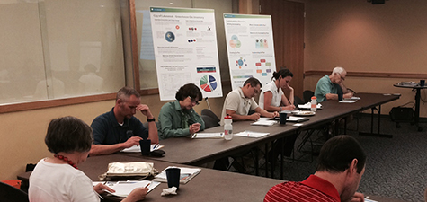
On May 11, 2015 City Council approved Lakewood's first community-wide Sustainability Plan Lakewood.org extracted Feb 2017 Sustainability plan: climate adaptation; energy-water-environment; sustainable economy; zero waste; public health; natural systems; transportation
Sustainability Division (2 permanent staff) in the Planning Department.
Courtesy Phil Nelson
Notes:
http://lakewood.org/Sustainability/Planning_for_Sustainability/Planning_for_Sustainability.aspx

Slide 40
CITIES: Sustainable Denver Summit, 14 Nov 2016
Mayor Michel B. Hancock
The Sustainable Denver Summit brought together 580 leaders from across the city’s business, nonprofit and civic communities to develop and announce commitments for new and expanded initiatives that will help Denver achieve its ambitious 2020 Sustainability Goals.
Courtesy Phil Nelson
Notes:
https://www.denvergov.org/content/denvergov/en/office-of-sustainability.html

Slide 41
Solutions: Personal
Personal Involvement: meetings, volunteer, educate yourself and others, read
Choices:
Conservation
EV (Electric Vehicles)
Solar Panels (PV – PhotoVoltaic)

Slide 42
Volunteer:
COSEIA (CO Solar Energy Industry Assoc.)
Upcoming conference: COSEIA definitely needs help for the next few weeks. Particularly in advance of, and including, COSEIA's "Clean Energy Means Business Summit" Nov 7-8. http://coseia.org/ https://www.cleanenergymeansbusiness.com/
They should write "CEMB Volunteer" in the subject line and email to both Rebecca rcantwell@coseia.org and Keelin kkelly@coseia.org
We need folks to boost attendance by making calls, setup and breakdown, and more.

Slide 43
Personal things you can do:
Get involved
Go to meetings, volunteer
Continue educating yourself
Make some commitments regarding
Conservation/reducing your Carbon Footprint
Get Solar – it’s an investment
If you have 2 cars make your primary one an Electric Vehicle (EV) and have your Internal Combustion Engine (ICE) car be a hybrid
LOTS of economic advantages: minimal maintenance, ~115 mpg equivalent
If I paid Xcel for the 20,000 miles for my Leaf = ~$500.00
With solar panels – house and EV 11.4% return for first year
Etc.

Slide 44
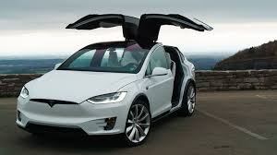
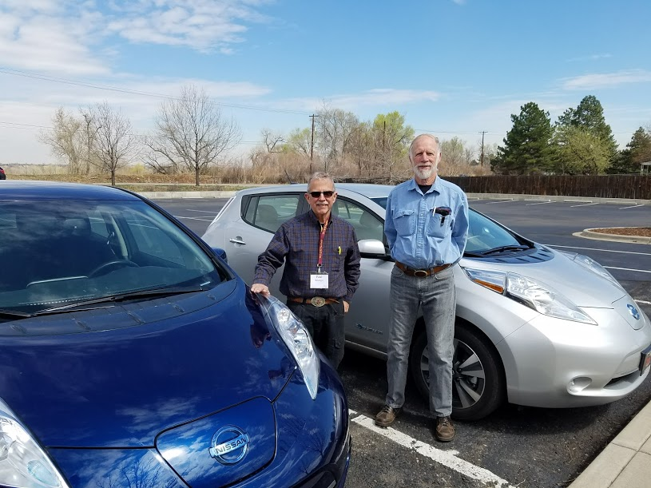
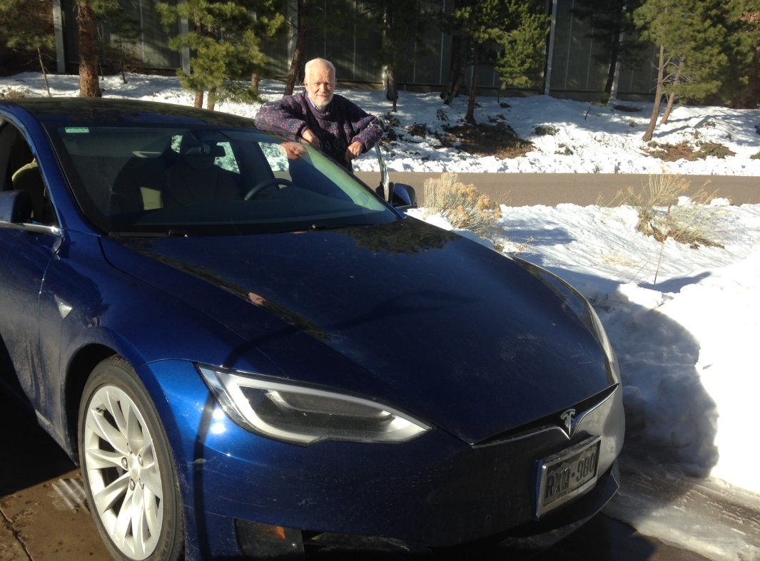
Evs (Electric Vehicles) no Emissions
Steve Stevens with Tesla X
90 kWh = 300 mile range
Paul Belanger & Phil Nelson with their Nissan Leafs
30 kWh = 107 mile range
Ron Larson with Tesla S
75 kWh = 250 mile range

Slide 45
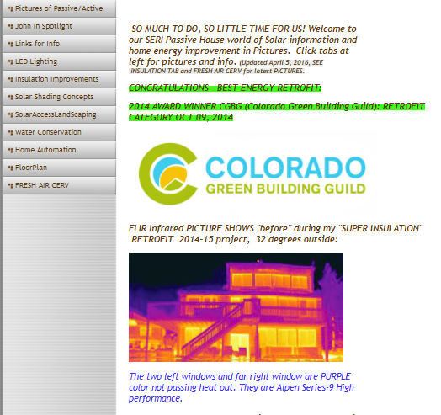
SOLUTIONS on a Personal Level
Home Solutions – LOTS OF IDEAS!
John Avenson – home solutions: http://www.avenson.net/

Slide 46
SOLUTIONS on a Personal Level
Steve Stevens – Beyond net zero: ethics, principles and practice - https://www.youtube.com/watch?v=8pbL_w8bJkQ&feature=youtu.be
CRES – NOVEMBER 30TH 7 P.M.

Slide 47
SOLUTIONS on a Personal Level
Organizations/websites:
350.org: https://350.org/
Conservation Colorado https://conservationco.org/
Citizens Climate Lobby https://citizensclimatelobby.org/
World Watch Institute: http://www.worldwatch.org/
http://www.worldwatch.org/bookstore/publication/earthed-rethinking-education-changing-planet-state-world-2017
Skeptical Science: https://skepticalscience.com/
Real Climate: http://www.realclimate.org/
Etc.

Slide 48
SOLUTIONS to Address Climate Change Issues:
Implies an Acknowledgement that We Need to Do Something! WHAT?
Newsletters:
Climate Nexus http://climatenexus.org/
Desmogblog https://www.desmogblog.com/
Eco-Justice Ministries; Peter Sawtell – weekly letter/”sermon”
http://www.eco-justice.org/ fb: https://www.facebook.com/EcoJusticeMinistries
Archives: http://www.eco-justice.org/E-list.asp
Other:

Slide 49
READ: Climate of Hope – Solutions Drawdown – and associated web pages

Slide 50
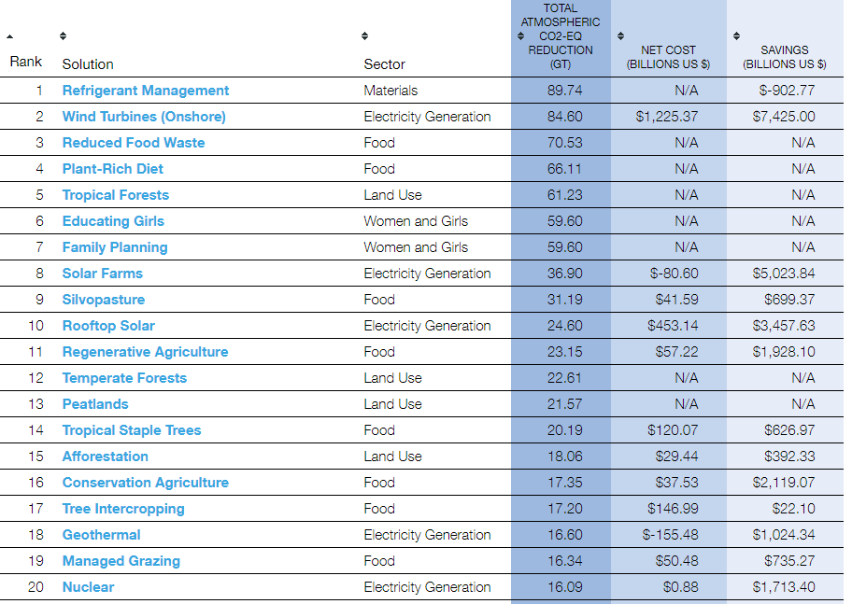
Summary of Solutions by Overall Rank
http://www.drawdown.org/solutions-summary-by-rank

Slide 51
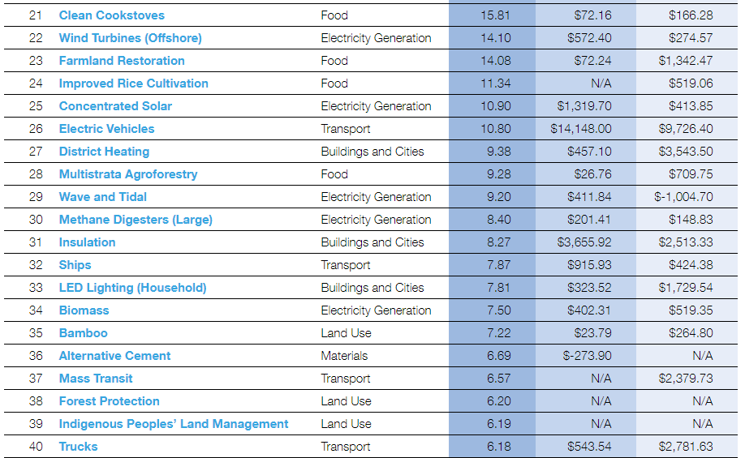
Summary of Solutions by Overall Rank
http://www.drawdown.org/solutions-summary-by-rank

Slide 52
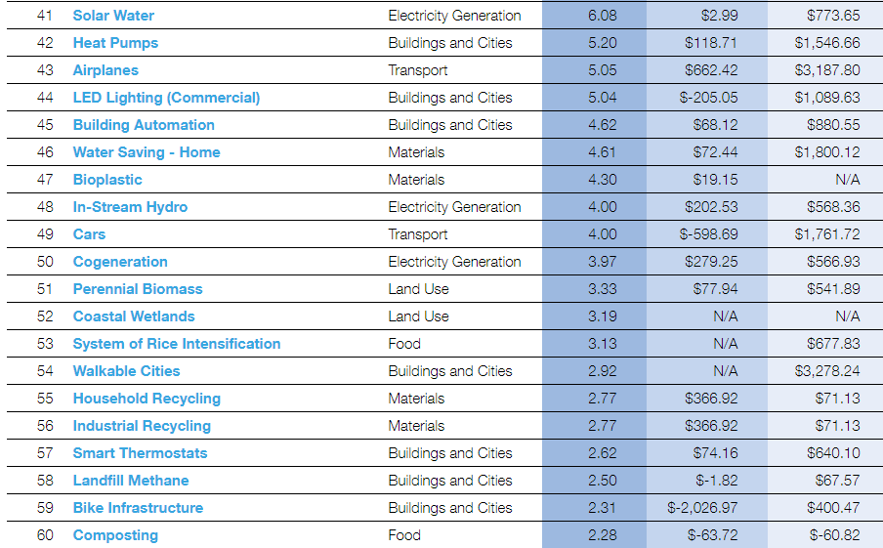
Summary of Solutions by Overall Rank
http://www.drawdown.org/solutions-summary-by-rank

Slide 53
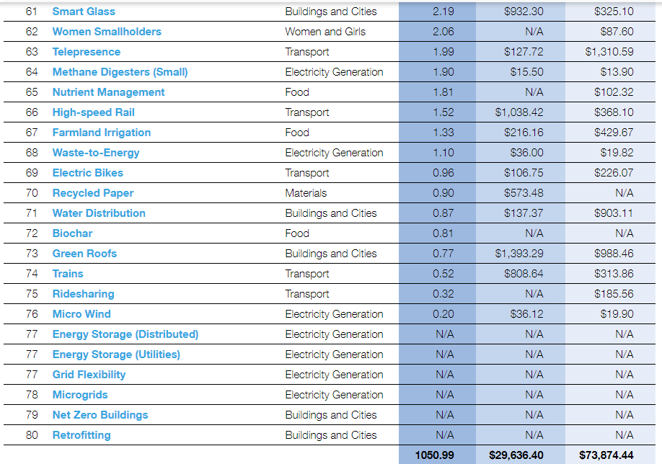
Summary of Solutions by Overall Rank
http://www.drawdown.org/solutions-summary-by-rank

Slide 54
Colorado Renewable Energy Society – YouTube of selected talks:
Drawdown CRES YouTube video: Drawdown: Ways out of the Climate Crisis. Paul Hawken, Chip Comins: https://youtu.be/4XrFnK1RrLE
Other Drawdown links:
http://www.drawdown.org/
http://www.drawdown.org/solutions
https://www.facebook.com/projectdrawdown

Slide 55
Drawdown
A Critique:
DOES NOT DEAL ENOUGH WITH CARBON NEGATIVITY –
Rather – mostly about carbon emission reduction; we need more than that – i.e. carbon negativity too to take out the excess we’ve put in
To reduce the heating/extreme weather events
To slow/stop Ocean Acidification

Slide 56
Web Links Energy/Other
U.S. Energy Information Administration https://www.eia.gov/
CRES https://www.cres-energy.org/
YouTube https://www.youtube.com/channel/UCr81EUb2qVJVfmmlJMxEHVw
NREL Presentation: GREG WILSON https://www.youtube.com/watch?v=7CDPHxcnq4c&t=23s
Governor Ritter Presentation https://www.youtube.com/watch?v=agowW1QKwms&t=6s
https://skepticalscience.com/How-Green-is-My-EV.html
http://energyshouldbe.org/
Why Storage is Key for a Renewable Energy Future: https://www.youtube.com/watch?v=Yc_hULwykvQ&t=13s
Clean Energy through Open Electricity Markets: https://www.youtube.com/watch?v=seGwTKTm38A

Slide 57
OLLI West Courses to Consider
Phil Nelson – Extreme Weather
Alec Tsoucatos – Steady state economics – when more is not enough
Great Decision – Peter Lohaus & Jeff Pederson
Friday 1/26 Jim Smith, Gas cars are obsolete and here’s why
Consider OLLI SOUTH too

Slide 58
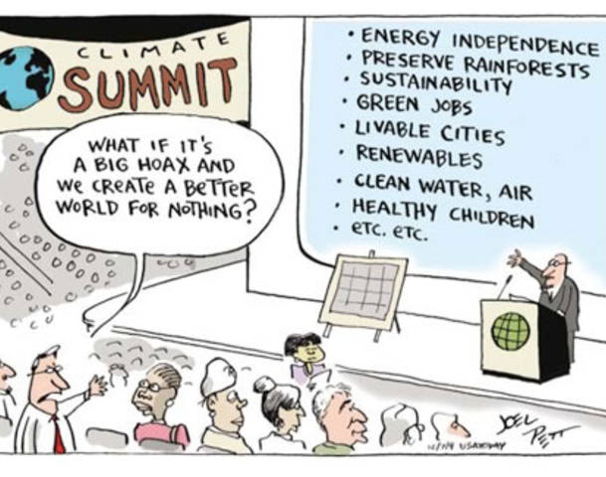
Joel Pett

Slide 59
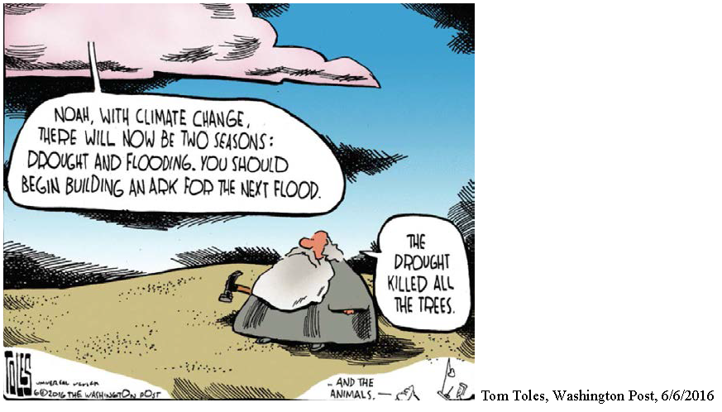

Slide 60
In closing
“ASK NOT WHAT YOU OUGHT TO DO, RATHER ASK WHAT YOU MUST DO!”
(attributed to a philosopher – please let me know who)
AND
For those that say “it can’t be done” I say: Stay out of the way of those that are DOING IT!

Slide 61
Climate of Hope
p. 27:
“If we don’t act now, when? And if we don’t act, who will?”

Slide 62
End of class slides October 31ST , 2017

Slide 63
https://i.kinja-img.com/gawker-media/image/upload/t_original/ihsllhptnnm4vb7wuvgq.jpg

Slide 64
EXTRAS

Slide 65
Useful Links for education / passing on
https://www.nap.edu/catalog/12781/americas-climate-choices 2011
https://www.nap.edu/catalog/12782/advancing-the-science-of-climate-change 2010
https://www.nap.edu/catalog/11175/radiative-forcing-of-climate-change-expanding-the-concept-and-addressing 2005

Slide 66
other
CCL:
Link for CCL Power Point Presentations FEB 25, 2017
Link to The Transition to Renewable Energy and the Colorado Economy
https://drive.google.com/file/d/0B9EqUuZ68yOLTEpKUUd3Zld4Vzg/view
https://drive.google.com/drive/folders/0B9EqUuZ68yOLbWg3aXNheEZhWDQ

Slide 67
Guiding Principles
So a little more on Citizens Climate Lobby
Politicians don’t create political will, they respond to it.
The bipartisan carbon fee and dividend policy is a simple, transparent policy to address the climate crisis.
CCL volunteers show respect for diverse views and appreciation for the work of others.
Kathleen Wells, Denver CCL, 2017

Slide 68
SOLUTIONS
Carbon fee/dividend:
citizensclimatelobby.org/ccl-applauds-republican-resolution-calling-for-action-on-climate-change/
http://citizensclimatelobby.org/
Facebook:
CCl – national: https://www.facebook.com/CitizensClimateLobby/?fref=ts
CCL-Colorado: https://www.facebook.com/CitizensClimateLobbyDenverChapter/

Slide 69
Ways to reduce your carbon footprint
Ways to save http://yourenergy.extension.colostate.edu/
Other https://youtu.be/BxKfpt70rLI
https://thinkprogress.org/its-been-45-above-normal-in-oklahoma-this-february-ba30f7bde27a
EDF Check out these tips from an EDF climate scientist on actions you can take in your own home and community to stop climate change.

Slide 70
http://www.avenson.net/
https://350.org/
http://www.yaleclimateconnections.org/2017/04/changing-minds-on-a-changing-climate/
https://www.theatlantic.com/science/archive/2017/04/climate-polling-burnout/523881/
steve stevens – Beyond net zero:
ethics,
principles and
34:16 - practice - https://www.youtube.com/watch?v=8pbL_w8bJkQ&feature=youtu.be

Slide 71
SOLUTION
VOTE
SUPPORT YOUR SENATORS AND REPRESENTATIVES SPEAKING OUT
WRITE/HARRASS THOSE THAT ARE NOT

Slide 72
Senator Bennet
https://www.bennet.senate.gov/?p=blog&id=3860
Bennet Urges President to Rescind Anti-Climate Executive Order: https://www.bennet.senate.gov/?p=blog&id=3860

Slide 73
Rep. Ed Perlmutter
http://perlmutter.house.gov/
Perlmutter Responds to Trump’s Climate Change Executive Order: http://perlmutter.house.gov/news/documentsingle.aspx?DocumentID=1671

Slide 74
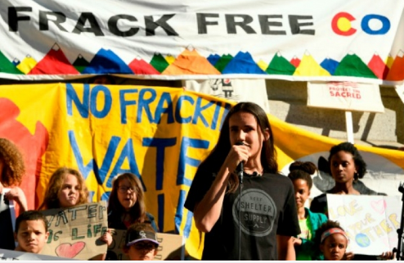
Support our Youth
https://www.ourchildrenstrust.org/news

Slide 75
IN SUMMARY
The world has been getting better
Changes are happening; WE NEED TO CHANGE:
25+ Ways to Reduce Your Carbon Footprint: http://cotap.org/reduce-carbon-footprint/
We need to support science and new technologies

Slide 76
25 charts and maps that show the world is getting much, much better
http://www.vox.com/2014/11/24/7272929/charts-thankful
So – let’s not regress; let’s continue to improve our world and transition to a new future: A NEW NORMAL
There are few, if any, historical examples of civilizations consciously making sacrifices on behalf of descendants two or more generations removed.
In that regard we need a social paradigm shift
Gloom and Doom? NO! IT’S A CHALLENGE, and humanity has always been challenged and we are an adaptable species that has met the challenge over and over again!

Slide 77
ECONOMIC PROGRESS: Extreme poverty has fallen
Hunger is falling
Child labor in decline
More leisure time
Income spent on food has plummeted in US
Health care: life expectancy is rising
Child Mortality is down
Death in childbirth is rarer
People are getting taller
More people have access to malaria bednets
http://www.vox.com/2014/11/24/7272929/charts-thankful

Slide 78
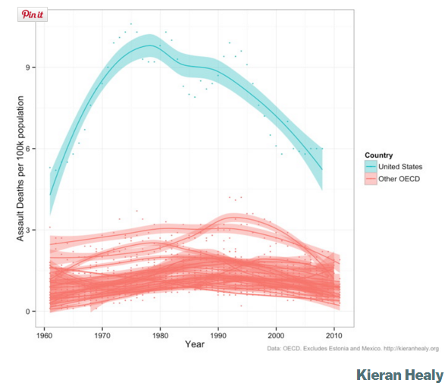
Guinea worm is almost eradicated
Teen births in US are down
As is smoking
War is on the decline
Homicide rates are down in Europe
And the US too
Violent crime declining
Rapidly reduced the supply of nuclear weapons
More countries are democracies
More people going to school longer
http://www.vox.com/2014/11/24/7272929/charts-thankful

Slide 79
Literacy is up as well
US unsheltered homeless declined nearly 32% since 2007
Moore’s law is still going (# transistors on a chip doubling) i.e. greater computer power
Access to internet increasing
Solar power is getting cheaper
http://www.vox.com/2014/11/24/7272929/charts-thankful

Slide 80
Web Links Energy/Other
U.S. Energy Information Administration https://www.eia.gov/
CRES https://www.cres-energy.org/
YouTube https://www.youtube.com/channel/UCr81EUb2qVJVfmmlJMxEHVw
NREL Presentation: GREG WILSON https://www.youtube.com/watch?v=7CDPHxcnq4c&t=23s
Governor Ritter Presentation https://www.youtube.com/watch?v=agowW1QKwms&t=6s
https://skepticalscience.com/How-Green-is-My-EV.html
http://energyshouldbe.org/
Why Storage is Key for a Renewable Energy Future: https://www.youtube.com/watch?v=Yc_hULwykvQ&t=13s
Clean Energy through Open Electricity Markets: https://www.youtube.com/watch?v=seGwTKTm38A

