Slide 1
PART B: A Changing Power System Storage vs. the Grid Small or Large
Power Source Options in Decarbonization
Baseload Power or Not
Storage vs. the Grid

Slide 2
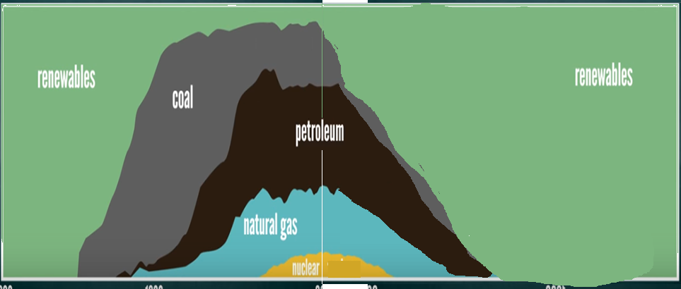
PROJECTIONS: Renewables to Coal-Petroleum-Natural Gas-Nuclear -- Back to Renewables & Nuclear Sources
https://www.youtube.com/watch?v=Fjbx5Xq_ULc&t=10s

Slide 3
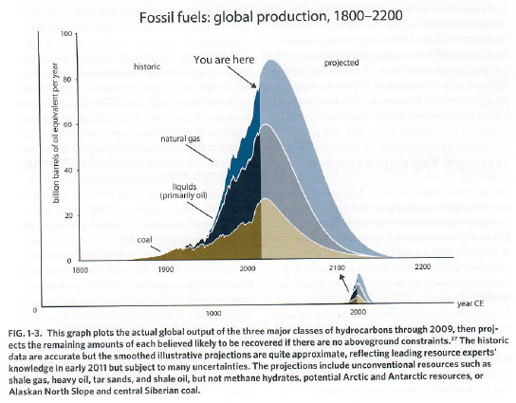
Reinventing Fire…, Lovins, A. 2011

Slide 4
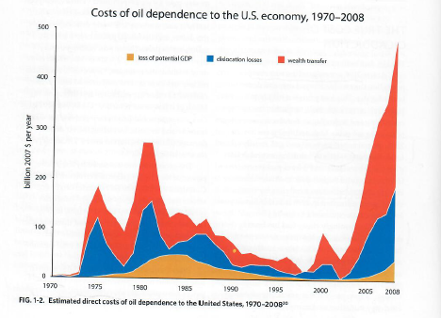
Reinventing Fire…, Lovins, A. 2011

Slide 5
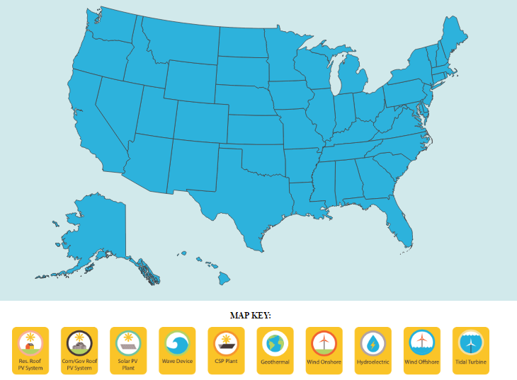
The Solutions Project
100% RENEWABLE ENERGY VISION
Stanford http://thesolutionsproject.org/infographic/

Slide 6
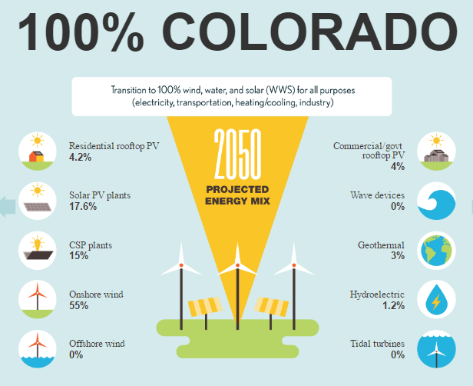
The Solutions Project
100% RENEWABLE ENERGY VISION
Stanford http://thesolutionsproject.org/infographic/

Slide 7
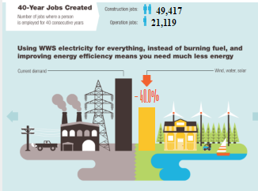
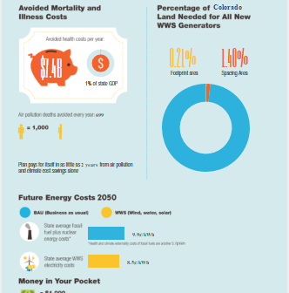
The Solutions Project
100% RENEWABLE ENERGY VISION
Stanford http://thesolutionsproject.org/infographic/

Slide 8
A Changing Power System
CRES YouTube: Many videos on this and related topics
https://www.youtube.com/channel/UCr81EUb2qVJVfmmlJMxEHVw/videos
Thank Martin Voelker for his wonderful work doing this – free!

Slide 9
A. Net Zero Carbon Buildings
J-CRES Meeting last week:
K.K. DuVivier
¼ Electricity Plug-load
1. SOLAR PV + STORAGE
¼ Domestic Hot Water
½ Space Heating
II. DG THERMAL—HOT WATER
& SPACE CONDITIONING
Courtesy of K.K. DuVivier CRES 4/2017

Slide 10
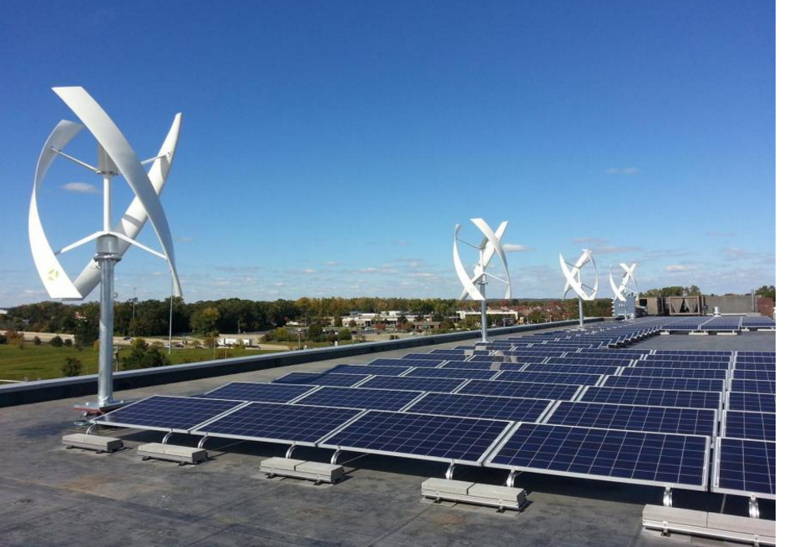
Why not distributed wind or hydro?
Nov 2016 report from NREL concludes that resource potential for distributed wind exceeds the total US electricity demand, but only 934 MW of capacity.
https://cleantechnica.com/2014/12/29/bipartisan-group-senators-pushing-distributed-wind-heres-matters/
http://www.gamengadgets.com/water-pipes-will-generate-electricity-for-portland/
Courtesy of K.K. DuVivier CRES 4/2017

Slide 11
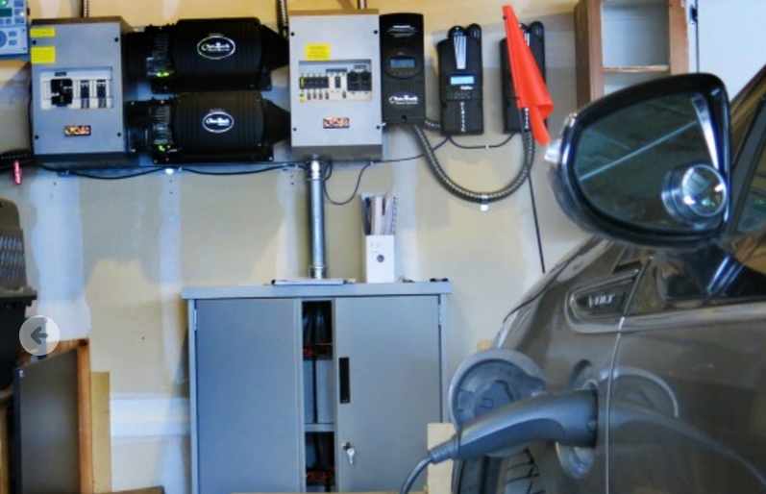
B. Solar + Storage (the next killer app)
US solar capacity tripled to 32 gigawatts (end of 2016), up from 10 gigawatts in 2013.
US total technical potential for 1,118 GW of rooftop solar PV, which could generate 1,432 TWh of annual energy generation (2016).
By the first half of 2015, the US had only installed about 1% of the technical potential.
Only 26% of rooftop area of small buildings is optimal for PV, but has the greatest potential—731 GW or 65% of the technical potential.
http://www.cpr.org/news/gallery/slideshow-kk-duvivier-and-lance-wrights-home-solar-settlement
Courtesy of K.K. DuVivier CRES 4/2017

Slide 12
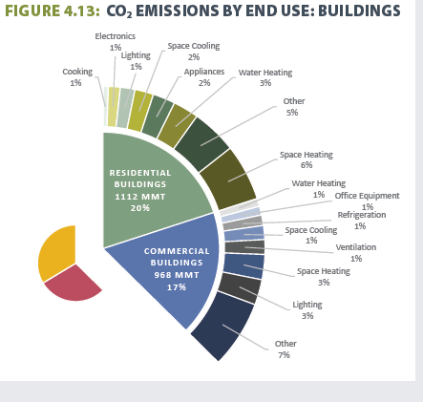
C. Distributed Thermal Resources
37% of CO2 emissions from residential & commercial buildings combined.
Largest contributors are:
Water Heating and
Space Heating and Cooling
About ½ of US floor space is currently heated with systems that burn fossil fuels.
Energy Efficiency is one solution, but another is increased electrification.
https://www.whitehouse.gov/sites/default/files/docs/mid_century_strategy_report-final.pdf at 59
Courtesy of K.K. DuVivier CRES 4/2017

Slide 13
Storage options
https://en.wikipedia.org/wiki/Energy_storage
2Methods
2.1Outline
2.2Mechanical storage
2.3Thermal storage
2.4Electrochemical
2.5Other chemical
2.6Electrical methods
2.7Interseasonal thermal storage

Slide 14
BACKUP OR GRID
Balanced power is necessary: not too much, not too little
SOLUTION – EITHER
Backup:
Battery,
Compressed Air,
Re-pumped Hydro,
H₂ (this can be 2-way for excess power or needed power)
Rubber Bands, etc.
Grid

Slide 15
Future Energy System – Commodity H₂

Slide 16
Ken Regelson videos
CRES YouTube: Many videos on
https://www.youtube.com/channel/UCr81EUb2qVJVfmmlJMxEHVw/videos
Energy Should Be web page: http://energyshouldbe.org/
Why Storage is Key for a Renewable Energy Future: https://www.youtube.com/watch?v=Yc_hULwykvQ&t=14s
To Allow Lots of Renewables, Baseload Coal & Nuclear Must Go: https://youtu.be/deWtgpheDJM
Etc.

Slide 17
Grid: Big or Small?
A case for small?
http://www.wbur.org/bostonomix/2017/04/19/microgrid-joint-base-cape-cod

Slide 18
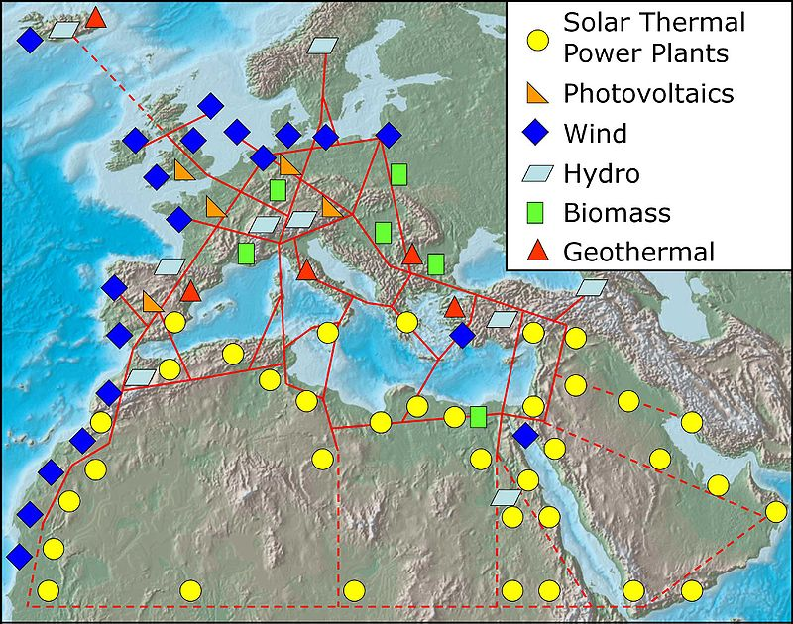
Grid: Big or Small?
Case for super-grid:
https://en.wikipedia.org/wiki/Super_grid

Slide 19
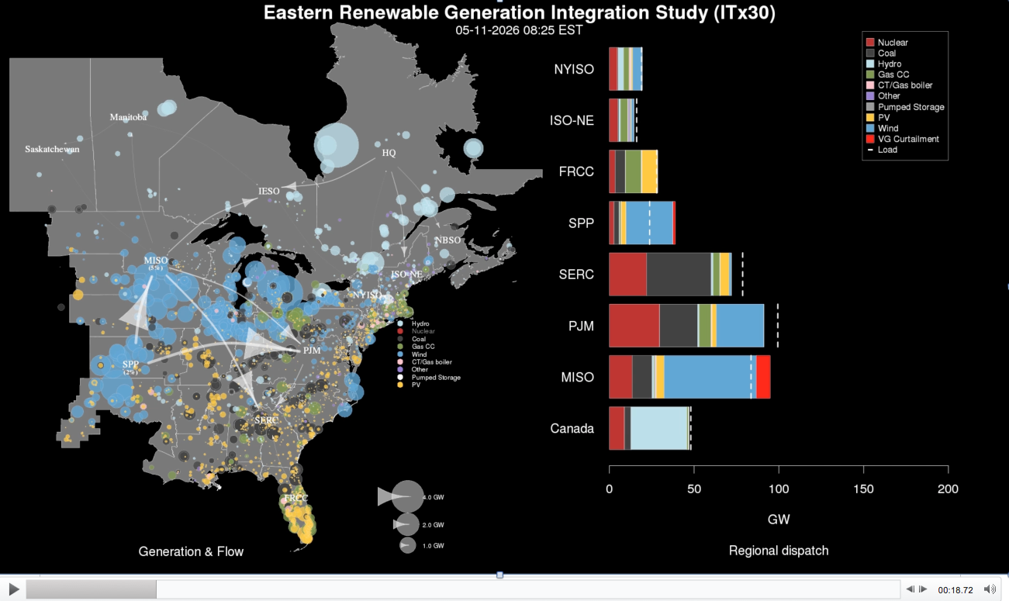
Click on next slide for simulation

Slide 20
TOO BIG TO LOAD – CONTACT ME

Slide 21
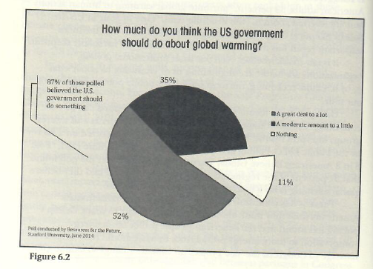
We’d like the role of Government BUT IT DOES NOT LOOK PROMISING RIGHT NOW?
Bill Ritter, Jr., Powering Forward, 2016

Slide 22
THAT’S WHY WEEK 8 WE WILL DEAL WITH GEOENGINEERING OPTIONS WITH FOCUS ON: WITH PERSONAL SOLUTIONS AND SEQUESTRATION – PARTICULARLY BIOFUELS AND BIOCHAR

Slide 23
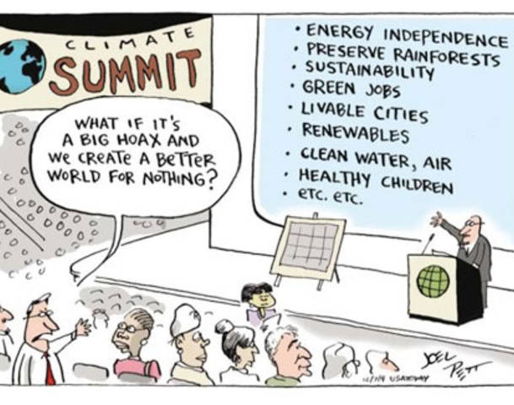
What if?
Joel Pett

Slide 24
REMINDER: WEEK 7, MAY 8TH, NREL TOUR – BE AT Learning center 12:45 p.m.
NREL Education Center: 15013 Denver West Parkway Golden, CO 80401
Google maps https://www.google.com/maps/dir//15013+Denver+W+Pkwy,+Golden,+CO+80401/@39.7408398,-105.1729051,16z/data=!3m1!4b1!4m8!4m7!1m0!1m5!1m1!1s0x876b84596aab36ab:0x5eac346d18c1fbe5!2m2!1d-105.1685277!2d39.7408399?hl=en

Slide 25
https://i.kinja-img.com/gawker-media/image/upload/t_original/ihsllhptnnm4vb7wuvgq.jpg

