Slide 1
Earth’s Climate: Past, Present and Future;
Concerns and Solutions
Week 4: Wednesday April 20, 2016
Paul Belanger
Concerns: Rates of change, Ocean acidification, modeling
Recap of climate variables and past records
Rates of change
Proxies that tell us of climate records
Ocean Acidification
Climate Modeling

Slide 2
Week 2’s slide set http://denverclimatestudygroup.com/?page_id=1796
Week 3’s slides and video links http://denverclimatestudygroup.com/?page_id=1798

Slide 3
Recap of climate variables and past records

Slide 4
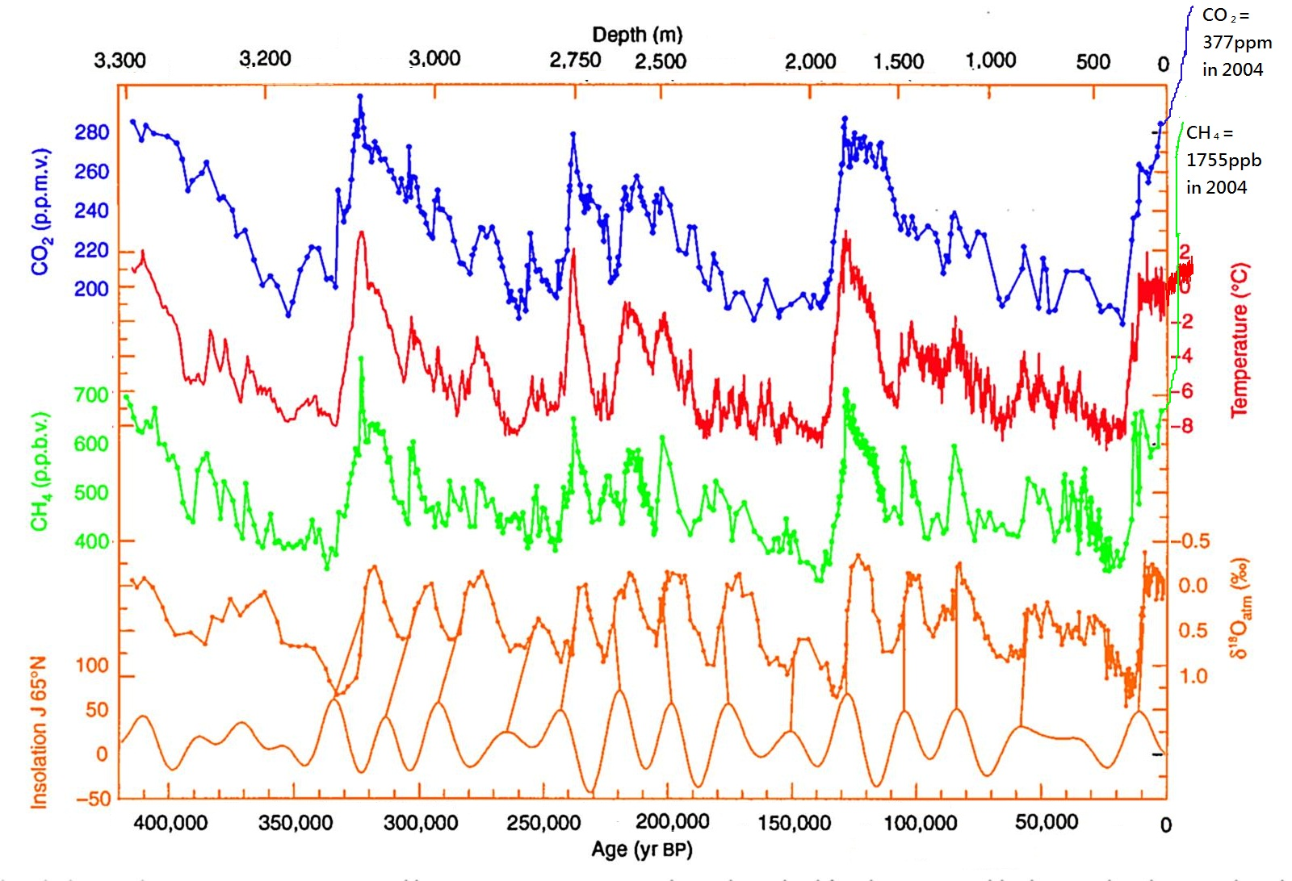
400ppm in 2015
http://www.antarcticglaciers.org/climate-change/
Notes:
Source: http://www.antarcticglaciers.org/climate-change/

Slide 5
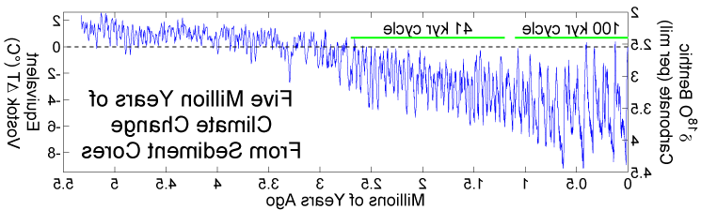

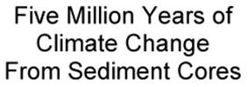
Climate Changes from Ocean Sediment Cores, since 5 Ma. Milankovitch Cycles
41K
100 K
5.0Ma
4.0Ma
3.0Ma
2.0Ma
1.0Ma
0
When CO₂ levels get below ~400-600 ppm Orbital parameters become more important than CO₂

Slide 6
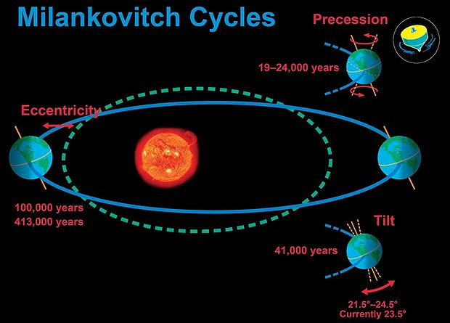
http://cnx.org/content/m38572/1.5/
Notes:
COMET® at the University Corporation for Atmospheric Research (UCAR) pursuant to a Cooperative Agreements with the National Oceanic and Atmospheric Administration, U.S. Department of Commerce. ©1997-2009 University Corporation for Atmospheric Research. All Rights Reserved.
Maybe use a ball and stick model?

Slide 7
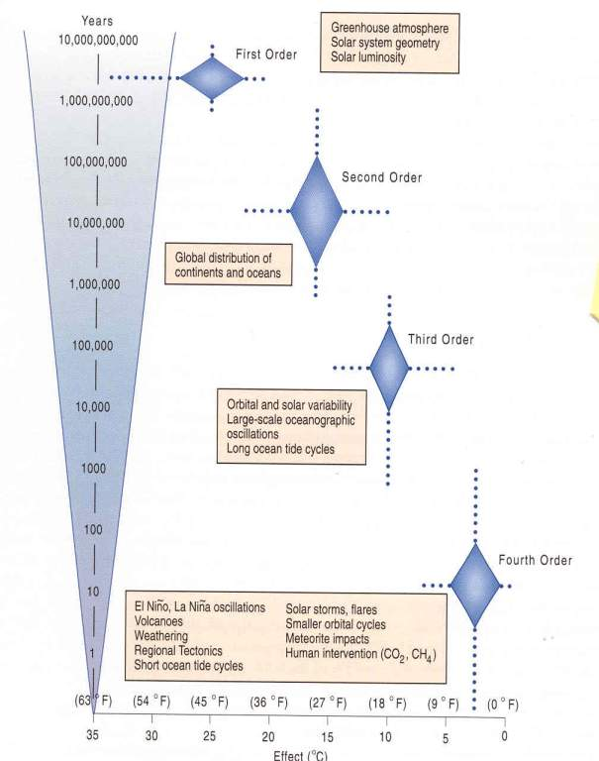
Gerhard et al., 2001

Slide 8
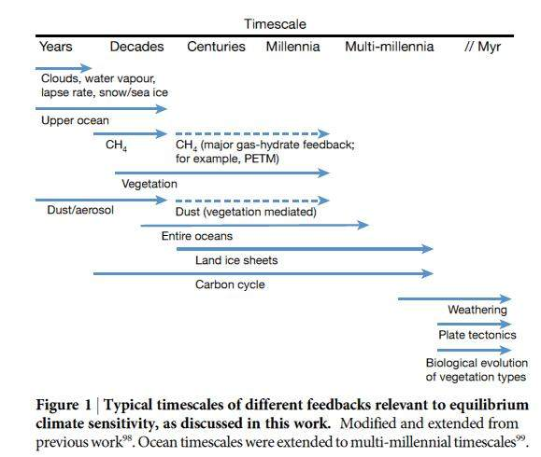
FEEDBACKS
2º Forcings
Continents
(latitudes & elevations)
Ocean
circulation
weathering
CO₂
4º Forcings
Volcanic eruptions
Sunspots
Cycles
El Nino/
La Nina
Cloud
Solar storms
3º Forcings
Obliquity
Precession
Eccentricity
CO₂ /CH₄
1º Forcings
Solar
Luminosity
Atm. Comp.
Rohling, et al., (PALAESENS Project mbrs), 2012
Notes:
FIRST ORDER: CONTINENTAL POSITIONS, LAND COVER,

Slide 9
Azolla event:
~ 49 Ma
50 million years ago (50 MYA) Earth was ice-free.
Atmospheric CO₂ amount was of the order of 1000 ppm 50 MYA.
Atmospheric CO₂ imbalance due to plate tectonics ~ 10⁻⁴ ppm per year.
Notes:
9

Slide 10
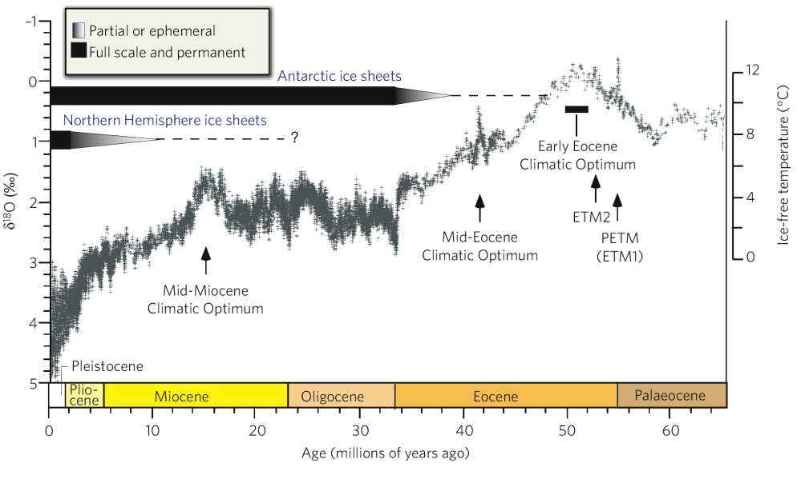
Cenozoic Deep Sea Climate Record
hyperthermals
41k-100k & amplitude
change:
Increase in
Antarctic ice
Changes in W. Pacific/Indian Ocean and/or closing of
Isthmus
of Panama
Azolla sequestering event
Opening of the Drake passage isolating Antarctica and further drop in CO₂
Zachos et al. 2008

Slide 11
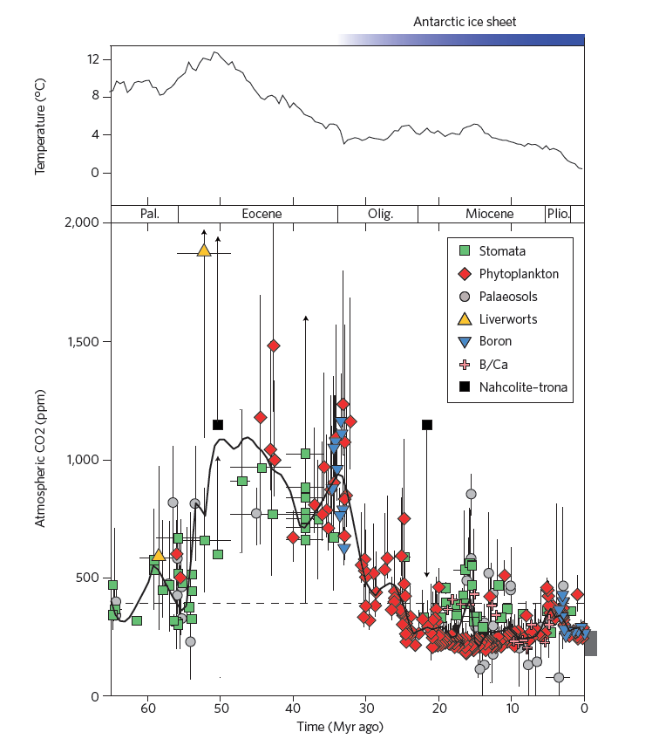
Azolla event:
~ 49 Ma
Notes:
11

Slide 12
Long-term Carbon Cycle: rocks
Two generalized reactions…
Photosynthesis/Respiration
CO₂ + H₂0 ↔ CH₂O + O₂
Weathering/Precipitation
CO₂ + CaSiO₃ ↔ CaCO₃ + SiO₂

Slide 13
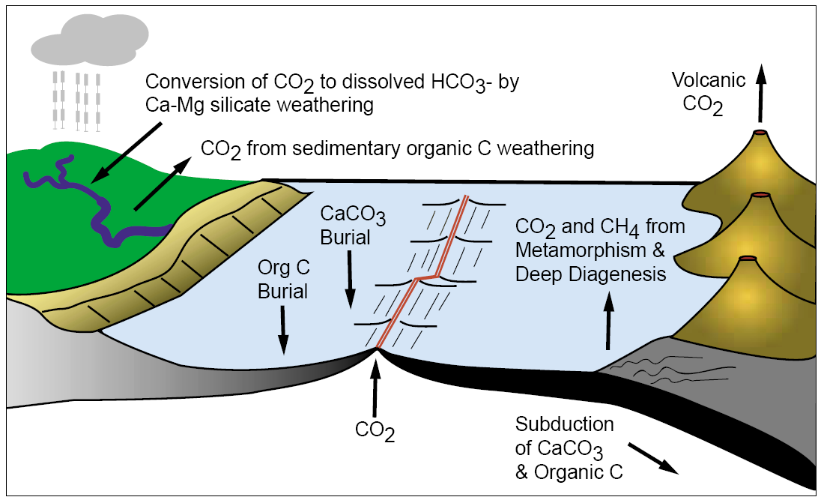
Long-term carbon cycle: rocks
Berner, 2001

Slide 14
Azolla event:
~ 49 Ma
50 million years ago (50 MYA) Earth was ice-free.
Atmospheric CO₂ amount was of the order of 1000 ppm 50 MYA.
Atmospheric CO₂ imbalance due to plate tectonics ~ 10⁻⁴ ppm per year.
Notes:
14

Slide 15
Azolla event:
~ 49 Ma
Notes:
15

Slide 16
So – what changed?

Slide 17
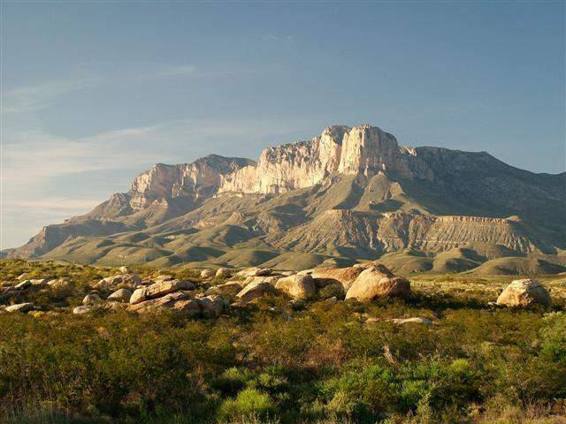
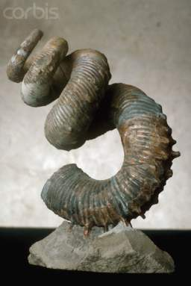

Precipitation (sink):
CO₂ + CaSiO₃ → CaCO₃ + SiO₂
GUESS WHAT:
AS CONTINENTS DRIFT TO HIGH LATITUDES AND HIGHER ELEVATIONS AND BECOME GLACIATED IT LEADS TO:
GREATER MECHANICAL WEATHERING OF SILICATES:
    increasing sequestration of CO₂ in sediments
    decreasing the amount in the atmosphere
ADDITIONALLY in the Cenozoic:
MID-OCEAN SPREADING RATES SLOW DOWN
    Less CO₂ into the atmosphere for volcanoes
=
CO₂ DRAW DOWN THROUGH TIME!

Slide 18
Rates of change

Slide 19
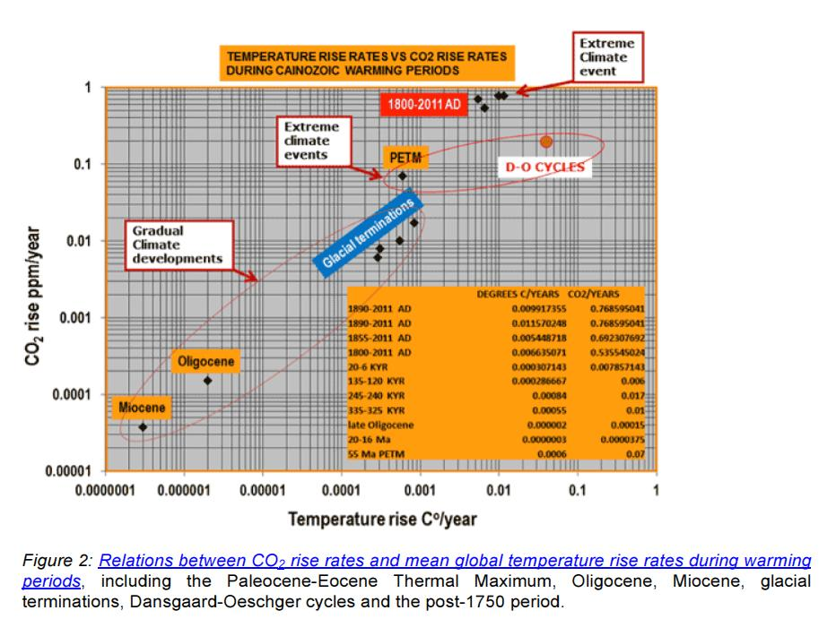
Unprecedented rates of change

Slide 20
40% change in 50 years!
400ppm in 2015
http://www.antarcticglaciers.org/climate-change/
Notes:
Source: http://www.antarcticglaciers.org/climate-change/

Slide 21
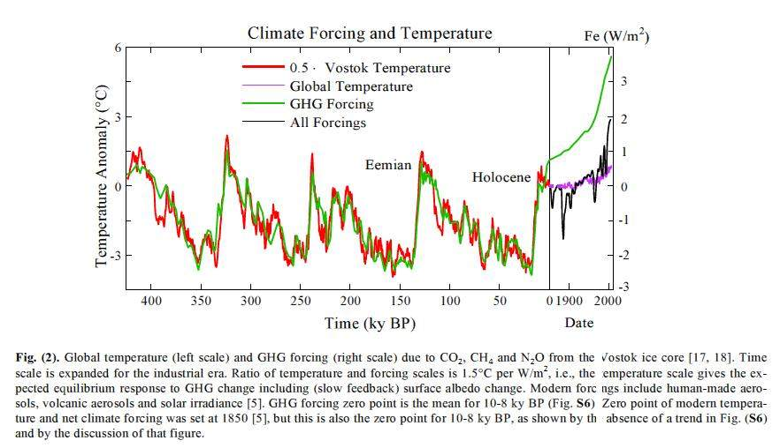
400 ppm
(2014)
280ppm
180ppm

Slide 22
Glacial-interglacial change. Over the course of the past 24,000 years, CO2 concentrations have risen (black curve) (1) as Earth emerged from glaciation, as shown by climate records from Greenland and Antarctica
(blue curves) (14, 15). Schmitt et al. (2) report a record of the change in the 13C/12C ratio of CO2 during this time (red curve). The isotopic ratio is expressed in delta notation, where δ13C is the deviation of a sample ratio
from that of an internationally expected standard, expressed in parts per thousand. Comparison of the CO2 record with the isotopic record provides insights into the mechanisms behind the CO2 rise.
/ http://www.sciencemag.org/content/early/recent / 29 March 2012 / Page 1/ 10.1126/science.1219710

Slide 23
Climate Changes from Ocean Sediment Cores, since 5 Ma. Milankovitch Cycles
41K
100 K
5.0Ma
4.0Ma
3.0Ma
2.0Ma
1.0Ma
0
When CO₂ levels get below ~400-600 ppm Orbital parameters become more important than CO₂

Slide 24
Paleocene/Eocene Thermal Maximum
PETM

Slide 25
Cenozoic Deep Sea Climate Record
Azolla sequestering event
hyperthermals
41k-100k & amplitude
change:
Increase in
Antarctic ice
Changes in W. Pacific/Indian Ocean and/or closing of
Isthmus
of Panama
Opening of the Drake passage isolating Antarctica and further drop in CO₂
Zachos et al. 2008

Slide 26
Azolla event:
~ 49 Ma
Notes:
26

Slide 27
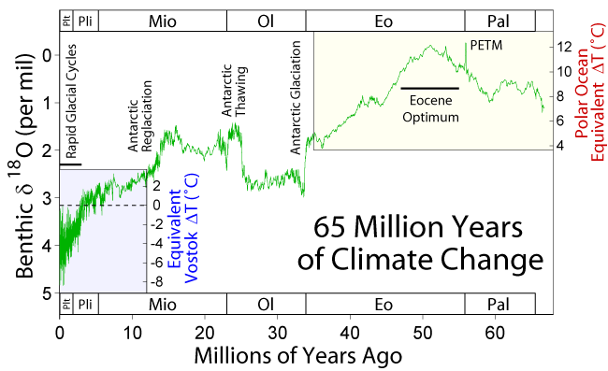
Proxy data: stable isotopes
Wikipedia
Notes:
Complexities here relate to the onset of current ice-house stage. Continental configuration important – opening of the Drake Passage, closing of the Isthmus of Panama forcing the present North Atlantic conveyor belt. Gulf Stream – start of Northern Hemisphere glaciations. But let us also look at an astronomical driver – cycles in earth’s orbit

Slide 28
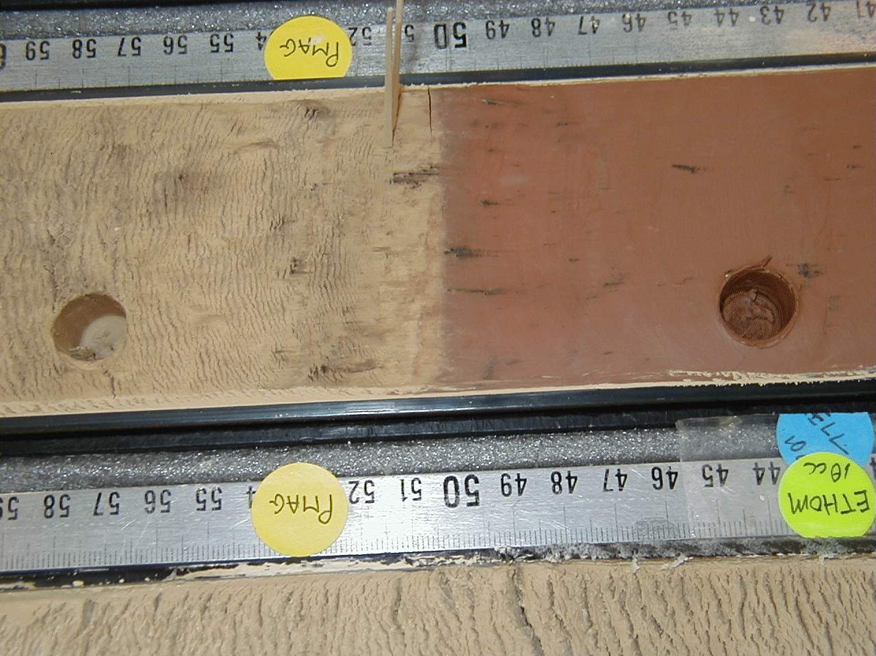
2 to 4 cm / 1000 years
0.2 to 0.4 cm / 1000 years
1000 years
1000 years
?

Slide 29
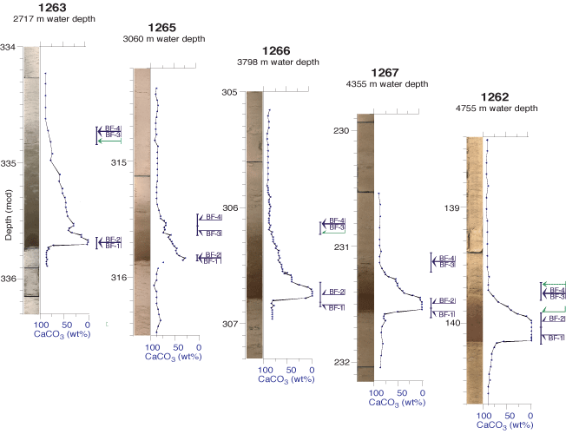

Slide 30
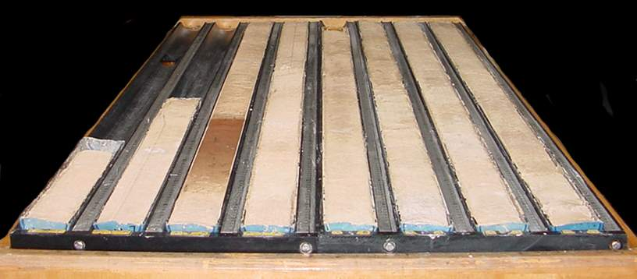
It took a long time to recover

Slide 31
The Azolla event

Slide 32
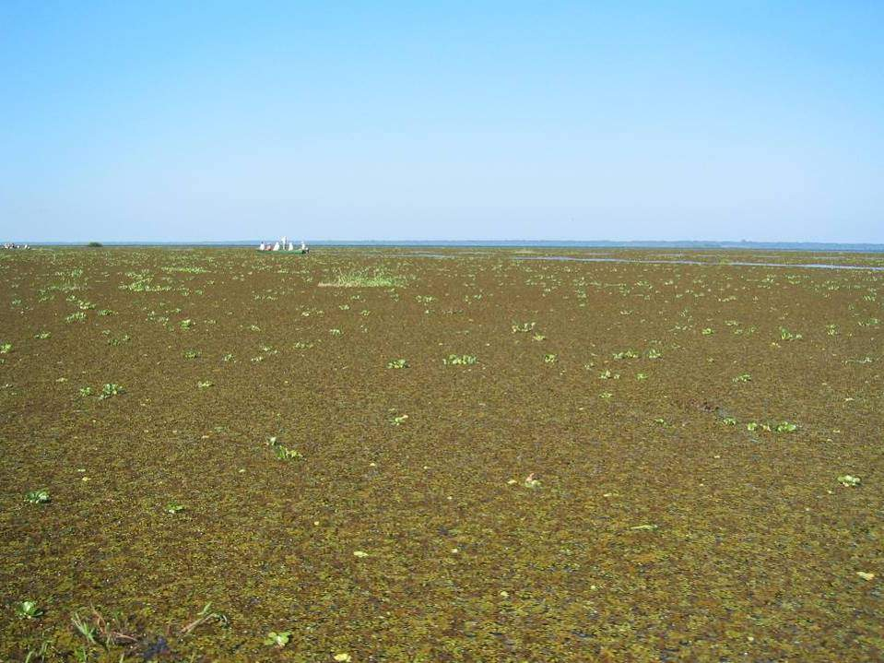
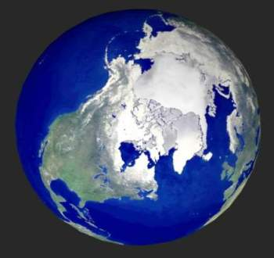
The Arctic Sea 50 million years ago

Slide 33
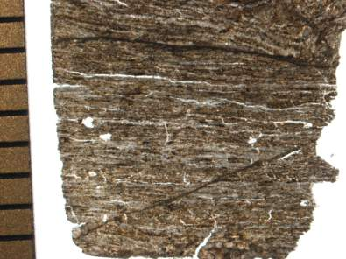
ACEX Azolla core
>8 meter ACEX core with 90% Azolla
Azolla occurs as laminated layers
indicates Azolla deposited in situ
bottom-water anoxia at ACEX site
Bujak, pers. Comm.

Slide 34
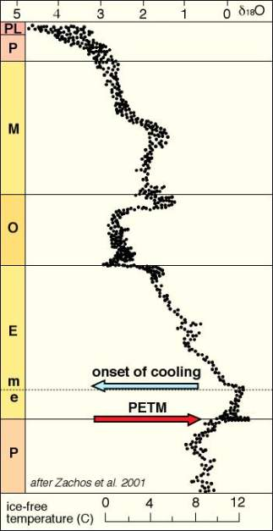
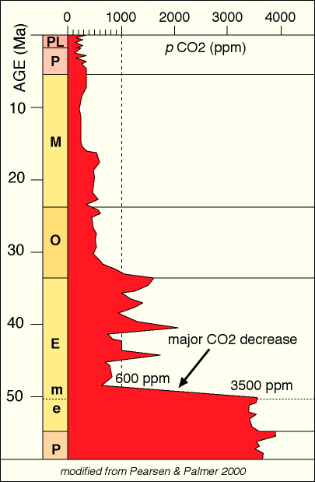
UNPRECEDENTED DROP IN CO₂
the massive decrease in atmospheric CO₂?
Bujak, pers. Comm.

Slide 35
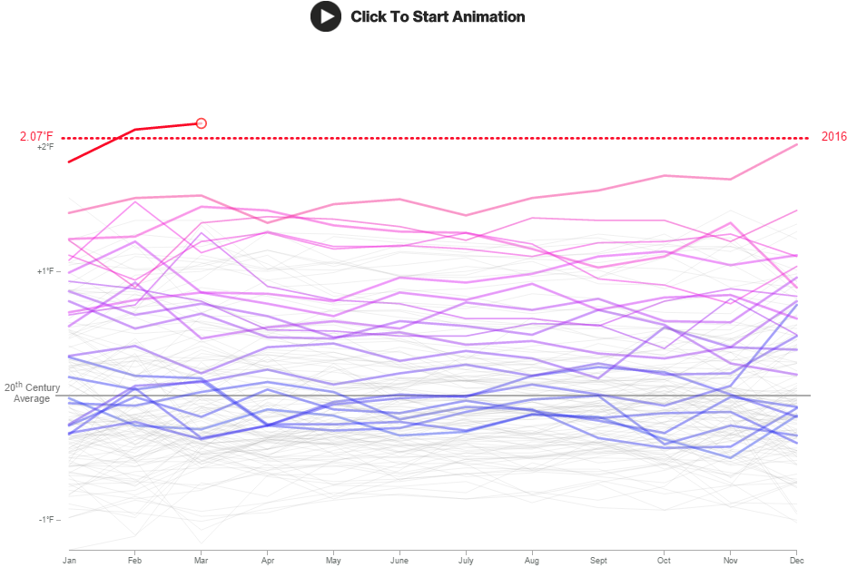
http://www.bloomberg.com/news/features/2016-04-19/earth-s-temperature-just-shattered-the-thermometer

Slide 36
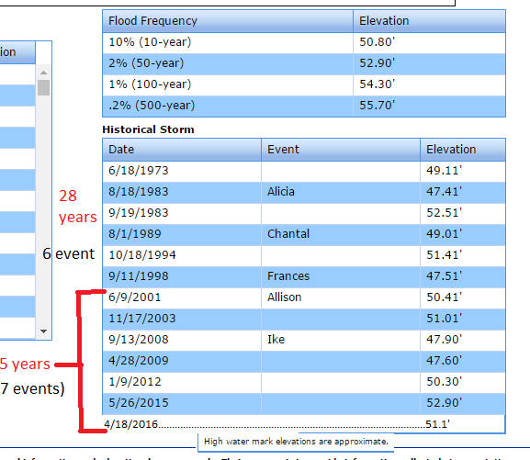
http://www.harriscountyfws.org/GageDetail/Index/440?r=1&span=7#stream

Slide 37
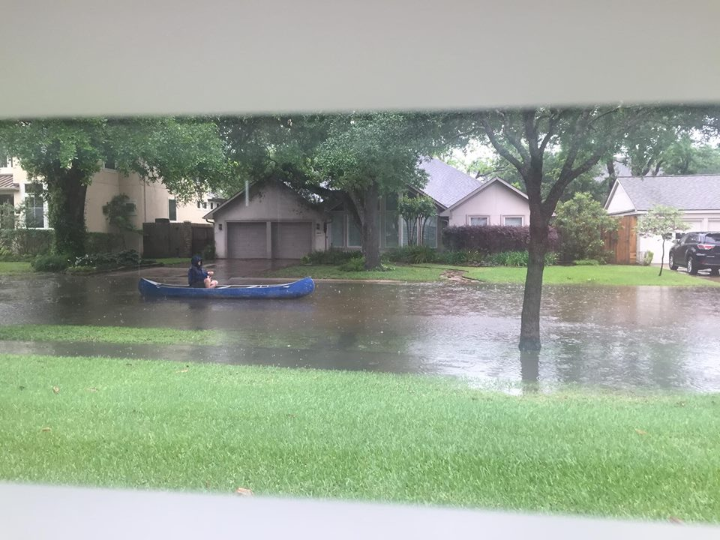

Slide 38
Proxies that tell us of climate records

Slide 39
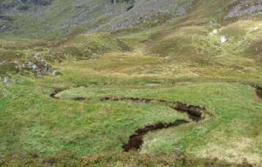
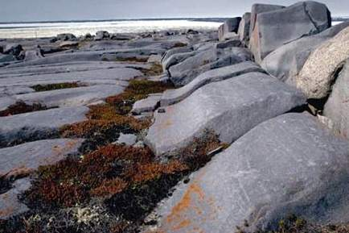
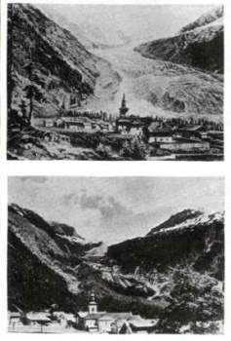

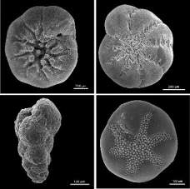
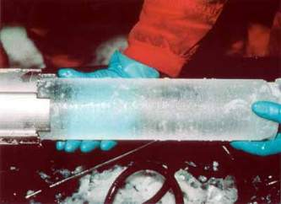
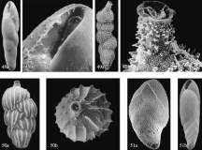

Scientific History of Climate change – PROXY DATA

Slide 40
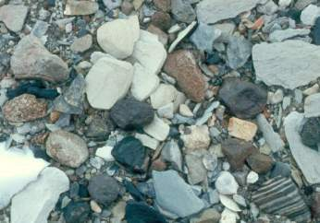
SOME OF THE EARLIEST PROXY DATA
WAS FROM TERRESTRIAL DEPOSITS
Strandlines/shorelines
Moraines
Till
Kettle lakes, etc.
We may know what caused these today, but imagine back then?

Slide 41
IT’S THE INTERPRETATION THAT’S NOT ALWAYS CORRECT
Darwin observed ancient Alpine shorelines:
interpreted as ocean shoreline
Agassiz – later correctly interpreted as ice- dammed lake-shore strandlines/shoreline

Slide 42
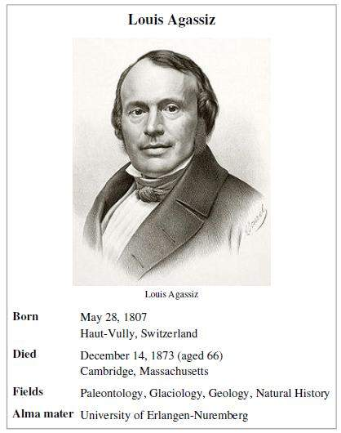
Jean Louis R. Agassiz
“Father” of Glaciology
1807-1873
Paleontologist
Glaciologist

Slide 43
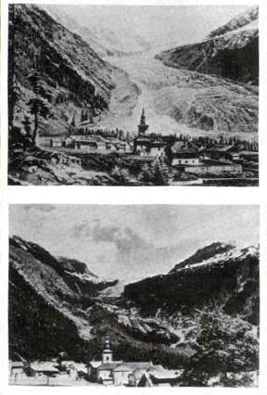
Photographic proxy data/evidence
Ruddiman, 2008

Slide 44
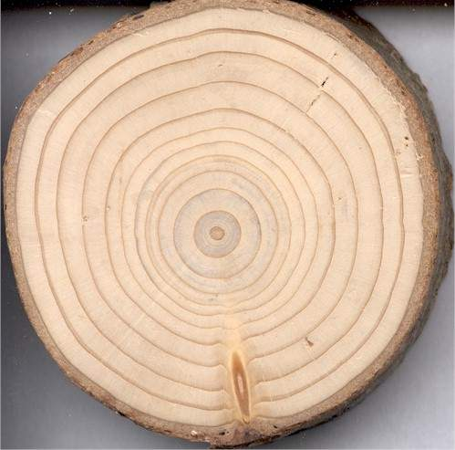
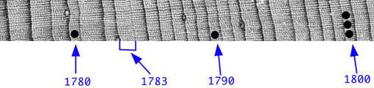
EARLY PROXY DATA:
TREE RINGS

Slide 45
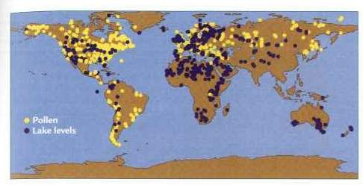
Pollen & Lake core data
Ruddiman, 2008

Slide 46
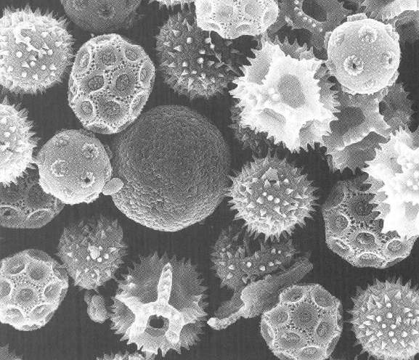
PROXY DATA:
POLLEN DATA

Slide 47
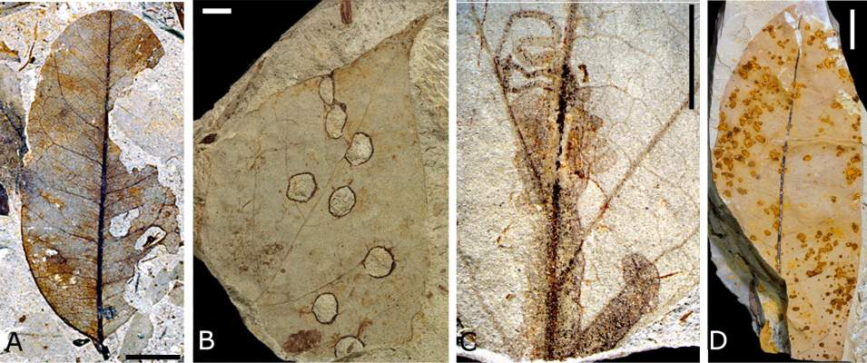
PROXY DATA:
LEAVES

Slide 48
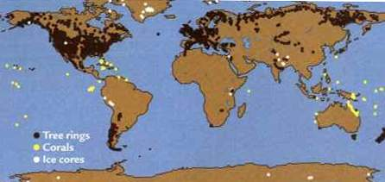
Tree rings, corals, ice cores
Ruddiman, 2008

Slide 49
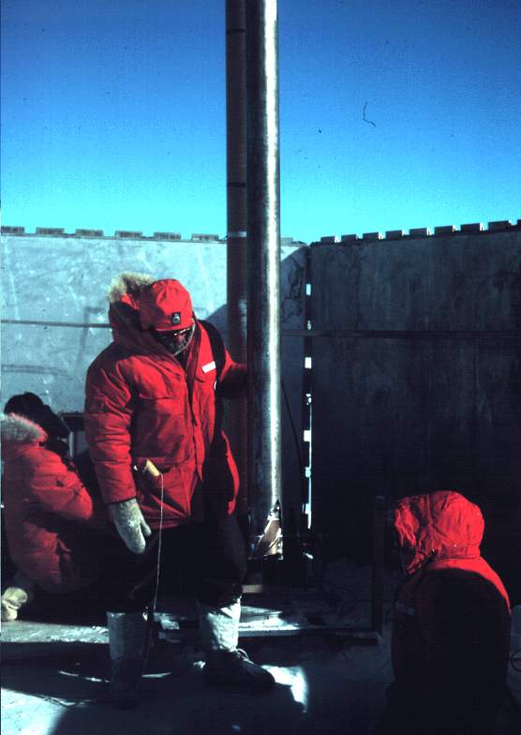
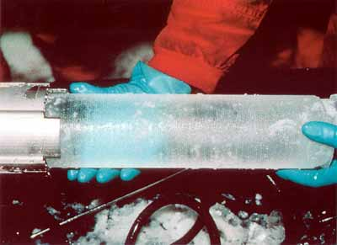
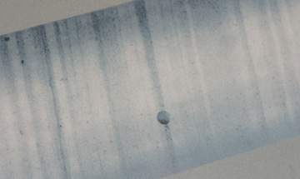
PROXY DATA:
ICE CORES

Slide 50
TERRESTRIAL DATA
North American:
Wisconsin
Illinoian
Kansan
Nebraskan
European:
Wurm
Riss
Mindel
Gunz

Slide 51
LATER EVIDENCE CAME FROM
THE MARINE RECORD
NOT WITHOUT IT’S PROBLEMS,
BUT MORE COMPLETE

Slide 52
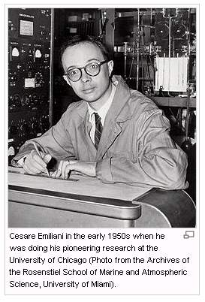
Cesare
Emilani:
Paleontologist,
Chemist
Father of
Paleoceanography

Slide 53
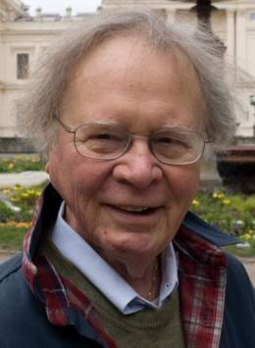
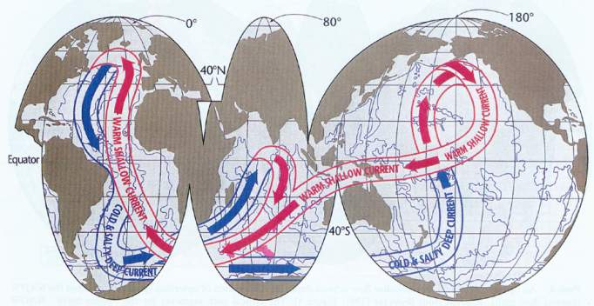
Other Paleoceanographers
Wally Broecker
Thermal-haline
“conveyor” belt of circulation

Slide 54


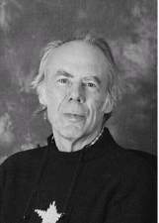
Other Paleoceanographers
Bill Ruddiman
Nick Shackleton

Slide 55
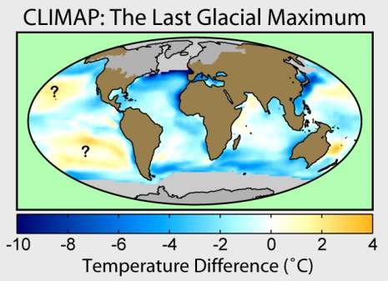


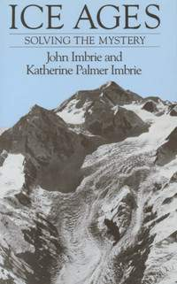
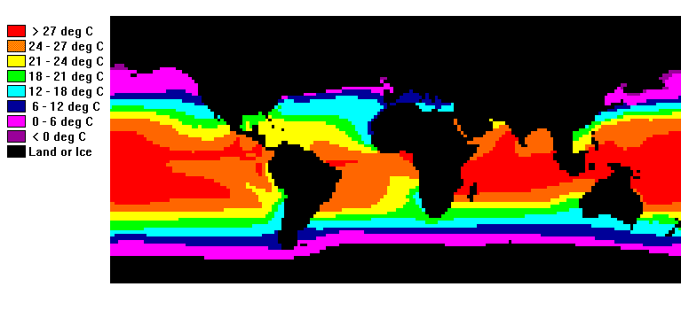
Other Paleoceanographers
John Imbrie:
CLIMAP

Slide 56




PROXY DATA:
CORE DATA

Slide 57




PROXY DATA:
BENTHIC
FORAMS

Slide 58


PROXY DATA:
PLANKTONIC
FORAMS

Slide 59


Deep Sea Coring
Ruddiman, 2008

Slide 60
Empirical: real measured data

Slide 61


Lest we forget: CO2 is still going up
*
400 ppm
http://en.wikipedia.org/wiki/Keeling_Curve

Slide 62


What about Methane?
http://www.esrl.noaa.gov/gmd/aggi/aggi.html
http://clathrates.blogspot.com/2012/04/threat-of-methane-release-from.html

Slide 63

SOURCE OF METHANE

Slide 64

Oxygen used by burning
The observed downward trend is 19 ‘per meg’ per year. This corresponds to losing 19 O₂ molecules out of every 1 million O₂ molecules in the air/year.
http://scrippso2.ucsd.edu

Slide 65
Ocean Acidification

Slide 66

http://www.pmel.noaa.gov/co2/story/Ocean+Carbon+Uptake

Slide 67
Ocean acidification
Web page post Monday October , 2015 (and fb)
Let’s start with a video: https://youtu.be/W1TZ8g8JYVU from http://www.skepticalscience.com/ocean-acidification-global-warming.htm

Slide 68



VIDEO HIGHLIGHTS: Ocean acidification
  Adding CO₂ adds H⁺ ions making water more acidic (lowers pH)
  This in turn reduces CO₃ ⁻² ions
  reducing CO₃ ⁻² makes it more difficult for organisms to make their shell – especially aragonitic ones
http://www.skepticalscience.com/ocean-acidification-global-warming.htm

Slide 69
Continued
  Takes hundreds of years to equilibrate from weathering – or buffering from the deep sea carbonates as we saw in the PETM
  0.1 decrease in pH = 26% CO₃ ⁻² ions
  reducing CO₃ ⁻² makes it more difficult for organisms to make their shell – especially aragonitic ones

Slide 70

http://www.skepticalscience.com/ocean-acidification-global-warming.htm

Slide 71


Slide 72

Pteropods
http://ocean.si.edu/ocean-acidification?gclid=Cj0KEQjw-b2wBRDcrKerwe-S5c4BEiQABprW-CHiUm54_8lcDb8ns9yN_W-5pYHfqqSf7QUb6MFohssaAmCM8P8HAQ

Slide 73

pH through time

Slide 74
Ocean acidification
  CaCO₃ + H₂CO₃ = Ca⁺² + 2HCO⁻₃ [1]
  H₂CO₃ is carbonic acid - a relatively weak naturally occuring acid that forms by the reaction between water and carbon dioxide: H₂O + CO₂ = H₂CO₃ [2]

Slide 75
Unprecedented rates of change

Slide 76

Past and present; future estimates
R. Norris et al., Science, 2013

Slide 77

History of oceans for last 65 m.y.
We know a great deal about past CO₂ , temp., etc.
Now
65 m.y.
R. Norris et al., Science, 2013

Slide 78

History of oceans for last 65 m.y. and 100,000 year projections into the future
Using the past to model the future
…and a SEGWAY to Modeling
R. Norris et al., Science, 2013

Slide 79
Full list of Videos from Skeptical Science
http://www.skepticalscience.com/denial101x-videos-and-references.html

Slide 80
Modeling

Slide 81

But first – terminology you’ll see being used regarding misrepresentation

Slide 82
Models – 2 videos
Principles that models are built on – view today
https://www.youtube.com/watch?v=mYU2uawYPlE&feature=youtu.be
From the experts: Climate models – leaving it for you to view at your leisure:
https://www.youtube.com/watch?v=PZo1TYpsy2U&feature=youtu.be
NOAA’s Science On a Sphere (SOS) http://sos.noaa.gov/What_is_SOS/index.html ; used at DMNS where I’ve been co-developing a climate change playlist, soon to be released. In the meantime see http://spaceodyssey.dmns.org/exhibitsprograms/interactives-exhibits/sos.aspx

Slide 83
Full list of Videos from Skeptical Science
http://www.skepticalscience.com/denial101x-videos-and-references.html

Slide 84


Slide 85

1: THE CLIMATE IS WARMING
Drivers, aka forcings (causes)

Slide 86
Intergovernmental Panel on Climate Change
IPCC
http://www.ipcc.ch/report/ar5/ - three working groups:
  WG I: Physical Science Basis – what we’ve been dealing with thusfar
    Especially headlines for policy makers and chapters 5 (paleoclimate), 6 (Carbon) and 9 (models) that can be found at http://denverclimatestudygroup.com/?page_id=63
  WG II: Impacts, Adaptations and Vulnerability; Part A: Global and Sectoral Aspects
  WG III: Mitigation of Climate change – in coming weeks
Synthesis report – my other PowerPoint based on http://www.ipcc.ch/report/ar5/syr/

Slide 87
Joint U.S. National Academy of Science and Royal Society 20-point summary:
OR: Joint U.S. National Academy of Science and Royal Society 20-point summary: 20-point Climate-Change Summary (pdf) – summarized in the following 3 slides

Slide 88

20
Q/As to follow this slide
Joint U.S. National Academy of Science and Royal Society 20-point summary:

Slide 89



Slide 90


Slide 91
Joint U.S. National Academy of Science and Royal Society 20-point summary:
FOR ANSWERS SEE MY OTHER PowerPoint

Slide 92
Joint U.S. National Academy of Science and Royal Society 20-point summary:
OR: Joint U.S. National Academy of Science and Royal Society 20-point summary: 20-point Climate-Change Summary (pdf) – summarized in the following 3 slides

Slide 93
If we are so concerned about leaving a national debt to our children and grandchildren, and BTW we should be, shouldn’t we put the costs of climate change as part of that equation?
For those that don’t accept climate change maybe it would be a good thing to limit CO₂ into the atmosphere anyway, especially at the rates we are putting it into the atmosphere – BECAUSE OF OCEAN ACIDIFICATION issues and the law of unintended consequences!

Slide 94

A Climate knowledge quiz:
http://www.csmonitor.com/Environment/2014/0827/Climate-change-Is-your-opinion-informed-by-science-Take-our-quiz/Gas

