Slide 1
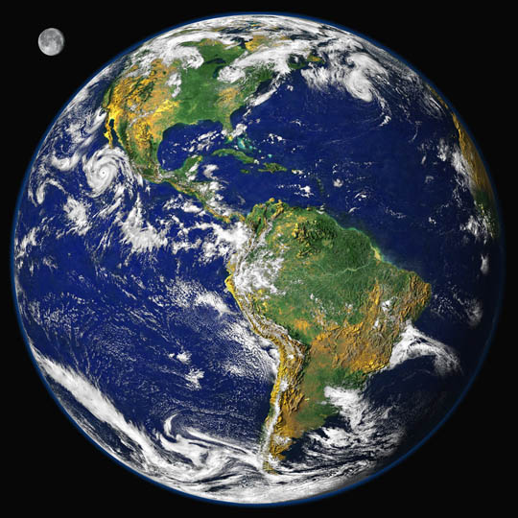
Cutting Emissions
Pricing Carbon
Fee And Dividend
Paris Accord
Compiled by Phil Nelson, 2017

Slide 2
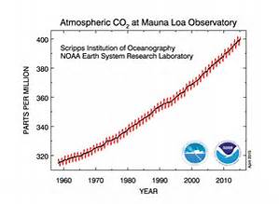
We were warned
The Keeling Curve

Slide 3
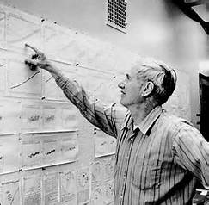
Charles David Keeling, Scripps Institution of Oceanography
“Keeling’s measurements of the global accumulation of carbon dioxide in the atmosphere set the stage for today’s profound concerns about climate change. They are the single most important environmental data set taken in the 20th century.” C.F. Kennel, 2006
8020vision.com
Notes:
http://pubs.acs.org/doi/pdf/10.1021/ac1001492

Slide 4
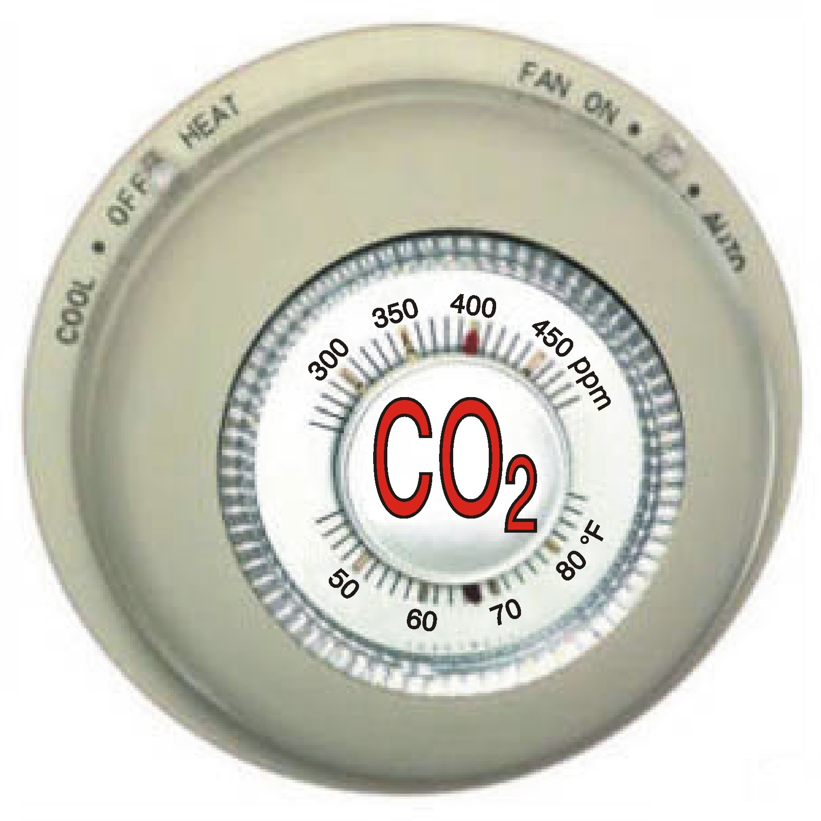
Carbon Dioxide Controls the Earth’s Temperature
Water vapor and clouds are the major contributors to Earth’ greenhouse effect, but the planet’s temperature ultimately depends on the atmospheric level of carbon dioxide.
Carbon dioxide, methane, and other gases provide the core support for the greenhouse effect. Without them, water vapor would quickly precipitate from the atmosphere, plunging the earth into an icebound state.
Hence the “thermostat” shown in the picture.
NASA GISS: Lilly Dell Valle
Based on papers by Lacis et al, 2010, Science and Schmidt 2010, J. Geophysical Res.
Notes:
Nasa.gov Oct 14, 2010
Abstract of the paper in Science by Lacis et all: Ample physical evidence shows that carbon dioxide (CO₂) is the single most important climate-relevant greenhouse gas in Earth’s atmosphere. This is because CO₂, like ozone, N₂O, CH₄, and chlorofluorocarbons, does not condense and precipitate from the atmosphere at current climate temperatures, whereas water vapor can and does. Noncondensing greenhouse gases, which account for 25% of the total terrestrial greenhouse effect, thus serve to provide the stable temperature structure that sustains the current levels of atmospheric water vapor and clouds via feedback processes that account for the remaining 75% of the greenhouse effect. Without the radiative forcing supplied by CO₂ and the other noncondensing greenhouse gases, the terrestrial greenhouse would collapse, plunging the global climate into an icebound Earth state.

Slide 5
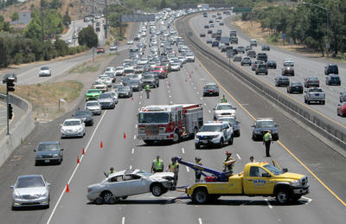
Prevent Further Damage
aka “Mitigation”
Car accident on 101 Freeway
Notes:
https://www.bing.com/images/search?view=detailV2&ccid=93gp1T%2FM&id=BB168F827514F04F0E2847C06595092BBBEDFC8A&q=photo+highway+accident&simid=608029712479092770&selectedindex=88&qpvt=photo+highway+accident&mode=overlay&first=1&thid=OIP.Mf77829d53fcc7a123a70d94d11577a69o0

Slide 6
More Water Vapor and Clouds
Warmer Air, Warmer Water (Global Warming)
HUMAN RESPONSES
Personal
Family, Friends, Neighbors
Town and City
State
National
International
Atmosphere Biosphere Cryosphere
(Climate Change)
Notes:
J = journalism

Slide 7
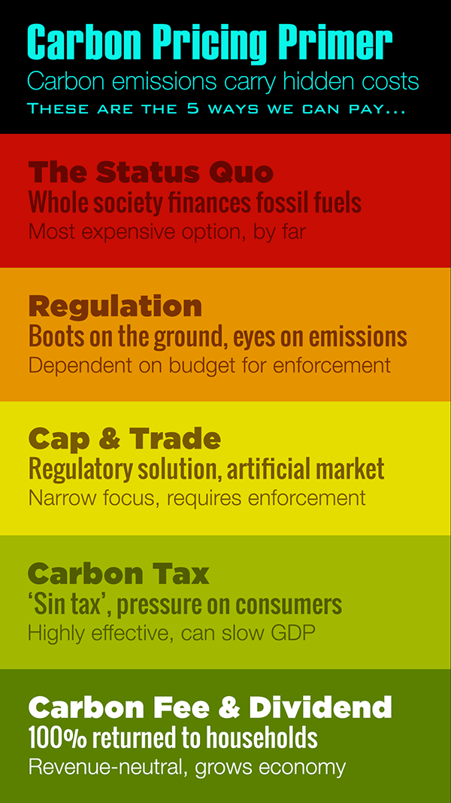
Five Ways to Pay
Poet economist, extracted 14 April 2017
Notes:
https://poeteconomist.files.wordpress.com/2014/08/5ways2pay-v2.png/

Slide 8
Pricing Carbon
Notes:
A record-strength low pressure system that stalled out over northern New Mexico and sourthern Texas brought widespread severe weather.
https://www.wunderground.com/blog/JeffMasters/comment.html?entrynum=3286

Slide 9
Cap and Trade or a Carbon Tax?
Notes:
A record-strength low pressure system that stalled out over northern New Mexico and sourthern Texas brought widespread severe weather.
https://www.wunderground.com/blog/JeffMasters/comment.html?entrynum=3286

Slide 10
Price on Carbon – Putting the Market to Work
http://priceoncarbon.org/pricing-mechanisms/
Notes:
http://priceoncarbon.org/pricing-mechanisms/
Putting a price on carbon emissions can be done by principally two methods: Cap and Trade and Carbon Tax. The essential difference between the two methods is where the government control is set and where the market control is set, as shown in the table. Hybrid models using elements of either are also possible.

Slide 11
Carbon Tax
Notes:
A record-strength low pressure system that stalled out over northern New Mexico and sourthern Texas brought widespread severe weather.
https://www.wunderground.com/blog/JeffMasters/comment.html?entrynum=3286

Slide 12
Singapore Plans Southeast Asia's First Carbon Tax From 2019 Bloomberg 20 Feb 2017
The proposal would charge between S$10 ($7) and S$20 a ton on emissions of carbon dioxide and five other greenhouse gases…. Singapore would be the first Southeast Asian nation to put a price on carbon.
It would raise electricity costs by 2 percent to 4 percent, according to a government report released after Heng’s speech.
“Singapore is vulnerable to rises in sea level due to climate change. Together with the international community, we have to play our part to protect our living environment.”
Notes:
https://www.bloomberg.com/news/articles/2017-02-20/singapore-plans-southeast-asia-s-first-carbon-tax-by-2019

Slide 13
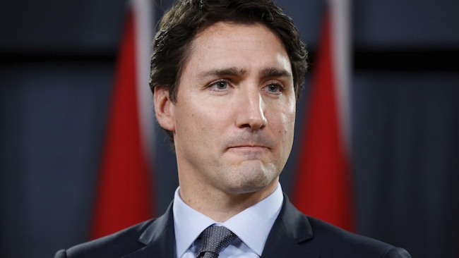
Canada to implement national carbon price
On October 3, 2016, Prime Minister Justin Trudeau announced that Canada would have a national carbon price in place by 2018. The price would establish a floor of $10 per ton of carbon dioxide the first year and rise to $50 per ton by 2022. Each of Canada’s provinces and territories will be allowed to determine their own mechanism – tax or cap-and-trade – for setting the price, and the federal government will provide a pricing system for provinces and territories that do not adopt one of the two systems by 2018. The federal carbon price will be revenue neutral and will be returned to the provinces to use as they see fit.
Notes:
Citizens Climate Lobby Weekly Briefing, 5 Oct 2016
https://citizensclimatelobby.org/nationwide-carbon-price-in-canada-marks-start-of-transformation-to-clean-economy/?utm_term=press%20release&utm_campaign=WeeklyBriefing&utm_content=email&utm_source=Act-On+Software&utm_medium=email

Slide 14
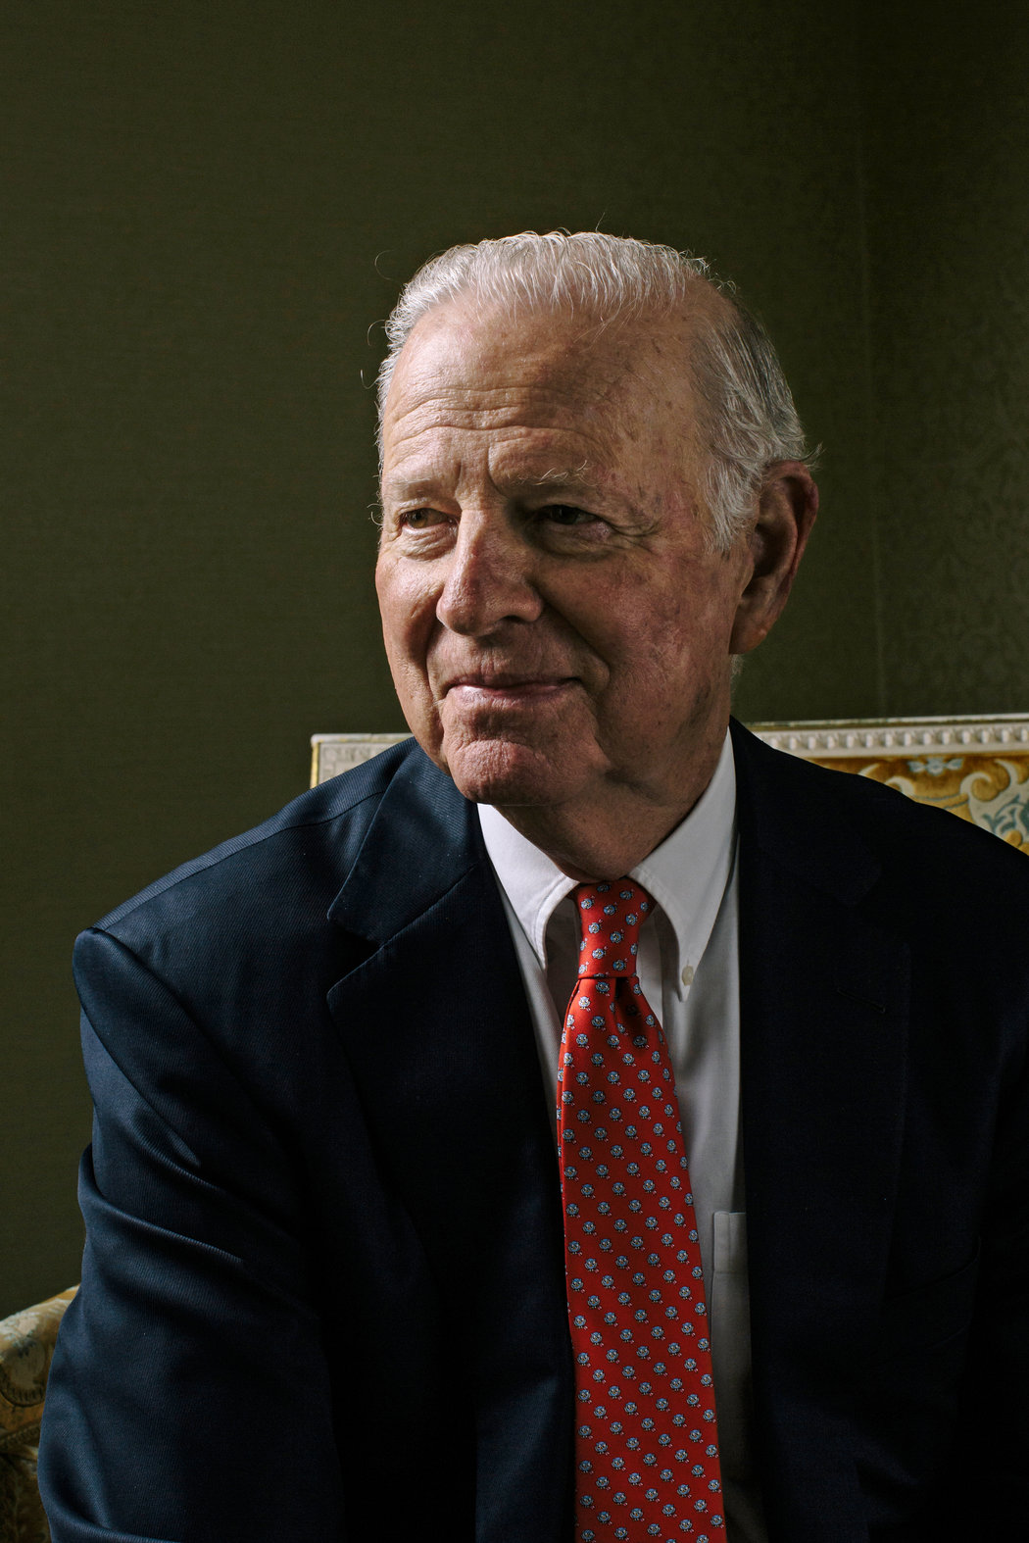
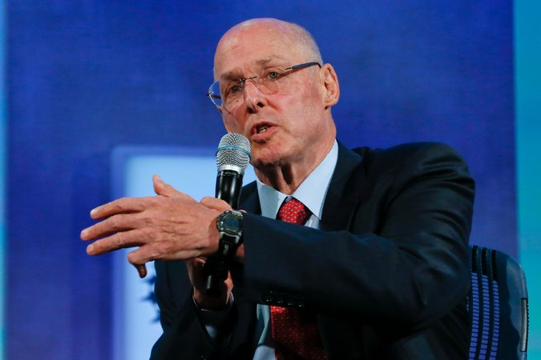
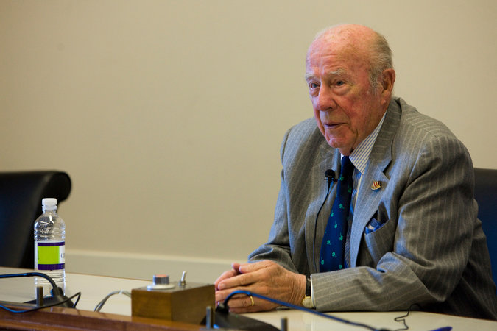
Carbon tax push from former GOP officials faces uphill slog By MICHAEL BIESECKER and CATHERINE LUCEY Associated Press 8 Feb 2017
Former Secretary of State Jim Baker went to the White House on Wednesday to gain Trump administration support for the plan, which would place a new tax on oil, natural gas and coal and then use the proceeds to pay quarterly dividends to American taxpayers.
With the "carbon dividends" potentially reaching about $2,000 annually for a family of four, the group estimates that about two-thirds of Americans would receive more money back than they would pay in increased fuel costs.
James Baker
Hank Paulson
George Schultz
Notes:
http://customwire.ap.org/dynamic/stories/U/US_TRUMP_CLIMATE?SITE=AP&SECTION=HOME&TEMPLATE=DEFAULT
Ted Halstead, president of the Climate Leadership Council, said the group said that sooner or later Republicans will have to support some sort of action to reduce carbon emissions.
"The climate problem is not going away. It will only get worse," said Halstead, who attended Tuesday's meeting at the White House.
Photos from https://www.nytimes.com/2017/02/07/science/a-conservative-climate-solution-republican-group-calls-for-carbon-tax.html?_r=0

Slide 15
The Conservative Case for Carbon Dividends Climate Leadership Council Feb 2017
Four Pillars of a Carbon Tax
A GRADUALLY INCREASING CARBON TAX
CARBON DIVIDENDS FOR ALL AMERICAN
BORDER CARBON ADJUSTMENT
SIGNIFICANT REGULATORY ROLLBACK
James Baker
Hank Paulson
George Schultz
Notes:
https://www.clcouncil.org/wp-content/uploads/2017/02/TheConservativeCaseforCarbonDividends.pdf
Photos from https://www.nytimes.com/2017/02/07/science/a-conservative-climate-solution-republican-group-calls-for-carbon-tax.html?_r=0

Slide 16
Guess Who’s for a Carbon Tax Now
Tina Rosenberg, NYT Opinion Pages, 11 April 2017
“If Trump does not go down the path of a carbon tax, we should not lose our resolve. We should stick to our values as Canadians to do something to protect the environment.” — Michael Crothers, President, Shell Canada, November, 2016
“Climate change is happening. We think a broad-based carbon price is the right answer.” — Steve Williams, Head of Suncor, Canada, May, 2015
Notes:
https://www.nytimes.com/2017/04/11/opinion/guess-whos-for-a-carbon-tax-now.html?ribbon-ad-idx=1&rref=opinion&module=Ribbon&version=origin&_r=0

Slide 17
Guess Who’s for a Carbon Tax Now
Tina Rosenberg, NYT Opinion Pages, 11 April 2017
“Carbon pricing systems encourage the quickest and most efficient ways of reducing emissions widely.” — Ben van Beurden, the Netherlands, Chief Executive of Royal Dutch Shell, October, 2015
“A global carbon price would help to unleash market forces and provide the right incentives for everyone to play their part. History has shown the power of market forces in making economies less energy intensive as people have found more efficient ways to use energy.” — Bob Dudley, Britain, Chief Executive of BP, February, 2015
Notes:
https://www.nytimes.com/2017/04/11/opinion/guess-whos-for-a-carbon-tax-now.html?ribbon-ad-idx=1&rref=opinion&module=Ribbon&version=origin&_r=0

Slide 18
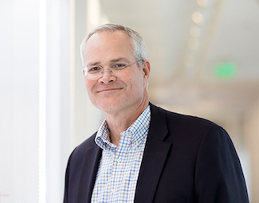
The future of energy –
opportunities and challenges
Darren Woods, CEO Exxon Mobil
“Governments can help advance the search for energy technologies by funding basic research and by enacting forward-looking policies. A uniform price of carbon applied consistently across the economy is a sensible approach to emissions reduction. One option being discussed by policymakers is a national revenue-neutral carbon tax. This would promote greater energy efficiency and the use of today’s lower-carbon options, avoid further burdening the economy, and also provide incentives for markets to develop additional low-carbon energy solutions for the future.”
Energy Factor, a publication of Exxon Mobil, 23 Feb 2017
Notes:
https://energyfactor.exxonmobil.com/perspectives/the-future-of-energy-opportunities-and-challenges/#.WK-KXYGTg8s.twitter

Slide 19
A Price on Carbon May Be Coming Soon to the U.S. After years of debate, says Amy Myers Jaffe, the likelihood of a U.S. carbon tax or cap-and-trade program is greater than ever. Wall Street Journal, 13 Sept 2016
For one thing, the economic rationale for a carbon price is stronger than it ever has been. At the same time, technological advances have made it much cheaper to move away from carbon-emitting technologies, making a carbon price less punitive than it would have been in the past. Meanwhile, one of our biggest global rivals, China, is about to impose a carbon-pricing plan, meaning that the U.S. may not be at a competitive disadvantage if it institutes a similar program.
{The same issue of WSJ ran an article: Why a Price on Carbon Is Unlikely in the U.S. Anytime Soon}
Illustration: Anastasia Vasilakis for The Wall Street Journal
Notes:
http://www.wsj.com/articles/a-price-on-carbon-may-be-coming-soon-to-the-u-s-1473820117

Slide 20
Fee and Dividend
Notes:
A record-strength low pressure system that stalled out over northern New Mexico and sourthern Texas brought widespread severe weather.
https://www.wunderground.com/blog/JeffMasters/comment.html?entrynum=3286

Slide 21
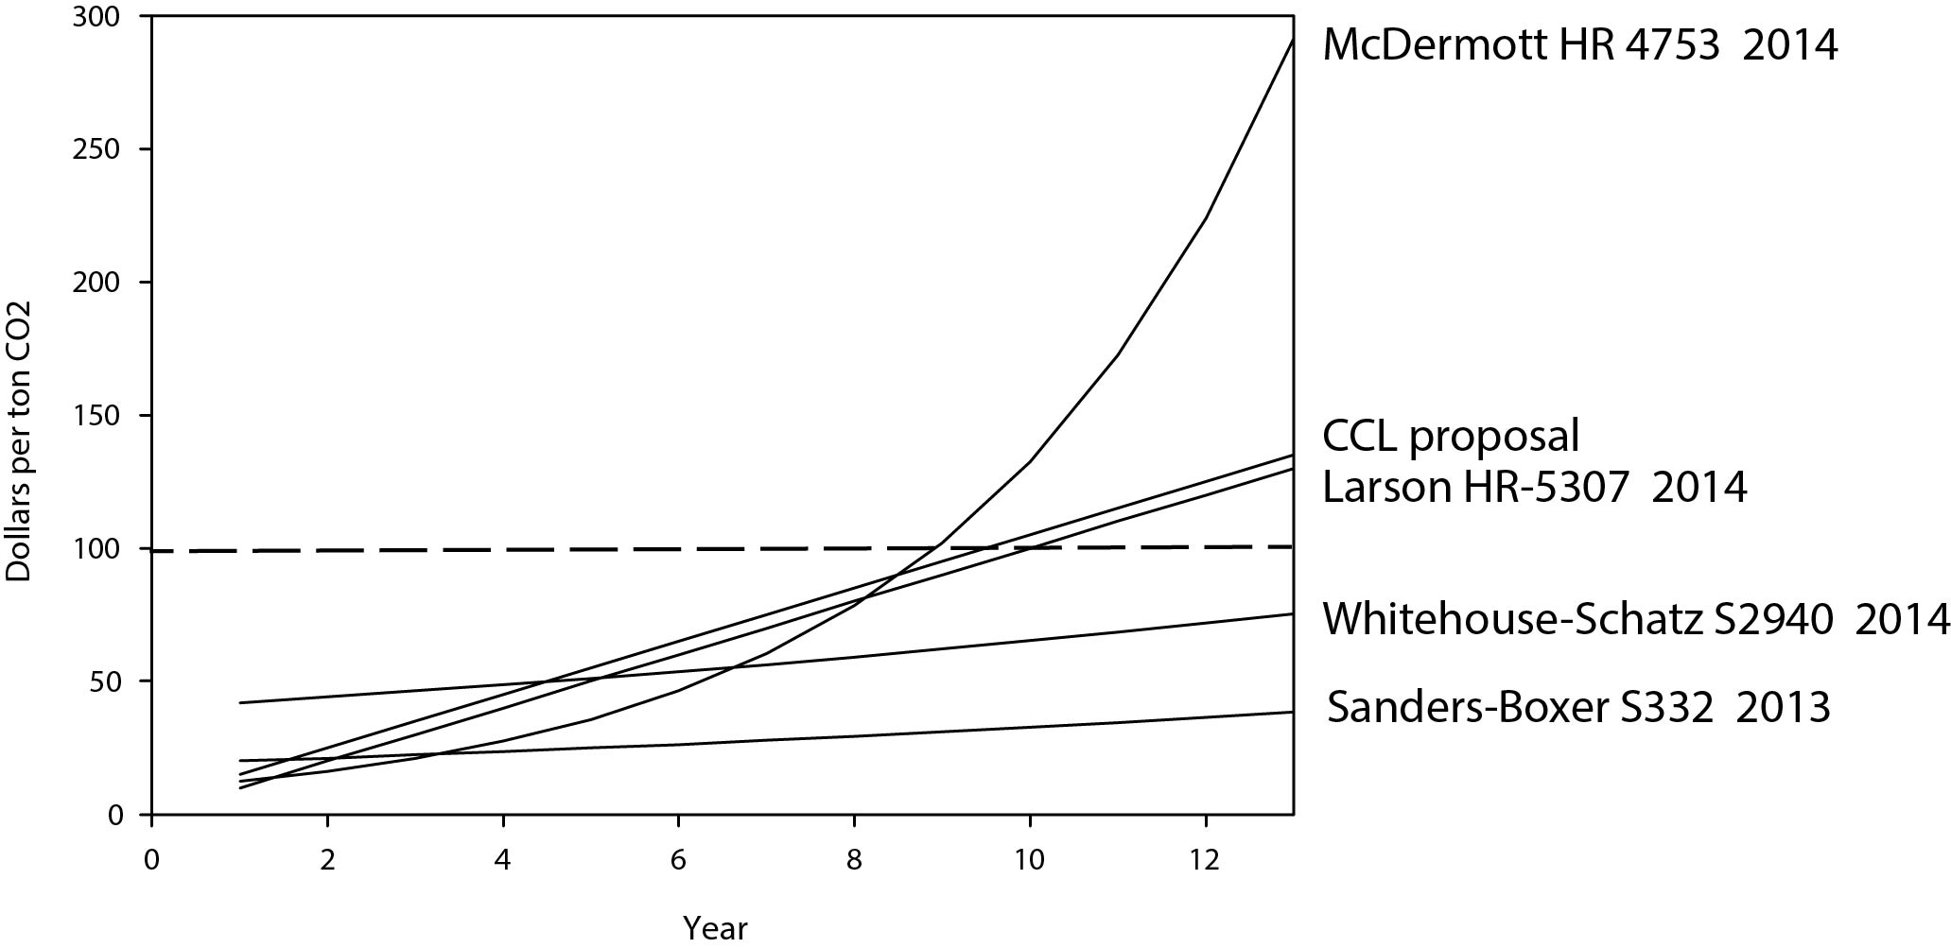
Bills and Proposals for U.S. Congress
Notes:
Source: PH Nelson

Slide 22
Bills and Proposals for U.S. Congress
 | Rebate | Invest | Debt reduction, reduce taxes
Sanders-Boxer EPA (amends Clean Air Act) | 60 percent | 40 | 0
Larson Treasury (modifies tax code) | 10 | 20 | 70
McDermott Treasury & EPA | 100 | 0 | 0
Van Hollen Carbon permits at auction. Treas & EPA | 100 | 0 | 0
Whitehouse-Schatz Treas, EPA, DOE | 33 | 33 | 33
Comparisons with other proposals
Citizens Climate Lobby | 100 | 0 | 0
Jorgenson | 0 | 0 | 100
Notes:
Source: PH Nelson

Slide 23
Citizens Climate Lobby, June 2015
Notes:
JUNE 2015:
900 CITIZEN CCL VOLUNTEERS ON CAPITOL HILL AT THEIR OWN EXPENSE TO TALK TO THEIR REPRESENTATIVES
500+ CONGRESSIONAL MEETINGS

Slide 24
What we have now
Fossil Fuels
Coal, Oil, Natural Gas
American Households
Business as Usual
Renewable Energy
Low- Carbon Business

Slide 25
With Fee and Dividend
1. Steadily rising fee on CO₂ collected at the source
2. ALL money is distributed on equitable basis
Fossil Fuels
Coal, oil, natural gas
Pass-
Through
American Households
Fee
Dividend
3. Two-thirds of households break even or receive more in dividend than they would pay in higher prices.
Business as Usual Declines
Renewable Energy
Wind turbines, solar systems, modernized power grid
Low-Carbon Business Increases
(Housing, vehicles, food)
4. Lower-carbon goods & efficiency make economic sense--a market-based solution!
BENEFITS (20 years):
CO₂ ⬇52% GDP + $ 1.375 trillion ✜ Lives Saved 227,000 Jobs ⬆2.8 million
.

Slide 26
Attributes of a good policy
Significant reductions in greenhouse gas emissions
Economic efficiency
Reasonable total cost
Transparency
Compatibility with both Democratic and Republican philosophies
D. Kline, CCL Boulder, 2016
Notes:
NO REGRETS POLICY WOULD BE IDEAL (NO REGRETS IS LIKE FREE INSURANCE)
NOW WILL SHOW ESTIMATED IMPACT OF POLICY THAT MEETS THESE CRITERIA
-- AND IS IN FACT(estimated to be) BETTER THAN “NO REGRETS”

Slide 27
More Water Vapor and Clouds
Warmer Air, Warmer Water (Global Warming)
HUMAN RESPONSES
Personal
Family, Friends, Neighbors
Town and City
State
National
International
Atmosphere Biosphere Cryosphere
(Climate Change)
Notes:
J = journalism

Slide 28
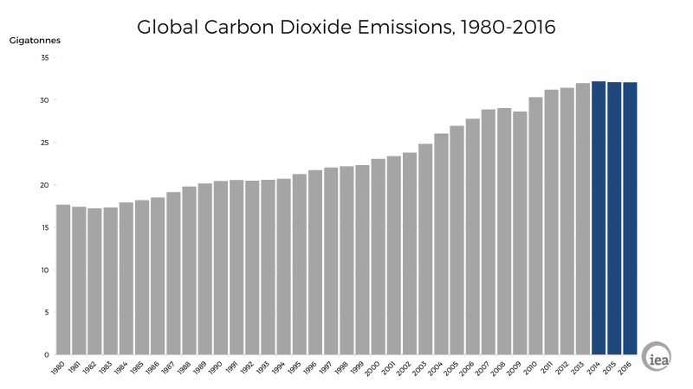
A Slowdown in Global Carbon Emissions
Vox, 21 March 2017
International Energy Agency
Over the past three years, something genuinely shocking has been happened. Global CO2 emissions from energy have stayed flat, even as the world economy has kept chugging along.
Notes:
http://www.vox.com/energy-and-environment/2017/3/21/14998536/slowdown-co2-emissions

Slide 29
Global Carbon Emissions and the UN Conference of Parties
1995 1997 2005 2010 2015
COP3 COP11 COP16 COP21
KYOTO MONTREAL CANCUN PARIS
International Energy Agency
Notes:
http://www.vox.com/energy-and-environment/2017/3/21/14998536/slowdown-co2-emissions

Slide 30
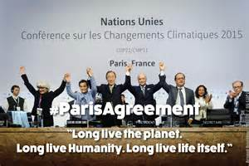
blhd.musirawaskab.go.id
Notes:
http://abcnews.go.com/US/wireStory/paris-climate-agreement-effect-30-days-42590135

Slide 31
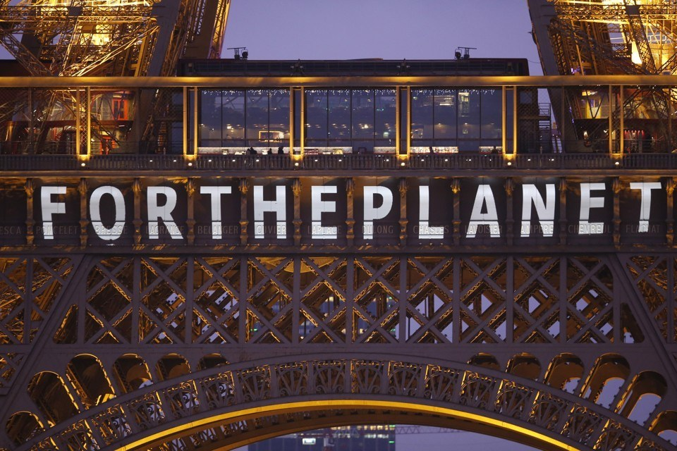
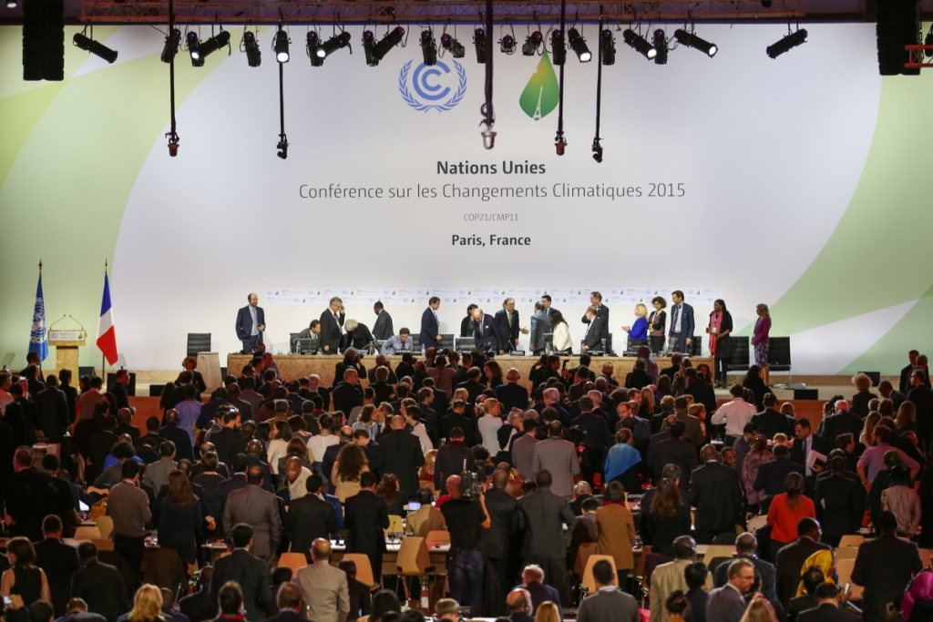
COP 21 Paris, France Dec 2015
Llamasoft.com
Notes:
http://abcnews.go.com/US/wireStory/paris-climate-agreement-effect-30-days-42590135

Slide 32
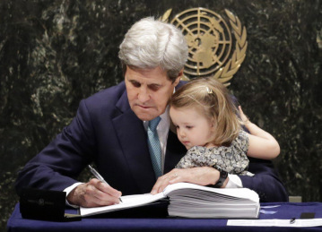
U.S. climate action commitments are the overwhelming will of the people. Nation will follow through and lead global transition. John Kerry at COP22 in Marrakech, 16 Nov 2016
He quoted Winston Churchill who said “Sometimes doing your best is not enough; you have to do what is required.” This anecdote was woven through the speech. His voice broke when he remembered signing the Paris Agreement with his granddaughter on his lap in the UN General Assembly.
John Kerry signing the Paris Agreement with his granddaughter on his lap at the UN, April 2016.
Notes:
https://engage4climate.org/2016/11/16/kerry-what-is-required-to-secure-our-climate-future/

Slide 33
Paris Climate Agreement to Take Effect Nov. 4, 2016
The landmark Paris agreement on climate change will enter into force on Nov. 4, after a coalition of the world's largest polluters and small island nations threatened by rising seas pushed it past a key threshold on Wednesday.
President Barack Obama hailed the news as "a turning point for our planet," and U.N. Secretary-General Ban Ki-moon called the agreement's strong international support a "testament for the urgency of action."
U.N. deputy spokesman Farhan Haq said late Wednesday that the European Union and 10 countries deposited their instruments of ratification on Wednesday. The percentage of emissions they account for topped the 55 percent threshold needed for the treaty to take effect, he said.
blhd.musirawaskab.go.id
While the targets in the agreement are not legally binding, the treaty does require countries to report on emissions and their progress on reaching the goals in the national climate plans they submitted to the U.N. The countries are also required to maintain those plans, update them every five years and to pursue measures to implement their stated goals.
Notes:
http://abcnews.go.com/US/wireStory/paris-climate-agreement-effect-30-days-42590135

