Slide 1
Earth’s Climate: Past, Present and Future
Fall Term - OLLI West: week 1, 9/16/2014
Paul Belanger, Geologist/Paleoclimatologist
Introductions
Key principles of climate change
The difference between weather and climate
Climate system: feedbacks, cycles and self-regulation (climate, not government)
What determines Earth’s climate

Slide 2
Intro:
Intro:
  my background,
  web page http://denverclimatestudygroup.com/ (OLLI tab) and
  DU portfolio http://portfolio.du.edu/earthclimate ,
  CV (about tab)
Logistics
Stan Hamilton: classroom assistant, liaison to me/OLLI

Slide 3
Intro:
Going to:
my word document
web page: http://denverclimatestudygroup.com/
DU portfolio: http://portfolio.du.edu/earthclimate

Slide 4



Three books to consider:
Simple succinct Summary:
  What We Know About Climate Change (Boston Review Books) by Kerry Emanuel (Nov 30, 2012)
Intermediate Level Book:
  Earth: The Operators' Manual by Richard B. Alley (Apr 18, 2011)
  http://earththeoperatorsmanual.com/
More comprehensive book:
Experimenting on a Small Planet: A Scholarly Entertainment by William W. Hay (Dec 14, 2012)

Slide 5
GREENHOUSE
  Visible vs. Infrared/longer wave – a function of “black body” temperature: instead of glass keeping the heat in it’s the gas properties keeping the heat of infrared in; blanket effect.

Slide 6
GREENHOUSE GASES
  Water – H2O – the amount is a feedback of temperature held in by the “blanket” of other GHGs
  Carbon dioxide - CO2
  Methane - CH4
  Ozone - O3
  Nitrous oxide- N2O
  others

Slide 7
Blanket Earth
Blanket Earth:
http://climate.nasa.gov/causes/

Slide 8
VIDEO - what is climate
https://www.futurelearn.com/courses/climate-change-challenges-and-solutions/todo/123
And go to 1.4

Slide 9
What determines Earth’s climate

Slide 10


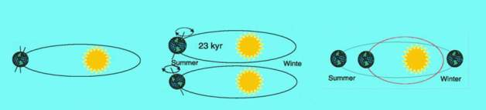



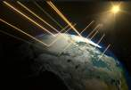
INTRODUCTION: Definitions:
  First order Forcings: EXTERNAL Influences (3):
    SOLAR input:
0.9% less 100 My ago
Obliquity
Precession
Eccentricity
    Atmospheric Opacity
    (gases that absorb radiation in or out)
    Albedo (30-85%)
  Feedbacks: INTERNAL dynamics and responses
    e.g. higher water vapor in atm. due to heating of atm

Slide 11
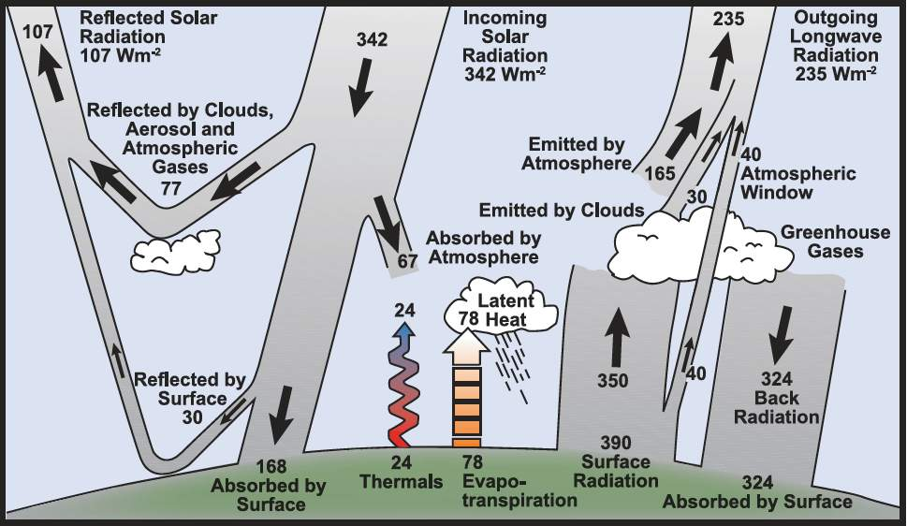
Milankovitch ~= 3-8 W/m²
Sunspots ~=
0.3 – 0.5 W/m²
Current
GHGs ~= 1.6W/m²
DOUBLING: 280 to 560 ppm CO2 = ~ 3 W/m²
http://www.skepticalscience.com/Milankovitch.html
Notes:
See http://www.skepticalscience.com/Milankovitch.html for good explanation
Eccentricity affects entire globe equally; 100,000 year periodicity: 0.45 w/m-2; yearly delta of 6.4% over course of year
Obliquity - hemispherical: 22-25; currently 23.5, 41,000 year periodicity
Precession: 19k 23k – when n. hemisphere nearest sun in summer (currently we are furthest) – why hypsithermal was slightly warmer.
Precession varies on timescales of 19,000 and 23,000 years, and is thus important even over historical times. The precessional cycle is the key player behind the Holocene Climate Optimum, a time between ~7,000 and 5,000 years ago of particularly warm Northern Hemispheric extra tropical summers, and colder tropical and extra tropical winters.
Eccentricity is the only Milankovitch cycle that alters the annual-mean global solar insolation (i.e., the total energy the planet receives from the sun at the top of the atmosphere). For the mathematically inclined, the annually-averaged insolation changes in proportion to 1/(1-e²)^{0.5,} so the solar insolation increases with higher eccentricity. This is a very small effect though, amounting to less than 0.2% change in solar insolation, equivalent to a radiative forcing of ~0.45 W/m² (assuming present-day albedo). This is much less than the total anthropogenic forcing over the 20th century. However, eccentircity does modulate the precessional cycle, as we shall see.
Obliquity: Obliquity describes how tilted a planet’s axis is (Fig. 3 shows the obliquity of eight planets, plus Pluto which is labeled as a planet). The tilt of the Earth is ultimately what allows for the existence of seasons, since the Northern Hemisphere is pointed toward the sun in the boreal summer, and away from the sun in the boreal winter. The tilt of Earth’s axis (in other words, the angle between the spin–axis and a line perpendicular to the orbital plane) varies between about 22 to 25° (currently 23.5°) over a period of nearly 41,000 years, driving changes in the distribution of sunlight between the equator and high latitudes (with more tilt implying more sunlight at high latitudes, and less at lower latitudes; therefore more oblique orbits favor deglaciation on Earth).
Precession: Precession does not describe how tilted the Earth’s axis is, but rather the direction of its axis. This changes what star is the “North Star” over time (today it is Polaris, but near the end of the last deglaciation it was Vega), and as described below, governs the timing of the seasons. This is illustrated in Figure 4 (a and b) below.

Slide 12
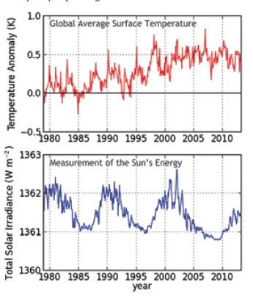
4: THE SUN’S ROLE IS MINIMIZING

Slide 13
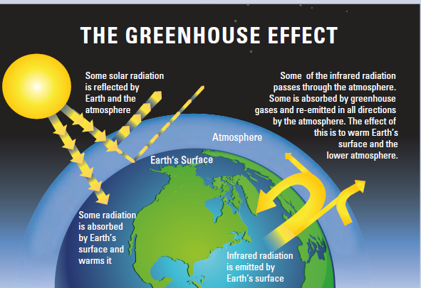
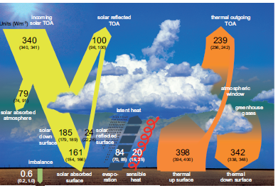

Slide 14
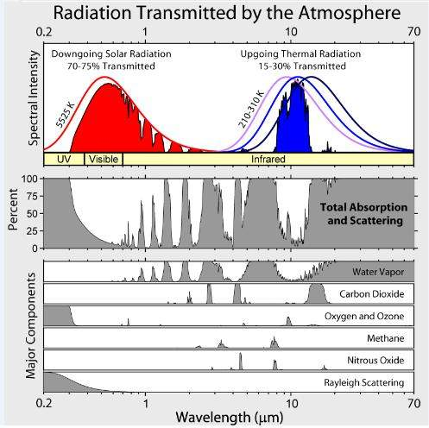

Slide 15
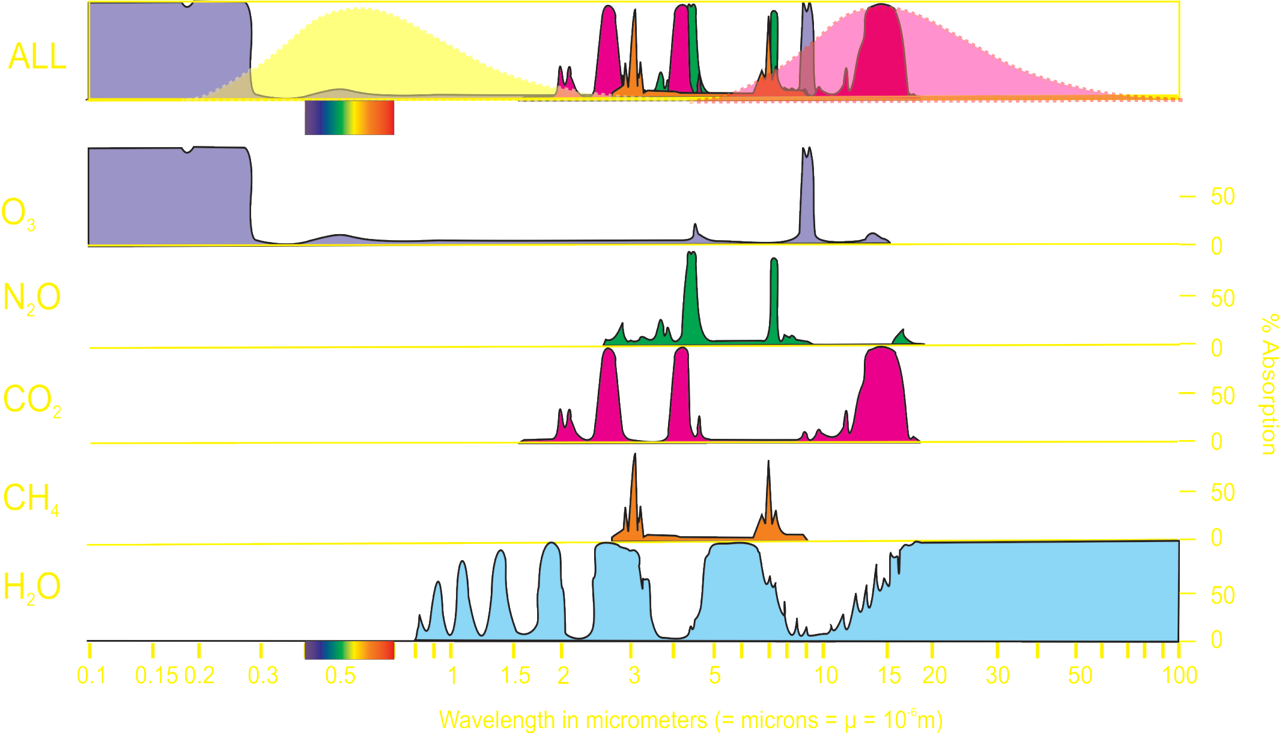
Absorption of Radiation by Greenhouse Gases
Incoming
Radiation
5700 K
Outgoing
Radiation
289 K

Slide 16
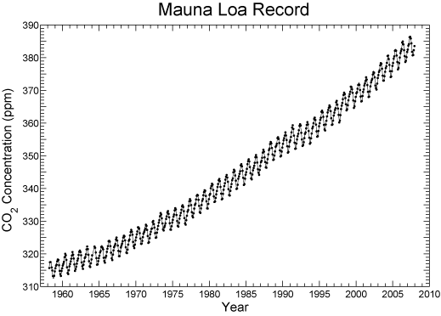
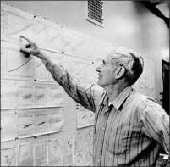
3: EMISSIONS FROM HUMAN ACTIVITIES LARGELY TO BLAME
40% increase in CO₂
Dead carbon altering atmospheric C¹⁴
That Carbon is more negative/enriched in C¹²

Slide 17
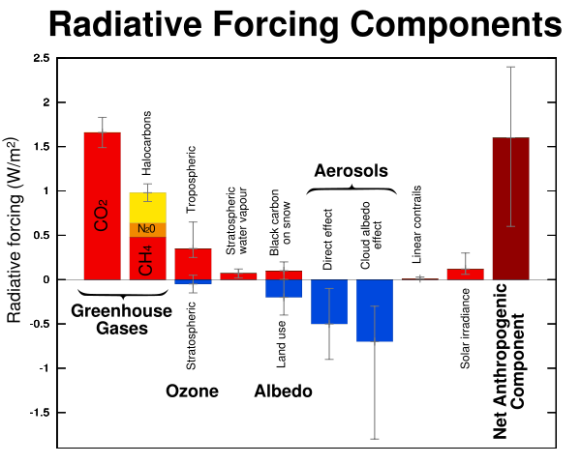
GLOBAL WARMING CONCERNS
Incoming Solar irradiance: 342 W/m²
IPCC, 2007

Slide 18
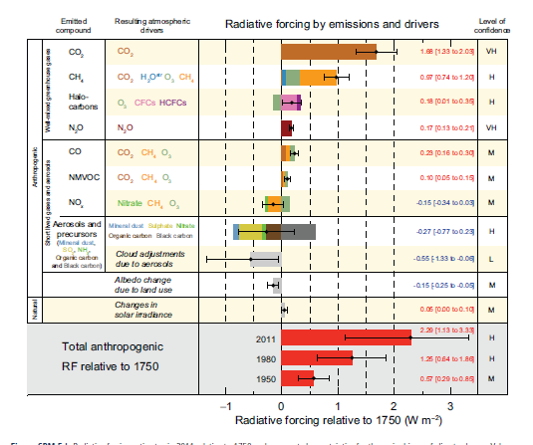
1: THE CLIMATE IS WARMING
Drivers; aka forcings, i.e. causes

Slide 19
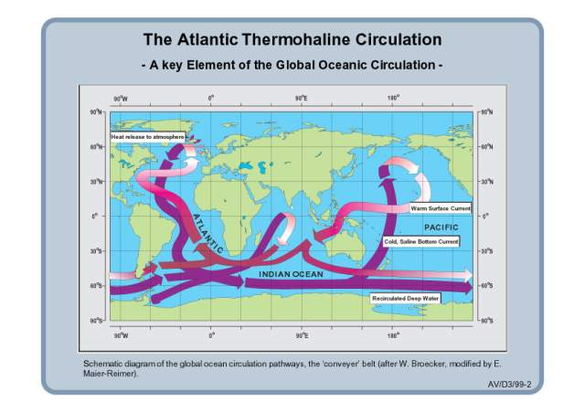

Slide 20
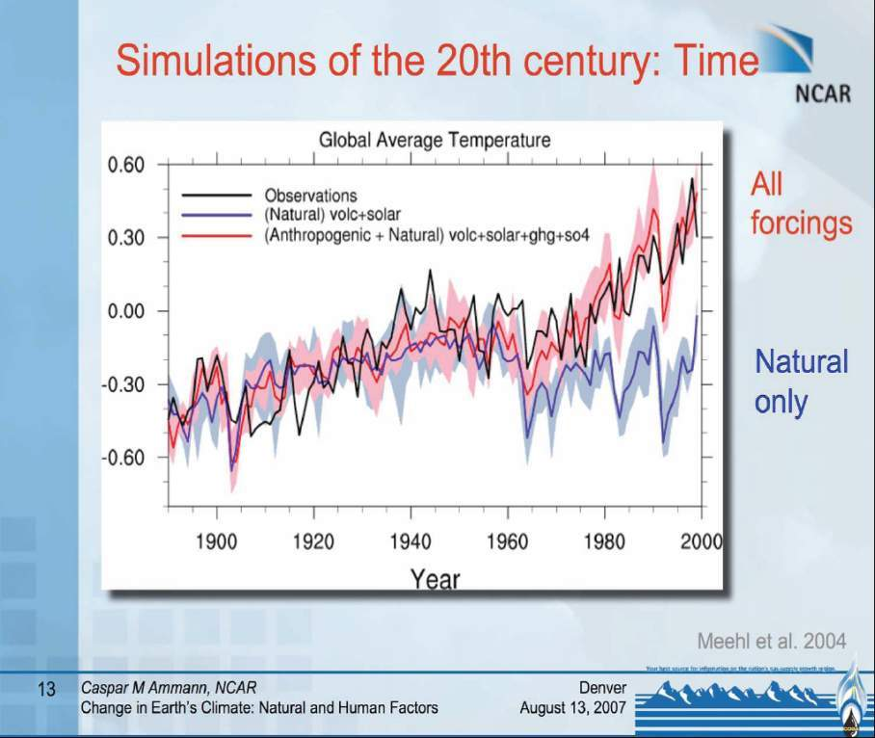

Slide 21
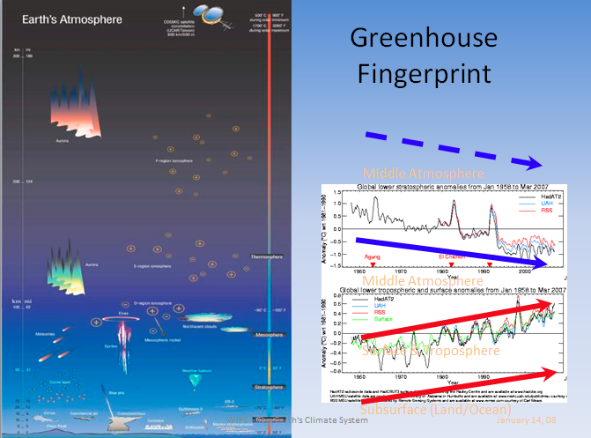
5: SURFACE TO STRATOSPHERE CHANGES

Slide 22
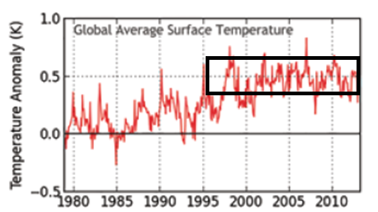
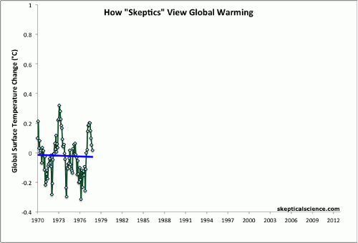

Slide 23
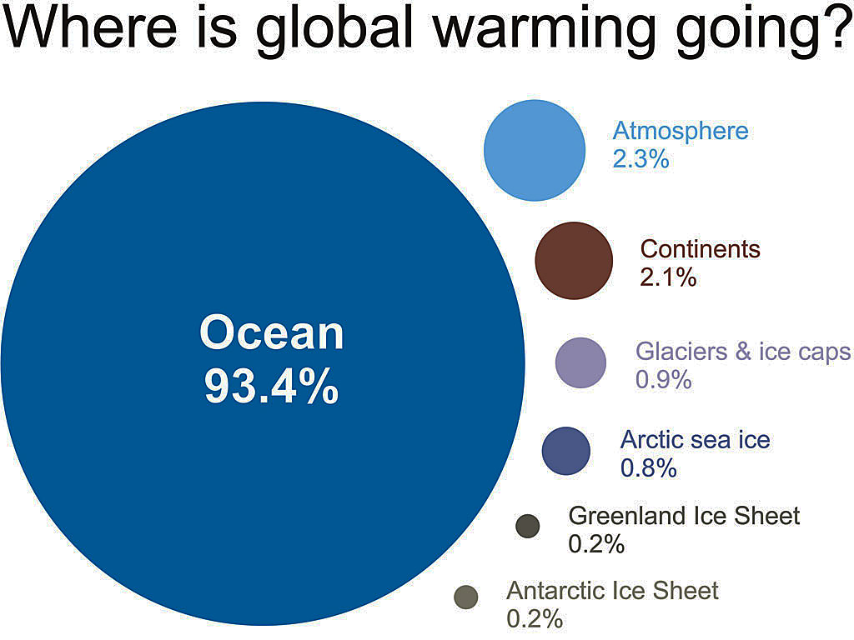
Only ~2% stays in atmosphere
~2% warms the land
Melting ice absorbs ~2%
John Cook, from IGPP 2007 data; ~93% to oceans continues (NOAA/NODC, 2012)

Slide 24
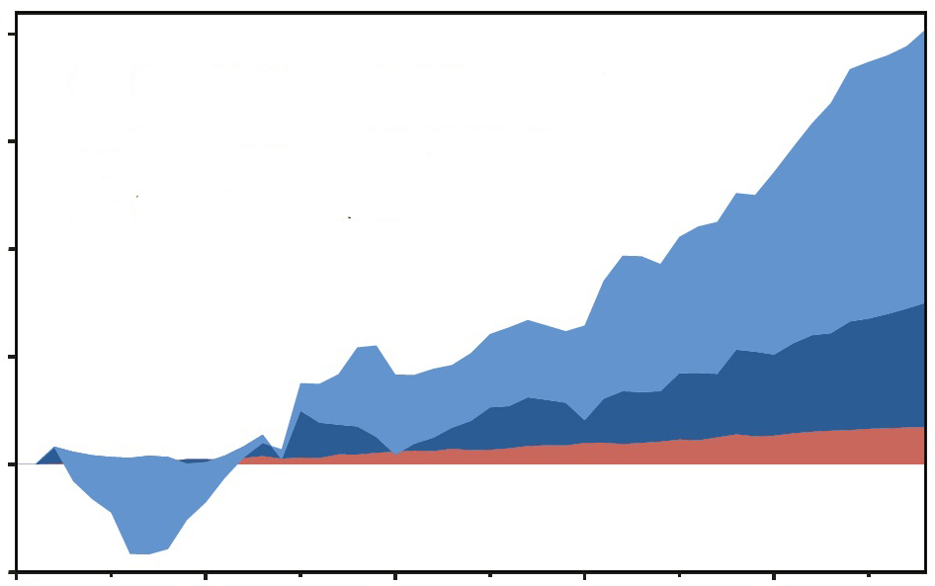
Change in heat content, 1958-2011
20
5-year moving averages
15
Oceans, 0-700 m depth
Oceans, 700-2000 m depth
10
10²² Joules
(Increasing heat, not shown, goes deeper than 2000 m)
5
0
Atmosphere + land + ice melting
-5
1960 1970 1980 1990 2000
(NOAA 2012 data, Nuccitelli et al. 2012 plot)

Slide 25
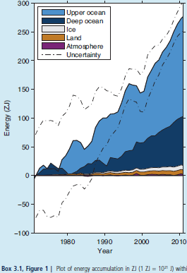
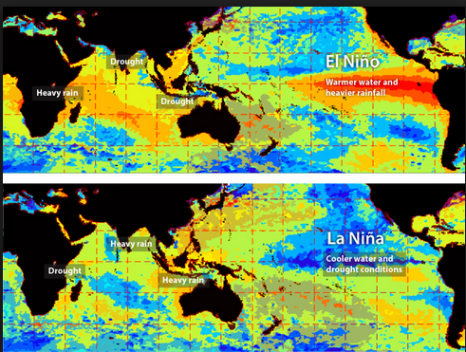
http://www.skepticalscience.com/graphics.php?g=47

Slide 26
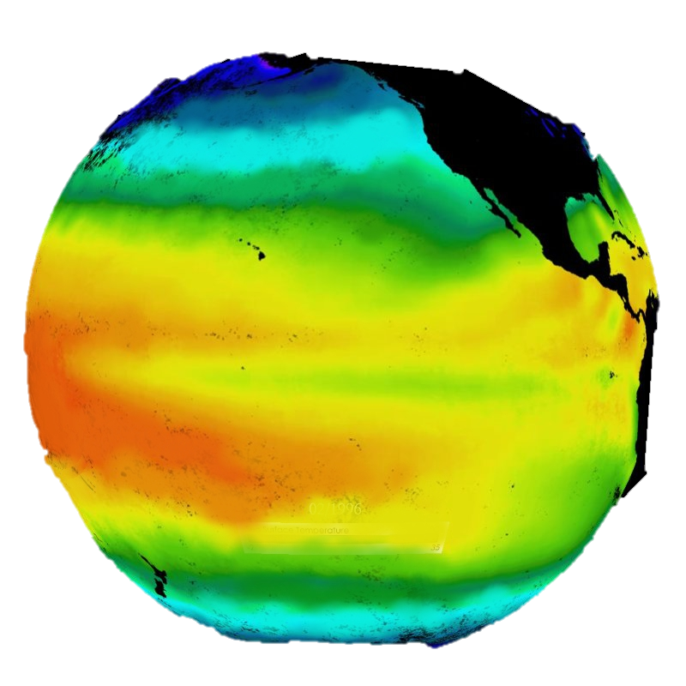
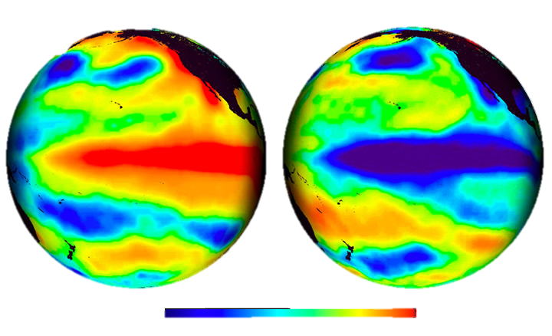
The Pacific –
‘normal condition’
El Niño
La Niña
Temperature Anomaly °C
-4
-2
0
2
4

Slide 27
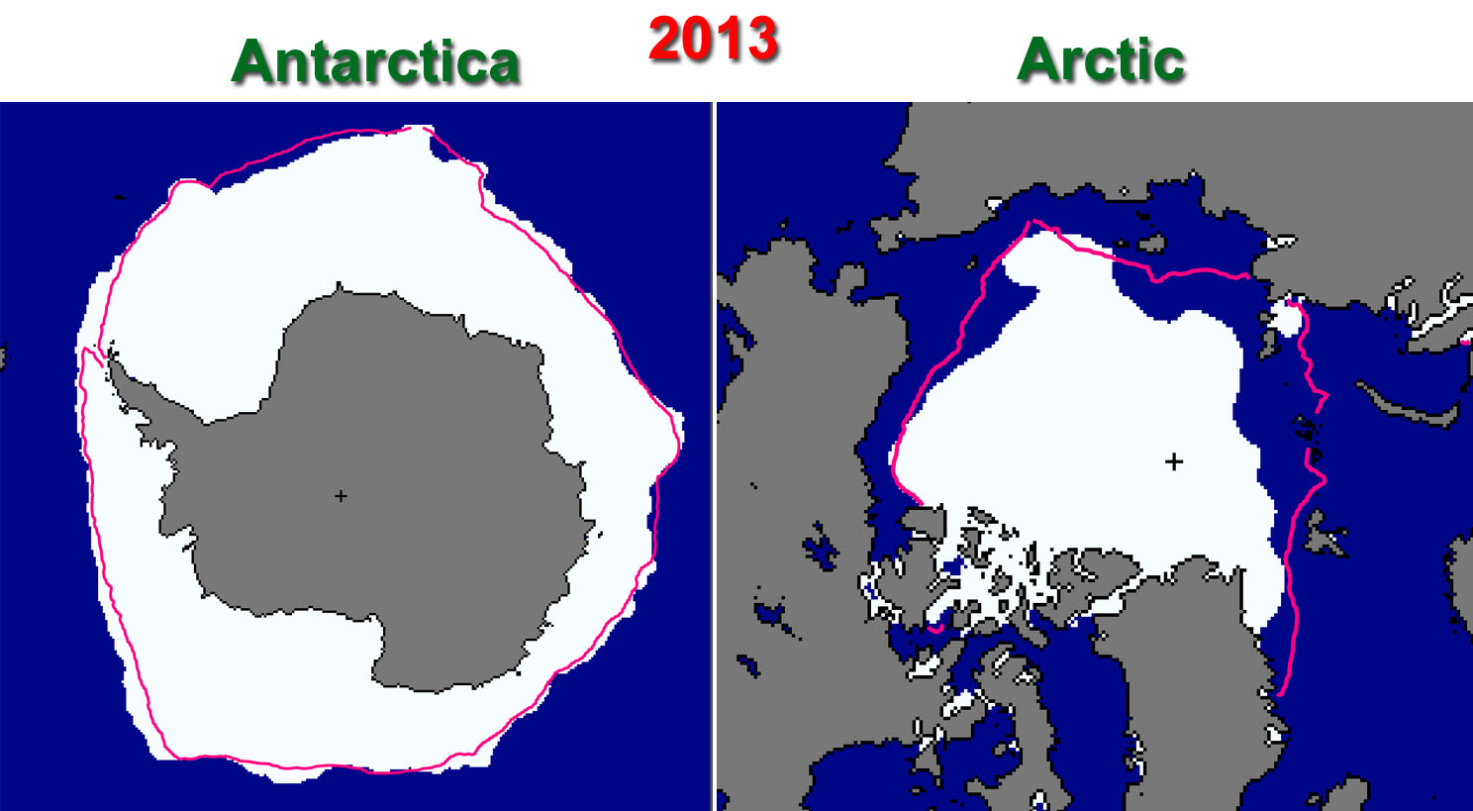
12. ARCTIC ICE vs. ANTARCTIC SEA ICE
Ans. More moisture in air around Antarctica (AA) to nucleate sea ice
Despite > AA is does not compensate for Arctic loss
https://itsnotnova.files.wordpress.com/2013/10/arcticvsantarctic2013.jpg

Slide 28
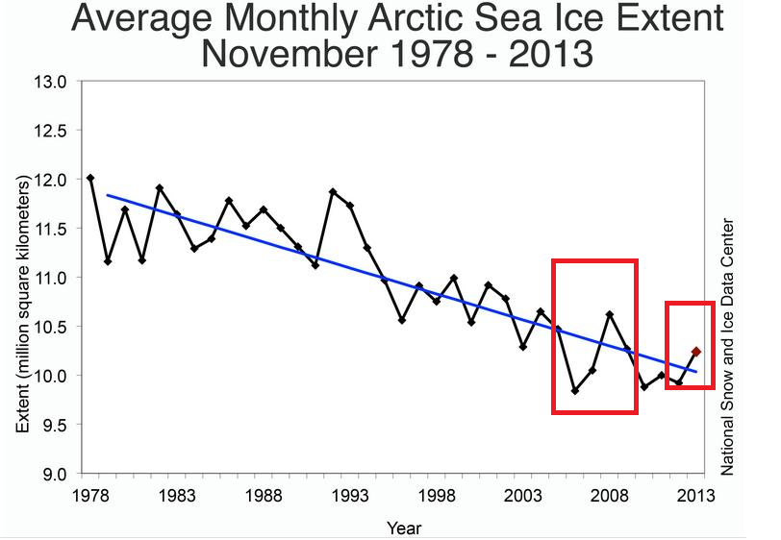
For more see: http://www.skepticalscience.com/melting-ice-global-warming.htm

Slide 29
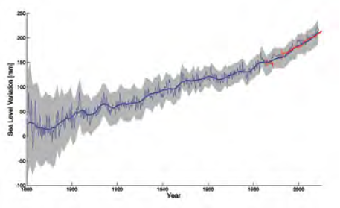
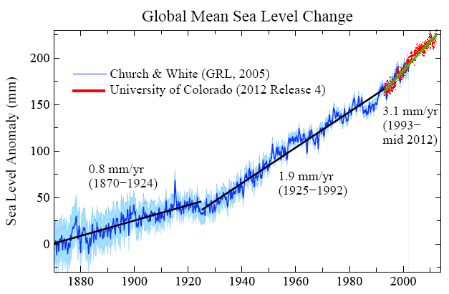
14: HOW FAST IS SEA LEVEL RISING?
Blue: Sea level change from tide-gauge data (Church J.A. and White N.J., Geophys. Res. Lett. 2006; 33: L01602)
Red: Univ. Colorado sea level analyses in satellite era (http://www.columbia.edu/~mhs119/SeaLevel/).

Slide 30
Loaded Climate Dice: global warming is increasing extreme weather events.
Extreme summer heat anomalies now cover about 10% of land area, up from 0.2%.
This is based on observations, not models.
Frequency of occurrence (vertical axis) of local June-July-August temperature anomalies (relative to 1951-1980 mean) for Northern Hemisphere land in units of local standard deviation (horizontal axis). Temperature anomalies in the period 1951-1980 match closely the normal distribution ("bell curve", shown in green), which is used to define cold (blue), typical (white) and hot (red) seasons, each with probability 33.3%. The distribution of anomalies has shifted to the right as a consequence of the global warming of the past three decades such that cool summers now cover only half of one side of a six-sided die, white covers one side, red covers four sides, and an extremely hot (red-brown) anomaly covers half of one side.
Source: Hansen, J., Sato, M., and Ruedy, R., Proc. Natl. Acad. Sci., 2012.

Slide 31
End of week 1

