Slide 1
Some of Psychology’s Contributions to Understanding the Climate Crisis Kathleen Wells EEE Seminar, October 17, 2016 Sources: American Psychological Association Task Force on the Interface Between Psychology and Global Climate Change Yale Project on Climate Communication: Engaging Diverse Audiences with Climate Change: Message Strategies for Global Warming’s Six Americas and Climate Change Psychology: Five Insights; The work of George Marshall and George Lakoff Acknowledgments: Paul Belanger- Technical Assistance; Thad Cummins- Videos

Slide 2
Presentation Outline I. What Do Americans Think About Climate Change? Profiles of Six “Attitude Types”: The Six “Americas” Video Profiles: One Alarmed and One Dismissive Citizen II. What are the Communication Challenges? (Psychological Processes that Influence How Individuals Cope with Climate Change) Inhibitors of Taking Action Complications of Assessing Risk Difficulties Persuading the Doubters and Dismissives III. What Lessons Can Be Drawn from Psychology Regarding Climate Communication?
:

Slide 3
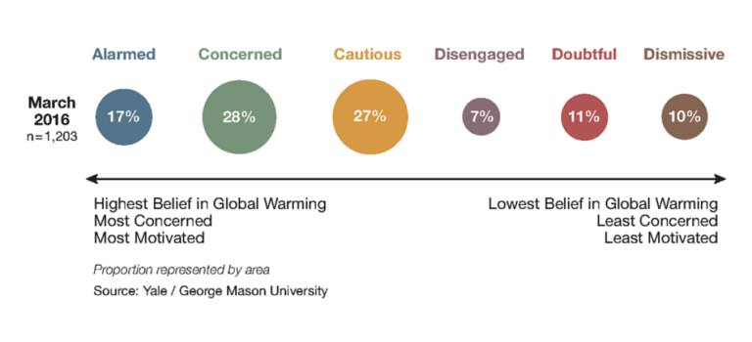
The Six Americas

Slide 4
The Six Americas Differ With Respect Key Beliefs About Climate Change and : Demographic characteristics Political ideology, behavior, and party identification Cultural values Involvement with the issue Inclination to accept or reject climate science

Slide 5
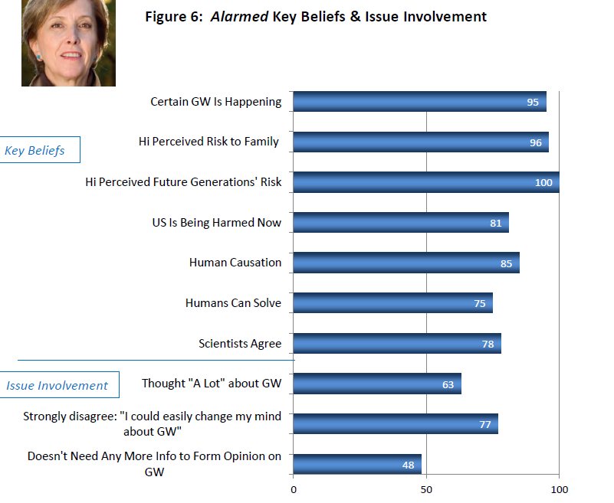

Slide 6
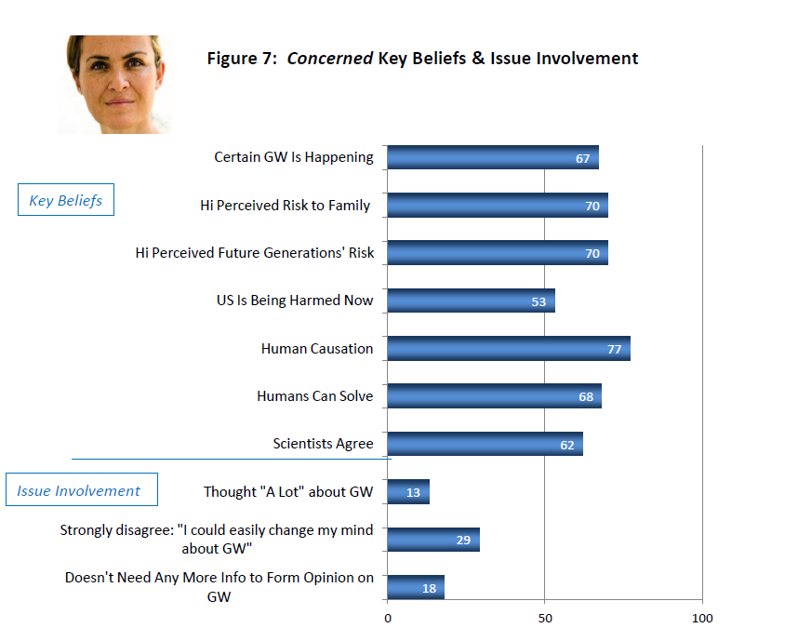

Slide 7
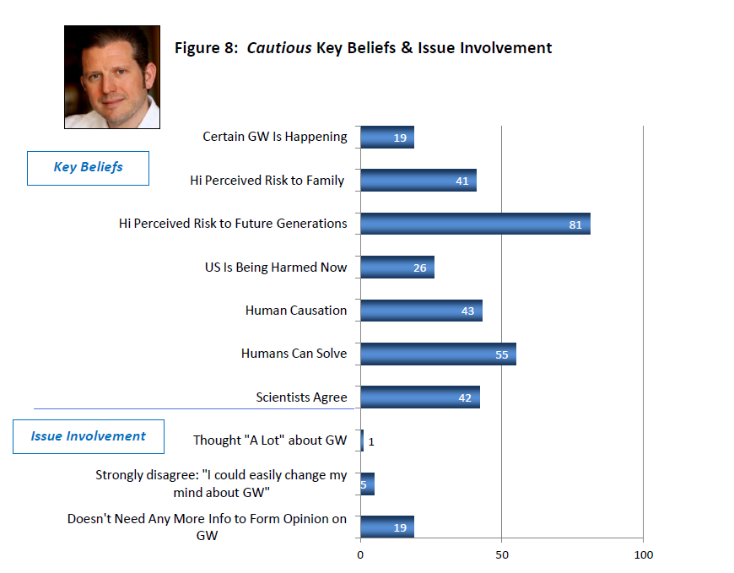

Slide 8
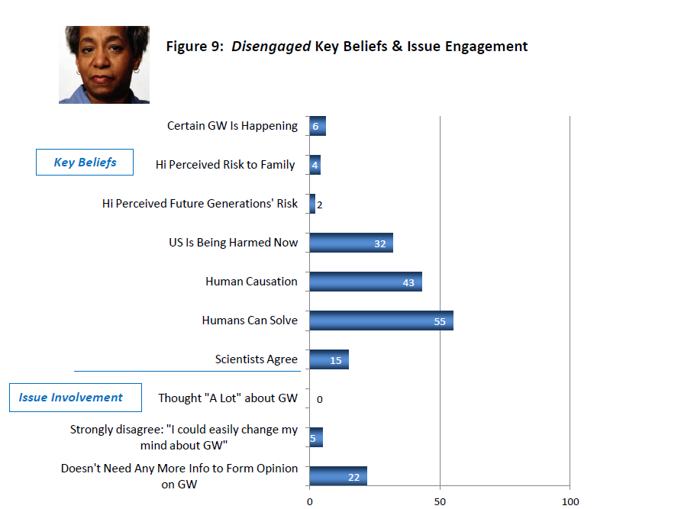

Slide 9
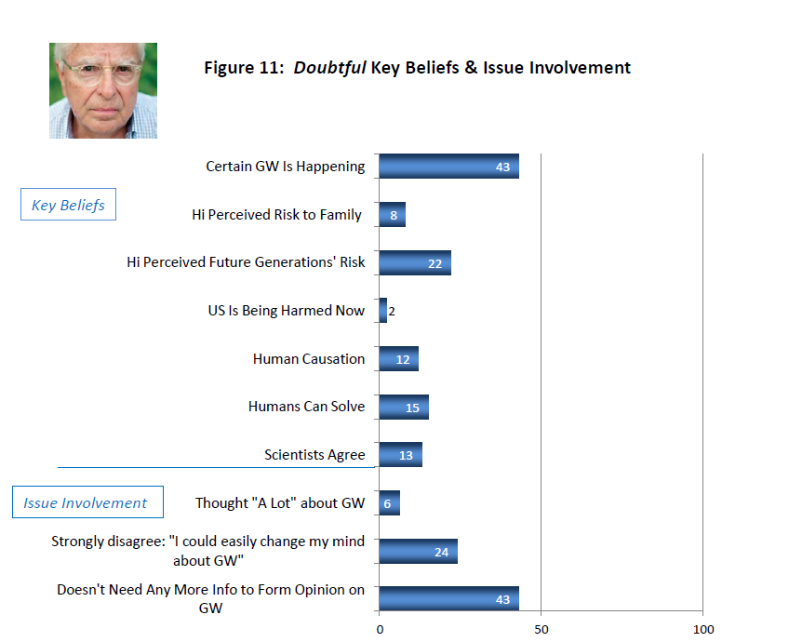

Slide 10
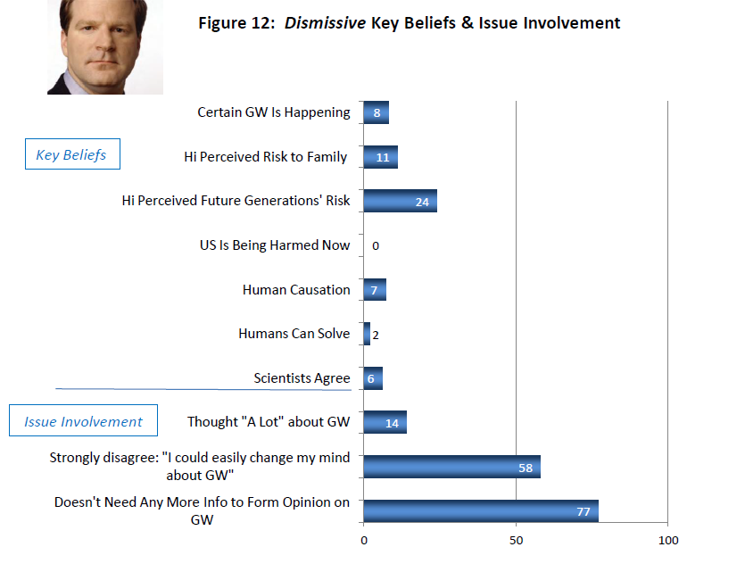

Slide 11
Two Examples: Senator Bernie Sanders and Former Governor Sarah Palin Listen for Attitudes About Science, Willingness to Process Information, Engagement with Climate Issue, Moral Presuppositions
Bernie Sanders YouTube clip – played from beginning to 5 minutes
Sarah Palin YouTube Clip – played from 00:15 to 1:42

Slide 12
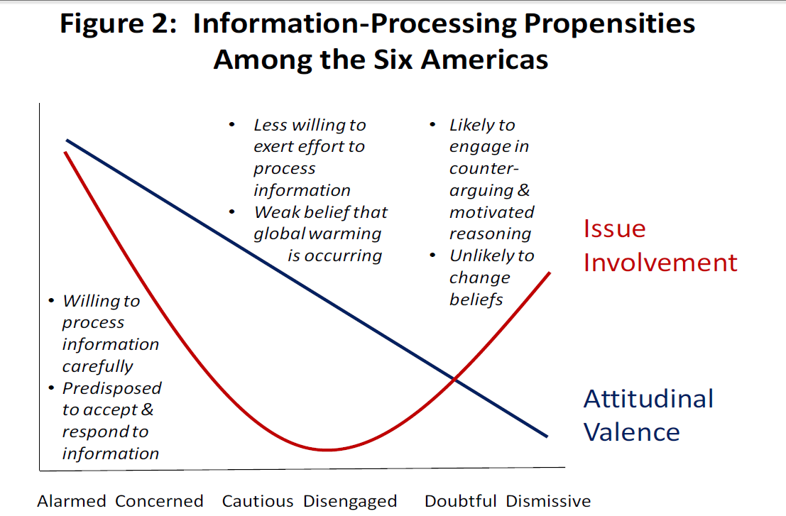
Greater Involvement

Slide 13
What are the Key Communication Challenges for Three Groups 1. High Involvement Public/Accept Climate Change: The Alarmed and the Concerned (45%) 2. Low Involvement Public: The Cautious and the Disengaged (34%) 3. High Involvement Public/Reject Climate Change: The Doubtful and the Dismissive (21%)

Slide 14
Communication Challenges: Group 1: Highly attentive to information, want to know what they can do to reduce global warming KEY Challenge: Motivating them to take action Group 2: Uncertain about reality of climate change, but unlikely to find answers, as they pay little attention to information about issue KEY Challenge: Reaching them with information Group 3: Fairly certain climate change is not happening KEY Challenge: Understanding the motivational structure behind views and promoting the adoption of new views

Slide 15
Group 1: The Alarmed and the Concerned Why motivating them to take action is difficult: Nature of the phenomena: Everyone is to blame Social construction of climate change: Social norms have developed that exclude climate change from what can be addressed and/or discussed publicly Passive bystander effect: Management of conflict between wanting to act and wanting to protect the self by claiming to know less than one does and waiting for others to act first Negative psychological effects of climate change: Gradual, accumulative, paralyzing

Slide 16
Group 1: The Alarmed and the Concerned
Communication Strategies to Promote Engagement:
Employ messages with information and complexity
Use strong logically-sound arguments for actions
Focus on solutions to climate change
Build perceptions of collective- and self-efficacy
Help Group 1 to become opinion leaders

Slide 17
Group 2: The Cautious and the Disengaged Why risk of climate change is difficult to apprehend and reaching this group with information is a challenge: Nature of the phenomena: Invisible, result of systemic rather than direct causes, described in terms of variables distributed over time Requires cognitive rather than primarily emotional processing and making concrete abstract events that will occur in the future Influenced by generalized expectations of stability and change, pre-existing frames of reference

Slide 18
Group 2: The Cautious and the Disengaged Significant percentages don’t understand news or seek information about climate change: “I have difficulty understanding news reports about global warming.” Cautious= 44% and Disengaged=77% “In general, I don’t like to read or hear anything about global warming.” Cautious=37% and Disengaged=59%

Slide 19
Group 2: The Cautious and the Disengaged Communication Strategies to Promote Acceptance of Information Unlikely to attend to information that requires cognitive effort More likely to attend to messages that: Rely on peripheral/heuristic information processing (e.g., humor) Demonstrate that appropriate climate change views are respected and advocated by sources credible to the target audience (social norms) Show rather than tell what is happening Personalize the threat so that the information provided is emotionally significant Generate involvement through story (narrative strategies)

Slide 20
Group 3: The Doubtful and the Dismissive Why persuading others to adopt counter-attitudinal views is difficult: Information may trigger counter-arguing Information casting doubt on the seriousness of climate change may be accepted uncritically whereas the opposite message (climate change is a serious threat) may be rejected uncritically

Slide 21
Group 3: The Doubtful and the Dismissive Climate change may be perceived as a threat to pre-existing cultural values making it especially challenging to reach these groups Direct engagement may result in a boomerang effect such that pre-existing attitudes are strengthened However: For the Doubtful, emphasis on personal experiences with climate change may be helpful For both groups, a focus on public health effects of climate change may work

Slide 22
Key Communication Strategies From Psychology
Five lessons from Psychology that policy-makers can use to engage a significant portion (but not all) of the general public:
Privilege experience over analysis
Link message to group norms
Reduce psychological distance
Frame the big picture: Nobody likes losing but everyone likes
gaining
Play the long-game: Tap the potential of human motivation

Slide 23
The End The EEE seminar disrupts silence and interrupts despair over climate change, encourages a culture of urgent engagement, and helps us to develop narratives of hope. Thank you.

