Slide 1
Earth’s Climate: Past, Present and Future; Concerns and Solutions Week 5: Wednesday February 20th, 2019 Paul Belanger Solutions

Slide 2
Revised syllabus
https://denverclimatestudygroup.com/wp-content/uploads/2019/02/Belanger-2019-winter-syllabus-Earth-climate-past-present-future20190213.pdf
Starting with Today:
Wednesday 1-3, February 13th:
Models, physics and what do they tell us
Skepticism vs. Denial:
5 Characteristics
List of videos that might be useful: https://skepticalscience.com/denial101x-videos-and-references.html
Denial 101x: here's a link to a newly available self-paced version of the course I took in April and May: https://www.edx.org/course/making-sense-of-climate-science-denial-2
Industry statements past and present
Ice coring – see next week list if time permits
Wednesday 1-3, February 20th:
Antarctic ice cores
Arctic Ice cores
What the data tells us
REVIEW LAST SLIDE FROM LAST WEEK: Solutions: how to cut emissions!
Solutions Part A: – start of discussion onward (see below)
LAST WEEK

Slide 3
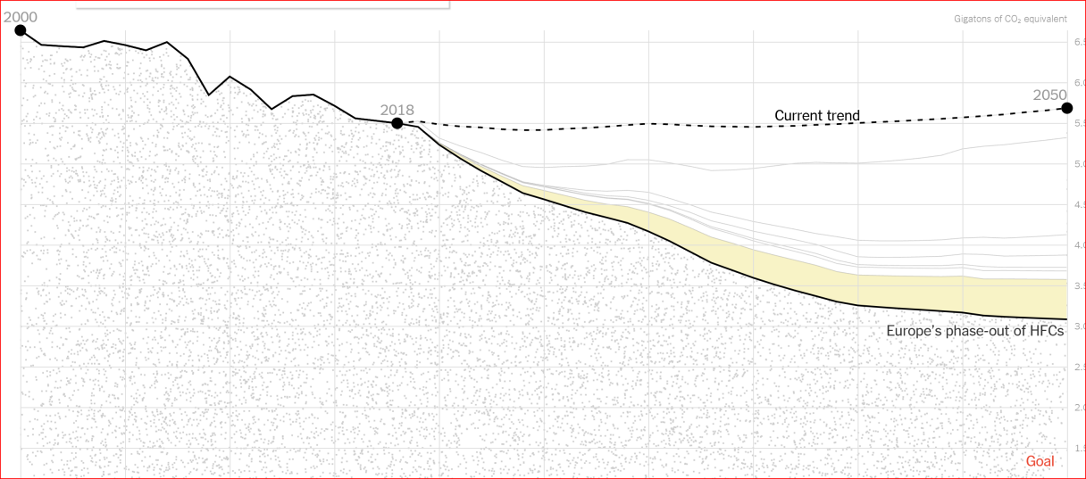
Solutions - Adoption of 7 policies
https://www.nytimes.com/interactive/2019/02/13/climate/cut-us-emissions-with-policies-from-other-countries.html?smid=fb-nytimes&smtyp=cur&fbclid=IwAR13rNqUxYrKOomsaKQKotuuYQ1SBUK_lIddhZbL0E9lNp70f9NHhuy8_Nw

Slide 4
Adoption of 7 policies
Carbon tax: The tax on coal, oil and natural gas starts at $7.50 per ton of carbon dioxide in 2020 and reaches $37.50 per ton by 2033. This is based on the rates and schedule for British Columbia’s carbon tax, which began in 2008. …
Clean electricity standard: This policy is partly modeled after existing state-level standards. It requires utilities to increase the amount of electricity they produce from carbon-free sources — including wind, solar, nuclear, hydro, geothermal and biomass — until they reach 100 percent clean electricity in 2050. For comparison, California is steadily increasing its clean electricity requirements to 100 percent by 2045, while New York has announced a 2040 goal.
Electric vehicle push: Rather than model Norway’s specific set of electric vehicle tax incentives, this scenario assumes that the United States makes a push to match the rapid recent growth in Norway’s electric vehicle sales over the next eight years. (Between 2011 and 2018, electric vehicles and plug-in hybrids went from 1.6 percent of new sales in Norway to 49 percent.) After 2027, ….
Industrial efficiency standards: The industrial efficiency gains are based on a 2016 Department of Energy study …..
Building codes: This policy reduces energy use in new homes and buildings. In 2016, the California Energy Commission calculated that the state’s stricter building codes would reduce energy-use intensity by 29 percent for residential buildings and 13 percent for commercial …..
Methane standards: Canada’s methane rules aim to reduce emissions from oil and gas operations 40 to 45 percent below 2012 levels by 2025. …
HFC phaseout: This….

Slide 5
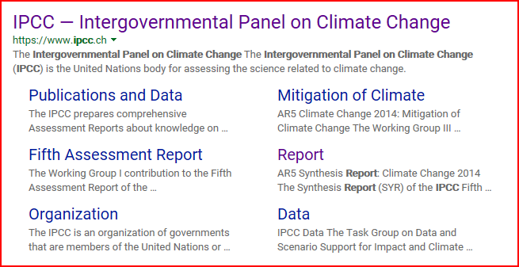
IPCC — Intergovernmental Panel on Climate Change
IPCC — Intergovernmental Panel on Climate Change -- https://www.ipcc.ch/

Slide 6
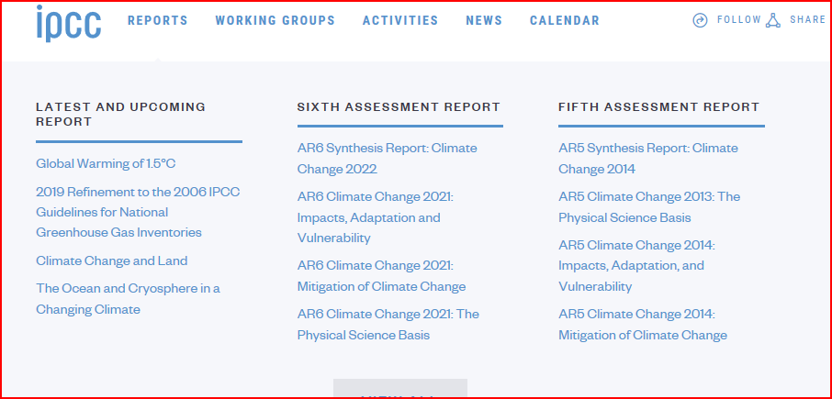
IPCC REPORTS
Assessment reports (AR #) with 3 working groups:

Slide 7
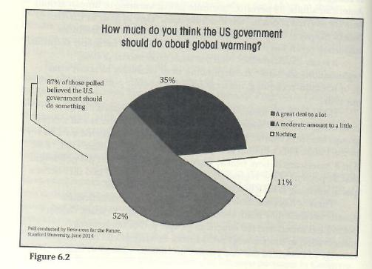
We’d like the role of Government BUT IT DOES NOT LOOK PROMISING RIGHT NOW?
Bill Ritter, Jr., Powering Forward, 2016

Slide 8
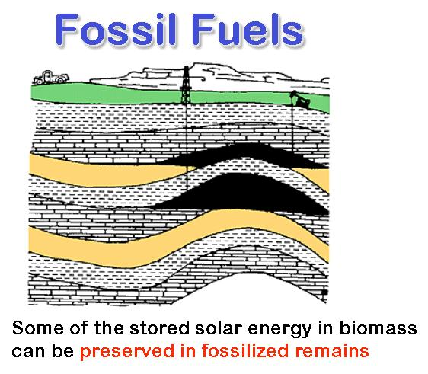
Fossil fuels: oil, gas, coal
We owe a lot to fossil fuels
It’s only recently we’ve fully appreciated it’s consequences
It’s time for change!
From Where has all the carbon gone: Scott.Denning@ColoState.edu

Slide 9
We are a planet with brains
Climate change is only the most visible of the modifications we've made--up until this point, inadvertently--to the planet.
And our current behavior threatens not only our own future but that of countless other creatures.
….shows what a strange and novel development it is for a species to evolve to build machines, and ultimately, global societies with world-shaping influence.
BTW – David Grinspoon will be at Conf. World Affairs (CWA), Boulder NEXT week of 4/8: http://www.colorado.edu/cwa/

Slide 10
Solutions
What’s it take? A very complex issue
Policy changes – How to Effect change?
Cooperation and Resolve – How to agree – COP = Conference of Parties (COP21 = aka Paris agreement)
Economic changes
Sustainable practices – large and small scale
Lifestyle changes

Slide 11
Youth Movement
https://www.theguardian.com/commentisfree/2019/feb/15/planet-children-protest-climate-change-speech

Slide 12
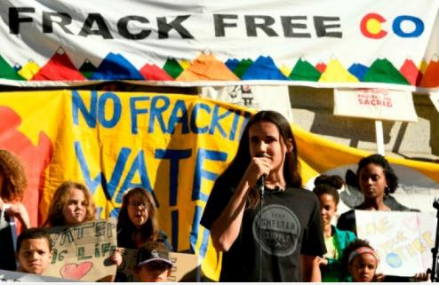
https://www.ourchildrenstrust.org/news

Slide 13
Dr. James E. Hansen
July, 2017: Video for "Young People's Burden"
March, 2017: Sophie Sez #3: $1,000 for you - and a better world for your children. (Transcript)
March, 2017: Sophie Sez #2: Obama Missed A Golden Opportunity - but We Can Still Win! (Transcript)
http://www.columbia.edu/~jeh1/

Slide 14
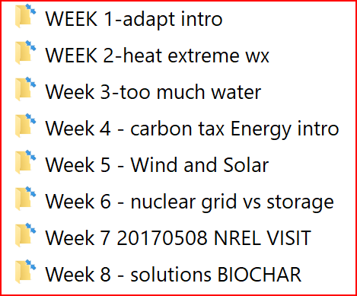
Adapting to Climate change: Extreme Weather Events, a Worldwide Energy Revolution and Geoengineering options Paul Belanger, Ph.D.; & Phil Nelson, Ph.D. Geologist/Paleoclimatologist; & Geophysicist SPRING 2017
My OLLI archive - Spring 2017 – top of the page: https://denverclimatestudygroup.com/?page_id=2224

Slide 15
SOLUTIONS – Energy, Transportation and Geoengineering Options
Changing our energy needs
Economize ANY Energy usage: insulate, reduce trips
Decarbonize Energy for Generating Electricity
Electrify everything for cooking, heating, manufacturing – EVERYTHING
Decarbonize Energy for Transportation
EVs, Fuel cells,
Why that is not enough = Geoengineering options
SRM – SOLAR RADIATION MANAGEMENT
CDR – CARBON DIOXIDE REMOVAL

Slide 16
How to achieve solutions
HIT the WALLET
Fee/dividend or tax carbon
Remove fossil fuel subsidies
Incentivize non-carbon sources of energy and transportation
REDUCE EMISSIONS
SEQUESTER SOME
CHANGE OUR LIFESTYLES

Slide 17
Sustainability Economics
Herman Daly – Steady State Economics
Alec Tsoucatos – OLLI instructor; also involved EEEF
Kate Raworth – Doughnut Economics
Paul Sutton – DU Sustainability and EEEF

Slide 18
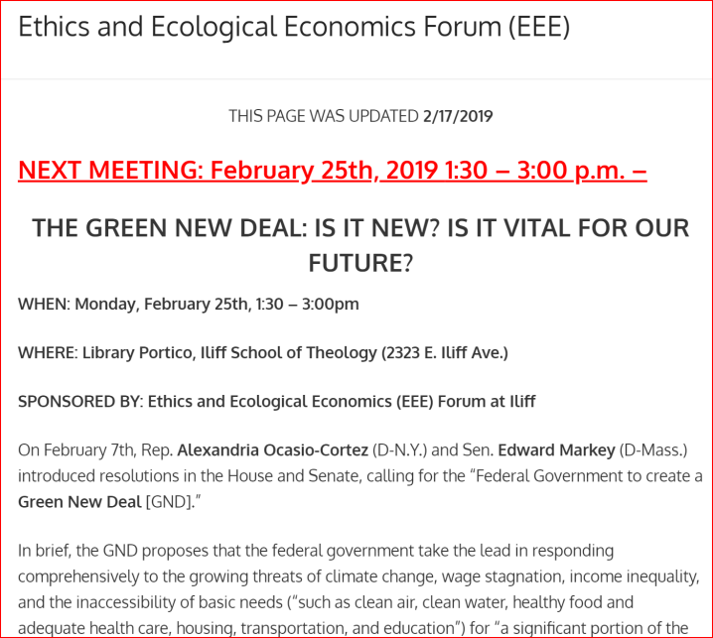
This Monday: Ethics and Ecological Economics Forum (EEEF)
https://denverclimatestudygroup.com/?page_id=683

Slide 19
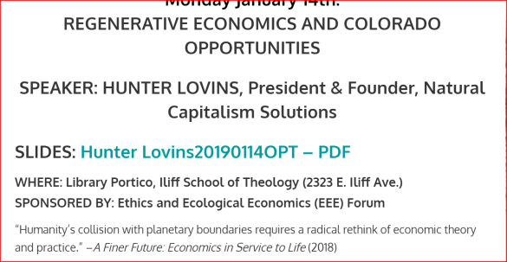
Social Justice and Economics
xxx

Slide 20
Solutions How to Overcome our Inertia and Apathy

Slide 21
APATHY / INERTIA WHY?
IT’S too late
It’s too big a problem
It’s up to the government
I’m not long for here anyway
It’s too expensive
I’m too busy
https://eos.org/articles/climate-scientists-new-hurdle-overcoming-climate-change-apathy

Slide 22
APATHY / INERTIA vs. good motives:
IT’S our planet
It’s the right thing to do
I CARE FOR FUTURE GENERATIONS!
It’s for our grandkids, or dogs or cats
I believe in promoting the best of human values by example
https://eos.org/articles/climate-scientists-new-hurdle-overcoming-climate-change-apathy

Slide 23
SOLUTIONS TO APATHY
CHANGE OUR WAY OF THINKING

Slide 24
Earth in human hands
Kerry Emanuel, MIT Prof. Meteorology:
“…there are few, if any, historical examples of civilizations consciously making sacrifices on behalf of descendants two or more generations removed”
NEEDED CABINET POSTION:
Secretary of the future

Slide 25
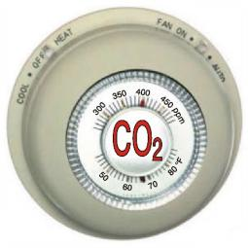
More Water Vapor and Clouds
Warmer Air, Warmer Water (Global Warming)
Atmosphere Biosphere
Hydrosphere Cryosphere
(Climate Change)
Human Activity
J
Courtesy Phil Nelson
Notes:
J = journalism, especially science journalism

Slide 26
More Water Vapor and Clouds
Warmer Air, Warmer Water (Global Warming)
HUMAN RESPONSES
Personal
Family, Friends, Neighbors
Town and City
State
National
International
Atmosphere Biosphere
Hydrosphere Cryosphere
(Climate Change)
Courtesy Phil Nelson
Notes:
J = journalism

Slide 27
CRES YouTube Channel: https://www.youtube.com/channel/UCr81EUb2qVJVfmmlJMxEHVw/videos

Slide 28
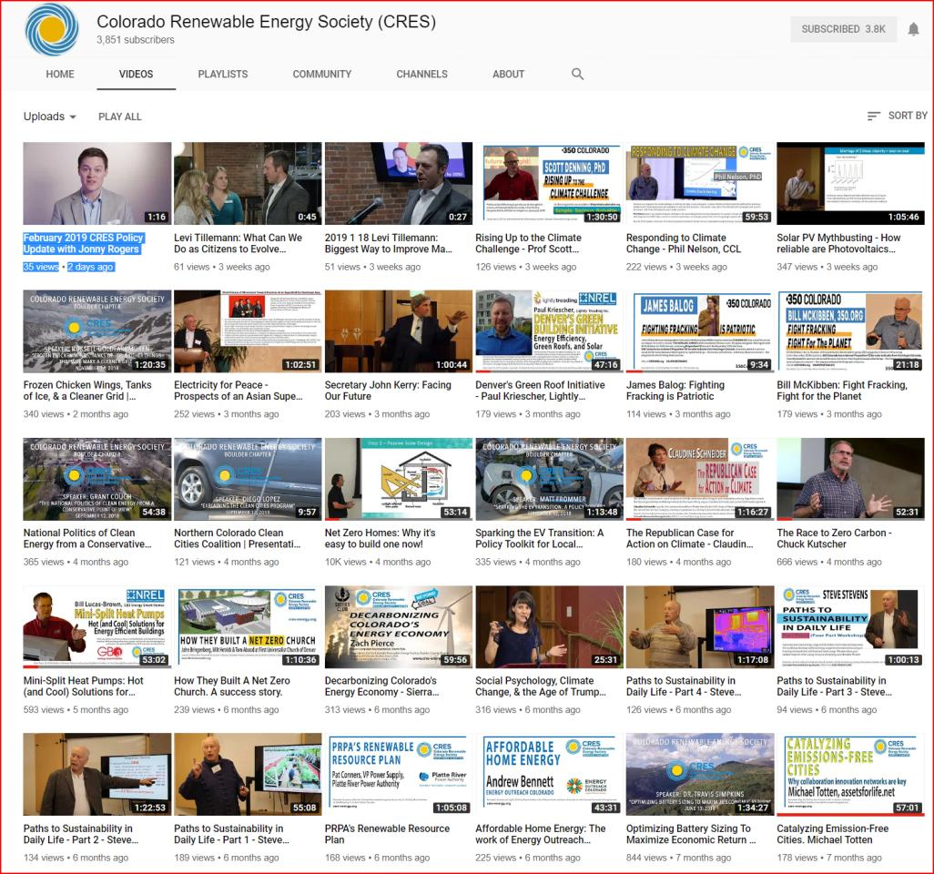

Slide 29
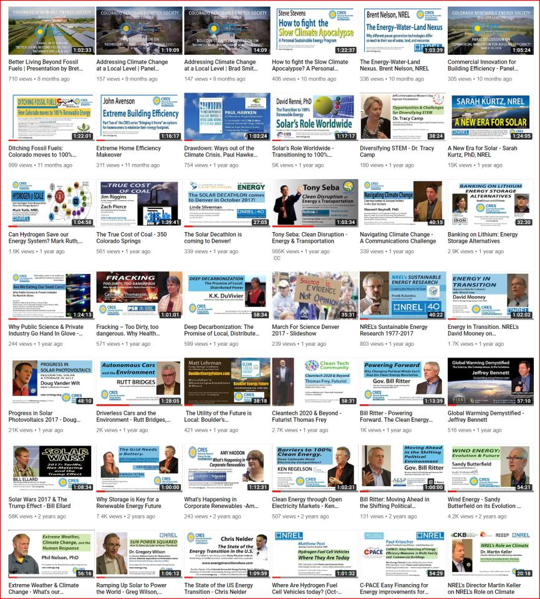

Slide 30
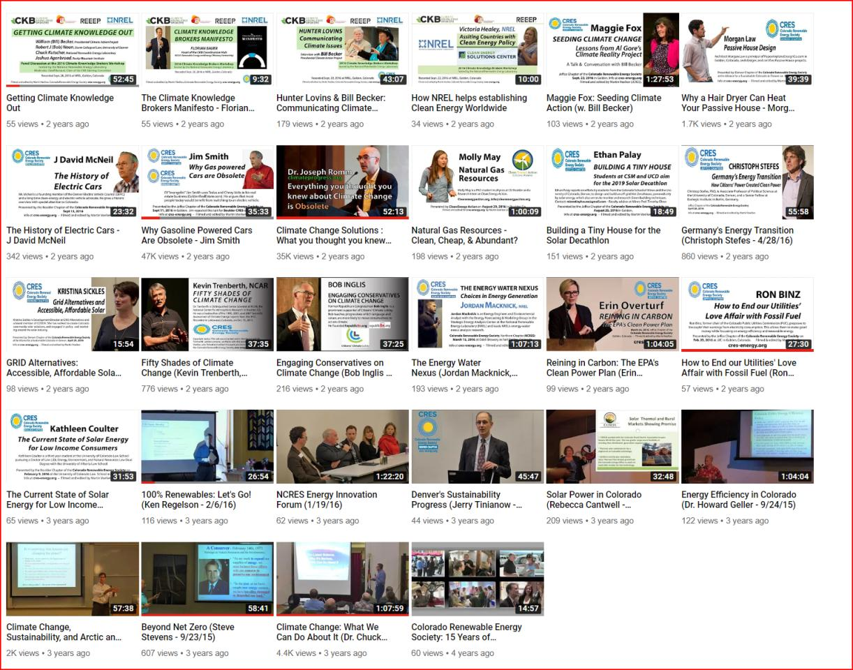

Slide 31
CRES YouTube Channel: https://www.youtube.com/channel/UCr81EUb2qVJVfmmlJMxEHVw/videos
Tony Seba: Clean Disruption - Energy & Transportation
https://youtu.be/2b3ttqYDwF0
Ramping Up Solar to Power the World - Greg Wilson, NREL
https://youtu.be/7CDPHxcnq4c
Driverless Cars and the Environment - Rutt Bridges, Futurist
http s://youtu.be/0BWJcpesr6A
Bill Ritter - Powering Forward. The Clean Energy Revolution can't be stopped
https://youtu.be/agowW1QKwms
Drawdown: 60 Minutes with Paul Hawken
https://www.youtube.com/watch?v=4XrFnK1RrLE
Can Hydrogen Save our Energy System Mark Ruth, NREL
https://www.youtube.com/watch?v=4u93y-l0cwM&t=199s
100% Renewables: Let's Go! (Ken Regelson - 2/6/16)
https://youtu.be/xDBPE6ZUGXQ
Why Storage is Key for a Renewable Energy Future
https://youtu.be/Yc_hULwykvQ

Slide 32
Colorado Renewable Energy Society – YouTube of selected talks:
ON Hydrogen:
Ramping Up Solar to Power the World - Greg Wilson, NREL: https://www.youtube.com/watch?v=7CDPHxcnq4c
Can Hydrogen Save our Energy System? Mark Ruth, NREL
https://www.youtube.com/watch?v=4u93y-l0cwM

Slide 33
Powering Forward: …America's Energy Revolution
A historic energy revolution is underway in the United States & THE WORLD:
Wind, sunlight, and other sustainable resources
Power plants on their roofs
Entire communities are switching to 100 percent renewable energy; Hawaii has such a commitment!
Urgent need to prevent climate change is causing people around the planet to question their reliance on carbon-intensive oil, coal, and natural gas.

Slide 34
Ken Regelson links
EnergyFreedomCO.org
Innovation and lower costs through competition.
EnergyShouldBe.org
100% Renewables

Slide 35
When you have excess power:
Ramping Up Solar to Power the World - Greg Wilson, NREL: https://www.youtube.com/watch?v=7CDPHxcnq4c

Slide 36
Geoengineering

Slide 37
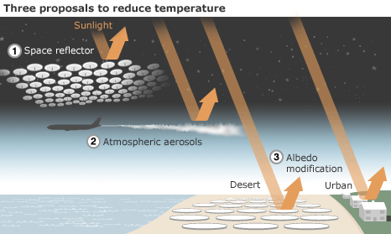
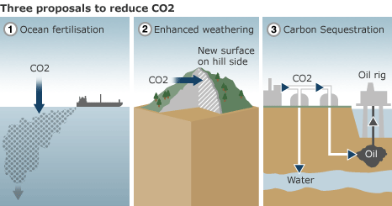
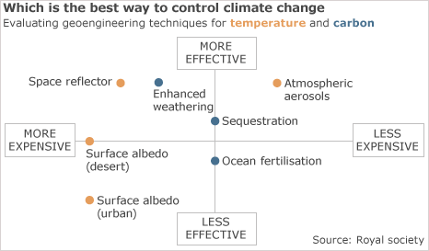
Solar Radiation Management vs. Carbon dioxide Removal (SRM VS. CDR)
Biochar & Beccs
https://en.wikipedia.org/wiki/Biochar
https://en.wikipedia.org/wiki/Bio-energy_with_carbon_capture_and_storage
Royal Society

Slide 38
Additional
SRM – Solar Radiation Management
Cloud Brightening to increase Earth’s Albedo (reflectivity) also investigated
CDR – Carbon Dioxide Removal (carbon negativity)
Ocean fertilization with Iron to create algal blooms that sink to the sea floor:
https://en.wikipedia.org/wiki/Ocean_fertilization
Enhanced weathering: taking unstable mantle minerals, particularly Olivine to lock up Carbon https://en.wikipedia.org/wiki/Enhanced_weathering
Carbon Sequestration often ignores the potential of Biochar
Carbon Sequestration synonymous with Carbon Negativity

Slide 39
https://www.eldersclimateaction.org/

Slide 40
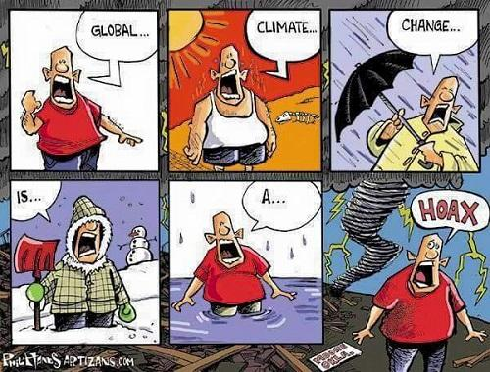
https://www.skepticalscience.com/2019-SkS-Weekly-Digest_07.html

Slide 41
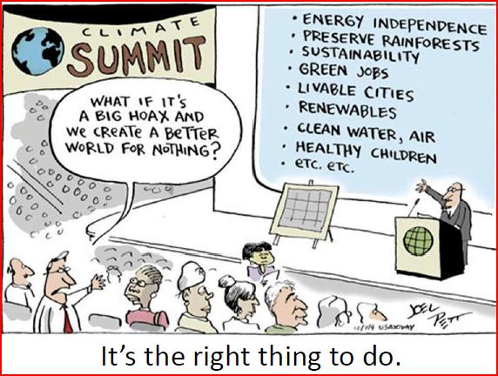

Slide 42
How does one respond to Deniers of climate change? With Simple Facts and Logic
1. Is climate changing? YES
Scientific ….
2. Do people have anything to do with it? YES
Greenhouse gas emissions (primarily carbon dioxide from fossil fuel burning) have to warm the atmosphere—it is what they do. ….
3. Is climate change bad? YES
…change in the environment of stable civilizations is disruptive to those civilizations….
Alterations in areas in which crops can be grown… when leaves fall, when insects emerge, etc.), …
Shifting storm tracks, and rising sea level may have devastating economic, social, and political consequences on modern societies.
Ocean Acidification
4. Can we do anything about it? YES
….cessation of emissions can stabilize climate in the 21st century….
5. Is it worth doing anything about? YES
Economic analyses ….
https://eos.org/editors-vox/responding-to-climate-change-deniers-with-simple-facts-and-logic?utm_source=eos&utm_medium=email&utm_campaign=EosBuzz033117

Slide 43
WHAT TO DO?
PLEASE QUESTION MOTIVES IF ONE SAYS: “Well I’m not really sure how much is man-made”
AND ASK or think about their credentials!
Are they climate scientists?
AND Don’t spend too much time (waste?) expecting to change world views

Slide 44
Web Links on Climate
https://skepticalscience.com/
https://skepticalscience.com/denial101x-videos-and-references.html
http://www.realclimate.org/
http://climatecentral.org/
https://climate.nasa.gov/ https://climate.nasa.gov/causes/ , etc.
Jeffrey Bennett: http://www.globalwarmingprimer.com/tour/
http://www.globalwarmingprimer.com/primer/primer4/
Jeff Masters/Weather underground: https://www.wunderground.com/weather-infographics/climate-change-today
https://www.wunderground.com/blog/JeffMasters/show.html
http://www.nationalgeographic.com/magazine/2017/04/seven-things-to-know-about-climate-change/
Extreme Weather: Phil Nelson: https://www.youtube.com/watch?v=gQ1kPMYCFEY&t=9s

Slide 45
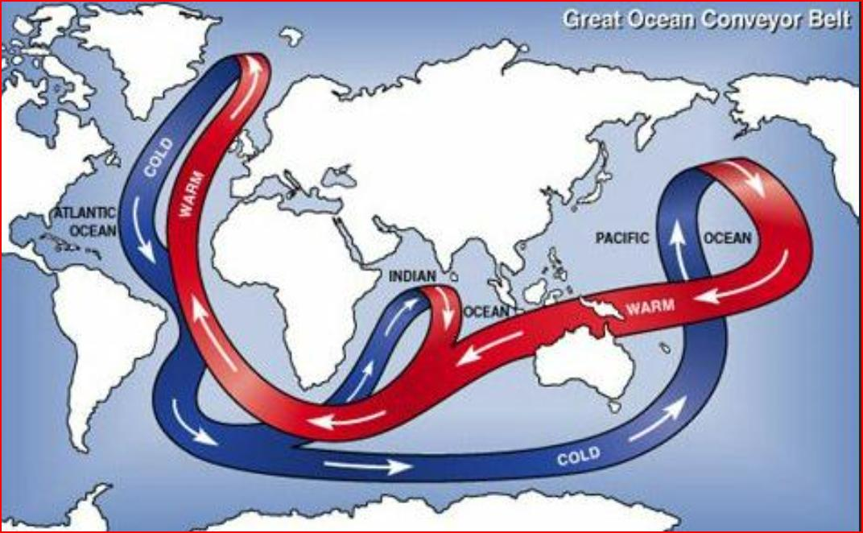
https://weather.com/news/news/2019-02-18-wally-broecker-dies-global-warming

Slide 47
WALLY BROECKER 11/29/1931-2/18/2019
https://en.wikipedia.org/wiki/Wallace_Smith_Broecker
https://weather.com/news/news/2019-02-18-wally-broecker-dies-global-warming
Wally Broecker’s ebook – What Drives Glacial Cycles Broecker
Wally Broecker’s 1975 paper BroeckerScience1975 Are we on the brink of a pronounced GLOBAL WARMING

Slide 48
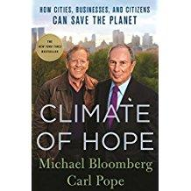
READ: Climate of Hope – Solutions Drawdown – and associated web pages

Slide 49
Drawdown
A Critique:
DOES NOT DEAL ENOUGH WITH CARBON NEGATIVITY –
Rather – mostly about carbon emission reduction; we need more than that – i.e. carbon negativity too to take out the excess we’ve put in
To reduce the heating/extreme weather events
To slow/stop Ocean Acidification

Slide 50
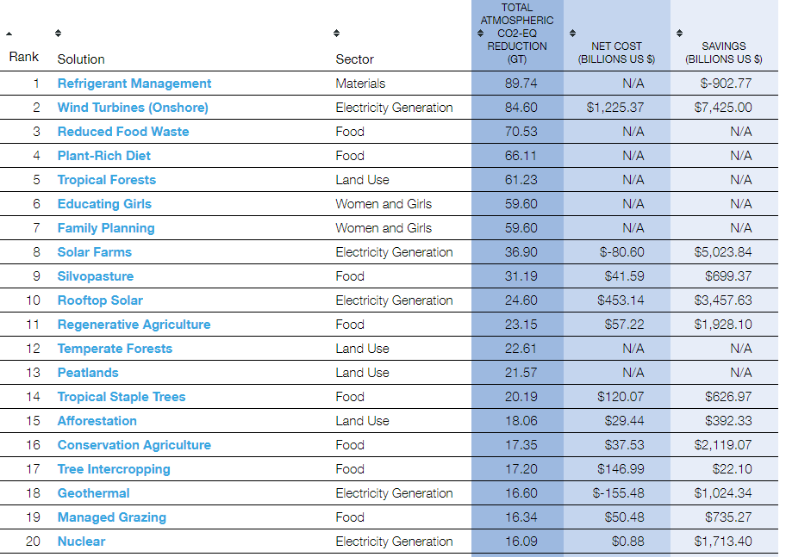
Summary of Solutions by Overall Rank
http://www.drawdown.org/solutions-summary-by-rank

Slide 51
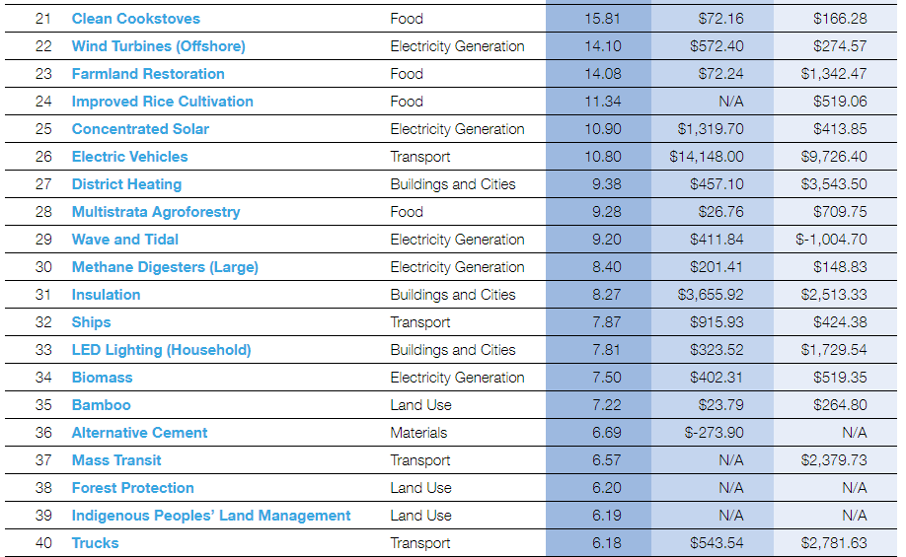
Summary of Solutions by Overall Rank
http://www.drawdown.org/solutions-summary-by-rank

Slide 52
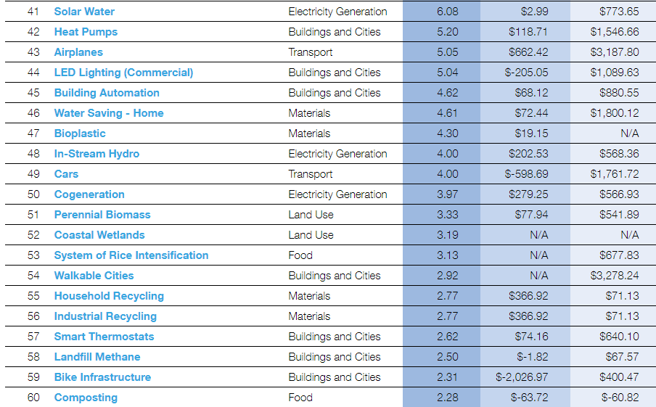
Summary of Solutions by Overall Rank
http://www.drawdown.org/solutions-summary-by-rank

Slide 53
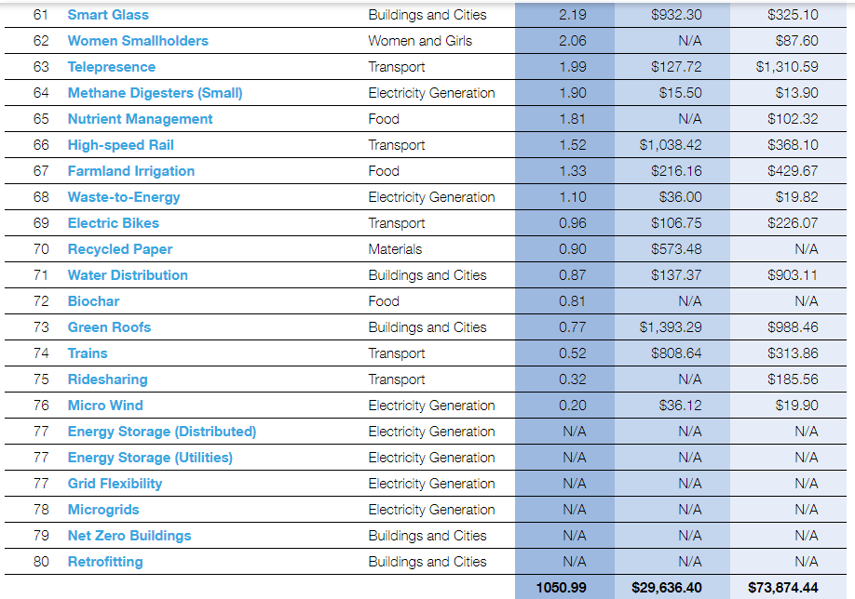
Summary of Solutions by Overall Rank
http://www.drawdown.org/solutions-summary-by-rank

Slide 54
Colorado Renewable Energy Society – YouTube of selected talks:
Drawdown CRES YouTube video: Drawdown: Ways out of the Climate Crisis. Paul Hawken, Chip Comins: https://youtu.be/4XrFnK1RrLE
Other Drawdown links:
http://www.drawdown.org/
http://www.drawdown.org/solutions
https://www.facebook.com/projectdrawdown

Slide 55
OLLI Courses to Consider
Phil Nelson – Extreme Weather
Alec Tsoucatos – Steady state economics – when more is not enough
Great Decision – Peter Lohaus & Jeff Pederson

