Slide 1
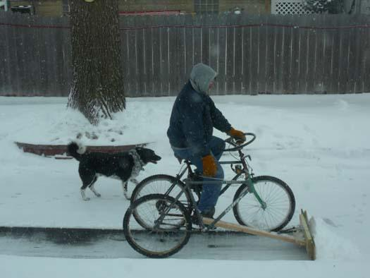
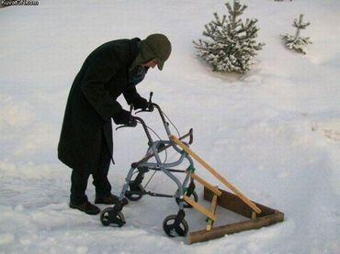
Earth’s Climate: Past, Present and Future;
Concerns and Solutions
Week 8: Wednesday March 13th, 2019
Paul Belanger
Solutions – part B
Class canceled due to snowstorm: had to go plow!

Slide 2
Solutions
2 weeks ago – Solutions PART A – expanded in next slide
Then Bob Raynolds on Anthropocene last week March 6th
This week – Solution PART B – More on renewables (wind and solar) – private and commercial/non-profit options, why it’s not enough and what can be done!

Slide 3
Solutions – Part A
Expanded description: Week 6, February 28th:
https://denverclimatestudygroup.com/wp-content/uploads/2019/02/OLLI-East-week-6-slides-final.pdf without simulation of grid
Plant Hardiness change
Link to Spring 2017 where 6 of the 8 weeks on solutions:
    https://denverclimatestudygroup.com/?page_id=2224
Economics: Growth vs. Steady State; EEEF and IPCC
Youth involvement
Technology changes in Energy: Renewables, Energy storage and Grid alternatives
Other publications: Climate of Hope, Drawdown, CRES Youtube channel
GEOENGINEERING: SRM (Solar Radiation Management) vs CDR (Carbon Dioxide Removal)
And ended with a video on Fusion Developments at Lockheed
ETC…..

Slide 4
This week – Part B
Item by item in following slides
More on what WE as society and what YOU as a person can do
FIRST – NEED TO CHANGE OUR THINKING ON THE ECONOMY
DECARBONIZING ENERGY GENERATION: WIND and SOLAR
  PERSONAL
  COMMERCIAL/NON-PROFIT
DECARBONIZING TRANSPORTATION
WHY IT’S NOT ENOUGH – WE NEED TO TAKE OUT (SEQUESTER):
  SOIL RESTORATION
  BIOCHAR
  OTHER
EXTRAS

Slide 5
More on what WE as society and what YOU as a person can do
FIRST – NEED TO CHANGE OUR THINKING ON THE ECONOMY
DECARBONIZING ENERGY GENERATION: WIND and SOLAR
  PERSONAL
  COMMERCIAL/NON-PROFIT
DECARBONIZING TRANSPORTATION
WHY IT’S NOT ENOUGH – WE NEED TO TAKE OUT (SEQUESTER):
  SOIL RESTORATION
  BIOCHAR
  OTHER

Slide 6

The Story of Stuff
The goal of BETTER vs. MORE
Educate yourself and be awarel
PLAY VIDEO
https://storyofstuff.org/movies/the-story-of-solutions/
https://youtu.be/cpkRvc-sOKk

Slide 7
More on what WE as society and what YOU as a person can do
FIRST – NEED TO CHANGE OUR THINKING ON THE ECONOMY
DECARBONIZING ENERGY GENERATION: WIND and SOLAR
  PERSONAL – slides from John Bringenberg
  COMMERCIAL/NON-PROFIT
DECARBONIZING TRANSPORTATION
WHY IT’S NOT ENOUGH – WE NEED TO TAKE OUT (SEQUESTER):
  SOIL RESTORATION
  BIOCHAR
  OTHER

Slide 8
AN IMPORTANT MESSAGE IN GOING SOLAR AND ELECTRIC VEHICLES
Debunk: Too Long to Reach Breakeven

Slide 9
OPTIONS
BUY OR FINANCE: HOME INSTALLATION ON YOUR ROOF
LEASE INSTALLATIONS ON YOUR ROOF (discounts amount you pay for electricity -~ 75%?)
COMMUNITY SOLAR:
  Ideal if you have too much shade
  Someone maintains it – not that there’s much to maintain
  If you move it’s still yours as long as you’re still a customer of that utility

Slide 10
Does it survive hail
YES
However if your surrounding roof is damaged mount and remount costs apply (~ $3 to $5,000; insurance should still cover?).
  Option – fix just the periphery of the roof that’s damaged
    i.e. insurance companies want you to replace the whole roof even if underneath is undamaged!

Slide 11
Personal Action: Electricity
FOLLOWING SLIDES also on the web page:
    – PDF – John Bringenberg Solar program abridged: JohnBringenberg Jan 27 solar program abridged (NXPowerLite Copy)
    – preferred as Pptx: JohnBringenberg Jan 27 solar program abridged (NXPowerLite Copy)
    Also posted OLLI page, OLLI East, week 8 https://denverclimatestudygroup.com/?page_id=24

Slide 12
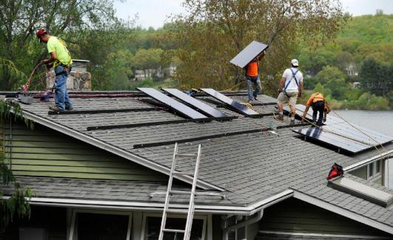
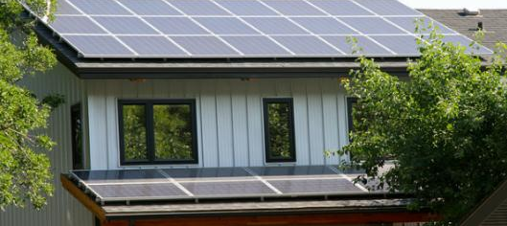

Personal Action: Electricity
The following slides; special thanks to: John Bringenberg john@bringenberg.com - 720-289-3289

Slide 13
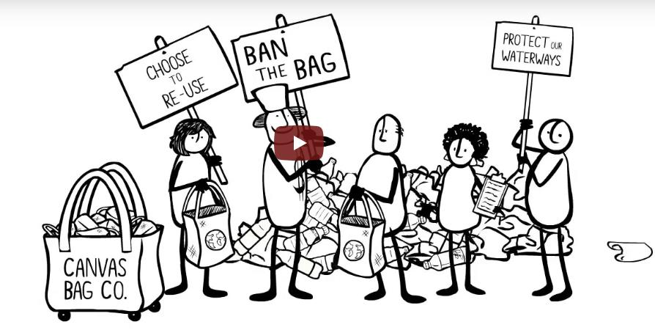
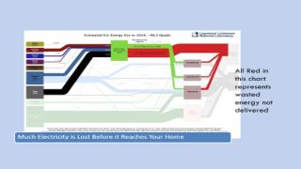
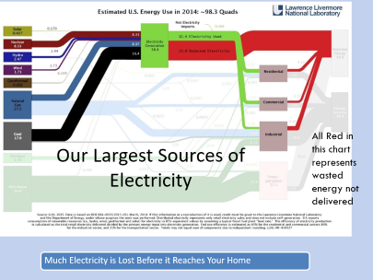
SAME LINK AS SLIDE 6
The Story of Solutions

Slide 14
Topics Today
A hidden (seldom discussed) climate value of energy efficiency and Distributed Generation … a.k.a rooftop solar.
Why ROI [or “how long until break even?”] is not the right question when considering rooftop solar.
What do the economics of rooftop solar look like?
The Joy of opening your electric bill when you have rooftop solar.

Slide 15

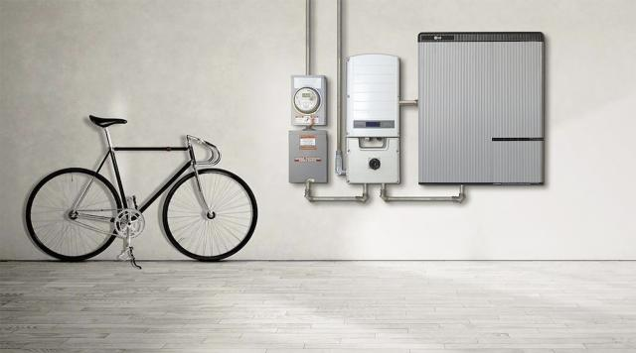
Solar Technology and Storage
Most improvements are to racking, smart inverters and storage
Steady modest improvement in cell performance

Slide 16
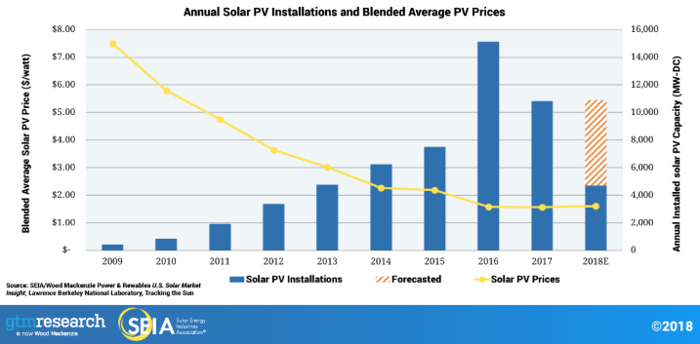
Solar Marketplace

Slide 17
Solar Means Local Jobs
Over 250,000 Americans work in solar -
More than double the number in 2012
More than 9,000 companies in every U.S. state.
2017 - generated $17 billion investment in the US economy.

Slide 18
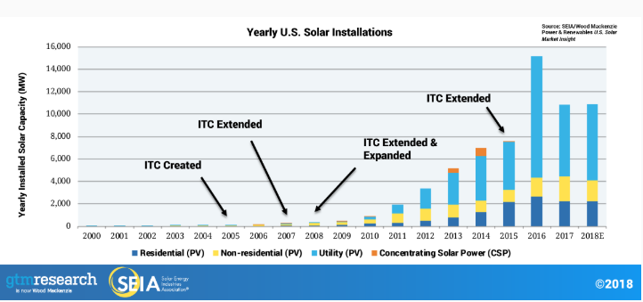
Tax Credits – Key Factor

Slide 19
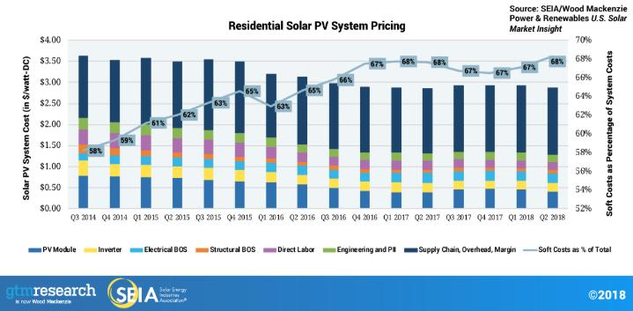
Pricing Impacts are Changing

Slide 20
Community Solar
Started in CO
CEC – Community Energy Collective
SunShare
Most have gravitated to commercial systems
Bill Credit = about $0.07 out of $0.12
  Most current deals = they keep bill credits and REC’s
  Charge no upfront costs
  Customer retains 10% of the bill credits. (~$0.007 discount)

Slide 21
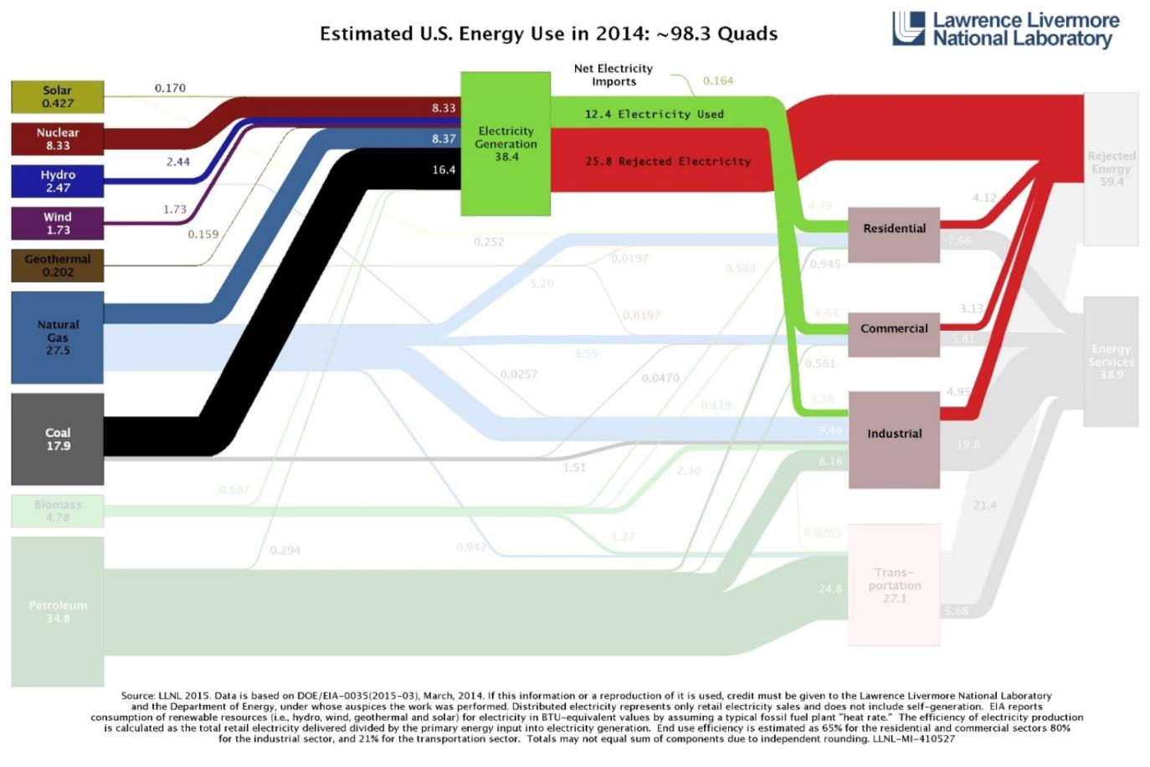
Our Largest Sources of Electricity
All Red in this chart represents wasted energy not delivered
Much Electricity is Lost Before it Reaches Your Home

Slide 22
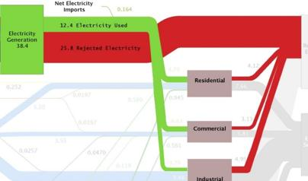

All Red in this chart represents wasted energy not delivered
Much Electricity is Lost Before it Reaches Your Home

Slide 23
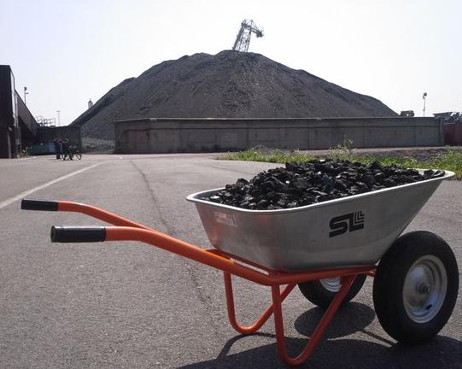
The Real Costs of One Light Bulb

Slide 24
The Real Costs of One Light Bulb
All Red in this chart represents wasted energy not delivered

Slide 25
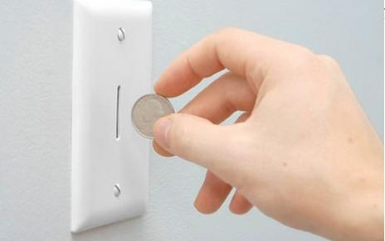
The Real Costs of One Light Bulb

Slide 26

Debunk: Too Long to Reach Breakeven
One of the most common concerns about going Solar.
Doesn't it take a long time to break even?

Slide 27
Debunk: Too Long to Reach Breakeven
True:
After approximately 8 – 12 years the monthly savings has paid for the 30+ year system and energy is essentially free thereafter.
The $12,000 - $20,000 investment in rooftop solar will return ~4% - 7% annual ROI for each of 20+ years.
Also True:
Your previous and next utility payment have negative financial gain ... Each month takes you further from any breakeven. Perpetual cost. Never ROI.
Can’t solve this problem by continuing to pay your utility.

Slide 28
Debunk: Too Long to Reach Breakeven
System Example:
5.4kW system
18 Solar Modules, 300kW each
Cost at $3.75 / W = ~ $20,250
First year Tax Credit = $6,075 (can take over 19 years)
$0.125/kWh Energy increases at average 4% year
Use internal cash liquidated from other sources

Slide 29
Debunk: Too Long to Reach Breakeven

Slide 30
Debunk: Too Long to Reach Breakeven
Tax benefits absorbed in Year 1
20 Year Internal Rate of Return = 6.7%
Can’t solve this problem by continuing to pay your utility.

Slide 31

Residential PACE is Possible in 2019
Residential PACE is among the most popular form of renewable and EE financing … yet only offered in 3 states.
  California, Florida, Missouri
Colorado is possible to be the 4th State in first half of 2019.
100% financing is attached to the property tax. (not attached to the homeowner)
  Stays with the home upon sale
  Credit score does not disqualify
  State administrated program with oversight
  Qualified lenders and contractors

Slide 32
The previous slides; special thanks to: John Bringenberg john@bringenberg.com - 720-289-3289

Slide 33
TO REPEAT:
AN IMPORTANT MESSAGE IN GOING SOLAR AND ELECTRIC VEHICLES
Debunk: Too Long to Reach Breakeven

Slide 34
More on what WE as society and what YOU as a person can do
FIRST – NEED TO CHANGE OUR THINKING ON THE ECONOMY
DECARBONIZING ENERGY GENERATION: WIND and SOLAR
  PERSONAL
  COMMERCIAL/NON-PROFIT – slides from Nick Perugini
DECARBONIZING TRANSPORTATION
WHY IT’S NOT ENOUGH – WE NEED TO TAKE OUT (SEQUESTER):
  SOIL RESTORATION
  BIOCHAR
  OTHER

Slide 35

FOR THE FULL SET OF SLIDES GO HERE:
– PDF – Nick Perugini – commercial and non-profit insights: SolarOpportunitiesForBusinesses&Non-Profits10-8-2017
– Pptx – Nick Perugini – commercial and non-profit insights: SolarOpportunitiesForBusinesses&Non-Profits10-8-2017 Nick Perugini
Special thanks to: Nick Perugini: nickthesolarguy@gmail.com ,
(303) 817-3104

Slide 36
FROM NICK PERUGINI
The attached .ppt from 2017 is geared toward Businesses and nonprofits; links to full set below; slide 11 repeated below:
  Slide 11 are some of the pros and cons of some finance methods.
  Slide 17 and on, have good advice on choosing your installer
The link mentioned to Xcel area Community Solar (SLIDE #10) providers by county is this:
https://www.xcelenergy.com/programs_and_rebates/residential_programs_and_rebates/renewable_energy_options_residential/solar/available_solar_options/community-based_solar
FOR THE FULL SET OF SLIDES GO HERE:
– PDF – Nick Perugini – commercial and non-profit insights: SolarOpportunitiesForBusinesses&Non-Profits10-8-2017
– Pptx – Nick Perugini – commercial and non-profit insights: SolarOpportunitiesForBusinesses&Non-Profits10-8-2017 Nick Perugini
Special thanks to: Nick Perugini: nickthesolarguy@gmail.com ,
(303) 817-3104

Slide 37
Slide 11 are some of the pros and cons of some finance methods.
Choose Your Method
Strong partners will offer all options and assist in uncovering the best solutions for you
Own and realize all benefits
  Best for most profitable corporations
  For on-site only
  Appetite for tax credits and depreciation usually needed to pencil
  All benefits pass to asset owner (you).
  Comfort in owning, monitoring, and maintaining equipment (however minimal)
  Finance options:
    Cash, Loan, Property Assessed Clean Energy finance (“PACE”)
Third Party Ownership
  Can be on or off-site
  Typically best for municipalities and non-profits
  Also good for very risk averse corporations not wanting to utilize capital
  Little to zero capital requirement
  No tax credit or depreciation appetite necessary
  No monitoring and maintenance requirement
  Finance options:
    Power Purchase Agreement (“PPA”) a.k.a. Solar Services Agreement (“SSA”)
    Capital Lease (much like a loan)
    Equipment Lease
  Realize less benefits than ownership

Slide 38
FOR THE FULL SET OF SLIDES GO HERE:
– PDF – Nick Perugini – commercial and non-profit insights: SolarOpportunitiesForBusinesses&Non-Profits10-8-2017
– Pptx – Nick Perugini – commercial and non-profit insights: SolarOpportunitiesForBusinesses&Non-Profits10-8-2017 Nick Perugini
Special thanks to: Nick Perugini: nickthesolarguy@gmail.com ,
(303) 817-3104

Slide 39
IT’S HAPPENING FOLKS:

Slide 40
Renewables:
Photovoltaics (PV)
Concentrated solar power (CSP) - https://en.wikipedia.org/wiki/Concentrated_solar_power
Wind
Geothermal – not discussed here but keep in mind and/or contact me: pebelanger@glassdesignresources.com
  Ground source
  Deep thermal
Hawaii becomes First State to Mandate 100% Renewable Energy.
See NREL slides for more details: http://denverclimatestudygroup.com/wp-content/uploads/2015/04/OSHER-10.14.15.pdf

Slide 41
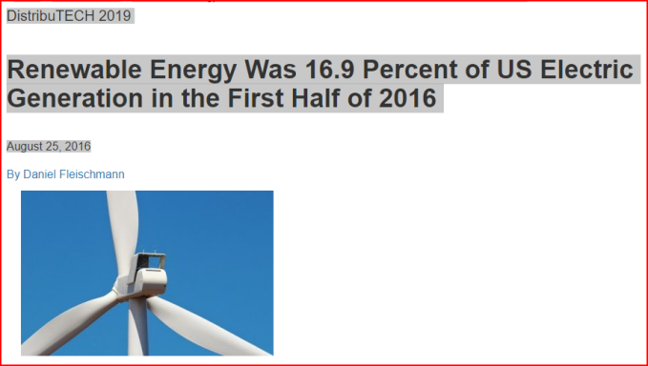
Renewable Energy News & Information
Interesting site though I’m not familiar
  https://www.renewableenergyworld.com/index.html
  https://www.renewableenergyworld.com/articles/2016/08/renewable-energy-was-16-9-percent-of-u-s-electric-generation-in-the-first-half-of-2016.html
It’s happening: 17% and growing and economically

Slide 42
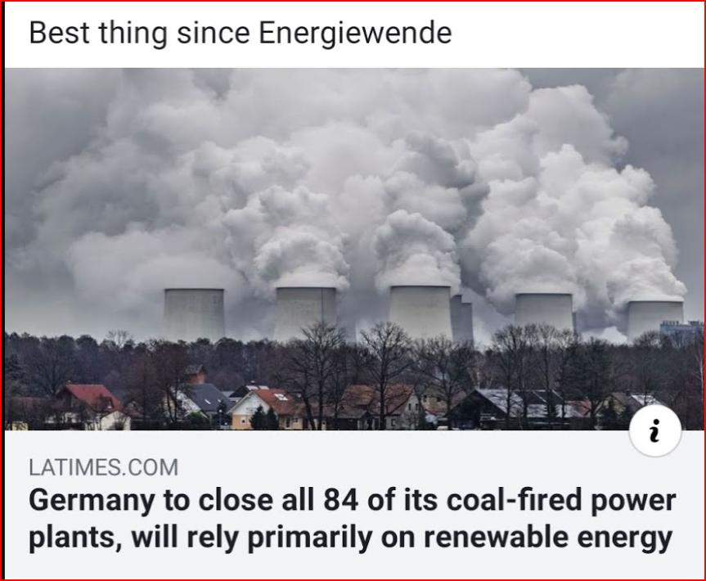

Slide 43
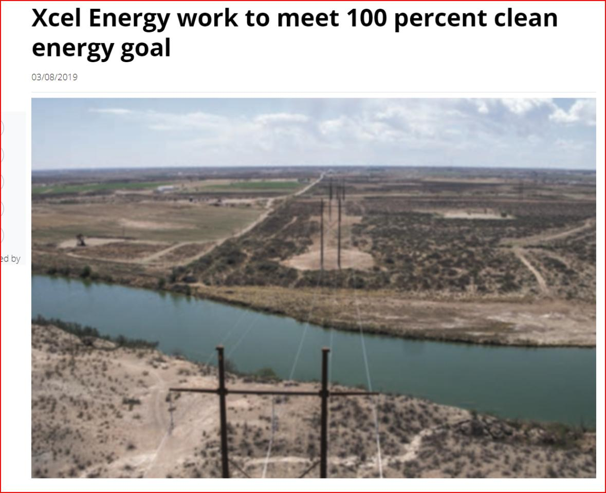
https://www.elp.com/articles/2019/03/xcel-energy-work-to-meet-aggressive-clean-energy-goal.html

Slide 44
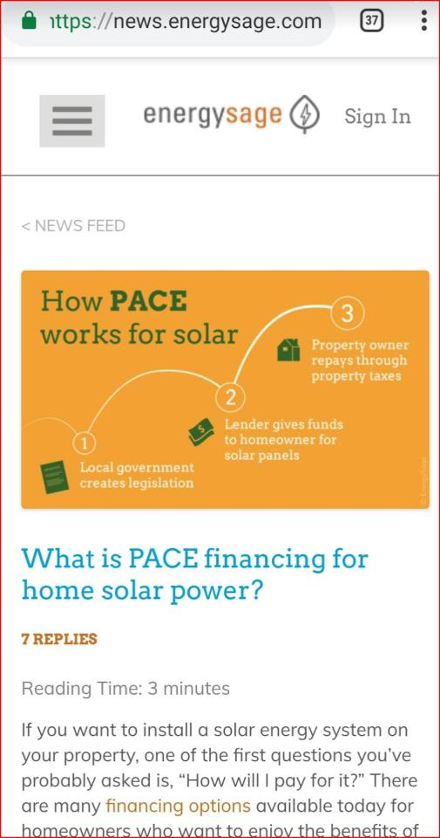
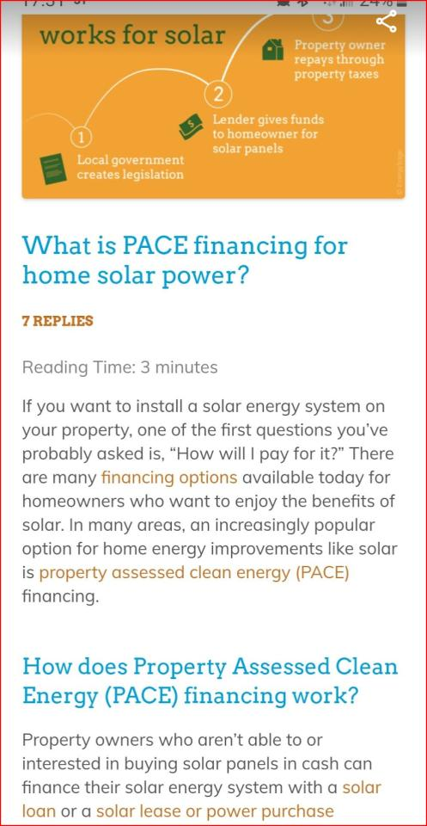

Slide 45
More on what WE as society and what YOU as a person can do
FIRST – NEED TO CHANGE OUR THINKING ON THE ECONOMY
DECARBONIZING ENERGY GENERATION: WIND and SOLAR
  PERSONAL
  COMMERCIAL/NON-PROFIT
DECARBONIZING TRANSPORTATION
WHY IT’S NOT ENOUGH – WE NEED TO TAKE OUT (SEQUESTER):
  SOIL RESTORATION
  BIOCHAR
  OTHER

Slide 46
DECARBONIZING TRANSPORTATION
LINKS - posted at bottom of OLLI page:
2018 NOTES AND INFORMATION: By Don Sorenson:
  EV Poster Page 1
  EV Poster Page 2
  Solar Vs Coal
From David McNeil DEVC,INFO
  The State of United States
From COSEIA CONFERENCE – PANELISTS
  SPMW cbr 031218
OTHER:
  PlugInAmericaFlier
  gas-vs-solar-ev-charging-2017

Slide 47
DECARBONIZING TRANSPORTATION
LINKS - posted at bottom of OLLI page: continued
Prior notes/posts:
SLIDES FROM CURRENT EVENTS 2/13/2018: China takes pole position on EVs and renewables
MORE ON EVS and SUSTAINABILITY:
  SustainabilityPresentation – Jim Smith
  Best Energy Retrofit – by John Avenson: avenson.net/
  Denver Electric Vehicle Council: devc.info
  COLORADO EV PLAN (THIS LINK WORKS!): Colorado EV PLAN January_2018.pdf
  OTHER EV links (thanks Don Sorenson):
    Refuel Colorado for Colorado State EV info
    National Drive Electric Week
    Plugin America
    Forth (EV promotion link in Portland)
    Electrification Coalition

Slide 48
DECARBONIZING TRANSPORTATION
LINKS - posted at bottom of OLLI page: continued:
The following links are from a GREAT DECISIONS slide presentation I embellished on on 1/31/2018 discussing China. Slides include references and links below:
  China takes pole position on EVs and renewables
  Time Mag china takes the pole position
  China Catching Up to United States in Research and Development – Eos
  Amory Lovins slides Oct 6 2017 – Large file
  The Gasoline-Powered Automobile Is Obsolete – New Version

Slide 49
We can Invest in Solar Panels or Community Solar
AN INVESTMENT - Here’s why:
  A personal story
  SPENT:
    $30,000 (excluding 30% fed credit) for 30 panels (rounding out cost)
  RETURN:
    Saved $1000 in electricity for 1 year
    With my Leaf – powered by solar panels I drove 14,000 miles replacing a car 25mpg say $2.50 / gallon = i.e. I did NOT spend $1,400 on gasoline
    RETURN $2,400 in ONE year on $30,000 investment! = 8%
    NOW INCLUDING THE 30% FED TAX CREDIT = 11.4%

Slide 50
Buy and Electric Vehicle (EV)
100 mpg equivalent
Batteries > 100,000 miles
Motor 1,000,000 miles
No oil change EVER
No maintenance
Why Gasoline Powered Cars Are Obsolete - Jim Smith https://www.youtube.com/watch?v=d7tRlsoZgdI

Slide 51
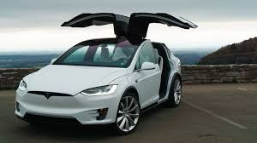
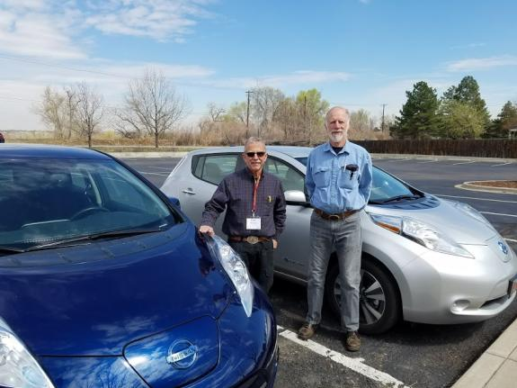
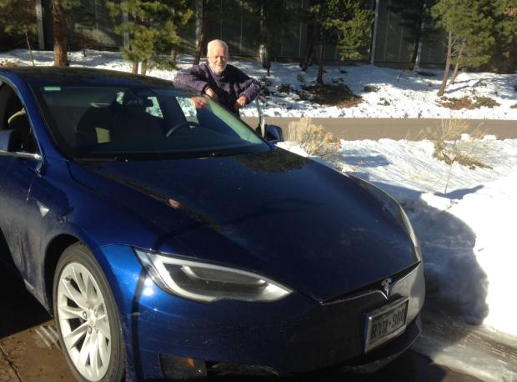
EVs no Emissions
Steve Stevens with Tesla X
90 kWh = 300 mile range
Paul Belanger & Phil Nelson with their Nissan Leafs
30 kWh = 107 mile range
Ron Larson with Tesla S
75 kWh = 250 mile range

Slide 52
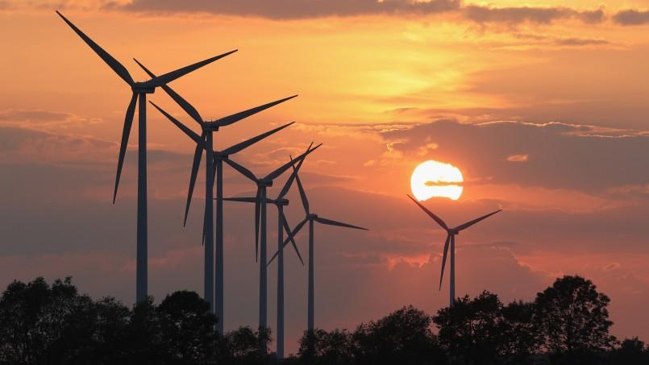
Imagining a World After Fossil Fuels
https://skepticalscience.com/How-Green-is-My-EV.html
https://www.stratfor.com/weekly/imagining-world-after-fossil-fuels

Slide 53
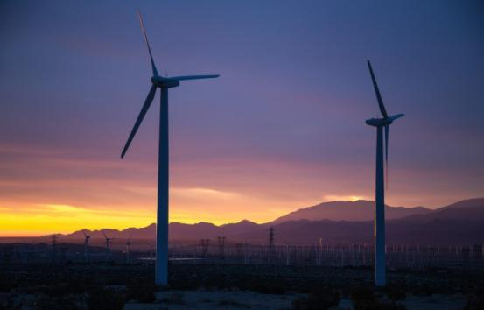
BREATHE EASY:
COAL is not coming back
Renewables win!
RENEWABLES are cheaper!
  Wind especially
  PV next – but will become even cheaper
  Battery backup
  Concentrated Solar Power for Thermal backup
http://www.coloradoindependent.com/164687/bill-ritter-colorado-clean-energy-trump-coal

Slide 54
AN IMPORTANT MESSAGE IN GOING SOLAR AND ELECTRIC VEHICLES
IF HAVE A 2ND CAR PLEASE make it an EV – it makes economic sense as well as the right thing to do!
Debunk: Too Long to Reach Breakeven

Slide 55
More on what WE as society and what YOU as a person can do
FIRST – NEED TO CHANGE OUR THINKING ON THE ECONOMY
DECARBONIZING ENERGY GENERATION: WIND and SOLAR
  PERSONAL
  COMMERCIAL/NON-PROFIT
DECARBONIZING TRANSPORTATION
WHY IT’S NOT ENOUGH – WE NEED TO TAKE OUT (SEQUESTER):
  SOIL RESTORATION
  BIOCHAR
  OTHER

Slide 56
Why it’s not enough – links to slides from March 26th, 2018
MONDAY March 26TH: CO2 Removal and Nature Conservancy presentation by Betsy Neely + What is and the Need for Biochar by Paul Belanger
Part A: Why PRICING IS NOT ENOUGH & WHY WE NEED SEQUESTRATION! – Paul Belanger
  Pptx: TROUBLE LOADING contact me pebelanger@glassdesignresources.com if copy desired
  Pdf: 2018.03.26 Belanger-why pricing is no enough EEEF
Part C: Biochar and Related Soil Restoration Solutions: Paul Belanger & Ron Larson
  Pptx: 2018.03.26 Belanger-Larson Biochar EEEF
  Pdf: 2018.03.26 Belanger-Larson Biochar EEEF
For more on Biochar see updated Biochar Page: https://denverclimatestudygroup.com/?page_id=28
Leading web page: International Biochar Initiative: http://www.biochar-international.org/
https://denverclimatestudygroup.com/?page_id=683

Slide 57
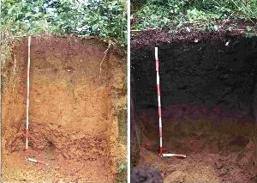
Biochar
Definition: https://en.wikipedia.org/wiki/Biochar
Biochar tab: http://denverclimatestudygroup.com/?page_id=28

Slide 58
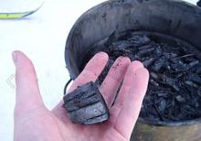
Carbon Dioxide Removal (CDR)
https://en.wikipedia.org/wiki/Biochar:
“Biochar is charcoal used as a soil amendment. Like most charcoal, biochar is made from biomass via pyrolysis. Biochar is under investigation as an approach to carbon sequestration to produce negative carbon dioxide emissions.^{[1]} Biochar thus has the potential to help mitigate climate change via carbon sequestration.^{[2][3]} Independently, biochar can increase soil fertility ofacidic soils (low pH soils), increase agricultural productivity, and provide protection against some foliar and soil-borne diseases.^{[4]} Furthermore, biochar reduces pressure on forests.^{[5]} Biochar is a stable solid, rich in carbon, and can endure in soil for thousands of years.^{[1]”}

Slide 59

Cool Planet - @ 9:00 minutes
https://youtu.be/JPJsYZLU_sM?t=535

Slide 60
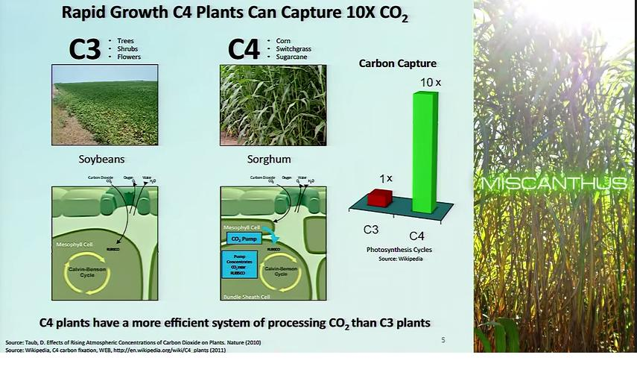
Following slides from Cool Planet Video
https://youtu.be/JPJsYZLU_sM?t=535

Slide 61
Types of Photosynthesis
About C3, C4 and Cam Photosynthesis and Plants:
Photosynthetic efficiency: http://en.wikipedia.org/wiki/Photosynthetic_efficiency
C3 carbon fixation: http://en.wikipedia.org/wiki/C3_carbon_fixation
C4 carbon fixation:http://en.m.wikipedia.org/wiki/C4_carbon_fixation
Summary table comparison: http://www.cropsreview.com/types-of-photosynthesis.html
C3 C4 CAM Photosynthesis video: https://www.youtube.com/watch?v=Yg_pdXzWXVA

Slide 62
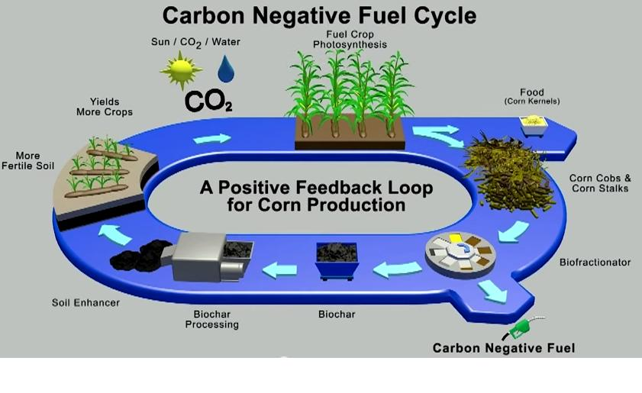
Carbon negative fuel cycle: Biochar and Biofuels
https://youtu.be/JPJsYZLU_sM?t=535

Slide 63
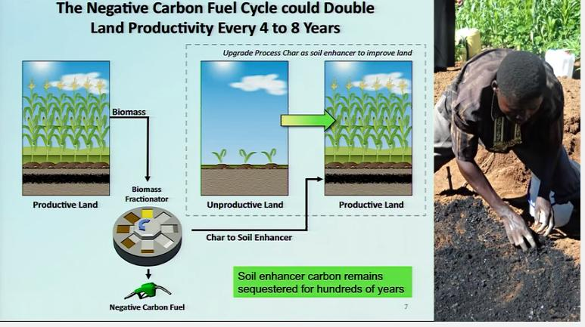
Soil Enhancement
https://youtu.be/JPJsYZLU_sM?t=535

Slide 64
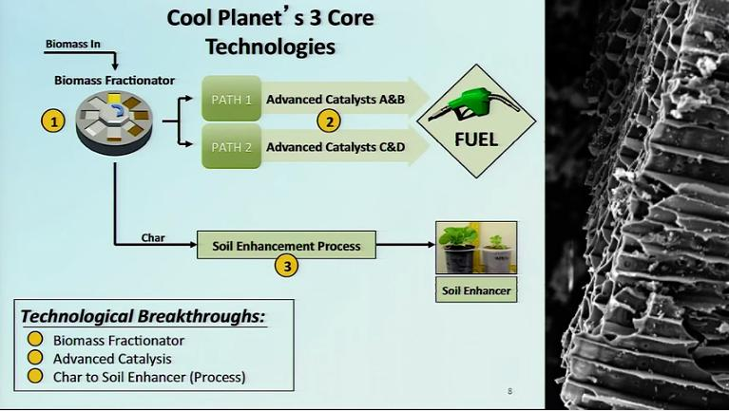
Core Technologies:
https://youtu.be/JPJsYZLU_sM?t=535

Slide 65
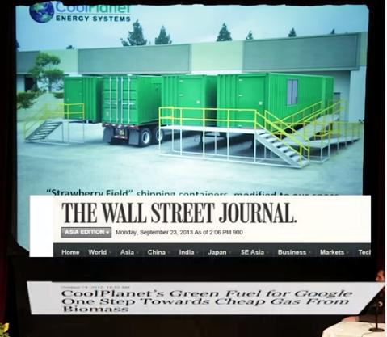
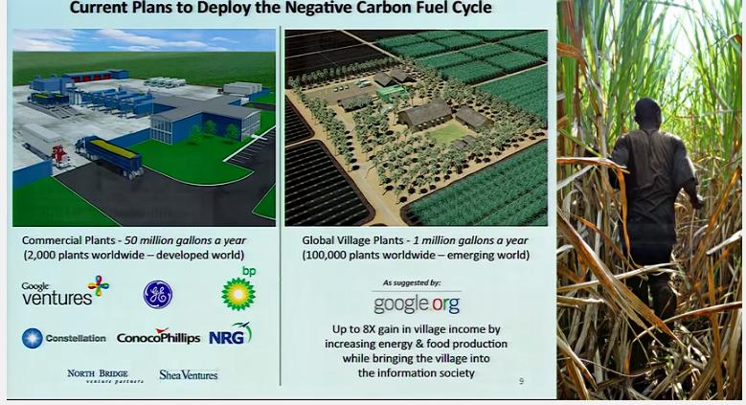
Sponsorships
https://youtu.be/JPJsYZLU_sM?t=535

Slide 66
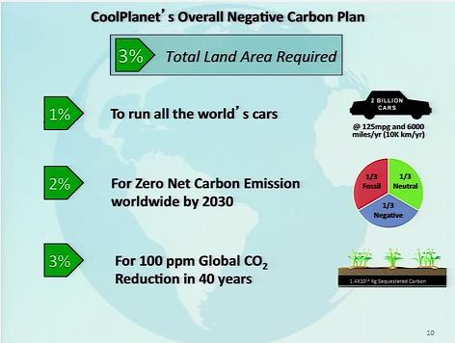
CARBON NEGATIVE BENEFITS:
- Sequester CO2
- create Biofuels
https://youtu.be/JPJsYZLU_sM?t=535

Slide 67
BIOCHAR
Ron Larson Presentation MAY 15TH to OLLI West class:
  BIOCHAR: POLICY AND COMPETION: http://denverclimatestudygroup.com/wp-content/uploads/2014/07/Larson-biochar-PART-B-BIOCHAR2017.pdf

Slide 68
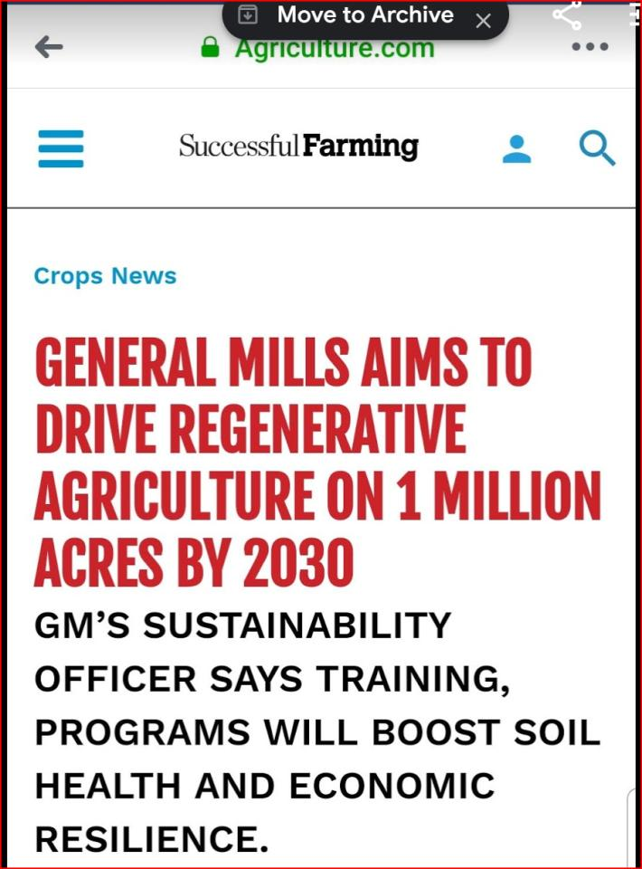

Slide 69
Bio-energy with carbon capture and storage
(BECCS)
Bio-energy with carbon capture and storage
https://en.wikipedia.org/wiki/Bio-energy_with_carbon_capture_and_storage

Slide 70
OTHER - EXTRAS
Efficiency – the single quickest way to reduce:
  What NREL is doing: Efficiency, Solar, wind, other
Other strategies:
  CCL – carbon fee/dividend
  Cap and trade?
Gloom and Doom? NO! IT’S A CHALLENGE, and humanity has always been challenged and we are an adaptable species that has met the challenge over and over again!

Slide 71
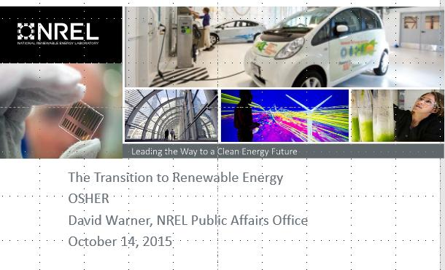
National Renewable Energy Lab: NREL
http://www.nrel.gov/
Go to this 74 slide presentation: TRANSITION TO RENEWABLE ENERGY: OSHER 10.14.15

Slide 72
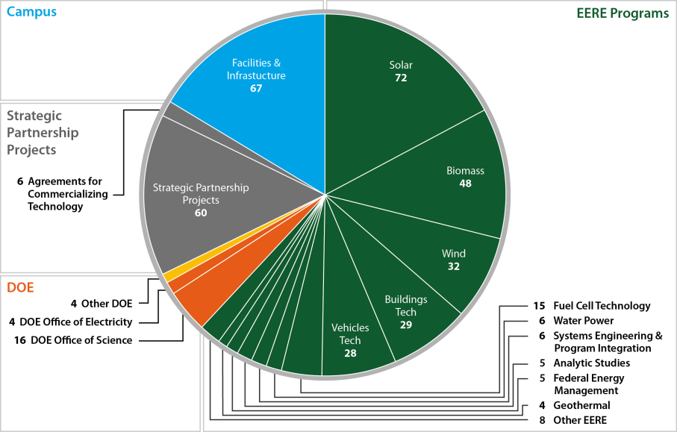
See What DOE’s National Renewable Energy Lab (NREL) is Doing!
Go to this 74 slide presentation: TRANSITION TO RENEWABLE ENERGY - OSHER 10.14.15

Slide 73
SOLUTIONS
Carbon fee/dividend:
citizensclimatelobby.org/ccl-applauds-republican-resolution-calling-for-action-on-climate-change/
http://citizensclimatelobby.org/
Facebook:
  CCl – national: https://www.facebook.com/CitizensClimateLobby/?fref=ts
  CCL-Colorado: https://www.facebook.com/CitizensClimateLobbyDenverChapter/

Slide 74
IN SUMMARY
The world has been getting better
Changes are happening; WE NEED TO CHANGE:
  25+ Ways to Reduce Your Carbon Footprint: http://cotap.org/reduce-carbon-footprint/
We need to support science and new technologies

Slide 75
DON’T FORGET WEEK 6 SLIDES AND LINKS:
Week 6 (2/28): Solutions; part A
PDF SLIDES: OLLI East week 6 slides final

Slide 76


READ:
Climate of Hope – Solutions
Drawdown – and associated web pages

Slide 77
Drawdown
http://www.drawdown.org/solutions-summary-by-rank
Drawdown video: 60 minutes with Paul Hawken: https://youtu.be/4XrFnK1RrLE

Slide 78
Colorado Renewable Energy Society – YouTube of selected talks:
Drawdown CRES YouTube video: Drawdown: Ways out of the Climate Crisis. Paul Hawken, Chip Comins: https://youtu.be/4XrFnK1RrLE
Other Drawdown links:
  http://www.drawdown.org/
  http://www.drawdown.org/solutions
  https://www.facebook.com/projectdrawdown
http://www.drawdown.org/solutions-summary-by-rank

Slide 79
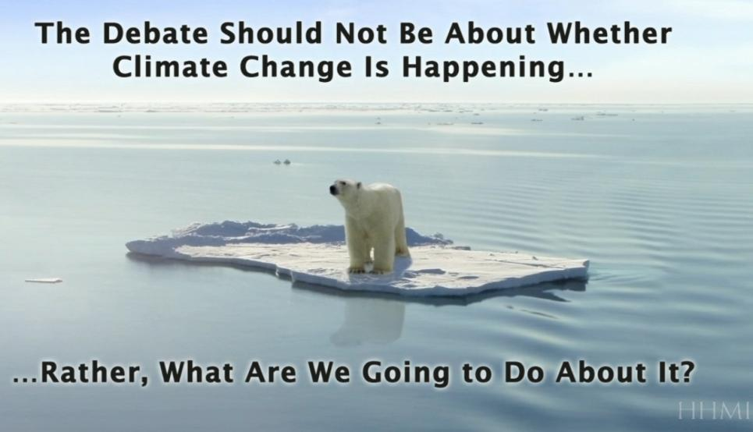
http://media.hhmi.org/hl/12Lect4.html

Slide 80

Doing something every day can be profoundly helpful in giving people hope, and it’s a path to change.
CLICK HERE:
https://www.yesmagazine.org/planet/how-to-not-be-completely-depressed-about-climate-change-20190107?fbclid=IwAR177qhNTknD9K0-kfIZmj9G9pKmzdPGSti2fEcQ3DITEAKxrA_R0Wm8ac0

Slide 81
