Slide 1
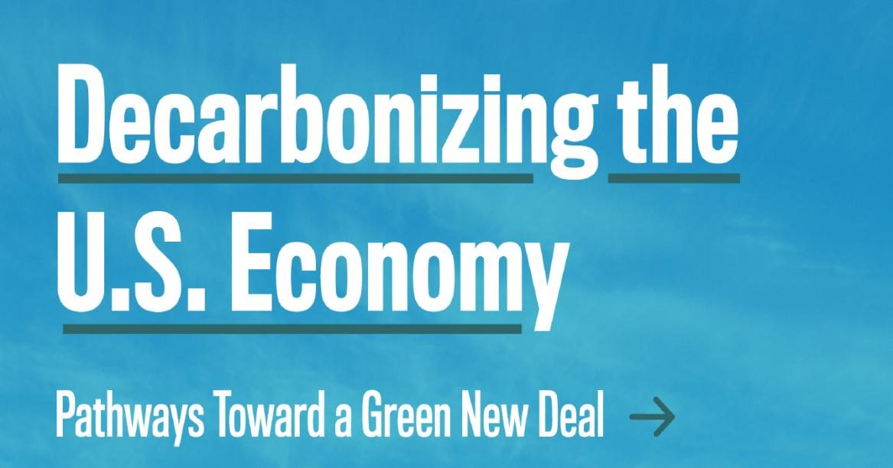
A Roosevelt Institute report written by:
Mark Paul
Anders Fremstad
J.W. Mason

Slide 2
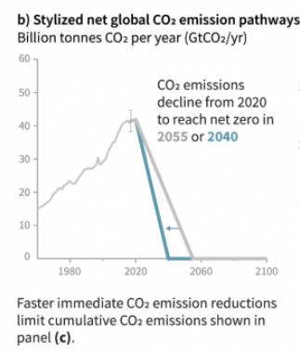
The climate crisis

Slide 3
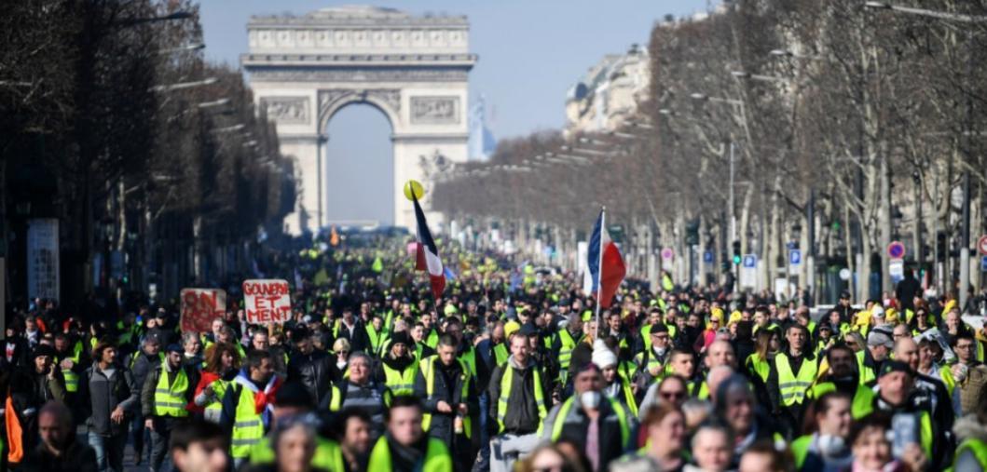
The inequality crisis

Slide 4
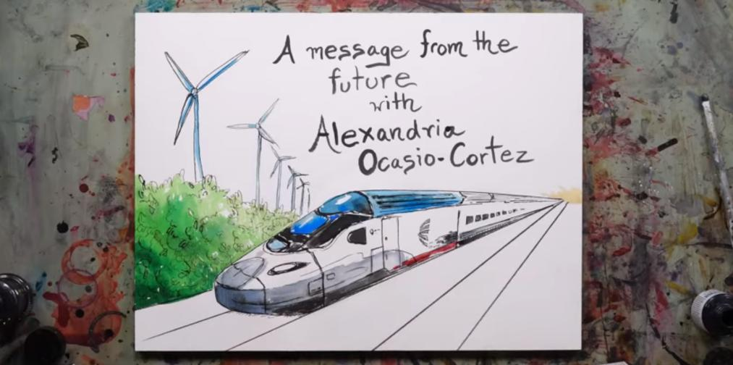
A Green New Deal

Slide 5
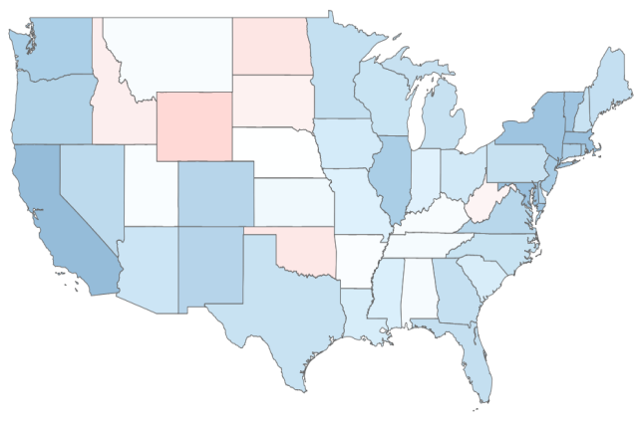
Public support for a Green New Deal
“Democrats say this would improve the economy by giving people jobs, fight climate change and reduce pollution in the air and water.
Republicans say this would cost many jobs in the energy sector, hurt the economy by raising taxes, and wouldn't make much of a difference because of carbon emissions from China.
Do you support or oppose this policy?”
“Some Democrats in Congress are proposing a Green New Deal bill which would phase out the use of fossil fuels, with the government providing clean energy jobs for people who can’t find employment in the private sector. All jobs would pay at least $15 an hour, include healthcare benefits and collective bargaining rights. This would be paid for by raising taxes on incomes over $200,000 dollars a year by 15 percentage points.”
Data for Progress, February 2019

Slide 6
Public support for a Green New Deal
A Green New Deal is about as popular as
Providing a pathway to citizenship
legalizing cannabis
It is also much more popular than:
Rejoining the Paris climate agreement
Adopting a carbon tax
But a Green New Deal remains poorly defined.
NPR/Maris Poll, July 2019

Slide 7
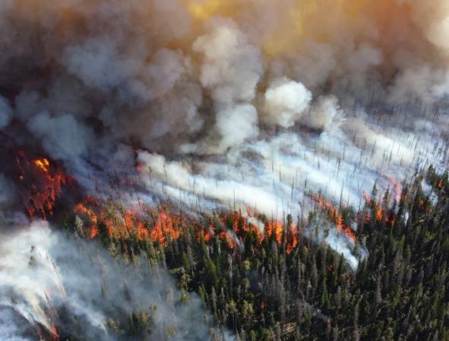
Framework for a Green New Deal
We propose three pillars to ambitious climate policy
Carbon dividend
Regulation
Carbon neutral building codes
Electric vehicles mandate
Public investment
Expand mass transit
Build a high-capacity national grid
Retrofit existing buildings
Pay farmers to capture carbon
Expand federal R&D
Direct credit to green businesses
Carbon dividends, regulation, and public investments are complements, not substitutes.
A Green New Deal will be less expensive than inaction.

Slide 8
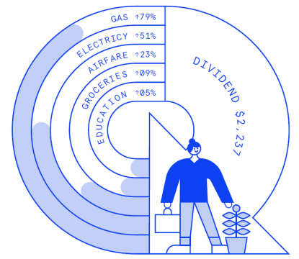
The economic case for a carbon dividend
$
$800
WTP
$200
$900b
$150b
Fremstad and Paul, 2018, “Disrupting the Dirty Economy.” People’s Policy Project.
4.5b
6b
tCO2

Slide 9
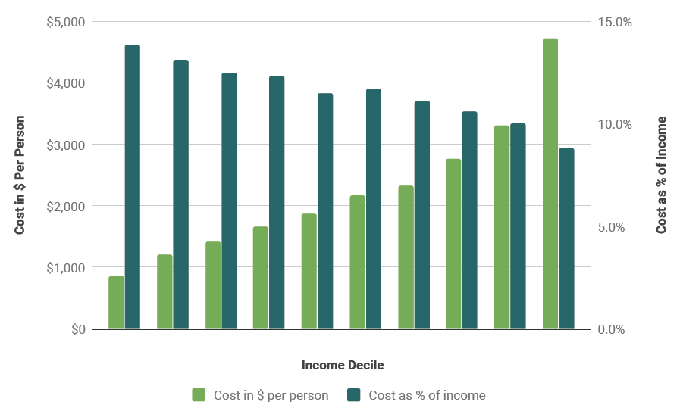
A carbon tax is regressive

Slide 10
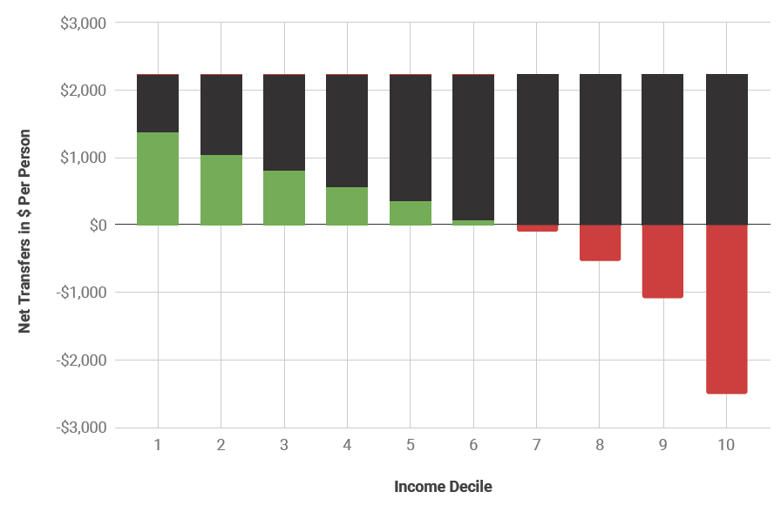
A carbon dividend is progressive

Slide 11
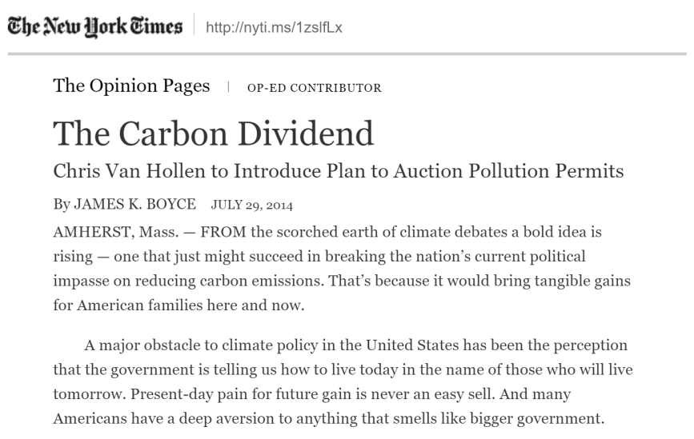

Slide 12
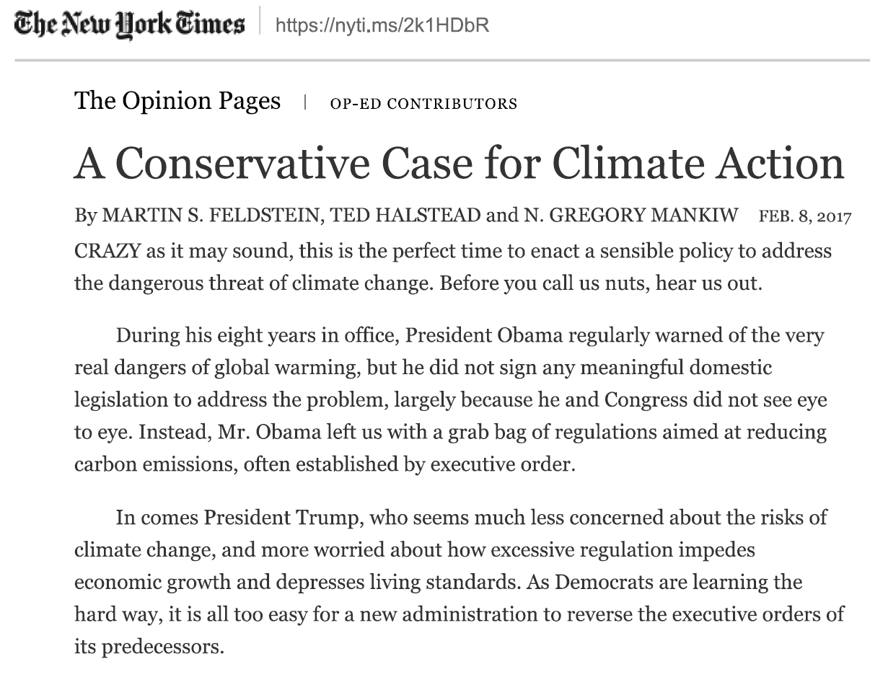
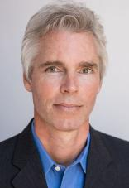

Slide 13
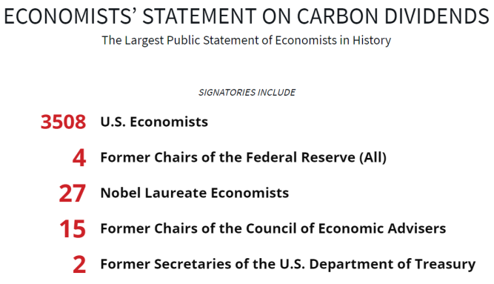
Economists’ support for a carbon dividend
“A sufficiently robust and gradually rising carbon tax will replace the need for various carbon regulations that are less efficient. Substituting a price signal for cumbersome regulations will promote economic growth and provide the regulatory certainty companies need for long- term investment in clean-energy alternatives.”
“To maximize the fairness and political viability of a rising carbon tax, all the revenue should be returned directly to U.S. citizens through equal lump-sum rebates. The majority of American families, including the most vulnerable, will benefit financially by receiving more in “carbon dividends” than they pay in increased energy prices.”
“A carbon tax offers the most cost-effective lever to reduce carbon emissions at the scale and speed that is necessary. By correcting a well-known market failure, a carbon tax will send a powerful price signal that harnesses the invisible hand of the marketplace to steer economic actors towards a low-carbon future.”
https://www.clcouncil.org/economists-statement/

Slide 14
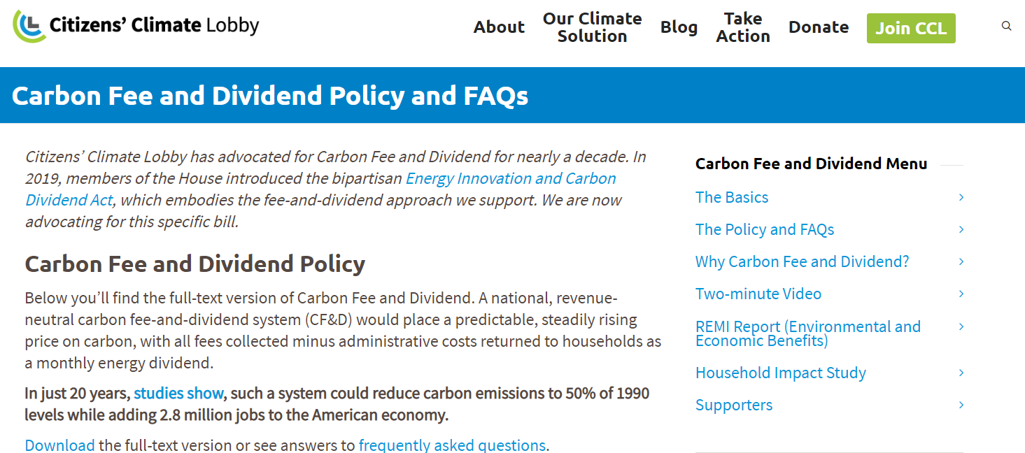
The movement for a carbon dividend

Slide 15
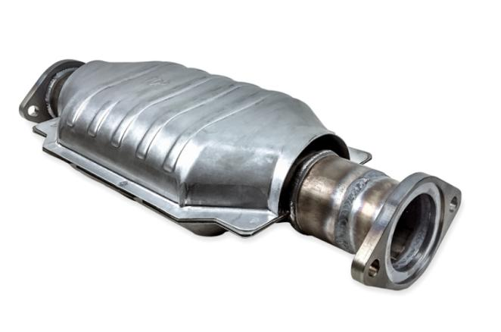
Case for regulations
In the idealized world of economic models, pricing carbon is a panacea that aligns self-interest with public good.
The actual economy is characterized by imperfections, including:
bounded rationality
asymmetric information
economies of scale
coordination problems
Regulations can be cheaper and more effective than pricing.
Technology mandates
Corporate Average Fuel Economy (CAFE)
In 1975, the EPA required new cars to be equipped with catalytic convertors, which reduce CO emissions by 90%.

Slide 16
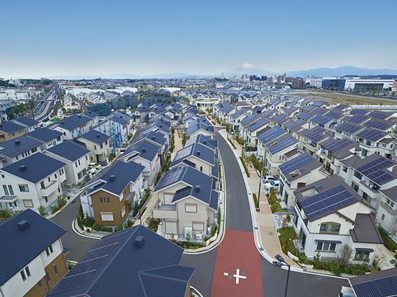
Carbon neutral building codes
Buildings account for 39% of GHG emissions.
Investments in energy efficiency payoff over the long run:
LEED and Energy Star
Voluntary certification increases rent.
Builders and landlords underinvest in energy efficiency.
By 2025, new buildings should:
Meet high energy efficiency standards
Rely entirely on electric power
Be accessible by green transportation
All new homes in California must have rooftop solar by 2020.

Slide 17
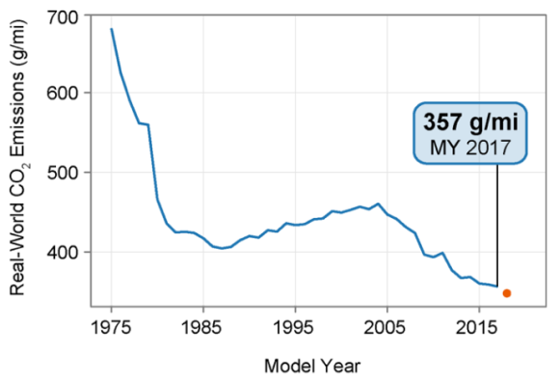
Electric vehicles mandate
Transportation accounts for 28% of emissions.
Investments in EVs will pay off in the long run.
EVs are simpler to maintain.
The average vehicle runs 11 years, but buyers underinvest upfront.
EV statutes are spreading
California requires 8% EVs by 2025.
Norway seeks 100% EVs by 2025.
The federal government should adopt and EV mandate
Increase EV’s market share over time.
100% EVs by 2030.
Corporate Average Fuel Ecoomy (CAFÉ) standards dramatically decreased emissions when we use them.

Slide 18
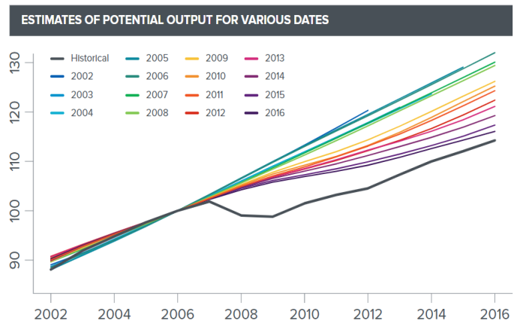
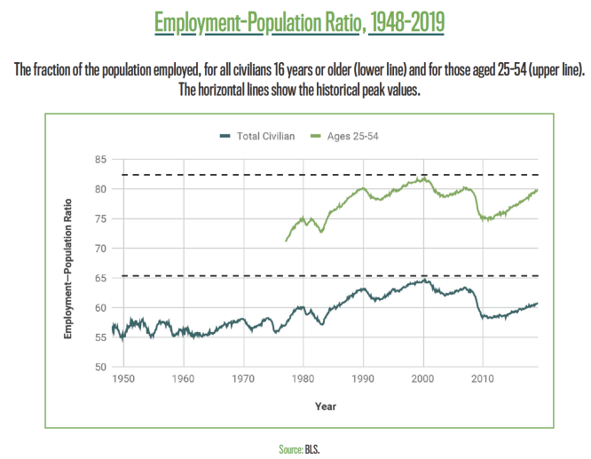
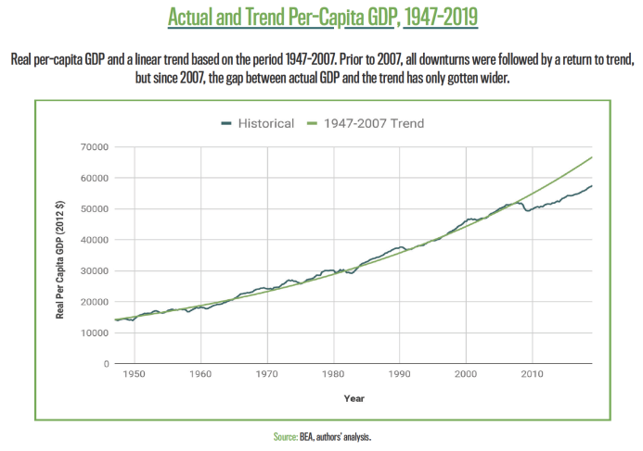
Case for public investment
Public spending is necessary for public alternatives to carbon-intensive economy:
Economies of scale
Coordination problems
Public investment can be financed in part through:
Financial transactions tax (0.5%)
Wealth tax (2-3% over $10m)
Progressive income taxes
Macroeconomic conditions are also good for deficit spending.
Unemployment is 3.7%...
…but labor force participation is still down 2% among prime age adults
Wages are stagnant
Inflation is below target
Output gap is about 10% of GDP
Josh Mason, “What Recovery?”, Roosevelt Institute, 2017.

Slide 19
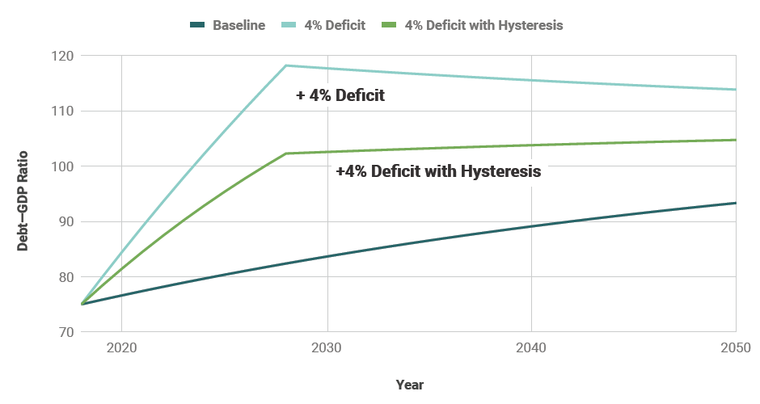
Case for deficit spending
Macroeconomy could support deficit spending of 4% of GDP
About $800b annually.
Future debt/GDP ratio given current interest rates, growth rates and primary deficit.
Baseline under BAU.
10 years of additional deficit spending equal to 4 percent of GDP.
10 years of additional deficit spending with the assumption that each point of government spending raises potential GDP by half a point.

Slide 20
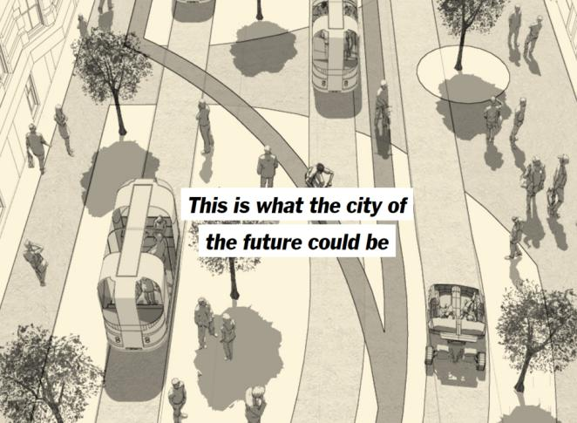
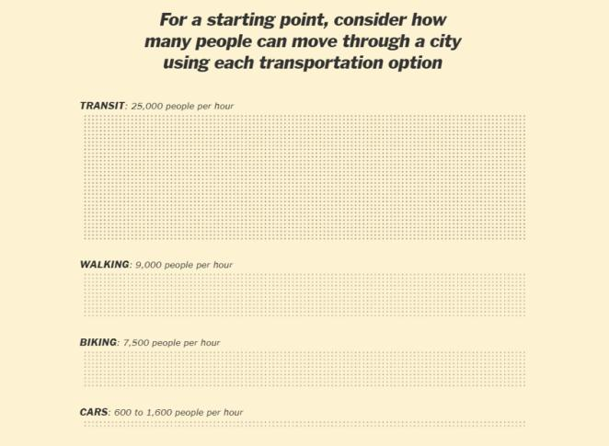
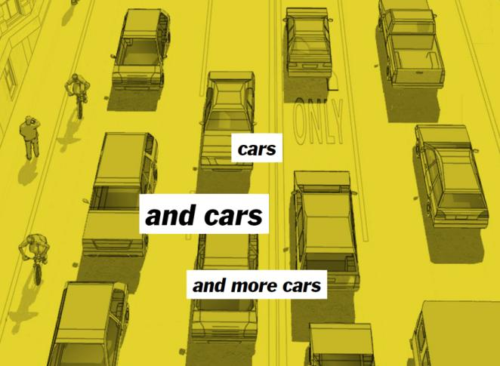
Expand mass transit
Our car based transportation system:
Generates 28% of emissions.
Costs government $200b for roads.
Costs households $1.1t for vehicles.
Leaves vehicles idle 96% of the time.
Causes congestion and deaths.
Mass transit + EVs + ridesharing + active transit would (UC Davis):
Reduce emissions by 80%.
Cost less than BAU.
Public investments should
Replace $18b in fares
Electrify existing systems
Expand capacity and establish new systems
Make decarbonized transit the first best option
Allison Arieff et al, New York Times, February 27, 2018.

Slide 21
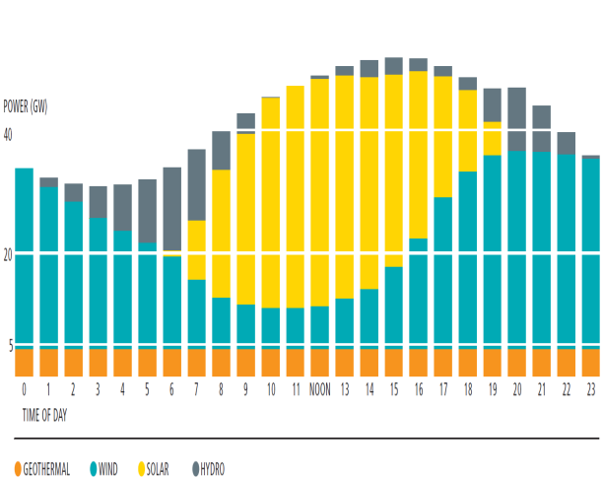
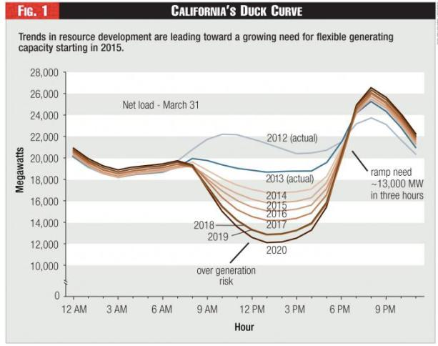
Build a high-capacity national grid
The electricity sector generates 28% of emissions.
100% renewable electricity is relatively low-hanging fruit
Carbon price (or RPS) works
Sunrise/sunset; wind patterns
An $80b high-capacity national grid would:
Link our separate grids
Reduce need for storage
Pay for itself (NREL)
Require federal funding
We need to store and move renewable energy.

Slide 22
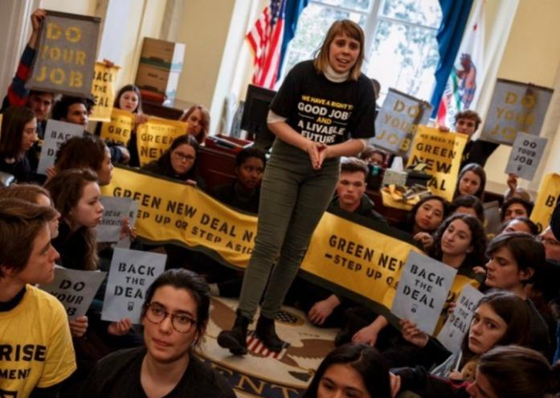
Conclusion
Averting catastrophic climate change requires rapid decarbonization.
Our framework for a Green New Deal is built on:
Carbon dividends
Regulation
Public investment
The case for a GND is particularly strong given historically slow rate of economic growth.

