Slide 1
Citizens Climate Lobby (CCL) – WA, 2nd district, Whidbey Island
The Case for Soil Restoration
with the Use of Biochar
Paul E Belanger, Geologist, Ph.D.
pebelanger@glassdesignresources.com
12/14/2019
See BIOCHAR PAGE:
https://denverclimatestudygroup.com/?page_id=28

Slide 2
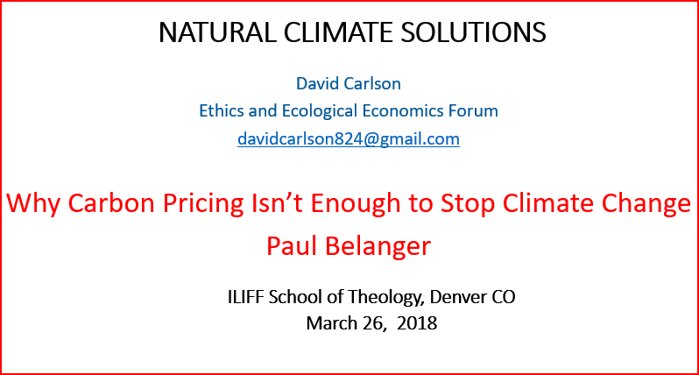
A Synthesis from 2 talks
Notes:
Following Gary regarding land use impacts I wish to follow up on how soil restoration particularly with the use of Biochar can help our climate emergency in the way of sequestering carbon for 100 of years.

Slide 3
If you are Wondering WHY
Decarbonizing energy, transportation, manufacturing is NOT going to happen fast enough
Because pricing won’t stop carbon emissions fast enough
Ocean acidification
Extreme weather events are going to become even more extreme and/or frequent
…etc…

Slide 4
THUS IT’S FOR CLIMATE MITIGATION IN THIS CASE CARBON SEQUESTRATION!

Slide 5
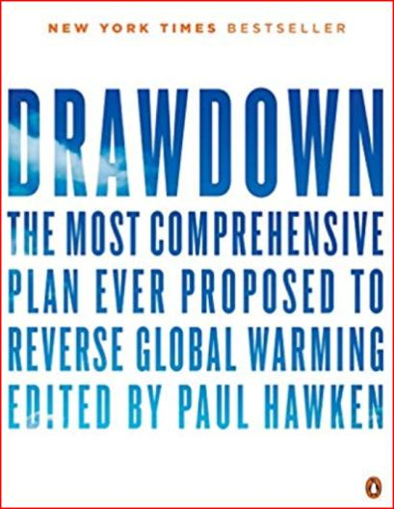
Popular Book by Paul Hawken (editor) DRAWDOWN

Slide 6
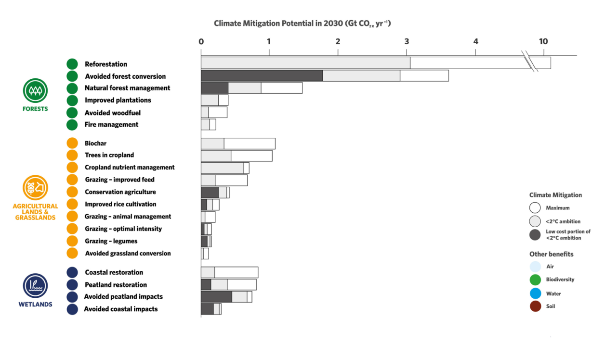
FOR CLIMATE MITIGATION
Here too:
VERY conservative
Here too:
https://ibi.memberclicks.net/return-to-member-landing-page

Slide 7
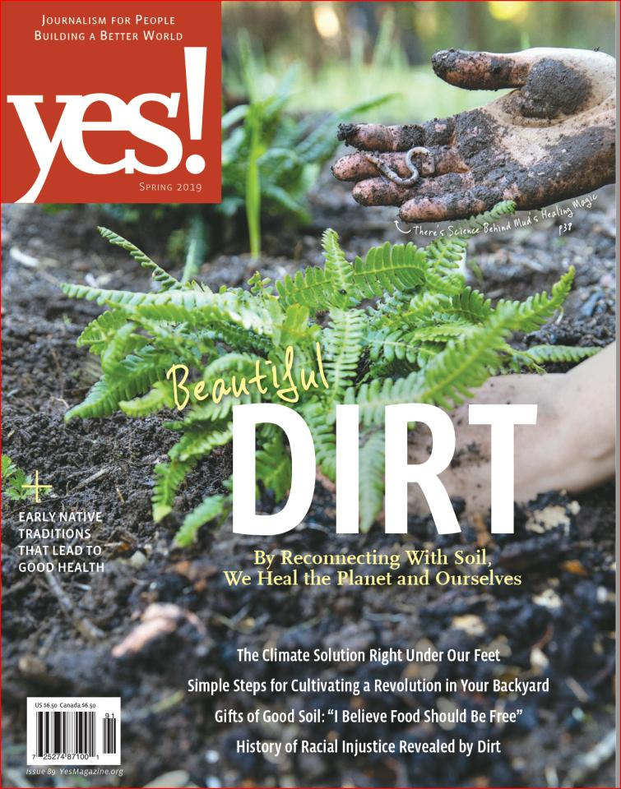
PROMOTES SOIL RESTORATION
INCLUDES BIOCHAR BENEFITS
SOMEWHAT NEGLECTS CARBON SEQUESTRATION

Slide 8
So, What is Biochar?
1. Main: Biochar is “ordinary” charcoal - after placement in the ground. (Not for combustion.)
2. Also - dozens of other [long-life] uses of charcoal (cattle feed, water quality, construction materials,……)
3. Terra Preta (1000’s of years, Amazon)

Slide 9
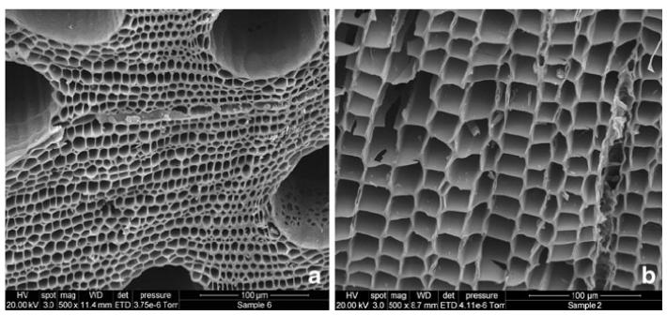

Slide 10
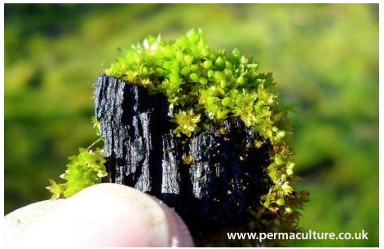

Slide 11
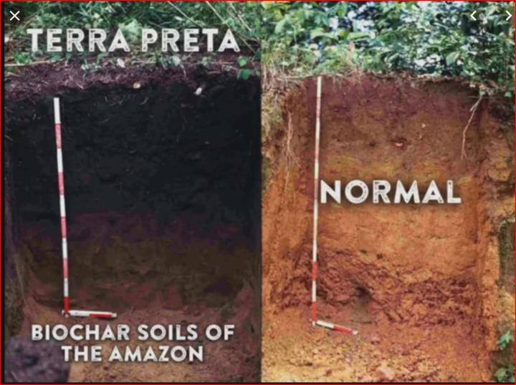
Buried in the Soil it looks like this:

Slide 12
Why is BIOCHAR Important ?
Carbon negativity (CO2, CH4, N2O) - How?
Fossil fuels are carbon positive; they add more carbon dioxide (CO₂) and other greenhouse gasses to the air and thus exacerbate global warming.
Compost and Ordinary biomass fuels are carbon neutral; the carbon captured in the biomass by photosynthesis would have eventually returned to the atmosphere through natural processes like decomposition.
Sustainable biochar systems can be carbon negative by transforming the carbon in biomass into stable carbon structures in biochar which can remain sequestered in soils for hundreds and even thousands of years. The result is a net reduction of CO₂ in the atmosphere, as illustrated in the diagram.
http://www.biochar-international.org/biochar/carbon

Slide 13
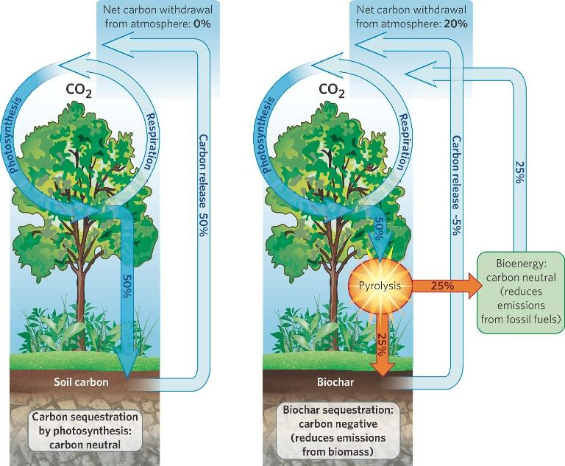
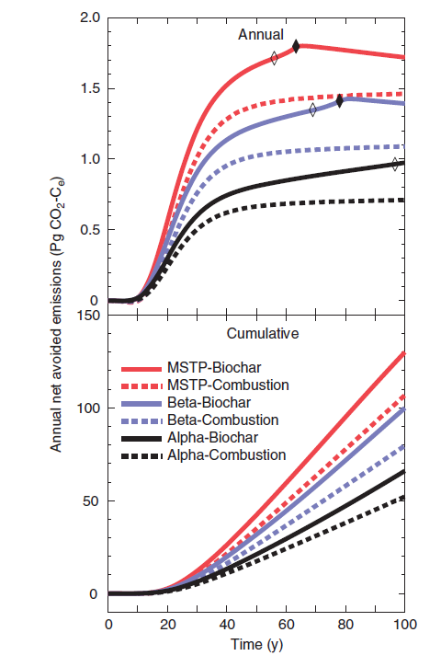
Carbon Neutral
Carbon Negative
http://www.biochar-international.org/biochar/carbon

Slide 14
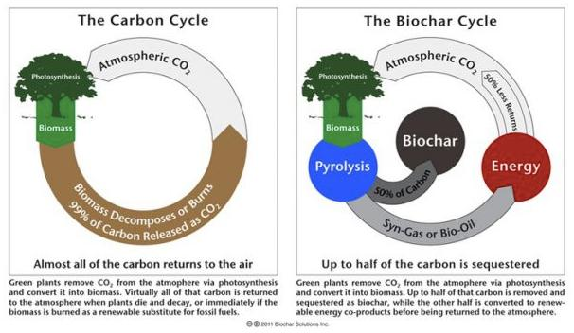

Slide 15
Advantages
Soil & Food (long life in soil, not an expense)
Carbon negativity (CO2, CH4, N2O)
Energy (solar & woodstove backup, stored energy)
Water quantity/quality
Waste disposal (biogas competitor)
Lowered fertilizer, irrigation costs
Jobs, rural income (and land value)
Forest health (Fires)
Ocean and HTC potential
Other (including sustainability)

Slide 16
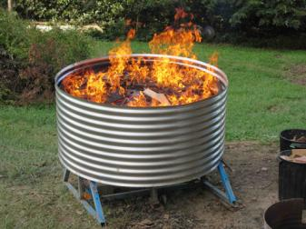
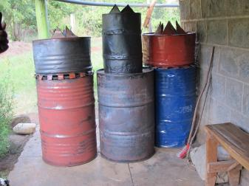
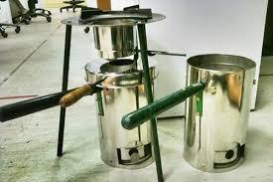
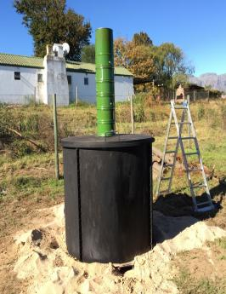
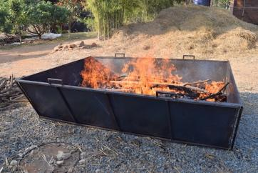
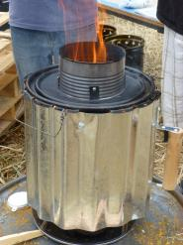
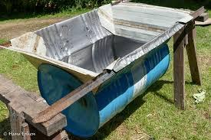
Flame Cap/TLUD? Don’t Flame Caps and TLUDs Function Differently? Ethos/2019 Norman T. Baker
Examples
Slide courtesy of Norm Baker

Slide 17
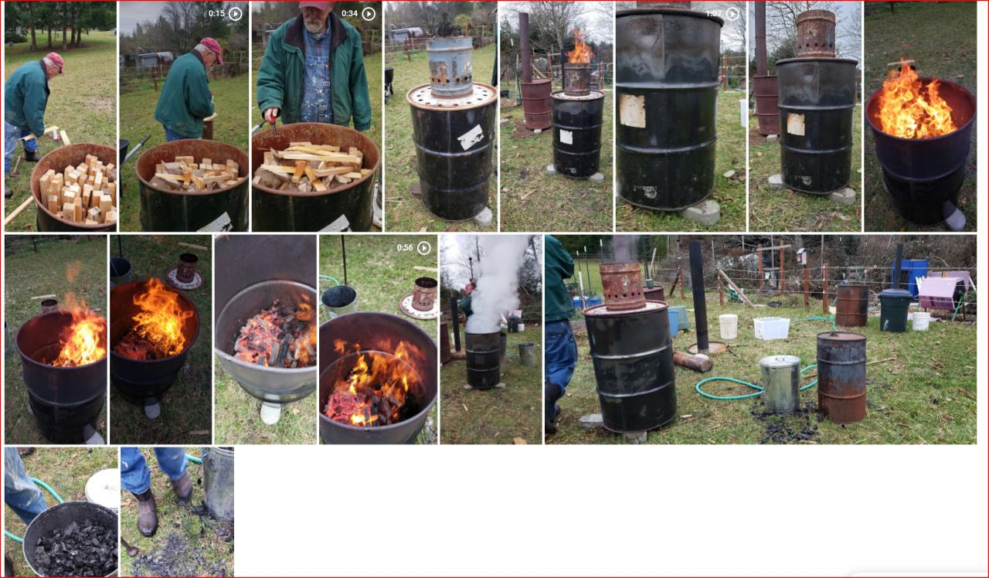

Slide 18
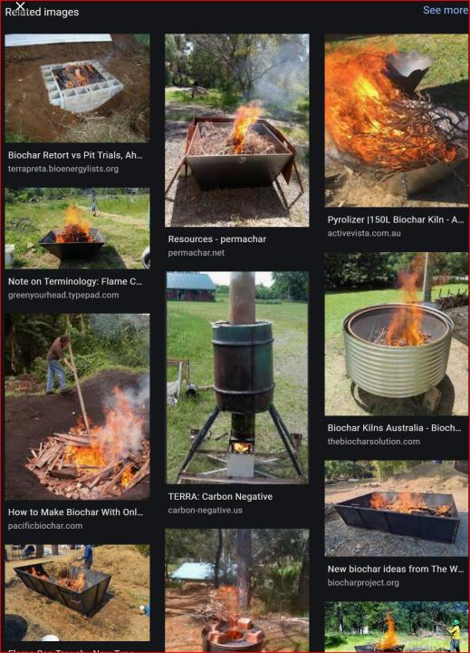

Slide 19
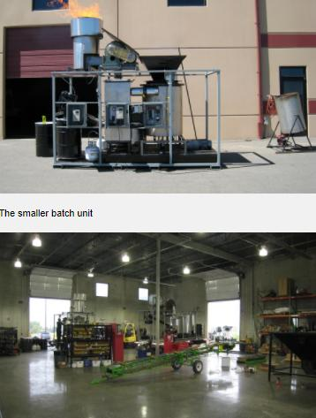
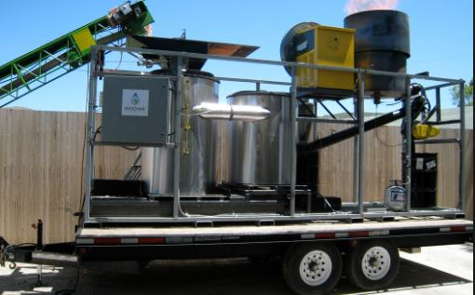
Mobile units:

Slide 20
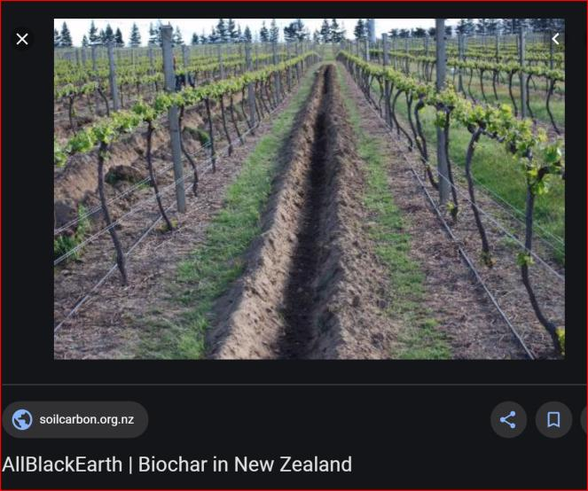
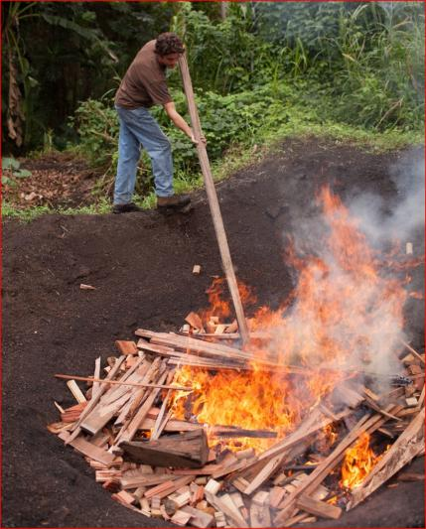
To Simply Incomplete burning and burial in Trenches

Slide 21
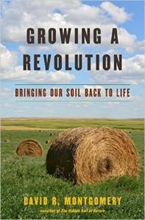
PUT CARBON IN GROUND: IDEALLY 5-8% BIOCHAR WITH COMPOST/OTHER ORGANIC MATTER
NO TILL - to allow soil to stabilize
COVER: to control weeds
ROTATE CROPS: to control pests
http://www.washington.edu/news/2017/05/02/new-book-by-uws-david-r-montgomery-addresses-how-to-rebuild-earths-soils/

Slide 22
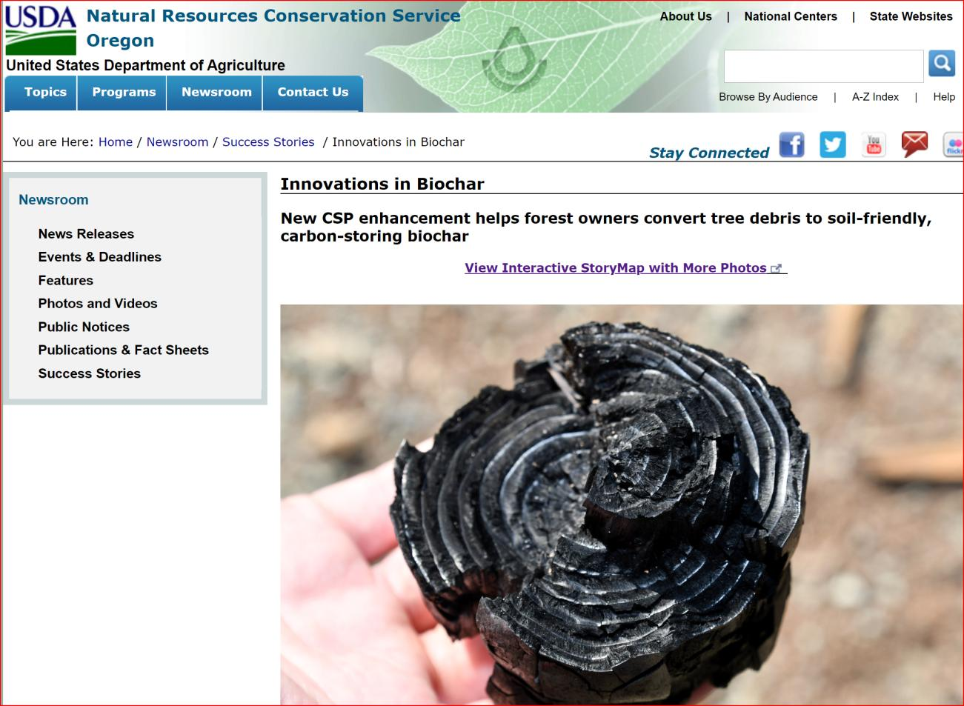
https://www.nrcs.usda.gov/wps/portal/nrcs/detail/or/newsroom/stories/?cid=nrcseprd1499267

Slide 23
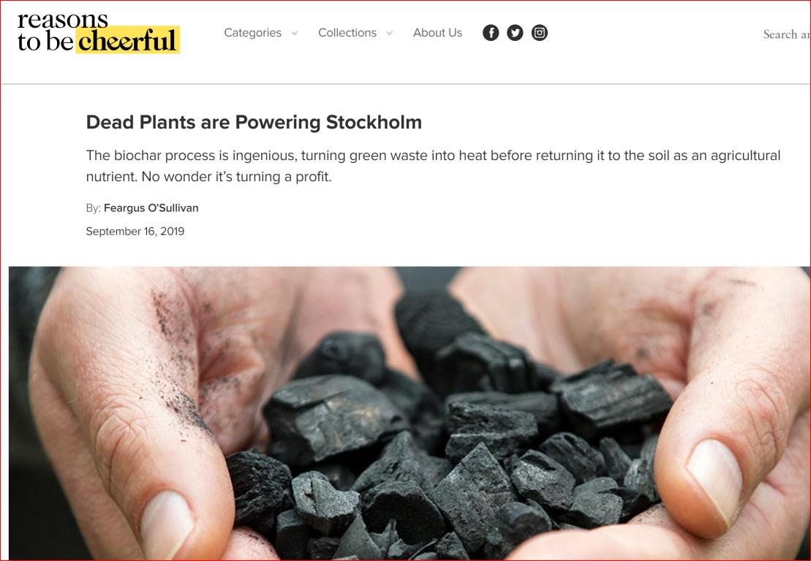
In Stockholm
https://reasonstobecheerful.world/dead-plants-are-powering-stockholm/

Slide 24
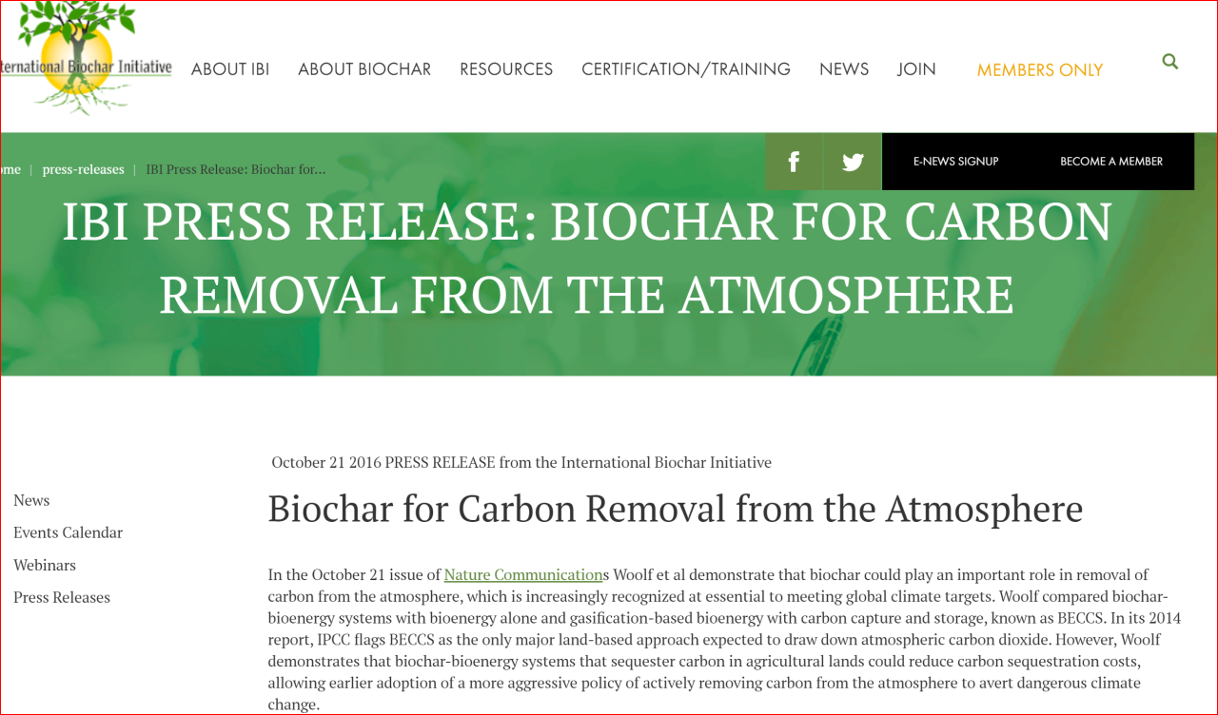
https://biochar-international.org/press-releases/ibi-press-release-biochar-for-carbon-removal-from-the-atmosphere/

Slide 25
Local Applications
Sedro-Woolley: Sedron Technologies
Janicki Omni Processor https://www.sedron.com/
https://en.wikipedia.org/wiki/Omni_Processor
Bill Gates 2 minute demo https://youtu.be/bVzppWSIFU0
POTENTIALLY: Whidbey Island
FOR safe neutralizing of SEWAGE SLUDGE

Slide 26
BIOCHAR ATTRIBUTES
http://www.biochar-international.org/biochar : Biochar is produced through pyrolysis or gasification — processes that heat biomass in the absence (or under reduction) of oxygen.
ATTRIBUTES:
resists degradation
produce oil and gas byproducts that can be used as fuel, providing clean, renewable energy.
When buried in the ground as a soil enhancer, the system can become "carbon negative.“
By burial and
By continued microhabitat support for microbes and bacteria to replenish the soil

Slide 27
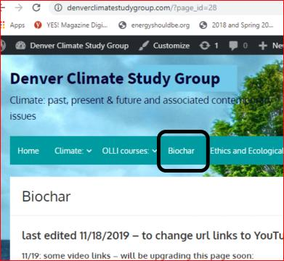
Contact information:
Paul E Belanger, Geologist, Ph.D.
pebelanger@glassdesignresources.com
Web page on BIOCHAR: https://denverclimatestudygroup.com/?page_id=28

Slide 28
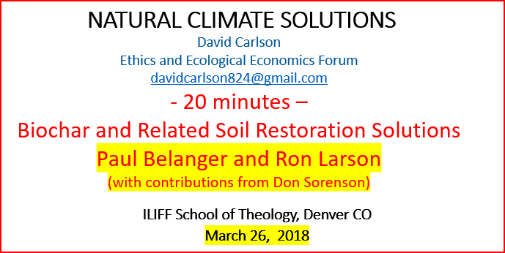
CREDITS:
IBI,
Ron Larson
Norm Baker
others
https://eeeforum.org/older-archives/

